Slide 1
Organizing for Single Payer with Resolutions
Kay Tillow, All Unions Committee for SP
Brad Zehr, Boston University School of Medicine
Andrea DeSantis, DO AAFP Single Payer Member interest Group

Slide 2
Goals of this Workshop
Tips for getting into the game: Identifying existing (or the potential to create new) forums for organizing around the topic of Single Payer within your professional organization.
Putting a strategy in place
Writing a Resolution
Tips for success
Group networking activity

Slide 3
AAFP Congress of Delegates Orlando Florida 2016
Six past presidents
organized an unprecedented show of support for
Single Payer.

Slide 4
Single Payer Resolutions at the AAFP Congress of Delegates
Approved: The resolution for support of legislation allowing Medicare to negotiate drug prices. (Oregon, Illinois, and New York)
Three were tabled for further Board review:
Two resolutions supporting Single Payer
Physician Protection under SP (New York chapter)
The AAFP advocate for a SP system (New York chapter)\
One resolution asking for the study of SP (Illinois)

Slide 5
Out of that deferred action came Board Report F…
The AAFP hired RTI, an international research firm in Raleigh, NC to conduct an independent study
Six experts in the field of health finance reform were interviewed along with a systemic review of over 100 (peer-reviewed and grey literature) studies.
Three Health Care Models were examined
Single Payer
Bismark Model
Public Option of ACA

Slide 6
Board Report F…
Summary of coverage and financing of US against 13 other OECD countries….We came in last!
Pro…It will be used as a resource document for any needed action in the near future.
Con…The board still made a statement against in favor of our pluralistic (chaotic) system of care.

Slide 7
AAFP Congress of Delegates 2017

Slide 8
Resolution #503 Health (Care) is a Human Right – Accepted!
Co-Sponsored by VT, NH, NY, IL, MA, CA and CO
Amended in Committee: the word CARE was removed RESOLVED, That the American Academy of Family Physicians recognizes that health is a basic human right for every person..
Floor argument ensued and the following wording added…
RESOLVED, That the right to health includes universal access to timely, acceptable and affordable health care of appropriate quality. Whew!

Slide 9
Resolutions from COD 2017
#513 Vermont’s Publicly Funded Primary Care Program – Accepted!
#514 New York sponsored a resolution to support Single Payer
Deferred for board review for further study and vote at COD 2018 in New Orleans…
This is a WIN!

Slide 10
Everyone Was Talking About SP

Slide 11
Other Societies Taking Action
American Psychiatric Association - Dr. Leslie Gise
The Michigan State Medical Society (MSMS) - Dr. James Mitchiner
American College of Emergency Room Physicians has set up a task force to study SP - Dr James Mitchiner
American College of Physicians (ACP)
American Academy of Pediatrics (AAP) -Dr Rober Zarr
American Society of Clinical Oncology (ASCO) - Dr. Ray Drasga
Vermont Medical Society - Deb Richter

Slide 12
The American Medical Association
Dr. Peter Orris An “updated study of health care payment models”
Brad Zehr with The AMA Medical Student Section

Slide 13
Brad Zehr at the AMA Medical Student Section national meeting in Chicago 2014

Slide 14
With fellow students and Don Berwick at a health policy forum for gubernatorial candidates in Roxbury, MA

Slide 15
City Hall in Vicco, Kentucky, where the commissioners passed a resolution endorsing HR 676.

Slide 16
Kentucky unionists marching on Frankfort--the campaign for union resolutions for support of HR 676

Slide 17
Join Existing Committees or Communities
Join an existing committee or group
Already tasked to oversee content and programing around similar topics like patient care, practice improvement, health of the public, health of the work force
Start a committee or interest group within your organization
e.g., The American Academy of Family Physicians’ Member Interest Group (“MIGs”) were started by a few young students and residents at their annual national conference

Slide 18
Attend Workshops and Meetings and Ask Tough Questions
Medical bankruptcy
Churn
Underinsurance
Increasing administrative costs
Physician burnout
Observe who responds favorably
and take it from there

Slide 19
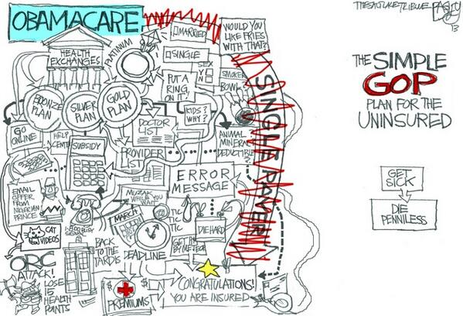

Slide 20
Find the Like Minded…
Identify influential SP supporters/sympathizers who are active or have a long history within the Society.
Reach out with emails, phone calls and conversations asking for advice and direction
Past present presidents and board members
Staff and chapter directors
Medical School Faculty
Single Payer activists in your community

Slide 21
Chat and Chews

Slide 22
Most American Physicians Want National Health Insurance
Psychiatry
Peds Specialties
Emergency Med
General Peds
General Int. Med
Med Specialties
Family Med
OB-Gyn
General Surgery
Surg Specialties
Radiology
 |  |  | O
0 | 25% | 50% | 75% | 100%
Percent supporting National Health Insurance
2007 detail of surveys of random samples of US physicians.
Carroll and Ackerman. Ann Int Med 2008;148:566

Slide 23
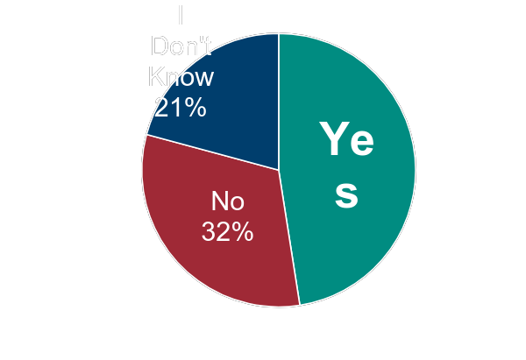
2017 LinkedIn Survey
“Would you support a move to single-payer healthcare, like universal Medicare coverage?”
Data based on Feb. 2017 survey of 500+ US physicians

Slide 24
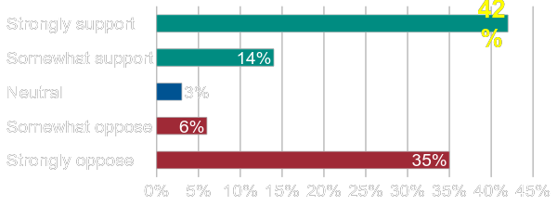
Plurality of Physicians Strongly Support Single Payer Healthcare
70,000 physicians surveyed Aug. 3 2017; 1,033 responses received. Error rate of +/- 3.1% per U Tenn statisticians
Merritt Hawkins, an AMN Healthcare Company
www.merritthawkins.com

Slide 25
Local and National Meetings and Conferences
Offer to give or organize a PNHP national speaker to give evidence based lectures to attendees, students and residents.
Consider submitting a formal resolution or two for Single Payer or a topic relevant to Single Payer. See printed materials
Invite and help staff a PNHP booths at local or national meetings.

Slide 26
Sponsorship Of a Booth in The Exhibit Areas

Slide 27
Tips for Success… Be Organized as You Organize…
Set Goals and Objectives
Create positions to help divide up the work:
Chair, Co-chair, Secretary, Treasurer, Meeting Coordinator..
Hold regularly scheduled group call-in or on-line meetings (same time and day of the month)
Keep meeting notes and working documents in a central on-line and interactive location
Keep it positive and have fun!

Slide 28
Crafting and Submitting Resolutions
Investigate the protocol for submission
Find samples of prior resolutions; fill in single payer topics
Outright support of Single Payer
Related topics pertinent to… Medicare negotiating drug prices, reducing out of pocket expenses, universal billing or ”All Payer”
Using bridge language like “The study of…”
Collaborate with special groups to co-sponsor or submit their own version. Those in teaching, Minority physicians, rural doctors.
Give ‘em the old One-Two punch!

Slide 30
Break-Out Activity…please gather into small discussion groups
Identify where our current finance system impacts the quadruple aim in a negative manner specific to your specialty.
Identify where SP would help correct that problem
Come up with one or two things you can do to start influencing, networking, and organizing for single payer in your medical society or local medical association.
Open discussion

Slide 31
Reach Out to PNHP for Support
Advice!
Resources!!
Expertise!!!

