Slide 1
SINGLE PAYER AND SOCIAL JUSTICE: CHANGING THE DIALOGUE
Olveen Carrasquillo, MD, MPH
Professor of Medicine and Public Health
Chief, Division of General Internal Medicine
Interim Chief, Geriatrics & Palliative Care

Slide 2
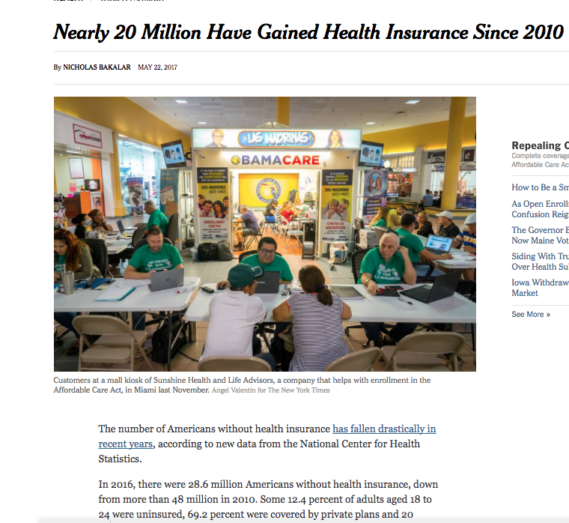

Slide 3
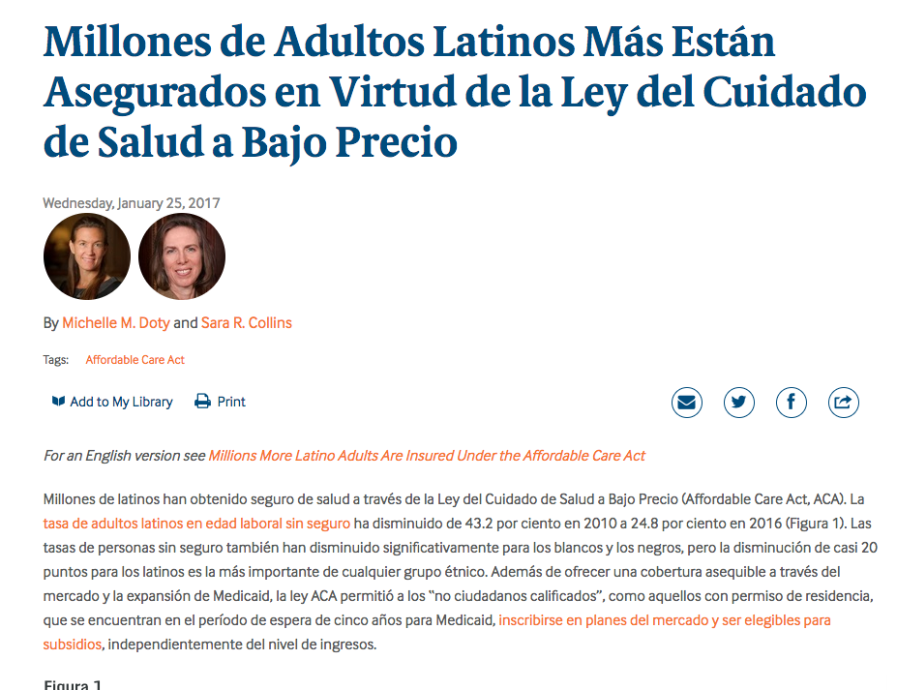

Slide 4
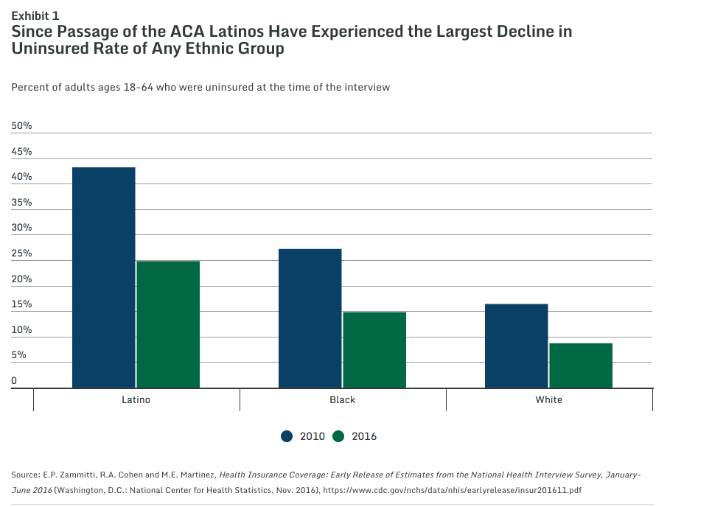

Slide 5
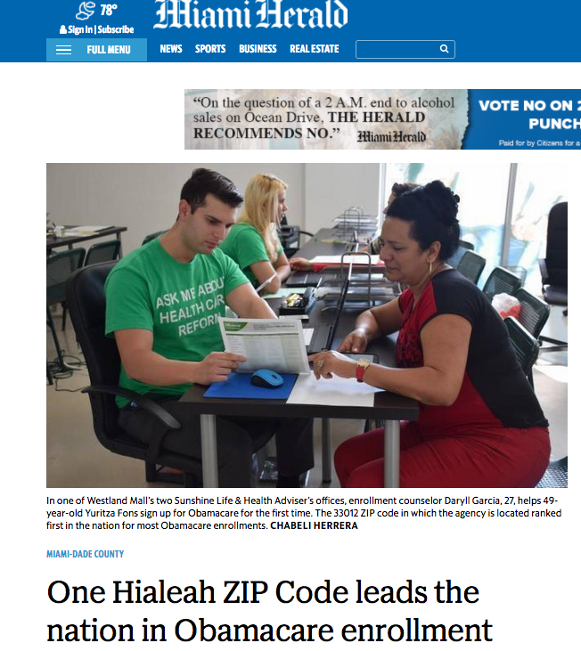
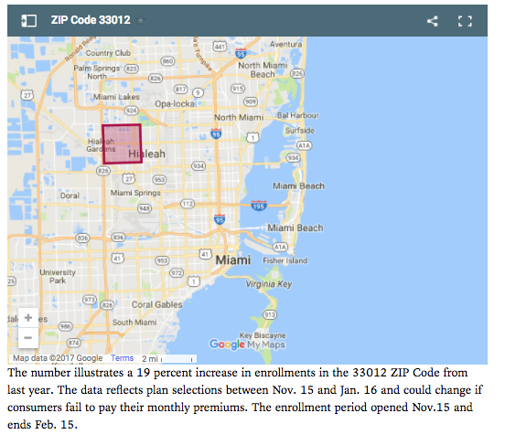

Slide 7
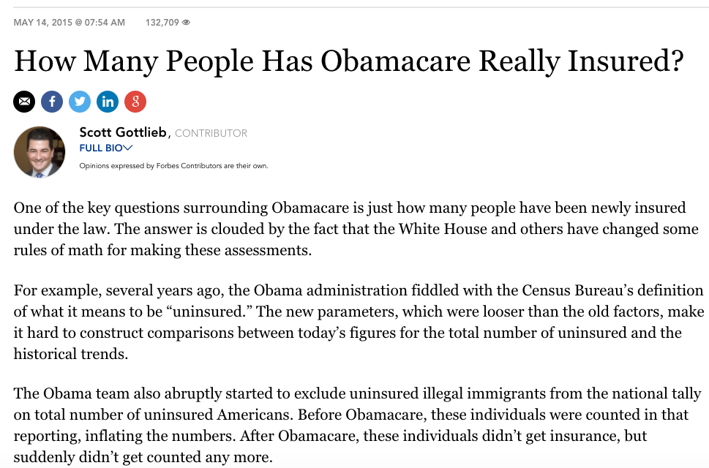
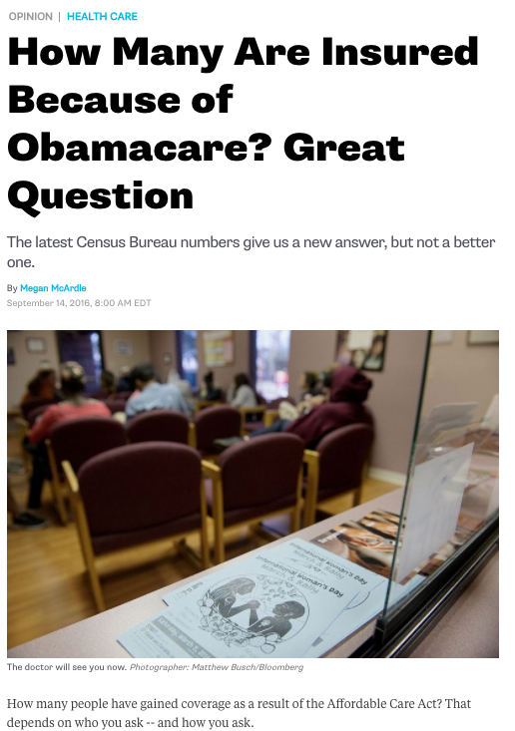

Slide 8
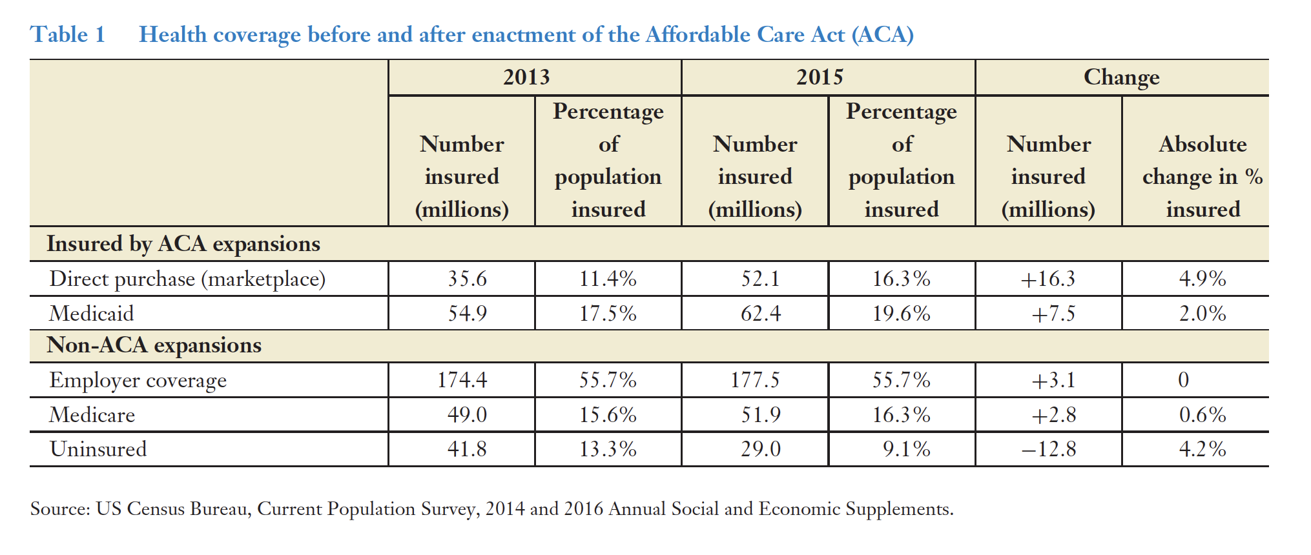
Carrasquillo & Muller, Refinement of the Affordable Care Act: A Progressive Perspective Ann Rev Medicine Jan 2018

Slide 9
Refinement of the Affordable Care Act: A Progressive Perspective
3 Important limitations of ACA
ACA did not achieve universal coverage
Many states chose not Expand Medicaid
Premium Assistance was insufficient to get many to sign up
Undocumented were excluded
ACA continues to perpetuate inequities in our health system
Disparities in coverage persist
Medicaid is not equitable coverage
Marketplace plans are not not equitable coverage (not comprehensive / limit choice)
Used a very expensive approach to expanding coverage
Could have been done for much less and covered everyone
Carrasquillo & Muller, Refinement of the Affordable Care Act: A Progressive Perspective Ann Rev Medicine Jan 2018

Slide 10
What is wrong with this picture?

Slide 11
Whom is left out? Large Numbers of Immigrant Latinos Remain Uninsured
Percent adults ages 19–64 uninsured
Source: The Commonwealth Fund Affordable Care Act Tracking Surveys, July–September 2013 and February–April 2016.

Slide 12
Another way Frame ACA and Latinos
4 million Latinos gained coverage under ACA, 9 million did not
70% of uninsured Latinos did not benefit from ACA
Hispanics still 150% more likely be uninsured than whites
Blacks 60% more likely to be uninsured than NHWs
Black or Latino make up 33% of population
But they make up 55% of uninsured

Slide 13
Strong bi-partisan agreement that undocumented will get no benefit from ACA FB Latinos Make Up 75% of Uninsured Latinos: Most Are Low-Income and Do Not Speak English Well
Income
How well do you speak English?
Uninsured Latino adults ages 19–64 who are foreign-born
Uninsured Latino adults ages 19–64 who are foreign-born and whose interview was conducted in Spanish
Note: 78 percent of uninsured Latinos are foreign-born.
Source: The Commonwealth Fund Affordable Care Act Tracking Survey, February–April 2016.

Slide 14
What KS told me in 2014…
"Of course the Obama administration cares deeply about the health care needs of the undocumented. It is just so sad that politically there is nothing we can do about it. This is why we have no plans of trying to address this anytime soon.”
Carrasquillo, O. Nat Inst Latino Policy Blog May 13, 2016 http://www.nilpnetwork.org/NiLP-Archives.html

Slide 15
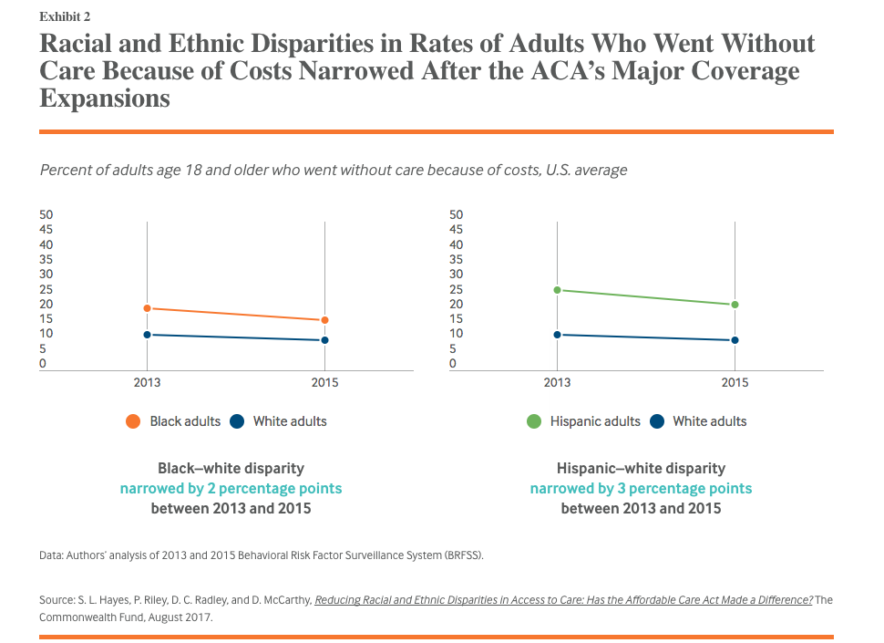

Slide 16
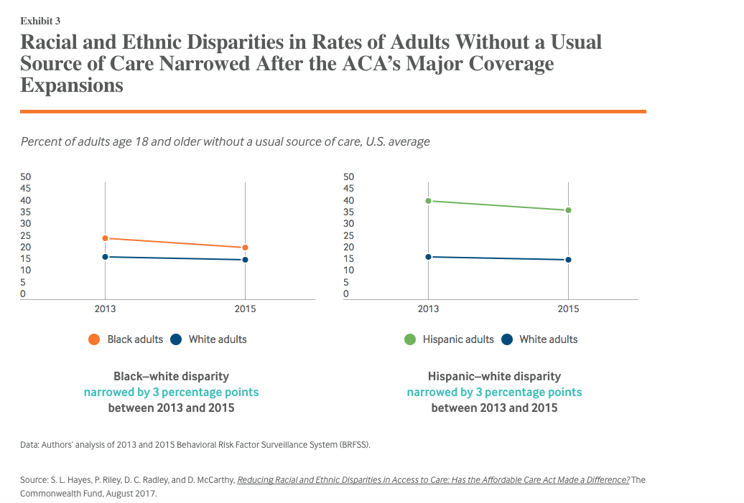

Slide 17
Medicaid- is not equitable coverage!!!!
How much do you want do you paid for 20 minutes
of your time?
A. $ 10
B. $ 30
C. $ 70
D. $100

Slide 18
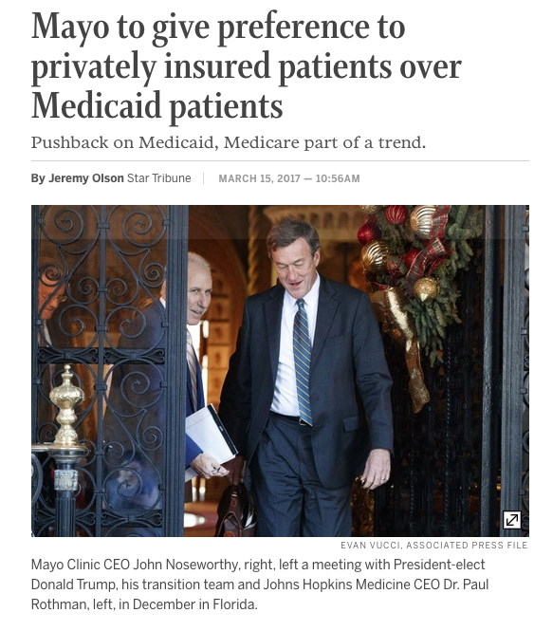
Inequitable Coverage!!!

Slide 19
How will single payer help
Universal Coverage- Everyone is and nobody out
Includes undocumented!!
Equitable High Quality (well compensated) Coverage
Will that end disparities?
Of course not

Slide 20
Other issues

Slide 21
Will Single Payer Help

Slide 22
Social Determinants of Health
Conditions in which people are born, grow, live, work and age
Shaped by the distribution of money, power and resources at global, national and local levels
Mostly responsible for health inequities

Slide 23
SDH
Access to social and economic opportunities
Resources and supports available in our homes, neighborhoods, and communities
Quality of our schooling
Safety of our workplaces
Cleanliness of our water, food, and air
Nature of our social interactions and relationships.

Slide 24
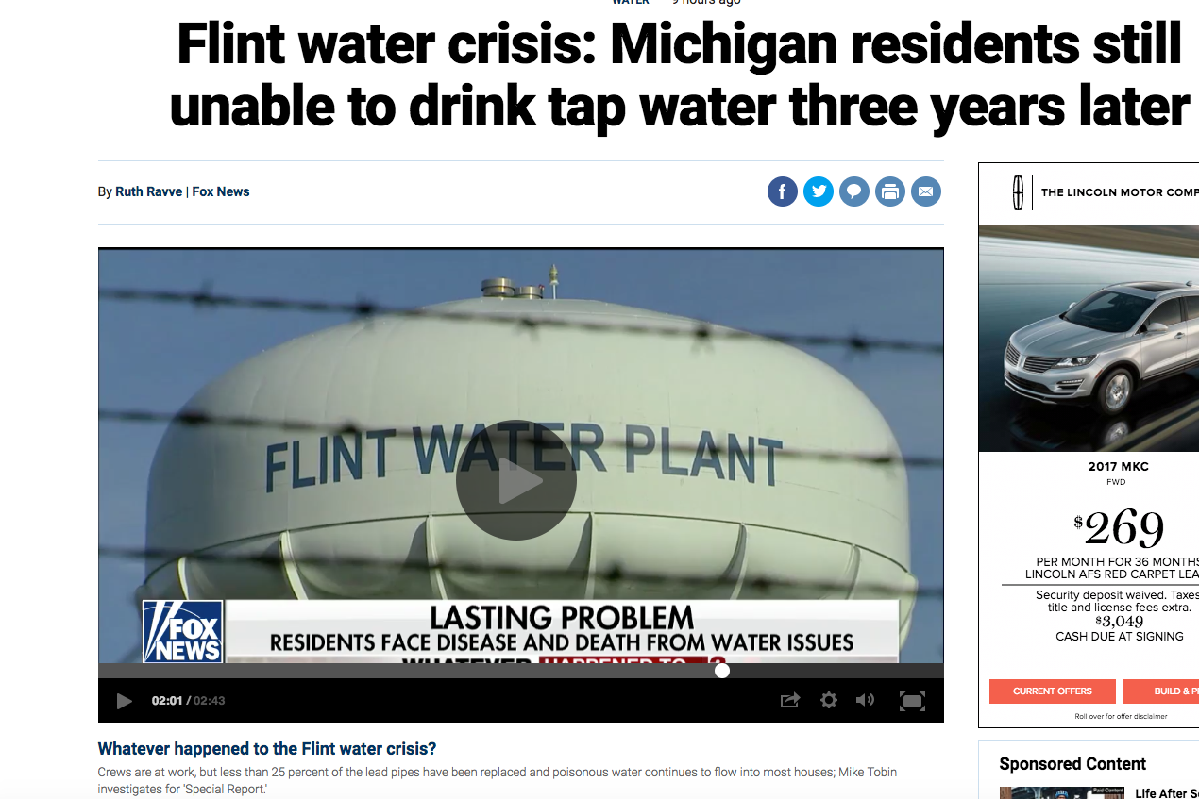
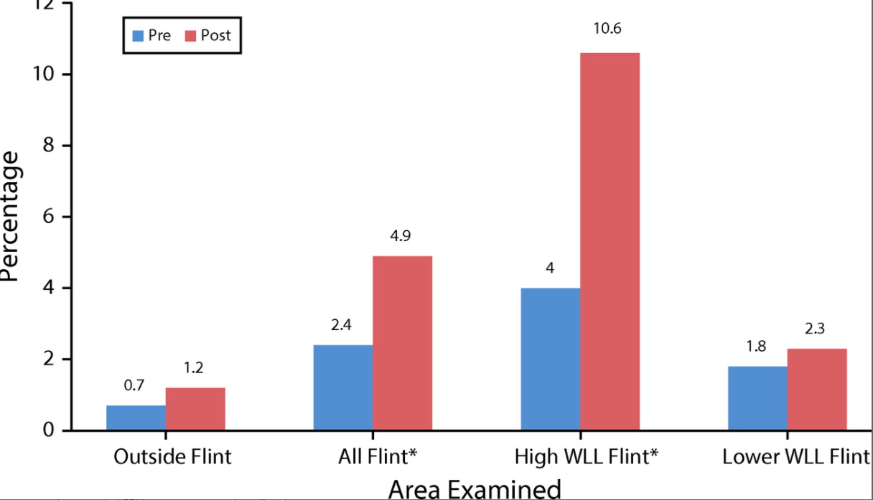
Will Single Payer Fix This?
Mona Hanna-Attisha et al . Elevated Blood Lead Levels in Children Associated With the Flint Drinking Water Crisis
AJPH Feb 2016

Slide 25
Will Single Payer Fix this?

Slide 26
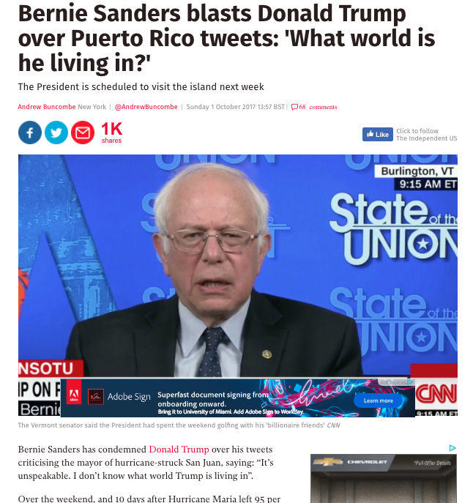
S. 1804 Medicare for All Act of 2017
term ‘‘United States’’ shall include the States,
the District of Columbia, and the territories
of the United States
SEC. 502. ADDRESSING HEALTH CARE DISPARITIES.
Endorsed by
Latinos for Healthcare Equality
League of United Latin American Citizens (LULAC)
H.R.261 — 115th Congress
This bill amends title XVIII (Medicare) of the Social Security Act
to automatically enroll eligible residents of Puerto Rico in
Medicare's medical insurance program.

Slide 27
Will single payer help?
Yes!!!
Universal Coverage- Everyone is and nobody out
Equitable High Quality (well compensated) Coverage
But….
Will not address other major drivers disparities
Many other issues aside from insurance
Cultural competence/ language ➔ SDH
We need to be seen as advocates on these other issues as well

