Slide 1
Creating and Delivering a Compelling Presentation about Medicare for All
Ed Weisbart, MD
Claudia Fegan, MD

Slide 2
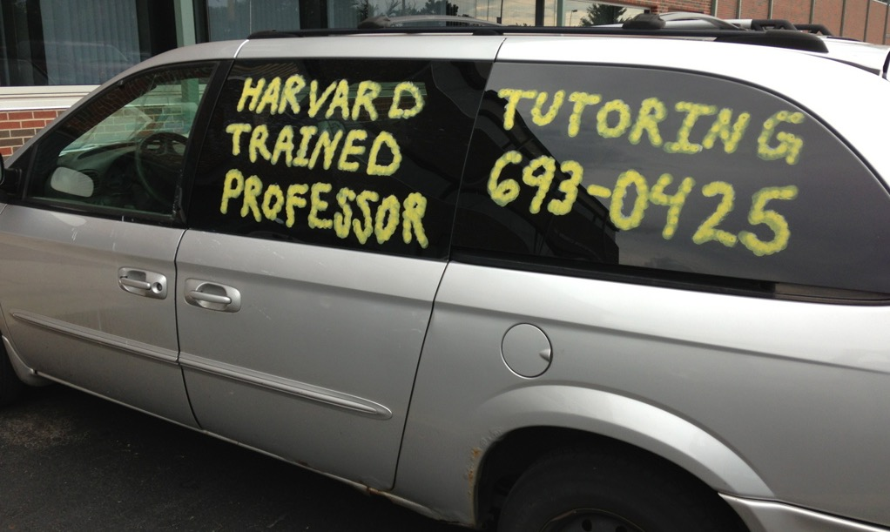
My Career Has Been About Medicine, Business, and Politics
Family Medicine
Physician
Express Scripts
Chief Medical Officer
Physicians for a
National Health Program
Large urban academic practice
Surrounded by like-minded progressives
Conservatives were the outliers
Stereotyped conservatives as less informed, less generous, cold-hearted
Then I moved to Missouri…
Forced to reconcile that most of these conservatives were decent, generous, educated, and tried to do the right thing.
1982 – 2003
Practice in Chicago at Rush Medical University
2003 – current
Washington University internal medicine volunteer faculty
2003 – 2010
Fortune 100 company in St Louis MO with $15B revenue and 12,000 employees
Responsible for clinical integrity of all products and services
PNHP nationally:
Established 1987, 21,000+ members
MO chapter chair:
Founded in 2012, now reaches more than 3,000 people
Also advocates for Medicaid expansion

Slide 3
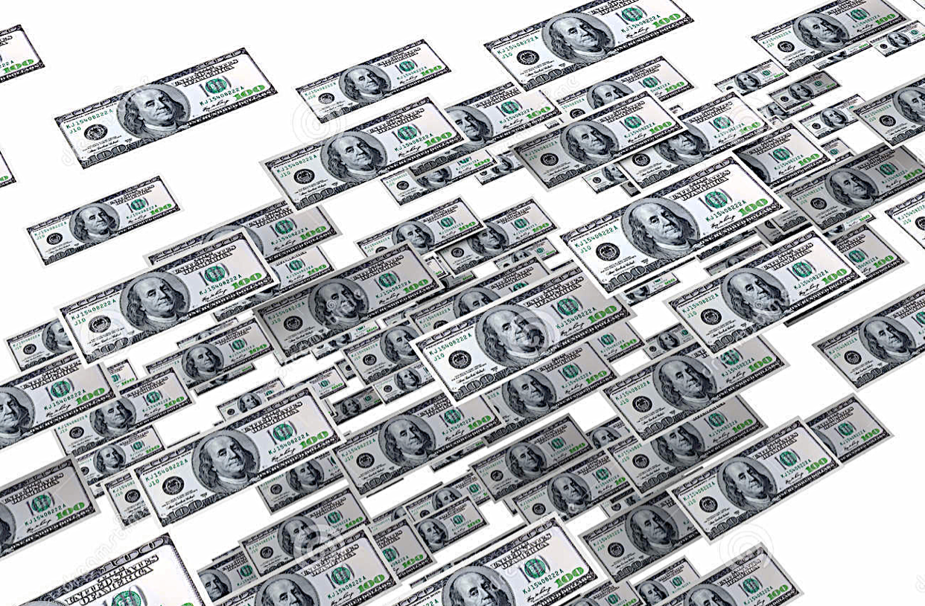
Medicare for All? Single Payer? NHI?
What’s the difference?
Which one is
best to use?
Also known as
“National Health
Insurance”
also known as
“Medicare for All”
“Single Payer”

Slide 4
Medicare for All? Single Payer? NHI?
Also known as
“National Health
Insurance”
also known as
“Medicare for All”
“Single Payer”
“Government take-over”
“What is a ‘payer’?”
“Medicare has big problems”

Slide 5
Words Matter – Keep the Message Simple
Americans supporting
Use data to shape the message
http://www.kff.org/global-health-policy/press-release/public-split-on-what-to-do-about-the-health-care-system-though-more-support-building-on-aca-than-repealing-it-replacing-with-a-gop-alternative-or-creating-a-single-payer-plan/ Accessed July 1, 2017

Slide 6
Got $10 to Risk?
Losses generally count
double of gains.
Heads: You lose $10.
How much do you need to gain on tails for you to play?

Slide 7
Medicare for All Focused on Loss Aversion
Gain Centric Messages
Loss Centric Messages
Save money for the other things you want.
See any doctor you want.
Live longer and healthier.
Stop wasting your money.
Why should insurers pick your doctor?
Don’t die younger than you need to.

Slide 8
We Each Have Different Comfort Zones
Efficiency, financials, performance, measurements
Methods, regulation, quality, control, timing, policies
Facts
Forms
Manny Elkind
“Whole Brain Model”
Use arguments outside
your own comfort zone
Futures
Feelings
Concepts, vision, purpose, strategy, global
Relationships, communication, culture, values
Manny Elkind, Mindtech Inc.

Slide 9
Medicare for All from the Four Quadrants
Life expectancy
Uncontrolled costs
Pass HR 676
Implement through a link to Social Security
Facts
Forms
Which approach to take?
Start by listening!
Futures
Feelings
A nation more globally competitive
Anecdotes of needless pain and suffering
Manny Elkind, Mindtech Inc.

Slide 10
Liberals and Conservatives Often Think Differently
George Lakoff
“Moral Politics”

Slide 11
Lakoff Identified Two Cognitive Models
Nurturant
Mother
Two-Framed
Strict
Father
Equality
Diversity
Helping hand
Both frames are active
Looks undecided
Hierarchical
Social Darwinism
Consequences
20% of Americans
60% of Americans
20% of Americans
Liberals
Independents
Conservatives

Slide 12
Lakoff Identified Two Cognitive Models
Personal freedom, consequences of your actual choices, and prudence
Insurers limit your choice of doctors and hospitals
You can decide not to get care, not die because you can’t afford care.
Less wasteful to buy insulin than dialysis
They want to agree but have questions.
Use stories to activate nurturing frame.
Address gaps and misinformation.
Ask for commitment and action.
Liberals
Independents
Conservatives

Slide 13
Moral Foundations Questionnaire
Jonathan Haidt
“The Righteous Mind”
Online survey of 132,000 Americans
Identified five moral values
Compared individual scores with where people stood on the political spectrum
Haidt, Jonathan. The Righteous Mind. 2013.

Slide 14
Five Moral Pillars
Fairness
Reciprocal altruism, justice, rights, autonomy
Caring
Empathy, kindness, gentleness, nurturance
Loyalty
Patriotism, self-sacrifice, “one for all, all for one”
Authority
Deference to leadership, respect for traditions
Sanctity
Bodies are temples desecrated by immorality
Haidt, Jonathan. The Righteous Mind. 2013.

Slide 15
Our Moral Foundations Vary With Our Politics
Strongly
Endorse
Fairness
Caring
Both sides believe
they hold the
moral high ground.
“You heartless
bastards don’t care.”
“Your lack of morals will destroy our society.”
Loyalty
Authority
Sanctity
Strongly
Reject
Very Liberal | Slightly Liberal
Moderate
Slightly Conservative | Very Conservative
Chart from Haidt, Jonathan. The Righteous Mind. 2013.
(Commentary by Ed Weisbart)

Slide 16
Five Moral Pillars of “Cover Everybody”
Do not expect
these two arguments
to persuade conservatives.
Fairness
Healthcare is a human right
Caring
Protect the vulnerable
Loyalty
Temper data about poor outcomes with reasons for national pride
Authority
Collaborate with faith leaders who support universal access
Sanctity
Today’s system is a violation of our stewardship responsibilities

Slide 17
Five Moral Pillars of “Cover Everybody”
Fairness
“You’ll lose votes
if your ads engage only
one moral taste receptor
while your oponents’ ads
engage them all.”
Caring
Loyalty
Authority
Joshua Greene
“Moral Tribes”
Sanctity

Slide 18
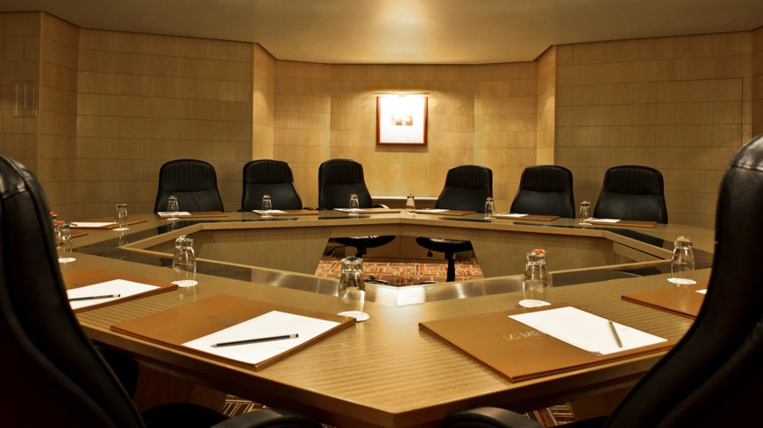
Tribalism Trumps Moral Pillars
“Moral Tribes”
Joshua Greene
More on this in tomorrow’s
2:00 breakout group

Slide 19
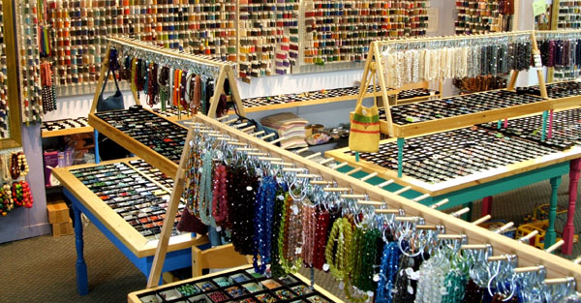
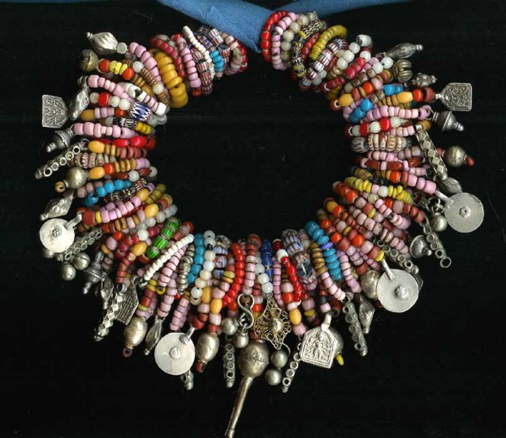
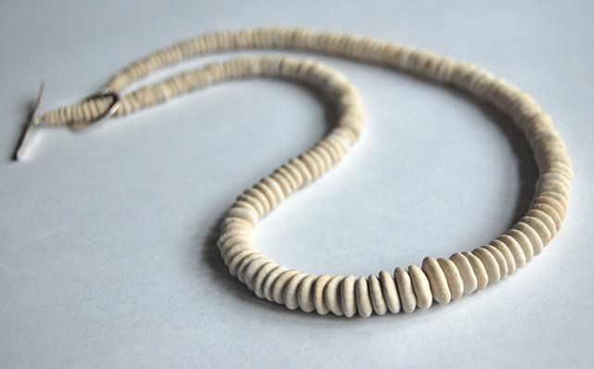
Build a Cogent Story
I dread going to bead stores.
I love beautiful necklaces.

Slide 20
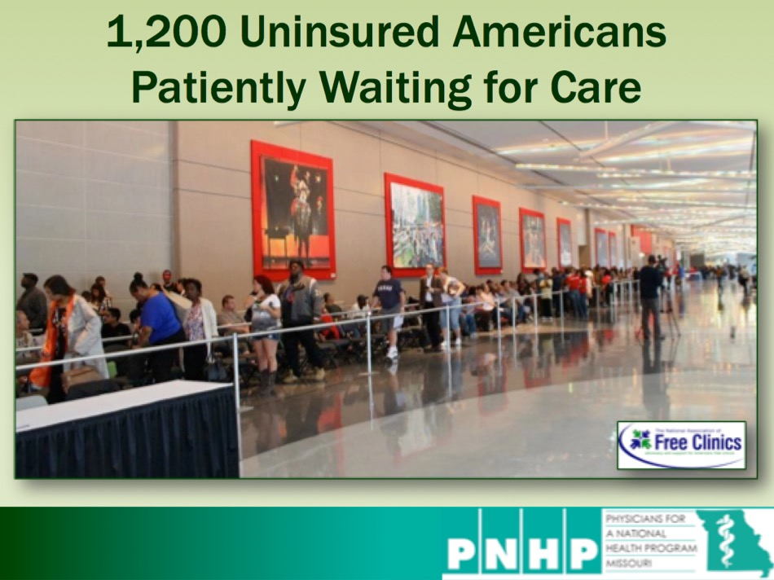
Design Your Story Arc
Intro
Three things
to accomplish
Establish your credibility
Get permission to speak on the topic
Activate their “nurturing” frame

Slide 21
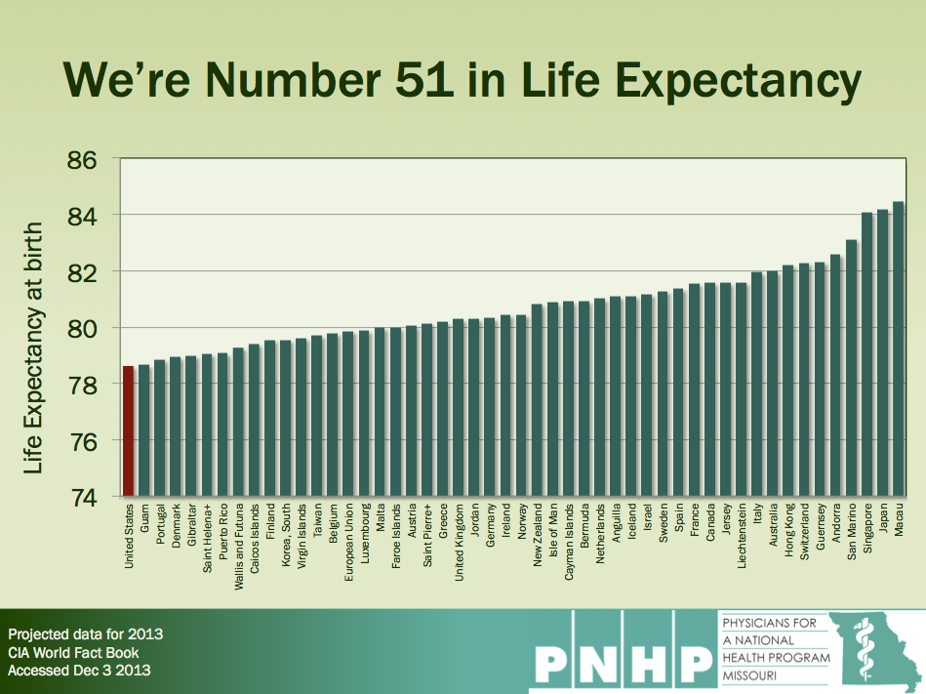
Design Your Story Arc
Intro
Predator
Exposition
Solutions, Strategies
Call to Action
Loss aversion
“The more ferocious the predator, the higher the ratings.”
Establish your credibility, get permission, activate nurturing
Select up to three key messages evidence
Incremental vs robust
Line of sight
Audience-specific
The sooner the better

Slide 22
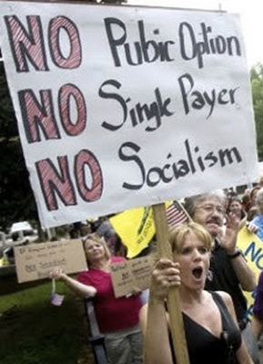
Design Your Story Arc
Intro
Predator
Exposition
Solutions, Strategies
Call to Action
Don’t overplay
this part
Categorize each slide and
balance your time appropriately

Slide 23
None of This Helps If You Can’t Speak

Slide 24
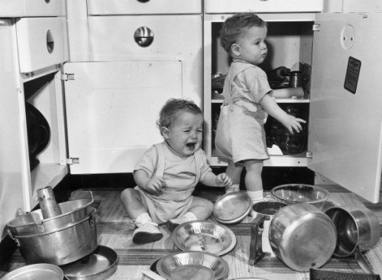
We’ve All Heard These Things
“I’m sorry, but…”
“I’m fighting a cold so…”
“Too much material, so…”
“I know this doesn’t show up on my slide...”
“I’d rather be talking to you about…”
“This is really Dr. X’s presentation, but…”
“Somebody please watch the clock for me…”

Slide 25
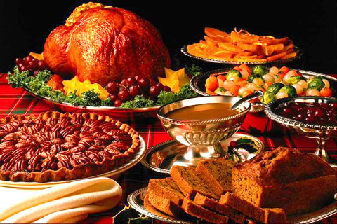
I Want Dinner, Not a Tour of Your Kitchen
Smells good
Looks good
Tastes good
Has a flow to it
Leaves me satisfied
Makes me want to come back

Slide 26
Be Yourself, Sort Of
Be Yourself
Sort Of
Say what you believe
Stand or walk where you want
Dress for comfort
1st person singular pronouns are powerful
2nd person engage
3rd person distance
Stay on message
No rocking or swaying
Avoid mannerisms (“like”) and pause fillers (“um”, “er”, “look”...)
Use your outdoor voice
Be remembered for your content, not your clothing choices

Slide 27
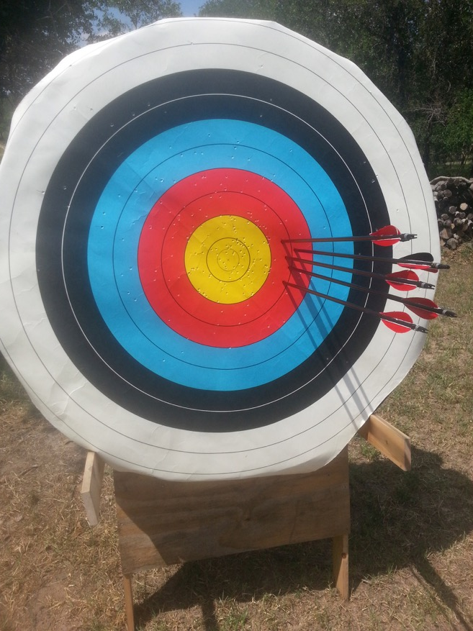
Be Yourself, Sort Of
Humor is a
narrow target
surrounded by a moat of
not funny.

Slide 28
Look Relaxed, But You Are On a Stage
It’s your job to
manage their expectations
You’re giving a performance
An agenda is not a workplan.
Get permission: “Here’s where we’ll be in 45 minutes; is that what you were expecting?”
Your audience should always track where you are in the talk
Don’t tune the piano on stage. Play the music.
Know your opening line
They can read

Slide 29
Track Your Own APMs
“Actually, I actually find that
this is actually an
important point, actually.”
-Actual speaker’s name protected
If someone
points this out to you, thank them.
Actually.
APM = “Actuallys” per Minute

Slide 30
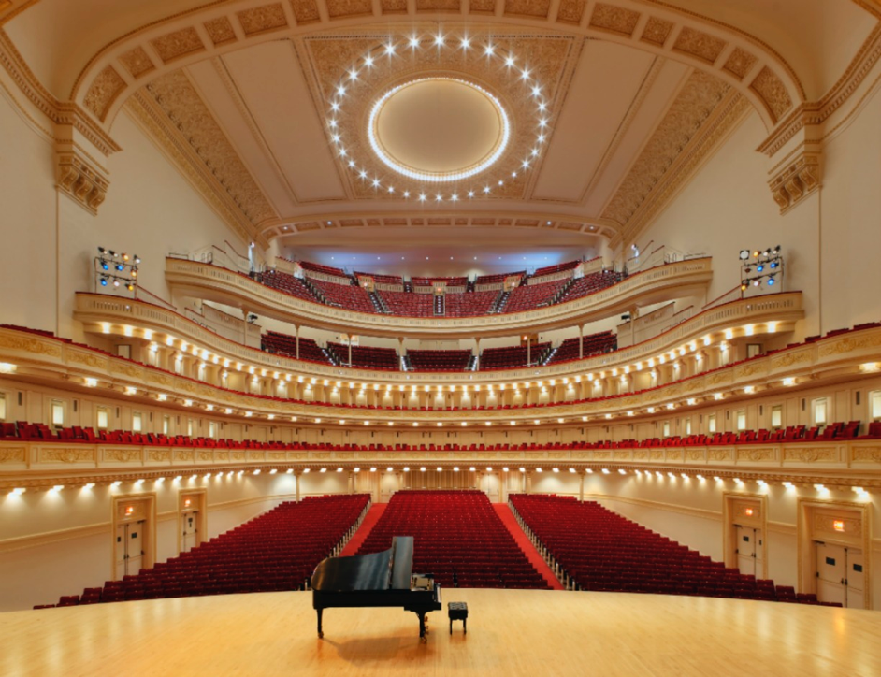
How Do You Get to Carnegie Hall?

Slide 31
You Can Often Control the Room Arrangement
Maximizes interactions
Torticollis de
PowerPoint
Minimizes interactions

Slide 32
“PowerPoint” Is Not “Word”
Three exceptions…
Legal
Legislative
Webinars
6 line maximum
20 point font minimum
28 point much better
Paragraphs
Books

Slide 33
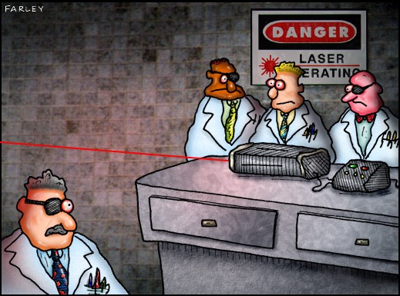
Lasers are for
amusing cats.

Slide 34
Checklist
Double check address and time. If a campus, study the map.
Laptop, cords, adapters
Remote slide advancer
Projector
Screen (is one on site?)
Long extension cord
Cord that can plug in two devices
3-prong adapters
Audio system if showing a film
Don’t trust their answers
Back-up plan (thumb drive and printed copy)
Clock / timer
No more than two pertinent leave-behinds (with contact info)
Email sign-up sheets
Business cards

Slide 35
Let’s try it out:
Why build our solution
on Medicare?

Slide 36
The Free Market Solution: Medicare for All
National Health Service
National Health Insurance
Wild Wild West Health Insurance
Public Funding
Public Delivery
Great Britain, Italy, New Zealand
Veterans Administration
Socialized medicine
Public Funding
Private Delivery
Canada, Spain, Ireland, Australia
Medicare
Applies the free market to medicine
“Multi-payer”
Mixed Funding
Mixed Delivery
Only in the USA

Slide 37
The Free Market Solution: Medicare for All
National Health Insurance
“The Improved and Expanded
Medicare for All Act”
HR 676
Public Funding
Private Delivery
Canada, Spain, Ireland, Australia
Medicare
Applies the free market to medicine
Very similar to SB 1804

Slide 38
HR 676: Medicare for All
Improve Medicare
Expand Medicare
Comprehensive benefits
Eliminate financial barriers to care
No need for “Medicare supplemental” or “wrap” or “Advantage”
All Americans, including Congress
Roll up most other programs
No need for state-based programs like Medicaid

Slide 39
We’re Number 28 in Life Expectancy
Japan
Switzerland
Spain
Italy
Iceland
France
Australia
Sweden
Luxembourg
Norway
Korea
Israel
Netherlands
Austria
Greece
United Kingdom
Ireland
Belgium
Finland
Slovenia
Portugal
Germany
Denmark
Costa Rica
Chile
Czech Republic
USA
2014 Life Expectancy at birth
2014 data from OECD accessed Nov 29 2016
https://data.oecd.org/healthstat/life-expectancy-at-birth.htm

Slide 40
Medicare Means
Healthier Americans
1
3
5
7
9
11
13
15
17
Medicare is a crown jewel of America.
Expanding it makes good business sense.
USA
Rank
Age 65
Women
Men
0-1 | 1-4 | 5-9 | 10-14 | 15-19 | 20-24 | 25-29 | 30-34 | 35-39 | 40-44 | 45-49 | 50-54 | 55-59 | 60-64 | 65-69 | 70-74 | 75-79 | 80-84 | 85-89 | 90-94 | 95-99
Institute of Medicine. Shorter Lives, Poorer Health.
Fig 1-9: Ranking of US mortality rates by age group among 17 peer countries, 2006-2008. 2013
Peer nations are Australia, Austria, Canada, Denmark, Finland, France, Germany, Italy, Japan, Norway, Portugal, Spain, Sweden, Switzerland, Netherlands, United Kingdom
Age

Slide 41
Compare These Two Stories
Disruptive to
loyalty and santity
Taps into
loyalty and sanctity

Slide 42
Medicare Means
Stop Wasting Our Money on Bureaucracy
Insurance Overhead
Q1 2016
Medicare
Parts
C and D
Source: Day, Himmelstein, Broder, Woolhandler – Int. J Health Serv 2014
Updated data from firms’ SEC filings (Q12016)
Overhead = (Premium revenue – Medical Expenses) / Premium Revenues
Medicare updated with 2016 Medicare Trustee Report 2012 data as cited by Kip Sullivan, Journal of Health Politics, Policy, and Law. Vol 38, No. 3, June 2013 DOI 10.1215/03616878-2079523 available at http://www.pnhp.org/sites/default/files/Medicare_admin_costs_JHPPL.pdf .

Slide 43
Medicare Means
Stop Wasting Money on Advertising

Slide 44
Medicare Means
Stop Wasting Money on Lots of Stuff
Marketing and advertising
Sales teams
Account management
Billing
Access to venture capital
Redundant systems
Profit margins
Returns to shareholders
Multi-million dollar executive compensation
Economic arguments
framed to tap into
loss aversion
A more in depth analysis of the difference in overhead between traditional Medicare and private insurance is available at “How to think clearly about Medicare administrative costs: Data sources and measurement,” Kip Sullivan, J.D., Journal of Health Politics, Policy and Law, Vol. 38, No. 3, June 2013.

Slide 45
Medicare for All Makes Economic Sense
25 independent studies,
at the state and federal level, confirm that the
savings would fund full coverage.
http://www.pnhp.org/facts/single-payer-system-cost Accessed 2/25/2017

Slide 46
Medicare for All Makes Economic Sense
$ Billions
Increased market power (better pricing on
drugs and devices)
Admin costs to providers (hospitals and physicians)
Increased utilization
(home health, dental, etc.)
Covering the uninsured
Health insurance admin
Medicaid Rate Adjustment
Gov. admin ($23B)
New Costs
New Savings
Analysis of HR676
Friedman, G. Dollars & Sense. March/April 2012

Slide 47
Which Quadrants Did We Just Hit?
Efficiency, financials, performance, measurements
Methods, regulation, quality, control, timing, policies
Facts
Forms
Futures
Feelings
Let Medicare negotiate the price of drugs and devices
Adjust physician fee schedule to recover the cost of reduced medical office administrative staff
Manny Elkind, Mindtech Inc.

Slide 48
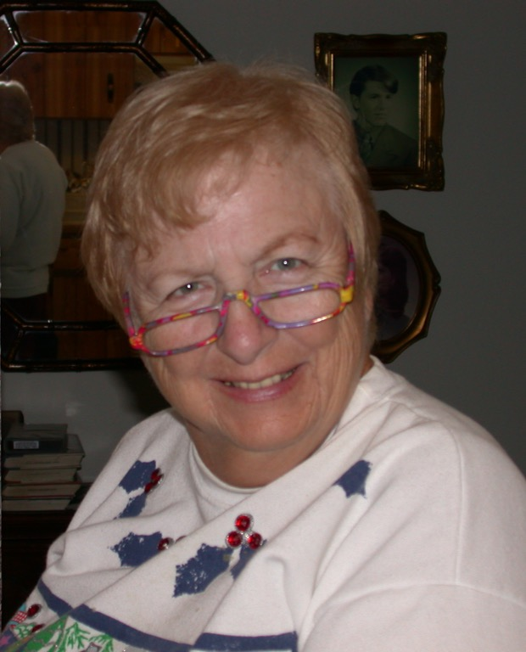
Medicare Means
Freedom of Choice
Meet Pat (my mother-in-law)
Rare cardiac problem
Lives in Florida
World experts in St. Louis
Medicare paid 100% of care
98% of physicians “in network”

Slide 49
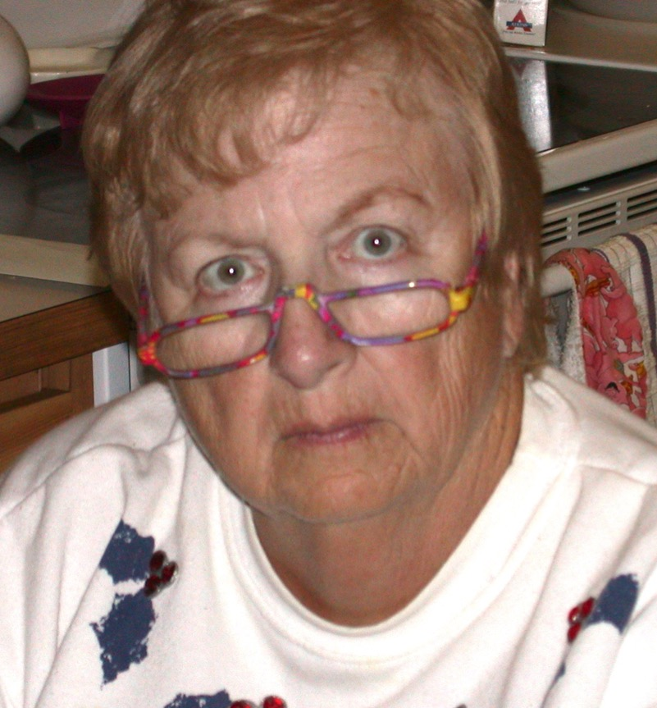
Medicare Means
Freedom of Choice
You think you can mess with my insurance?

Slide 50
Medicare Means
Freedom of Choice
Physicians in practice in USA
Physicians opting out of Medicare
Medicare’s “directory”
685,000
9,539
98%
of practicing physicians
Go to any doctor or hospital
Anywhere in the United States
You’re back in control.
2013 data from Fiscal Times
http://www.thefiscaltimes.com/Columns/2013/09/04/Are-Doctors-Really-Ditching-Medicare Accessed July 16, 2017

Slide 51
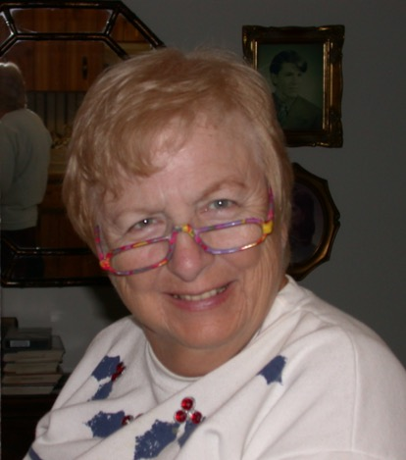
What Principles Did We Just Use?
Feelings
Facts
Sanctity
Authority
685,000
9,539
>98%
“You think you can mess with
my health insurance?"

Slide 52
750,000 Americans Travel Abroad for health care each year
What Kind of Care?
Where?
Cardiac Surgery
Orthopedic Surgery
Cosmetic Surgery
Oncology
Dentistry
Thailand
Mexico
India
Singapore
Malaysia
Cuba
Brazil
Argentina
Costa Rica
A story that taps into
loyalty and sanctity
Not about caring
and fairness
http://wwwnc.cdc.gov/travel/yellowbook/2016/the-pre-travel-consultation/medical-tourism
Accessed Sept 23 2015

Slide 53
American Physicians Are Moving to Canada
American Physicians Practicing in Canada
https://www.cma.ca/Assets/assets-library/document/en/advocacy/10-phys-by-country.pdf
Accessed Dec. 2 2016

Slide 54
Canadian Physicians Are Going Back Home
Net loss
(number moving abroad
- number returning)
A negative number indicates that more physicians returned from abroad then moved abroad
Source: https://www.cma.ca/En/Pages/canadian-physician-statistics.aspx Accessed Dec. 2 2016

Slide 55
What Did We Just Do?
Messaging Principles
Authority
Loyalty
Loss Aversion

Slide 56
Where Should You Speak?
\
Start here
Aim here
Host a house party
Role play with friends
Toastmasters
Natural Supporters
Faith-based
Social workers
Nurses, teachers
Green Party mtgs
Adjacent Allies
Retirees
Democratic Clubs
Medical Students
Psych, Peds, ER, other PCPs
Challengers
Surg., Anaesth., Radiology
Hospital staff
Rotaries, Kiwanis
Republican clubs
Levels of physician support for Medicare for All taken from Carroll and Ackerman. Ann Int Med 2008;148:566

Slide 57
Claudia Fegan, MD PNHP National Coordinator
“One of 10 Minority Executives to Watch”
Feb. 13, 2016

Slide 59
You’ve Heard These Questions; Pick One and Build Your Answer
Wouldn’t “Medicare for All” bankrupt the USA?
If everyone has free access to comprehensive care, how can we control costs?
Wouldn’t “Medicare for All” lead to rationing?
If everyone has free access to comprehensive care, how can we meet the increased demand?
Isn’t the “Free Market” the best strategy?

Slide 60
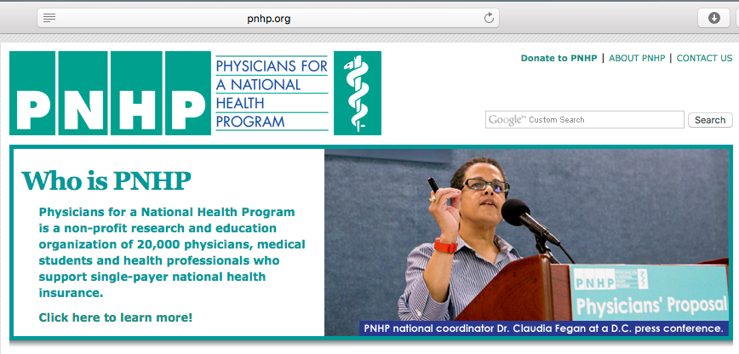
Join us!
www.PNHP.org
Like us!
facebook.com/PNHP
Follow us!
@PNHP

