Slide 1
Your Role in the Movement for Single Payer
Margaret Flowers, MD
PopularResistance.org

Slide 2
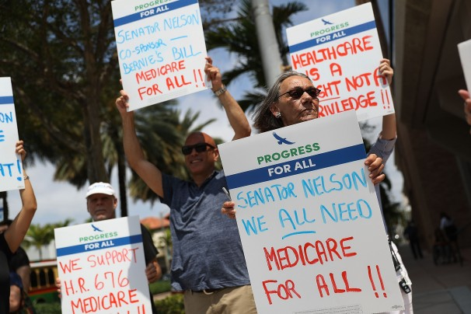
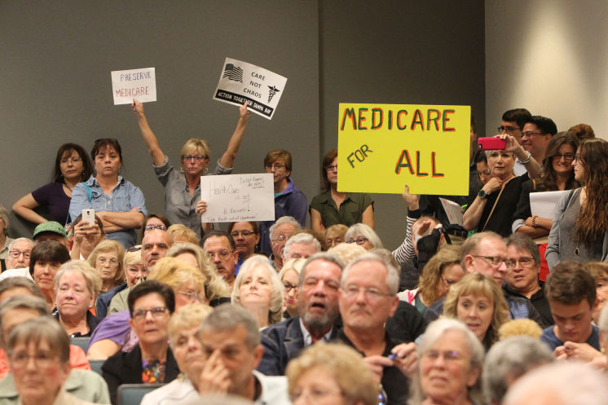
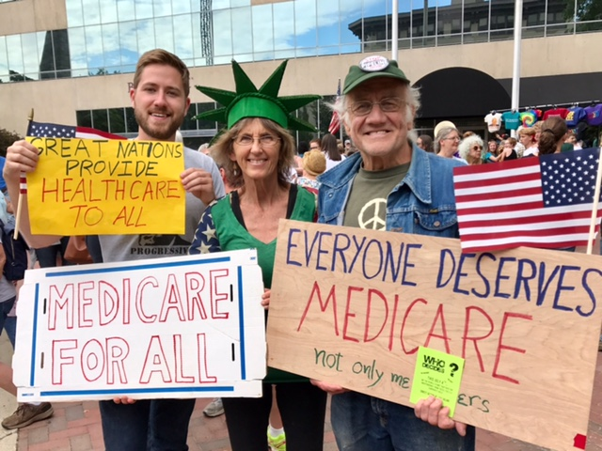
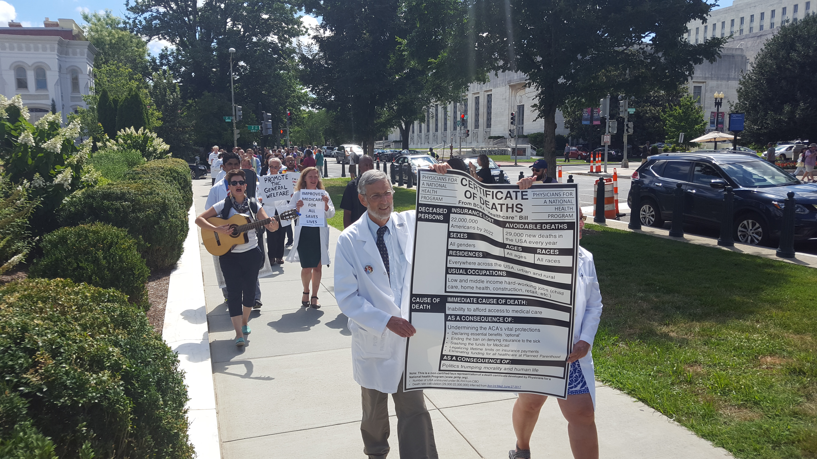
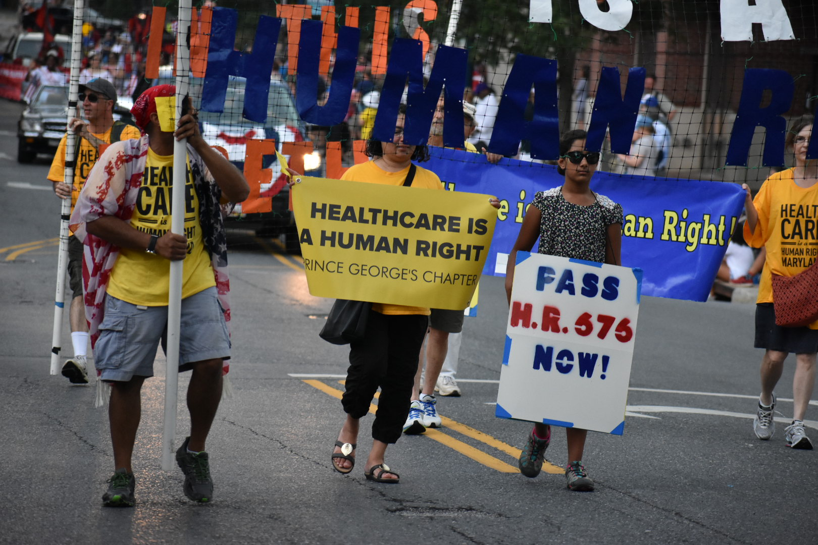
Single Payer Movement Swells

Slide 3
8 Stages of Successful Social Movements
Bill Moyer’s Movement Action Plan
Stages 1 – 3 – Percolation
Stage 4 – Take off
Stage 5 – Let down
Stage 6 – Building consensus
Stage 7 – SUCCESS
Stage 8 – Defending gains and moving on

Slide 4
Basic Conflict
Powerholders vs People Power
Powerholders – The elites, through their dominant control of the state, institutions, laws, myths, traditions, and social norms, serve the interests of the elites, often to the disadvantage of the whole society. Power flows from the top to bottom.
People Power - The powerholders' power is dependent on the cooperation, acquiescence, or support of the mass public. This model is represented by an inverse triangle, with the people at the top and the power elite at the bottom.

Slide 5
What the powerholders do
Task: Maintain the status quo
Keep the issue out of sight and off the table
Control information
Deny the issue exists
Create myths and threats
Discredit the opposition
Appear to take action
Make minor reforms
Co-opt the opposition

Slide 6
What the social movement needs to do
Task: Show that the social movement upholds values and the powerholders violate them
Keep the issue in the spotlight
Counter the myths
Eliminate the threats
Organize and mobilize people
Refuse to compromise too soon
Support grassroots action
Avoid focus on electoral, partisan politics
Reject co-option

Slide 7
How we win
Build a diverse movement of movements – solidarity
Become a mass (not a fringe movement)
Achieve national consensus
Mobilize at least 3.5% of the population
Maintain flexibility (not a POO)
Hold position of principled dissent

Slide 8
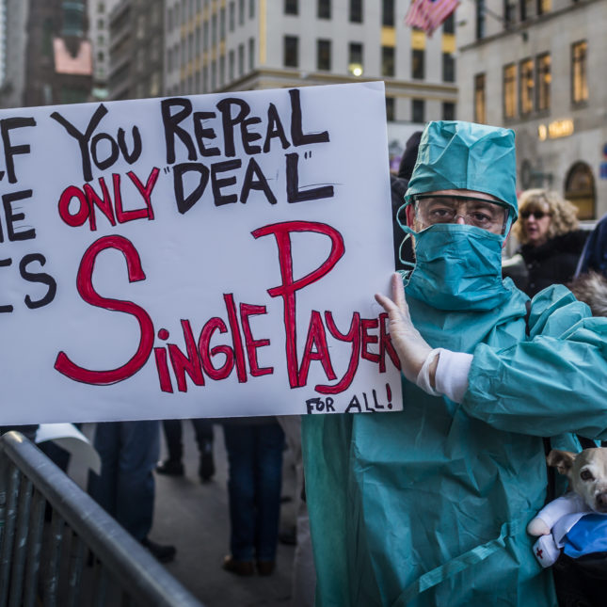
Stage 6: Building consensus
Public must understand:
There is a problem.
The current system can’t fix the problem.
There is an alternative solution that will fix the problem.

Slide 9
12 Phases of stage 6
Keep the issues on the political and social agenda;
Win majority support against current conditions and policies;
Cause powerholders to change strategy although they do not solve problems;
Counter each change in strategy by showing it is a gimmick, not a solution;
Push powerholders to new strategies that take riskier positions and make it harder to hold old positions;
Create strategic campaigns that erode support for the powerholders;
Expand policy goals as the movement realizes the problems are greater than was evident;
Develop stronger and deeper opposition to current conditions and policies;
Promote solutions and a paradigm shift;
Win majority support for the movement’s solutions;
Put the issues on the political and legal agendas;
Finally, the powerholders change positions to appear to get in line with public opinion while attacking the movement and its solutions.

Slide 10
Crisis point
Opposition to current policies grows quickly.
Support for alternative policy rises (movement helps this process)
Everyone wants the issue resolved, but government is unable to take action.
At the end of Stage 6, many powerholders begin to join the calls for change.
As elites defect to support majority opinion, the political price paid by those who want to maintain unpopular policies exceeds their benefits and creates a political crisis that leads to resolution.

Slide 11
Stage 7: Success
Dramatic showdown – something triggers another “take off” moment and the public mobilizes in mass numbers.
Victorious retreat - the people in power realize they can no longer continue the status quo and launch a face-saving endgame, changing their policies and taking credit.
Attrition - where the social, economic and political machinery slowly evolve to new policies and conditions.

Slide 12
Where do you fit in?
Bill Moyer identifies 4 roles of social change.
All are necessary.
A person can play multiple roles but often one role is suited for our personality and strengths.
Which role is best for you?
Think back to a time in your childhood when you faced a problem – how did you handle it?
Did you turn to authority, take personal initiative, turn to others to work collectively or raise a ruckus?

Slide 13
The Advocate (Reformer)
Childhood – sought out authorities to solve problems.
Transmits movement analyses and goals to authorities.
Performs legal efforts – lobbying, courts, etc.
Works to create and expand new laws and policies.
Acts as a watchdog to ensure the new laws and policies are funded and carried out.

Slide 14
The Helper (Citizen)
Childhood – works to solve the problem through personal efforts.
Upholds a widely-held vision of the democratic, good society.
Demonstrates ordinary people support social change.
Gives the movement legitimacy.
Makes it harder for authorities to discredit the movement.
Reduces the potential for violent attitudes and actions.

Slide 15
The Organizer (Change Agent)
Childhood – works to solve the problem collectively.
Supports the involvement of large numbers of people in the process of addressing social problems.
Promotes a new social and political majority consensus favouring positive solutions.
Promotes democratic principles and human values.
Supports the development of coalitions.
Counters the actions of authorities.
Moves society from reform to social change by promoting a paradigm shift.

Slide 16
The Rebel
Childhood – raises a commotion to pressure powerholders to act.
Puts issues on the social and political agenda through dramatic. Nonviolent actions.
Dramatically illustrates social issues.
Shows how institutions and official authorities violate public trust by causing and perpetuating critical social problems.
Forces society to face its problems.
Promotes democracy.

Slide 17
Positive and negative roles

Slide 18
A few words about conflict
Conflict can take a stagnant group and move it to a stronger level.
Three phases of groups:
Honeymoon – superficial polite efforts to get the job done.
Chaos – fighting.
Community – creates a high-performance team, which happens when members accept on a deeper level the diversity of who they are
From George Lakey: https://wagingnonviolence.org/feature/building-our-muscles-for-conflict/

Slide 19
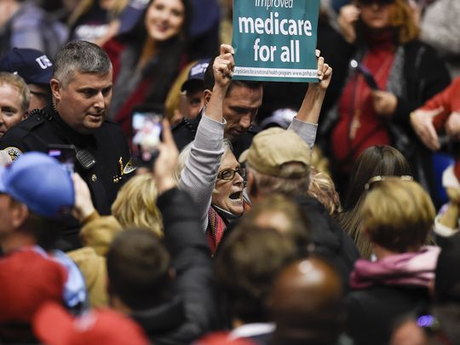
Now that you understand movements, what will you do?
Reformer
Citizen
Change Agent
Rebel

