Slide 1
#SinglePayer
Advancing Health Justice Through Social Media

Slide 2
SNaHP & PNHP social media
Facebook.com/SNHP1
Facebook.com/DoctorsForSinglePayer
@snahp_national
@PNHP
Physicians for a National Health Program
Follow these accounts, and encourage your friends and colleagues to do the same. We also have a LinkedIn profile, but it’s about as exciting as the typical LinkedIn profile.

Slide 3
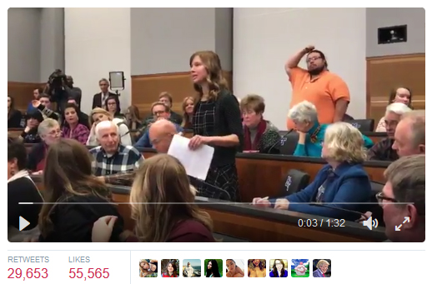
The power of video
On Feb. 9, French teacher Jessi Bohon posed a question to Rep. Diane Black (R-Tenn). Video of her question went viral, and six days later she published an op-ed in the Washington Post calling for single payer.

Slide 4
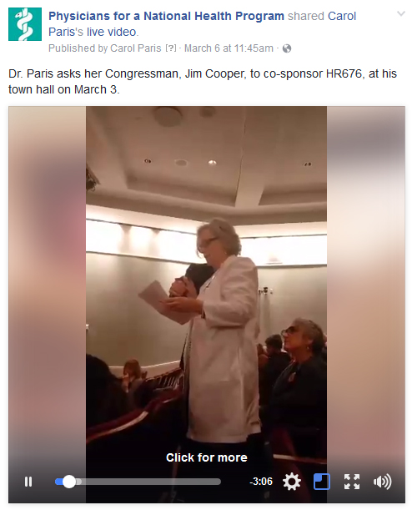
Facebook Live
PNHP president Dr. Carol Paris live streamed her question to Rep. Jim Cooper (D-Tenn) to Facebook Live. Pros: Good question, good audio, applause. Cons: Poor lighting, network issues, vertical video.

Slide 5
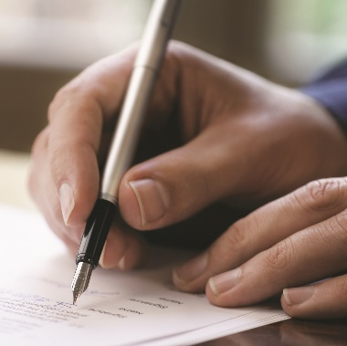
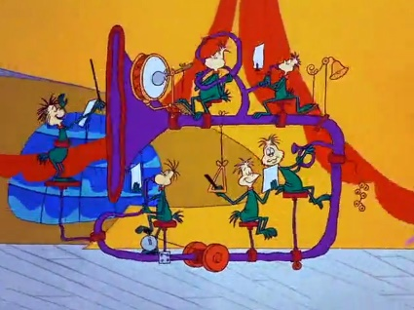
Best practices for FB Live
1) Shoot horizontal video, 2) Write a thoughtful description, 3) Wear your white coat, 4) Encourage friends and colleagues to share your video ahead of time, 5) Ensure adequate lighting and consider ambient noise, 6) Work together as a team.

Slide 6
What are we doing here?
Grab a placard. Write a message explaining why you support single payer. Be personal. Be analytical. Be persuasive. Be political. Just don’t express support for, or opposition to, a candidate for public office or a political party.

Slide 7
Facebook Live video protocol
1) Put on your white coat. 2) Line up behind the camera. 3) Once we start streaming, share the live video. 4) When it’s your turn, walk into the frame and hold up your sign. 5) Wait for a hand signal and then exit the frame.

Slide 8
Let’s all go to the lobby
Once you’ve shown your sign, we encourage you to 1) Take a photo of your sign and post it to social media using #SNaHP2017. 2) Have a professional photo taken. 3) Contact your reps. 4) Take your sign home with you. 5) Gather for a group photo at 3:30pm.

Slide 9
One more time…
Create a sign
Share the Facebook Live video
File past the camera and display your sign
Exit to the lobby and:
Post a picture of your sign to social media
Ask your member of Congress to co-sponsor HR 676
Take your sign home with you to display
Participation is, of course, voluntary. If you would prefer not to participate in our Facebook Live video, feel free to bypass the line and go directly to the lobby.

