Slide 1
“Medicare Extra for All” Center For American Progress

Slide 2
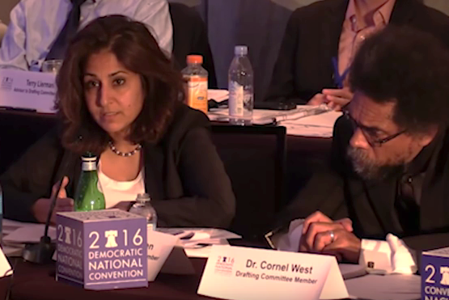
The Newest Thing: “Medicare Extra for All”
Neera Tanden, President
Center for American Progress
Friday June 24 2016:
One of seven votes (7:6) that kept
Medicare for All off of the
2016 Democratic Party Platform
https://www.healthcare-now.org/blog/dnc-drafting-committee-votes-against-single-payer/
Accessed Apr 1 2018

Slide 3
Who is the
“Center for American Progress”?
AT&T
American Express
Bank of America
Blackstone
BlueCross BlueShield
CVS
Express Scripts
Facebook
Ford Fdn
General Electric
Google
H&R Block
Microsoft
Pacific Gas and Electric
PepsiCo
Quest Diagnostics
Samsung
Schwab Charitable Fund
Travelers Indemnity Co.
United Arab Emirates
Walmart
Walton Family Fdn
Many more, including “Anonymous”
What kind of healthcare proposal
would these groups propose, and why?
https://www.americanprogress.org/c3-our-supporters/
Accessed Apr 1 2018

Slide 4
Medicare Extra for All
What?
Robust benefits: Outpatient and inpatient care, prevention, mental health, substance abuse, rehab, dental, vision, hearing, pharmacy, long-term care, etc.
Who?
Available to any lawful resident, any age, any income, any current insurance
How?
Auto-enrolled at birth, age 65, or if uninsured
Premiums automatically withheld in taxes.
https://www.americanprogress.org/issues/healthcare/reports/2018/02/22/447095/medicare-extra-for-all/
Accessed Apr 1 2018

Slide 5
Medicare Extra for All
Premiums, deductibles, copays,
and out-of-pocket limits that vary by income
Income Level | Premium | Actuarial Value
<150% FPL | None | 100%
150-500% FPL | 0 – 10% of income | 80-100%
>500% FPL | 10% of income | 80%
Income Level | Premium
<150% FPL | None
150-500% FPL | 0 – 10% of income
>500% FPL | 10% of income
Income Level
<150% FPL
150-500% FPL
>500% FPL
Capping the premium guarantees increasing subsidies to insurers
https://www.americanprogress.org/issues/healthcare/reports/2018/02/22/447095/medicare-extra-for-all/
Accessed Apr 1 2018

Slide 6
Medicare Extra for All
Preserves employer-based insurance.
Small employers (<100 employees) have no obligations to contribute to healthcare
Larger employers have four options
Continue to sponsor their own coverage
Minimum 80% actuarial value
Contribute >70% of premium
Shift employees into Medicare Extra
(lose tax benefits)
Either pay >70% of ME4A premiums or
Pay the same premium as prior to ME4A
Shift to a payroll tax (<8%)
(also lose tax benefits)
https://www.americanprogress.org/issues/healthcare/reports/2018/02/22/447095/medicare-extra-for-all/
Accessed Apr 1 2018

Slide 7
Medicare Extra for All
The good
The bad
The ugly
Open to anyone
Mainstreams Medicaid
No state variations
No churning for low-income
Eliminate waiting for disability
Complicated
Some will remain uninsured
Partial coverage unless low income
Premiums, copays, deductibles, etc.
Networks
Preserves private insurance. Never a level playing field.
Wasteful; misses most of the savings
Peels off key allies for Medicare for All (Medicaid, long-term care, disabled)

Slide 8
Medicare Extra for All
“This proposal would be a boon
for the private health insurance industry
by adding both costs and complexity
to our inefficient, ineffective,
semi-functional health care non-system –
most of which would remain in place.”
Max Fine
Last surviving author of
the 1965 Medicare law
https://theintercept.com/2018/03/12/single-payer-health-care-democrats/

