Slide 1
Separate and Unequal How Universal Health Care Would Mitigate Disparities
Ed Weisbart, MD, CPE, FAAFP
Chair, Physicians for a National Health Program – Missouri chapter

Slide 2
The Three Reasons I’m Here Today
Proudly Patriotic
Fairness
Fiscal Prudence

Slide 3
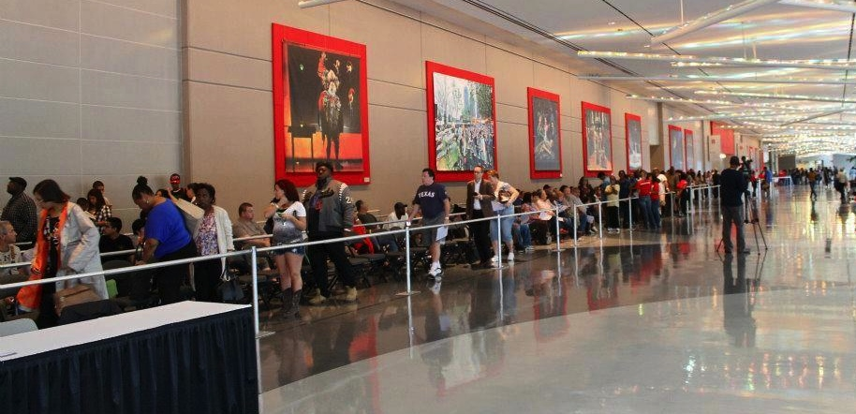
1,200 Uninsured Americans Patiently Waiting for Care

Slide 4
Volunteerism Is Alive and Well in the USA

Slide 5
Volunteerism Is Alive and Well in the USA

Slide 6
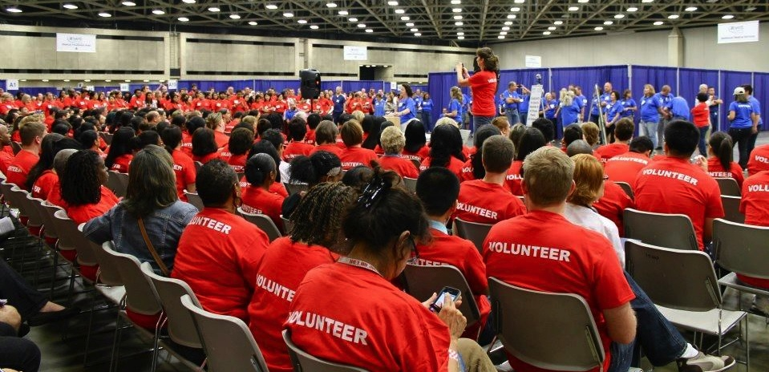
Volunteerism Is Alive and Well in the USA

Slide 7
Patients Mix at NAFC Clinic Events Public Policy Determines Who Is Left Out
NAFC Clinic Patient Age Mix
USA Age Utilization Mix (2010)
Medicare
Public policies
matter
SCHIP
Unpublished data from the National Association of Free and Charitable Clinics
Reported privately on July 6, 2014
National data from http://www.cdc.gov/nchs/data/ahcd/namcs_summary/2010_namcs_web_tables.pdf accessed July 12 2014

Slide 8
Patients Mix at NAFC Clinic Events Public Policy Determines Who Is Left Out
Hispanic
13%
83% of NAFC clinic event
patients come from
full-time working households.
They just don’t have
access to an affordable health care benefit.
Other
6%
African-
American
53%
White
28%
Patient Ethnicity
Unpublished data from the National Association of Free and Charitable Clinics
July 6, 2014

Slide 9
We’re Number 51 in Life Expectancy
Monaco
Macau
Japan
Singapore
San Marino
Andorra
Guernsey
Switzerland
Hong Kong
Australia
Italy
Liechtenstein
Canada
Jersey
France
Spain
Sweden
Israel
Iceland
Anguilla
Netherlands
Bermuda
Cayman Islands
Isle of Man
New Zealand
Ireland
Norway
Germany
Jordan
United Kingdom
Greece
Saint Pierre+
Austria
Malta
Faroe Islands
Luxembourg
European Union
Belgium
Taiwan
Virgin Islands
Finland
South Korea
Caicos Islands
Wallis and Futuna
Puerto Rico
Saint Helena+
Gibraltar
Denmark
Portugal
Guam
United States
Life Expectancy at birth
Projected data for 2013
CIA World Fact Book
Accessed Dec 3 2013

Slide 10
We Die of Things That Health Care Would Have Helped
Examples: ischemic heart disease, diabetes, stroke, and bacterial infections.
2006-2007
amenable deaths per 100,000 population before age 75
Source: Adapted from E. Nolte and M. McKee, “Variations in Amenable Mortality—Trends in 16 High-Income Nations,” Health Policy, published online Sept. 12, 2011.

Slide 11
Our Life Expectancy Varies with Our Geography and Race
Life Expectancy at Birth
2010 data, accessed July 6 2014
http://kff.org/other/state-indicator/life-expectancy-by-re/

Slide 12
Our Life Expectancy Varies with Our Geography and Race
Life Expectancy at Birth
2004-14 data from MO Information for Community Assessment
http://health.mo.gov/data/lifeexpectancy/ (accessed July 6 2014)
Credit to Ambriah Brown MPH of STL Regional Health Commission

Slide 13
Common Myths About the Racial Gap in Life Expectancy
Drug Abuse
Violent Communities
Biology

Slide 14
African American Lives Are Cut Short by Common Treatable Conditions
6
5
4
3
2
1
0
All other causes:
1.9 years
Years of life expectancy gap between African-American and White Americans
Cancer:
1.2 years
Heart Disease:
1.7 years
Homicide: 0.6 years
Stroke: 0.5 years
http://www.cdc.gov/mmwr/preview/mmwrhtml/mm5036a2.htm accessed July 6 2014

Slide 15
African American Women in Chicago More Likely to Die Of Breast Cancer
50
40
30
20
10
0
African-
American
1989:
Treatment advances, increased screening and awareness
Deaths per 100,000 women
White
1982 | 1985 | 1988 | 1991 | 1994 | 1997 | 2000 | 2003
2006
Age-Adjusted Female Breast Cancer Mortality for Chicago, Per 100,000 Population.
Prepared by The Sinai Urban Health Institute
Thanks to David Ansell MD

Slide 16
Case Study: Chicago Geography of Disparity
High breast cancer mortality,
African American communities
High breast cancer mortality,
Non-African American communities
Hospitals with American College of Surgeons Approved Cancer Programs
Age-Adjusted Female Breast Cancer Mortality for Chicago, Per 100,000 Population. 2000-2005
Prepared by The Sinai Urban Health Institute
Thanks to David Ansell MD

Slide 17
African Americans Are Less Likely to Get Voice Preservation Therapy
Adjusted for age, year, gender, and tumor characteristics
Odds ratio for receiving radiation therapy as initial treatment among laryngeal cancer patients
Arch Otolaryng-Head and Neck Surg 2012;138:644

Slide 18
Racial Disparities Exist In Treatment for Many Diseases
Rates of surgery for lung cancer¹
Rates of cardiac cath after heart attack²
Rates of kidney transplantation³
Rates of joint replacement⁴
¹NEJM, 1999,341:1231-1233
²NEJM;2001,344,1443-1449
³NEJM, 2000;;343:1537-1544
⁴NEJM;2000, 342:1043

Slide 19
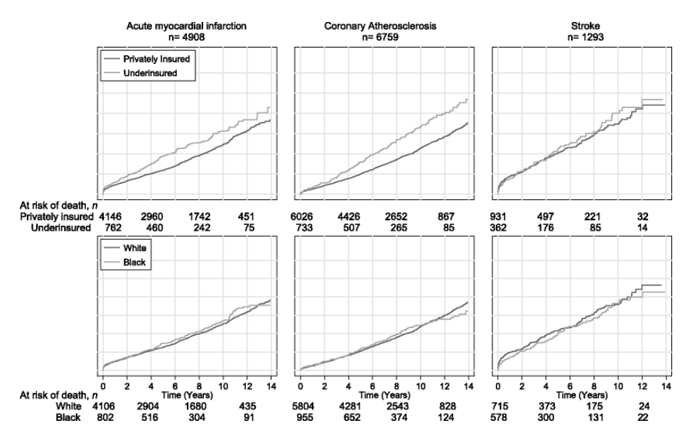
Insurance Matters Too.
Race Matters…
Relative Risk of Death after Heart Attack
African American
Underinsured
White
Privately Insured
0 | 2 | 4 | 6 | 8 | 10 | 12 | 14
0 | 2 | 4 | 6 | 8 | 10 | 12 | 14
Years Post MI
Years Post MI
Ng K, Brotman D, Lau B, and Young J. JGIM 2012; 27:1368

Slide 20
Excess Post-MI Mortality in African Americans Largely Driven by Insurance Status
Relative Risk of Death after Heart Attack
(p<0.05)
Under-insured data significant at p<0.05.
Ng K, Brotman D, Lau B, and Young J. JGIM 2012; 27:1368

Slide 21
Most of the Uninsured Are Non-White
Non-White:
55%
Non-elderly, 2011
http://kaiserfamilyfoundation.files.wordpress.com/2013/04/8423.pdf
Accessed July 5 2014

Slide 22
Disparities in Insurance Coverage
How well does the
ACA mitigate this?
Non-elderlies without insurance, 2011
http://kaiserfamilyfoundation.files.wordpress.com/2013/04/8423.pdf
Accessed July 5 2014

Slide 23
Most of the Uninsured Qualify for ACA Option
Up to 138% FPL:
ACA intended Medicaid access
Non-elderly, 2011
http://kaiserfamilyfoundation.files.wordpress.com/2013/04/8423.pdf
Accessed July 5 2014

Slide 24
ACA Is Not a Panacea… Disparities Persist in Massachusetts
Odds ratio for CABG or PCI during hospitalization for ischemic heart disease
African-Americans
were 30% less likely than whites to get CABG or PCI
We need to do
better than this.
Odds ratio compared to whites in MA.
Model adjusts for age, gender, comorbidities, and neighborhood educational attainment.
Albert, M et al. Circulation 2014;129:2528-2538.

Slide 25
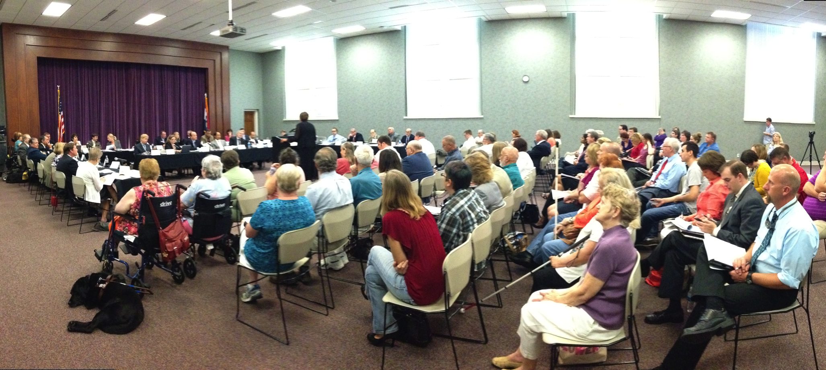
The ACA Expands Medicaid
MO House Interim Task Force on Medicaid Expansion
Independence, Springfield, Columbia, Kennett, Cameron, St. Louis

Slide 26
Missouri Medicaid Today
400% ($95,400)
300% ($71,550)
200% ($47,700)
100% ($23,850)
0
300%
Premium
185%
100%
85%
No
Premium
18%
X
Children | Pregnant | Blind | Aged or Disabled | Parents | Childless Adults
Y-axis is % of Federal Poverty Level; Example of a family of four

Slide 27
ACA Road to Universal Access
400% ($95,400)
300% ($71,550)
200% ($47,700)
100% ($23,850)
0
Sliding scale premium subsidies:
100% - 400% of poverty level
100-138% poverty: patient’s choice
Medicaid in all states: up to 138% of poverty
Y-axis is % of Federal Poverty Level; Example of a family of four

Slide 28
Missouri Medicaid Tomorrow
400% ($95,400)
300% ($71,550)
200% ($47,700)
100% ($23,850)
0
Sliding scale premium subsidies:
100% - 400% of poverty level
Under 100% FPL:
No New Support
Children | Pregnant | Blind | Aged or Disabled | Parents | Childless Adults
Y-axis is % of Federal Poverty Level; Example of a family of four

Slide 29
Medicaid Expansion Is Almost Entirely Federally Funded
State responsibility for cost of expansion population

Slide 30
Missouri Is Being Taxed For a Program We’re Turning Down
Federal responsibility for cost of expansion population
Our federal tax dollars are
paying for Medicaid but MO is
not getting the benefits

Slide 31
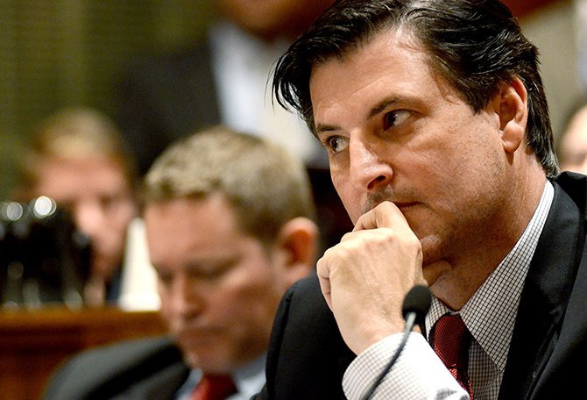
Does This Pass the Sniff Test?
“Giving Medicaid to
an uninsured person
does not improve
their health.”
John Lamping
MO State Senator

Slide 32
“Oregon Proved That Medicaid Does Not Improve Health”
Randomized Prospective Controlled Trial
Expanded Medicaid via a lottery in 2008
6,387 newly, 5,842 controls
No significant difference in average blood pressure, cholesterol, or glucose
Utilization increased, outcomes did not
Commonly Shown Results
Most recent data is two years after the lottery
Baicker, K. The Oregon Experiment. NEJM 2013;368:1713-22

Slide 33
The Rest of the Story in the Oregon Study
HgbA1c in both total populations averaged 5.6%
Intermediate markers showed dramatic improvements
94.6% non-diabetics dilute the population-wide metrics
Surrogate endpoints were all encouraging
Study not powered to show broad population impact
Average patient in the study for 17 months
Baicker, K. The Oregon Experiment. NEJM 2013;368:1713-22

Slide 34
Oregon: Expand Medicaid, Improve Health
No Medicaid
Medicaid
Depression p<0.05; the others area clinically meaningful but not powered to show statistical significance
Baicker, K. The Oregon Experiment. NEJM 2013;368:1713-22

Slide 35
Oregon: Expand Medicaid, Increase Preventive Medicine
54%
more
32%
more
103%
more
All results valid at P<0.02 or better.
Baicker, K. The Oregon Experiment. NEJM 2013;368:1713-22

Slide 36
Oregon: Expand Medicaid, Increase ER Usage by 40%
A 40% relative increase means
one extra visit per person
every four years
Annual emergency room visits per person
Taubman, S. Science Magazine. Jan 2, 2014.

Slide 37
Oregon Medicaid 2011-2013 Continues to Improve
Emergency Room visits
13% reduction
Hospitalizations for adult asthma
18% reduction
Hospitalizations for heart failure
32% reduction
Hospitalizations for COPD
36% reduction
“Welcome to Insurance” phone calls;
schedule PCP appointments; re-book no-shows
http://www.oregon.gov/oha/Metrics/Documents/report-february-2014.pdf accessed Feb 5 2014

Slide 38
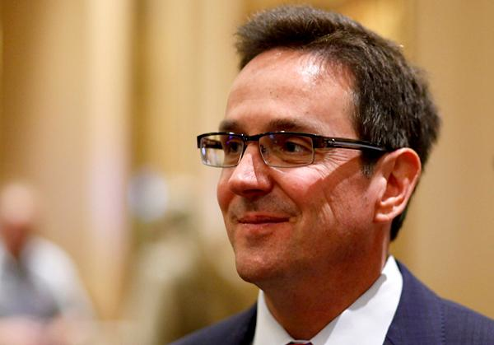
“Doctor Is Off Base on Medicaid. Expansion Will Hurt Taxpayers, Students”
“The cost directly hurts public education and the Missouri taxpayers who pay the bill.”
MO Senator Kurt Schaefer
Chair, Senate Appropriations
Schaefer, K. Columbia Daily Tribune. March 9, 2014

Slide 39
Expanding Medicaid Is Budget Favorable
Increased Revenue
Reduced State Share of Existing Programs
Individual income tax
Sales tax
Pregnant women
Breast/Cervical cancer
Mental Health
Disability
Spend-down
Many others
Luebberring, L. Director, MO Budget Office
Medicaid Impact on Budget. Jan 31, 2014

Slide 40
Failure to Expand in 2013: MO Cut Education, IT, and others
Expansion was budget favorable
Added $15.5M in new state tax revenue
Avoided $31M in other state expenditures
Decline expansion, cut budget to stay balanced
Cut higher education expansion by $14M
Cut $5M from state’s information technology budget
Eliminated $2.3M for export initiative
Reduced preschool grants and more
http://www.dailystatesman.com/story/1941684.html
Accessed Dec 13 2013

Slide 41
Expanding Medicaid in 2015 Adds $1 Billion to MO Budget by 2022
$74M
$71M
Cumulative impact on MO Budget
$97M
$134M
$146M
$180M
$185M
$94M
Luebberring, L. Director, MO Budget Office
Medicaid Impact on Budget. Jan 31, 2014
UMSL budget from http://web.mst.edu/~hale/BAC/FY2013BudgetBook%5B1%5D.pdf accessed March 15, 2014

Slide 42
How Much Is a Billion Dollars for Missouri?
Annual gain from Medicaid expansion
2014 UM Tuition & Student Fees
$123 Million
$100
Million
Medicaid impact from Luebberring, L. Director, MO Budget Office
Medicaid Impact on Budget. Jan 31, 2014
UM Budget from http://mubudget.missouri.edu/presentations.php
Accessed July 9, 2014

Slide 43
Medicaid Expansion Is About Life and Death In Missouri
Better women’s health
4,086 more mammograms
Better treatment of chronic diseases
12,947 more diabetics receiving medications
21,816 fewer adults with depression
Between 218 and 700 fewer deaths
Many fewer preventable deaths
14,134 more Pap smears
Isn’t this the point of a health care system?
Annual data for Missouri from Dickman S, Himmelstein D, McCormick D, and Woolhandler S. Opting out of Medicaid Expansion: The Health and Financial Impacts. Health Affairs Blog. January 30, 2014

Slide 44
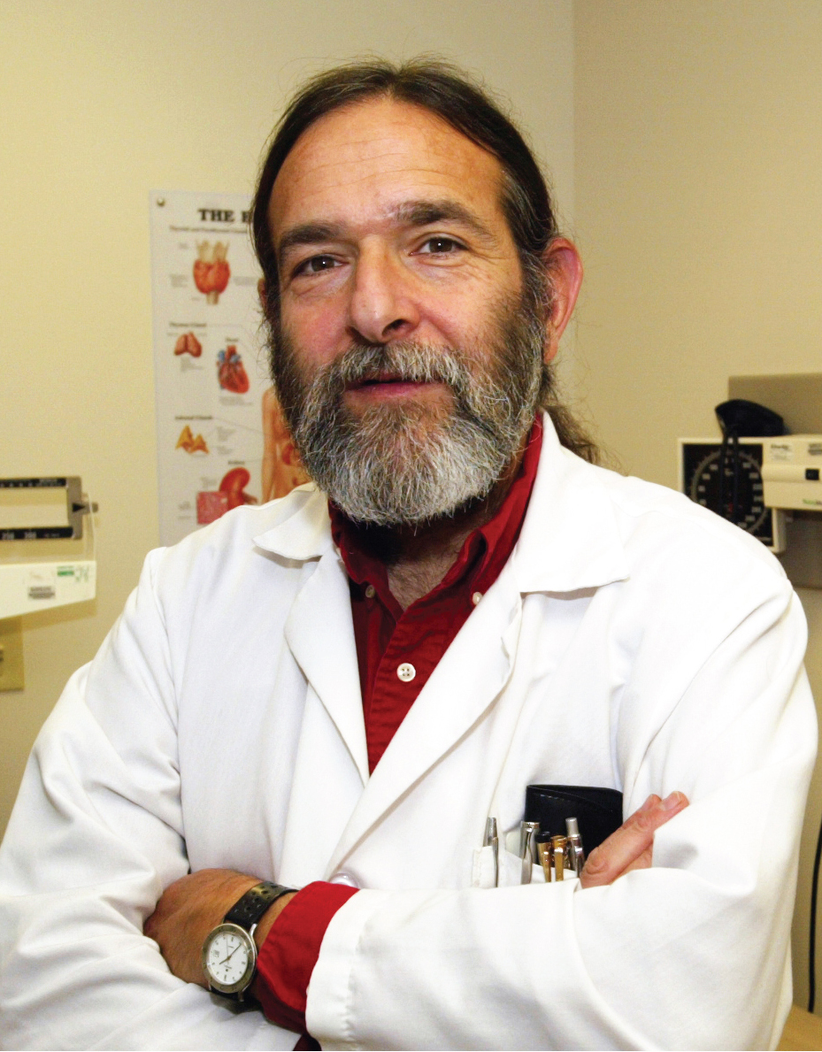
Medicaid: The Only Safety Net
“Medicaid is far from perfect.
In many parts of the country, Medicaid pays so little that patients have trouble finding a doctor who will accept it.
A single-payer program like Canada’s that covers all Americans is a far better solution for both the poor and the middle class.
But until we get to single payer, Medicaid is the only safety net for many low-income Americans.”
Dr. David Himmelstein
Co-author of Health Affairs Blog Jan 30 2014
Co-founder of Physicians for a National Health Program

Slide 45
The ACA’s Biggest Flaw
Preserves the
insurance industry
Limited lists of doctors and hospitals
Large gaps in covered benefits
Financial barriers to care
Needless complexity
Millions remain uninsured

Slide 46
A National Health Program for the USA

Slide 47
Four Ways the World Organizes Health Care
“Single Payer”
National Health Insurance
National Health Service
All Payer
Market-Based Mix
Medicare
Canada
VA
Great Britain
Highly regulated non-profit insurance
Germany
USA only
Public funds, private delivery
Public funds, public delivery
Multiple payers, modestly regulated with high cost and large coverage gaps

Slide 48
“The Improved and Expanded Medicare for All Act”
National Health Insurance
National Health Service
All Payer
Market-Based
Medicare
Canada
VA
Great Britain
Highly regulated non-profit insurance
Germany
USA only
Public funds, private delivery
Public funds, public delivery
Modest regulations
HR 676
“True North” for
USA health care?

Slide 49
HR 676 “Medicare for All” Builds on Medicare
Fix Medicare
Comprehensive benefits
No need for “Medicare supplemental” or “wrap”
Expand Medicare
All Americans, including Congress
“Everybody in, nobody out.”
No financial barriers
Roll up most other programs
Preserve private delivery

Slide 50
New Savings Exceed New Costs
Cover everyone
with better benefits and save
$243 Billion
$ Billions
Admin costs
to providers
Increased utilization
(especially home health and dental)
Increased market power (pharma and devices)
Covering the uninsured
Health insurance admin
Medicaid Rate Adjustment
Gov. admin ($23B)
New Costs
New Savings
Friedman, G. Dollars & Sense. March/April 2012

Slide 51
Canada Figured This Out Already
19%
17%
15%
13%
11%
9%
7%
5%
USA 1971: HMO Act
USA
Health costs % of GDP
Canadian Single Payer
“Uniquely American”
Canada
1960 | 1970 | 1980 | 1990 | 2000
2014
Source: Statistics Canada, Canadian Institute for Health Info, and NCHS/Commerce Dept.

Slide 52
Canadians Spend Less and Live Longer
Life Expectancy Gap
(CA minus US)
(years)
They spend half as much as we do,
and now live 2.5 years longer.
Source: World Bank.
Accessed Nov. 29, 2013

Slide 53
Physicians Don’t Leave Canada
Net loss (Canadians moving abroad less Canadians returning)
A negative number indicates that more physicians returned from abroad then moved abroad
Source: Canadian Institute for Health Information

Slide 54
American Physicians Are Now Moving to Canada
American Physicians Practicing in Canada
Glauser, W. Canadian Medical Association Journal. June 19, 2014
http://www.cma.ca/multimedia/CMA/Content_Images/Inside_cma/Statistics/10PhysByCountry.pdf

Slide 55
Canadian Physicians’ Incomes 2010 – 2011
Specialty | Income
Family Medicine | $265,881
Internal Med | $361,551
Pediatrics | $270,073
Psychiatry | $214,702
Dermatology | $398,410
Specialty | Income
OB-GYN | $449,121
General Surgery | $411,995
Thoracic Surgery | $529,728
Ophthalmology | $573,258
Canadian physician average: $307,482
Source: Canadian Institute for Health Information

Slide 56
2013 Canadian Malpractice Costs
Specialty | Ontario* | Quebec | Other Provinces
Primary Care | $2,268 | $1,386 | $1,344
Cardiology | $4,080 | $3,217 | $1,608
Anesthesia | $7,812 | $6,199 | $4,296
Neurosurgery | $42,216 | $28,240 | $19,836
Obstetrics | $49,416 | $43,295 | $17,904
Canadian physicians don’t talk much about tort reform.
*Government of Ontario reimburses physicians for premiums above 1986 level
Canadian Medical Protective Association
www.cmpa-acpm.ca

Slide 57
Most American Physicians Want National Health Insurance
Psychiatry
Peds Specialties
Emergency Med
General Peds
General Int. Med
Med Specialties
Family Med
OB-Gyn
General Surgery
Surg Specialties
Radiology
0 | 25% | 50% | 75% | 100%
Percent supporting National Health Insurance
2007 detail of surveys of random samples of US physicians.
Carroll and Ackerman. Ann Int Med 2008;148:566

Slide 58
Americans Are Not as Divided As You Might Think
Are the benefits from government programs
such as Social Security
and Medicare
worth the costs?
Source: CBS News / New York Times Poll, April 14, 2010

Slide 59
The Three Reasons I’m Here Today
Proudly Patriotic
Fairness
Fiscal Prudence

Slide 60
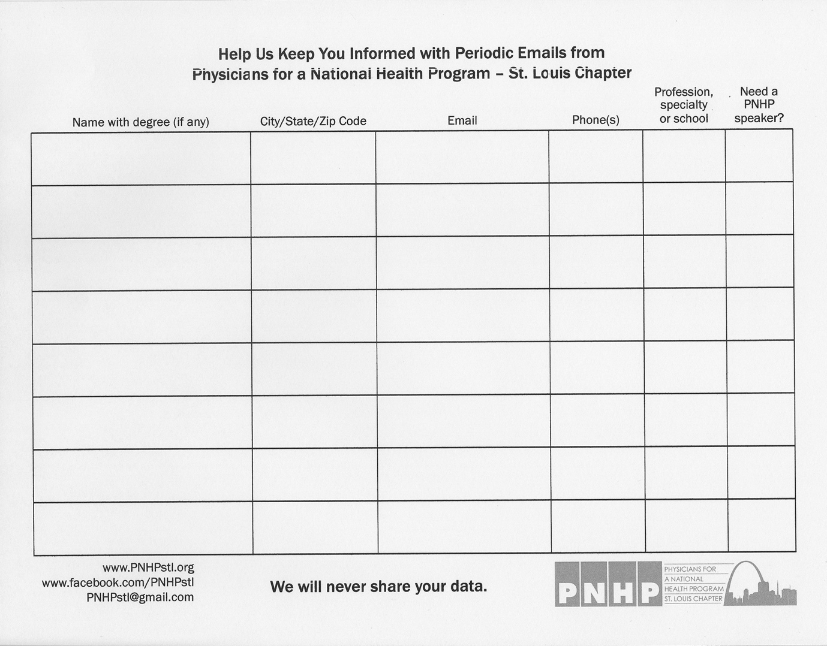
Help Us Keep You Informed

