Slide 1
Health Disparities and Social Determinants of Health
Walter Tsou, MD, MPH
PNHP
September 30, 2015

Slide 2
WHO Health Definition
“a complete state of physical, mental and social well-being, and not merely the absence of disease or infirmity.”

Slide 3
Healthy People 2010

Slide 4
Healthy People 2010

Slide 5
Healthy People 2010

Slide 6
l
Healthy People 2010

Slide 7
l
Healthy People 2010

Slide 8
Healthy People 2010

Slide 9
A
Healthy People 2010

Slide 10
Social Environment
Food
Housing
Job opportunities
Education
Technology
Transportation
Public Safety and Crime
Social Support
Poverty
Language and Culture

Slide 11
Physical Environment
Natural environment, such as green space (e.g., trees and grass) or weather (e.g., climate change)
Built environment, such as buildings, sidewalks, bike lanes, and roads
Worksites, schools, and recreational settings
Housing and community design
Exposure to toxic substances and other physical hazards
Physical barriers, especially for people with disabilities
Aesthetic elements (e.g., good lighting, trees, and benches)
Healthy People 2020

Slide 12
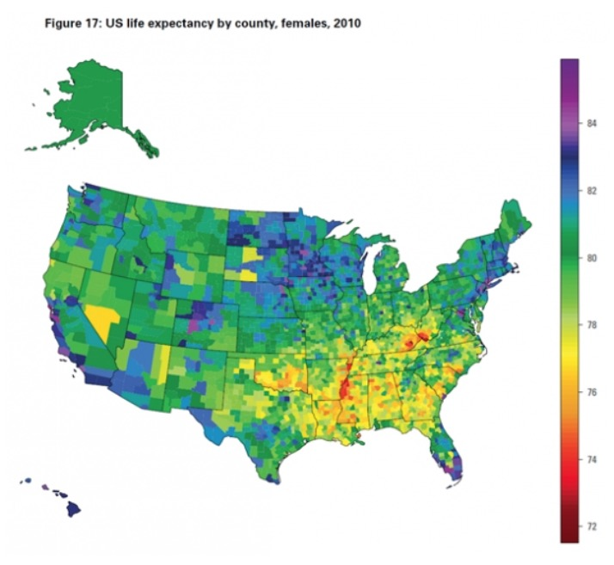
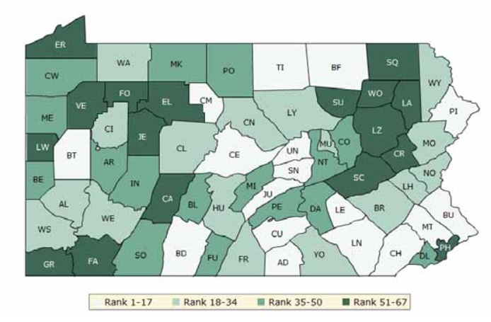
Place Matters Life Expectancy
Montgomery County 78 yrs.
Philadelphia 71 yrs.

Slide 13
MDGs to Sustainable Development Goals (SDGs)
Health equity
Universal health care
SDGs
End poverty
End hunger
Healthy living
Equitable education
Gender equality
Water and sanitation
SDGs (cont.)
Sustainable energy
Full employment
Infrastructure
Reduce inequality
Cities safe and sustainable
Sustainable consumption
Climate change
Respect oceans and seas
Forest and land conservation
Peace and justice for all
Global partnership

Slide 14
UN Adopts SDGs

Slide 15
WHO Definition
The social determinants of health (SDH) are the conditions in which people are born, grow, work, live, and age, and the wider set of forces and systems shaping the conditions of daily life. These forces and systems include economic policies and systems, development agendas, social norms, social policies and political systems.

Slide 16
6 Ways to Talk about SDH
1 Health starts—long before illness—in our homes, schools and jobs.
2 All Americans should have the opportunity to make the choices that allow them to live a long, healthy life, regardless of their income, education or ethnic background.
3 Your neighborhood or job shouldn’t be hazardous to your health.
4 Your opportunity for health starts long before you need medical care.
5 Health begins where we live, learn, work and play.
6 The opportunity for health begins in our families, neighborhoods, schools and jobs.
“A New Way to Talk About Social Determinants of Health”, RWJF

Slide 17
Equality vs. Opportunity
Republicans find “equality in health” alienating
Republicans were supportive of “fairness” and “health choices”
“Single payer framing” for Republicans means more choices for the poor in choosing doctors and hospitals allowing them to make their own individual decisions.

Slide 18
Getting to the Root Causes
Why is ? a problem in my community? (eg. heroin)
“But why?” technique to find root causes
Knowledge, awareness, attitudes, behavior?
Culture, economy, politics?
Built environment, housing, transportation?
“Could this have been prevented?” to find solutions

Slide 19
Three overarching factors
Advocates Life Expectancy Higher
Liberals Lower Income Inequality
All Higher Social Connectedness
All Higher Control of One’s Life

Slide 20
Three overarching factors
Advocates Life Expectancy Higher
Liberals Lower Income Inequality
All Higher Social Connectedness
Libertarian Higher Control of One’s Life
Single payer health reform offers the benefits of all three factors

Slide 21
Defining Health Disparities
Uniquely American term
Racial or ethnic differences in the quality of healthcare that are not due to access related factors or clinical needs, preferences, and appropriateness of intervention.
Institute of Medicine
“Inequalities that exist when members of certain population groups do not benefit from the same health status as other groups”
Fox Chase Office of Health Communications and Health Disparities

Slide 22
Differences, Disparities, and Discrimination
IOM Report Unequal Treatment; Gomes and McGuire 2001

Slide 23
“There is a significant body of evidence that has identified disparities in health care “- IOM
Notes:
Unequal treatment is the name of the report issued by the Institute of Medicine which chronicled the existence of racial and ethnic disparities in health care. This is a quote from the report’s summary: “There is a significant body of evidence that has identified disparities in health care.”

Slide 24
When I was Health Commissioner of Phila . . .

Slide 25
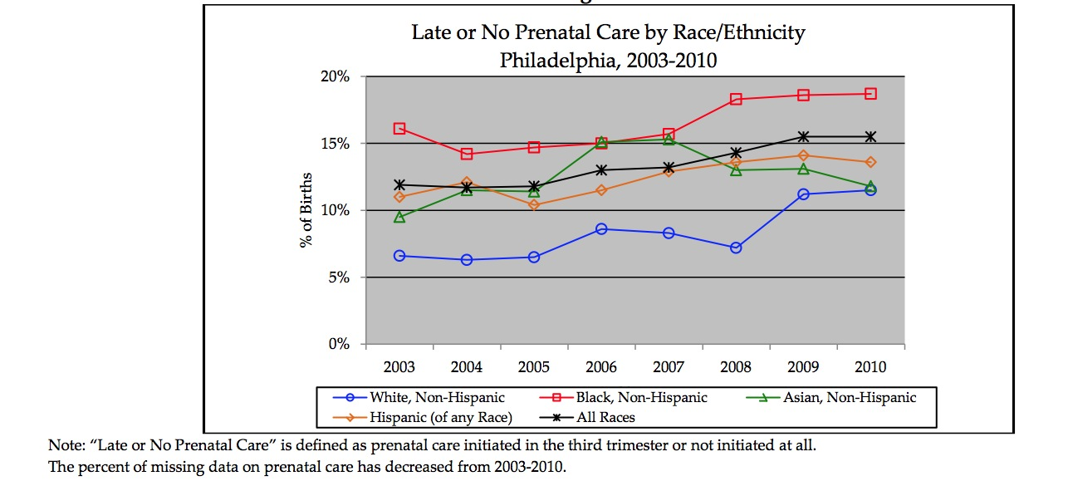
Phila. Infant Mortality by Race 2005-10
} 250% difference

Slide 26
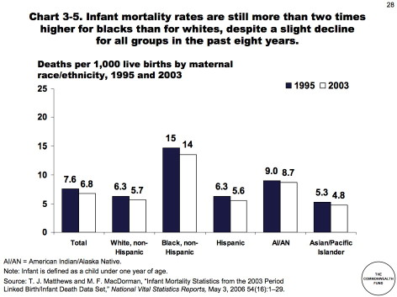
Difference

Slide 27
Infant mortality differences persist
} 250% difference
No improvement over decade
No evidence that it narrows

Slide 28
“Patients” experiencing symptoms of heart disease, from Schulman et al. (1999)

Slide 29
“Patients” experiencing symptoms of heart disease, from Schulman et al. (1999)

Slide 30
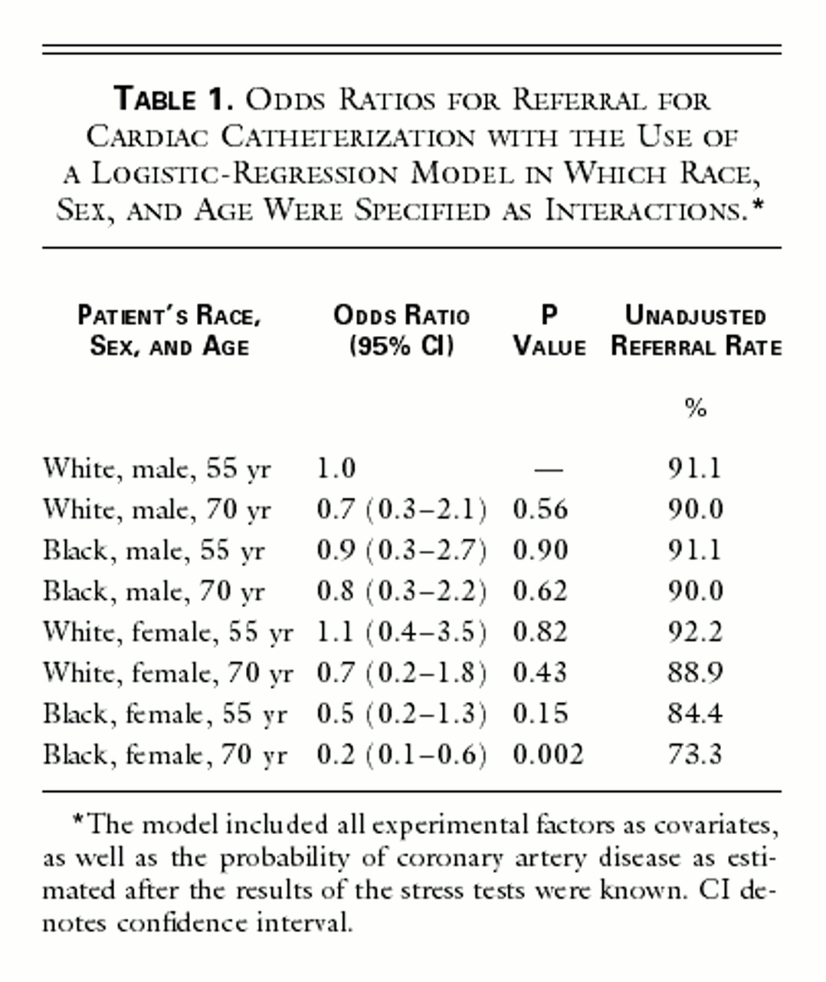
Odds Ratios for Referral for Cardiac Catheterization with the Use of a Logistic-Regression Model in Which Race, Sex, and Age Were Specified as Interactions
Helft, G. et al. N Engl J Med 1999;341:285-287
Notes:
Table 1. Odds Ratios for Referral for Cardiac Catheterization with the Use of a Logistic-Regression Model in Which Race, Sex, and Age Were Specified as Interactions.

Slide 31
Odds Ratios for Referral for Cardiac Catheterization with the Use of a Logistic-Regression Model in Which Race, Sex, and Age Were Specified as Interactions
Helft, G. et al. N Engl J Med 1999;341:285-287
Notes:
Table 1. Odds Ratios for Referral for Cardiac Catheterization with the Use of a Logistic-Regression Model in Which Race, Sex, and Age Were Specified as Interactions.

Slide 32
Universal Hep B vaccine almost eliminates disparities
CDC, Div of Viral Hepatitis

Slide 33
What Reduces Disparities?
Start young
Universal
Access
Consistent rules for everyone

Slide 34
Madigan Army Medical Center, Infant Mortality, 1985-1990
} 22% diff
Rawlings and Weir, Am J Dis Child, 1992

Slide 35
Lessons learned
Guaranteed access to care
Higher education and income

Slide 36
Are we capable of practicing universal health care?
The Effects of Race and Other Socioeconomic Factors on Health Service Use Among American Military Veterans. (Study of 19,270 vets)
Tsai J, Desai MU, Cheng AW, Chang J.
“Results showed that use of the VA health care system was not associated with race, but was associated with VA disability compensation, lack of private health insurance, and greater health care need. Contrarily, in non-VA healthcare systems, veterans who were racial minorities, less educated, and without private health insurance were less likely to use services.”
Psychiatr Q. 2013 Aug 15

Slide 37
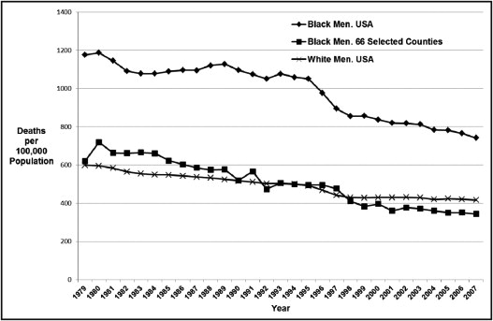
Are there counties with low black male mortality rates?
Am J Med. 2013 Jan;126(1):76-80

Slide 38
Are there counties with low black male mortality rates?
Of 1307 counties with black mortality rates classified as reliable by the National Center for Health Statistics (at least 20 deaths), 66 recorded lower mortality among black men than corresponding US whites. Most notable, 97% of the 66 counties were home to or adjacent a military installation versus 37% of comparable US counties (P<.001). Blacks in these counties had less poverty, higher percentages of elderly civilian veterans, and higher per capita income. Within these counties, national black:white disparities in mortality were eliminated for ischemic heart disease, accidents, diseases of the liver, chronic lower respiratory diseases, and mental disorder from psychoactive substance use.
Am J Med. 2013 Jan;126(1):76-80

Slide 39
Characteristics of those with low black male mortality
Am J Med. 2013 Jan;126(1):76-80

Slide 40
Elimination of racial/ethnic disparities in military facilities
Surveillance mammography
Colon cancer survival in those over 50yo
Lung cancer survival
Pediatric asthma
Oral health

Slide 41
Given equal treatment, blacks do BETTER than whites!
LA Times –Sept 23, 2015

Slide 42
Nine year follow-up of VA patients
547K Black patients
2.5 M White patients
2004-6, nine yr. follow-up
White mortality rate 32
Black mortality rate 22.5
NHANES cohort of 5000
Black mortality 42% higher than white
Kovesdy, Norris, Boulware, et. al, Circulation, Sept 18, 2015

Slide 43
US Population Pyramid, 1900-2000

Slide 44
Where are our young people?
Incentivize couples to have babies?
Immigration! Rules for accessing health care

Slide 45
Eliminate health disparities
Universal
Start with the young
Belief that everyone succeed
Beyond just an Office of Health Equity
Top priority of the highest elected official – role of government – “Health in all policies”
Mayor
County Commissioners
Governor
Congress
President

Slide 46
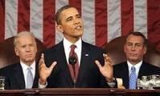
“The domestic agenda for my Administration is the elimination of health disparities”

Slide 47
Fighting Sacred Cows
Invest in the very young
Fully funded public education
Jobs not based on who you know, but what you know
Wealth inequality: Tax the rich, give to the poor
Live in a colorblind community
Immigration reform including path to citizenship for the undocumented
Single payer, national health insurance
To eliminate disparities, celebrate diversity

Slide 48
Questions?

