Slide 1
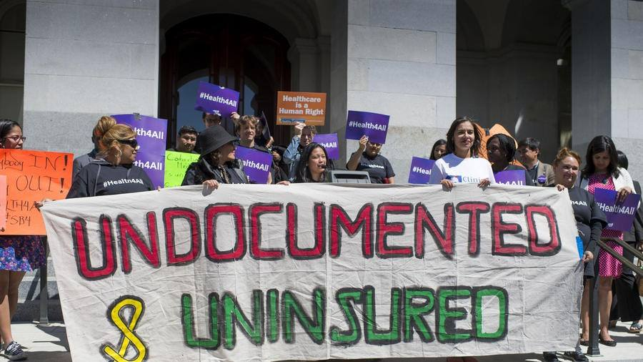
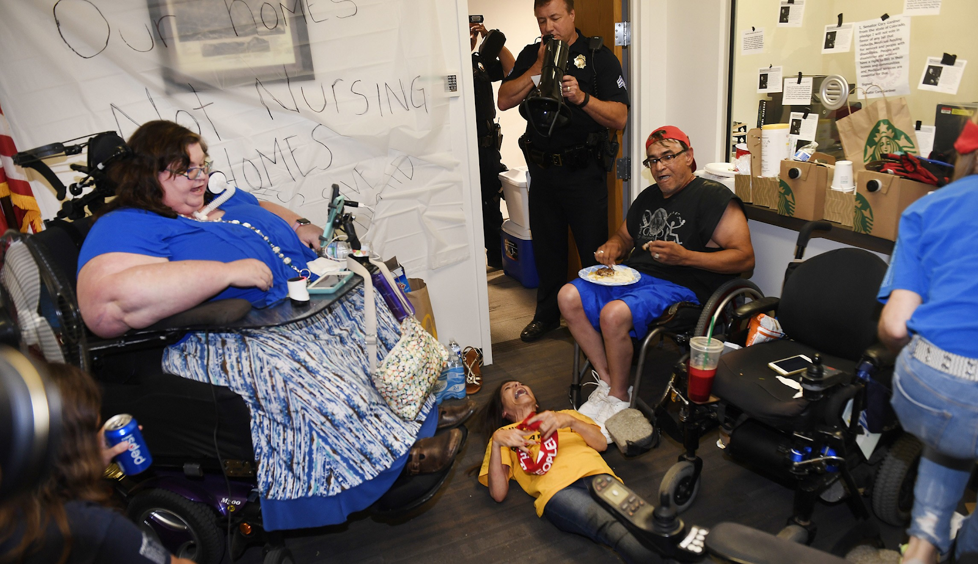
Intersections of Health Care Reform A critical discussion
Notes:
Carrie Ann Lucas, Disability Rights Activist and Attorney, Dies Following Denial From Insurance Company.

Slide 2
What makes up a good health care system?
Access
Affordable
High quality
Equitable
Everyone covered
Comprehensive
Notes:
S
Access = No barriers to care. Easy access and you can choose the doctor/hospital you want.
Affordable
High quality also includes
a sufficient number of providers/hospitals to prevent waitlists
Coordinated care
Focus on prevention/early intervention

Slide 3
What do providers want of their health care system?
Simple funding and payment system
Adequate and timely payments
Easily administered care and payment
Comprehensive coverage of patients that’s cheap, fair, and equitable
Quality medical education, research, and technology
Notes:
S
Simple funding and payment = less billing, administration, restrictions, approval requests for interventions, etc.
By cutting admin costs = saving serious $$$ for patients

Slide 4
What’s wrong with our system?
Access – barriers to care, uninsurance, under-insurance
Costs – twice as high as other industrialized nations
Quality – behind other industrialized nations
Choice – highly restricted
Efficiency – fragmented, bureaucratic
Inequity – a whole slew of disparities
Notes:
T
Access – 12.2% uninsured, 33M Americans, 21% under-insured 39M 19-64yrs
Costs/affordability – spending more than 2x other industrialized countries, % of GDP. Out of pocket expenses. US public spending per capita
Public & total spending slide (7),Physician & managers slide (8)
Quality – leads in potential years of life lost for all causes (PNHP156). Growing gap in life expectancy by income .WHO ratings 37th. Life exp, infant & maternal mort,
Equity
Choice physician vs insurance plan. Have to choose based on hospital/insurance “networks”, HMOs, etc.
Efficiency of health care spending when measured by improvements in life expectancy. Fragmentation leads to admin inefficiency (31% of Health care dollars), WHO ratings 37th; OECD nations - 22nd out of 27 - on the efficiency of.

Slide 5
What is Single Payer?
Notes:
S

Slide 6
Medicare for All
Gov’t FINANCED healthcare, not gov’t run healthcare
Universal, covers everyone – “Everybody In – Nobody Out”
Comprehensive care
No fiscal barriers to care – deductibles, copays, etc.
A single, public agency processes and pays bills
Notes:
S
Patients can choose their physician/hospital or STAY WITH THEIR CURRENT PROVIDER
Financed through progressive taxes
Automatic enrollment - everyone receives a card assuring payment for all needed care
Public agency processes and pays bills
No premiums, deductible or co-pays
No private health insurance for what’s covered in national health plan
Doctors and hospitals remain independent, negotiate fees and budgets with public agency = improved planning
Private delivery system stays the same, although removing profit incentive.

Slide 7
How can we afford it?

Slide 8
How U.S. Health Care Is Paid For Now
$$$ PROFITS $$$
ADMIN
Pre-existing conditions?
Private Insurers
• Blue Cross
• Aetna
ADMIN
Premiums
In network? Out of network?
Deductibles
ADMIN
Prior approvals?
Aka “Death Panels” ☹
ADMIN
You
Taxes
ADMIN
Health Care
• Medicaid
• State employees
State
ADMIN
ADMIN
Taxes
ADMIN
• TriHealth
• Medicare
Individual Market
Federal
ADMIN
CO-OP
ADMIN
ACA
GoFundMe?
Premium subsidies
Out of pocket costs
Notes:
T
You and maybe your employer pays private insurers that pay providers
You pay taxes US government and state
You pay out of pocket expenses to providers for what's not covered by insurance
CO-OP = Consumer Operated and Oriented Plan Program

Slide 9
How Single Payer Health Care is Paid for
You
Health Care
Gov’t
Fund
Various fixed and
progressive taxes
Pays providers
directly
Notes:
Introducing modest tax increases means that everyone is lumped into one streamlined “risk-pool” = very efficient and cheap
Physicians for a National Health Program estimated an immediate savings of 350 billion per year.

Slide 10
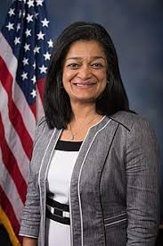
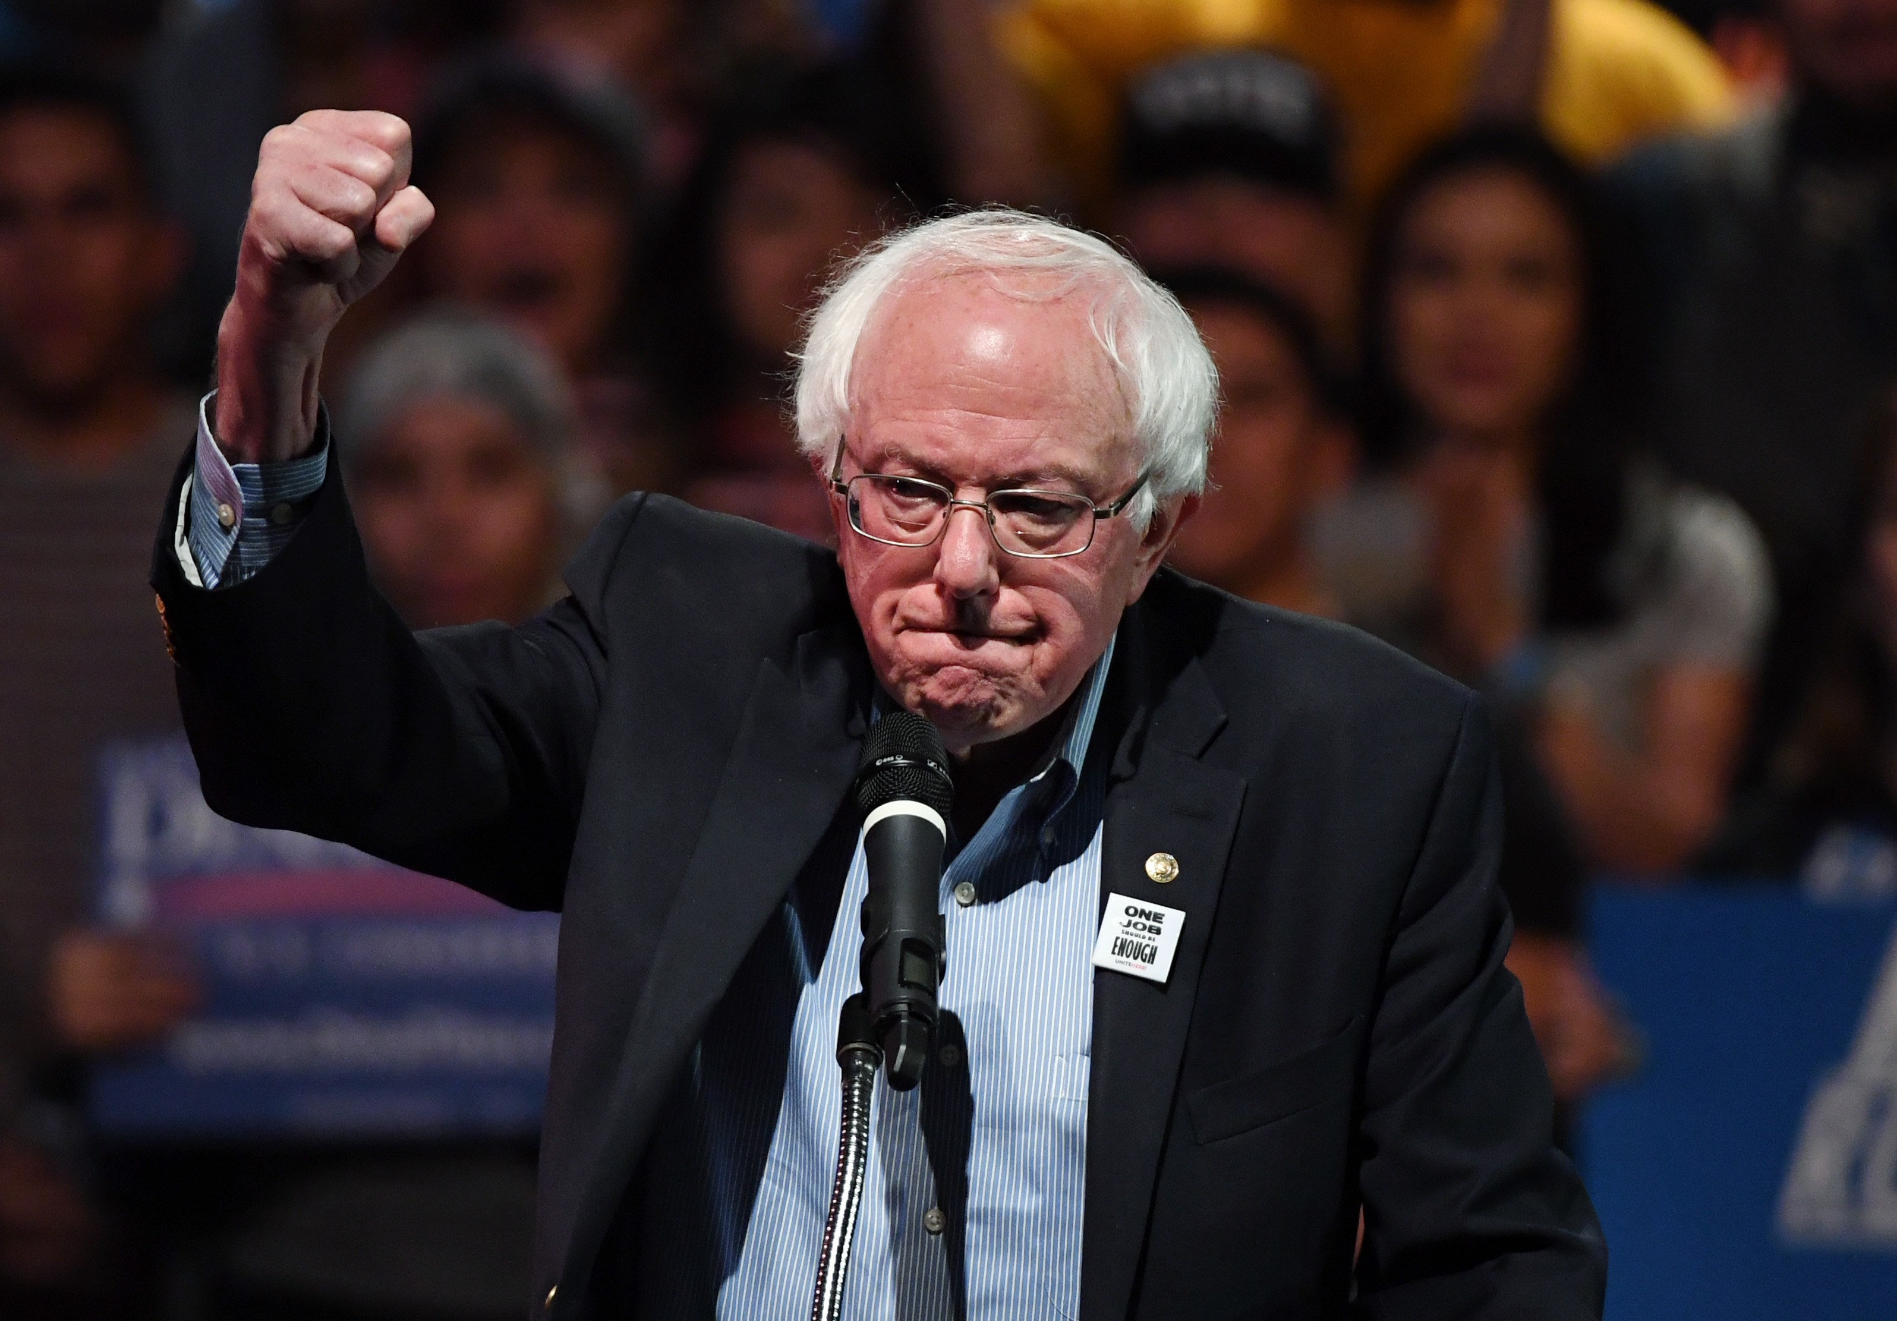
Proposed Legislation
Various State Proposals
US House of Representatives (Pramila’s Bill)
US Senate (Bernie’s Bill)
Notes:
T
Bernie’s (S 1804) and Pramila’s bills (HR 1384) are the ideal single-payer plans
Primary and preventative care,
medical devices,
lab services,
maternity care,
prescription drugs,
emergency care (including transportation),
mental health services,
dental services,
and vision care
Pramila’s bill also provides long-term care services
**************NOT SURE WHAT THIS IS, TATIANA ************************
(A) – Medicare, Medicaid, CHIP, ACA & employer subsidies
(B) - Establish a 5% health tax on the top 5% of income earners, 10% tax on top 1% of wage earners
(C) - Establish employer/employee payroll tax of 4.75% (includes present 1.45% Medicare tax)
(D) - ¼ of 1% stock transaction tax

Slide 11
Panelists
Notes:
S

Slide 12
Thank You
Notes:
S

