Slide 1
SNaHP Summit 2019:
Single Payer Update
Robertha Barnes, MS/MD; SUNY Upstate
Sydney Russell Leed, MD/MPH; SUNY Upstate
Michael Zingman, MS3; Columbia P&S

Slide 2
The line -up:
The need for a single payer system
Updates on the nationwide single payer movement
Updates on state single payer initiatives
The opposition

Slide 3
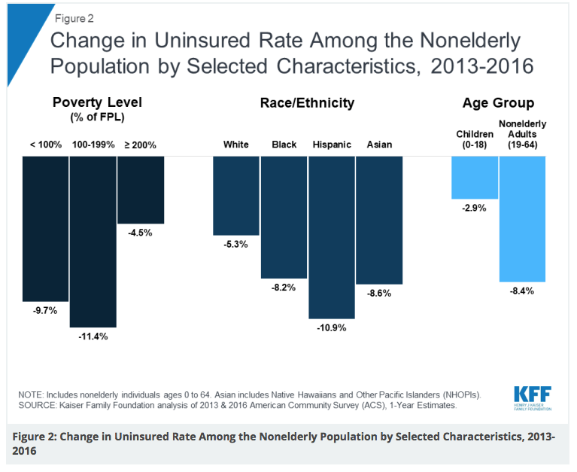
The need: a reminder of the ACA’s accomplishments
When the ACA went into effect in 2014, the number of uninsured and underinsured rates dropped dramatically and continued to fall through 2016 in all at risk demographics
Notes:
When the major ACA coverage provisions went into effect in 2014, the number of uninsured and uninsured rate dropped dramatically and continued to fall through 2016, when just below 27 million people (10% of the nonelderly population) lacked coverage. As you can see in all the at risk demographics, there was a decrease in the the rate of people who are uninsured. (at risk demo= ppl beloew fed poverty level, racial minorities and the non-elderly

Slide 4
The need: Attacks on the Affordable Care Act (ACA)
Notes:
Then in 2017, Trump came into office claiming to want to help the healthcare system by improving coverage and adding better benefits and lowering cost but he didn‘t come with a plan and all he’s really done is attempt to repeal the ACA then when that didn’t work, he undermined it.

Slide 5
The need: Attacks on the Affordable Care Act (ACA)
Notes:
https://www.thebalance.com/how-could-trump-change-health-care-in-america-4111422
Repetitive attempts to repeal the ACA failed, so the Trump administration became sneaky and undercut the ACA in several ways that they knew wouldn’t gain as much attention and make potential voters upset.

Slide 6
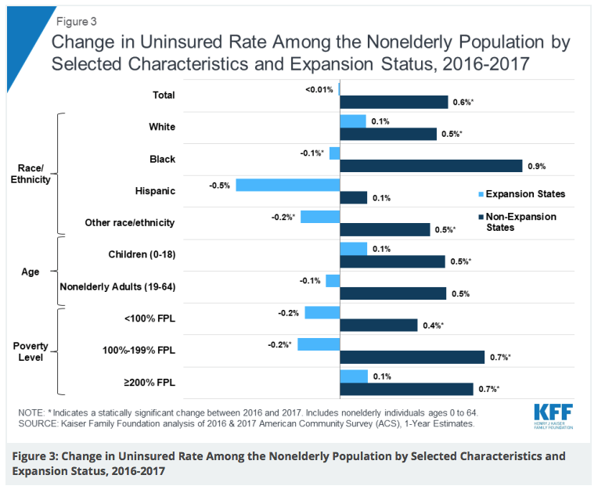
The need: A reversal of the ACA’s improvements
The uninsured rate begins to increase again in 2016-2017 among all at risk demographics

Slide 7
The need: increasing coverage, decreasing cost
Nearly half of American adults under 65 are remain either uninsured or underinsured(1)
What is “underinsurance”?
Annual out of pocket expenses>10% income OR
If income is <200% Federal poverty level and out of pocket expenses >5% income OR
Deductibles >5% income

Slide 8
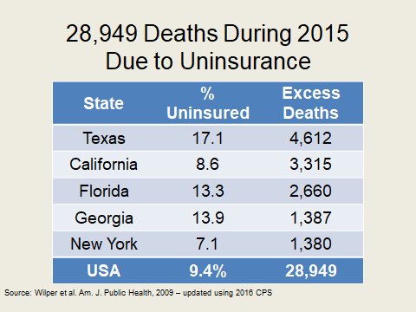
The need: increasing coverage, decreasing cost
Many Americans are dying unnecessarily because they are uninsured
Notes:
In states when uninsurance rates are high, there are relatively high excess death rates

Slide 9
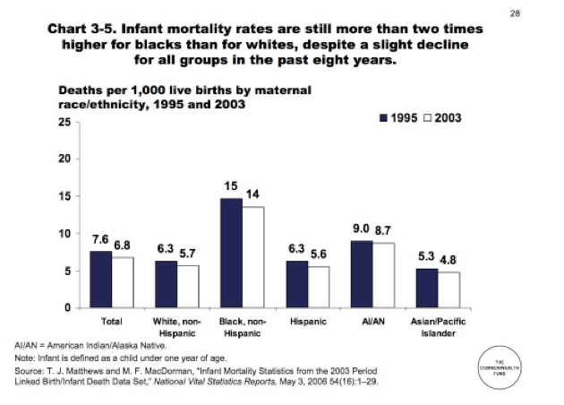
The need: resolving health disparities

Slide 10
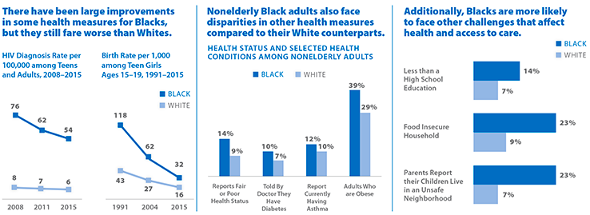
The need: resolving health disparities
Kaiser Family Foundation, 2018
Notes:
Hiv diagnosis rates and teenage pregnancy rates are decreasing for black americans but its still higher. Black Americans are also more likely to be reported as having fair or poor health status and face challenges that affect health and access to care

Slide 11
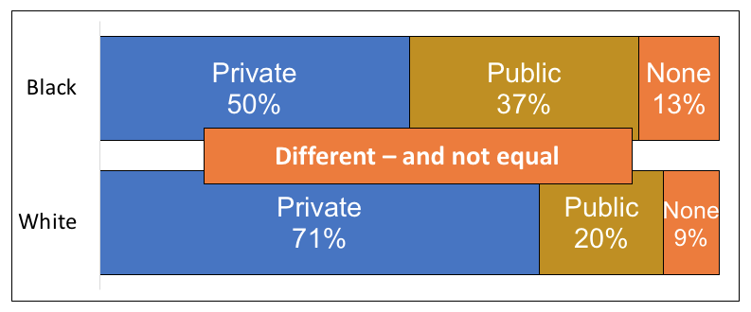
The need: resolving health disparities
Until age 65, Race determines your type of insurance
Notes:
Black americans are more likely to have public insurance or no insurance

Slide 12
The need: resolving health disparities
Notes:
I also wanted to note that women are paying more for insurance, specifically family and individual deductibles

Slide 13
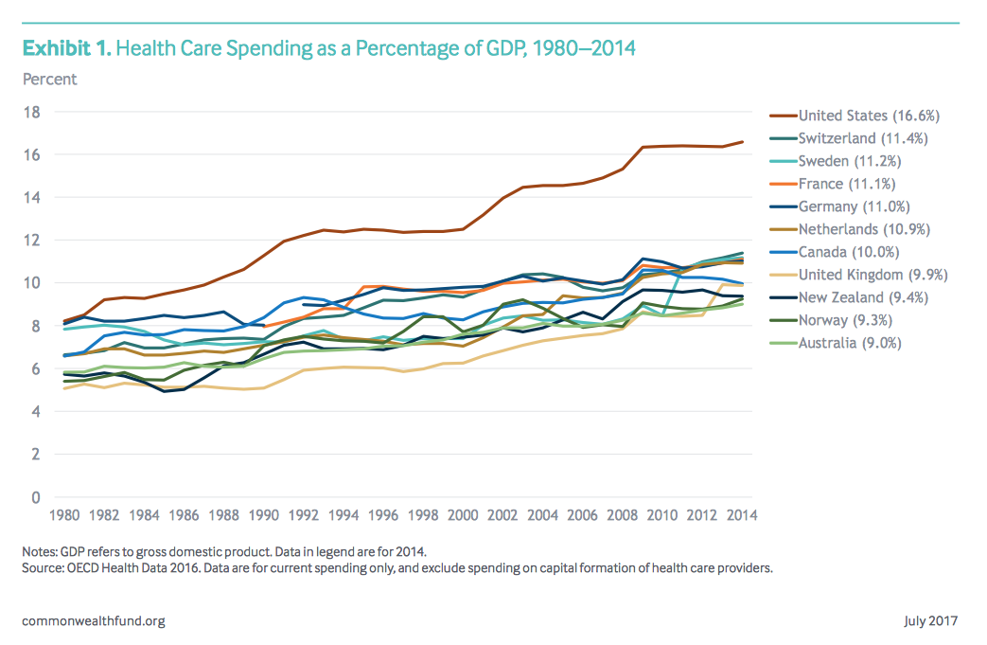
The need: single payer makes economic sense
Nearly 20% of our GDP is spent on healthcare (roughly double of the next highest income countries(2) however, our health outcomes are worse.
Notes:
We’re spending a lot of our GDP on healthcare but our health outcomes are worse which doesnt add up

Slide 14
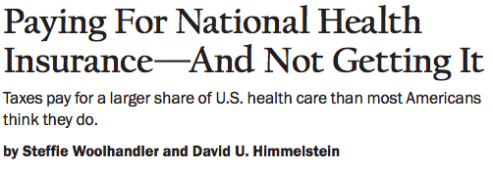
60% of healthcare spending is publicly financed – more than enough to pay for single-payer healthcare, when you consider cost savings from:
Increased bargaining power
Reduced administrative waste
No need for marketing
Increased risk pooling

Slide 15
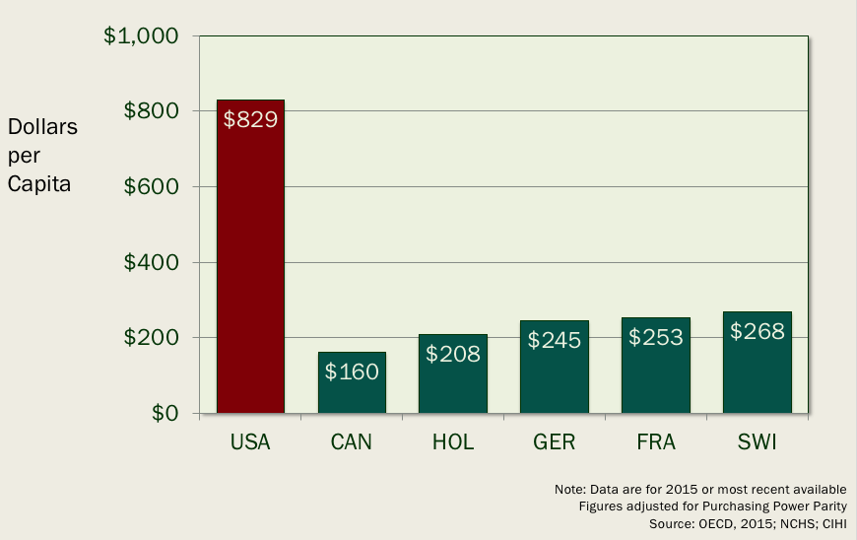
We spend a lot more on overhead cost
Administrative costs are typically 5-6x that of public plans (not to mention our lost time spent in billing/paying people to interface with insurance companies)

Slide 16
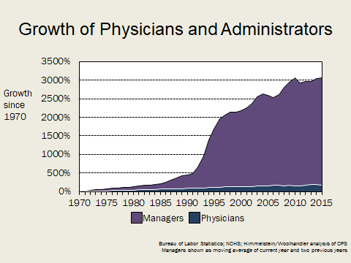
The need: single payer makes economic sense

Slide 17
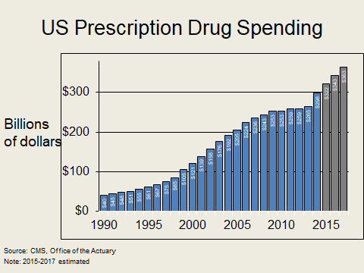
The need: single payer makes economic sense
No government oversight on prescription drug prices means pharmaceutical companies can charge whatever they want!
Notes:
No government oversight on prescription drug prices means pharmaceutical companies can charge whatever they want! They are smart and increase the cost slowly and progressively over time (not like martin scriely)

Slide 18
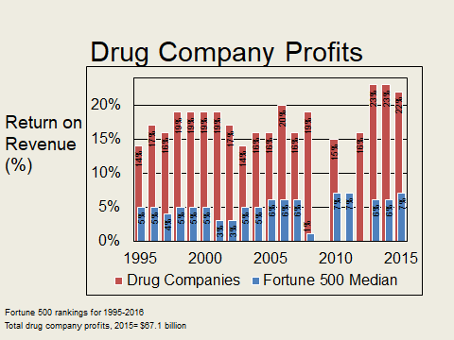
The need: single payer makes economic sense
Drug companies are making a lot of profit!!

Slide 19
Updates on National Health Reform
While Medicare-for-All has gained popularity and focus, there remains no consensus among the 2020 presidential candidates about how healthcare should be reformed and a desire amongst many to focus on incremental reform
Health Care Reform Bills in Congress fall into two major camps: 1) public option and 2) single-payer

Slide 20
What is a Public Option and Why Does it Matter?
Two types:
1) Expansion of existing government programs, like Medicare/Medicaid.
2) New government-run health plan for those under age 65 to compete against private insurers in the individual market exchanges.
Goals:
Fill in the gaps in places where insurance options are limited & offer competitive prices
Ensure that all have access to affordable plans even if private insurers raise rates or exit the market
Notes:
https://www.vox.com/health-care/2019/1/10/18175331/single-payer-public-option-newsom-inslee-deblasio
http://money.com/money/4772750/what-is-public-option-health-insurance/

Slide 21
Problems with the Public Option
Maintains our administratively inefficient, expensive and fragmented healthcare system
Patients will still have limited choice of provider restricted by networks
Leaves employer-based system intact, does not guarantee patients can keep doctor regardless of employment/health
Public plans will be left with the sickest patients and experience rising costs while private insurers continue to have healthier patients and maintain high profits
Unlikely to reduce health care costs
Notes:
http://www.pnhp.org/change/Public_Option_Myths_and_Facts.pdf

Slide 22
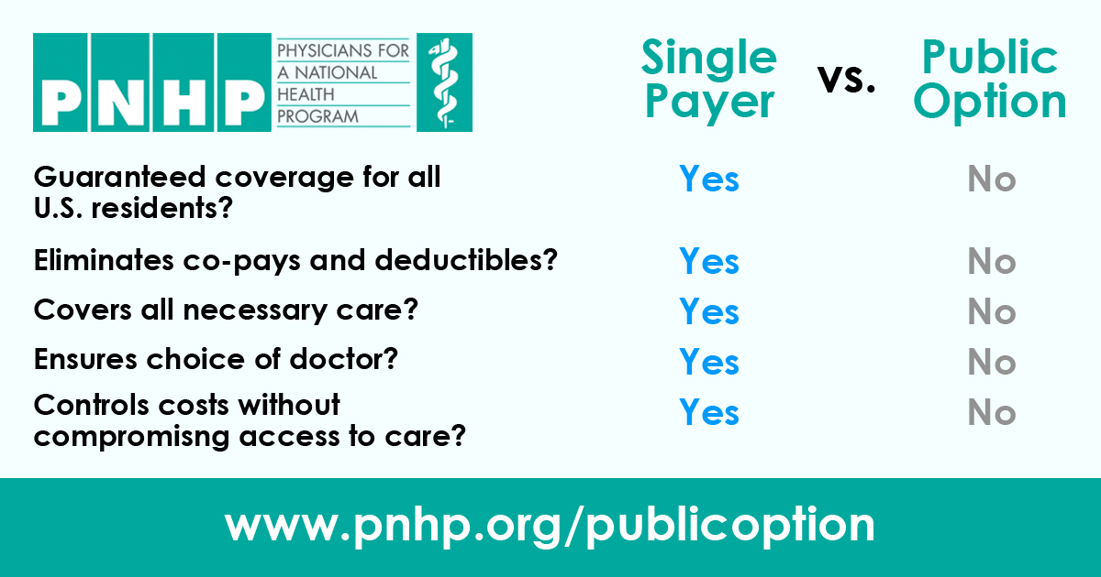
What is a Public Option and Why Does it Matter?
Notes:
http://pnhp.org/why-the-public-option-is-not-a-real-solution-to-our-health-care-woes/

Slide 23
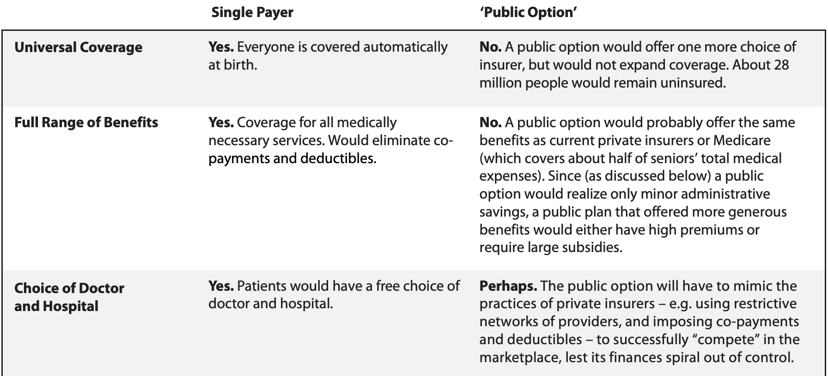
What is a Public Option and Why Does it Matter?
Notes:
http://pnhp.org/system/assets/uploads/2018/06/sp_vs_publicoption.pdf

Slide 24
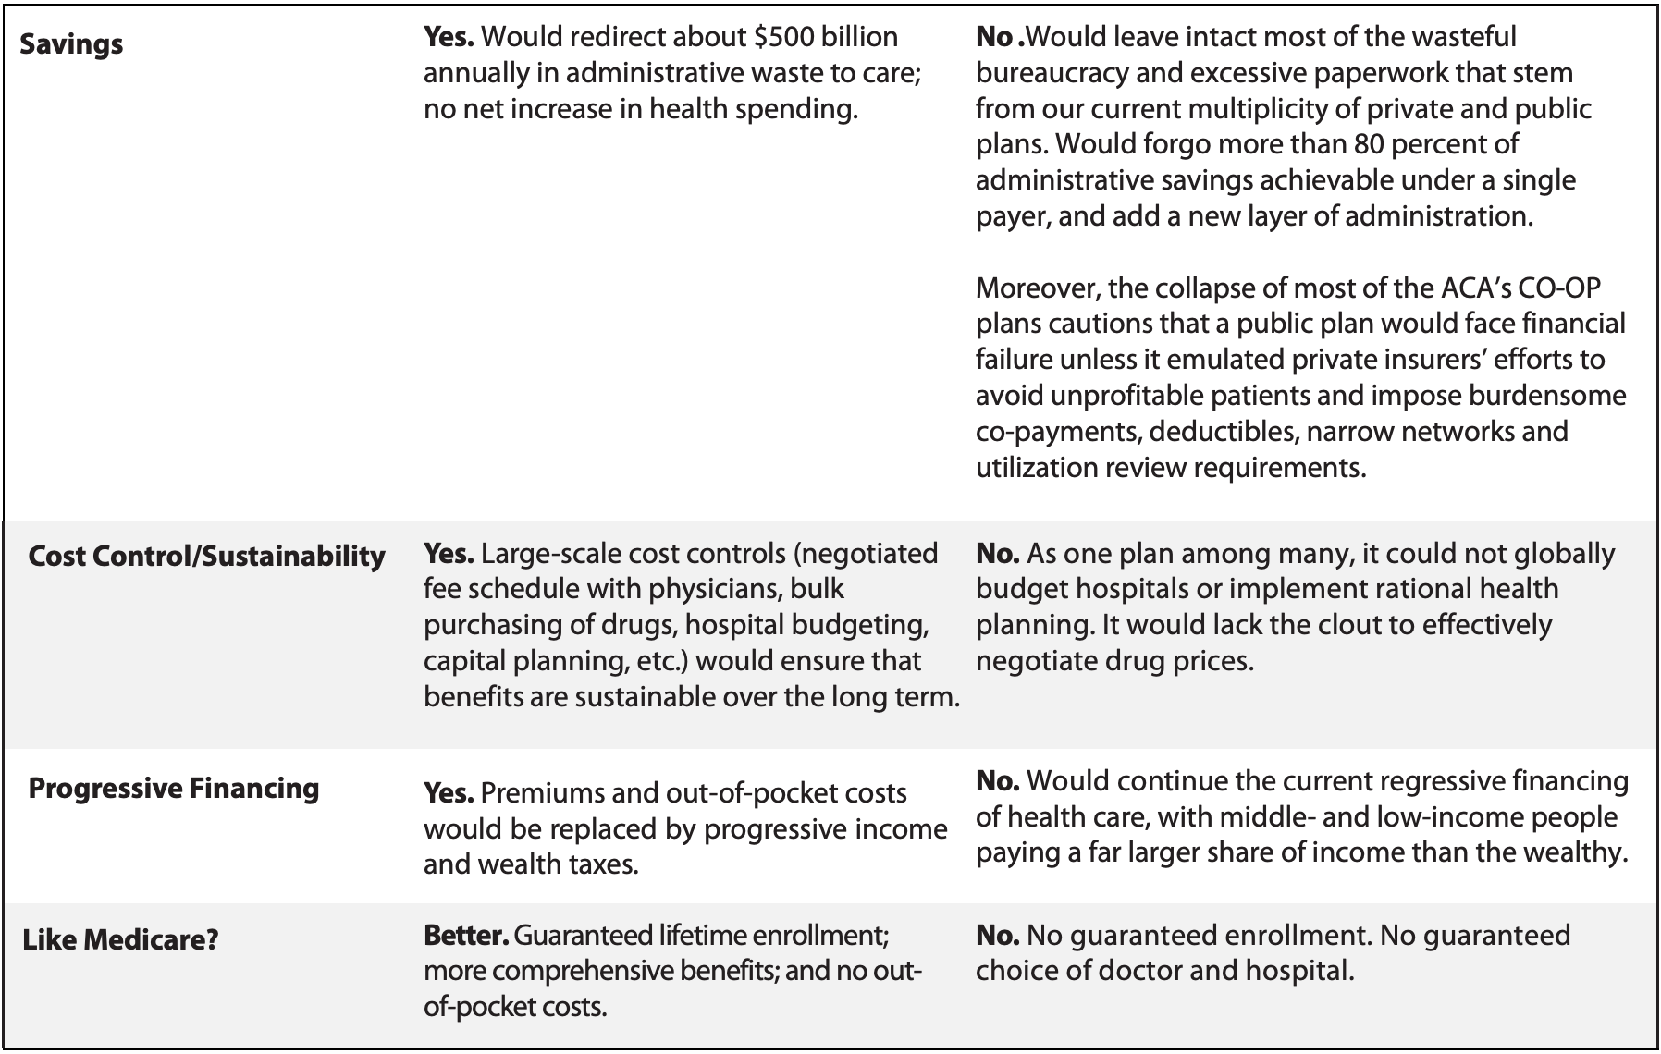
What is a Public Option and Why Does it Matter?
Notes:
http://pnhp.org/system/assets/uploads/2018/06/sp_vs_publicoption.pdf

Slide 25
National Public Option Bills
Prior legislative session (2017-2018; 116th Congress) - many public option or Medicaid buy-in proposals
CHOICE Act - Rep. Jan Schakowsky (HR635) and Sen. Whitehouose (S194)
Medicare-X Choice Act - Rep. Higgins (HR4094) and Sen. Bennett (S1970)
Choose Medicare Act - Rep. Richmond (HR6117) and Sen. Merkley (S2708)
Medicare at 55 Act - Sen. Stabenow (S1742)
Medicare Buy-In and Health Care Stabilization Act - Rep. Higgins (HR3748)
State Public Option Act - Sen. Brian Schatz (S2001) and Rep. Ben Ray Lujan (HR4129)
“Medicare for America Act” - Rep. Rosa DeLauro (HR7339)
Notes:
http://files.kff.org/attachment/Table-Side-by-Side-Comparison-Medicare-for-all-Public-Plan-Proposals

Slide 26
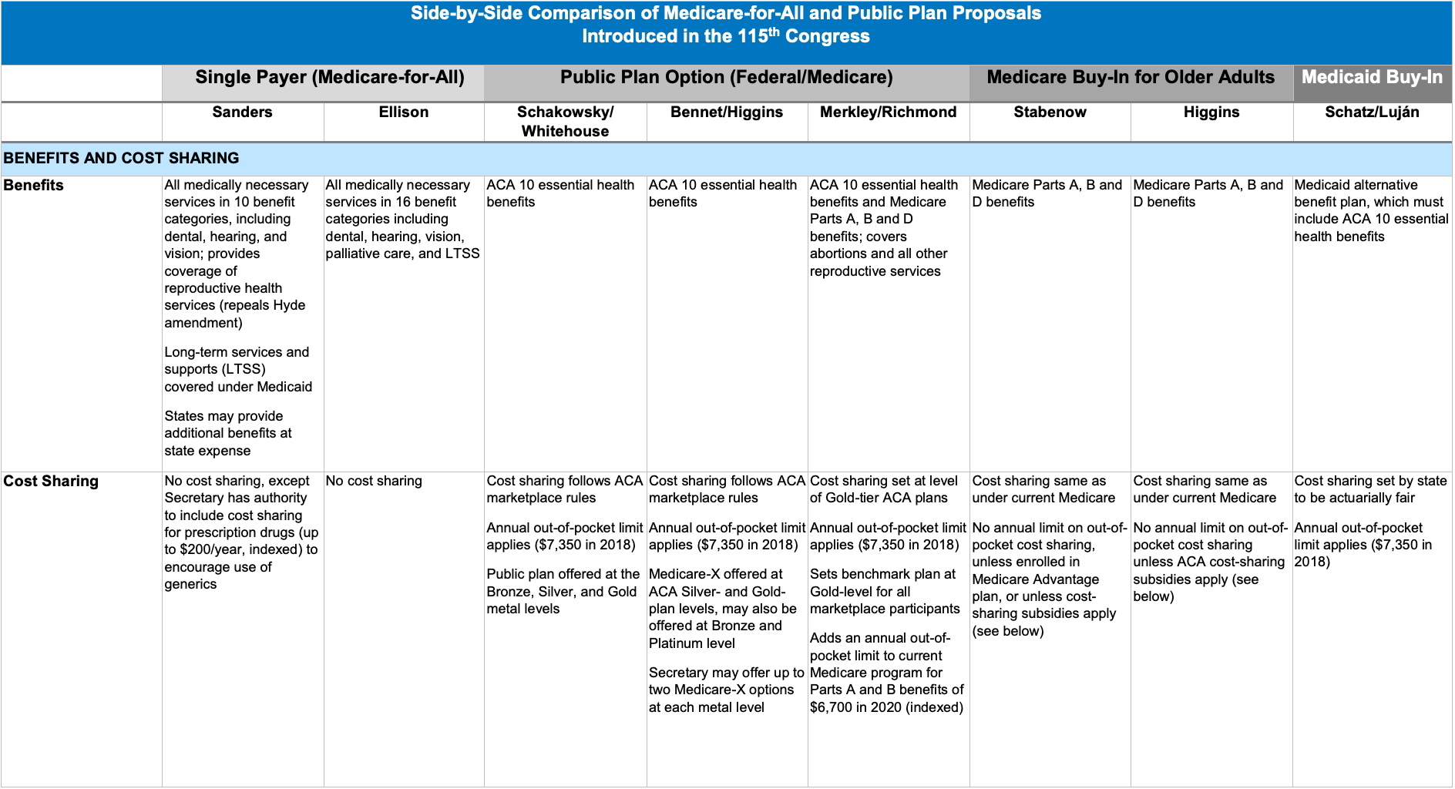
National Public Option Bills
Notes:
http://files.kff.org/attachment/Table-Side-by-Side-Comparison-Medicare-for-all-Public-Plan-Proposals

Slide 27
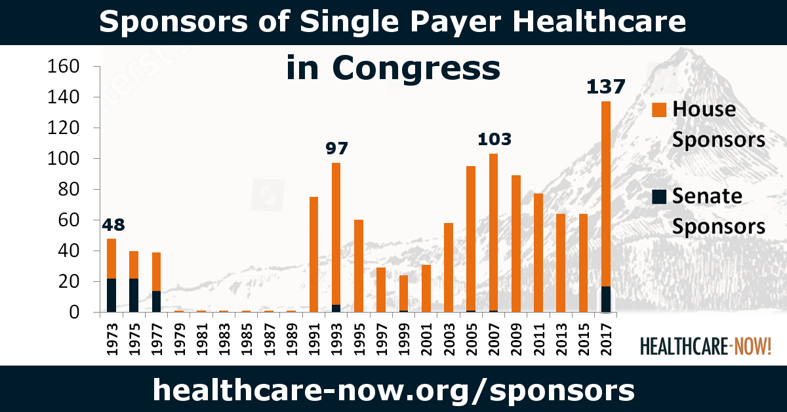
National Single-Payer Bills
Last year: HR676 (Ellison) and S1804 (Sanders)

Slide 28
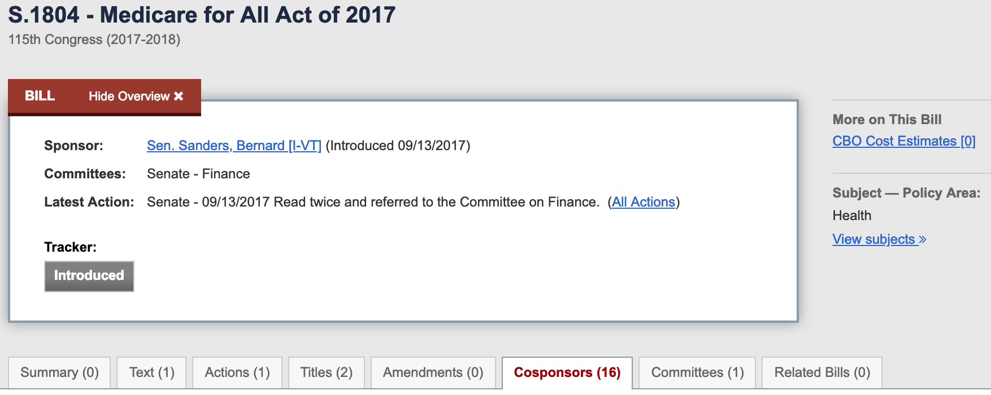
National Single-Payer Bills

Slide 29
National Single-Payer Bills
Senate bill from last year did NOT include:
Global budgeting of hospitals and other healthcare institutions
Establishment of a national long-term care program
Full coverage of all medications without co-pay
Exclusion of for-profit health care providers

Slide 30
National Single-Payer Bills
House: HR1384 - Rep. Pramila Jayapal
Released on February 27th
106 original co-sponsors!
Senate: Medicare for All Act - Sen. Bernie Sanders
Not yet introduced

Slide 31
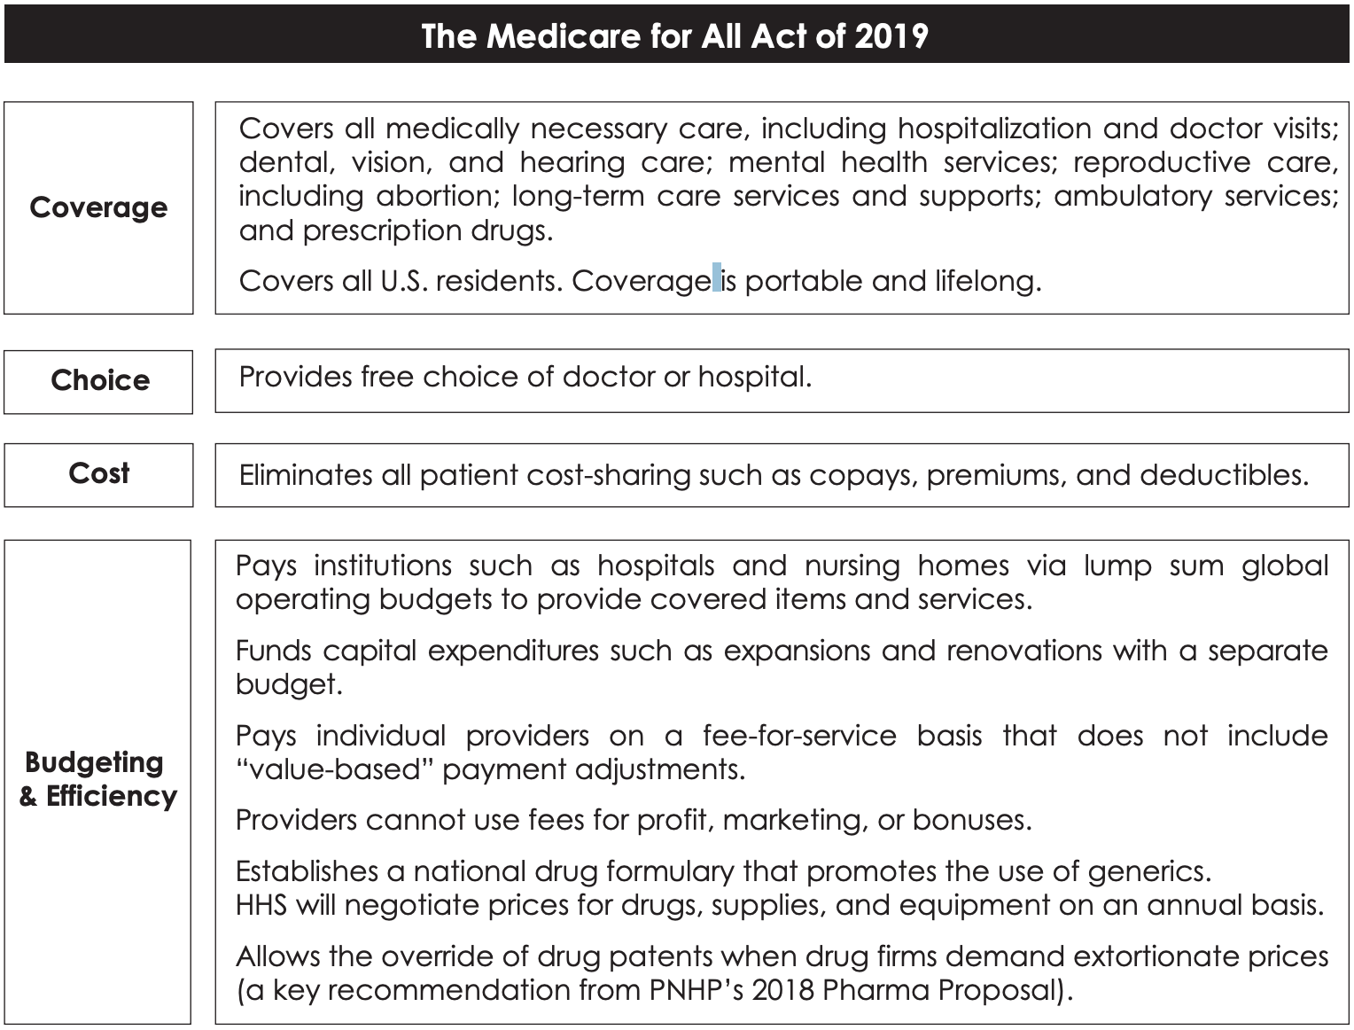
Updates in the New Jayapal Single-Payer Bill (HR1384)

Slide 32
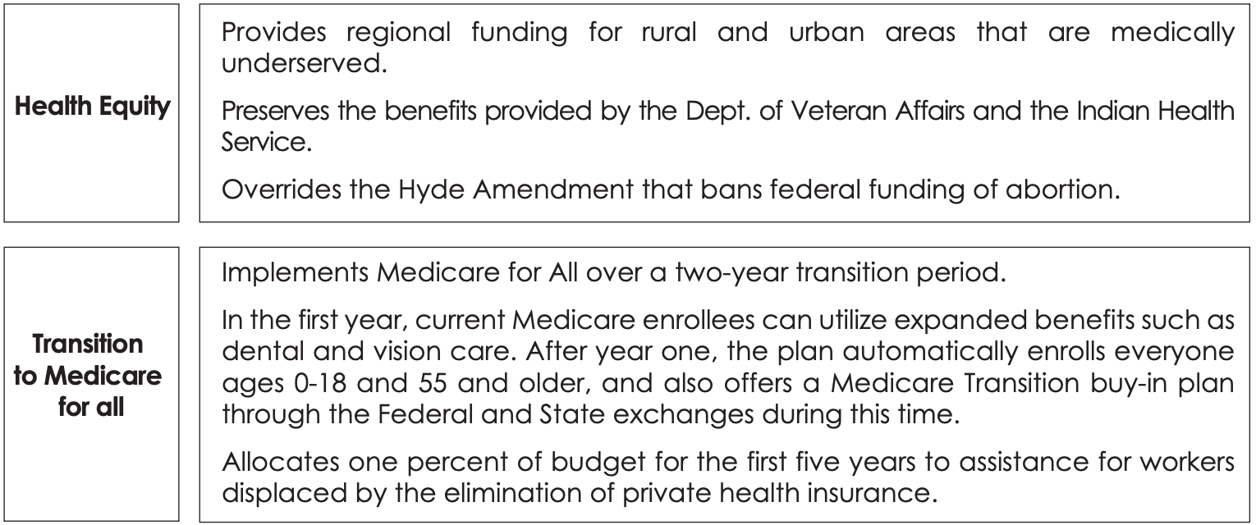
Updates in the New Jayapal Single-Payer Bill (HR1384)

Slide 33
Updates in the New Jayapal Single-Payer Bill (HR1384)
Most ambitious national Medicare-for-All plan to date
Covers all medically necessary care - including dental, vision, hearing, mental health, reproductive (including abortion), long-term care, and prescription drugs
Covers all U.S. residents, portable + lifelong
NO cost-sharing (copays, premiums and deductibles)
Provides free choice of doctor or hospital.
Global budgeting and fee-for-service payment of providers
Establishes a national drug formulary that promotes the use of generics
Notes:
http://pnhp.org/news/pnhp-endorses-the-medicare-for-all-act-of-2019/
https://www.vox.com/policy-and-politics/2019/2/26/18239630/medicare-for-all-pramila-jayapal-bill

Slide 34
Updates in the New Jayapal Single-Payer Bill (HR1384)
NEW FEATURES:
Allows the override of drug patents when drug firms demand extortionate prices (key recommendation from PNHP)
Overrides the Hyde Amendment that bans federal funding of abortion
Implemented over a two-year transition period (after year 1, automatically enrolls everyone 0-18 and 55+)
Different from 4 year transition period in Sanders bill (from 2018)
Notes:
While endorsing the Medicare for All Act as a strong single-payer bill, PNHP notes an area for improvement: Since for-profit providers (including hospitals, dialysis centers, nursing homes, home care agencies, and hospices) have been shown to provide inferior care at inflated prices, PNHP recommends moving to a fully nonprofit health system in addition to the bill’s current constraints on profit-making. To achieve an orderly transition of for-profit providers to nonprofit status, the doctors’ group recommends a bond-funded buyout of investor-owned facilities.

Slide 35
Updates in the New Jayapal Single-Payer Bill (HR1384)
PNHP has endorsed this bill and described it as the most ambitious yet
However, a lingering concern is the presence of for-profit providers (hospitals, nursing homes, hospices, dialysis, etc.) which provide worse care at higher prices.
Notes:
While endorsing the Medicare for All Act as a strong single-payer bill, PNHP notes an area for improvement: Since for-profit providers (including hospitals, dialysis centers, nursing homes, home care agencies, and hospices) have been shown to provide inferior care at inflated prices, PNHP recommends moving to a fully nonprofit health system in addition to the bill’s current constraints on profit-making. To achieve an orderly transition of for-profit providers to nonprofit status, the doctors’ group recommends a bond-funded buyout of investor-owned facilities.

Slide 36
Summary of SNaHP Goals & Values
Coverage of all medically necessary care - including dental, vision, hearing, mental health, reproductive (including abortion), long-term care, and prescription drugs
True single-payer with no for-profit providers or insurance alternatives for any services provided under the single-payer plan
Guaranteed enrollment, guaranteed choice
More than just a public option

Slide 37
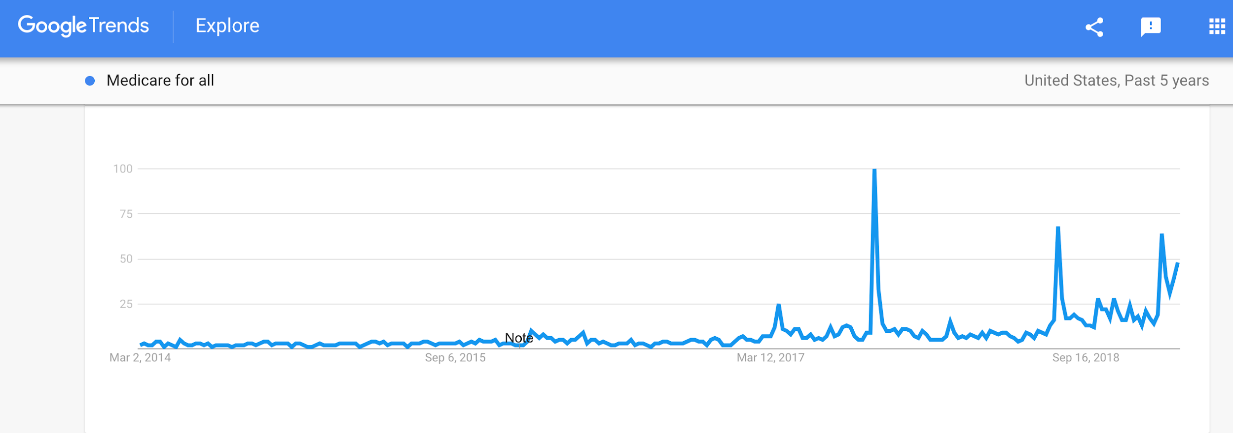
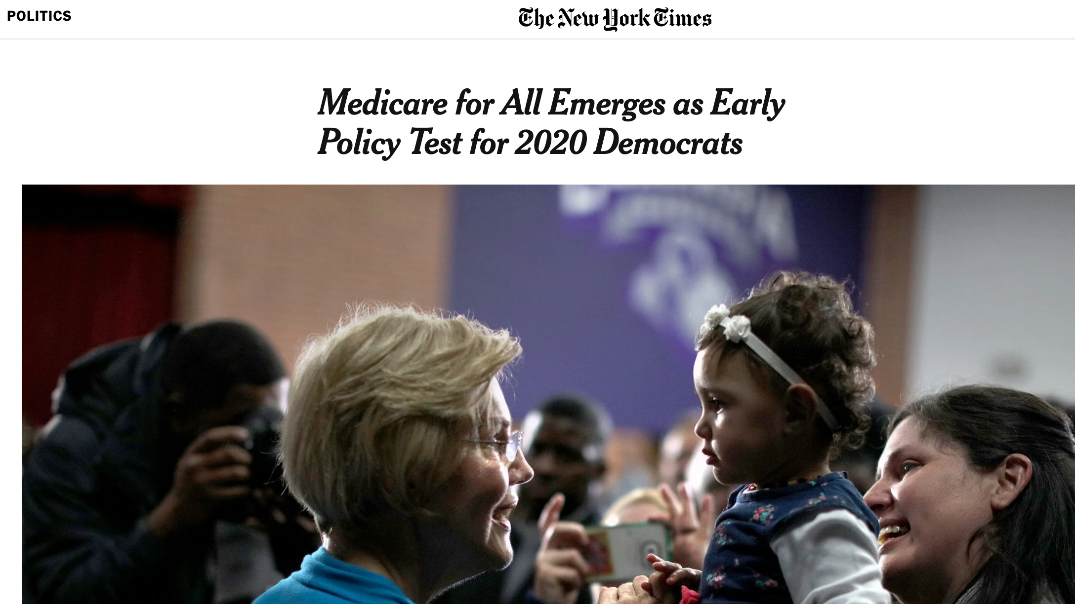
Focus on Single-Payer
Much greater coverage in news and social media, much more public and online debate over merits, economics and political feasibility

Slide 38
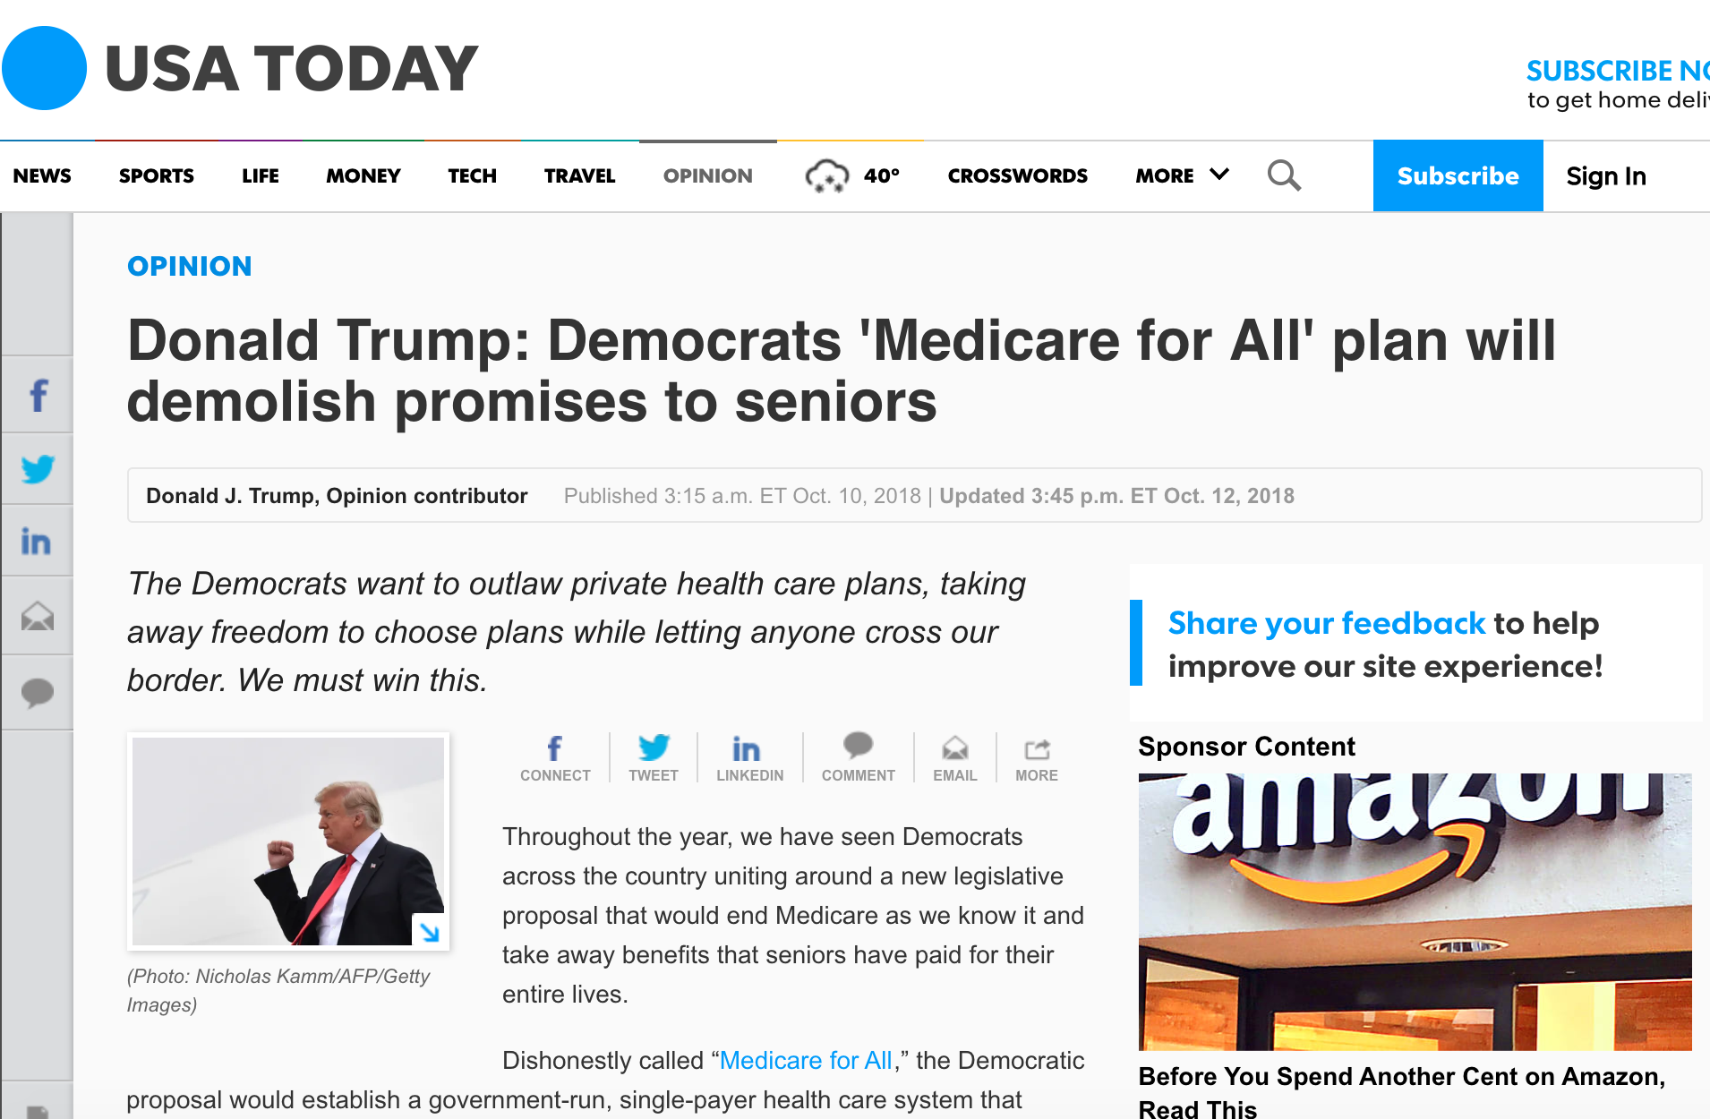
Attacks on ‘Medicare for All’

Slide 39
Updates on State Single-Payer Bills
Per Healthcare-NOW, 18 states currently have single-payer healthcare legislation
Significant increase in opportunity and discussion of single-payer in many states, particularly those with full Democratic control after 2018 elections
Much greater focus on economic/budget analyses in different states

Slide 40
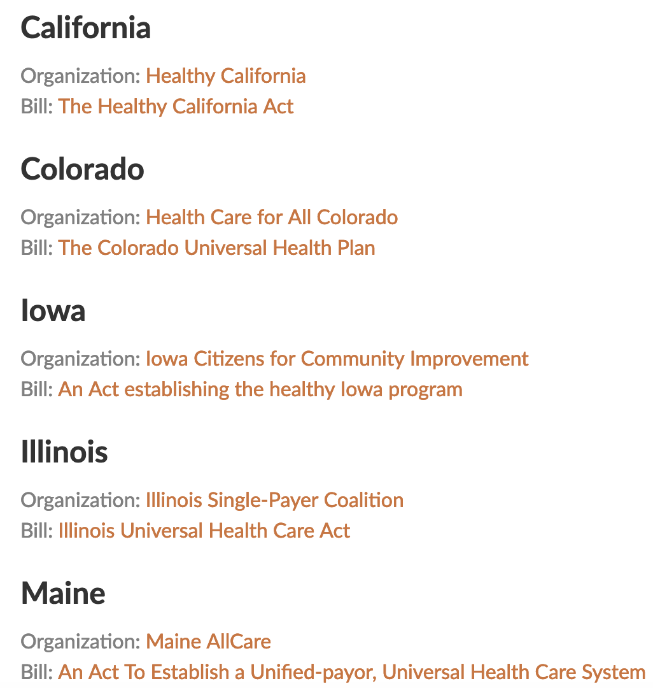
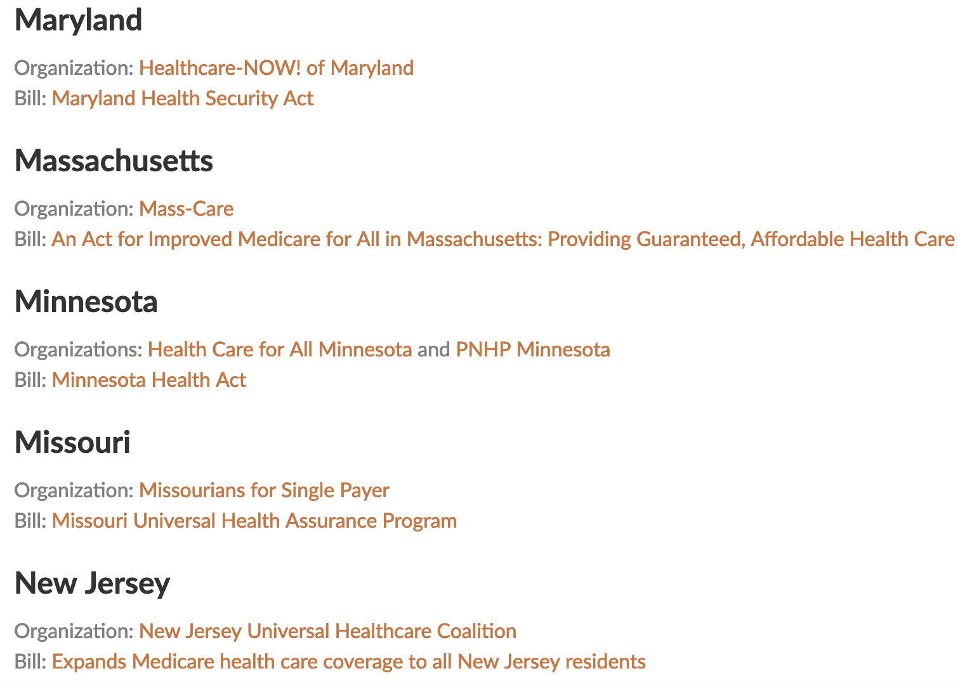
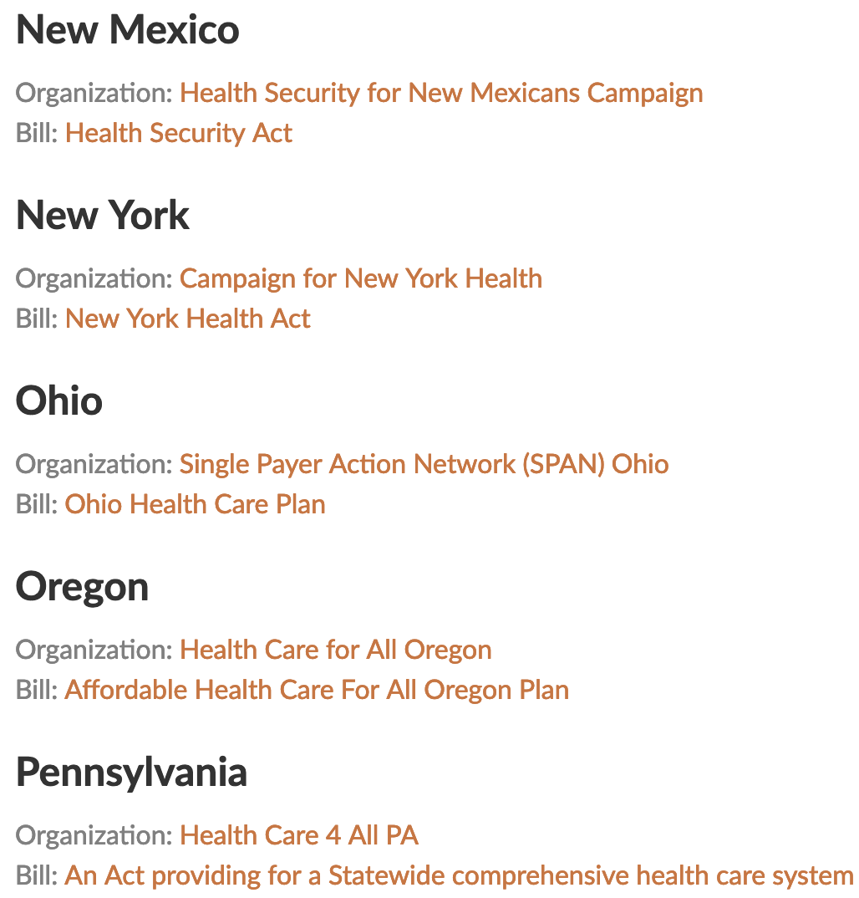
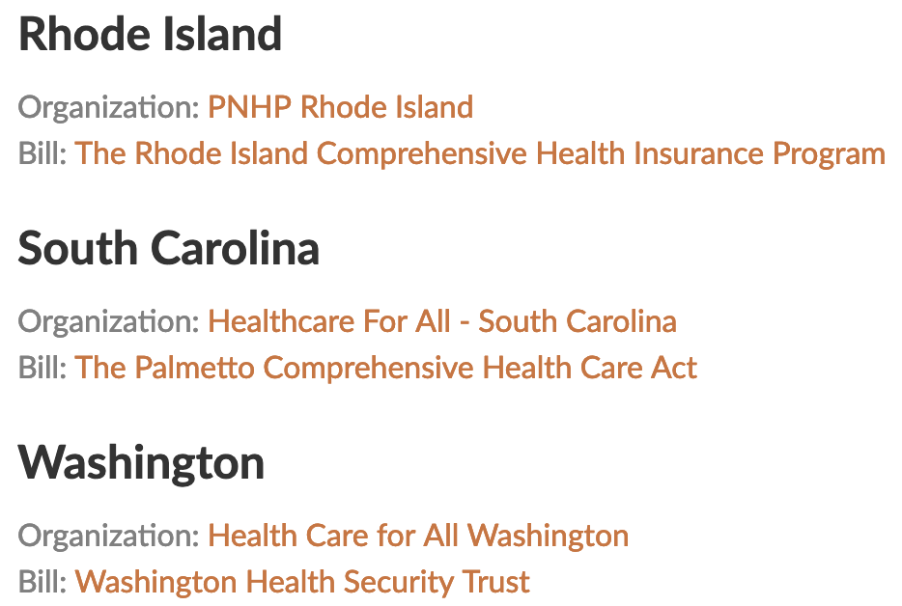
Updates on State Single-Payer Bills
There are many more states with legislation and exciting updates/political opportunities!
https://www.healthcare-now.org/legislation/state-single-payer-legislation/

Slide 41
Updates on State Single-Payer Bills: CALIFORNIA
Healthy California Act (SB 562) - large campaign by California Nurses Association last year
Shelved by Assembly Speaker Anthony Rendon
Newly-elected Governor Gavin Newsom endorsed SB 562 during campaign, has since stated support for single-payer but has not encouraged introduction of a new version
Newson has requested federal waivers while looking to expand coverage to immigrants
No California Democrats introduced a single-payer bill before key legislative deadline last week
Notes:
https://www.sacbee.com/news/politics-government/capitol-alert/article226819984.html

Slide 42
Updates on State Single-Payer Bills: WASHINGTON
Washington Health Security Trust (WHST) Bill
Sponsor: Rep. Sherry Appleton
Economic study requested by 2018 legislature, delayed to June ‘19
HR 6097 (Jayapal - House bill)
Would enhance state access to federal health care funds
SB 5822/HB 1877
Convenes a working group to study the establishment of a universal health care system in Washington, to report findings by Nov 2020
Public hearings in Senate Health + Ways & Means committees
Bridge to single-payer bill
Lay foundation for single-payer system
Notes:
https://www.healthcareforallwa.org/our_2019_legislative_priorities
https://www.thestranger.com/slog/2019/02/26/39298721/washington-lawmakers-consider-a-new-path-toward-single-payer-health-care-at-state-level

Slide 43
Updates on State Single-Payer Bills: NEW YORK
NY Health Act (A. 5248/S. 3577)
Passed State Assembly 4 years in a row by large margin
RAND Study last year - conservative estimates: savings of $15 billion annually (avg. $2800 savings for 90% of NYers), 2% inc. in employment
First full Democratic majority in decades
Legislation reintroduced on Feb 11th - 81 Assembly Members and 22 Senators as original cosponsors
Updates in 2019 Legislation:
Full inclusion of Long Term Care
Implementation even in absence of federal waivers (although they will be sought) - technical mechanisms to create work-around
Re-training assistance for insurance company employees and up to 2 years of unemployment coverage

Slide 44
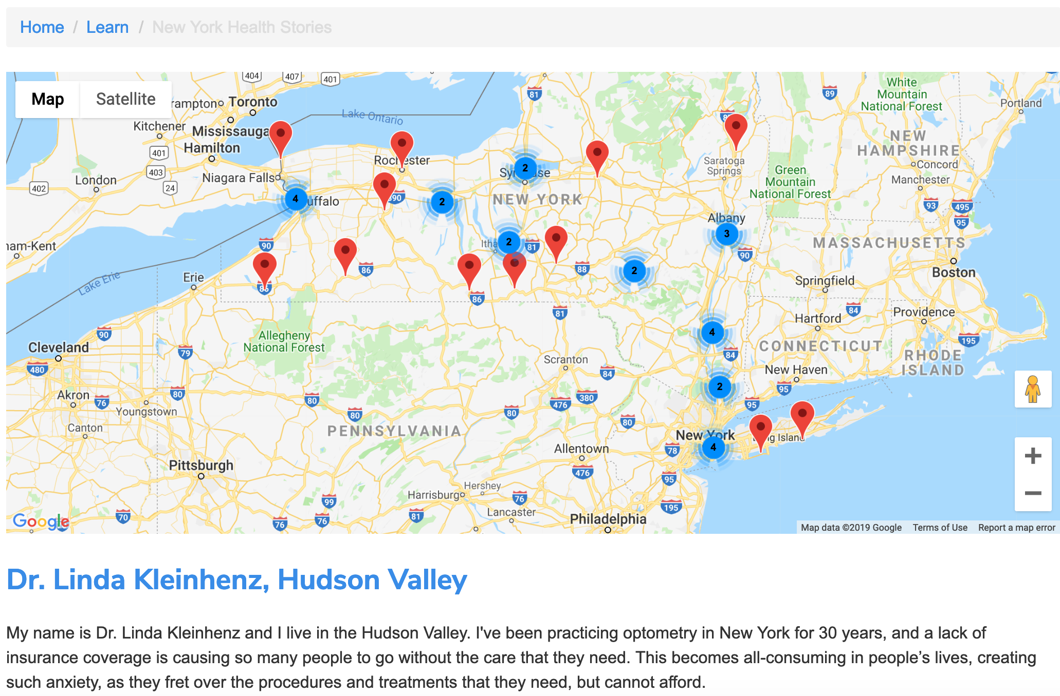
Updates on State Single-Payer Bills: NEW YORK
Businesses for NY Health Campaign
Doctors for NY Health Campaign
Healthcare Rights and Access Survey
Video Testimonials
Story Campaign

Slide 45
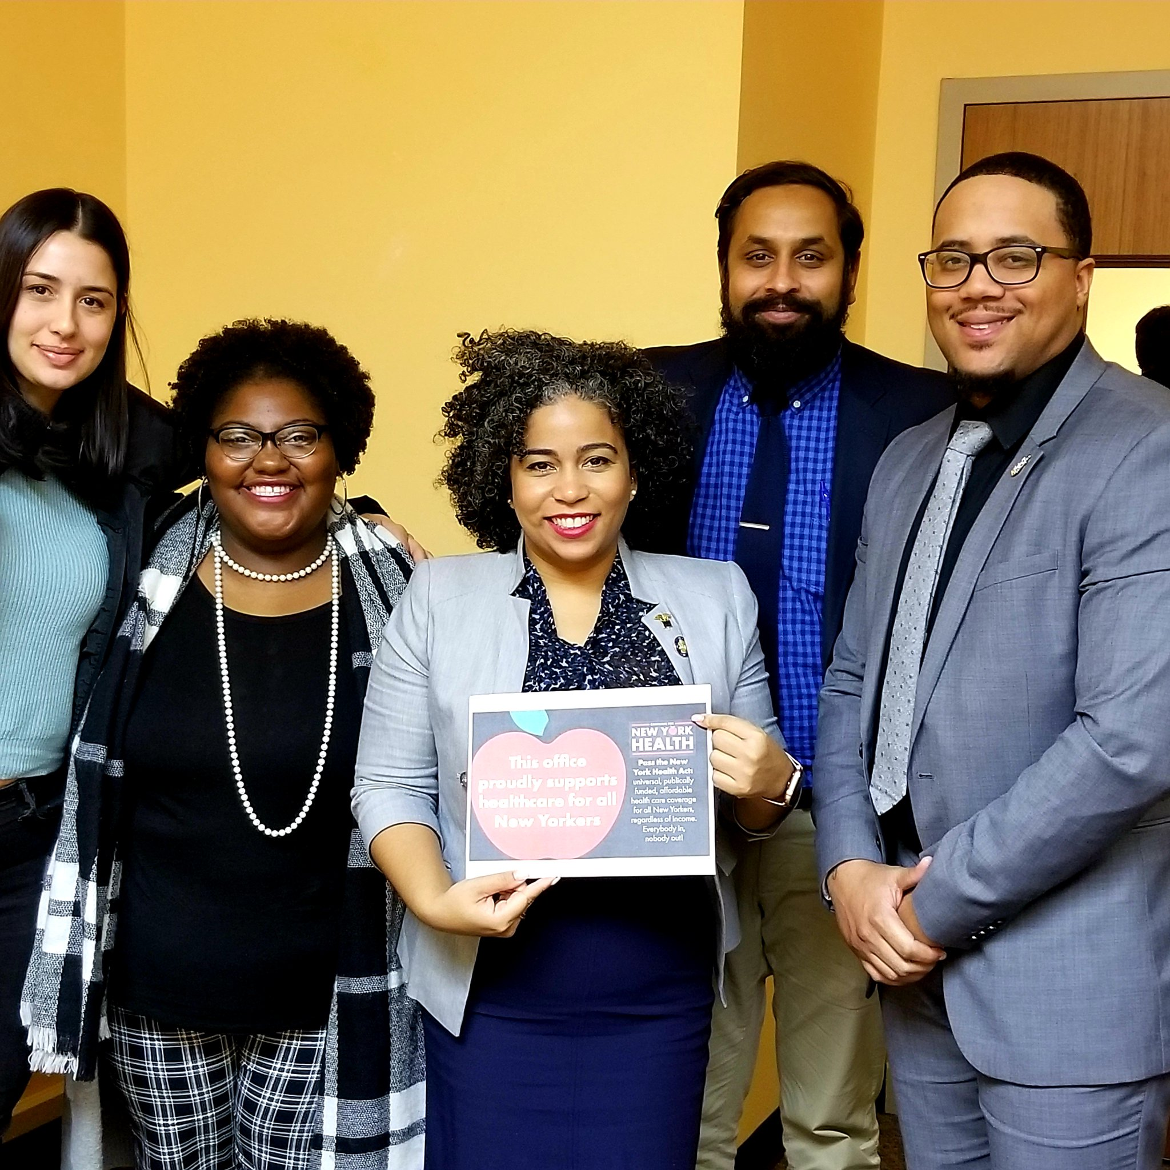
Updates on State Single-Payer Bills: NEW YORK
#HealthcareHero Weekly Actions

Slide 46
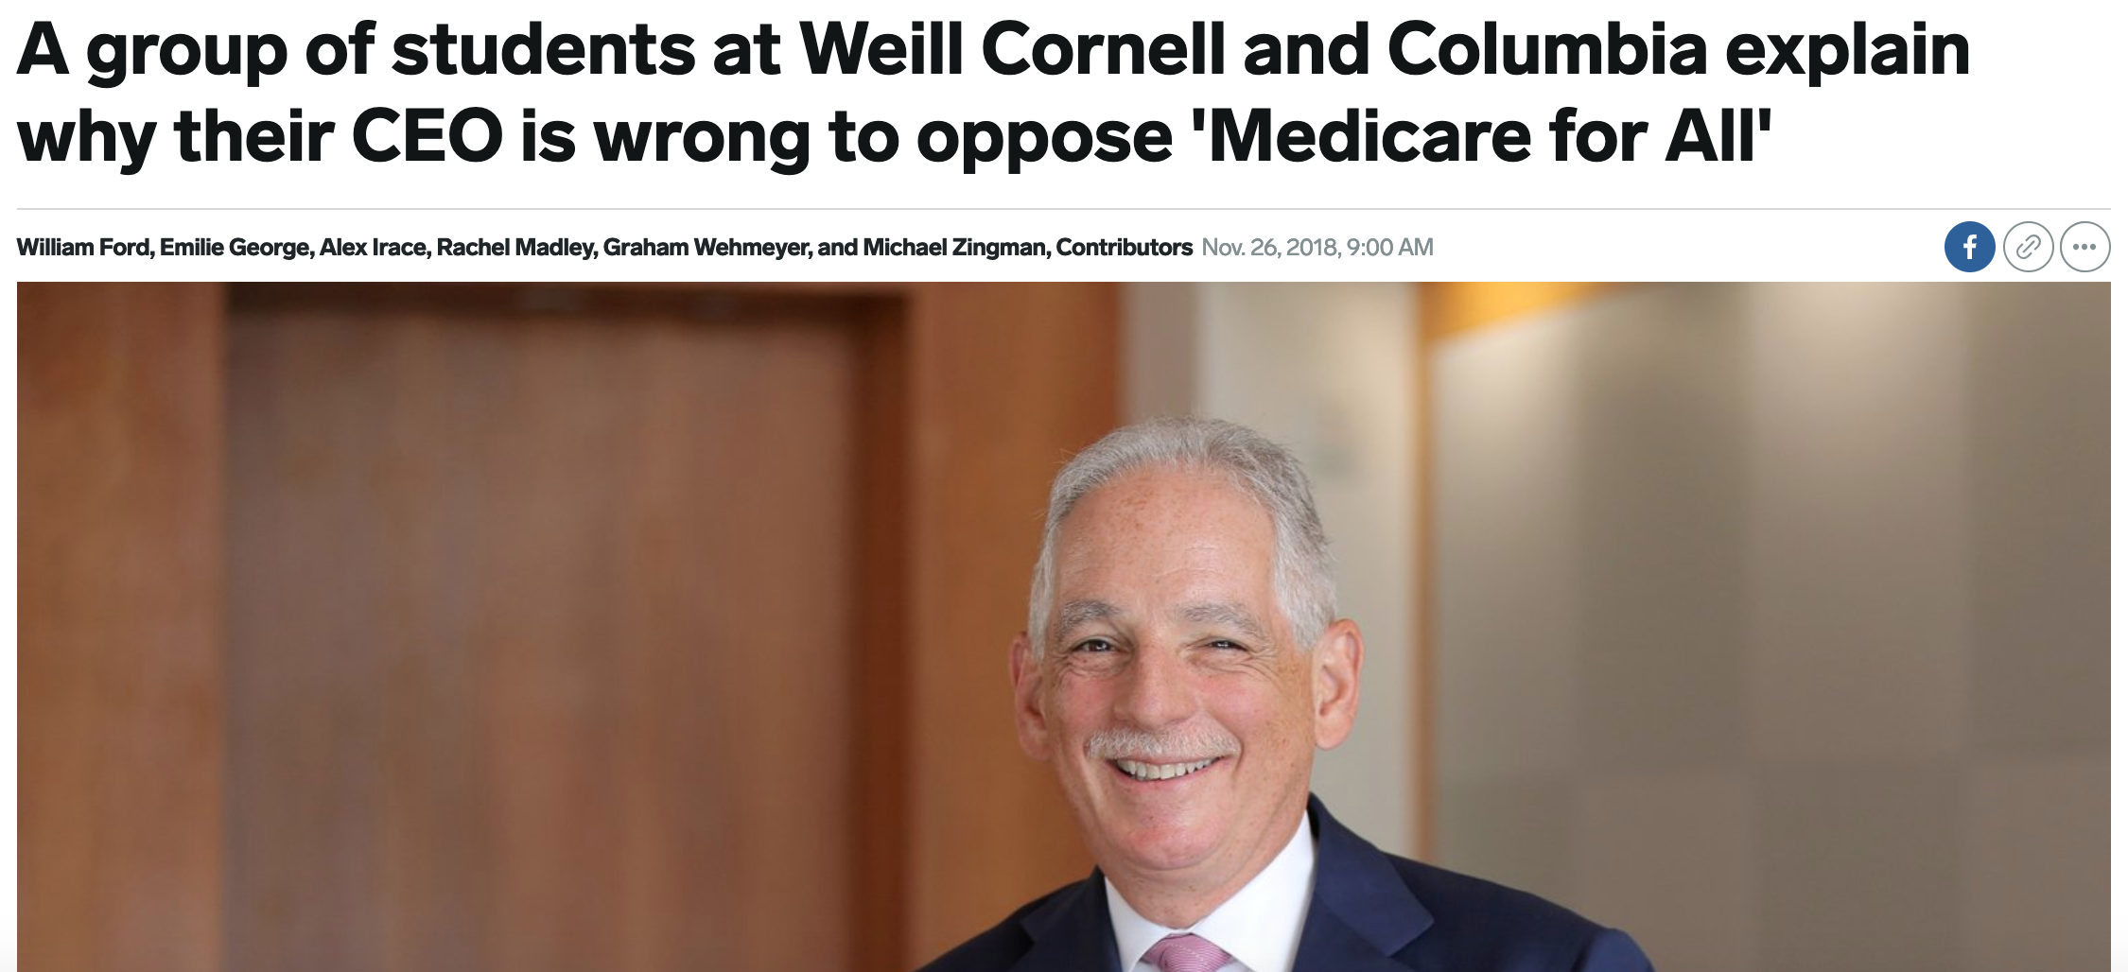
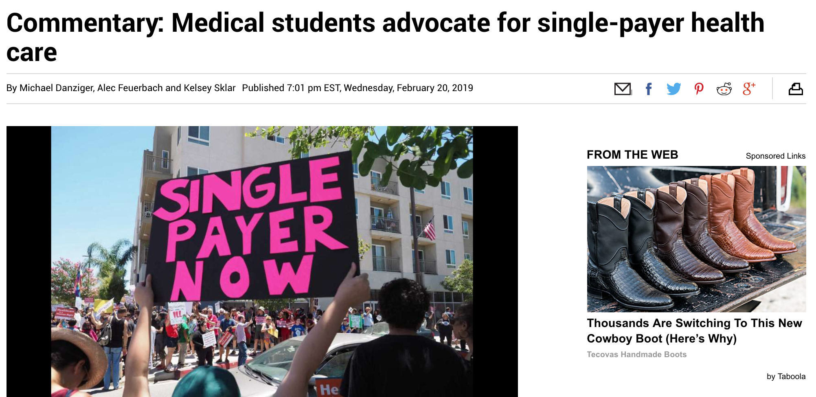
Student Op-Eds

Slide 47
Learn more about state-based single-payer later today!
Panel session: What can we learn from other state-based single-payer initiatives across the country?
1:30-2:15PM VEC 201

Slide 48
Opposition to Single-Payer
The more momentum single-payer gains, the more pushback we see from those who profit from our patients’ illnesses:
Private insurance companies
For-profit private hospitals
Providers who don’t take public insurance (e.g. some dentists)
Highly paid specialties and the American Medical Association
The NY response: Picket the Profiteers!
Protest tomorrow at Pfizer headquarters at 11am

Slide 49
Opportunities and Challenges Moving Forward
Need for increased & improved collaboration with other communities beyond current single payer activists and medical students
How would single payer address racial disparities in health, and where does it fall short?
Medical students can be involved in grassroots organizing

Slide 50
Opportunities and Challenges Moving Forward
Opportunities to include additional medical services – good for healthcare consumers but may reduce political feasibility
Abortion & other reproductive health services
Mental health services not currently covered by Medicaid (e.g. Marriage & Family Therapy)

Slide 51
Sources:
https://splinternews.com/the-only-guide-to-medicare-for-all-that-you-will-ever-n-1832594853
https://jamanetwork.com/journals/jama/article-abstract/2674671
https://www.kff.org/infographic/health-and-health-care-for-blacks-in-the-united-states/
https://www.kff.org/disparities-policy/issue-brief/changes-in-health-coverage-by-race-and-ethnicity-since-implementation-of-the-aca-2013-2017/
http://pnhp.org/publications/payingnotgetting.pdf
https://www.thebalance.com/how-could-trump-change-health-care-in-america-4111422
https://www.vox.com/health-care/2019/1/10/18175331/single-payer-public-option-newsom-inslee-deblasio
http://money.com/money/4772750/what-is-public-option-health-insurance/
http://www.pnhp.org/change/Public_Option_Myths_and_Facts.pdf
http://pnhp.org/why-the-public-option-is-not-a-real-solution-to-our-health-care-woes/
http://pnhp.org/system/assets/uploads/2018/06/sp_vs_publicoption.pdf
http://files.kff.org/attachment/Table-Side-by-Side-Comparison-Medicare-for-all-Public-Plan-Proposals
http://pnhp.org/news/pnhp-endorses-the-medicare-for-all-act-of-2019/
https://www.vox.com/policy-and-politics/2019/2/26/18239630/medicare-for-all-pramila-jayapal-bill
https://www.sacbee.com/news/politics-government/capitol-alert/article226819984.html
https://www.healthcareforallwa.org/our_2019_legislative_priorities
https://www.thestranger.com/slog/2019/02/26/39298721/washington-lawmakers-consider-a-new-path-toward-single-payer-health-care-at-state-level
https://www.healthcare-now.org/legislation/state-single-payer-legislation/

