Slide 1
The Uninsured

Slide 2
Uninsured All Year, 1940-2024
Medicare / Medicaid
Millions
Projected
Source: Social Security Bul, HIAA, CPS, and CBO estimate

Slide 3
Uninsured by Race/Ethnicity, 2017
US Census Bureau
Note: Figures for Native Amerians are for 2014

Slide 4
37,117 Deaths During 2017 Due to Uninsurance
State | % Uninsured | Excess Deaths
Texas | 17.3 | 6,264
California | 7.2 | 3,637
Florida | 12.9 | 3,480
Georgia | 13.5 | 1,788
New York | 5.7 | 1,447
USA | 8.8% | 37,117
Woolhandler & Himmelsetin. Ann Int Med 2017;167:424
Based on best estimate from multiple studies of 1 death per 769 uninsured/year

Slide 5
Medicaid: Poor Access, But Better Than Nothing

Slide 6
Medicaid Enrollment, 1987-2018
Millions of Americans
Bureau of the Census and Kaiser Foundation

Slide 7
Medicaid Covers Many Working Poor
Number of employees covered by Medicaid
Source: Modern Healthcare 2/3/2018

Slide 8
Medicaid Improved Access and Hypertension Control for the Poor
Odds ratio for Medicaid vs Uninsured
Christopher, Wilper, Himmelstein, Woolhandler, McCormick – AJPH 2015
Odds ratios are adjusted for sex, age, race/ethnicity, presence of chronic conditions, disability

Slide 9
Many Specialists Won’t See Kids With Medicaid
% of Clinics Scheduling
Appointments for Children
Bisgaier J, Rhodes KV.
N Engl J Med 2011;364:2324-2333
Notes:
9
Figure 2 Clinics Scheduling Specialty Care Appointments for Children, According to Type of Insurance. Public insurance was reported by callers as the Illinois Medicaid–Children's Health Insurance Program (CHIP) umbrella program; private insurance was reported by callers as Blue Cross Blue Shield. Each of the 273 clinics was called twice (for a total of 546 calls) by the same caller, with only insurance coverage varying between the two calls: once reporting Medicaid–CHIP coverage and once reporting private coverage. Calls were made 1 month apart, and the order of the reported insurance status was randomly assigned. Asthma clinics included 38 allergy–immunology clinics and 6 pulmonary disease clinics.

Slide 10
Medicaid Managed Care Enrollment Soaring
Millions of enrollees
Sanofi Public Payer Digest, 2016
Note: Medicaid payments for managed care firms, 2014 = $161.981 billion; MLR = 85.4% (overhead = $9 bil.
No evidence of cost savings; some evidence of worse quality

Slide 11
Medicaid Managed Care Patients Can’t Get Appointments
Won’t take new plan patient
8%
Offered appt >2 wks
24%
HHS OIG survey of
1800 physicians listed on managed care rosters finds
majority are unavailable
Offered appt <2 wks
25%
Not participating
43%
Source: HHS Inspector General’s Report. 12/2014. OEI-02-00670

Slide 12
Underinsurance Impedes Access, Worsens Health, Bankrupts Families

Slide 13
Under-Insurance Growing
Percent of Adults 19-64 under-insured*
Commonwealth Fund Health insurance Survey 2016
*Under-insurance = OOP >10% of income, or >5% of income if low income, or deductible >5% of income

Slide 14
High Deductible Plans on the Rise
Percent of private-insured persons with high deductible plan
Source: NHIS release 10/2018
*HAS = Health Savings Account
Note: High deductible = $1350/individual, $2700/family in 2018 – slightly less in earlier years

Slide 15
Many Plans Now Pay Nothing for Out of Network Care
Small Group Plans
Percent with any out-of-network benefit
Individual Plans
Source: RWJF 10/4/2018

Slide 16
Insured Cancer Survivors’ High Out-of-Pocket Costs
Mean annual out-of-pocket medical costs
A study of 1,409 cancer survivors over age 50
Sources: JAMA Oncology 2017;3:753. Based on analysis of data from Health and Retirement Study
Note: Medican household income was $51,371

Slide 17
High Deductibles Cut All Kinds of Care 150,000 Employees Lost “Cadillac” Coverage No Evidence that Patients Shifted to “Higher Value” Care
Percent utilization reduction
Brot-Goldberg et al, 5/2015 – http://eml.berkeley.edu/~bhandel/wp/BCHK.pdf accessed Nov. 15, 2017
Note: Findings closely resemble those of Rand Health Insurance Experiment
Note: Study found no evidence that patients shopped for lower prices

Slide 18
High Deductible Coverage (HDHP) Compromises Finances and Access
Percent of Adults 18-64
Cohen & Zammitti, NCHS, June, 2017 – Based on 2016 NHIS data
Note: Of people with job-based coverage, 26.9% had HDHP in 2011, rising to 39.6% in 2016
Note: HDHP = >$1200/$2400 single/family deductible in 2011. $1300/$2600 in 2016

Slide 19
Uninsured and Under-Insured Delay Seeking Care for Heart Attacks
Odds ratio for delayed care*
Source: JAMA April 15, 2010. 303:1392
*Adjusted for age, sex, race, clin. charact., hlth status, social/psych fx, urban/rural.
Under-insured=had coverage but patient concerned about cost

Slide 20
Drug Deductible Reduced Needed Medication Use Comparison at Firms That Added vs Didn’t Add Drug Deductible
Percent change in days of medication use after drug deductible implemented
Source: Huckfeldt et al. NBER W20927 – 2/2015

Slide 21
Higher Medication Co-Pays = Worse Pediatric Asthma Outcomes
Children age 5-18
Source: JAMA 2012;307:1284

Slide 22
Who Pays for Long Term Care?
NCHS – National Health Expenditure Accounts – Data are for 2017
Note: Includes spending for NHs + Home care + “other residential and personal care”

Slide 23
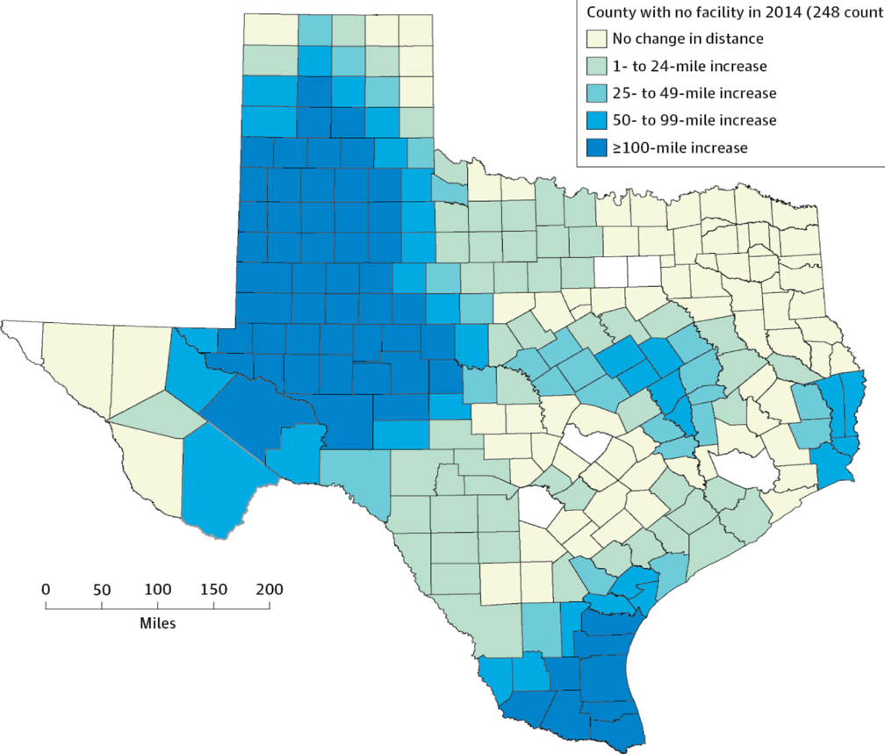
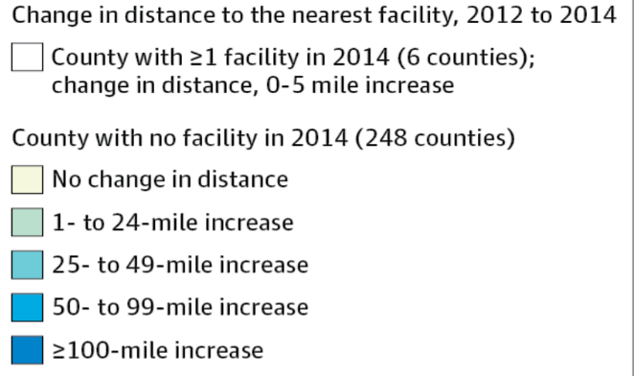
Texas Is Putting Abortion Facilities Out of Reach: Forcing Women to Travel 100 Miles Further
Copyright © 2012 American Medical Association.
All rights reserved

Slide 24
Most of the Medically Bankrupt Had Insurance at the Onset of Their Illness
Source: Himmelstein et al. Am J Med: August, 2009

Slide 25
Medical Bills Are Most Common Reason for Collection Calls
Percent of Consumers Receiving Collection Calls with Specific Type of Debt
Medical collection calls were the only category which did not differ by income
Consumer Financial Protection Bureau, January 2017

Slide 26
Planning for Retirement? Don’t Forget Health Care Costs
“Medicare covers only 51% of health care services….
For a 65 year old couple retiring this year, the cost of health care in retirement will be $240,000.”
New York Times. Wealth Matters

Slide 27
Despite Medicare, U.S. Seniors Have More Cost-Related Access Problems
Percent of persons >65 reporting cost-related access problems in past year
Source: Health Affairs 2017;36:2123

Slide 28
Medicare Needs Improvement
Percent of seniors spending at least 20% of income on premiums and out-of-pocket costs
For many seniors,
medical costs consume
more than 1/5th of income
Income Group (% of Federal Poverty Level)
Commonwealth Fund, May 12, 2017

Slide 29
Rising Economic and Health Inequality

Slide 30
Mean Family Income for Each Fifth: 1966 – 2016 (Inflation Adjusted)
Income
Source: Bureau of the Census
Constant USD, 2015

Slide 31
Widening Gap in Life Expectancy Between High and Low Earners
Remaining Life Expectancy for Men Turning 60
Source: Waldron. ORES, Social Security Admin, #108, 2007

Slide 32
Progress on Mortality Halted
Age adjusted mortality per 100,000
Source: NCHS
Note: Data for 2017 is preliminary

Slide 33
Income Inequality Worst in U.S.
Top 1% income share
Source: World Top Incomes database – data are for 2016/2017 or most recent available

Slide 34
Poverty Rates
Percent of Population Below Poverty
OECD 2018; Figures are for 2015 or most recent available

Slide 35
Incarceration Rates
Prisoners per 100,000 population
Walmsley – World Prison Population List, 11th Ed.

Slide 36
Prisoners Face Copays for Care
42 states and federal prison system charge copays for a visit.
Average copay = $3.47/visit.
Oklahoma example
Prisoners earn 5 cents per hour
$4 copay per visit = 80 hours of work income
Copay is equivalent of $580 at minimum wage
Source: The Marshall Project. May 30, 2018

Slide 37
Persistent Racial Inequalities

Slide 38
Black Americans Die Younger
Life Expectancy at birth
CDC, 2015 – Final Mortality Data for 2013
*Hispanics can be of any race, and Blacks and Whites include some Hispanics

Slide 39
Racial Differences in Maternal Mortality
Deaths per 100,000
Data for 2011-2014
Source: CDC, 2018

Slide 40
Median Family Income
Median income
(Inflation Adjusted, 2015 $s)
Whites
Blacks
Bureau of the Census, 2016 data

Slide 41
White High School Dropouts Have More Assets than College-Educated Blacks
Medican Wealth of Working Households Young than Age 55
Demos – The Asset Value of Whiteness – Based on 2013 sFederal Reserve survey data

Slide 42
Job Discrimination Persists Experimental Study of the Impact of “Whitening” Resumes
Callback rate after resume submitted
Black Applicant
Asian Applicant
Source: Kang SK, et al. Admin SciQ, 2016 – Job ads with pro-diversity language yielded same result
*e.g., change “Lamar J. Smith” to “L. James Smith” or “Lei Zhange” to “Luke Zhang”
** e.g., change “Aspiring Asian Business Leaders” to “Aspiring Business Leaders”

Slide 43
Driving While Black More Likely to Be Searched, Less Likely to Be Found with Contraband
Black Rate / White Rate
(1.0 = Equally Likely)
Car Searched
Contraband Found Among Those Searched
NY Times 10/25/15

Slide 44
Police More Likely to Kill Minority Men
Police killings per day in USA: 2.8
Police killings account for
8% of all USA homicides
Police killings per 100,000 men
Source: AJPH 2018;108:1241

Slide 45
Causes of Black/White Disparity In Adult Mortality
MMWR May 2, 2017
Note: “Other” includes conditions (e.g., diabetes) for which Black death rates are higher and some (e.g., COPD, cirrhosis) for which Black death rates are lower.

Slide 46
Black Enrollment in U.S. Medical Schools, 1976-2017
AAMC Goal:
11.7%
Percent Blacks in 1st Year Medical School Class
RWJ Fdn. 1987; AAMC;
JAMA Annual Medical Education Special Issue

Slide 47
Physicians/Population by Race/Ethnicity
Physicians per 1000 population
Data are for 2008
Source: AMA and Census Bureau

Slide 48
Black and Female Physicians Earn Less
Annual Income
Source: Ly et al. BMJ 2016;353:2923
Note: Figures are adjusted for hours worked, specialty, age, years in practice, practice type, percent of revenue from Medicare/Medicaid

Slide 49
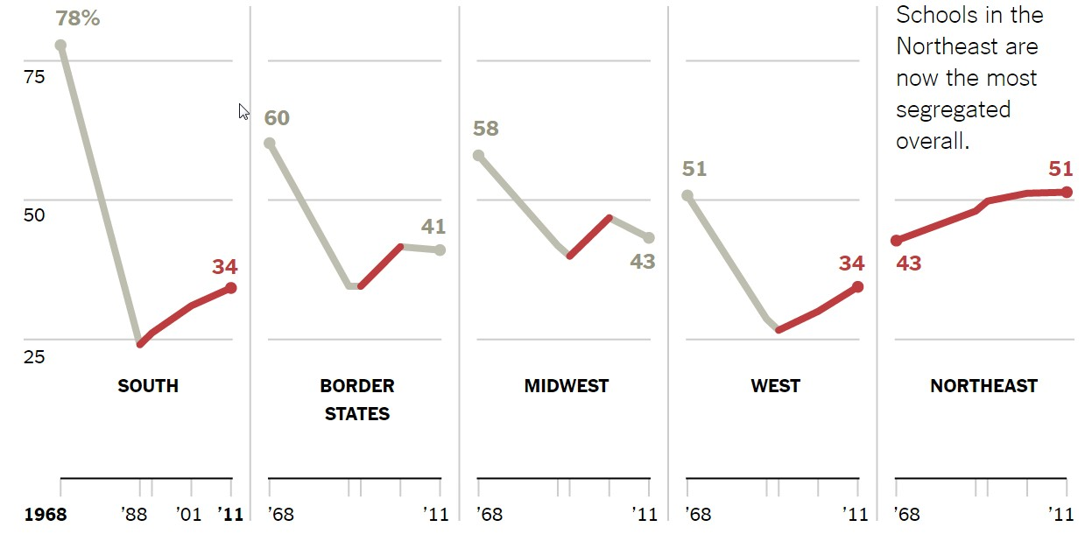
School Integration: Progress Reversed Share of Black Students Attending Schools that are > 90% Minority
Source: New York Times. 3/1/2018

Slide 50
Minority Children and Youth Get Few Psychiatrist Visits
Psychiatrist visits per year per 1,000 population
Source: Marrast, Himmelstein, Woolhandler. Int J Hlth Serv 2016

Slide 51
Blacks in VA: No Health Disadvantage
Odds ratio for Black vs White Vets
(<1 indicates lower rate for Blacks)
Kovesdy et al. Circulation 9/18/2015
Longitudinal study of 3,072,966 Vets cared for at VAs

Slide 52
Immigrants Get Little Care
Total Health Care
ED Care
Children
Health Care
$ per capita
*Adjusted for ethnicity, poverty, age, insurance status, patient/parent-reported health status
Source: Mohanty et al. Am J Public Health 2005;95:1431

Slide 53
Low Birth Weight Rose Among Arabic-Named Women in California After 9/11
Relative Risk of Low Birth Weight Post- vs Pre-9/11
Demography 2006;43:185
* Mother’s name Arabic, infant’s name not ethnically distinctive
** Mother’s name Arabic, infant’s name ethnically distinctive

Slide 54
Low Birth Weight Increased in Iowa After a Massive Immigration Raid
Relative Risk of Low Birth Weight
Int J Epidemiol 2017;839
Note: 2008 Postville, Iowa raid was the largest single-site immigration raid in history. 900 agents handcuffed and chained all Latinos at meatpacking plant.

Slide 55
Immigrants Subsidize Native-Born in Private Insurance
$17.0 Billion
Net contribution to private insurance, 2014 (premiums minus benefits)
$7.7 Billion
US Born
-$24.7 Billion
Documented Immigrants
Undocumented Persons
Source: Zallman et al. Health Affairs October, 2018

Slide 56
Immigrants Keep Medicare Afloat
$3.7 Billion
$10.1 Billion
Net contribution to Medicare Trust Fund, 2009
-$30.9 Billion
Source: Zallman et al, Health Affairs 2013;32:1153

Slide 57
Rationing Amidst A Surplus of Care

Slide 58
22.5% of 111,707 Defibrillator Implants Were Not Evidence-Based
Sometimes Lethal
In hospital death rate for non-evidence based ICD implant 0.6%
Cost of ICD implant ~$25,000
Note: In-hospital death rate for non-evidence-based ICD implantation was 0.6%.
Cost of ICD implant ~$25,000
Source: JAMA 2011;305:43

Slide 59
Many Elective PCIs Are Inappropriate
Uncertain
41.3%
Appropriate
33.9%
Inappropriate
22.0%
JAMA IM 2014;174:1630
Based on 1,225,562 patients in PCI Cath Registry

Slide 60
Urgent Care Centers and Retail Clinics Increase Use and Costs for Low Acuity Conditions
Visits per 1000 or $s per member for low acuity conditions
Source: JAMA IM 2018;178:1342

Slide 61
The Medical Arms Race: Which Hospitals Opened New Invasive Cardiology Programs, 1996-2014?
Strong predictors
A competing hospital opening a program
For-profit ownership
Also
predictive
Being a non-profit in a market dominated by for-profits
Weakly
predictive
Lack of service availability in the community
Source: NBER Working Paper W23530 - June, 2017

Slide 62
Administrative Overhead Rising

Slide 63
Growth of Physicians and Administrators
Growth since 1970
Bureau of Labor Statistics; NCHS; Himmelstein/Woolhandler analysis of CPS
Managers shown as moving average of current year and two previous years

Slide 64
Healthcare “Revenue Cycle Management” Firms: A New Layer of Administrative Waste
Firm | Number of FTEs
Parallon | 15,800
Conifer Health Solutions | 14,600
AGS Health | 4,683
GeBBS Healthcare Solutions | 4,500
nThrive | 3,369
Navigant Consulting | 2,440
Other firms | 3,665
Source: Modern Healthcare 12/18/2018:26

Slide 65
Doctors Spend Twice as Much Time on EHR/Desk Work as With Patients
Source: Sinsky et al. Ann Int Med 9/6/2016 – based on time/motion observation + home diary
Note: Figures are percent of office hours – exclude the 1-2 hrs/night of home EHR/desk work

Slide 66
EPIC EHR Notes Longer in US Documentation Driven by Payment Complexity
International
USA
Number of Institutions
Average Number of Characters per Ambulatory Note
Source: Ann Intern Med 2018; 169:51
13 international organizations represent 140,000 notes from Canada, the UK, Australia, the Netherlands, Denmark, the United Arab Emirates, and Singapore.
254 organizations within the United States represent 10 million notes.

Slide 67
Investor-Owned Care: Inflated Costs, Inferior Quality

Slide 68
Extent of For-Profit Ownership
Commerce Dept. Service Annual Surveys & MedPac. Data are Q1, 2017 or most recent available.
* Data are for non-government-owned hospitals
** Data are for share of establishments

Slide 69
Health Industry Profits, 2017
Pharmaceuticals | $44.4 B
Insurers | $21.8 B
Pharmacy / Lab Benefit Mgr. | $14.3 B
Equipment / Supplies | $7.7 B
Distributors / Wholesalers | $7.4 B
Fortune 500, 2018
Note: Pharma profits reflect one time tax charges for repatriated profits

Slide 70
Academic Leaders on For-Profit Health Corporations’ Boards
Academic Position | Number of Directorships | Pay per Directorship (median) | Shares Owned (mean)
CEO Hosp/System | 21 | $221,000 | 42,445
Dean | 17 | $268,000 | 32,113
Department Chair | 18 | $103,000 | 65,574
Professor | 131 | $160,000 | 171,856
Trustee | 83 | $227,000 | 342,198
Any | 309 | $193,000 | 193,629
Source: BMJ 2015;351:H4826

Slide 71
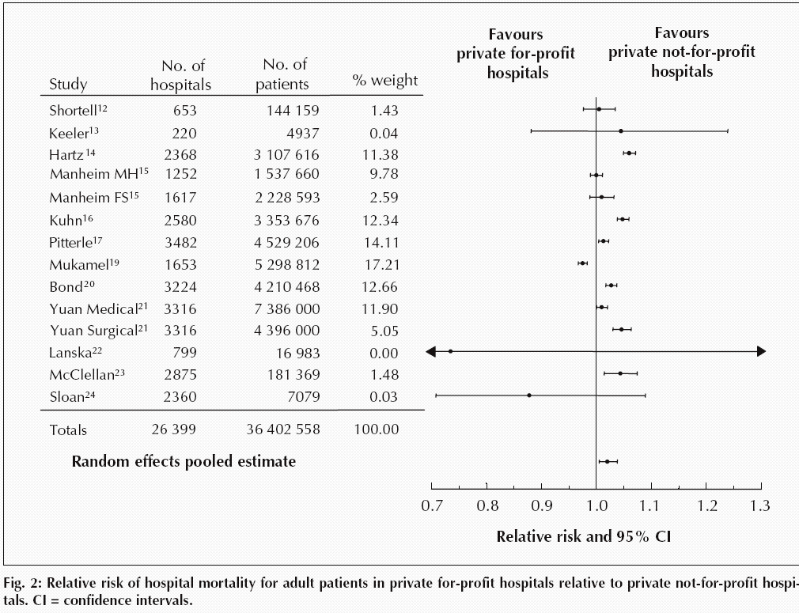
For-Profit Hospitals’ Death Rates Are 2% Higher
Relative risk of hospital mortality for adult patients in private for-profit hospitals relative to private not-for-profit hospitals
Source: CMAJ Devereaux et al. 166 (11): 1399.

Slide 72
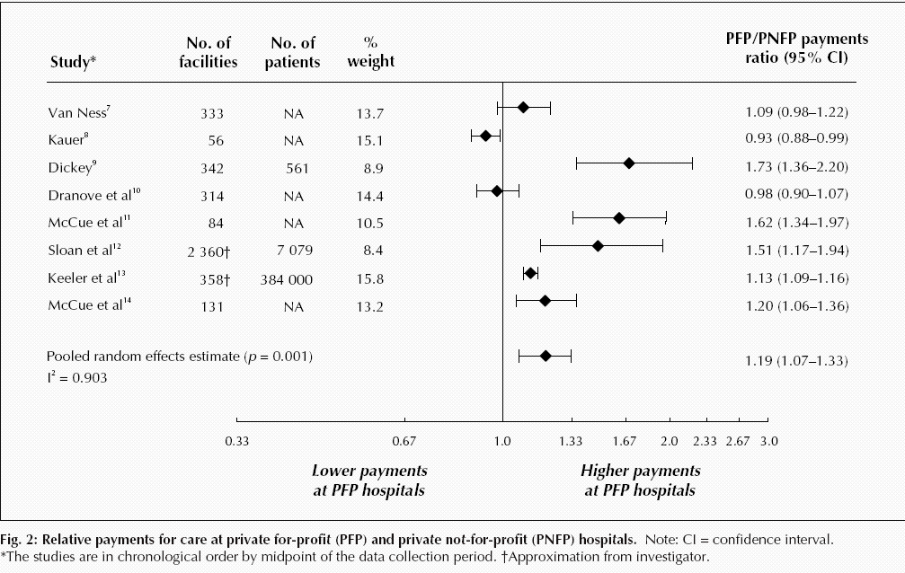
For-Profit Hospitals Cost 19% More
Relative payments for care at private for-profit (PFP) and private not-for-profit (PNFP) hospitals
Source: CMAJ Devereaux et al. 170 (12): 1817.

Slide 73
For Profit Hospitals Have Highest Readmission Rates for Every Condition
Readmission
rate adjusted
for severity
(Expected
rate = 1.0)
Source: PLOS One 9/18/2018 – based on Medicare data 2012-2015

Slide 74
For-Profit Hospitals’ Administrative Costs Are Higher
Percentage spent on administration
Himmelstein and Woolhandler
Analysis of 2011 Medicare hospital cost reports

Slide 75
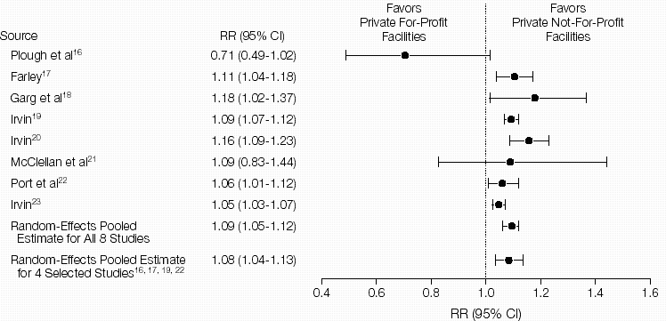
For-Profit Dialysis Clinics’ Death Rates Are 9% Higher
Relative Risk (RR) of Morality in Hemodialysis Patients
Source: JAMA 2002;288:2449
Notes:
75

Slide 76
VA Kidney Care: Less Dialysis, Better Survival
Percent of patients with new kidney failure
Source: JAMA IM 2018; 178:657
Kidney failure defined as eGFR<15
Non-VA defined as Medicare-paid, mostly delivered by investor-owned facilities

Slide 77
For Profit Home Care: Lower Quality
Source: Cabin, Siman, Himmelstein & Woolhandler.
Health Affairs 8/2014

Slide 78
For Profit Home Care: Higher Cost
Annual Cost per Patient
Source: Cabin, Siman, Himmelstein & Woolhandler.
Health Affairs 8/2014

Slide 79
Investor-Owned Nursing Homes: Worse Quality
Deficiencies per Nursing Home,
or % of Nursing Homes with 1 or more deficiencies
Inspections found more,
and more severe,
deficiencies
Source: CMS – Nursing Home Data Compendium 2015
”Severe” defined as actual harm or immediate jeopardy to patients

Slide 80
Hospice Goes For-Profit
Percent of hospices under for-profit ownership
Source: MEDPAC annual report, 2018 and previous reports
Profit rate: for-profits = 16.4%; non-profits = .1%.
Mean LOS: for-profits = 106 days; non-profits = 66 days

Slide 81
For-Profit Hospices Avoid Unprofitable Patients
Likelihood of accepting all patients, regardless of care needs
(and profitability)
Source: Health Affairs 2012;31:2690
Note: Based upon accepting patients on chemo, TPN, transfusions, tube feeds, intrathecal cath, palliative radiation, or living alone

Slide 82
US Prescription Drug Spending
Prescription drug spending,
Billions of dollars
Estimated
Source: CMS, Office of the Actuary
Note: 2017-2019 estimated

Slide 83
USA Spends the Most on Drugs Double the OECD Average
Per capita spending on prescription drugs
Sources: OECD, 2018
Note: Data are for 2016 or most recent year available.

Slide 84
As With Drugs, Device Prices Are Highest in the USA
Mean cost per device, 2014
(exchange rate adjusted $s)
Source: Health Affairs 2018;37:1570
Note: Devices account for 6% of U.S. health expenditures

Slide 85
What Goes Into a $6,000 Orthopedic Implant
Source: Modern Healthcare 2/5/2018

Slide 86
Insulin Cost Tripled 2006-2013
Average cost per patient in 2013:
$736
Mean expenditure per patient for insulin
Source: JAMA 2016;315:1400

Slide 87
Drug Company Profits
Return on Revenue (%)
Fortune 500 rankings for 1995-2017
Total drug company profits, 2017= $44.4 billion. Depressed by one-time charges for repatriated profits

Slide 88
Goldman Sachs asks in biotech research report: “Is Curing Patients a Sustainable Business Model?”
“The success of its [Gilead’s] hepatitis C franchise has gradually exhausted the available pool of treatable patients…
“In the case of infectious diseases such as hepatitis C, curing existing patients also decreases the number of carriers able to transmit the virus to new patients.”
CNBC Investing
Tae Kim @firstadopter. Published 3:15 PM ET Wed, 11 April 2018. Updated 7:20 PM ET Wed, 11 April 2018

Slide 89
Profits Dwarf Cancer Drug R&D Costs Analysis of All Drugs Approved 2006 – 2015 From Firms With Only One Approved Drug
Mean Cost or Revenue per Drug
(Millions)
Prasad et al. JAMA IM, online 9/11/2017
* Costs of all company R&D, including their non-approved agents
** Total revenue from sales since approve – mean of 3.8 years

Slide 90
Drug Companies’ Cost Structure
Marketing
and Admin
35%
Manufacturing
27%
Profits
(After Taxes)
18%
R&D
13%
Taxes
7%
Source: Health Affairs 2001;20(5):136

Slide 91
Investor-Owned Medicaid HMOs: Higher Administrative Costs, Lower Quality
Note: Publicly Traded = Publicly traded Medicaid-only plans
Source: McCue. Commonwealth Fund, June, 2011

Slide 92
Insurers Risk Select Via Formulary Design Put generics needed by sicker patients into high co-pay tier
Drugs of Choice | Illness | Plan 1 | Plan 2 | Plan 3
Anti-Retrovirals | HIV | No | No | No
Triptans | Migraines | No | No | No
Anti-Psychotics | Schizophrenia | No | No | No
Macrolides | Pneumonia | Yes | No | No
L-Dopa | Parkinson’s | Yes | No | No
Anti-Convulsants | Seizures | Yes | No | No
ACE Inhibitors | Hypertension | Yes | Yes | No
Metformin | Diabetes | Yes | Yes | No
Oster & Fendrick, Am J Managed Care 2014;9:693-4
Plan 3 = Harvard Pilgrim
“No” = No drug of choice available on Tier 1 (lowest co-pay)

Slide 93
Insurance Overhead, 2018
Medical Loss Ratio
SEC filings for first or second quarters, 2018
Note: Medical Loss Ratio = 1 – (medical benefits/premiums)

Slide 94
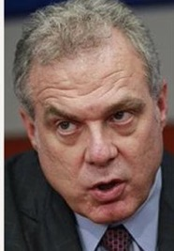
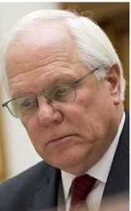
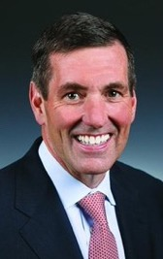
Health Insurance Company CEOs’ Totay Direct Compensation, 2016
Michael Neidorff | David Cordani | Mark Bertolini
Steve Helmsley | Joseph Swedish | Bruce Broussard
Centene
Annual Comp:
$32.2 M
Pay/Day:
$123,225
Cigna
Annual Comp:
$21.9 M
Pay/Day:
$84,017
Aetna
Annual Comp:
$ 41.7M
Pay/Day:
$159,647
Median earnings of full-time
wage and salary workers in 2016:
$43,264
United
Annual Comp:
$31.3 M
Pay/Day:
$119,918
Wellpoint
Annual Comp:
$17.1 M
Pay/Day:
$65,356
Humana
Annual Comp:
$17.0M
Pay/Day:
$65,208
Sources: DEF 14A Schedules, SEC; Bureau of Labor Statistics; Current Population Survey.
Annual CEO compensation includes salary, non-equity incentive pay, other compensation, and value of stock options exercised and stock awards that vested. In addition, these CEOs were given stock and option awards totaling $78.6 million (in aggregate) this year, which will provide value in future years.

Slide 95
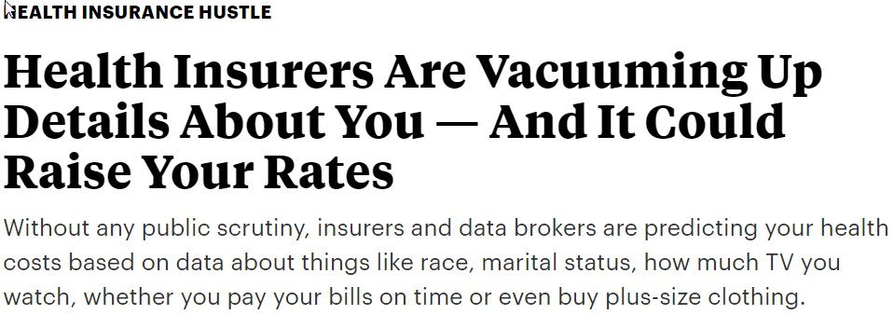

Slide 96
Medicare: More Efficient than Private Insurers

Slide 97
Growth in Spending 1969-2016: Medicare Vs. Private Insurers Per Enrollee, Common Benefits
Percent Increase
Medicare
Private Insurance
Source: CMS Office of the Actuary

Slide 98
Medicare Advantage Plans’ High Overhead
Sources: GAO 12/2013 and Medicare Trustees Report 2012 – Figures are for 2011
Note: MA overhead = $905/enrollee; profit = $447/enrollee
Total MA profit = $3.3 Billion

Slide 99
Medicare Advantage Plans’ Narrow Networks
More than a third of all Medicare Advantage plans lack an NCI cancer center.
49% of narrow networks exclude academic med centers.
Sources: Kaiser Family Foundation June, 2016
Note: “Narrow” = <30% of hospitals; “Medium Small” = 20-49%; “Medium” = 50-69%; “Broad” = >69%

Slide 100
Despite Medicare’s Lower Overhead, Medicare Advantage Plans Outcompete Traditional Medicare by Cherry Picking, Upcoding, and Lobbying for Overpayment

Slide 101
Medicare HMO Enrollment
Medicare HMO Enrollees (millions)
Source: CMS

Slide 102
Medicare and Medicaid Keep Private Insurers Afloat
Revenues of five largest private insurers,
$ Billions
Private
Medicare and Medicaid
Source: Health Affairs 2017;36:2185
Notes:
Aetna, Anthem, CIGNA, Humana, and United Healthcare
Figures exclude government payments for public workers’ coverage

Slide 103
A Few Sick People Account for Most Health Spending
Percent of total spending accounted for by each decile among non-institutionalized Americans
81.5%
Decile of Health Spending
Source: JAMA 2016;316:1348

Slide 104
Sickest Patients Switch Out of Medicare Advantage
Percent switching out during 2011
Plan switched out of:
Traditional Medicare
Medicare Advantage
Health Affairs 2015;34:1675
Similar results for patients with hospital or home care use, more marked among dual eligibles

Slide 105
Medicare plans put generics into higher “tiers”, Boosting Copays by $6.2 Billion
Percent of generic drugs in each tier, Private Medicare Part D plans
Source: Avalere 5/22/2018

Slide 106
Profit-Driven Upcoding Makes Accurate Risk Adjustment Impossible:
High cost providers inflate both reimbursement and quality scores
by making patients look sicker on paper.

Slide 107
CMS Payment to MA Plans: Same Patient, Different Coding
Original Coding
Base rate | $3,950
DM 2, uncomplicated | $1,040
Chronic Kidney Disease | $0
Obesity | $0
Depression | $0
Coronary Art. Dis., Chronic | $0
Total | $4,990
Enhanced Coding
Base rate | $3,950
DM 2 with Diabetic CKD | $3,180
CKD Stage 4 | $2,370
Morbid Obesity | $2,730
Major Depression | $3,950
CAD with Angina | $1,400
Total | $17,580
Enhanced Coding
Base rate | $3,950
DM 2 with Diabetic CKD | $3,180
CKD Stage 4 | $2,370
Morbid Obesity | $2,730
Major Depression | $3,950
CAD with Angina | $1,400
Enhanced Coding
Base rate | $3,950
DM 2 with Diabetic CKD | $3,180
CKD Stage 4 | $2,370
Morbid Obesity | $2,730
Major Depression | $3,950
Enhanced Coding
Base rate | $3,950
DM 2 with Diabetic CKD | $3,180
CKD Stage 4 | $2,370
Morbid Obesity | $2,730
Enhanced Coding
Base rate | $3,950
DM 2 with Diabetic CKD | $3,180
CKD Stage 4 | $2,370
Enhanced Coding
Base rate | $3,950
DM 2 with Diabetic CKD | $3,180
Enhanced Coding
Base rate | $3,950
SGIM Forum, 2017

Slide 108
Audits Found Massive Overpayments to MA Plans
Audits of 5 plans – Aetna, Humana, UnitedHealthcare, Independence Blue X, Lovelace
Plans overstated risk score for >80% of patients, resulting in overpayments for 58% of enrollees. Only 7.5% were “under-coded”.
Overcoding caused overpayment of $3,300/enrollee
Schulte. Center for Public Integrity, 7/10/15

Slide 109
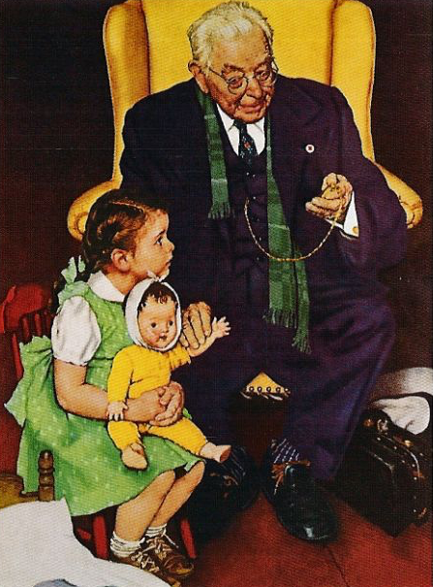
HMO “House Calls”: A New Upcoding Scam
HMOs send their “house call doctor” – or one from Mobile Medical Examination Services Inc.
Doctor seeks out unimportant diagnoses, e.g. mild arthritis
No treatment offered
Extra diagnoses allow HMOs to upcode, adding >$3 billion/year to Medicare Advantage payments
Efforts to outlaw upcoding “house calls” were scrapped after industry lobbying blitz
Schulte, Center for Public Integrity, 2014

Slide 110
Medicare Overpays Private Plans
Overpayments ($ Billions)
Total overpayments 2008-2016:
$173.7 Billion
Source: MedPAC and Geruso and Layton, 2015

Slide 111
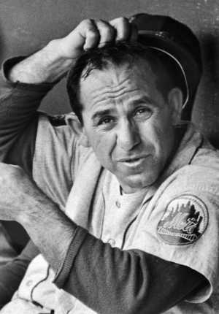
ACOs: Warmed Over Managed Care

Slide 112
HMO and ACO Similarities
Diagnosis:
FFS and “Fragmentation”
Rx:
Invert FFS incentives
Shift insurance risk to providers
Protect” patients with P4P
Consolidate providers into entities large enough to be “held accountable” for cost (via capitation)

Slide 113
ACOs’ Explosive Growth Since 2010
Number of ACOs
Sources: Health Affairs Blog 10/31/13 and 3/31/15. Leavitt Partners 6/28/17

Slide 114
Physician-Leadership of ACOs Waning
Share of ACOs led by physicians
Source: Modern Healthcare 2/5/18:18
Physician-led = no formal affiliation with a hospital

Slide 115
HMO and ACO Differences
More ACOs are provider-based (so far)
Patients not restricted to ACO (so far)
Patients are mostly unaware they’re in an ACO

Slide 116
Poll: Patients Reject ACOs
“Here are two different ways Medicare could pay doctors.
Which of these do you think
would be better for you?”
NEJM 2013;369:1066 – Kaiser/RWJ/Harvard Survey, 201

Slide 117
High Risk HMO Patients Fared Poorly in the RAND Experiment
Relative Risk of Dying
Diastolic Blood Pressure
Source: RAND Health Insurance Experiment, Lancet 1988;1:1017
Note: High Risk = 20% of population with lowest income + highest medical risk

Slide 118
Depressed Patients: Fee-For-Service vs. Managed Care
Primary Care Patients
Patients Seeing a Psychiatrist
Fee-For-Service
Number of Functional Limitations
Managed Care
Source: Medical Outcomes Study. JAMA 1989; 262:3298
Arch Gen Psych 1993; 50:517

Slide 119
Failure of Medicare HMO Risk Adjustment
Despite decades-long effort, CMS has failed to stop cherry-picking
Implications
No net savings, probable increased costs
Resources transferred from sick to healthy
Biggest cheaters are biggest winners
ACOs that embrace problem patients driven from the market
Intensive coding makes patients appear sicker on paper, ups risk-adjusted capitation fee and factitiously raises quality scores
ACOs that fail to cherry pick/upcode get low payments, and factitiously poor quality scores

Slide 120
Claims for ACO Savings Ignore Bonuses ACOs Slightly Increased Medicare’s Costs, 2013-2017
Medicare Payments
to ACOs,
2013-2017
$ Millions
2013
Total:
-$2,701
Million
2014
2015
2016
2017
Source: DHHS Inspector General, August 2017, and CMS 9/2018

Slide 121
Hospitals Paid Bundled Payment for Joint Replacement Avoided Frail Patients
Percent change from pre-bundled care period in share of patients with history of inpt. stay in past year (relative to control hospitals)
Source: JAMA 2018; 320:901

Slide 122
“Bundled Payment” Joint Replacement: Increased Costs After Accounting for Bonuses
Medicare payments per case, bundled payment vs. control hospitals
Results of a randomized controlled trial.
Source: JAMA 2018;320:892
Hospitals were randomly assigned to receive bundled payment for all care through 90 days post discharge

Slide 123
“Bundled Payment” for Medical Conditions*: No Savings, No Quality Improvement
Medicare payments per case, bundled vs:
No differences in mortality, readmissions,
or use of the emergency department.
Baseline
Bundled Payment Period
Source: NEJM 2018;379:260
*Conditions = AMI, COPD, CHF, Sepsis, Pneumonia

Slide 124
Hospitals Merging
System-Owned
Proportion of Hospitals That Are System-Owned vs. Independent
Independent
Source: Sanofi Hospital/Systems Digest, 2016

Slide 125
Hospitals and Health Systems Are Buying Up Primary Care Practices
50%
40%
30%
20%
10%
0
Hospital or Health Care System
Practice Ownership
Solo Practice
Medical Group
2010 | 2011 | 2012 | 2013 | 2014 | 2015 | 2016
Trands in Practice Ownership
Brent D. Fulton Health Aff 2017;36:1530-1538
Notes:
Percentages of primary care physicians working in organizations, by ownership type, 2010–16

Slide 126
Physician/Hospital Integration Raises Costs
Annual Outpatient Cost Increase with 1.9% Increase in Physician/Hospital Integration
Source: JAMA IM 2015;175:1932
Note: Physician/Hospital integration measured by % of MDs billing with a hospital place of service code

Slide 127
Hospital-Owned Practices: More IT, Higher Costs, More Readmissions
Rate compared to physician-owned practices
Source: Health Services Research – Online ahead of print July 5, 2018
Note: Comparisons are adjusted for multiple patient characteristics

Slide 128
The Toxicity of Pay for Performance (P4P)

Slide 129
Assumptions Implicit in P4P
Performance can be accurately ascertained
Individual variation is caused by variation in motivation
Financial incentives will add to intrinsic motivation
Current payment system is too simple
Hospitals/MDs delivering poor quality care should get fewer resources

Slide 130
Quality Scores Tell More About Patients than Physicians Harvard physicians with poorer/minority patients score low
Patient characteristics in panels of high-
and low-scoring physicians
Source: Hong C et al. JAMA 9/8/2010. 304:10;1107.

Slide 131
MACRA Penalizes Doctors With Sicker (or Poorer) Patients
Percent of practices receiving bonuses / penalties
JAMA 2017;318:453 – Figures are simulated based on 2015 Medicare data

Slide 132
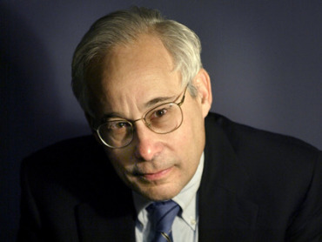
Pay for Performance?
“I do not think it’s true that the way to get better doctoring and better nursing is to put money on the table in front of doctors and nurses. I think that's a fundamental misunderstanding of human motivation.
“I think people respond to joy and work and love and achievement and learning and appreciation and gratitude – and a sense of a job well done. I think that it feels good to be a doctor, and better to be a better doctor.
“When we begin to attach dollar amounts to throughputs and to individual pay, we are playing with fire. The first and most important effect of that may be to begin to dissociate people from their work.”
– Don Berwick M.D.
Health Affairs. 1/12/2005

Slide 133
95% of Plans Cheat on HEDIS Quality Measures
Medicare Advantage plans failing to cheat fall in rankings
Percent of elderly patients prescribed drugs that should be avoided
Annals of Internal Medicine 2013;159:456
Researchers compared reported HEDIS scores for high risk prescribing to actual Medicare Part D payment records for all enrollees and for enrollees sampled for HEDIS scoring

Slide 134
Medicare’s Premier Demonstration: A P4P Failure at 252 Hospitals
Worse
5-year outcomes show no effect on mortality
Change from baseline in 30-day mortality
Better
Note: P4P failed even among poor performers at baseline
Source: NEJM March 28, 2012

Slide 135
Performance Monitoring Increased Documentation of Alcohol Counseling, But Not Real Counseling Rate
Alcohol counseling rate among patients screening positive for unhealthy use
Source: JGIM 2017;33:268

Slide 136
Medicare’s Readmission Penalties: Fewer CHF Readmissions, More Deaths
Source: Gupta et al. JAMA Cardiology. Posted online 11/12/2017
Note: Analysis based on 115,245 CHF discharges, 2008-2014

Slide 137
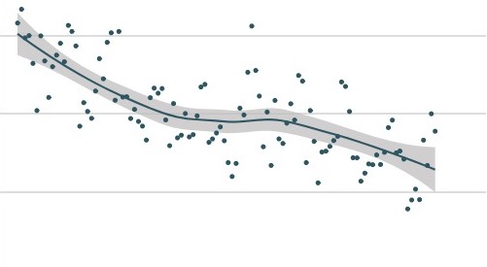
Did Readmission Penalties Slow Improvement in MI Mortality?
10%
9%
8%
7%
In-Hospital Mortality Rate
Readmission Penalties Announced
2006 | 2008 | 2010 | 2012 | 2014 | 2016
Source: JAMA Network Open. 2018;1(5):e182777

Slide 138
P4P Did Not Lower Hospital Mortality in England
P4P Hospitals
20%
15%
10%
5%
P4P Hospitals
30-Day Mortality
Control Regions
No
P4P
Bonuses Only
Bonuses plus Incentives
Difference
2007 | 2008 | 2009 | 2010 | 2011 | 2012
Source: N Engl J Med 2014;371:540-548

Slide 139
P4P Did Not Improve Mortality in England World’s largest P4P program tied 25% of GP income to quality targets
Change in Deaths/100,000 From Pre to Post P4P Implementation
Source: Lancet 2016;388:268
Note: Data shows trends compared to developed nations without P4P

Slide 140
VA Hospitals Have Lower Mortality and Readmissions than Other Hospitals
Mortality
Readmissions
30 Day Mortality or readmissions per 100 patients
JAMA IM 2017;177:882
PNA = Pneumonia; All rates are risk-adjusted

Slide 141
ACOs and P4P: Implementation Without Evidence
P4P – Official Medicare policy, widely adopted by private payers
Implementing everywhere interventions which
have been proven nowhere
risks failure on a colossal scale
No RCTs showing improved outcomes.
No improvement in 3 largest programs.
Negative side effects likely, e.g. increased CHF deaths.
VA (no P4P) has better quality than hospitals paid P4P
ACOs – Newest health policy panacea
No RCTs.
No savings once bonuses factored in.
Disturbing HMO experience.

Slide 142
Mandate Model Reform: Keeping Private Insurers In Charge

Slide 143
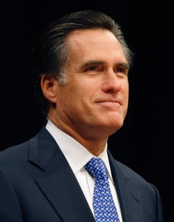
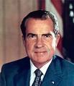
“Mandate Model” of Reform
Expanded Medicaid-like program
Free for the poor
Subsidies for low income
Buy-in without subsidies for others
Employer Mandate +/- Individual
Insurance Exchanges
Notes:
143

Slide 144
The Heritage Foundation Proposal: 1989
Universal coverage
Individual mandate
Refundable tax credits pegged to income and health status.
Minimum benefit package

Slide 145
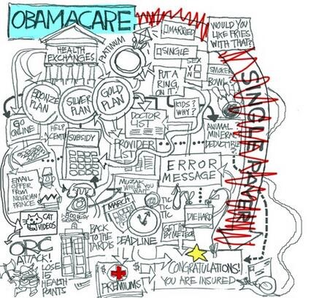
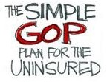

Slide 146
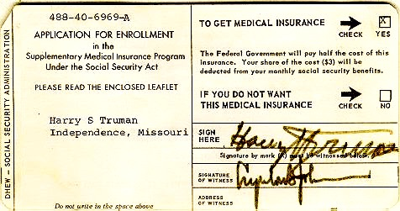
Medicare’s “Software” 18.9 million seniors enrolled within 11 months

Slide 147
ACA Decreased Incidence of Unmet Medical Needs Due to Cost
Better, but still not good.
Percent of Adults
Ages 18-64
Reporting an Unmet Health Need (Past 12 Months)
Income as Percent of Federal Poverty Level
Health Affairs 2017;36:1656

Slide 148
Administrative Costs Rising Quickly Since ACA’s Passage
Average rate of increase annually, 2009-2017
Himmelstein & Woolhandler, unplublished analysis based on NHEA and Medicare cost reports
Note: Hospital figure is for 2009-2016

Slide 149
Trump’s Health Financing Actions
Expand “association” and “short term” junk insurance – Increase under-insurance, undermine ACA risk pool raising cost for sicker people.
Let employers deny coverage for birth control.
Obstruct ACA enrollment.
Allow states to implement punitive Medicaid changes.
“Public charge” rule threatens documented immigrants if anyone in family uses Medicaid or nutrition services.

Slide 150
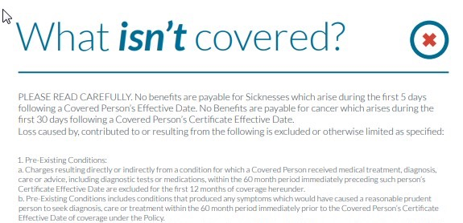
53…mountain climbing, bungee jumping, scuba diving....
…Also excluded is injury received while practicing, exercising, undergoing conditional or physical preparation for such activity.
Notes:
53. Participating in hazardous occupations or other activity including participating, instructing, demonstrating, guiding or accompanying others in the following: operation of a flight in an aircraft other than a regularly scheduled flight by a commercial airline, professional or semi-professional sports, extreme sports, parachute jumping, hot-air ballooning, hang-gliding, base jumping, mountain climbing, bungee jumping, scuba diving, sail gliding, parasailing, parakiting, rock or mountain climbing, cave exploration, parkour, racing including stunt show or speed test of any motorized or non-motorized vehicle, rodeo activities, or similar hazardous activities. Also excluded is injury received while practicing, exercising, undergoing conditional or physical preparation for such activity.

Slide 151
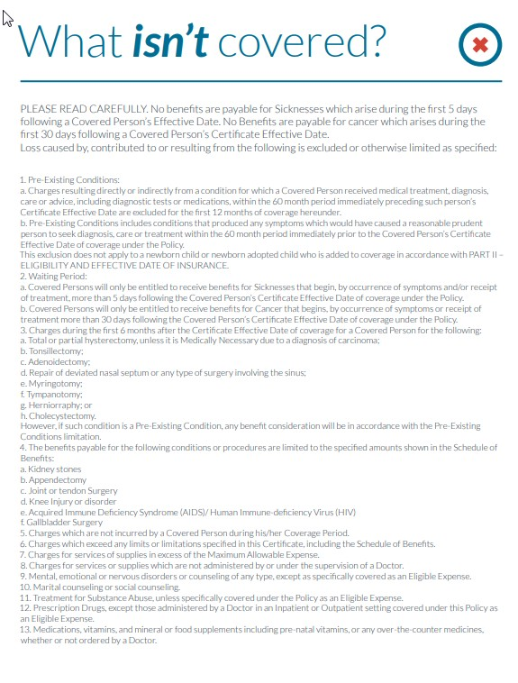
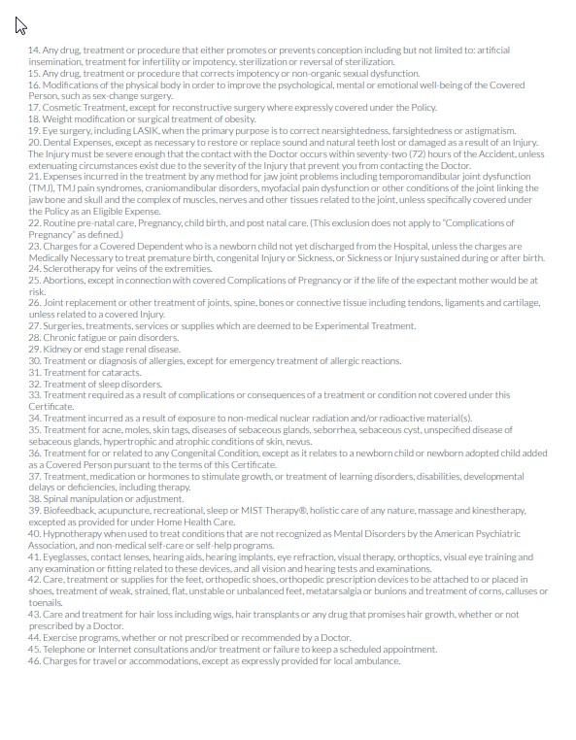
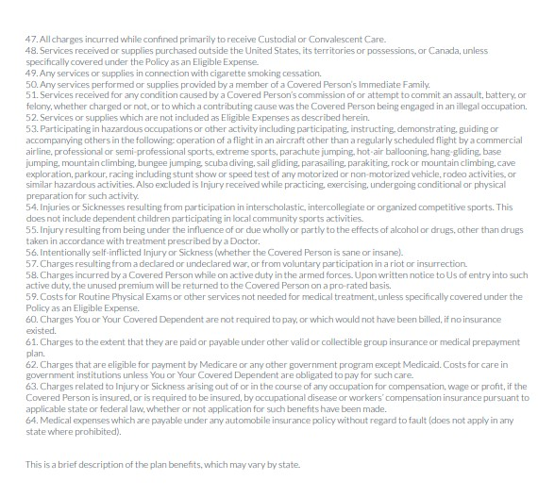
53. Participating in hazardous occupations or other activity including participating, instructing, demonstrating, guiding or accompanying others in the following: operation of a flight in an aircraft other than a regularly scheduled flight by a commercial airline, professional or semi-professional sports, extreme sports, parachute jumping, hot-air ballooning, hang-gliding, base jumping, mountain climbing, bungee jumping, scuba diving, sail gliding, parasailing, parakiting, rock or mountain climbing, cave exploration, parkour, racing including stunt show or speed test of any motorized or non-motorized vehicle, rodeo activities, or similar hazardous activities. Also excluded is injury received while practicing, exercising, undergoing conditional or physical preparation for such activity.

Slide 152
Medicaid Work Requirement: Trivial Savings Unless Exempt Groups Are Also Disenrolled
Percent of Medicaid spending
Source: Goldman, Woolhandler, Himmelstein et al. Forthcoming, JAMA IM & CBPP, May 23, 2018
Note: Spending on enrollees with multiple exemptions appear in only one category
Note: Estimated bureaucratic costs of administering requirement: $185 million per year in KY, $600 mil in PA

Slide 153
American Taxpayers Already Pay More Than People in Nations With National Health Insurance

Slide 154
²/₃ of Our Healthcare Spending Comes From Our Taxes
Tax Funded
65%
Source: Himmelstein & Woolhandler – Analysis of NCHS data

Slide 155
US Public Spending per Capita for Health Exceeds Total Spending in Other Nations
USA Total:
$10,720
Total Spending
USA Public
USA Private
Note: “Public” includes benefit costs for gvt employees and tax subsidies for private insurance
OECD 2018; NCHS; AJPH 2016;106:449 (updated) – Data are for 2017

Slide 156
The USA Trails Other Nations

Slide 157
USA Patients Skip Care More Often
Patients skipping a consultation, test, treatment, Rx, or follow-up due to cost in the past 12 months
Commonwealth Fund Survey, 2016

Slide 158
Even Americans with Above-Average Incomes Have Worst Access to Care
Percent Reporting Access Problem
Source: NEJM 10/23/2014

Slide 159
Life Expectancy
Years
OECD, 2018
Note: Data are for 2016 or most recent year available

Slide 160
Infant Mortality
Deaths in First Year of Life / 1000 Live Births
OECD, 2018
Note: Data are for 2016 or most recent year available

Slide 161
Maternal Mortality
Deaths per 100,000 Live Births
OECD, 2017 and Global Burden of Disease, 2015
Note: Data are for 2016 or most recent year available

Slide 162
Maternal Mortality: Unprecedented Increase
Maternal Deaths per 100,000 Live Births
Source: Obstetrics & Gynecology 2016;128:447
Note: California excluded from national figures because of discontinuity in ascertainment

Slide 163
High U.S. Costs Do Not Result From
Bad Health Habits
Aging
Overuse of Care

Slide 164
Smoking Prevalence Percent of population >age 15 who smoke daily
Source: OECD, 2018
Note: Data are for 2017 or most recent year available

Slide 165
Percentage of Elderly Percent of population >age 64
Source: OECD, 2018
Note: Data are for 2017 or most recent year available

Slide 166
Hospital Inpatient Days per Capita
Hospital days
per person
per year
Source: OECD, 2017 & AHRQ
Note: Figures are for 2016 or most recent available

Slide 167
Physician Visits per Capita
Source: OECD, 2018
Note: Data are for 2017or most recent year available

Slide 168
Number of Nurses per 1,000 Population
Source: OECD, 2018
Note: Data are for “professionally active nurses” for 2017 or most recent year available

Slide 169
PET Scan Units / Million Population
PET Scanners per Million Population
Source: OECD, 2018
Note: Data are for 2017 or most recent year available

Slide 170
USA Renal Failure Patients Are Less Likely to Get Transplants
Percent of ESRD Patients with Functioning Transplants
Source: OECD 2015
Note: Data are for 2013 or most recent year available

Slide 171
Other Countries Provide More Long Term Care
Percent of total population receiving LTC
OECD, 2018
Note: Data are for 2016 or most recent year available

Slide 172
Out-of-Pocket Payments
$ per Capita
Source: OECD 2018, NCHS
Notes: Data are for 2016 or most recent year available. Figures adjusted for Purchasing Power Parity

Slide 173
Medical Journal Articles per Capita Number of clinical medicine articles 1992-2002 per thousand population
Source: Lancet 2004;363:250

Slide 174
Insurance Overhead
$ per Capita
Source: OECD 2018; NCHS; CIHI
Notes: Data are for 2017 or most recent year available. Figures adjusted for Purchasing Power Parity

Slide 175
USA Doctors Face Biggest Rx Hassles Percent of Primary Care Doctors Saying MD or Staff Time Getting Needed Rx Approvals Is a Major Problem
Source: Commonwealth Fund Survey of Primary Care Physicians, November, 2012
Note: Rx indicates prescribed drug or treatment

Slide 176
USA Doctors’ Satisfaction Is Low Percent of primary care doctors saying they are satisfied or very satisfied
Source: Commonwealth Fund Survey of Primary Care Physicians, November 2012

Slide 177
Canada’s National Health Insurance Program

Slide 178
Minimum Standards for Canada’s Provincial Programs
Universal
Universal coverage that is not impeded, either directly or indirectly, whether by charges or otherwise, reasonable access.
Portable
Portability of benefits from province to province
Comprehensive
Coverage for all medically necessary services
Public
Publicly administered, non-profit program

Slide 179
Hospital Financing: Medicare vs. Medicare
American Medicare
Per-patient payments
Capital and operating payments intermixed
New investments funded from surplus/profit
For-profits thrive
Canadian Medicare
Global budget
Separate payment for capital
New investments funded by government grants
Eliminates opportunity for profitmaking

Slide 180
Medicare vs Medicare: Costs in a Parallel Universe
What if Medicare’s costs in the USA
had grown at Canada’s rate?
Medicare spending for aged (Billions)
Medicare, actual
Medicare at Canada’s growth rate
Source: Woolhandler & Himmelstein analysis based on CMS, CIHI, and Health Canada data
Note: Canada projections based on provincial spending for aged, adjusted for PPP

Slide 181
Free Care in Quebec Increased Physician Care for Serious Symptoms Biggest impact on poor and middle class
Percent of serious symptoms for which physician was seen
Source: NEJM 1973;289:1174

Slide 182
Quality of Care Slightly Better in Canada than in the USA A meta-analysis of patients treated for same illnesses
 | High-Quality Studies | Low-Quality Studies
Results favored USA | 2 | 3
Results favored Canada | 5 | 9
Mixed or equivocal results | 3 | 16
Source: Guyatt et al, Open Medicine, April 19, 2007. Table 1.

Slide 183
Cystic Fibrosis Patients Live Longer in Canada
Uninsured in USA die youngest
Hazard Ratio
for death.
USA vs Canadian
CF patients
(Canada = 1.0)
Ann Int Med 2017;166:537
Note: Hazard Ratios are adjusted for multiple genetic and clinical characteristics

Slide 184
Infant Mortality, USA and Canada
Deaths per 1,000 Live Births
First province implements NHP
USA
Canada
Statistics Canada, Canadian Institute for Healtb Information, Natl Ctr for Health Statistics

Slide 185
Infant Deaths by Income, Canada 2011 Even poor Canadians do as well as average Americans
Infant mortality per 1,000
Income quintiles, Canada
Source: CDC and StatCan

Slide 186
Life Expectancy Falling for Lower-Income Americans, Rising for All Canadians
Change in life expectancy at age 50 over past 3 decades
Source: Growing Gap in Life Expectancy by Income. NAS; Rich man Poor Man, CD Howe Institute
Data is non-weighted average of male and female figures
Data are for Canadians turning 50 in 2000 vs 1970, and for Americans turning 50 in 2010 vs 1980

Slide 187
Healthcare Costs as a % of GDP
Canada’s NHP Enacted
USA
Health costs
% of GDP
NHP Fully Implemented
Canada
Sources: Statistics Canada, Canadian Inst. for Health Inf., and NCHS/Commerce Dept.

Slide 188
US Medicare Coverage Much Worse than Canada’s
Percent of Seniors’ Total Medical Expenses Covered
Note: Not comparable to figures for employer coverage because of high LTC needs in elderly
Source: EBRI and Himmelstein/Woolhandler analysis of Health Canada data

Slide 189
How Canada Controls Costs
Low administrative costs (16.7% of health spending vs. 31.0% in USA)
Lump-sum, global budgets for hospitals
Stringent controls on capital spending for new buildings and equipment
Single buyer purchasing reins in drug/device prices
Low litigation and malpractice costs
Emphasis on primary care
Exclusion of private insurers (private plans overcharge U.S. Medicare by tens of billions annually)
Source: Himmelstein & Woolhandler, Arch Intern Med, December, 2012

Slide 190
Hospital Billing and Administration USA and Canada, 2018
$ per Capita
(PPP Adjusted)
Source: Woolhandler et al. NEJM 2003;349:768 (updated); Himmelstein et al, Health Aff 9/2014

Slide 191
USA Hospital Administration Costs
$ Billions
2018
Himmelstein et al. Health Affairs 9/2014 - updated

Slide 192
Physicians’ Billing and Office Expenses United States and Canada, 2018
$ per Capita
(PPP Adjusted)
Source: Woolhandler/Campbell/Himmelstein NEJM 2003;349:768 (updated)
Note: Excludes dentists and other non-physician, office-based practitioners

Slide 193
Overall Administrative Costs per Capita United States and Canada, 2018
Source: Woolhandler et al. NEJM 2003;349:768 (updated); Himmelstein et al. Health Aff 9/2014

Slide 194
Difference in Health Spending per Capita USA and Canada, 2018
Source: Woolhandler/Himmelstein/Campbell NEJM 2003;349:768 (updated)
NCHS; CIHI; PPP adj.

Slide 195
Few Canadian Physicians Emigrate Today
Net loss
(number moving abroad –
number returning)
A negative number indicates that more physicians returned from abroad then moved abroad
Source: Canadian Institute for Health Information

Slide 196
Canadian Physicians’ Incomes Average Clinical Payments per Physician, 2015-2016
Specialty | Income
Family Medicine | $275,000
Internal Med | $389,000
Pediatrics | $294,000
Psychiatry | $266,000
Dermatology | $378,000
Specialty | Income
OB-GYN | $398,000
General Surgery | $435,000
Thoracic Surgery | $569,000
Ophthalmology | $714,000
Avg All Canada | $339,000
Source: Canadian Institute for Health Information
Figures are in Canadian $

Slide 197
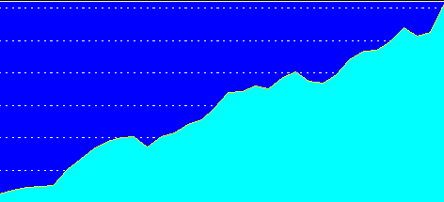
Trends in Canadian Physician Incomes
Mean physician income as multiple of all Canadian
full time employees
Source: Grant and Hurley, U Calgary School of Public Pol. Research Papers. July 2013, Vol 6, Iss 22.

Slide 198
Canadian Malpractice Insurance Costs, 2019
Specialty | Ontario* | Quebec | BC & Alberta
Family Med | $4,908 | $1,583 | $3,420
Psychiatry | $4,908 | $1,583 | $3,420
Cardiology | $8,448 | $2,248 | $5,028
Anaesthesia | $12,948 | $3,139 | $8,472
Neurosurgery | $38,980 | $7,312 | $26,424
Obstetrics | $73,924 | $18,050 | $48,588
*Government reimburses physicians for premiums above 1986 level. All figures in Canadian $s.
Source: Canadian Medical Protective Association www.cmpa-acpm.ca

Slide 199
“It’s not a big hassle. I can focus on patient issues, not administrative issues.”
Dr. Trina Larsen Soles
President of Doctors of BC
Represents physicians in British Columbia
Source: Modern Healthcare 4/9/18

Slide 200
“It’s an incredible bureaucratic mess to get anything done for patients.”
Dr. John Cullen
President-Elect
American Academy of Family Physicians
Source: Modern Healthcare 4/9/18

Slide 201
What’s OK in Canada?
Compared to the USA…
Life expectancy 2 years longer
Infant deaths 25% lower
Universal comprehensive coverage
More physician visits, hospital care; less bureaucracy
Quality of care equivalent to insured Americans’
Free choice of doctor and hospital
Health spending half of USA level

Slide 202
What’s the Matter in Canada?
The wealthy lobby for private funding and tax cuts; they resent subsidizing care for others.
Result: government funding cuts (e.g., 30% of hospital beds closed during the 1990s) causing dissatisfaction and waits for care.
USA and Canadian firms seek profit opportunities in health care privatization
Conservative foes of public services own many Canadian newspapers
Misleading waiting list surveys by right wing Fraser Institute

Slide 203
Wide Support for Medicare-for-All
Democrats
“Do you support or oppose a policy of Medicare for All?”
Republicans
Source: Reuters/Ipsos 8/23/2018

Slide 204
Wide Support for Medicare-for-All
Would you support or oppose providing Medicare to every American?”
Source: Harrisx/Hill.tv Poll, 10/22/2018

Slide 205
Rising Support for Single Payer
Percent favoring “a national health plan in which all would get insurance from a single government plan”
Source: Kaiser Foundation, 2018

Slide 206
Most Doctors Now Favor Single Payer Support Has Sharply Increased
2008
2017
Source: Merritt Hawkins surveys of physicians

Slide 207
A National Health Program for the USA

Slide 208
National Health Insurance
Universal – covers everyone
Comprehensive – all needed care, no co-pays
Single, public payer – simplified reimbursement
No investor-owned HMOs, hospitals, etc.
Improved health planning
Public accountability for quality and cost, but minimal bureaucracy
Proposal of the Physicians Working Group for Single Payer NHI
Gaffney et al AJPH June 2016 106:6 + Suppl.
JAMA 2003;290:798

Slide 209
Funding for the NHP
Revenue Sources
Recipients of Money
NHP
Fund
Medicare and Medicaid
Hospital Operating Costs
Hospital Capital Costs
State / Local Governments
HMOs
Employers
Fee-for-Service Physicians
Private Insurance Revenues
Home Care Agencies
New Taxes
Long-Term Care
NEJM 1989;320:102

Slide 210
Hospital Payment Under an NHP
Hospitals remain privately owned.
Capital purchases/expansion budgeted separately based on health planning goals.
Negotiated global budget for operating costs. Operating funds cannot be diverted to capital.
NEJM 1989;320:102

Slide 211
Three Options for Physician and Ambulatory Care Payment Under the NHP
Fee for
Service
Capitation for Institutions
With Salaried Physicians
Globally Budgeted Institutions
Mandatory assignment
Simplified negotiated fee schedule
Free disenrollment
No selective enrollment period
Capitation for operating costs, not capital purchases, profits or physician incentives
Inpatient care under hospital’s global budgets
Institutions with salaried physicians
Hospitals
Clinics
Home care agencies
Himmelstein and Woolhandler. NEJM 1989;320:102

Slide 212
HR 676 (the House Single Payer Bill)
Universal coverage, single, public plan
Comprehensive benefits, includes LTC
No copayments for covered services
Ban on duplicative private coverage
Hospital global budgeting
But…
no exemption from the
Hyde Amendment

Slide 213
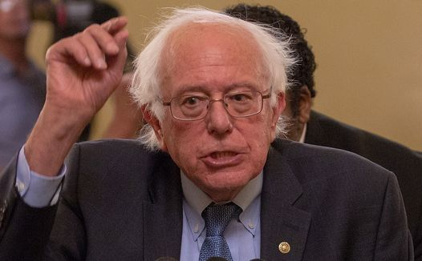
S.1804 & Draft Revision of HR676 Strengths
Universal coverage, single public plan
Comprehensive acute care benefits
No copays for covered services
Bans duplicative private coverage
Exemption from Hyde Amendment (upgrade from old version of HR676)
Drug formulary and price negotiations

Slide 214
S.1804 & Draft Revision of HR676 Concerns
LTC coverage (? means-tested)
Payment strategies
Global budgets for hospitals + others?
Separate operating/capital payments?
Medicare Advantage, ACOs?
Allows for-profit providers, with some constraints
Allows docs & hospitals to be partly in and partly out

Slide 215
Single Payer Transition: For Displaced Clerical and Administrative Workers
All 400,000 health insurance workers and about ½ of the 2.6 million clerical/administrative employees in healthcare providers likely to be displaced – total 1.7 million.
Many likely to be redeployed in expanded clinical workforce.
Funding for income support and job retraining modeled on WWII GI Bill.
Job displacement is common in the US – 60 million/year, including 20 million who are fired: 1.7 million = number who are fired every 31 days. (source: People’s Policy Report)

Slide 216
Single Payer Transition: For Patients
Every U.S. resident receives an insurance card.
Full coverage for all medically necessary care, no copayments, deductibles or coinsurance.
Prescription drug formulary, with alternatives covered when medically indicated
Free choice of any participating provider or hospital.

Slide 217
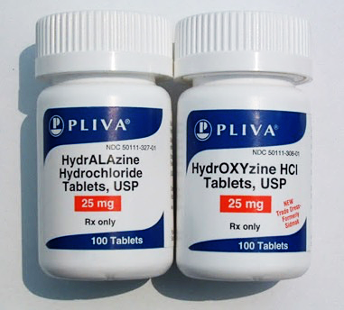
Sound-a-Likes Can Be Dangerous

Slide 218
Beware of Single-Payer “Sound-a-likes”
Single Payer Medicare for All
Medicare Extra for All
Medicare Advantage for All
Medicare Public Option

Slide 219
Public Option
Medicare competes with private insurance.
Many remain uninsured since buy-in optional + expensive.
Wouldn’t fix Medicare’s weaknesses
- Copays/deductibles
- Medicare Advantage rip-off
- Provider payment strategies drive gaming/abuses
Minimal administrative cost savings.
Medicare = de facto high risk pool, raising costs.

Slide 220
Medicare Extra for All
Like “Public Option” but buy-in mandatory for those without employer coverage.
Sliding scale premiums and copays.
Employers could offer private plans or contribute to employees’ Medicare buy-in.
Medicare Advantage option persists.
Traditional Medicare = de facto high risk pool
Sacrifices most administrative savings, hence unaffordable.

Slide 221
We Have What It Takes
Excellent hospitals, empty beds
Enough well-trained professionals
Superb research
Current spending is sufficient

