Slide 1
Chapter Organizing 101: Building your SNaHP chapter
Stephanie Michael, Kaytlin Gilbert, and Rachel Madley

Slide 2
Health Professional Student Organizing- it’s not easy
Packed schedules, involvement in other organizations, and school work make it difficult to maintain a large SNaHP chapter with all members highly active
This is OK!
Many SNaHP chapters have a small group of very active members and a larger network of member who attend events

Slide 3
Developing your SNaHP Chapter

Slide 4
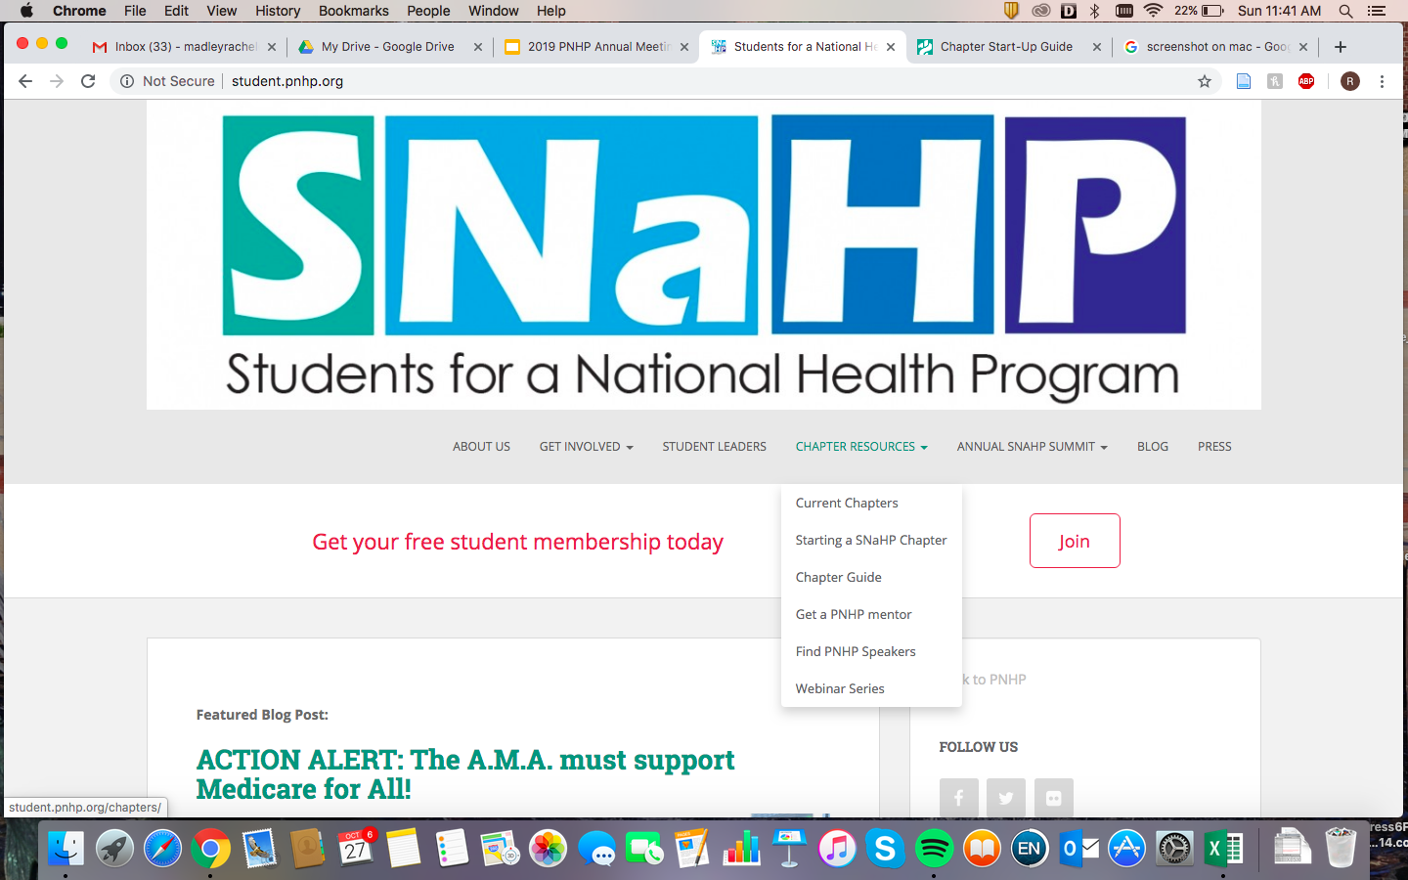
Key Resources Available to Chapters
Chapter Guide
Not just for new chapters
Funding from PNHP national for events ($150 per semester)
PNHP Mentor program/ speaker requests
Archived webinars
Stephanie and Rachel

Slide 5
Setting Chapter Goals
Gauge the interests of your members
What do you most want to focus on?
Set long-term and short-term goals for your chapter before each school year or semester
When setting goals:
Be specific
Set a deadline
Discuss what achieving the goal looks like/how to measure success

Slide 6
Chapter Events and Actions
Event type will depend on your chapter size and resources
Event/Action suggestions
Single Payer 101
Film screening
SNaHPpy hour
Canvassing outside your institution
Petition signing around campus
Phone/text banking
Speaker/writer training
Lobbying your elected officials (local, state and national) to support Medicare for All legislation
Asking your institution leadership to vocally support Medicare for All
Writing a Letter to the Editor or OpEd arguing for Medicare for All

Slide 7
Growing attendance at your events
Reach out to other student groups who have similar missions
Free clinic groups, human rights groups, Latino Medical Student Association, public health groups, American Medical Student Association
Reach out to other health professional programs on your campus
Dental, nursing, physical/occupational therapy, PhD, social work, public health, social medicine programs, Midwife programs
Reach out to community groups doing similar work
Healthcare NOW, Nurses unions, local progressive groups

Slide 8
Continuing Your Chapter
Begin identifying potential new leaders early
Get these member involved in small-scale leadership tasks
Coordinating food for an event, communicating with a visiting speaker, outreach to other student organizations
Create a file with all important information for the next leaders
Have an in-person transition meeting with old and new leaders
Have one old leader remain as the contact person for new leaders

Slide 9
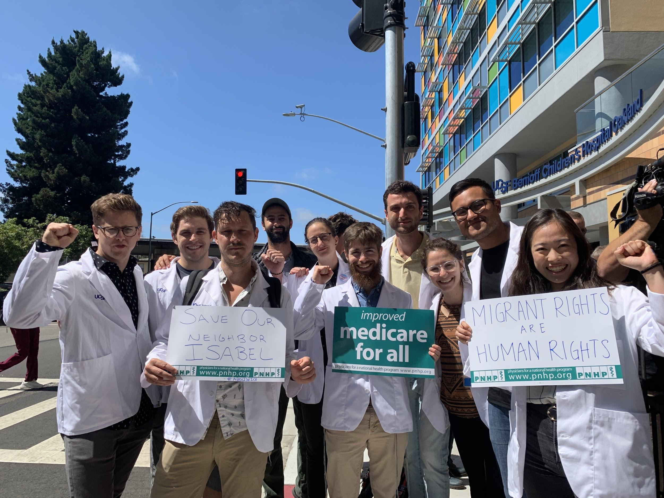
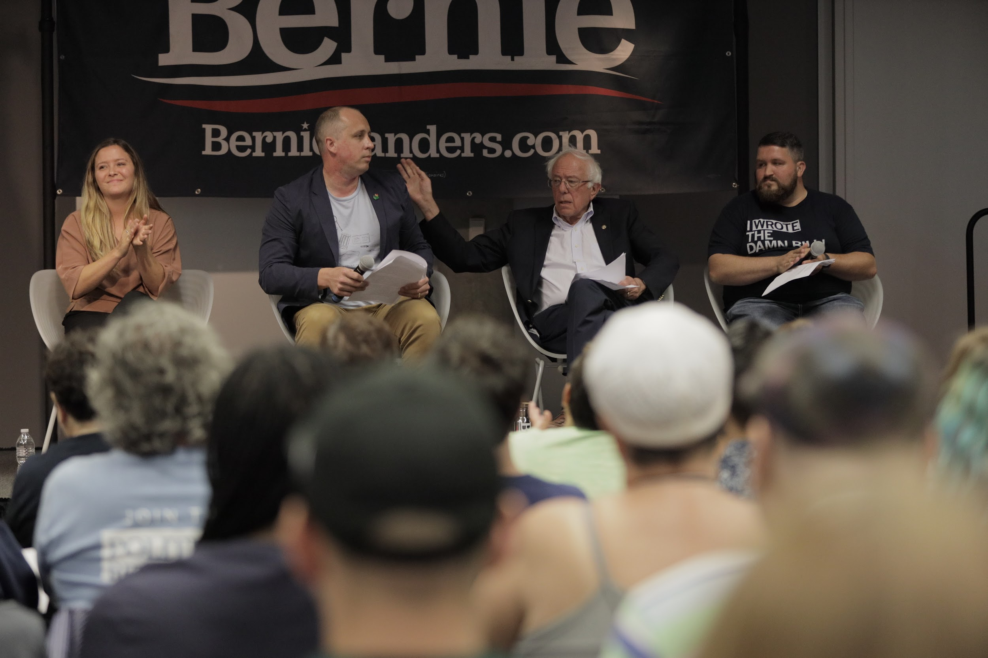
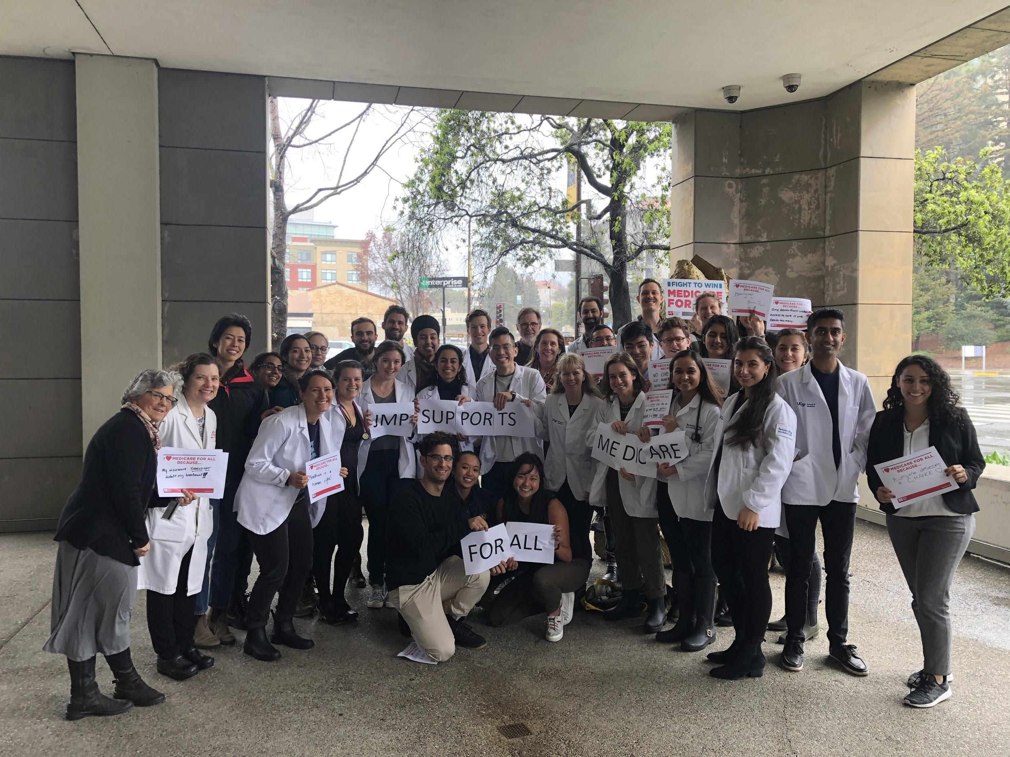
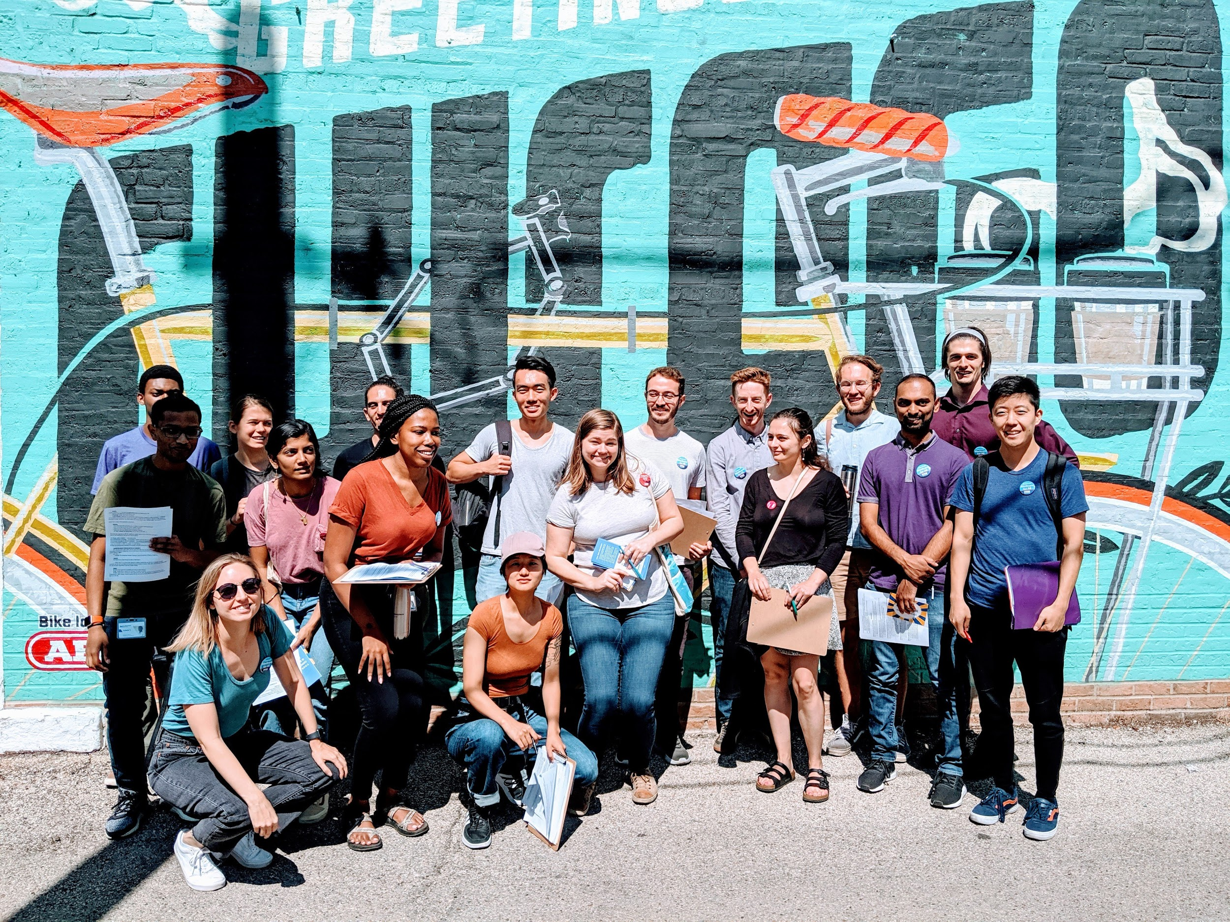
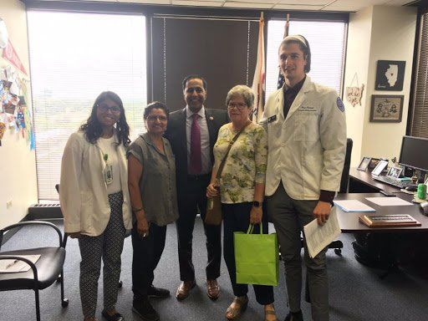
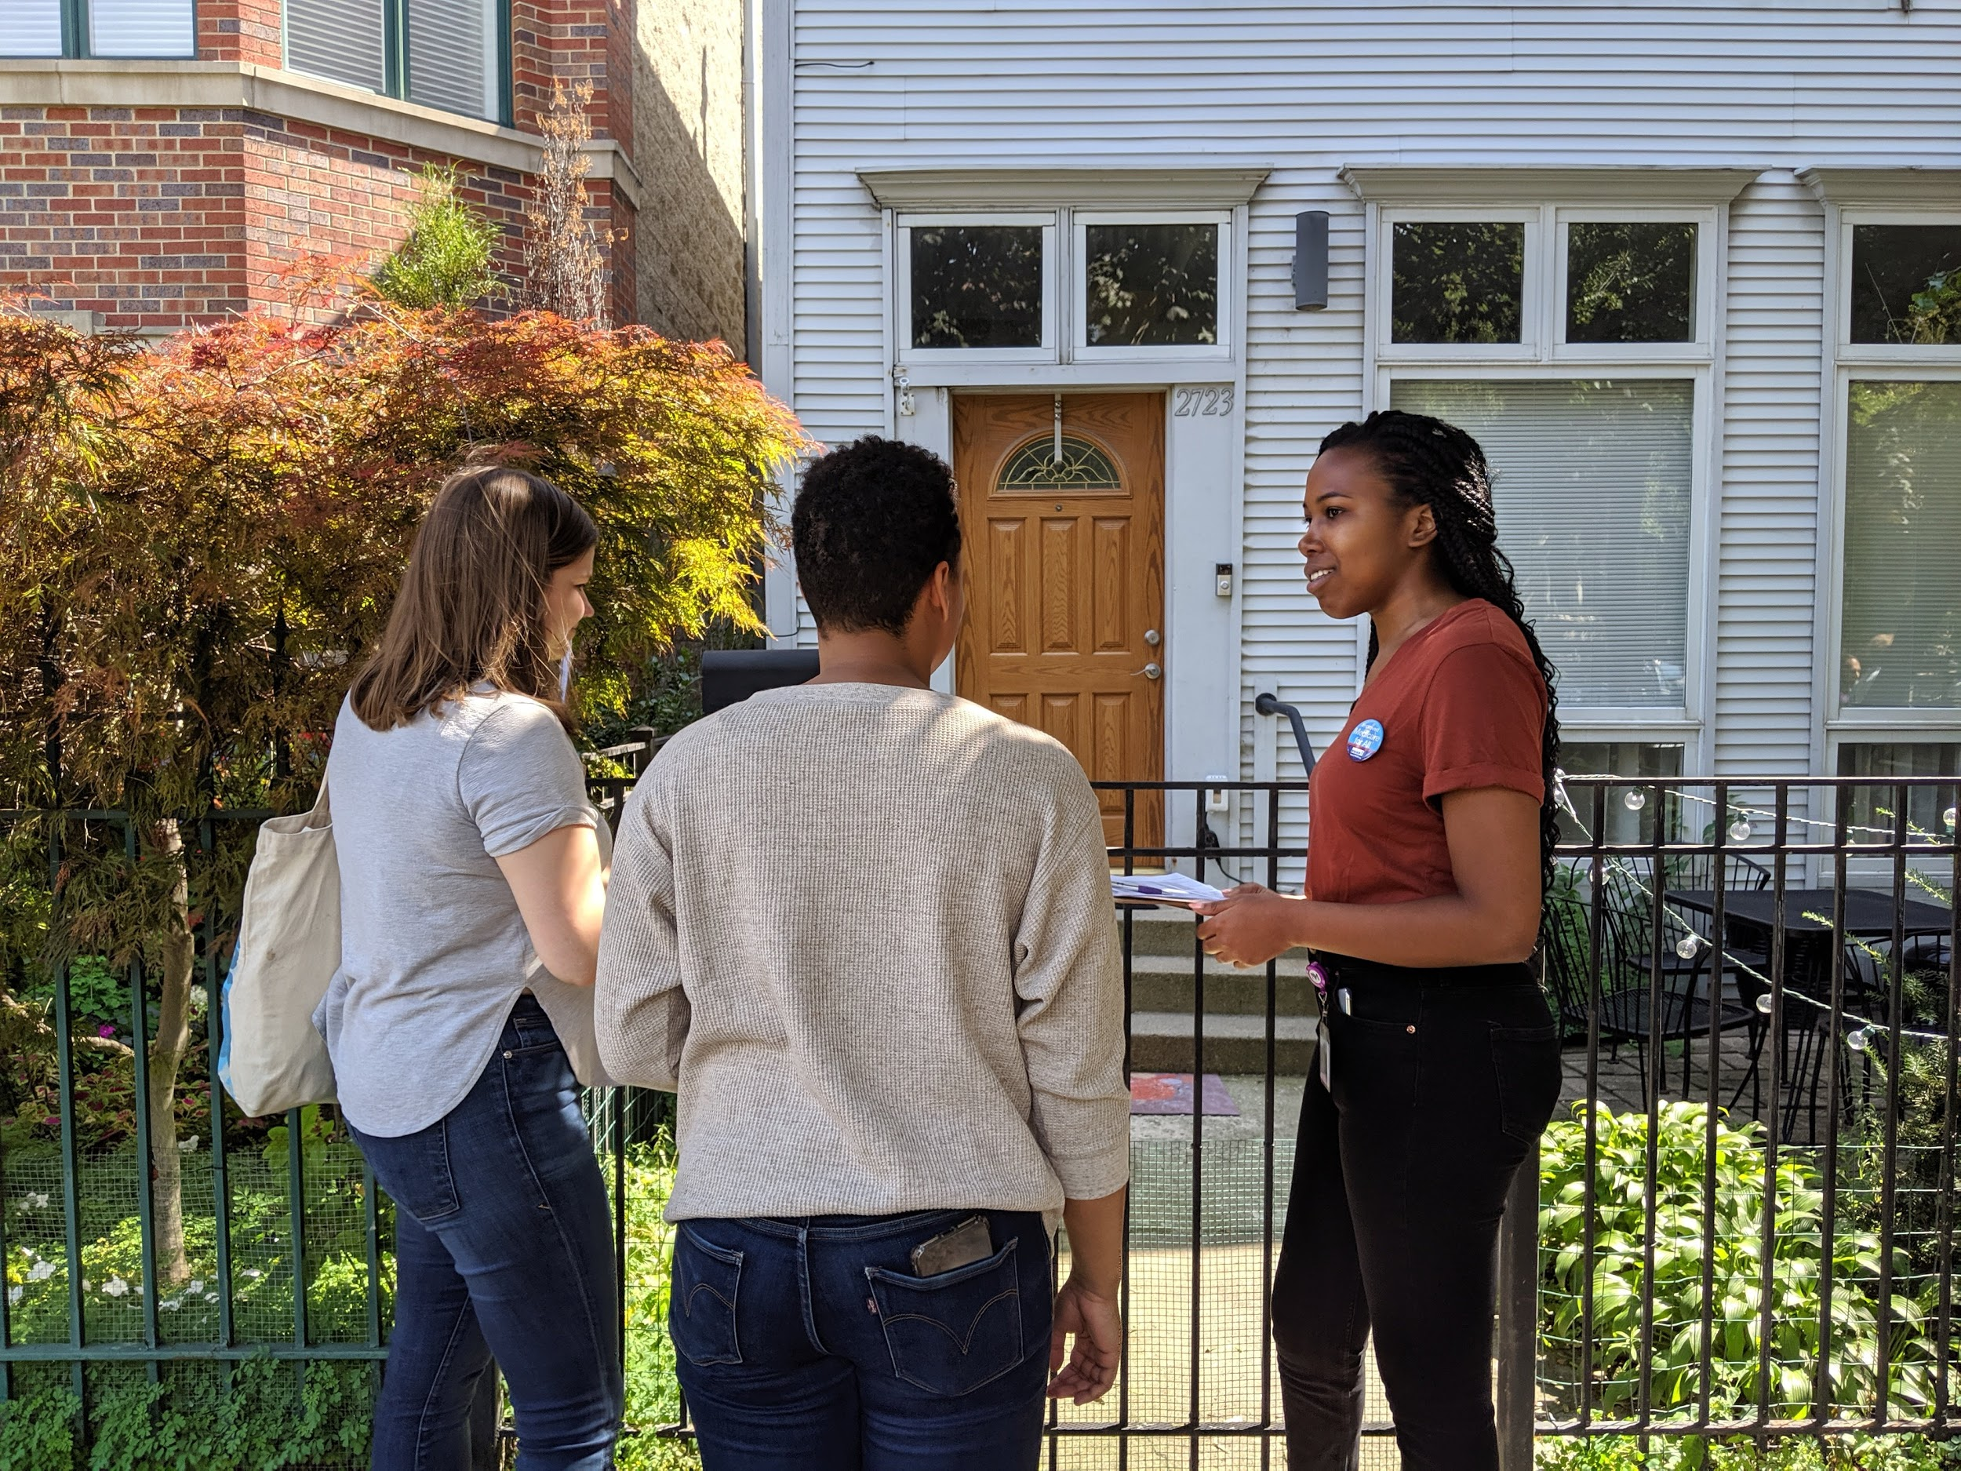

Slide 10
Set your own chapter goals
Rachel Madley- SNaHP Education and Development Committee Co-chair
madleyrachel@gmail.com
Stephanie Michael- SNaHP Education and Development Committee Co-chair
steph3792.sm@gmail.com
Kaytlin Gilbert- PNHP National Organizer
kaytlin@pnhp.org

