Slide 1
The Economics of Single-Payer
Jim Kahn, MD MPH
Professor, Institute for Health Policy Studies,
University of California San Francisco School of Medicine
Adam Gaffney, MD MPH
Instructor, Harvard Medical School
Pulmonary and Critical Care Medicine, Cambridge Health Alliance

Slide 2
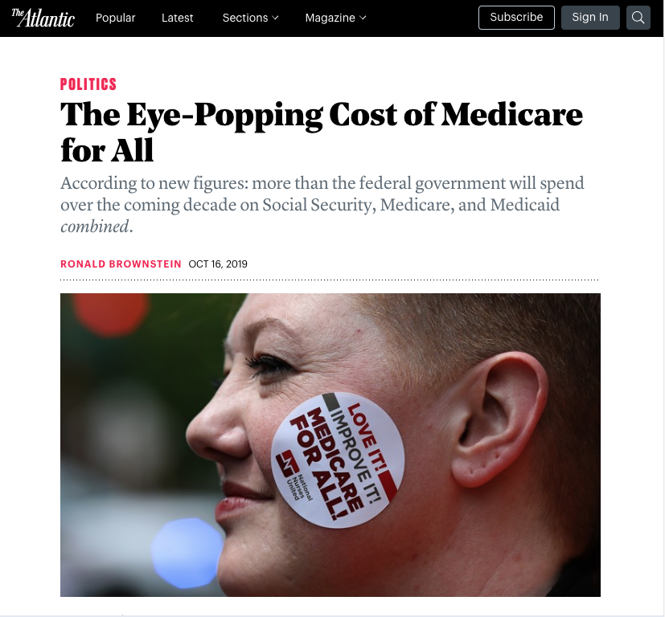

Slide 3
The “Cost” of Medicare for All:
Two Separate Questions
Effect on national health expenditures
(“Size of the pie”)
Transition from private > public financing
(“Size of the slices”)

Slide 4
2020 Projected National Health Expenditures (billions)
Total: $4.0 trillion
Center for Medicare and Medicaid Services, National Health Expenditures Accounts, 2018-2027

Slide 5
2020 Projected National Health Expenditures (billions)
Total: $4.0 trillion
Center for Medicare and Medicaid Services, National Health Expenditures Accounts, 2018-2027

Slide 6
2013 National Health Expenditures: Estimated Public vs. Private Share
Spending as % of total health expenditures, 2013
64.3% of health care spending is already public
Data source: Himmelstein DU, Woolhandler S. The Current and Projected Taxpayer Shares of US Health Costs. American journal of public health 2016:e1-e4.

Slide 7
The important economic question is the size of the pie.

Slide 8
What effects size of the pie?
New costs | Savings
Increased utilization | Administration A. Provider-Side B. Payer-Side
 | 2. Drug prices

Slide 9
1. Utilization

Slide 10
Rand health insurance experiment: Face-to-face physician visits use
Manning WG, Newhouse JP, Duan N, Keeler EB, Leibowitz A, Marquis MS. Health insurance and the demand for medical care: evidence from a randomized experiment. The American economic review 1987;77:251-77.
Notes:
* Individual deductible had 95% cost-sharing for outpatient services, none for inpatient services, and a lower OOP maximum

Slide 11
Rand HIE: Hospital Admissions
Manning WG, Newhouse JP, Duan N, Keeler EB, Leibowitz A, Marquis MS. Health insurance and the demand for medical care: evidence from a randomized experiment. The American economic review 1987;77:251-77.
Notes:
* Individual deductible had 95% cost-sharing for outpatient services, none for inpatient services, and a lower OOP maximum

Slide 12
Effect of Coverage on Utilization: Oregon Medicaid Experiment
Amy Finkelstein et al., “The Oregon Health Insurance Experiment: Evidence from the First Year,” The Quarterly Journal of Economics 127, no. 3 (August 2012): 1057–1106.

Slide 13
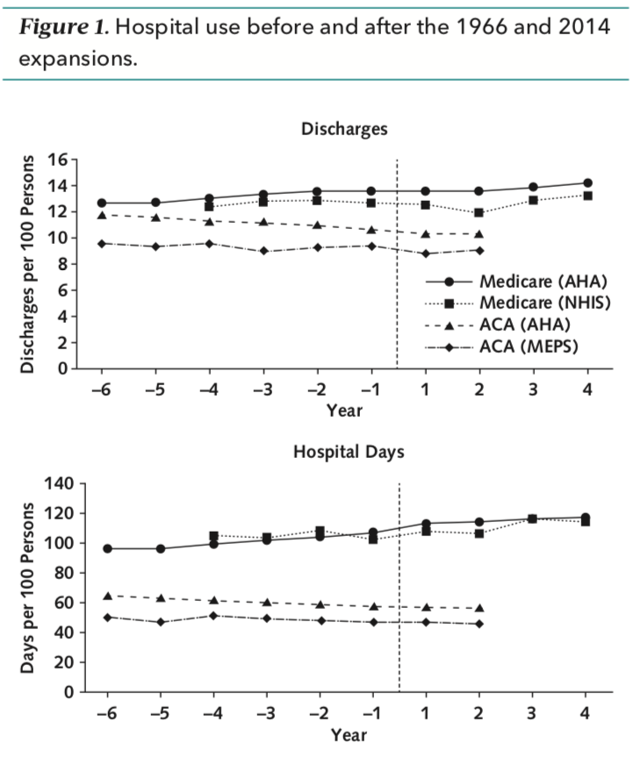
Gaffney A, McCormick D, Bor DH, Goldman A, Woolhandler S, Himmelstein DU. The Effects on Hospital Utilization of the 1966 and 2014 Health Insurance Coverage Expansions in the United States. Ann Intern Med 2019;doi:10.7326/M18-2806.

Slide 14
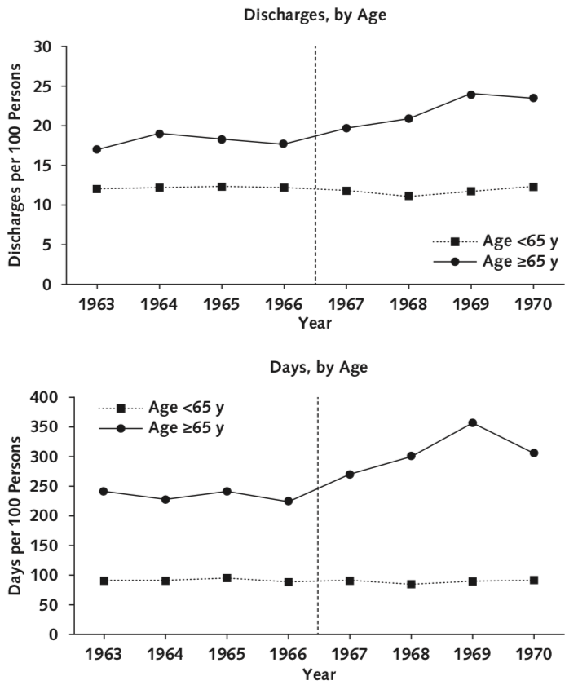
Gaffney A, McCormick D, Bor DH, Goldman A, Woolhandler S, Himmelstein DU. The Effects on Hospital Utilization of the 1966 and 2014 Health Insurance Coverage Expansions in the United States. Ann Intern Med 2019;doi:10.7326/M18-2806.

Slide 15
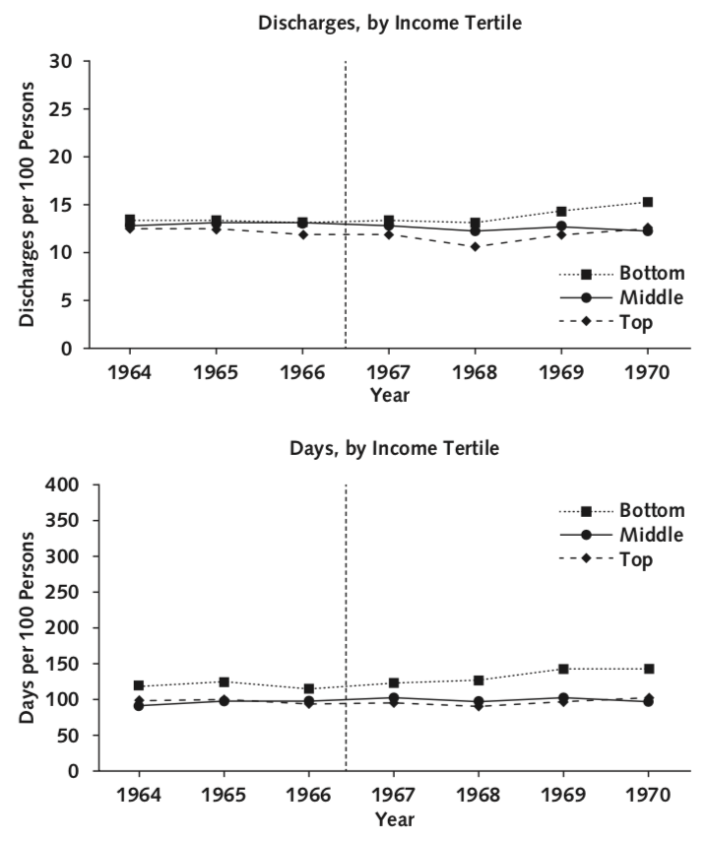
Gaffney A, McCormick D, Bor DH, Goldman A, Woolhandler S, Himmelstein DU. The Effects on Hospital Utilization of the 1966 and 2014 Health Insurance Coverage Expansions in the United States. Ann Intern Med 2019;doi:10.7326/M18-2806.

Slide 16
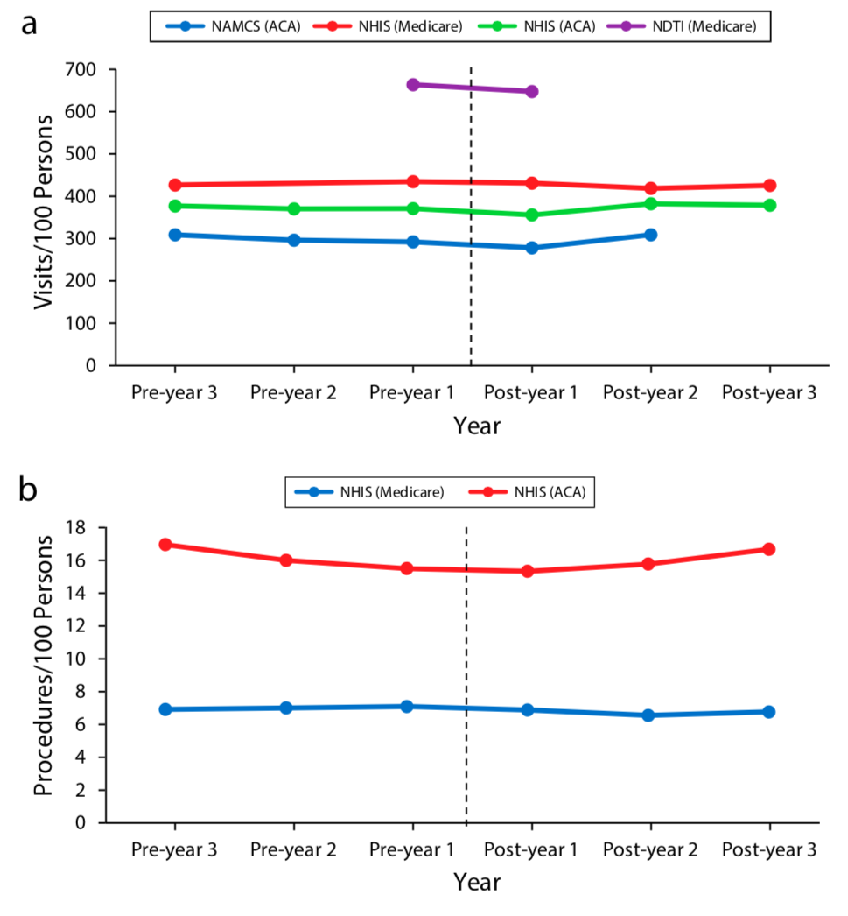
Gaffney A, McCormick D, Bor D, Woolhandler S, Himmelstein D. Coverage Expansions and Utilization of Physician Care: Evidence From the 2014 Affordable Care Act and 1966 Medicare/Medicaid Expansions. Am J Public Health 2019;e1–e8.doi:10.2105/AJPH.2019.305330.

Slide 17
Trends in physician utilization by income per 100 persons, 1963-1969
Gaffney A, McCormick D, Bor D, Woolhandler S, Himmelstein D. Coverage Expansions and Utilization of Physician Care: Evidence From the 2014 Affordable Care Act and 1966 Medicare/Medicaid Expansions. Am J Public Health 2019;e1–e8.doi:10.2105/AJPH.2019.305330.

Slide 18
Physician visits after the NHS : Rose for all but high-income earners
Source of data: Logan WPD. Illness, Incapacity, and Medical Attention Among Adults, 1947-49. The Lancet 1950;255(6608):773-76.

Slide 19
Physician utilization pre/post implementation of Medicare in Quebec
Source of data: Enterline PE, Salter V, McDonald AD, McDonald JC. The distribution of medical services before and after free medical care — the Quebec experience. New England Journal of Medicine 1973; 289: 1174–8.

Slide 20
2. Administrative Savings

Slide 21
3. Drug Prices

Slide 22
2015 Pharmaceutical Spending, per capita
OECD (2018), Pharmaceutical spending (indicator). doi: 10.1787/998febf6-en (Accessed on 12 June 2018)

Slide 23
The Comparative Cost of Fluticasone-Salmeterol
The U.S. Pays a Lot More for Top Drugs Than Other Countries. Bloomberg.com. [cited 2018 Sep 10];Available from: http://www.bloomberg.com/graphics/2015-drug-prices/

Slide 24
Relative prices: 30 most commonly prescribed medications, 2006-07
Squires DA. Explaining high health care spending in the United States: an international comparison of supply, utilization, prices, and quality. Commonwealth Fund Issue Brief. 2012;10:1-14.

Slide 25
Fortune 500 Profits
Ranked within industries. Fortune 2017;500:f33-40, cited in: Gaffney A, Lexchin J. Healing an ailing pharmaceutical system: prescription for reform for United States and Canada. BMJ. 2018;361:k1039.

Slide 26
2017 Pharma CEO Compensation
Physicians for a National Health Program. Health Industry CEOs’ Compensation in 2017 [Internet]. [cited 2018 Sep 11];Available from: http://www.pnhp.org/CEOs

Slide 27
Total R&D costs vs. revenues: 10 drugs, median 4 years after approval
Prasad V, Mailankody S. Research and Development Spending to Bring a Single Cancer Drug to Market and Revenues After Approval. JAMA Intern Med. 2017.

Slide 28
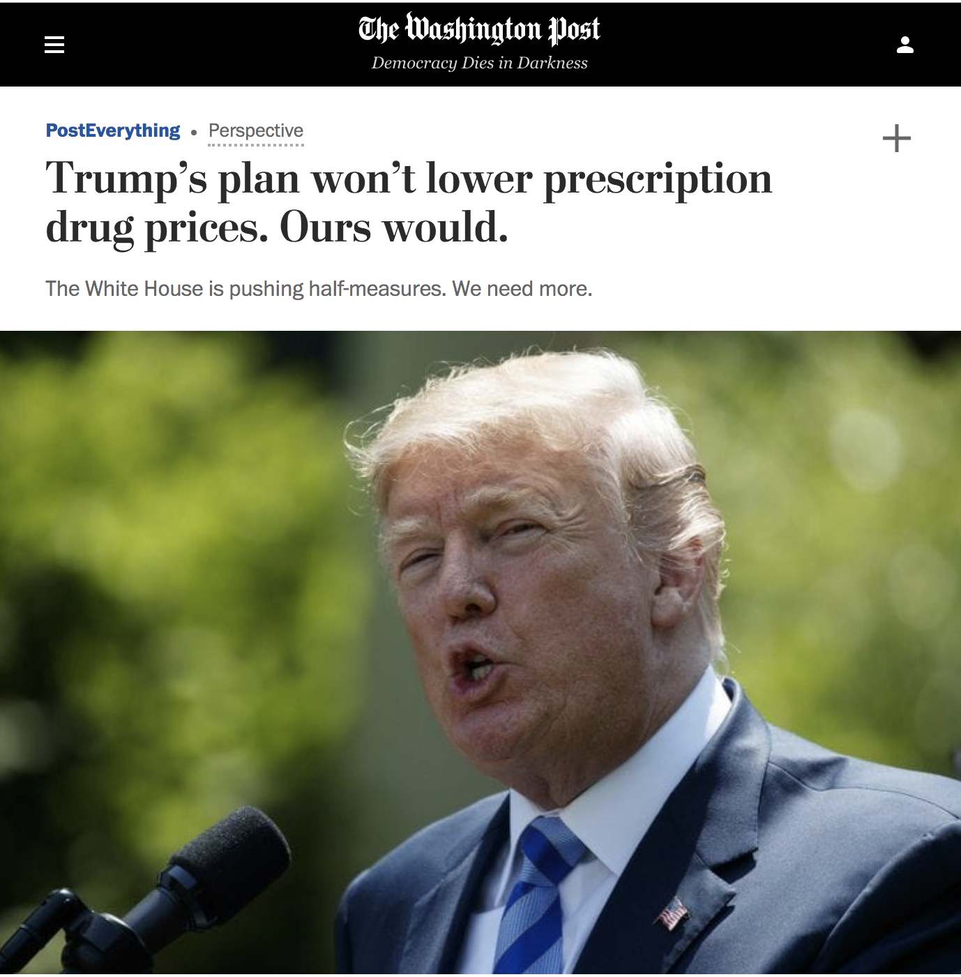

Slide 29
Gaffney A, Lexchin J. Healing an ailing pharmaceutical system: prescription for reform for United States and Canada. BMJ. 2018;361:k1039.

Slide 30
Savings from drug prices (2017)
 | $ (BILLIONS)
Estimated current drug spending | $500.1
Estimated current drug spending not already discounted | $429.3
Estimated current brand-name drug spending not already discounted | $309.1
Savings from 50% reduction in brand-name drug prices | $154.6
US / Canadian Pharmaceutical Working Group. Table 7: Estimated effects of proposed reforms on US national pharmaceutical expenditures, 2017. Available from: http://www.pnhp.org/sites/default/files/Pharma_Table7.pdf

