Slide 1
ABORTION ACCESS and SINGLE PAYER
Linda Prine MD
Kelita Fox MD
Erin Hendriks MD
Linda Prine MD

Slide 2
The Current Climate
http://www.nj.com/union/index.ssf/2016/04/women_rally_to_protest_against_donald_trump_in_pla.html
Notes:
Reproductive rights and women’s rights are likely to be challenged by the upcoming Trump administration

Slide 3
NO Federal Money for Abortion
1976 Hyde Amendment first passed
Hyde Amendment tacked onto yearly appropriations bill for health care funding
ACA did not end Hyde

Slide 4
Hyde Amendment:
Prohibits any federal funding for abortion, which affects:
Women on Medicaid
Women in armed services
Women on disability
Women in the Peace Corps
Native Americans on reservations
Women getting care in federally funded hospitals
Notes:
Hyde passed three years after Roe v Wade.
No federal money can be spent on abortion. This has been overly interpreted by the Reagan and Bush administrations to mean that not even information about abortion can be given out in a federally funded facility - in the US and abroad.

Slide 5
More about Hyde
17 States fund abortion with state Medicaid
Hyde disproportionately affects women of color
2016 is the first year the Democratic Party platform took a stand against Hyde

Slide 6
Few States use Own Funds to Cover Abortion
Notes:
17 States have policies or are under court order to pay for all or most abortions for Medicaid enrollees

Slide 7
State Law Abortion Restrictions
https://www.guttmacher.org/laws-affecting-reproductive-health-and-rights-2013-state-policy-review
Notes:
Rhode Island is no longer hostile, but Iowa is…

Slide 8
State Law Abortion Restrictions
Examples
Must be performed in a hospital
Second physician must participate
Provider may refuse to participate
Must be performed by OB/GYN
“Partial Birth Abortion” Banned
Mandated counseling on
Breast Cancer links
Fetal pain
Negative psychological effects
Funding prohibited except in cases of life or physical health endangerment

Slide 9
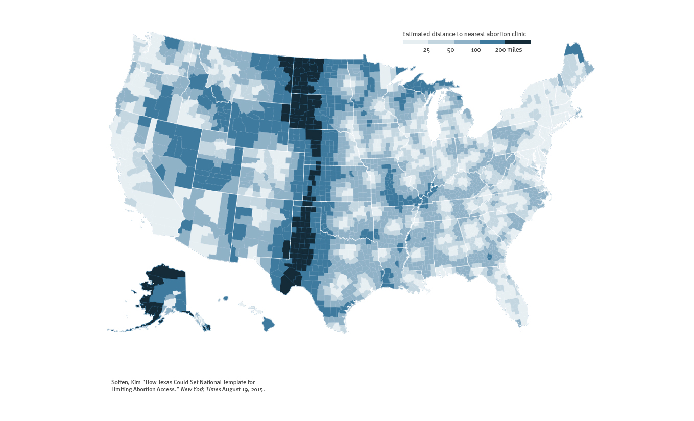
Abortion Access
Notes:
This is a map of the estimated distance a person would have to travel to get to an abortion clinic, with the darker areas requiring a larger distance.
And, if we were to overlay these two maps, we would see that many of the same people who would have a hard time accessing publicly funded clinics for contraception would also experience difficulties in accessing a clinic that provides abortion.

Slide 10
Religiously Affiliated Hospitals
Now account for 20% of all US Hospitals
Prevent physicians from prescribing contraceptives, irrespective of the MD’s religion or the patients’ religion
Affect medical school education and pharmacy school education
Religiously affiliated insurance plans now also can refuse to cover birth control (Hobby Lobby decision)
Notes:
We also have access issues that are growing as hospital mergers grow - access to even birth control!

Slide 11
Abortion Facts
One out of 4 (we think – but it is quickly moving underground)
Abortion is the most common medical procedure done on women
Abortion could be a simple primary care service with mifepristone (RU486, the “abortion pill”)
Early abortions are medically much safer
Abortion is 10 times safer than pregnancy
Notes:
Self-managed abortions are growing

Slide 12
New Rules Restrictions on Title X
Requires financial and physical separation from any organization that provides abortion or referral to abortion
Prohibits referral for abortion
Directs funds to faith based and other organizations that promote fertility awareness
and abstinence as means
of family planning

Slide 13
Racial Disparities 2014
Abortion patients 39% white
28% Black
25% Hispanic
6% Asian or Pacific Islander
3% other
Poor women have more abortions due to lack of access to contraception
Notes:
PNHP’s support for mental health care includes a strong stance against racial and ethnic disparities

Slide 14
2016 PNHP ENDORSED ABORTION COVERAGE AS PART OF SINGLE PAYER
Physicians for a National Health Program supports full coverage of women's health care services in the single payer plan that we advocate. This should include coverage for counseling regarding all family planning options, and free access to contraception, abortion and preventive cancer services for all residents of the United States.
www.pnhp.org/about/pnhp-mission-statement
Notes:
We probably need to reword this so that it’s clear vasectomy is covered, too. As well as infertility treatments to help people get pregnant!

Slide 15
MEDICARE FOR ALL ACT: S1129
Ends Hyde
Covers abortion but never says the word abortion
Allows HHS Secretary to determine gestational age via language about services that are “medically necessary and appropriate”.
Notes:
Again, we need to stop abortion stigma, say the word, it is part of health care!

Slide 16
Single Payer: Grow your supporters!
Notes:
Stop abortion stigma!

Slide 17
Abortion Care is Health Care
Notes:
I am an abortion provider because I care about my patients
We will talk about additional issues, like self-managed abortion and how to reach out to the reproductive rights community, in the workshop.

