Slide 1
Faulty & Faux Reform Plans
PNHP Annual Meeting 2019
David Himmelstein ⧫ Janine Petito

Slide 2
Outline
Overview of Reform Plans for 2020
The GOP
Democratic Presidential Hopefuls
Debate

Slide 3
The GOP
High-risk pools: Create federally-funded, state-run insurance for people with high-cost illnesses
Block grants: Let states decide how to use federal funds for healthcare for low-income residents
Health savings accounts: Boost programs to help individuals with income save it, tax-free
Notes:
Trying to compete with the dems, who are now demanding more universal coverage in light of what we all know about the failures of the ACA.
No big vision from the republicans, but three main ideas:
- High risk pools → these existed before the ACA with mixed levels of “success”
- Block grants → get rid of existing Medicaid expansion and premium subsidies; would likely lead to loss of coverage for many over time
- HSAs → won’t help with inequalities already inherent to the system we have
Overall: Not great.

Slide 4
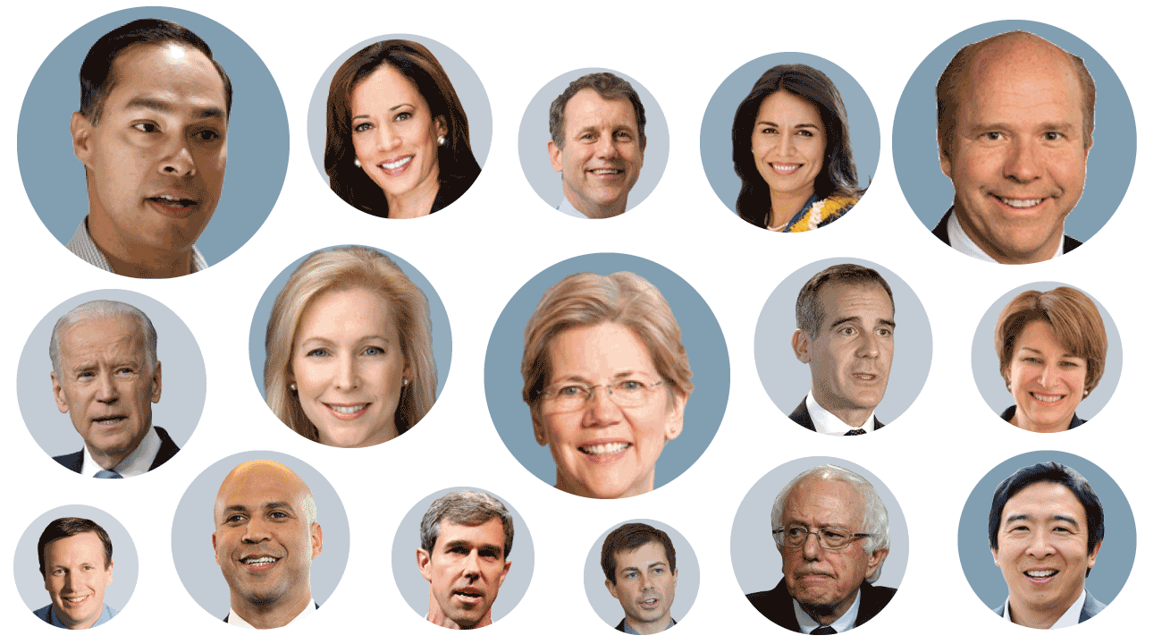
The Dems
Photos courtesy of Washingtonpost.com
Notes:
- There are many proposals out there
- It’s not easy to keep track of all of them
- We’re going to start by outlining the basics of each

Slide 5
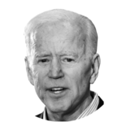
“Protect & Build on the ACA”
Give the option of public insurance buy-in
Increase tax credits for low-income families
Reduce the maximum cost of coverage from 9.86% to 8.5% of annual income
Increase the size of tax credits
Cover everyone under 138% of FPL
Allow Medicare to negotiate drug prices
https://joebiden.com/healthcare/
Notes:
- Buy-in is available for everyone (even those with private/ESI)
- Claims that public option would be able to compete with private coverage
- 8.5% is still A LOT
- Get everyone in a non-MA-expansion state onto either Medicaid or premium-free public option
- Automatically enroll everyone else
- Plans to pay for this by rolling back the Trump tax cuts on the very wealthy → back to 39.6% from 20%

Slide 6
“Medicare for All Who Want It”
Public option buy-in
Expand premium subsidies
Cap marketplace premium payments at 8.5%
Cap OOP costs for seniors on Medicare
Limit charges for out-of-network care
Allow Medicare to negotiate drug prices
peteforamerica.com/policies/health-care/
Notes:
- Essentially the same as Biden’s plan
- Theoretically, “This affordable public plan will incentivize private insurers to compete on price and bring down costs.”
→ “empowers people to make their own decisions regarding the type of health care that makes sense for them…”
- Will cost $1.5 trillion over 10 years; plans is to pay for it by rolling back Trump corporate tax cuts
- 8.5% goes for everyone
- Lower-income seniors will get even lower maximums

Slide 7
“Medicare for America”
Combine Medicaid, Medicare, and exchanges to create one public option
Enroll all without employer-sponsored insurance
Allow those with ESI to choose
Cap out of pocket expenses
9.7% on premiums
$3,500 or $5,000 annually on everything else
www-m.cnn.com/2019/03/23/politics/beto-orourke-medicare-for-america/index.html
Notes:
O’Rourke & Center for American Progress
- Retains private insurance plans
- Premiums based on income; capped at 9.7% of monthly income (very high!!)
- Out of pocket expenses continue, capped at $3500 and $5000
Medicare Advantage continues
- Finance through: 5% surtax on those with adjusted gross income > $500k, increasing medicare payroll tax, and undoing the republican tax bill
- No comment on reducing drug prices etc.
- No comment on payment systems

Slide 8
“Medicare Advantage for All”
Expand the Medicare benefit package
Allow private companies to offer plans
Regulate these in order to keep costs down
Phase in over ten years
But immediately enroll newborns and the uninsured, and allow buy-in
Audit drug prices and allow HHS to negotiate
kamalaharris.org/healthcare/
Notes:
Harris
- Includes mental health, telehealth…
- Longer transition billed as financial advantage; unclear how
- Says Medicare itself will regulate, does not say how; “stricter consumer protections”
- Taxes Wall Street and foreign tax shelters; no taxes on those earning < $100k

Slide 9
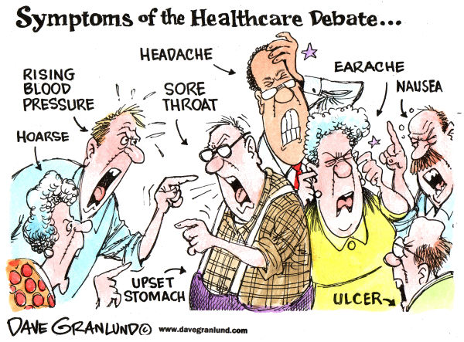

Slide 10
Discussion
1. Buy-in
2. Pay or Play
3. Medicare Advantage for All

Slide 11
Further Reading:
Himmelstein & Woolhandler. The Public Option on Healthcare is a Poison Pill. The Nation.
https://www.thenation.com/article/insurance-health-care-medicare/
Bruenig. Joe Biden’s New Health Plan Isn’t Just Bad — It’s Deadly. Jacobin.
https://jacobinmag.com/2019/07/joe-biden-health-care-plan-uninsured
Shure. We Don’t Need More “Choice” — We Need Medicare for All. Jacobin.
https://jacobinmag.com/2019/10/donald-trump-medicare-advantage-health-insurance
Where 2020 Democrats stand on Medicare-for-all. Washington Post.
https://www.washingtonpost.com/graphics/politics/policy-2020/medicare-for-all/
Health Care: See Where The 2020 Democratic Candidates Stand. NPR.
https://www.npr.org/2019/09/10/758172208/health-care-see-where-the-2020-democratic-candidates-stand

