Slide 1
Media 102: Social media and digital tools
Dixon Galvez-Searle, PNHP Alex Cabrera, University of Nevada, Reno School of Medicine Lisa Tan, Case Western Reserve University School of Medicine

Slide 2
Why should seniors support improved Medicare for All?
Answer in one or two sentences. Hold on to your answers – we’ll use them as part of a group activity later in the workshop.

Slide 3
Traditional vs. social media
Traditional media is produced (mostly) by professionals producing original news and entertainment. Social media is produced (mostly) by individuals sharing their own text, photos, videos, and links to things others have produced.

Slide 4
Sharing with your network
Individual social media accounts are linked to other accounts; friends, family, colleagues, acquaintances. You see what they post and they see what you post.

Slide 5
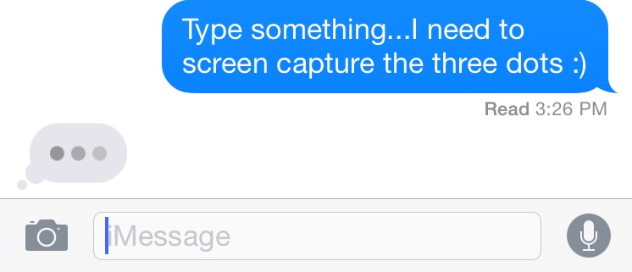
Crafting your message
Certain types of messages resonate on social media: shorter is better, images and video are more engaging, the white coat is a powerful symbol, #MedicareForAll is a useful hashtag.

Slide 6
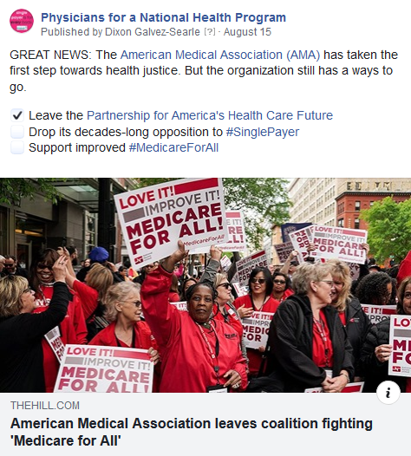
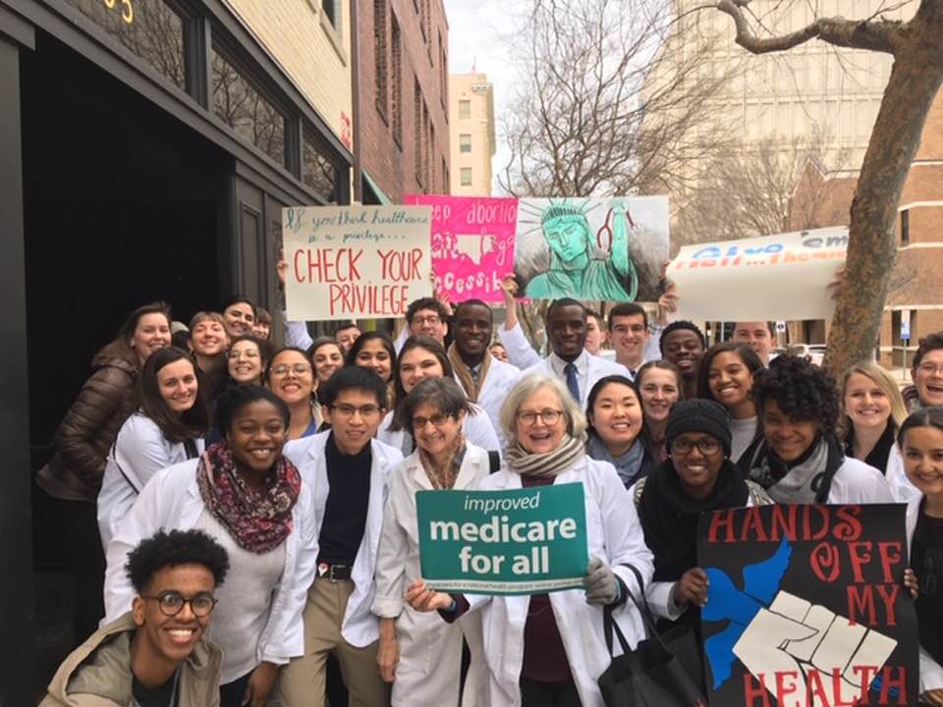
Organizing online
Social media is good for sharing your thoughts and opinions, but it can also be used to organize by publicizing events, circulating petitions, amplifying important messages, and employing hashtags like #SinglePayer #MedicareForAll.

Slide 7
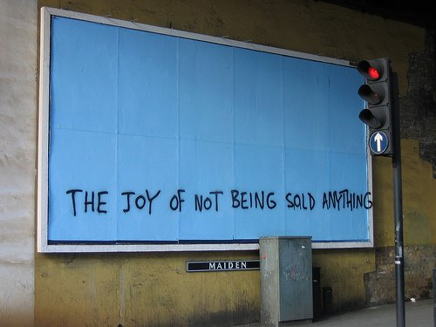
Advertising on social media
Social media networks are for-profit businesses, and are advertising to you constantly. You might see sponsored posts in your news feed, or be encouraged to follow influencers. The rules and regulations are ever-changing and opaque.

Slide 8
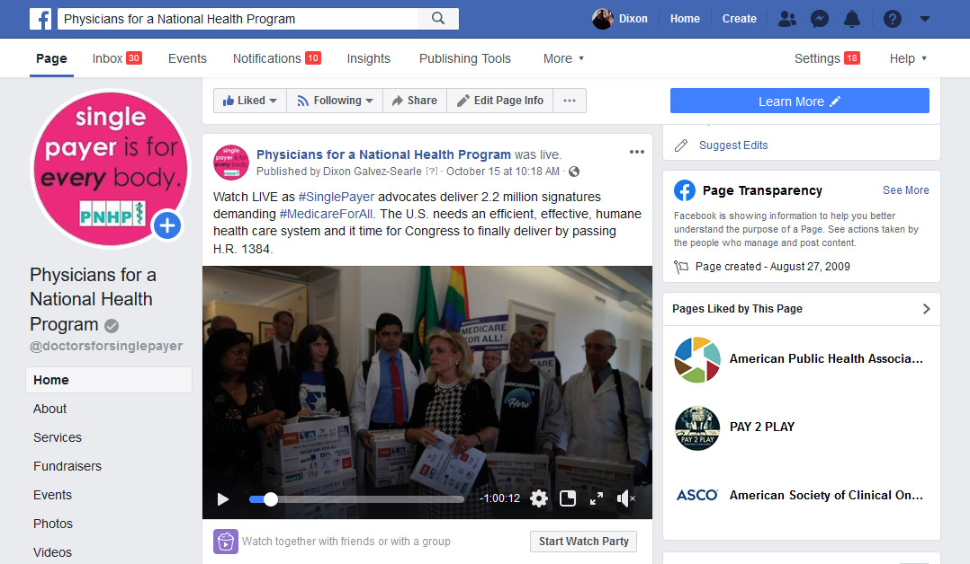
Facebook
Facebook is a legacy social network, which became widely available in Sept. 2006. It has over one billion active users.

Slide 9
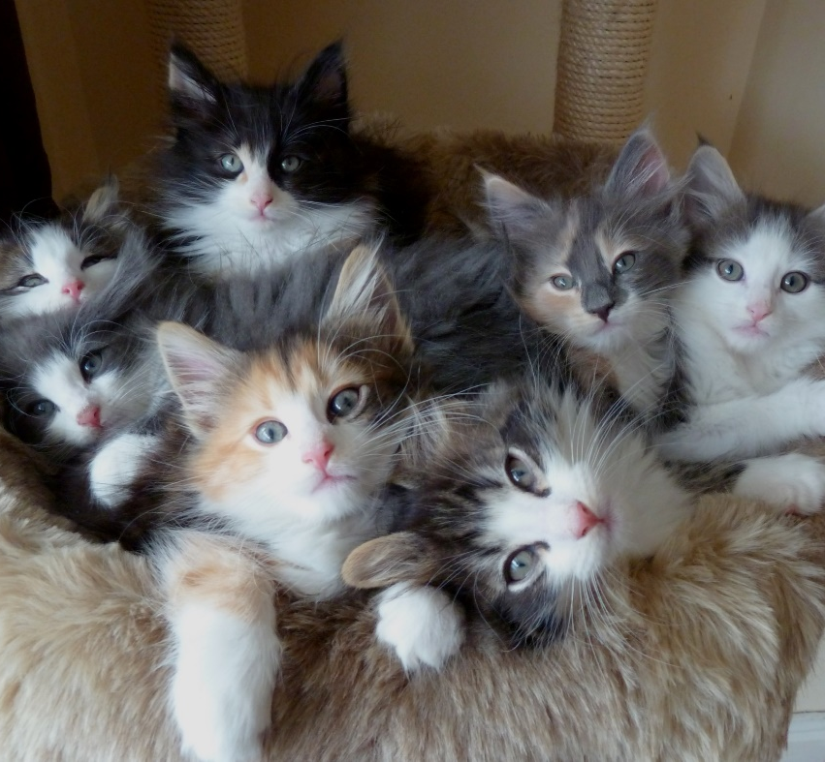
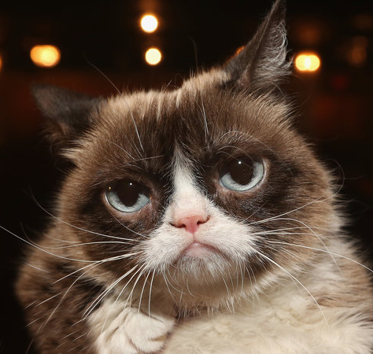
Profiles, groups, and pages
Profiles are for individuals. Groups are for like-minded people who opt in and want to discuss a particular topic. Pages are for institutions (businesses, organizations, celebrities).

Slide 10
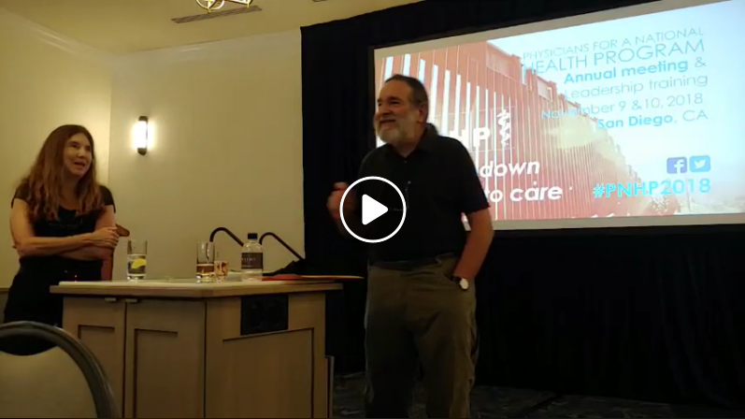
Broadcasting LIVE video
Facebook allows users to broadcast video from their mobile app. This is great for events like PNHP annual meeting, town halls, rallies, protests, etc. Be sure to plan ahead of time; lighting and sound are especially important.

Slide 11
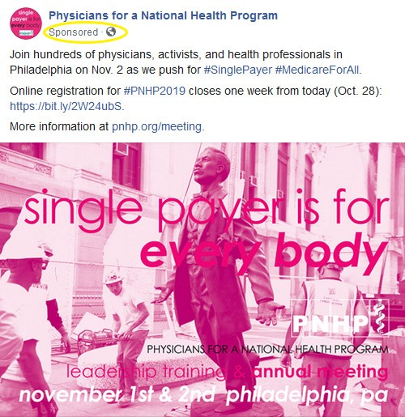
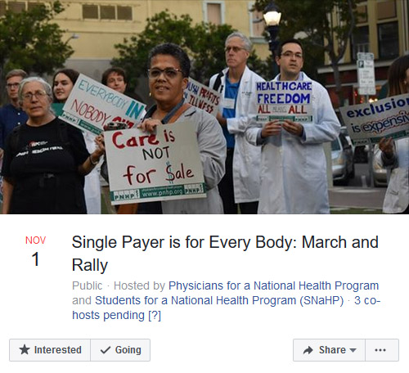
Events and advertising
Facebook events allow you to get the word out to your members and followers, and provide updates on a dedicated page. You can also target sponsored posts based on location, interests, and other demographics.

Slide 12
Twitter
Description of Alex’s Twitter slides.

Slide 13
Instagram
Description of Alex’s Instagram slides.

Slide 14
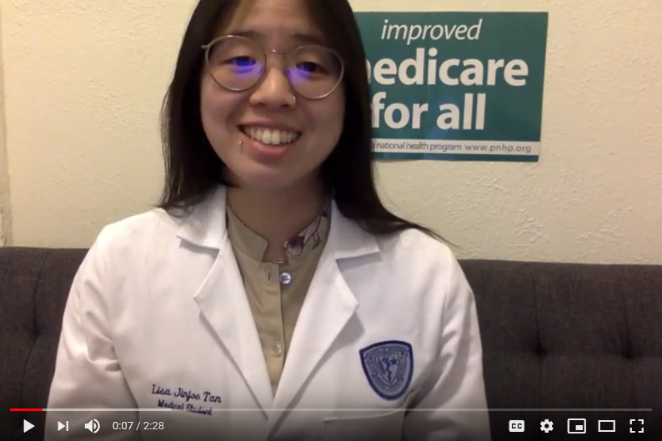
YouTube
YouTube is one of the largest social media networks in the world. With smartphone cameras improving at a rapid rate, more and more people are uploading their own videos.

Slide 15
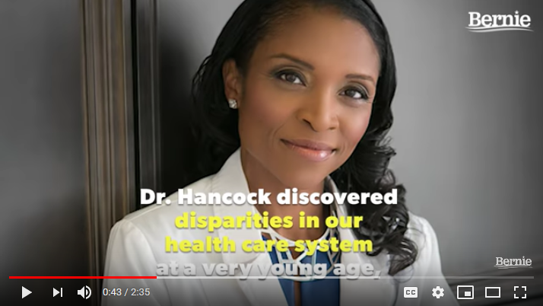
Video: Dr. Yolandra Hancock
Produced by the Sanders campaign, an example of the type of video you can produce if money is no object. Multiple cameras, stock footage, music, subtitles, compelling message.

Slide 16
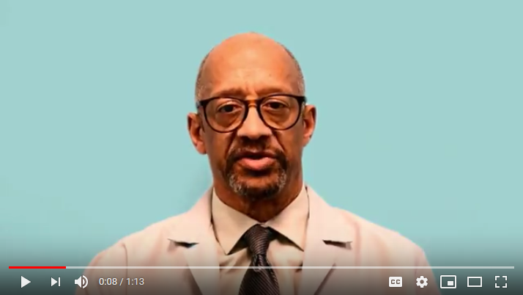
Video: Join PNHP
Produced by PNHP’s national office. We scripted this and asked Chicago-area members to participate. Everyone wore their white coat! Note that white balancing is important so the background doesn’t change with different skin tones.

Slide 17
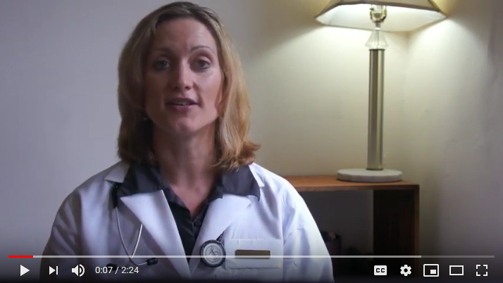
Video: Dr. Anna Stratis
Produced by Dr. Stratis as shadow testimony for a Congressional hearing on “pathways to universal coverage.” Short message, scripted beforehand, intentional background.

Slide 18
Break time
Hand in your answers for “Why should seniors support improved Medicare for All.” We’re going to shoot a video after the break! Be sure to bring your white coat.

Slide 19
Writing our video script
Why should seniors support improved Medicare for All? Let’s hear what you have to say and organize it into a coherent script. Then we’ll start recording video footage.

Slide 20
Quiet please
We’re going to record members giving their single-payer pitch one person at a time, and the camera will pick up extraneous background noise.

Slide 21
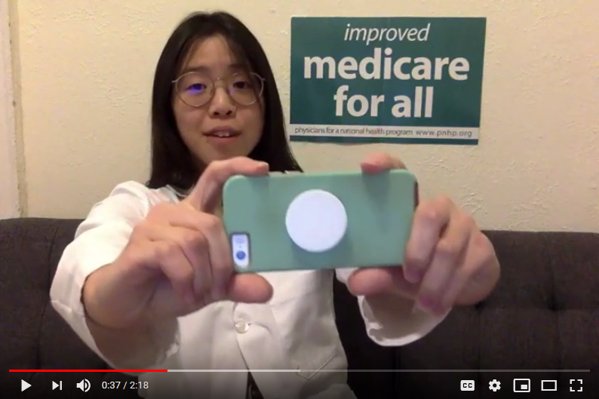
One more thing…
Now that we’ve created a video as a group, it’s time for everyone to record their own individual videos! Don’t forget to use the hashtag #PNHP2019.

Slide 22
Questions?
Anything else you want to know about social media or video production? Ask now, or email dixon@pnhp.org.

