Slide 1
Single Payer & its Impacts on Mental Health and Substance Use Disorder Treatment
Michael Zingman
MS4, Columbia University Vagelos College of Physicians & Surgeons

Slide 2
Mental Health & Access to Care
Mental health disorders are a leading cause of disability in the U.S.
1 in 5 U.S. adults have a mental illness, yet less than 40% of affected adults will receive any mental health services
4 million children/adolescents suffer from a serious mental illness, yet only 1/5th receive MH services
Inadequate treatment leads to suffering, homelessness, decreased productivity, suicide and increased costs
Higher rates of poverty, uninsurance, under-insurance among individuals with mental illness
https://www.ajmc.com/conferences/apa-2018/singlepayer-system-is-the-solution-for-mental-health-care-panelists-say
Slide adapted from unpublished report by Dr. Wes Boyd, Dr. Steven Kemble, Dr. Leslie Gise

Slide 3
Discussion
Q1: In what ways (that you know of) does the U.S. health system negatively impact mental health and substance use disorder treatment?

Slide 4
Discussion
Q2: Why do you think that mental health has been treated differently from “physical” health in our insurance system?

Slide 5
Evolution of U.S. Health Insurance
Blue Cross formed (1936), followed by Blue Shield (1946)
WWII: Health benefits linked to employment
1952: IRS rules employer contributions are tax deductible for employers and not income for employees
1950s: Commercial life insurance companies begin selling health insurance to employers
https://www.ncbi.nlm.nih.gov/books/NBK235989/
Slides adapted from Dr. Peter Steinglass
Notes:
Health insurance and other fringe benefits were on their way to becoming a standard feature of employment. A number of unions continued to sponsor health centers and other programs, but most focused on the employer-sponsored programs. A further important boost to these programs came in 1954 when the Internal Revenue Code made it clear that employers' contributions for health benefit plans were generally tax deductible as a business expense and were to be excluded from employees' taxable income. Between 1950 and 1965, employer outlays for health care rose from 0.5 to 1.5 percent of total employee compensation

Slide 6
Evolution of U.S. Health Insurance
1965: Medicare/Medicaid
1960s-1990s: rising cost of medical care due in part to innovations in medical technology and drugs
U.S. remains only industrialized nation without universal healthcare access
1990-2009: non-profit Blue Cross plans convert to for-profit companies; expansion of for-profit managed care limits access + costs keep rising (backlash)
Slides adapted from Dr. Peter Steinglass

Slide 7
Mental Health Managed Care Carve-Outs
MH services managed by separate entity from medical/surgical services, mostly by Managed Behavioral Health Organizations (MBHO)
Primary purpose was to control costs, not improve quality; gate-keepers, pre-authorization become routine
2002: 180 mil people covered by such plans – many MH providers refusing to participate in these plans → provider shortages
https://www.healthaffairs.org/do/10.1377/hpb20140403.871424/full/healthpolicybrief_112.pdf
Notes:
One issue left for regulation was whether or not plans could apply separate deductibles and out-of-pocket limits for mental health/substance use benefits and for medical/surgical benefits. Separate deductibles were fairly standard, in part, because most mental health/substance use benefits are provided through separate managed behavioral health care (MBHC) companies, an arrangement commonly described as a carve-out. For example, an employer might offer several different health plan options each with its own deductible but have one MBHC plan providing mental health/substance use benefits to all employees. Separate deductibles would force people who needed both types of services to satisfy a higher deductible than people needing only medical services and imposed a barrier to accessing benefits. As a result, the regulations clarified that plans cannot have separate deductibles and out-of-pocket limits for mental health/substance use and medical/surgical benefits.
Arguably, one reason patients with mental health and substance use disorders experience fragmentation is due to the use of carve-outs for providing mental health/substance use benefits. One challenge for group health plans is to integrate and coordinate mental health and substance use care with medical care despite using separate administrators.

Slide 8
Mental Health Parity Laws
1996: Mental Health Parity Act I
Annual/lifetime limits on MH benefits NO LOWER than medical/surgical benefits (previously no requirement for I insurers to cover MH services AT ALL)
Extended 6x up to 2007
2008 (took effect Jan 2010): Mental Health Parity and Addiction Equity Act
Health insurers/group plans must guarantee that limits in plans NOT EXCEED those in place for medical/surgical conditions
Private insurers responsible for provisions from MH carve-out plans
Slides adapted from Dr. Peter Steinglass
Notes:
The 1996 law, while a beginning step toward mental health parity, had numerous holes. The law did not address treatment limits, limitations on the types of facilities covered, differences in cost sharing, and the application of managed care techniques that continued to make coverage for mental health benefits less generous than coverage for other health benefits. For example, a plan could set a limit of ten visits for therapy to treat major depression or charge a higher copayment for an outpatient visit for mental health treatment than for a physical ailment without violating the law. In the decade after the passage of the MHPA, many states passed their own mental health parity laws, some going further than the MHPA toward full parity.
Motivated to cover the gaps in the original MHPA and riding a wave of greater acceptance by both the public and legislators, Congress passed the Mental Health Parity and Addiction Equity Act (MHPAEA) in 2008. Like the MHPA, the MHPAEA applied to large group health plans, both fully and self-insured, and included a cost exemption. The MHPAEA prohibited differences in treatment limits, cost sharing, and in- and out-of-network coverage. Importantly, the MHPAEA also applied to the treatment of substance use disorders, which the MHPA did not address. This was a historic step applauded by consumer advocates and the provider community. The Affordable Care Act (ACA) applied the MHPAEA to issuers in the individual market and qualified health plans offered through an exchange or marketplace, including the small business exchange known as SHOP. Importantly, the ACA defined coverage of mental health and substance use treatment as one of the ten essential health benefits (EHBs).

Slide 9
ACA
No pre-existing conditions exclusion
Children covered on parents’ policies until 26
Mandated list of minimum covered services
ACA defined coverage of mental health and substance use treatment as one of the 10 essential health benefits (EHBs)
Millions more covered, but millions remain uninsured
Insurance premiums continue to rise
Slides adapted from Dr. Peter Steinglass
Notes:
The Affordable Care Act (ACA) applied the MHPAEA to issuers in the individual market and qualified health plans offered through an exchange or marketplace, including the small business exchange known as SHOP. Importantly, the ACA defined coverage of mental health and substance use treatment as one of the ten essential health benefits (EHBs).
As a result, all health insurance plans in the individual and small-employer market—both inside and outside Marketplaces—must include coverage for the treatment of mental health and substance use disorders. In this way, the ACA went beyond the MHPAEA by mandating coverage rather than requiring parity only if coverage is provided

Slide 10
Problems in Current System
Despite expanding coverage, the ACA has done little to lower many barriers to appropriate psychiatric care
It has not sufficiently changed the predatory practices of insurers that single out individual with mental illness for special restrictions on access to care
Private insurers in commercial and Medicaid (managed care) markets require prior authorization for psych treatment more than medical/surgical treatment
Insurers limit provider networks and make it difficult to access needed care
Co-pays, deductibles, co-insurance are particularly problematic for those with mental illness

Slide 11
Problems in Current System
Reimbursement for psychiatric care is LOWER than that of other types of services – hospitals that offer psychiatric care often lose money (at least directly) by doing so
Health care facilities (not just insurers) obstruct access to outpatient psychiatric care and limit # of inpatient beds
Emergency rooms have become de facto psych wards
Shift of inpatient psychiatric care to public hospitals

Slide 12
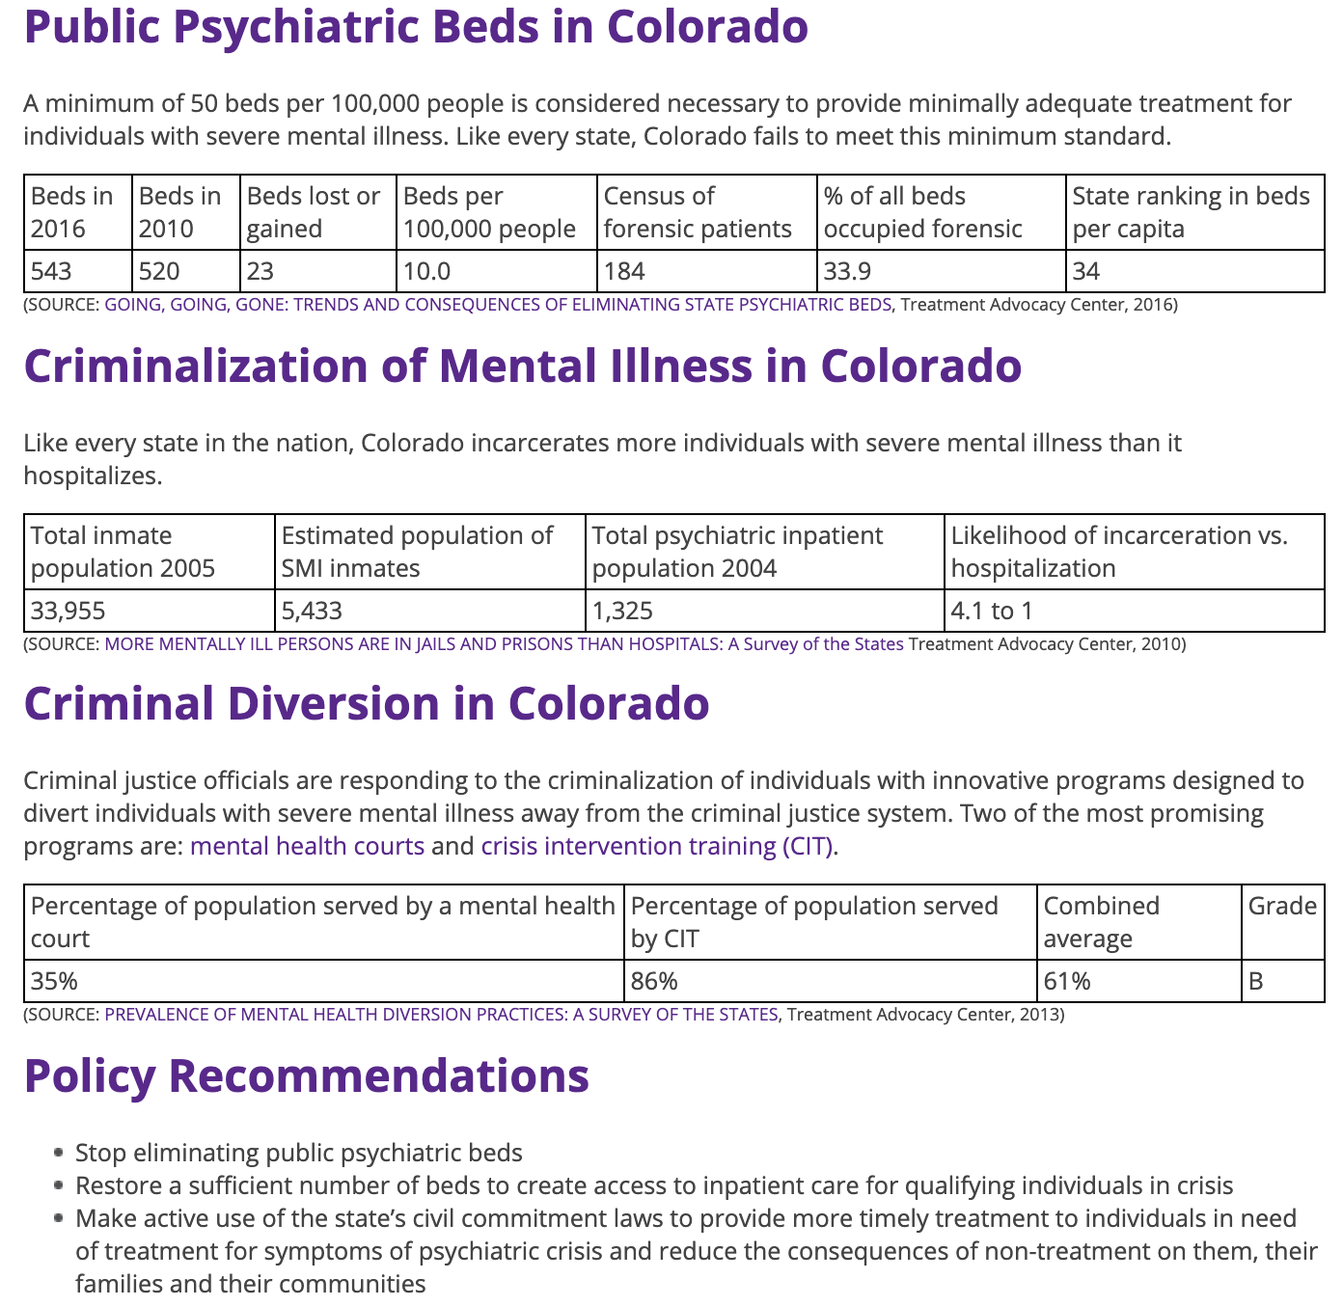
Problems in Current System
https://www.treatmentadvocacycenter.org/browse-by-state/colorado

Slide 13
Problems in Current System
https://www.treatmentadvocacycenter.org/browse-by-state/colorado

Slide 14
Discussion
Q3: How do you think a single payer system would improve upon these mental health parity laws and the ACA to promote better treatment of mental illness and substance use disorders?

Slide 15
Single Payer

Slide 16
MH in Current Legislation
HR 1384 (Jayapal)
SEC. 201. Comprehensive benefits.
(a) In general.—Subject to the other provisions of this title and titles IV through IX, individuals enrolled for benefits under this Act are entitled to have payment made by the Secretary to an eligible provider for the following items and services if medically necessary or appropriate for the maintenance of health or for the diagnosis, treatment, or rehabilitation of a health condition:
(1) Hospital services, including inpatient and outpatient hospital care, including 24-hour-a-day emergency services and inpatient prescription drugs.
(2) Ambulatory patient services.
(3) Primary and preventive services, including chronic disease management.
(4) Prescription drugs and medical devices, including outpatient prescription drugs, medical devices, and biological products.
(5) Mental health and substance abuse treatment services, including inpatient care.
(6) Laboratory and diagnostic services.
(7) Comprehensive reproductive, maternity, and newborn care.
(8) Pediatrics.
(9) Oral health, audiology, and vision services.
(10) Rehabilitative and habilitative services and devices.
(11) Emergency services and transportation.
(12) Early and periodic screening, diagnostic, and treatment services
(13) Necessary transportation to receive health care services for persons with disabilities or low-income individuals (as determined by the Secretary).
(14) Long-term care services and support (as described in section 204).
SEC. 204. Coverage of long-term care services.
(a) In general.—Subject to the other provisions of this Act, individuals enrolled for benefits under this Act are entitled to the following long-term services and supports and to have payment made by the Secretary to an eligible provider for such services and supports if medically necessary and appropriate and in accordance with the standards established in this Act, for maintenance of health or for care, services, diagnosis, treatment, or rehabilitation that is related to a medically determinable condition, whether physical or mental, of health, injury, or age that—
(1) causes a functional limitation in performing one or more activities of daily living; or
(2) requires a similar need of assistance in performing instrumental activities of daily living due to cognitive or other impairments.
(b) Eligibility.—The Secretary shall promulgate rules that provide for the following:
(1) The determination of individual eligibility for long-term services and supports under this section.
(2) The assessment of the long-term services and supports needed for eligible individuals.
(c) Services and supports.—Long-term services and supports under this section shall be tailored to an individual’s needs, as determined through assessment, and shall be defined by the Secretary to—
(1) include any long-term nursing services for the enrollee, whether provided in an institution or in a home and community-based setting;
(2) provide coverage for a broad spectrum of long-term services and supports, including for home and community-based services and other care provided through non-institutional settings;
(3) provide coverage that meets the physical, mental, and social needs of recipients while allowing recipients their maximum possible autonomy and their maximum possible civic, social, and economic participation
SB 1129 (Sanders)
“(b) Institutional long-Term care services defined.—In this section, the term ‘institutional long-term care services’ means the following:
“(1) Nursing facility services for individuals 21 years of age or over described in subparagraph (A) of section 1905(a)(4).
“(2) Inpatient services for individuals 65 years of age or over provided in an institution for mental disease described in section 1905(a)(14).
“(3) Intermediate care facility services described in section 1905(a)(15).
“(4) Inpatient psychiatric hospital services for individuals under age 21 described in section 1905(a)(16).
“(5) Nursing facility services described in section 1905(a)(29).

Slide 17
Impacts of Single-Payer (as per PNHP’s Physicians Proposal)
All U.S. residents covered
Comprehensive benefits, including all physical and MENTAL health care, rehab and LONG TERM CARE (no arbitrary coverage limits)
Better access without co-pays/deductibles/premiums
All providers included in plan, no restricted networks
Global operating budgets for clinics, hospitals and specialized programs for substance use
Clinicians get paid salaries in these settings
https://pnhp.org/what-is-single-payer/physicians-proposal/

Slide 18
Possible Impacts of Single-Payer
Independent practice clinicians would be paid on fee-for-time basis, including documentation and care coordination, to be incentive-neutral (not fee-for-service)
Funding/incentives for hospitals to expand mental health care based on community need
Pharmaceuticals
No co-pays for psychiatric medications on formulary
Prior auth only applying to drugs with inappropriate use for reasons other than medical necessity
Bulk purchasing and negotiations to control drug prices
More incentive to prioritize research towards treatment of SMI
https://pnhp.org/what-is-single-payer/physicians-proposal/

Slide 19
Discussion
Q4: What needs to be done beyond the adoption of a single payer system (or needs to be added to single payer legislation) to improve mental healthcare?

Slide 20
What Else is Needed
TRUE mental health parity (with ENFORCEMENT)
Mental Health Parity Compliance Act
https://www.healthaffairs.org/do/10.1377/hpb20140403.871424/full/healthpolicybrief_112.pdf
Notes:
Enforcing compliance with the MHPAEA is a key issue to watch in the next few years. State insurance commissioners have primary enforcement authority over health insurance issuers, but they are busy with ACA implementation and enforcement activities, so MHPAEA compliance may be low on their priority list
One common critique of parity is that by expanding coverage it could drive up costs, but research has shown this not to be the case. The implementation of parity in key settings allowed researchers to do a large-scale evaluation of any potential cost increases associated with parity. Research findings from the FEHB program as well as studies conducted in other settings showed that parity did not increase mental health spending, but did bring consumers important gains in terms of financial protection. These findings played a role in making parity more politically feasible.
Critics have argued that parity legislation alone is not enough to fix other underlying problems in how our health system provides access to treatment of mental health and substance use disorders. The supply and availability of mental health providers has been the subject of numerous research articles. A 2009 Health Affairs article by Peter Cunningham found that two-thirds of primary care physicians reported that they were unable to get outpatient mental health services for their patients—more than twice 1% The Mental Health Parity and Addiction Equity Act contains a one-year cost waiver if a plan’s costs go up at least 1 percent as a result of parity. “Eliminating the stigma and increasing the availability of high-quality providers are two keys to increasing access to care.” health policy brief mental health parit y 4 the percentage who reported trouble finding specialist referrals, nonemergency hospital admissions, or imaging services. Mental health professionals tend to be concentrated in high-population, high-income areas, and the lack of mental health care providers in rural areas as well as in pediatrics has been well documented. Finally, there is still a stigma associated with receiving mental health or substance use treatment. Eliminating the stigma and increasing the availability of high-quality providers are two keys to increasing access to care.
Arguably, one reason patients with mental health and substance use disorders experience fragmentation is due to the use of carve-outs for providing mental health/substance use benefits. One challenge for group health plans is to integrate and coordinate mental health and substance use care with medical care despite using separate administrators.
While the ACA expanded the reach of the MHPAEA both by direct application to the individual market and to issuers in the individual and small-employer market through the EHB requirement, some plans and benefits are still excluded. Some fee-for-service Medicaid options, employers with fewer than fifty employees who self-insure, and self-funded non–federal governmental health plans that opt out are not required to provide equivalent coverage. Small employers are likely to purchase insurance from an issuer who is subject to the EHB requirement and therefore mental health/ substance use parity. It remains to be seen whether small employers will self-insure at a greater rate, possibly by purchasing stop-loss coverage to limit their liability, in order to be exempt from EHBs and therefore parity. In addition, while Medicare coinsurance for mental health/substance use treatment is the same as for medical/surgical treatment beginning in 2014, Medicare still has a 190-day lifetime limit on inpatient psychiatric care that does not exist for inpatient medical care, although this affects a small number of people.
The Mental Health Parity Compliance Act would require health plans and insurers to conduct in-depth analyses to ensure that plans are compliant and would direct the Secretaries of both the Department of Health and Human Services and Labor to request these analyses if there are patient complaints that the plans are not compliant. Under the bill, 50 plans and insurers will be selected at random for an annual compliance investigation, and the report from this investigation will be submitted to Congress.
The Mental Health Parity Compliance Act is based on a best-practice approach that has been enacted in state legislatures in Delaware, District of Columbia, Illinois, New Jersey and Tennessee. It protects patients and ensures that those required to provide health insurance are following a law intended to support access to critical mental health services.
Senators Chris Murphy (D-CT) and Bill Cassidy (R-LA) introduced the bill in the Senate, and the legislation received support from the American Psychological Association, the American Psychiatric Association, Mental Health America, the American Occupational Therapy Association, and the Mental Health Liaison Group, which includes more than 50 member organizations representing consumers, families, providers advocating to strengthen access to high-quality mental and behavioral health care.
Congressman Donald Norcross (NJ-01) joined Representatives Katie Porter (CA-45) and Gus Bilirakis (FL-12) in introducing the Mental Health Parity Compliance Act, bipartisan legislation to improve health plans’ and insurers’ compliance with mental health parity laws.

Slide 21
What Else is Needed
Increase # of MH practitioners
Increase of inpatient psychiatric beds
Increased focus on treatment of serious mental illness (SMI), including education/training of providers
Integrated care – mental health care embedded in primary care and general medical settings
Elimination of for-profit hospitals
Incentives, funding for innovation/pilot programs to expand access to community-based services for SMI
https://www.healthaffairs.org/do/10.1377/hpb20140403.871424/full/healthpolicybrief_112.pdf
Notes:
Mental health professionals tend to be concentrated in high-population, high-income areas, and the lack of mental health care providers in rural areas as well as in pediatrics has been well documented.

Slide 22
What Else is Needed
Expand access to substance use treatment
Improve coordinated care - allow providers to share patient’s substance use records with other members on health care team
Funding increases for research into child and adolescent psychiatric disorders & treatment options
Expansion of loan forgiveness programs for child and adolescent psychiatry trainees
Increased federal support for training programs via GME funds
https://www.nami.org/getattachment/Learn-More/Mental-Health-Public-Policy/Public-Policy-Platform-December-2016-(1).pdf
https://www.mhanational.org/position-statements
https://www.treatmentadvocacycenter.org/fixing-the-system

Slide 23
What Else is Needed
Criminal justice reform
Decriminalization of marijuana and opioid use
Supportive housing
Immigration reform
Increased training and research for addiction treatment
Increased case managers and peer specialists
Expansion of school-based mental health programs
Expansion of behavioral health workforce
Increase funds for suicide prevention and awareness
Invest in veteran mental health
Expand telepsychiatry to alleviate geographic disparities
Expand first-episode psychosis programs
https://www.nami.org/getattachment/Learn-More/Mental-Health-Public-Policy/Public-Policy-Platform-December-2016-(1).pdf
https://www.mhanational.org/position-statements
https://www.treatmentadvocacycenter.org/fixing-the-system

Slide 24
Discussion
Q5: How can the single payer movement better focus on AND advocate for improved mental healthcare?
Q6: How can we bring individuals and families affected by mental illness/substance use disorders into the movement?

Slide 25
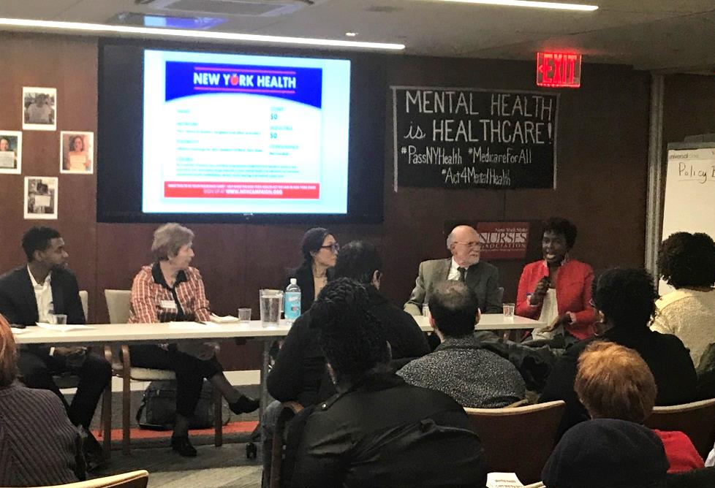
JAN 30 EVENT: NAMI-NYC & Campaign for NY Health

Slide 26
Opportunities for Advocacy
Local + State NAMI Chapters, National NAMI
Community-based mental health and substance use treatment and advocacy organizations
Treatment Advocacy Center – national, state, local
Professional Organizations:
American Psychiatric Association (APA)
American Academy of Child & Adolescent Psychiatry (AACAP)
American Academy of Community Psychiatrists (AACP)
PNHP Mental Health Proposal

