Slide 1
Flexin’ On Your Reps
Relationship Building with Elected Officials and Political Advocacy

Slide 2
Find your Representatives right now
Google : Find my Rep
https://www.house.gov/representatives/find-your-representative
Are they a cosponsor?
HR 1384 cosponsor
Our Letter: bit.ly/snahpletter

Slide 3
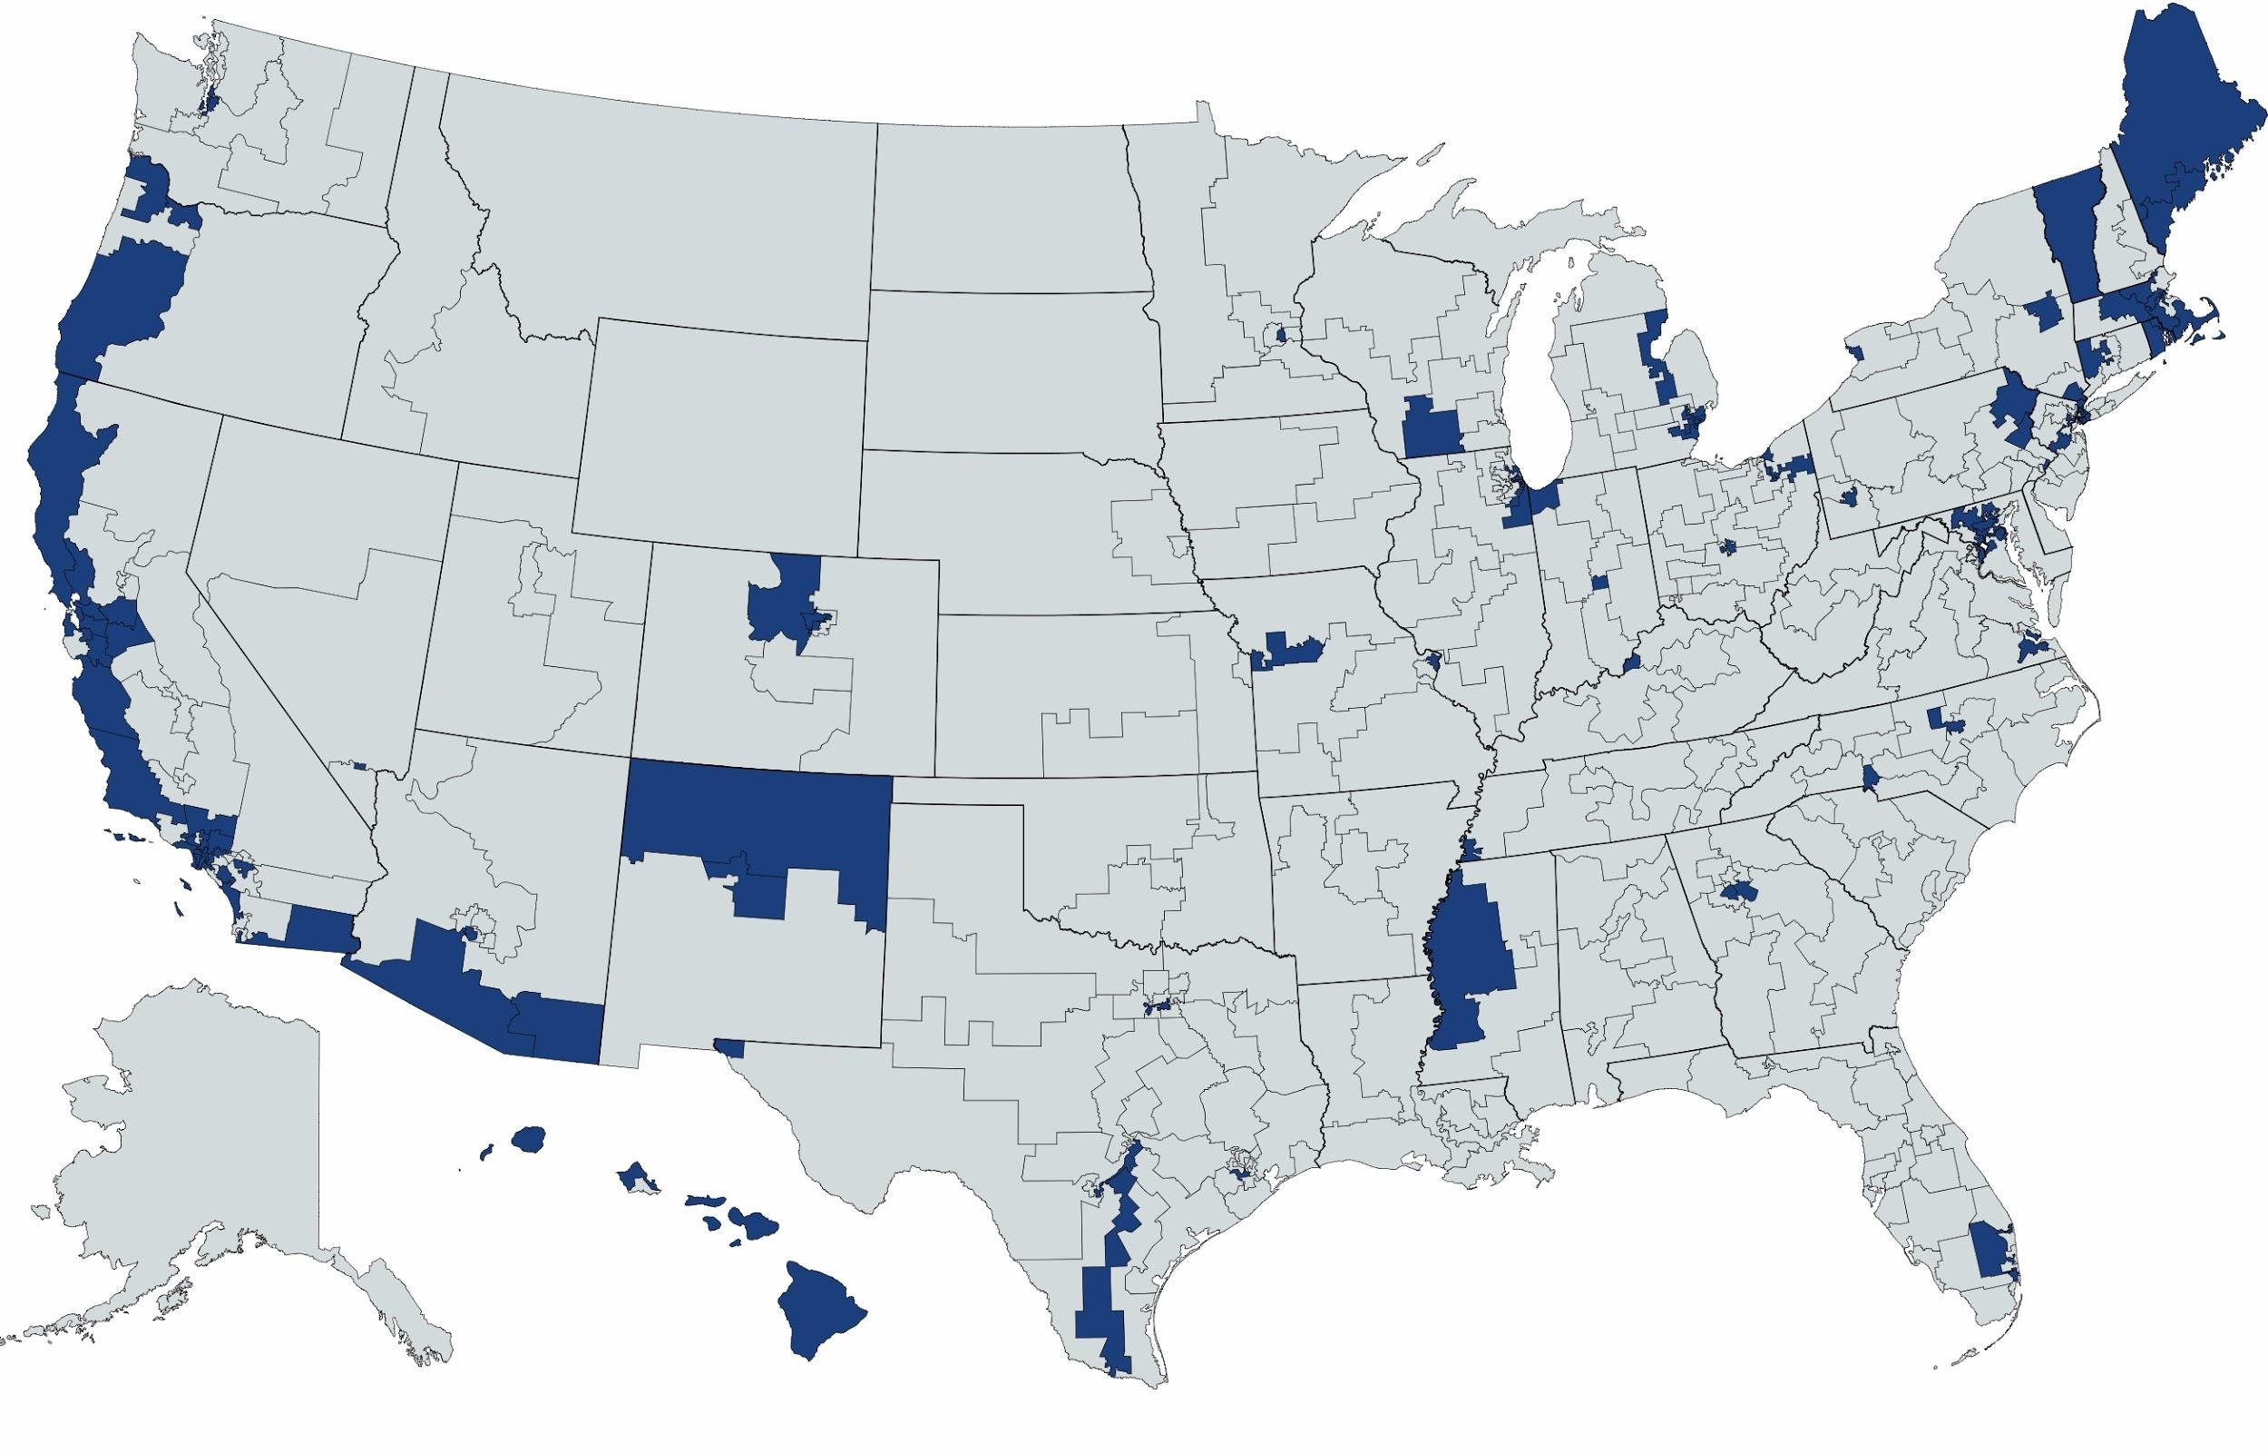
Geographical Depiction of House Representatives that support HR 1384

Slide 4
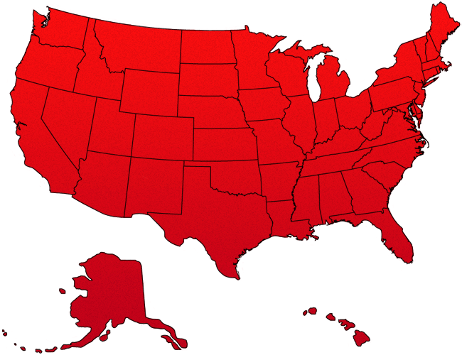
Depiction of Americans that need healthcare!!!

Slide 5
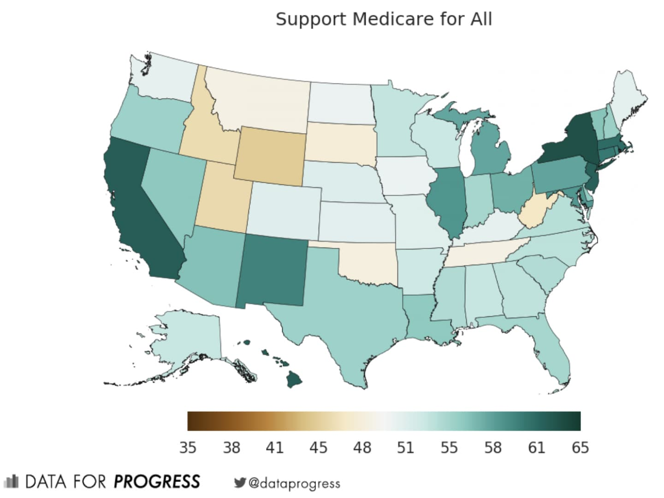
Map of greatest support for M4A
Citation (1)
Notes:
What we need now
Pressuring reps
Birddogging
Meeting one-on-one
Calling rep
Emailing and meeting with aides
SUPPORT YOUR REPS who align with your values and support bills you like
Canvassing for reps as it’s an election year
More cosponsors on bills!
There are some reps that cosponsor bills only to pull support later (e.g. Evans). Need to keep pressure on even after cosponsoring!

Slide 6
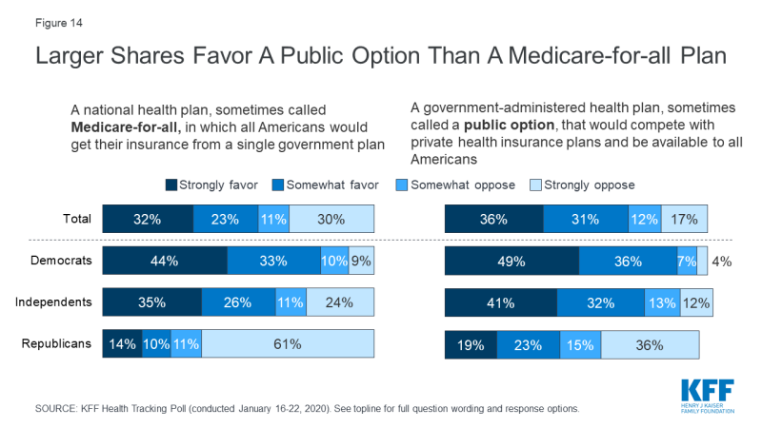
What do Dems and Republicans think of M4A Vs Public option?
Notes:
This definitely depends on how you frame the question.
E.g. “Do you support expanding Medicare to cover all Americans?” vs. “Do you support completely banning private insurance?”

Slide 7
Reasons Individuals site Support or Opposition

Slide 8
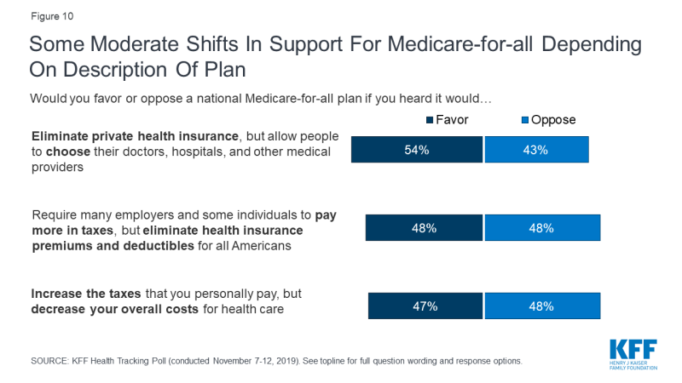
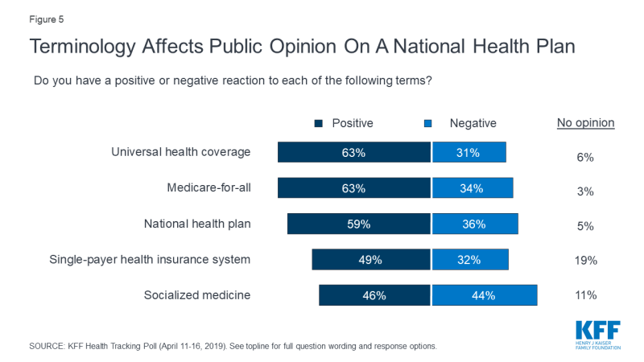
Framing is Everything.

Slide 9
M4A Defectors!!
John Garamendi (CA-03) Doris Matsui (CA-06) Anna G. Eshoo (CA-18)
J.Luis Correa (CA-46) Al Lawson (FL-05) Darren Soto (FL-09)
Kathy Castor (FL-14) Theodore E. Deutch (FL-22) Sanford D. Bishop (GA-02)
David Loebsack (ID-02) G.K. Butterfield (NC-01) Gwen Moore (WI-04)
Albio Sires (NJ-08) Donald S. Norcross (NJ-01) Marcy Kaptur (OH-09)
Dwight Evans (PA-03) James E. Clyburn (SC-06) Jim Cooper (TN-05)
Eddie Bernice Johnson (TX-30) Filemon Vela (TX-34)
Source (2)

Slide 10
Ways and Means Committee Members
Democrats that are not M4A supporters:
Richard Neal, MA-1 John Larson, CT-1 Bill Pascrell, NJ-9 Terri Sewell, AL-7 Suzan DelBene, WA-1 Gwen Moore, WI-4 Dwight Evans PA-2 Brad Schneider, IL-10 Tom Suozzi, NY-3 Stephanie Murphy, FL-7 Steven Horsford, NV-4

Slide 11
Energy and Commerce Members
Democrats that are not M4A supporters:
Frank Pallone, NJ-6 Anna Eshoo, CA-18 G.K Butterfield, NC-1 Doris Matsiu, CA-6 Kathy Castor, FL-14 David Loebsack, IA-2 Kurt Schrader, OR-5 Tony Cardenas CA-29 Raul Ruiz, CA-36 Scott Peters, CA-52 Ann McLane-Kustor, NH-2 A. Donald McEachin, VA-4 Lisa Blunt Rochester, DE Darren Soto, FL-9 Tom O’Halleran, AZ-1

Slide 12
House Budget Committee
Democrats that are not M4A supporters
Seth Moulton MA-6
Rosa DeLauro CT-3
Joe Morelle NY-25
Steven Horsford NV-4
Jim Cooper TN-4
Scott Peters CA-52
Albio Sires NJ-8

Slide 13
Important Reps. that need convincing
Nancy Pelosi (CA-12)(7 signatures, we need more!) AKA the queen bee
Anna Eshoo-(CA-18) leader on the House Energy and Commerce Committee
James Clyburn- (SC-6) Majority Whip
Michael Quigley (IL-5th) (43 signatures) (very blue chicago district)
Steve Cabot (OH-1) (31 Signatures)
Mike Thompson (CA-5) (11 signatures)
Brad Schneider (IL-10) - Ways and Means Committee (23 signatures)
Sean Casten (IL-6) (27 signatures)
Bill Foster (IL-11) - safely blue district, currently being primaried

Slide 14
We identified our targeted Reps. What do we do now?
Step 1: schedule a meeting your representative
Step 2: raise public awareness and form partnerships
Step 3: bird-dog, protest, and find M4A supporting candidates

Slide 15
Setting Up Meetings with Representatives
Reach out!
Apply on the Reps website
Cold call/email their office
Follow up call to the office later in the week. And stay persistent.
Remind staffers of how long you have been waiting
Don’t be hesitant to meet with aides.
They craft decisions and campaign stances
Ask to schedule a meeting for next quarter right now
Notes:
Apply online - One common application question is the “Purpose of the Meeting?”
Cold email - you will find and email on their website.
Note that many reps won’t meet with you if you do not live in their district. Some aides will ask for your address to ensure that you’re in their district.
Meeting with aides - they will pass on your message to their rep. Most offices do (should) keep a running tab of who is for what policy and will tally them up when it comes to voting on policy.
Follow up, follow up, follow up. They will often say that they’ll get back to you. They won’t…….take charge!

Slide 16
Meeting Your Rep
Appoint a narrator/lead
30 second personal narratives for each attendee
Give a pointed, prepared 5 minute summary of:
Why you support Medicare for All,
Preemptively give counterfacts to the most common arguments (“choice”, cost, etc.),
Explicitly state that you want the Rep to cosponsor and support M4A.
Then, the Rep should give an argument against M4A then talk pointedly about 2-3 issues that the representative has and clarify their misconceptions
Notes:
Appoint a narrator-starts the conversation
This person will thank the rep for meeting, state that you are here to ask them to support HR 1384, lay out the meeting agenda
establishing the agenda is important to controlling the conversation and preventing reps from talking the entire time without them listening to your viewpoint
Next, students should give 30 second personal narratives (no more than 5 narratives)
This helps the rep get to know your group and reason why you support M4A
Then, talk pointedly about 2-3 issues that the representative has regarding M4A and clarify their misconceptions
There are many bills out there, and some reps claim to not know HR 1384. Also some reps just don’t understand Healthcare system economics. So please explain to them.
Examples might be:
why Buy-in or fixing the ACA won’t work, nor cover everyone
M4A saves 300 billion over 10 years. And is affordable because we already fund it!
We have horrible healthcare in this country. Please are not happy with their care
Explain the improved outcomes, efficiency without
Insurers do not subsidizes the government system. The opposite is true
The government is more efficient than private insurance
M4A is the only plan to control healthcare inflation

Slide 17
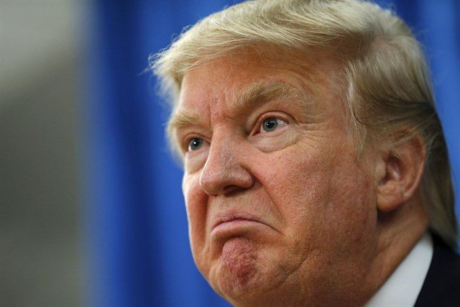
When Representatives don’t listen
Organize!
Hold Public events to explain M4A at libraries, friends houses, schools
Support other candidates running against M4A opposers. Break the Ice and go canvas for them!
Collect petition signature showing support for M4A
Bird-dogging
Notes:
Organize!
Partner with other groups, canvas and information constituents of the representatives decision to oppose M4A
Bird-dogging
burns the relationship-bridge to Reps. but they weren’t going to meet or listen anyways.
With public events, invite your reps/senators or their aides. They will send someone!

Slide 18
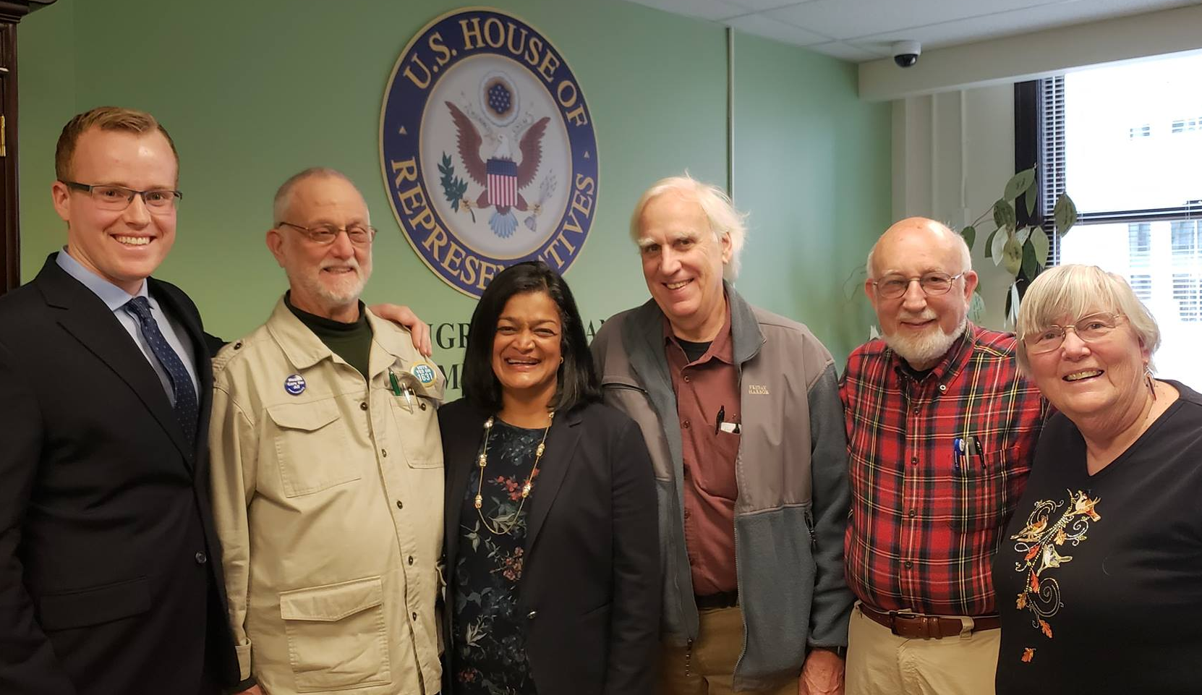
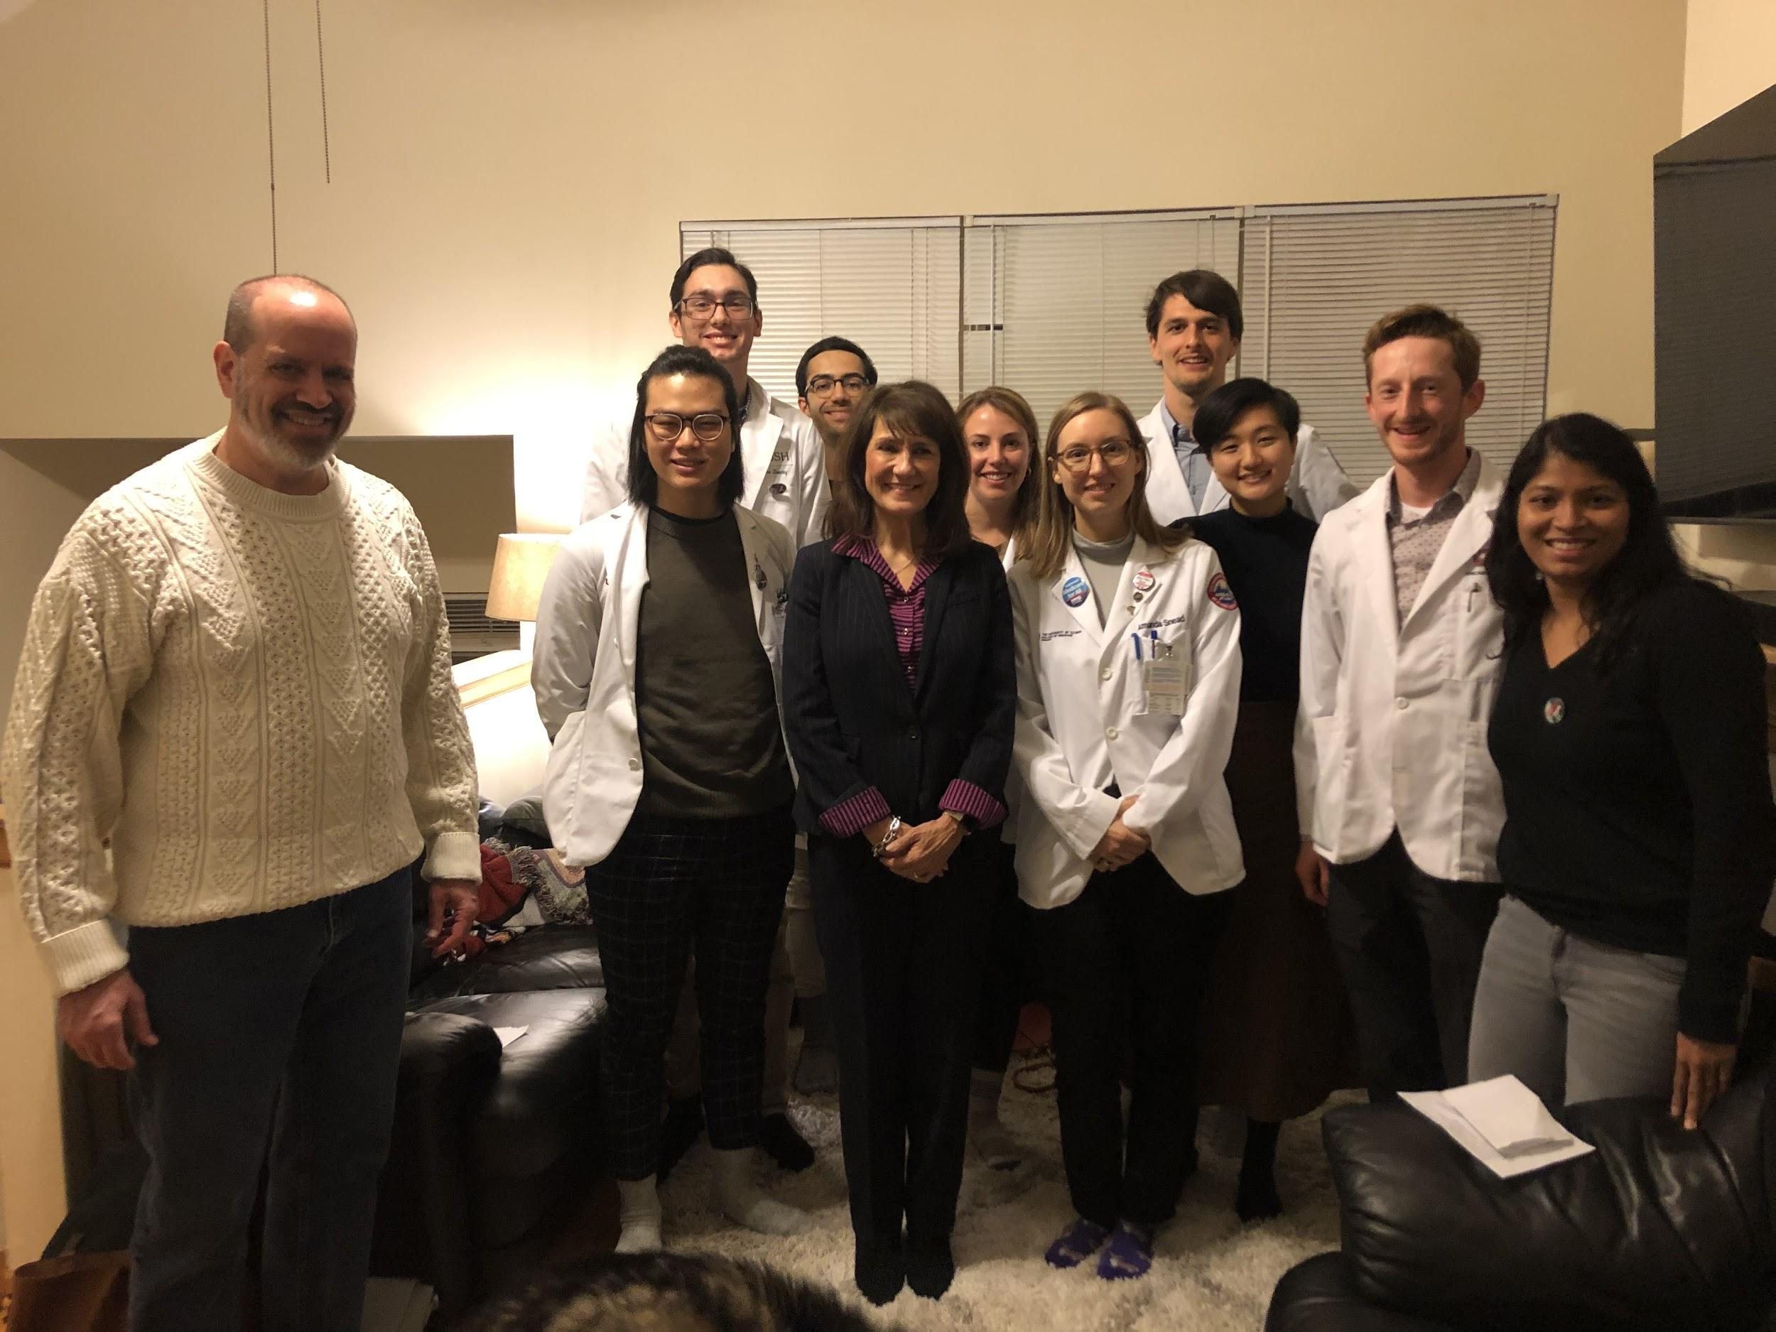
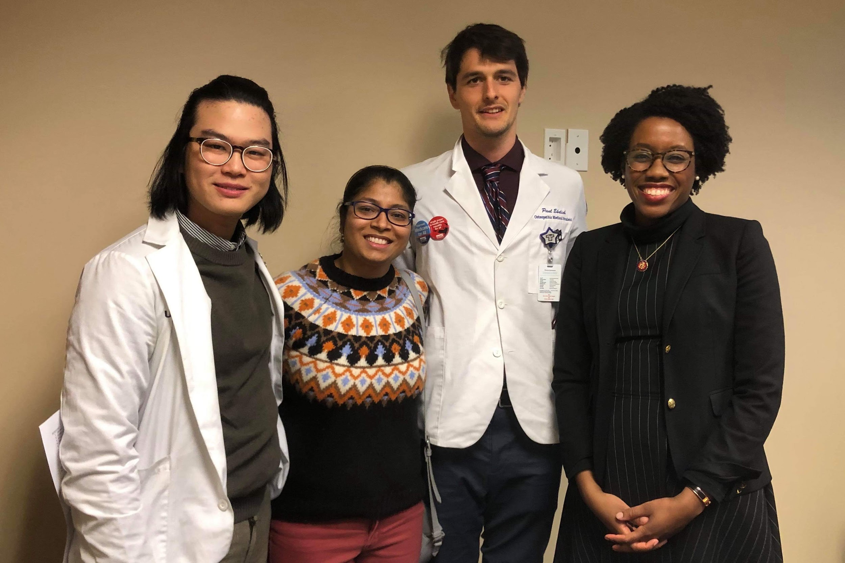
Time to Flex

Slide 19
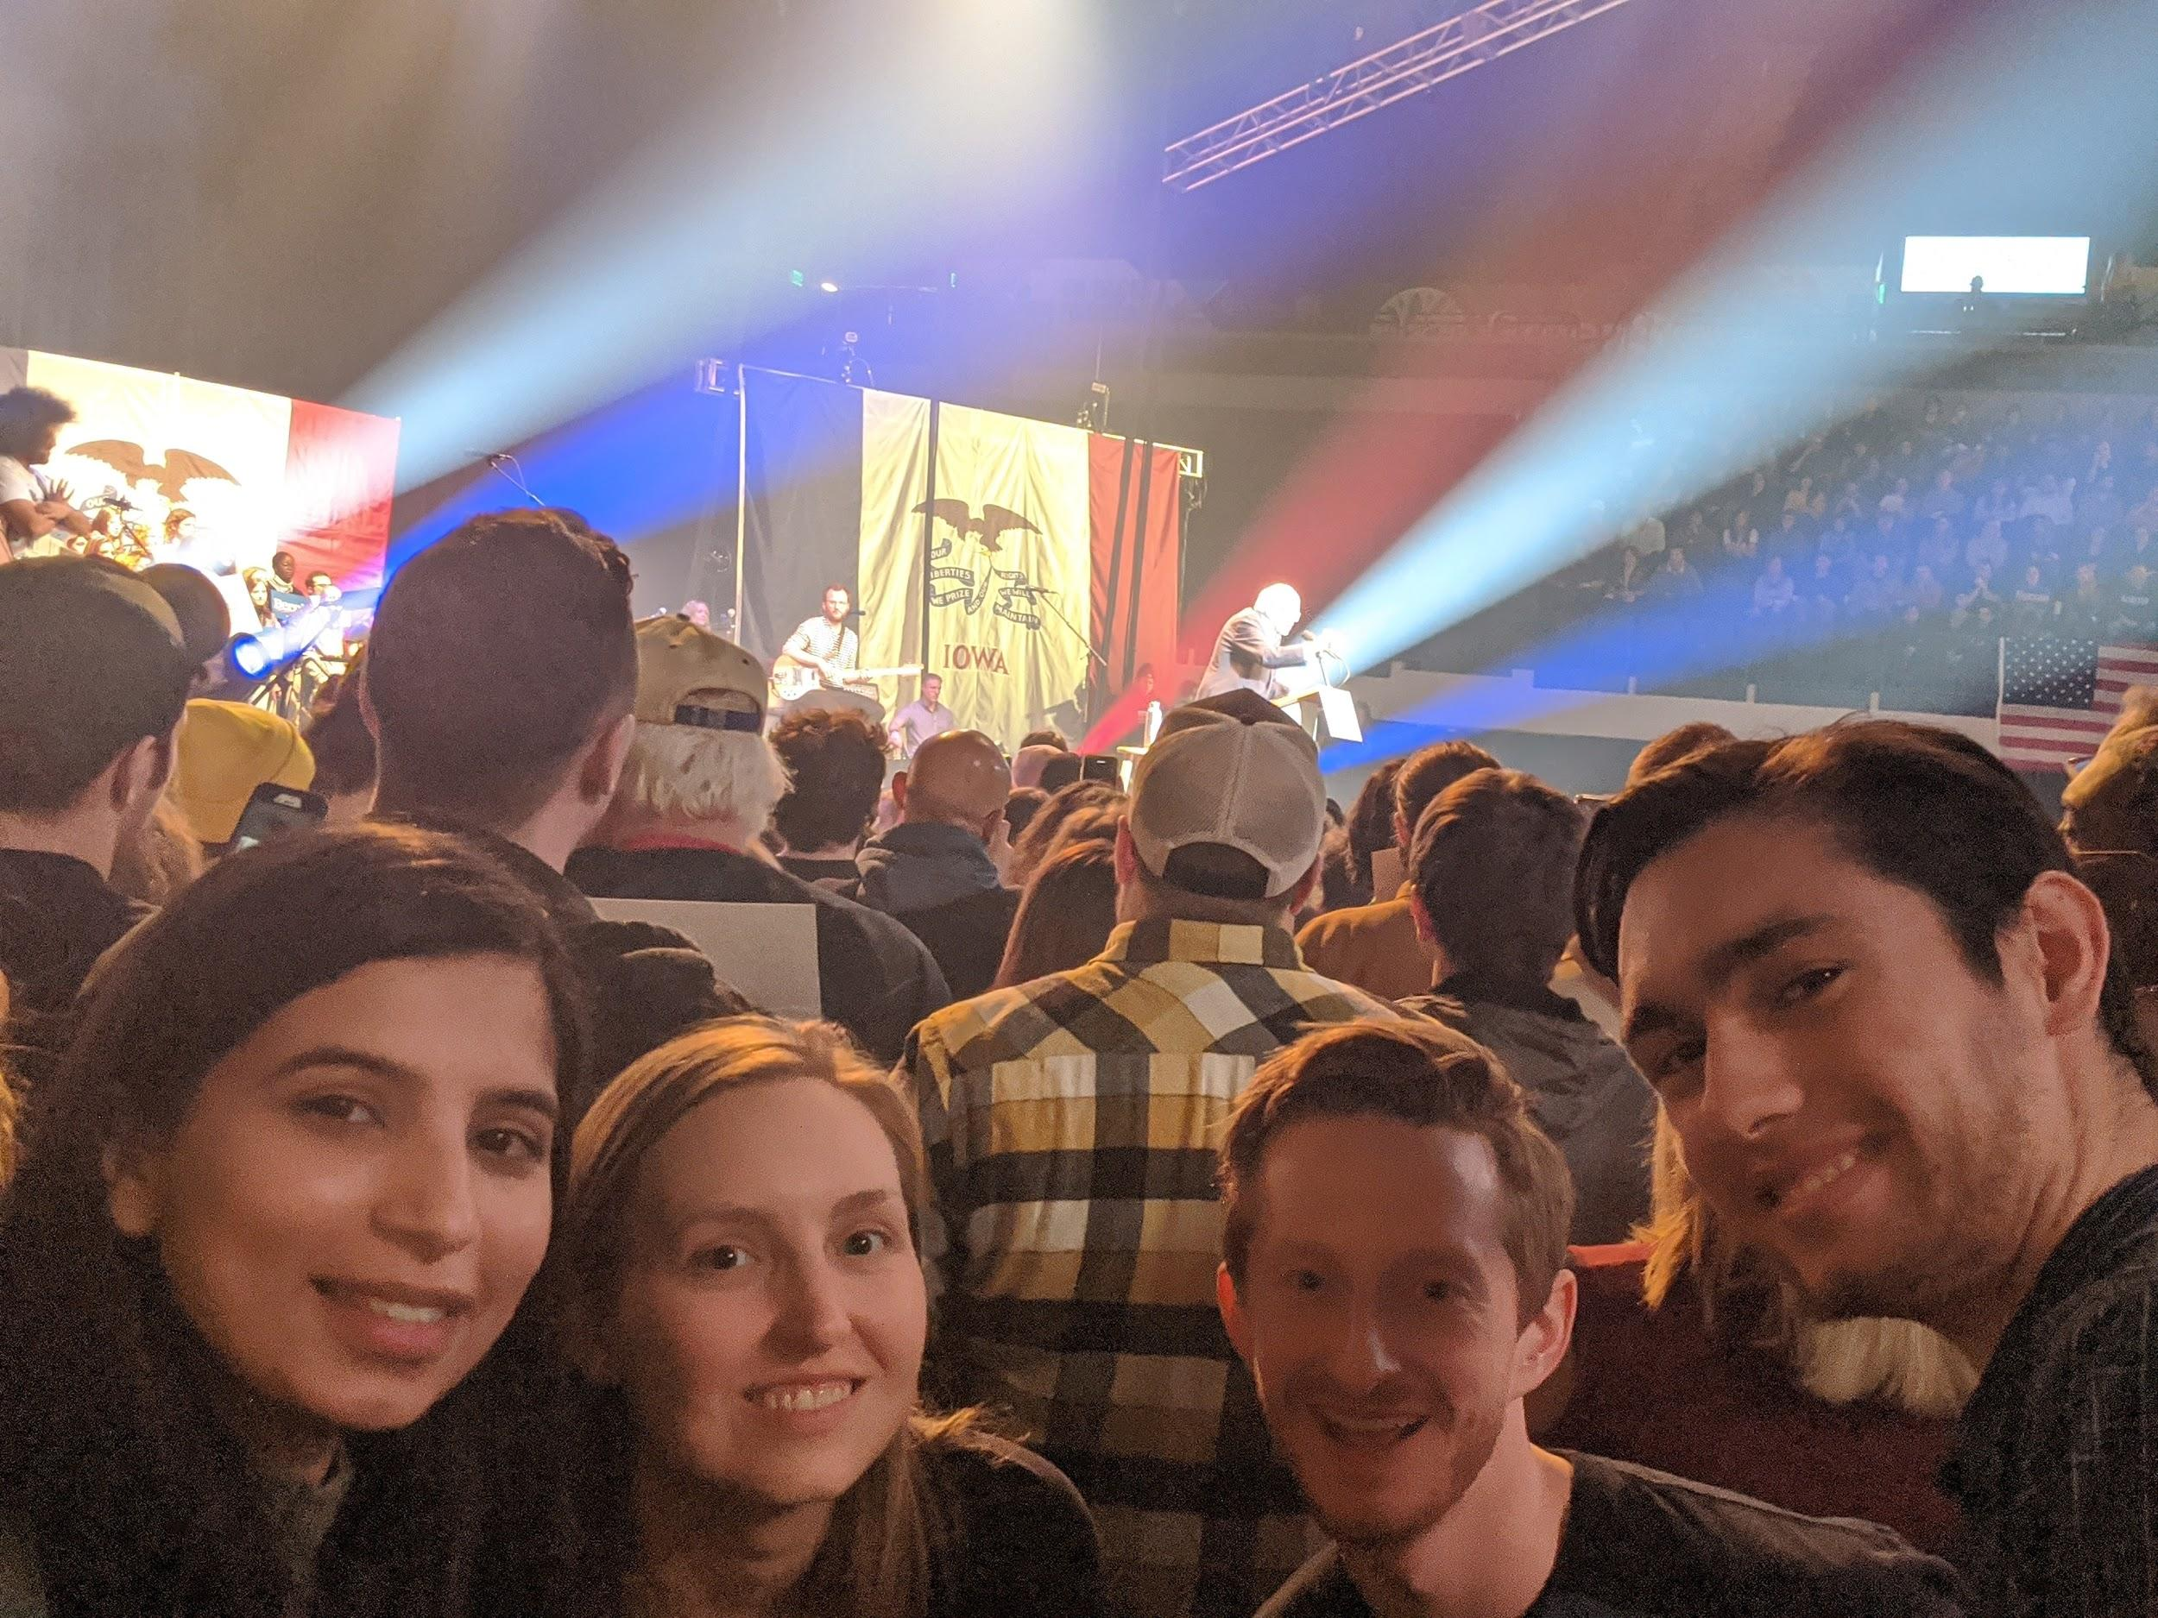
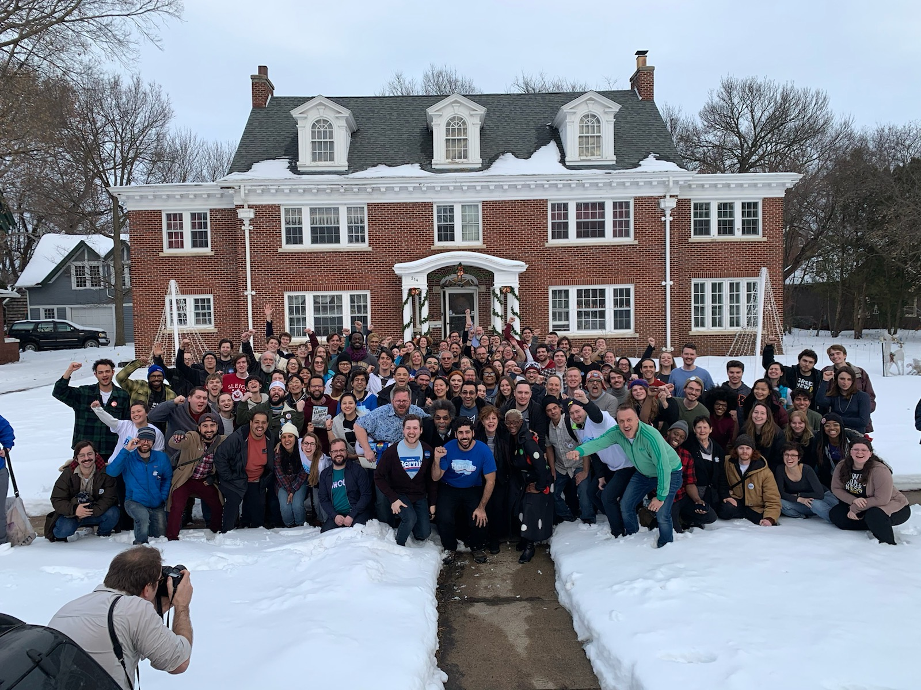
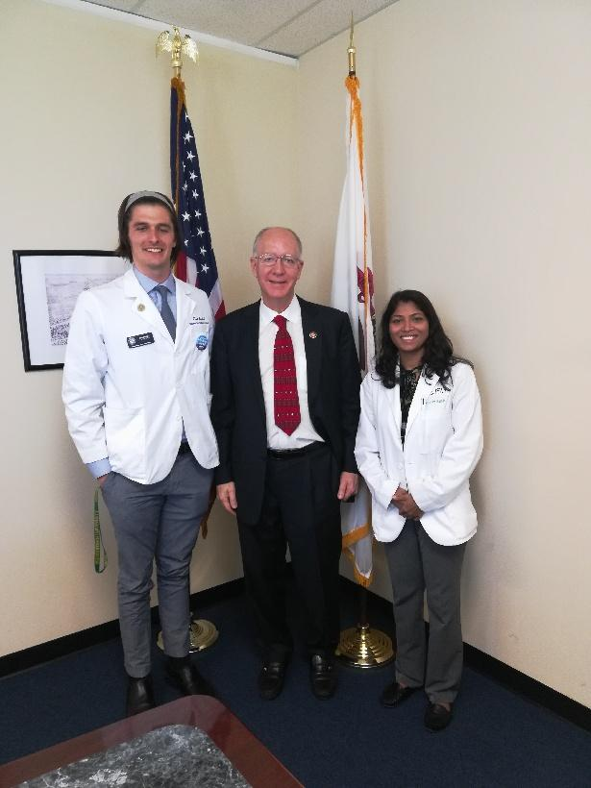
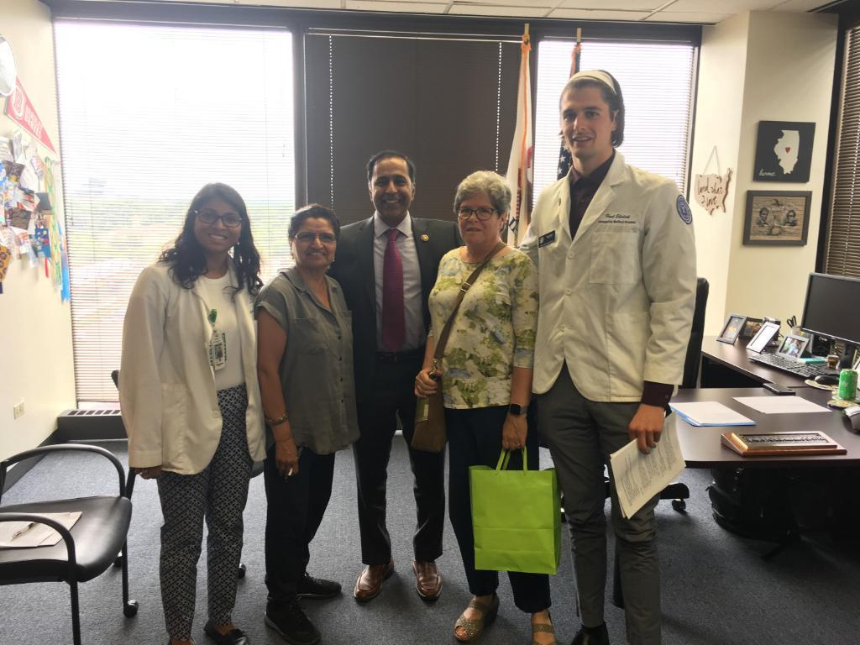
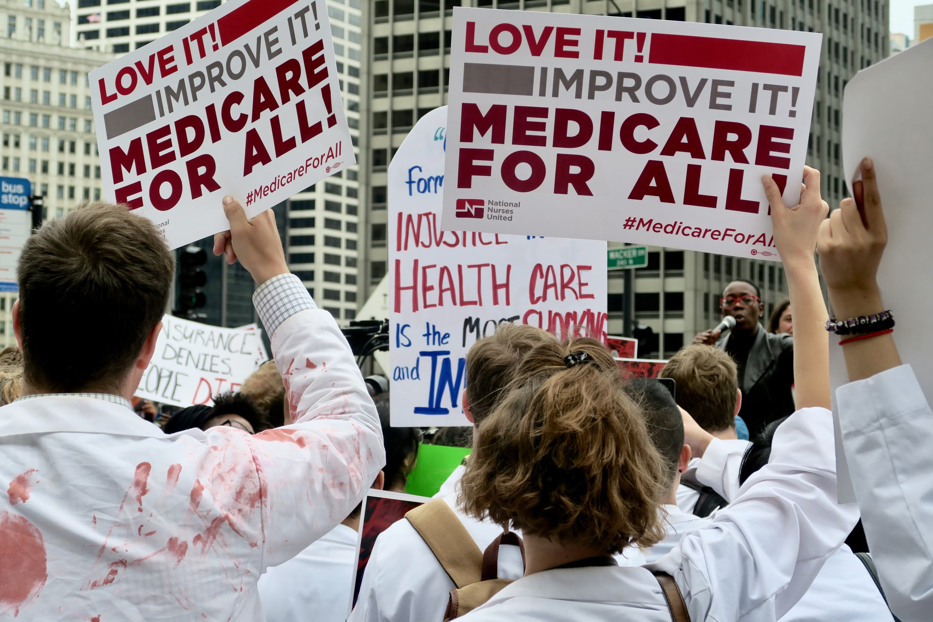
Time to Flex

Slide 20
Join the Political Advocacy team!
Help us push our elected officials to support and pass M4A!
Work with other chapters in your region.

Slide 21
Citations
https://www.washingtonpost.com/news/powerpost/wp/2018/03/19/medicare-for-all-enjoys-broad-support-but-pollsters-worry-that-it-hasnt-been-tested/
https://spacecommune.com/why-have-29-congressional-democrats-stopped-supporting-medicare-for-all-in-2019/

Slide 22
To get involved with the Political Advocacy Team or contact your representatives
pehrlich95@midwestern.edu
Paul Ehrlich
johnkearney253@gmail.com
John Kearney
Notes:
Neoliberalism in the Reagan era and how that reshaped healthcare from a public good to a private enterprise
Formulation of the physician’s proposal and how it has ultimately morphed into HR 676 then subsequently HR 1384
Current momentum (main talking point in presidential election, sister bill in senate, more cosponsors than ever for house bill (119), national organizing on a huge scale).

