Slide 1
Single Payer Update
Alex Cabrera, University of Nevada Reno
Ashley Duhon, LSU
Paul Glasheen, University of Colorado
Rachel Madley, Columbia University
Michael Zingman, Columbia VP&S

Slide 2
Coming Up:
State of affairs with American healthcare
Effects of our broken system
The solution, Improved Medicare For All
The opposition
How to get involved

Slide 3
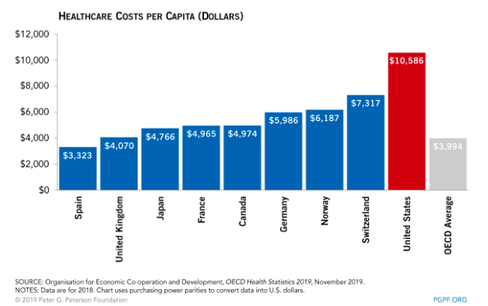
State of affairs in America’s healthcare system
The US spends more money on healthcare than many other countries with Universal Healthcare systems

Slide 4
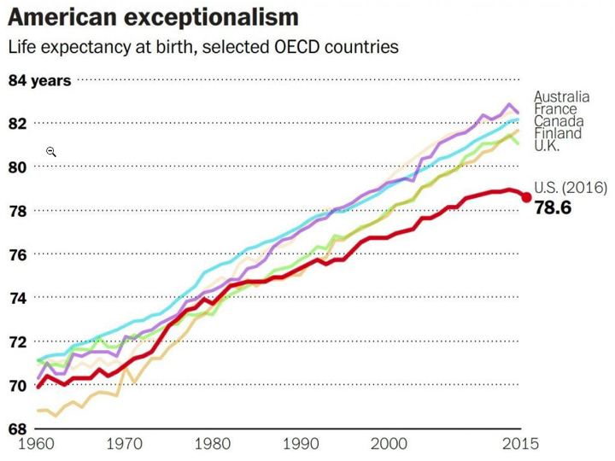
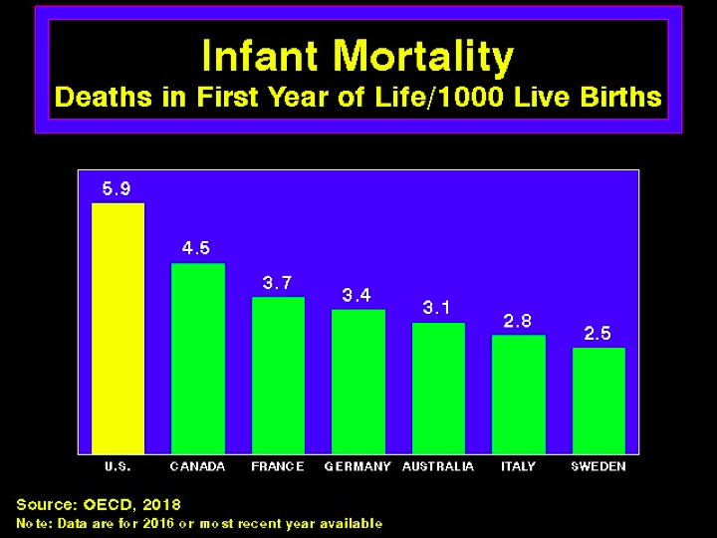
What does that money get us?
Decreasing life expectancy and increased infant mortality in the US

Slide 5
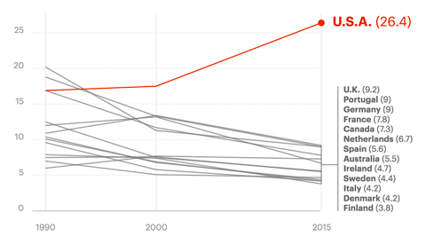
What does that money get us?
Maternal Deaths per 100,000 live births
Maternal mortality is rising in the US but decreasing in other countries

Slide 6
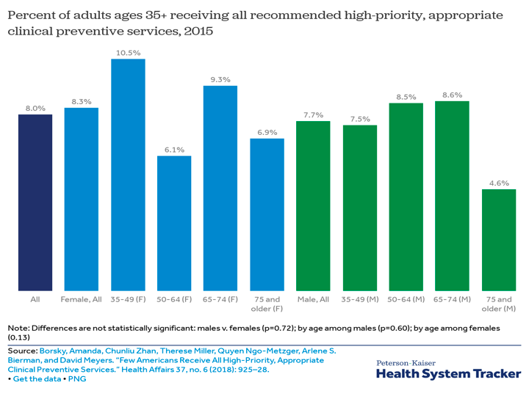
What does that money get us?
Only 8% of adults 35+ get all recommended preventative care (immunizations, cancer screening, counseling, preventative medicines)

Slide 7
What does that money get us?
Nearly half of American adults under 65 are remain either uninsured or underinsured
What is “underinsurance”?
Annual out of pocket expenses>10% income OR
If income is <200% Federal poverty level and out of pocket expenses >5% income OR
Deductibles >5% income

Slide 8
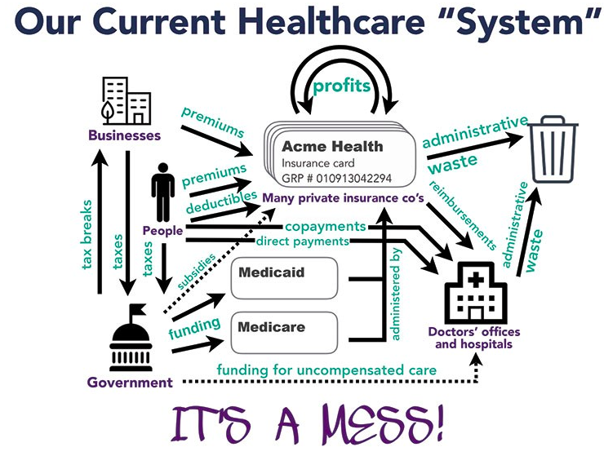
Why is our system so broken?
Source: PNHP-NY Metro and Campaign for NY Health
Notes:
We have a fragmented system with a mixture of public and private insurance with thousands of different plans and networks
This results in extreme administrative waste
Private insurance prioritizes profit over patients
Their bottom line is to make money, not healthcare
It is incredibly expensive with or without insurance

Slide 9
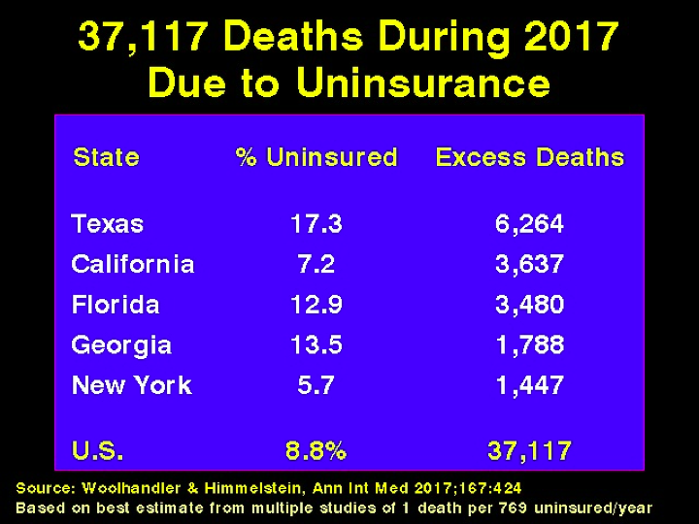
Effects of our broken system: Unnecessary Death
Notes:
In states when uninsurance rates are high, there are relatively high excess death rates

Slide 10
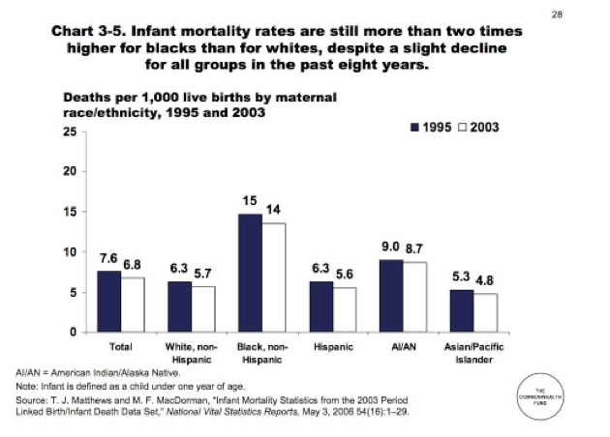
Effects of our broken system: Health Disparities

Slide 11
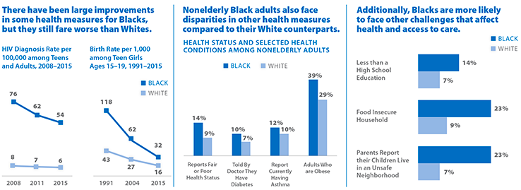
Effects of our broken system: Health Disparities
Kaiser Family Foundation, 2018
Notes:
Hiv diagnosis rates and teenage pregnancy rates are decreasing for black americans but its still higher. Black Americans are also more likely to be reported as having fair or poor health status and face challenges that affect health and access to care

Slide 12
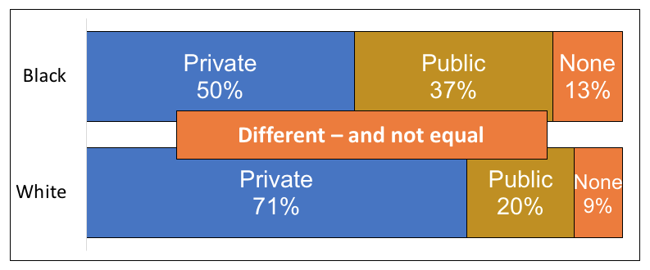
Effects of our broken system: Health Disparities
The need: resolving health disparities
Until age 65, Race determines your type of insurance

Slide 13
Effects of our broken system: Delayed Care

Slide 14
Effects of our broken system: Delayed Care

Slide 15
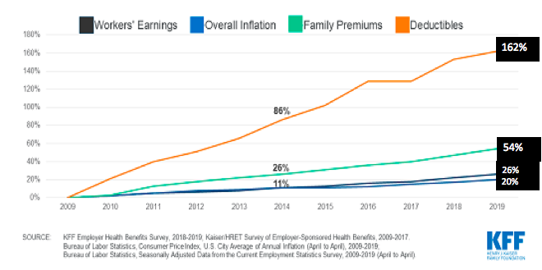
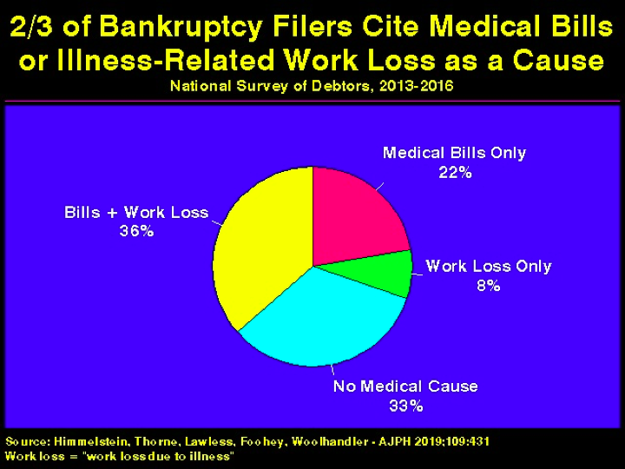
Effects of our broken system: Financial Hardship

Slide 16
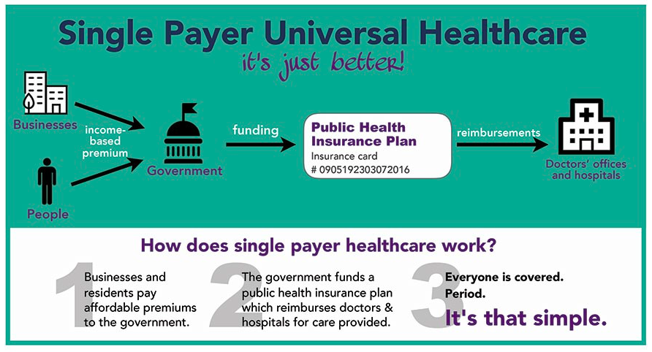
How do we fix it?
Notes:
Doctors remain privately operated but care is publicly funded

Slide 17
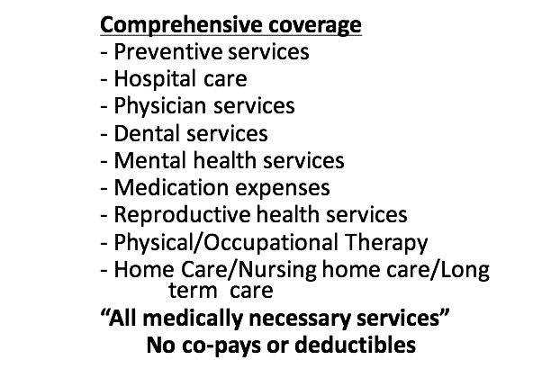
Improved and Expanded Medicare for All

Slide 18
Improved and Expanded Medicare for All
Economic Side
Funded by progressive taxes based on ability to pay and modest taxes on Wall Street
Provides immense administrative savings (estimated ~$500 billion annually)
Eliminates patient out of pocket expenses (co-pays, premiums, deductibles)
Allows for more bargaining power for lower drug prices

Slide 19
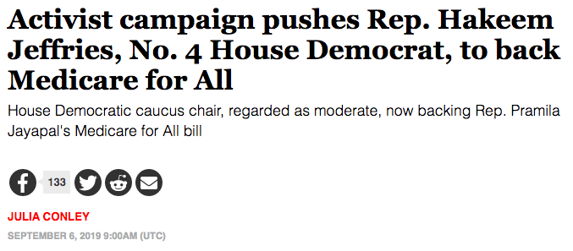
Updates on Medicare for All Legislation- National
118 co-sponsors of HR.1384 (Jayapal Bill)
14 co-sponsors of S.1199 (Sanders Bill)
Notes:
With Jeffries co-sponsorship, a majority of house democrats are now cosponsors of M4A
Popular support for M4A is rising as seen by the iowa caucus polling showing majority support M4A and other polls
Hearings held in Ways and Means, Education and Labor, Budget, and Energy and Commerce
More and more co-sponsors signing on

Slide 20
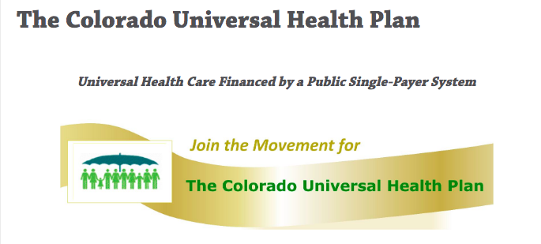
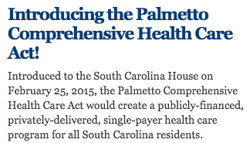
Updates on Medicare for All Legislation- State Level
18 states have introduced single-payer legislation

Slide 21
The opposition
Notes:
Health insurance companies, pharma companies
They don’t have the people power that the single-payer movement does but they have lots of money (ads, lobbying, etc)

Slide 22
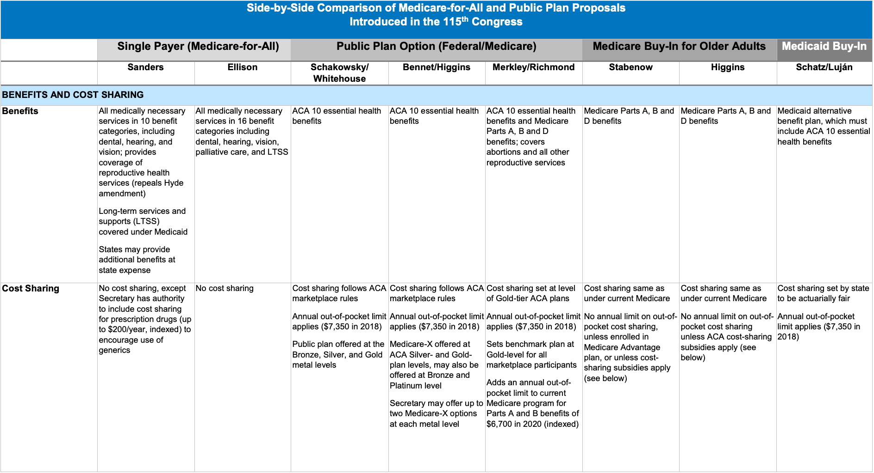
The opposition- Public Option Plans
Key Issues with a Public Option or “Medicare for All who want it”
It adds another insurance system to our confusing and costly group of other insurance plans
Results in no administrative cost savings
They will likely self select for the most vulnerable populations leading to higher costs while for-profit insurance companies have pools of lower cost people making it difficult for the public option to survive
Notes:
There are many different public option plans or “Medicare for All who want it”
All of them have the same key issues
They do not provide any healthcare savings to offset the costs
They will likely self select for the most vulnerable populations leading to higher costs while for-profit insurance companies have pools of lower cost people making it difficult for the public option to survive
http://files.kff.org/attachment/Table-Side-by-Side-Comparison-Medicare-for-all-Public-Plan-Proposals

Slide 23
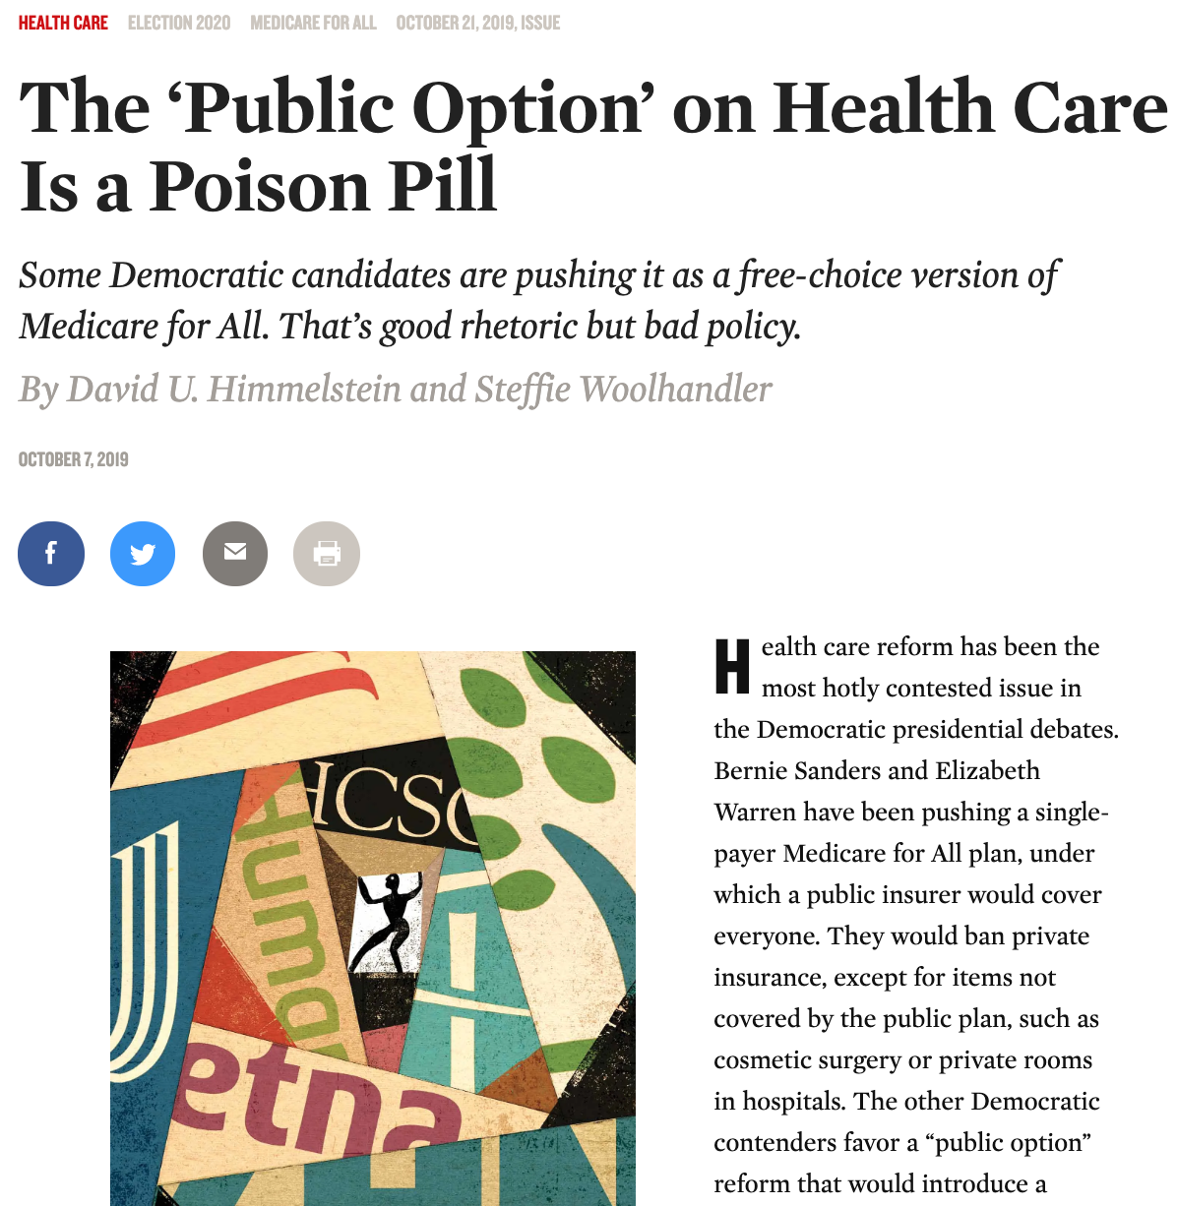
The opposition- Public Option Plans
“The case for a public option rests on faulty economic logic and naive assumptions about how private insurance actually works.”
“Private insurers have proved endlessly creative at gaming the system to avoid fair competition, and they have used their immense lobbying clout to undermine regulators’ efforts to rein in their abuses.”
“Private insurers employ a dizzying array of profit-​enhancing schemes that would be out of bounds for a public plan. These schemes, which continually evolve in response to regulators’ efforts to counter them, boil down to four strategies that are legal, in addition to occasional outright fraud.”
Obstructing expensive care
Cherry-picking and lemon-dropping
Upcoding
Lobbying to get excessive payments and thwart regulators
Notes:
§ Obstructing expensive care. Plans try to attract profitable, low-needs enrollees by assuring convenient and affordable access to routine care for minor problems. Simultaneously, they erect barriers to expensive services that threaten profits—for example, prior authorization requirements, high co-payments, narrow networks, and drug formulary restrictions that penalize the unprofitably ill. While the fully public Medicare program contracts with any willing provider, many private insurers exclude (for example) cystic fibrosis specialists, and few Medicare Advantage plans cover care at cancer centers like Memorial Sloan Kettering. Moreover, private insurers’ drug formularies often put all of the drugs—even cheap generics—needed by those with diabetes, schizophrenia, or HIV in a high co-payment tier. Insurers whose first reaction to a big bill is “claim denied” discourage many patients from pursuing their claims. And as discussed below, if hassling over claims drives some enrollees away, even better: The sickest will be the most hassled and therefore the most likely to switch to a competitor.
§ Cherry-picking and lemon-dropping, or selectively enrolling people who need little care and disenrolling the unprofitably ill. A relatively small number of very sick patients account for the vast majority of medical costs each year. A plan that dodges even a few of these high-needs patients wins, while a competing plan that welcomes all comers loses. Private insurers offer attractive premiums to businesses with young, healthy workers and exorbitant rates to those with older, sicker employees. As a letter this summer to The New York Times put it, like casinos, health insurers are profitable because they know the odds of every bet they place—and the house always wins.
§ Upcoding, or making enrollees look sicker on paper than they really are to inflate risk-adjusted premiums. To counter cherry-picking, the CMS pays Medicare Advantage plans higher premiums for enrollees with more (and more serious) diagnoses. For instance, a Medicare Advantage plan can collect hundreds of dollars more each month from the government by labeling an enrollee’s temporary sadness as “major depression” or calling trivial knee pain “degenerative arthritis.” By applying serious-​sounding diagnoses to minor illnesses, Medicare Advantage plans artificially inflate the premiums they collect from taxpayers by billions of dollars while adding little or nothing to their expenditures for care.
§ Lobbying to get excessive payments and thwart regulators. Congress has mandated that the CMS overpay Medicare Advantage plans by 2 percent (and even more where medical costs are lower than average). On top of that, Seema Verma, Trump’s CMS administrator, has taken steps that will increase premiums significantly and award unjustified “quality bonuses,” ignoring advice from the Medicare Payment Advisory Commission that payments be trimmed because the government is already overpaying the private plans. And she has ordered changes to the CMS’s Medicare website to trumpet the benefits of Medicare Advantage enrollment.

Slide 24
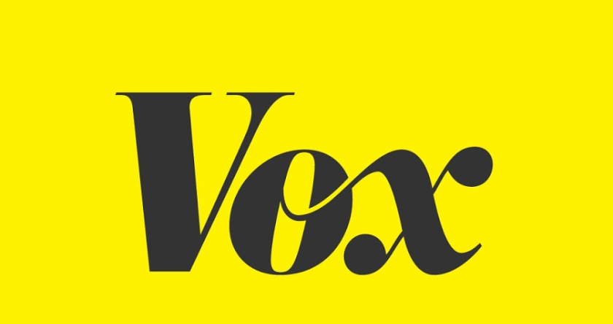
The opposition - on the campaign trail

Slide 25
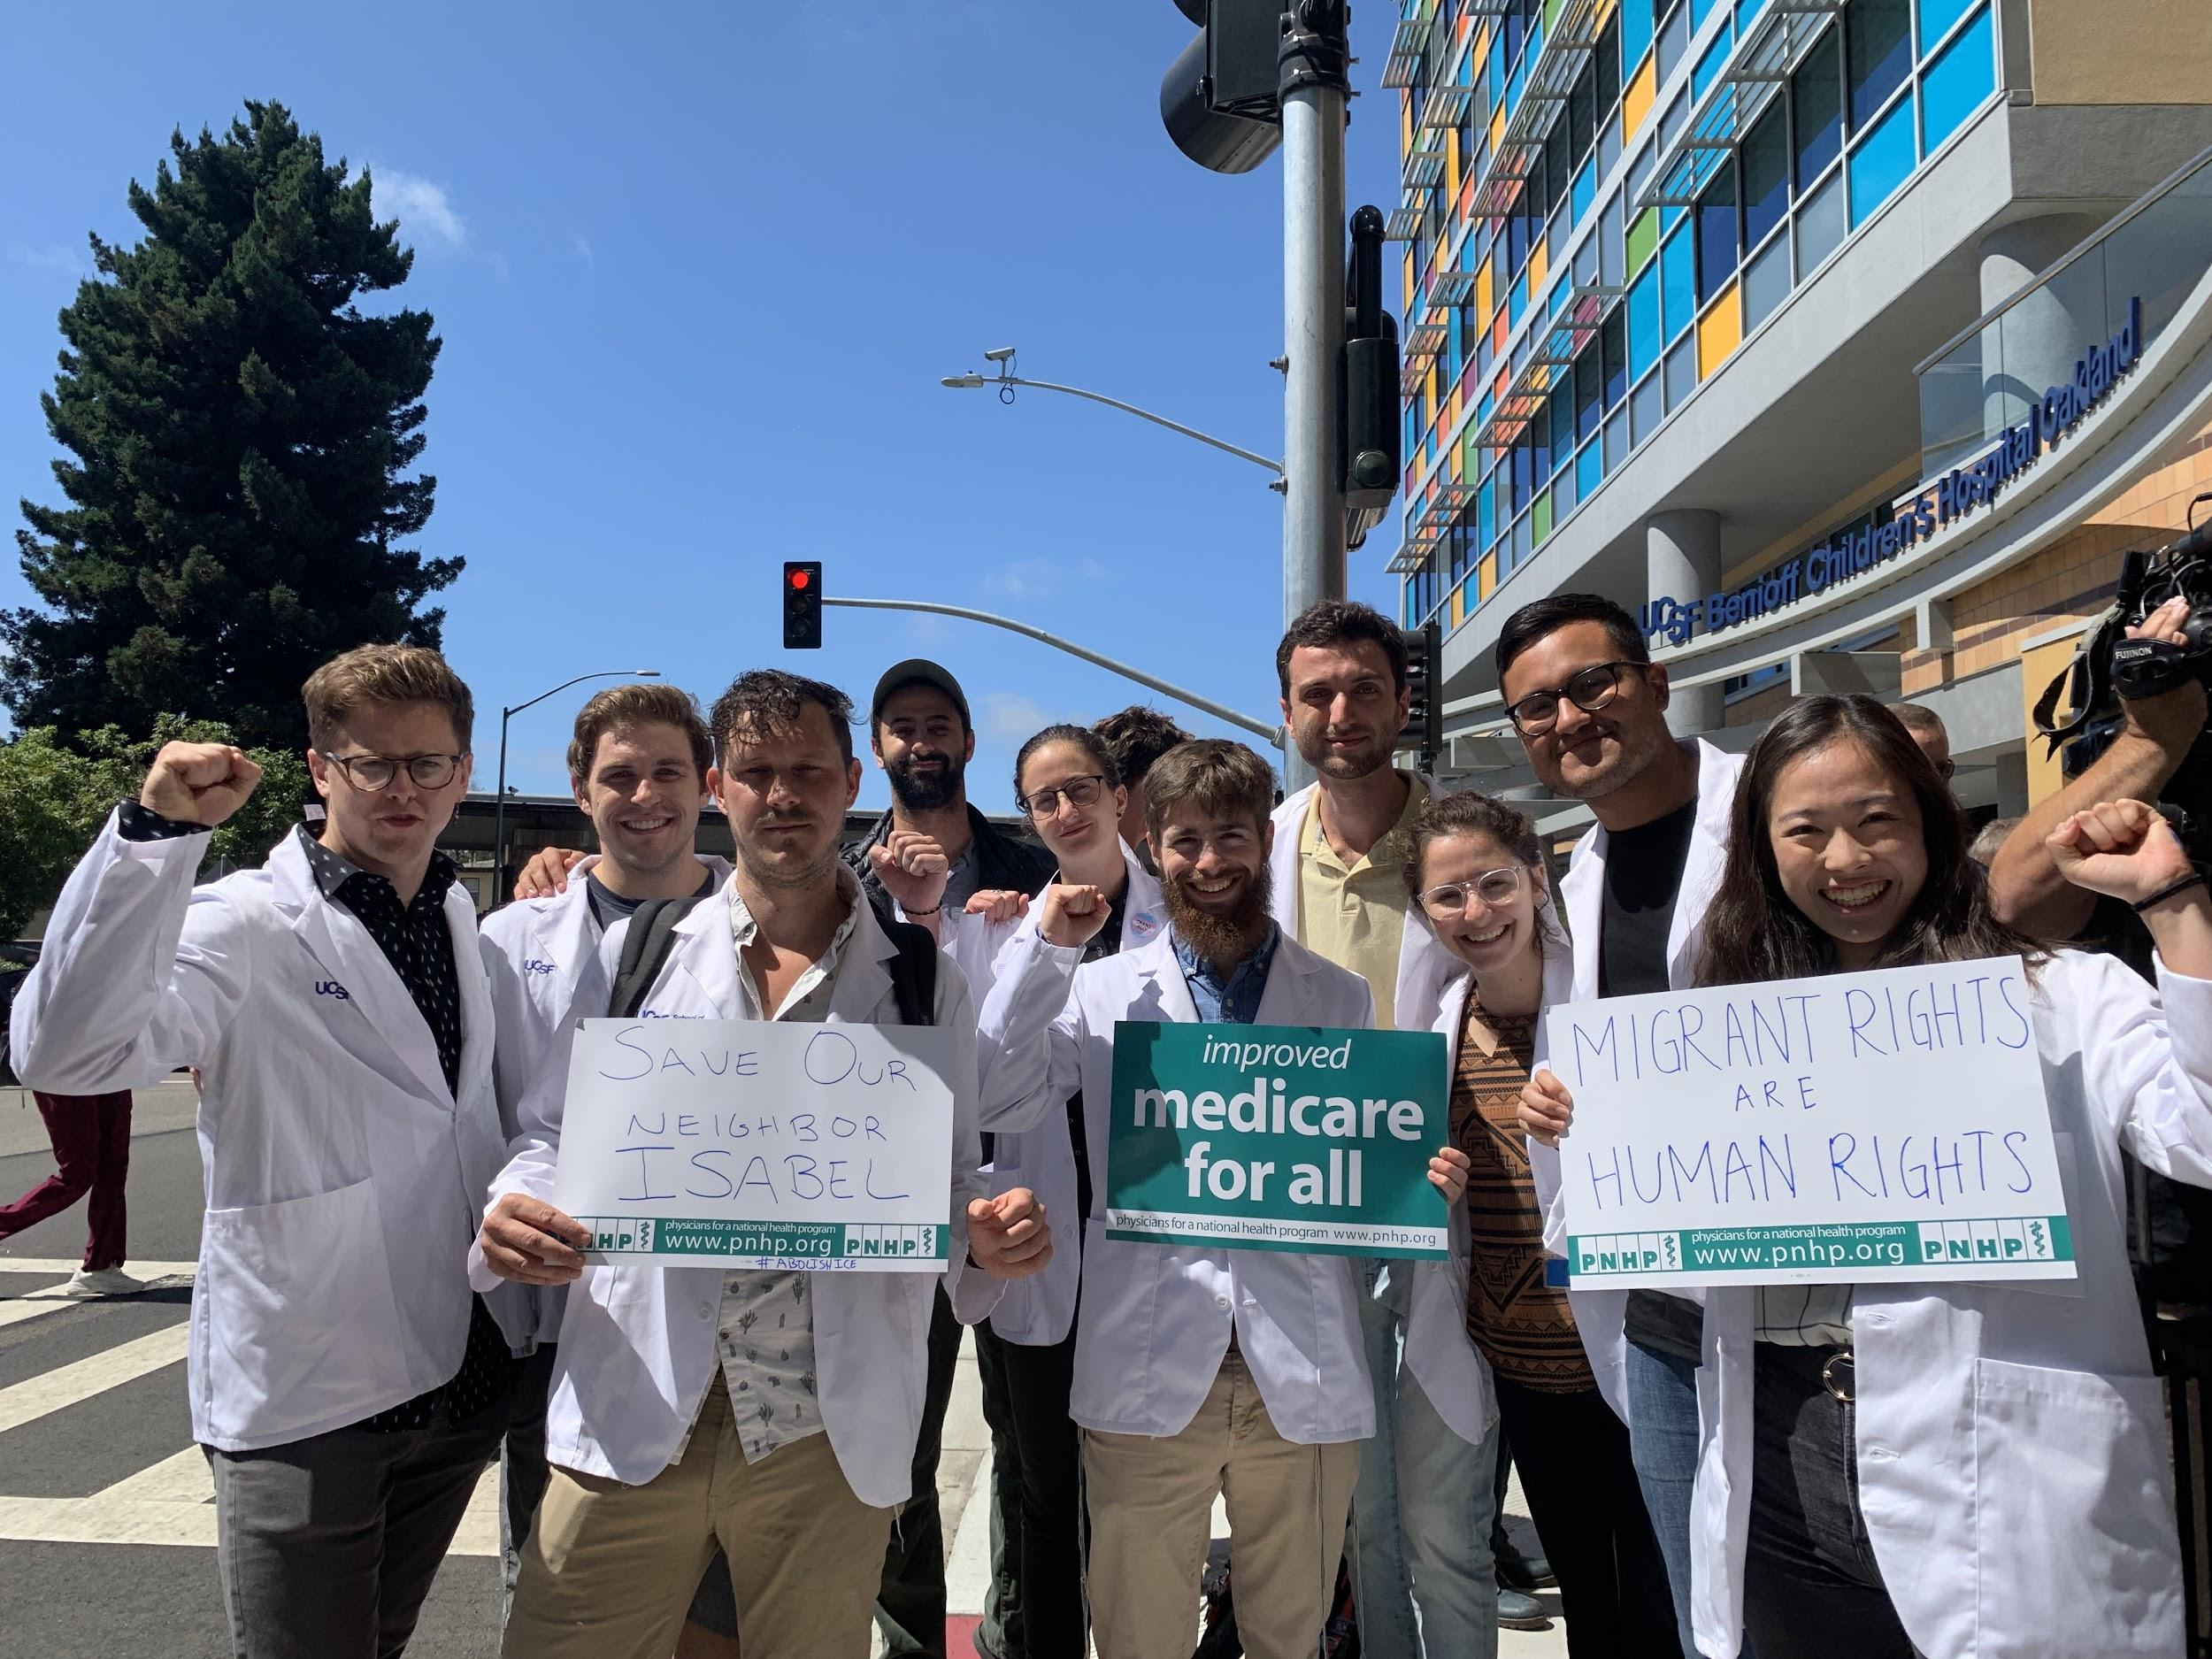
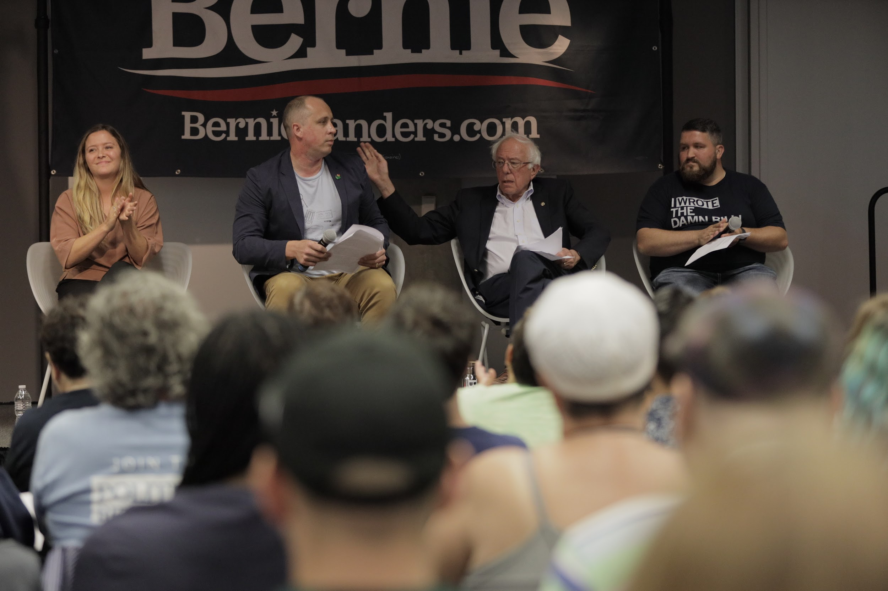
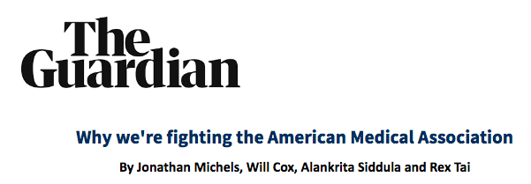
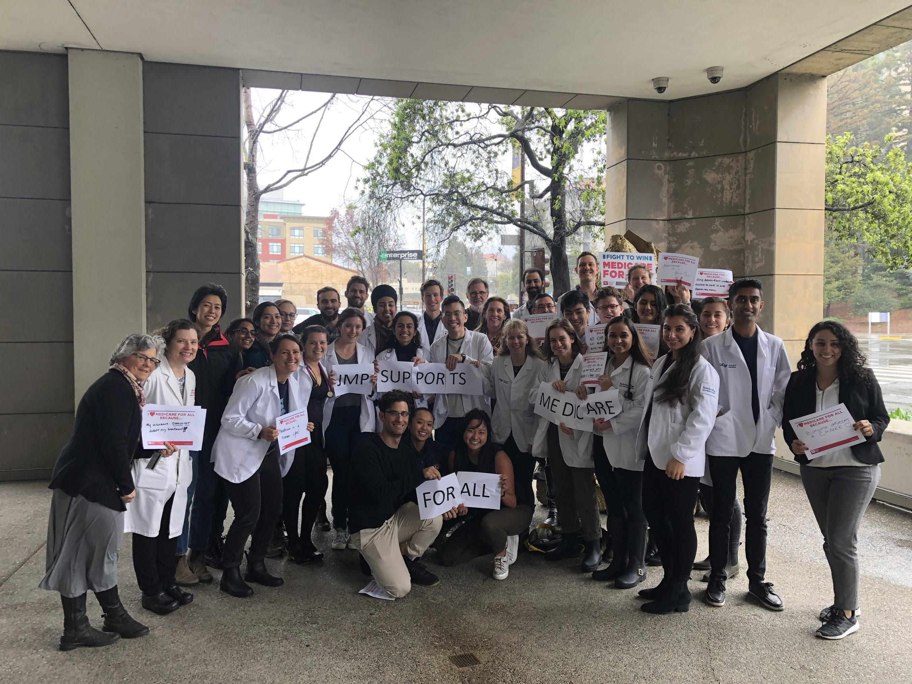
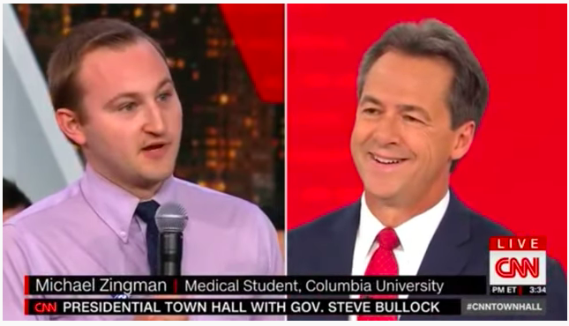
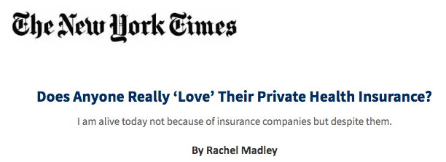
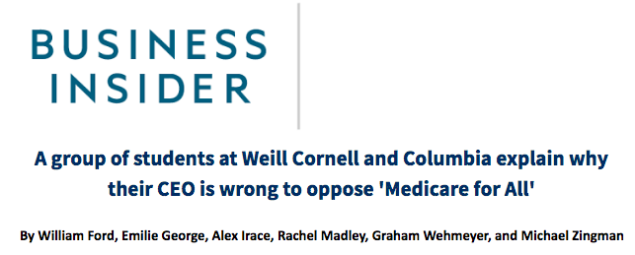
How to get involved- Newsletter and Videos

Slide 26
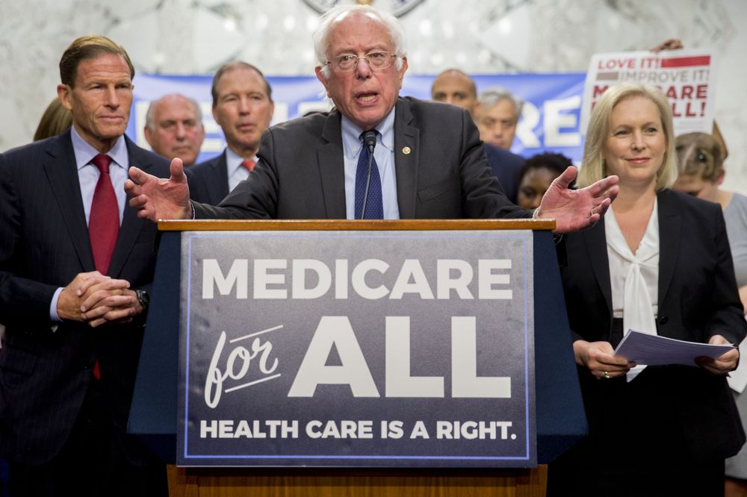
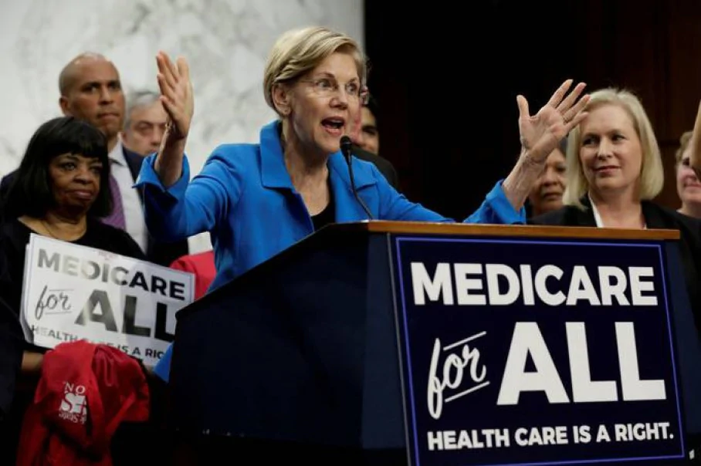
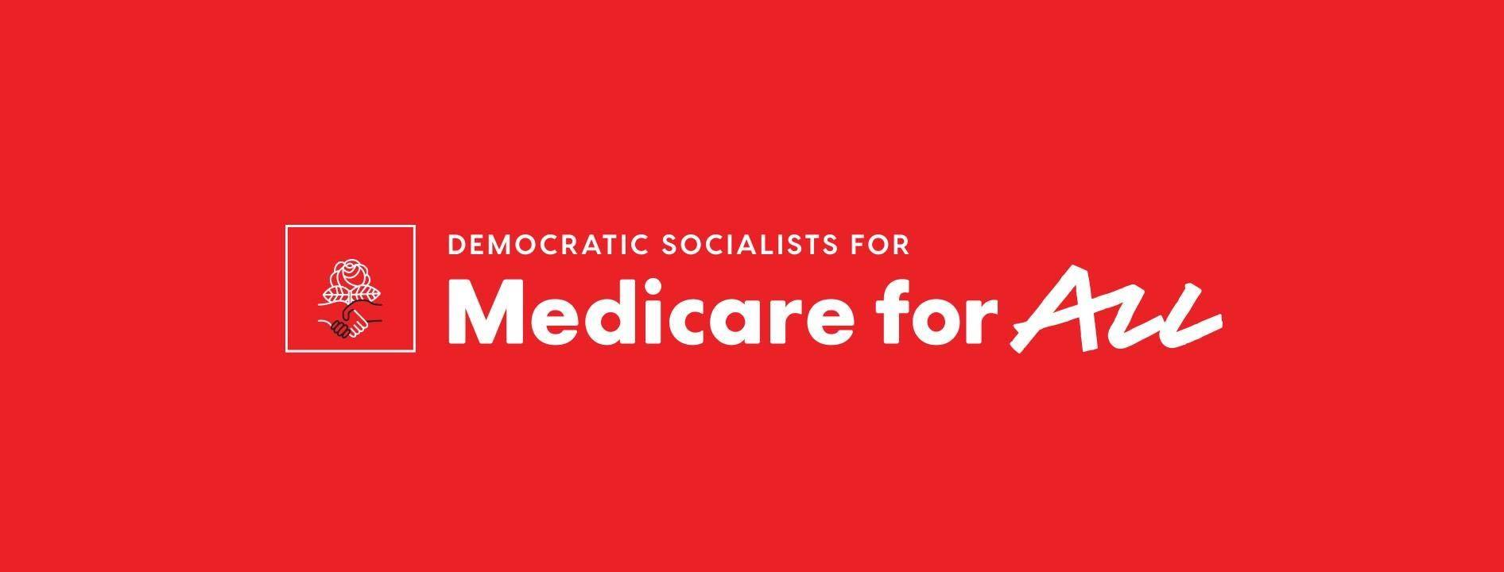
Getting Involved - join or support a coalition!

