Slide 1
Working with Media
A guide for SNaHP + PNHP activists 2020 SNaHP Summit
Clare Fauke is a communications specialist at PNHP.

Slide 2
Why bother with media?

Slide 3
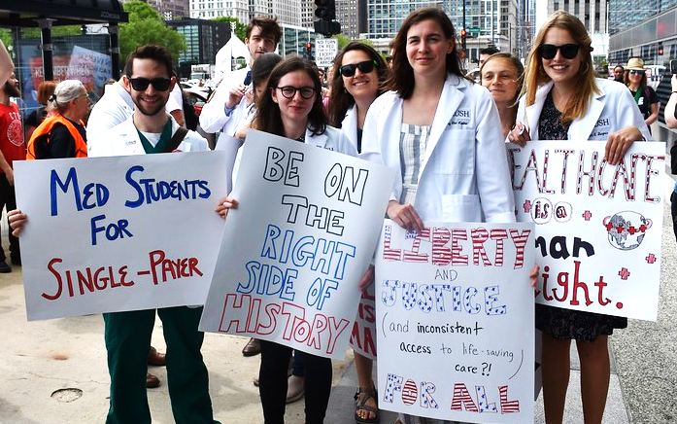
How do we get our message out?

Slide 4
Media tactics: Ranked in order of easiest to hardest. HINT: Like most things in life, the most difficult is also the most effective.
Letters to the Editor & Op-eds
Editorial Board meetings
Public Events

Slide 5
Letters to the Editor v. Op-eds
An Op-Ed is a short (600–750 words) article expressing an opinion or viewpoint on a timely news topic.
An LTE is a very short (150–200 words) response to current events or an article that recently appeared in the publication.

Slide 6
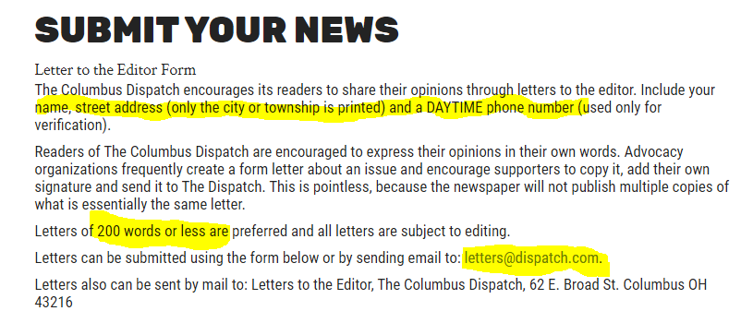
Op-eds & Letters to the Editor
Review your outlet’s submission guidelines!

Slide 7
Op-eds & Letters to the Editor
ALWAYS stick to word count limits.
Use your voice as a medical student, doctor, patient, etc. Lead with a personal experience.
Tie it to a news story or local official.
Use stats, but provide links to current, credible sources.
Submit in body of email (no attachments!). Include contact info and brief bio.

Slide 8
Editorial Board Meetings
What is an editorial board?
Includes editorial page editor, editorial writers, & reporters from various beats. Determines topics and positions for editorials.
Why meet with the editorial board?
Educate editors and reporters
Establish relationship with staff
Request endorsement of single payer

Slide 9
Editorial Board Meetings
How to set up a meeting:
Send an email to the opinion or editorial page editor to request a meeting: Briefly describe the issue, why it’s important, & your point of view. Follow up with phone call.

Slide 10
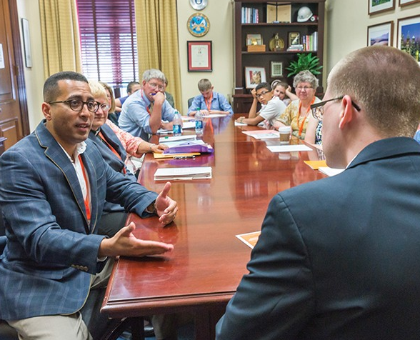
Editorial Board Meetings
Invite 1-2 colleagues
5-minute presentation making the case for single payer (no slide shows!).
One-page handouts for all participants.
Thank you and follow up.

Slide 11
Public Events
Movie screenings (Fix It, Big Pharma)
Educational panels
Rallies & Marches
“Die-ins”
Crash town hall meetings
NO PRESS CONFERENCES!

Slide 12
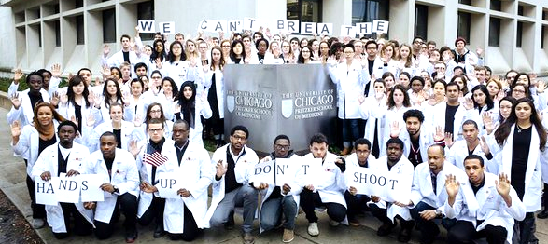
Public Events: Media strategy
Imagine the headline or photo you want to see published!

Slide 13
Public Events: Visuals, visuals, visuals
What is happening in this picture?

Slide 15
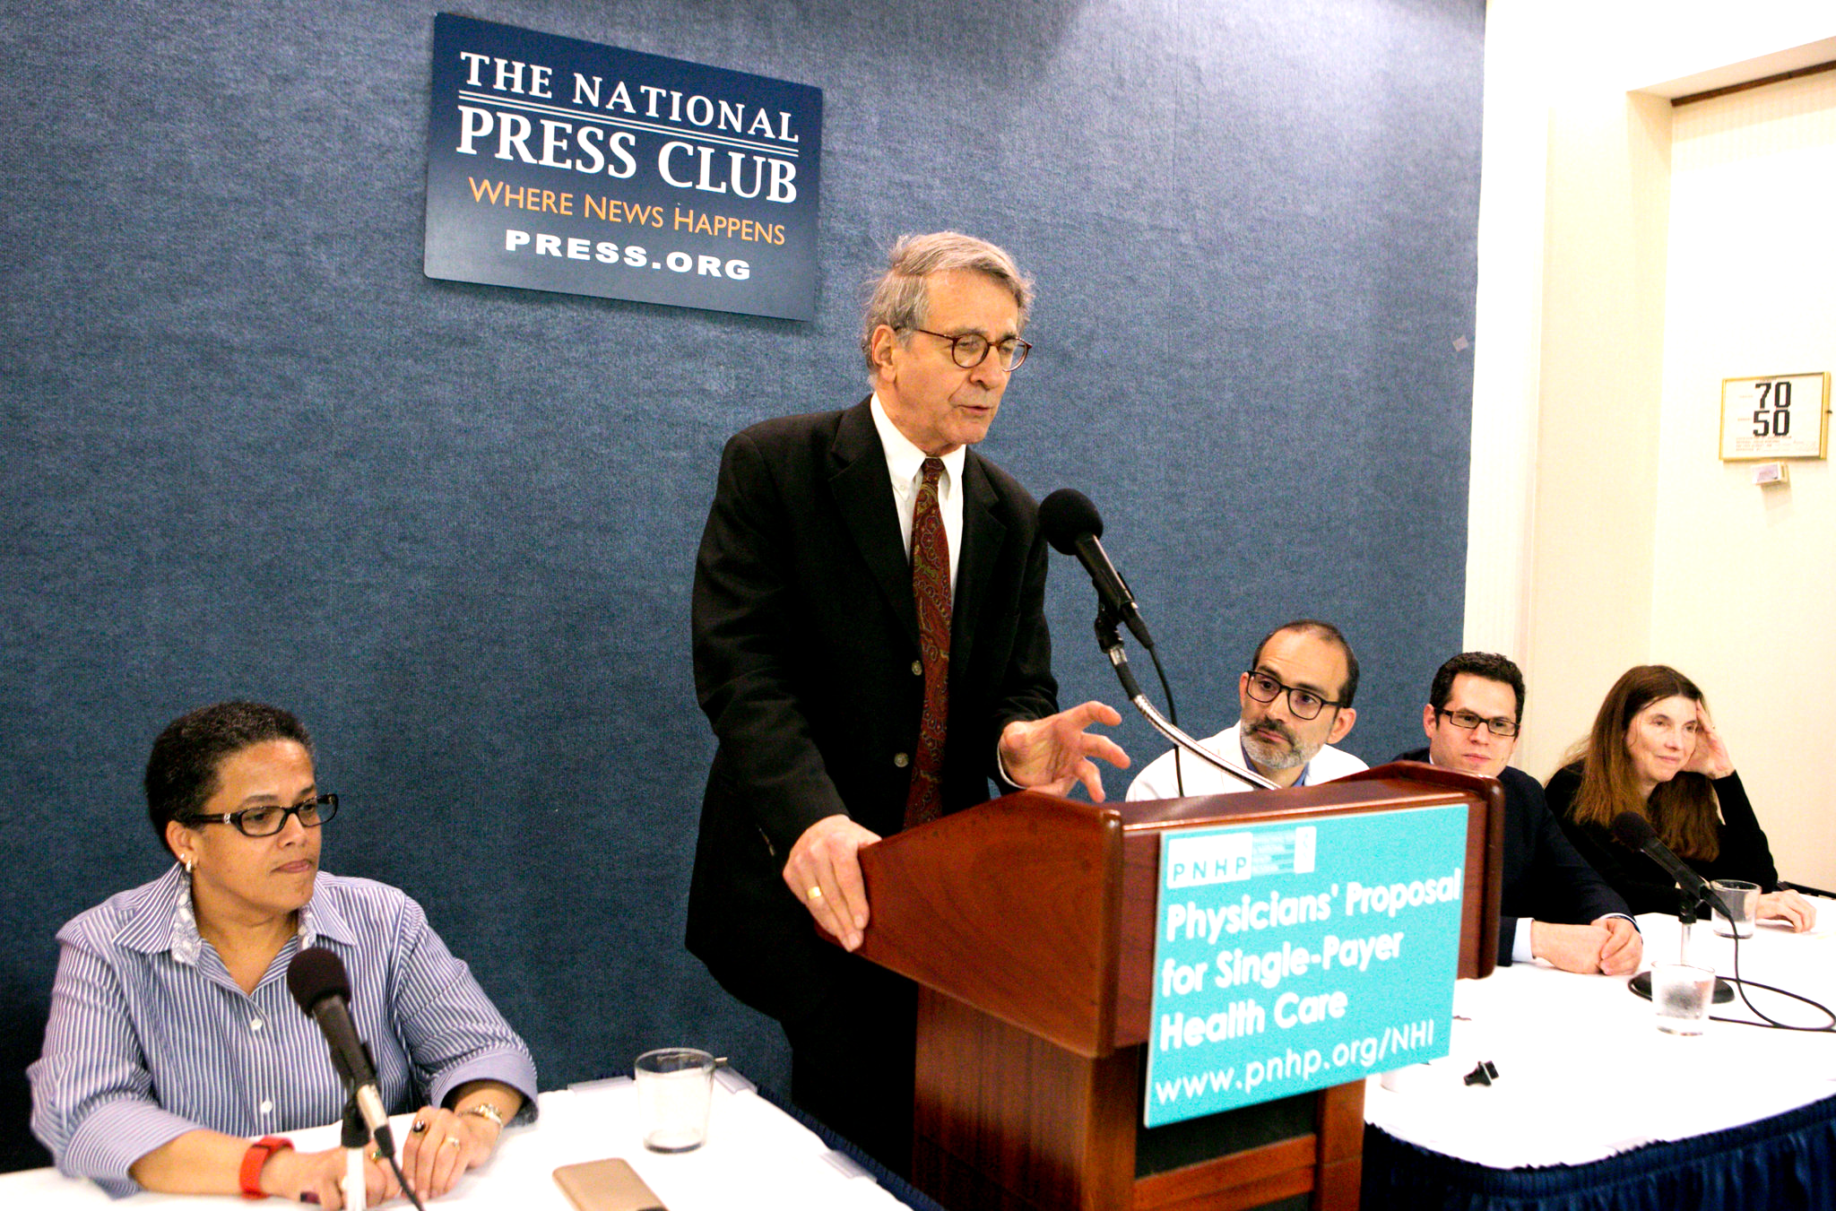
What is happening in this picture?

Slide 17
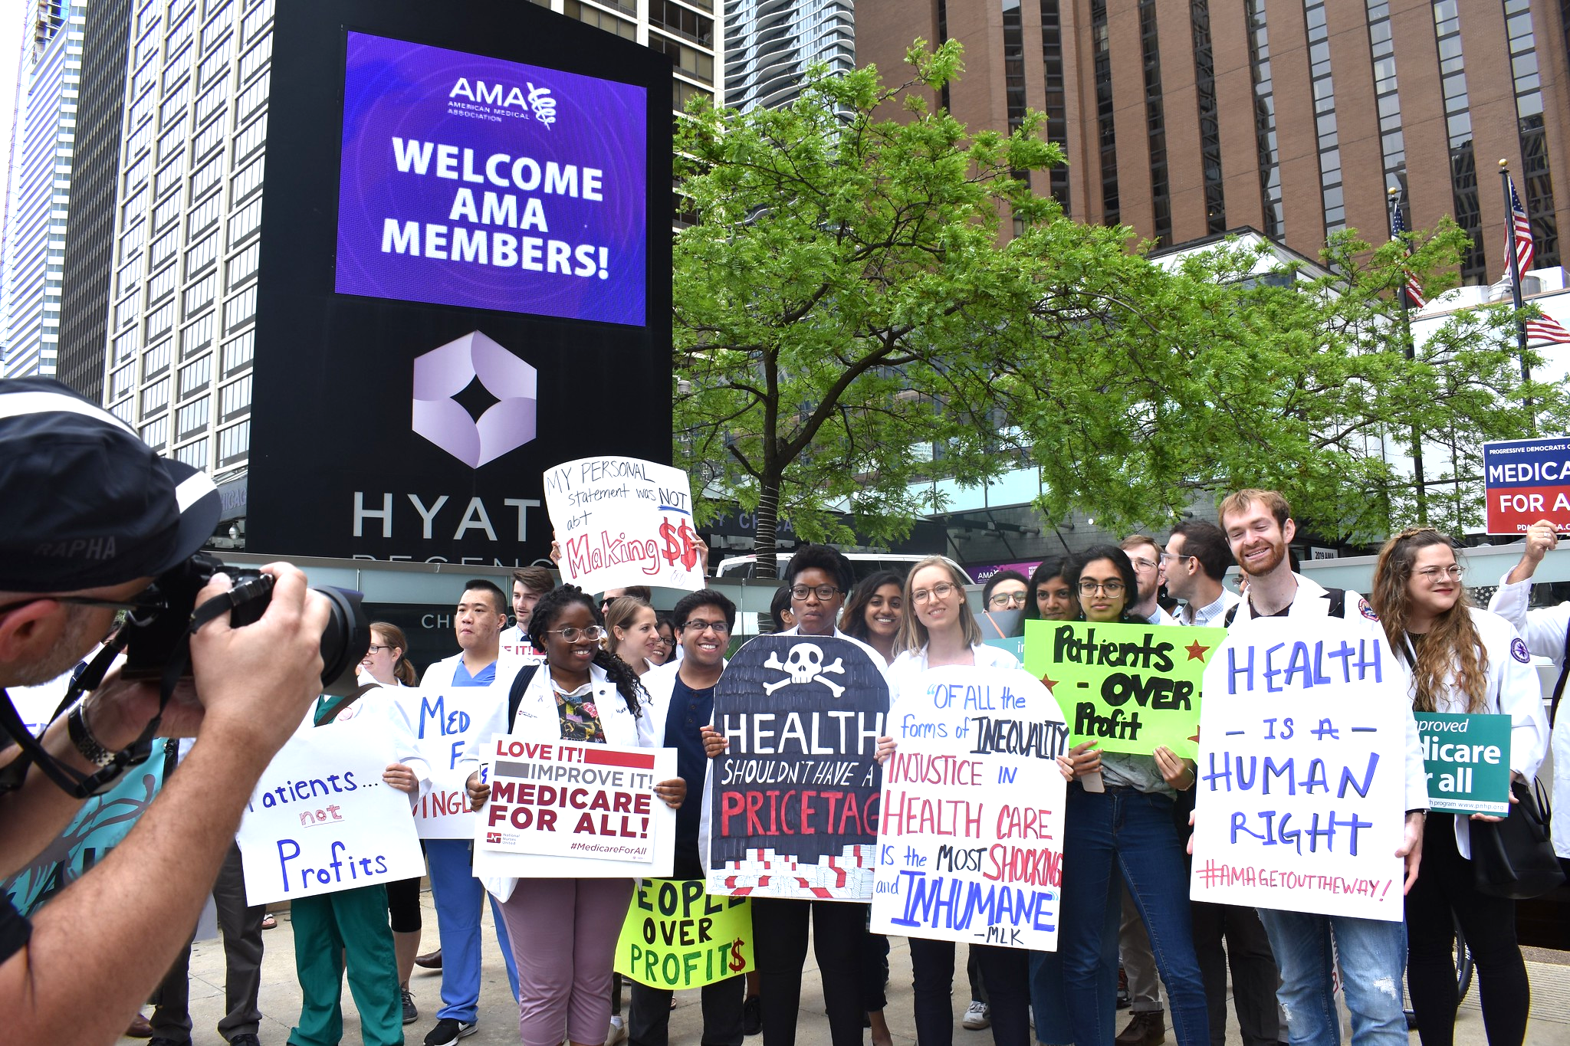
What is happening in this picture?

Slide 19
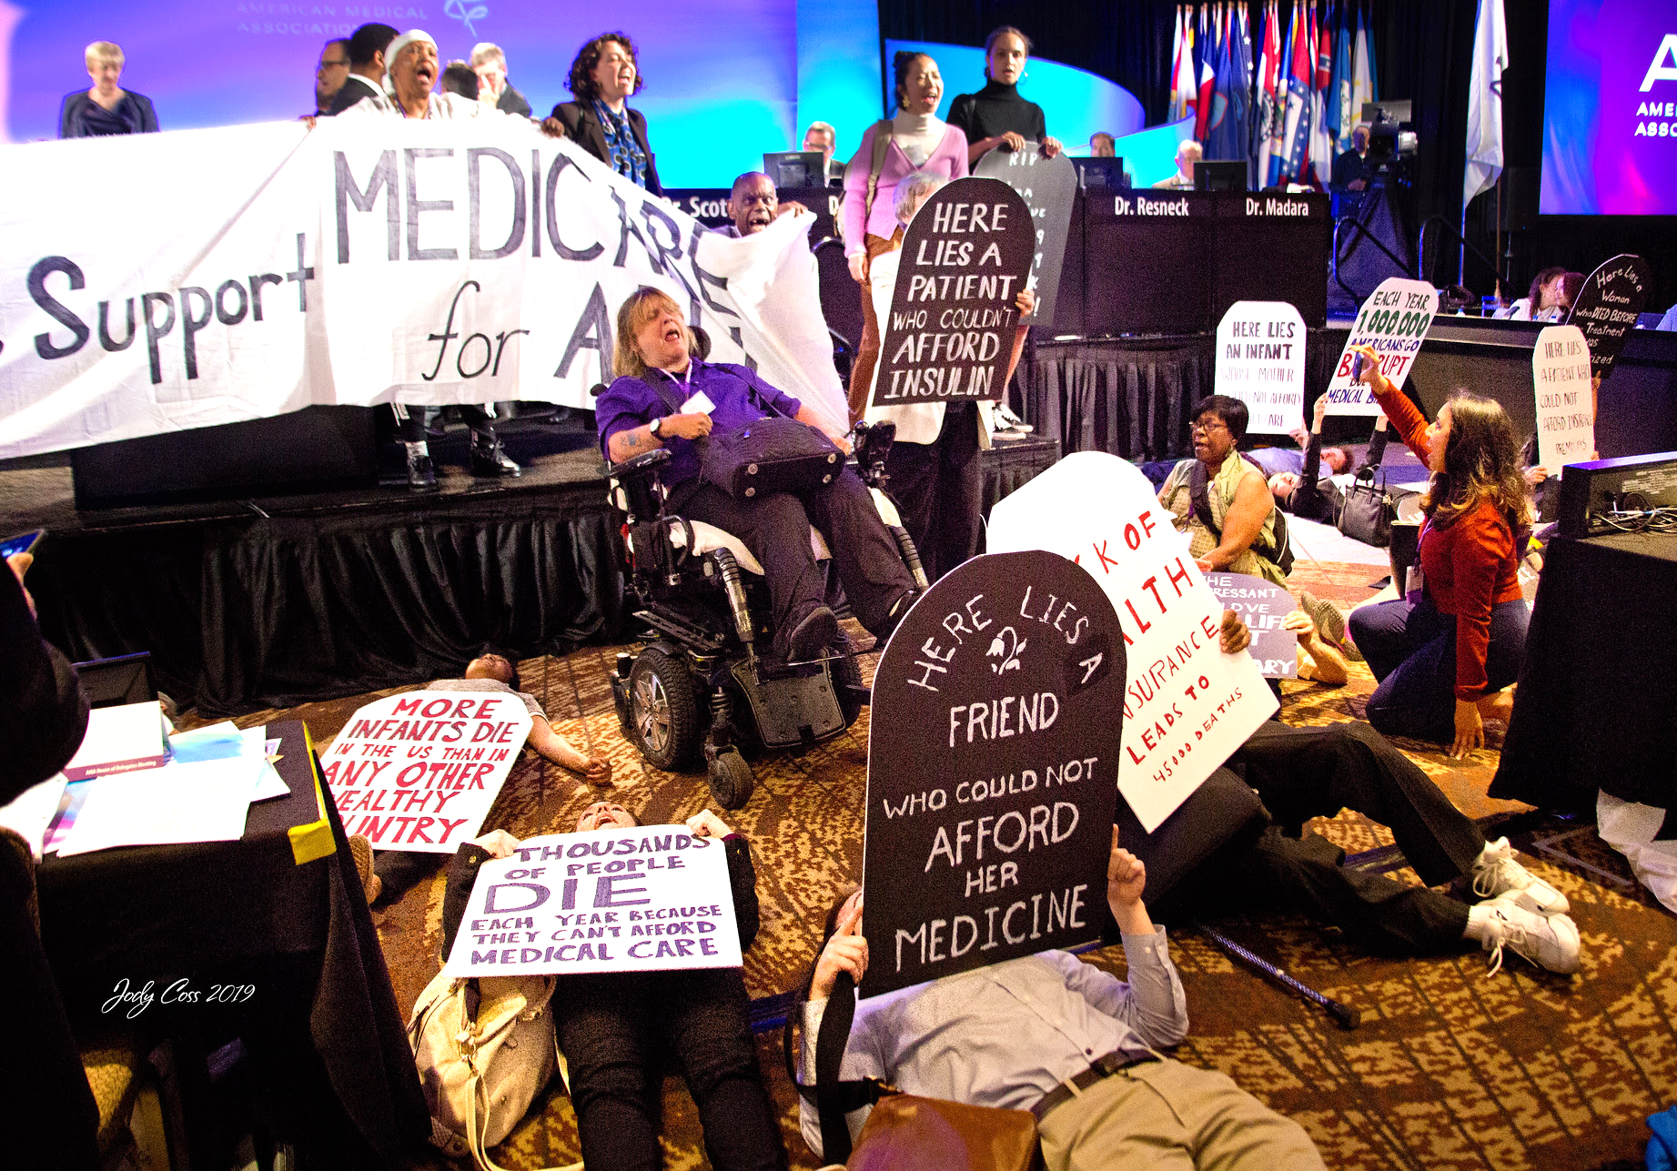
What is happening in this picture?

Slide 21
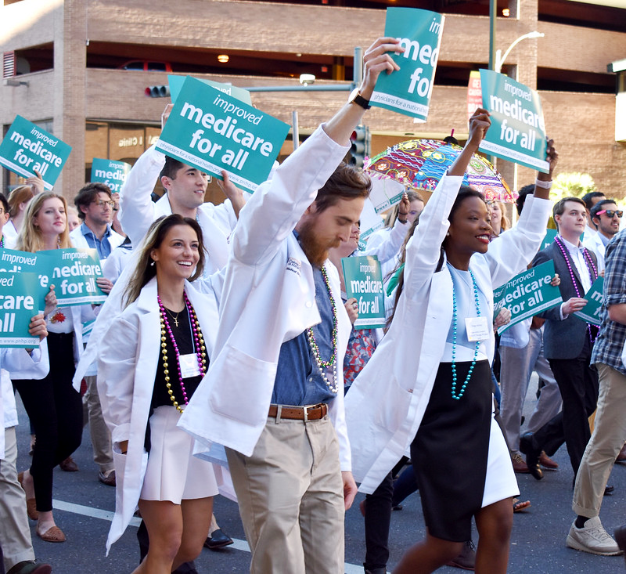
What is happening in this picture?

Slide 23
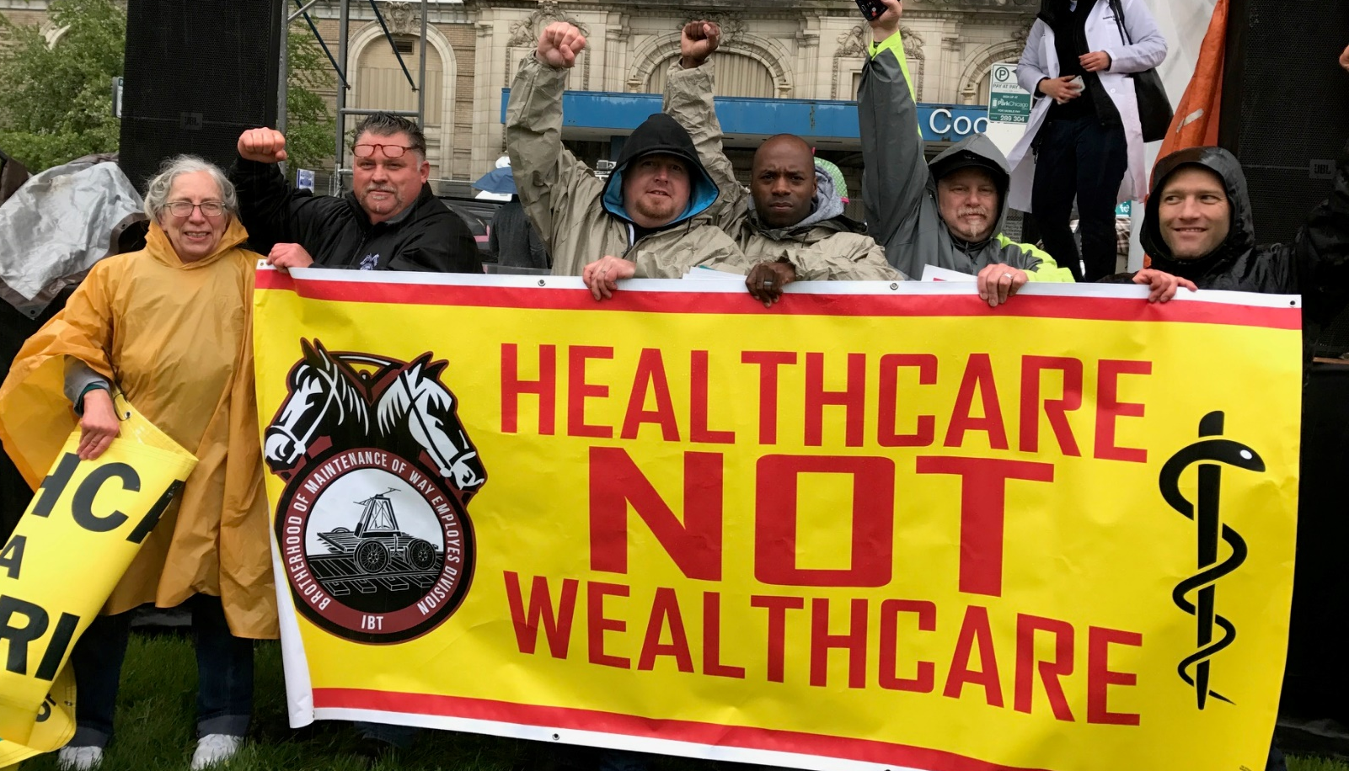
Public Events: Media strategy
Plan the event:
Early in the day (before noon)
Accessible location
Diverse & dynamic speakers
Visuals: White coats, signs, banners, props

Slide 24
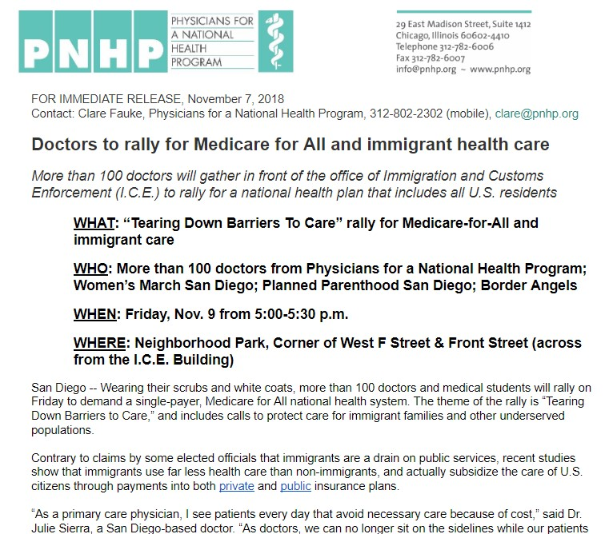
Public Events: Media outreach
Advisory: ✔ WHO ✔ WHAT ✔ WHEN ✔ WHERE ✔ WHY

Slide 25
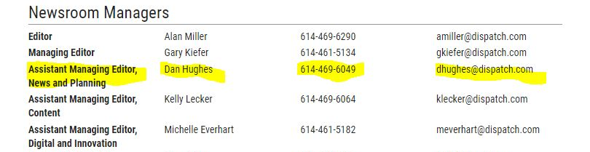
Public Events: Media strategy
Email advisory to health reporters & assignment editors 4-5 days ahead; follow up with call.

Slide 26
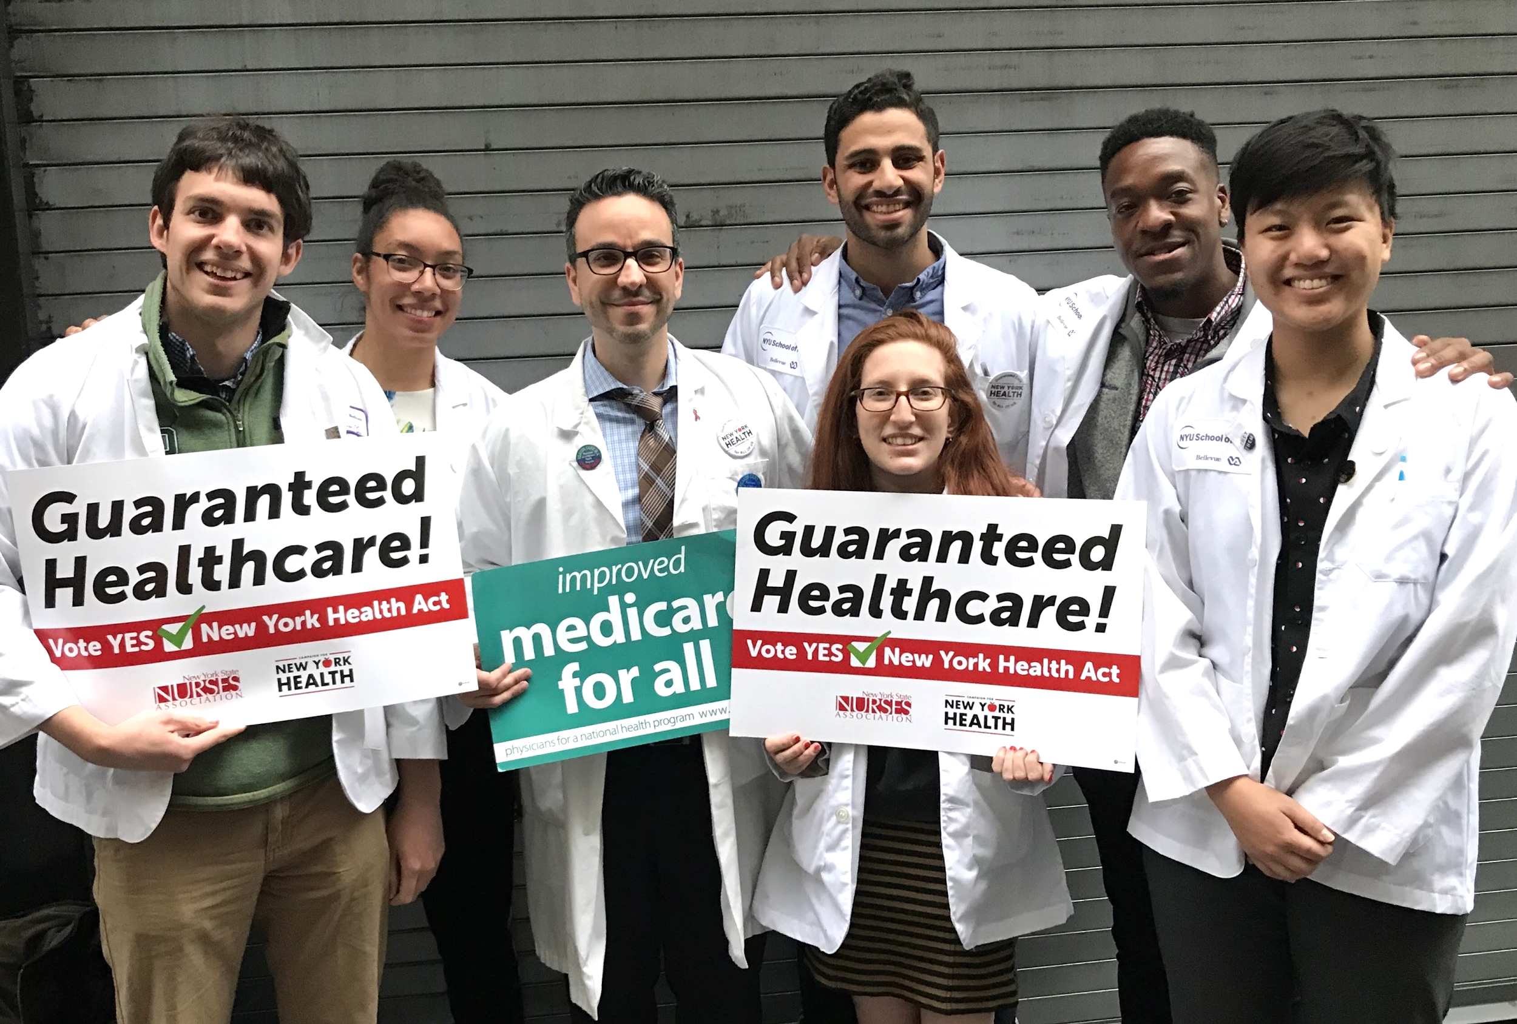
Public Events: Media strategy
Day of Event:
Press packets for dedicated liaison
Assign dedicated photographer
2-3 prepared spokespeople
Introduce yourself to anyone who even looks like a reporter.

Slide 27
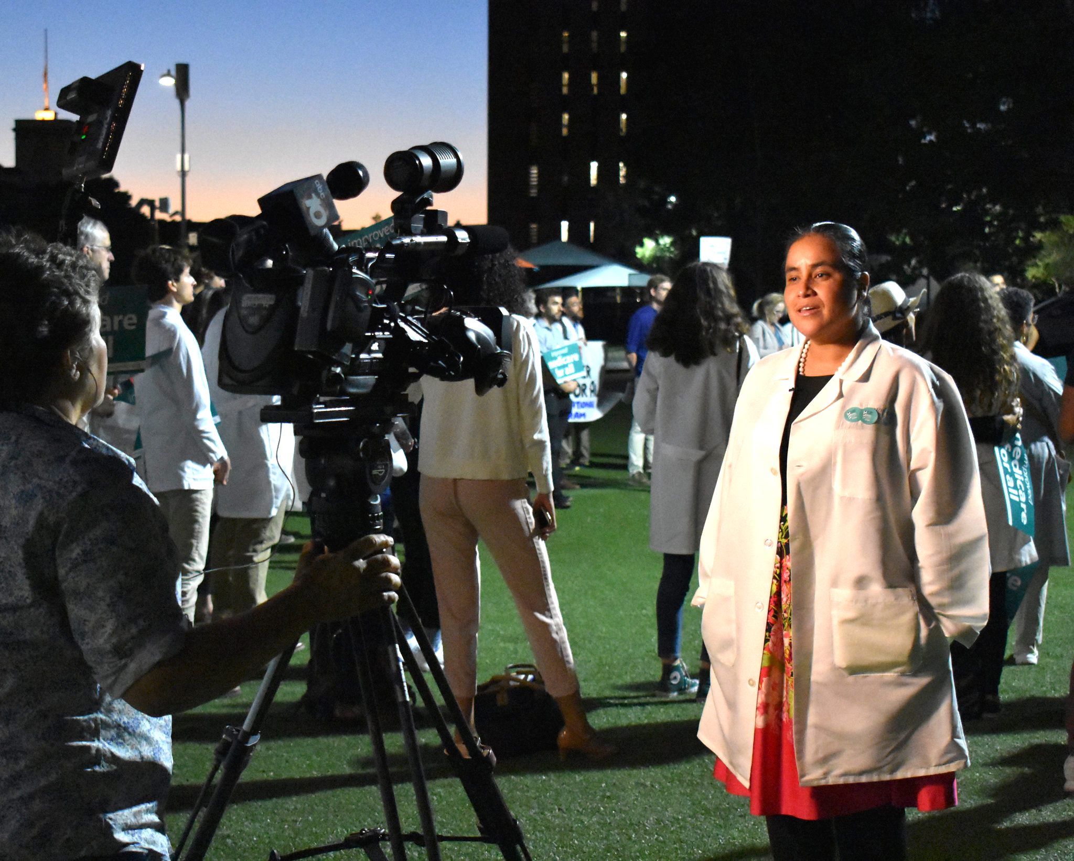
Talking with Reporters
Do your homework:
PNHP.org “FAQ” page
PNHP Data Update;
PNHP news
Subscribe to Don McCanne’s “Quote of the Day”
Read health care news every day
Make a list of tough questions and practice your answer!

Slide 28
Talking with Reporters
Stay on message: Address the question, then bring it back to single payer.
Don McCanne Rule: Conclude every statement with, “Under a well-designed single payer system…”
OK not to know: “I’m not sure but I’ll get back to you with the answer.” “I don’t know about that but I do know that with Medicare for all…” Bring it back to what you DO KNOW.
Doctor/ med student perspective: Use personal examples: patients delaying treatment, time wasted on billing, insurance denials, etc.

Slide 29
Talking with Reporters
Q: Won’t Medicare for all result in health care rationing? A: No, and in fact, the U.S. already rations care based on income. As a doctor, I see patients every day who skip medications or delay treatments because insurance refuses to cover it. More than 20,000 Americans die every year because they don’t have health insurance. That’s rationing! Under a well-designed single-payer system, everyone in the U.S. can see the doctor of their choice when they need to, not just when they happen to have coverage."

Slide 30
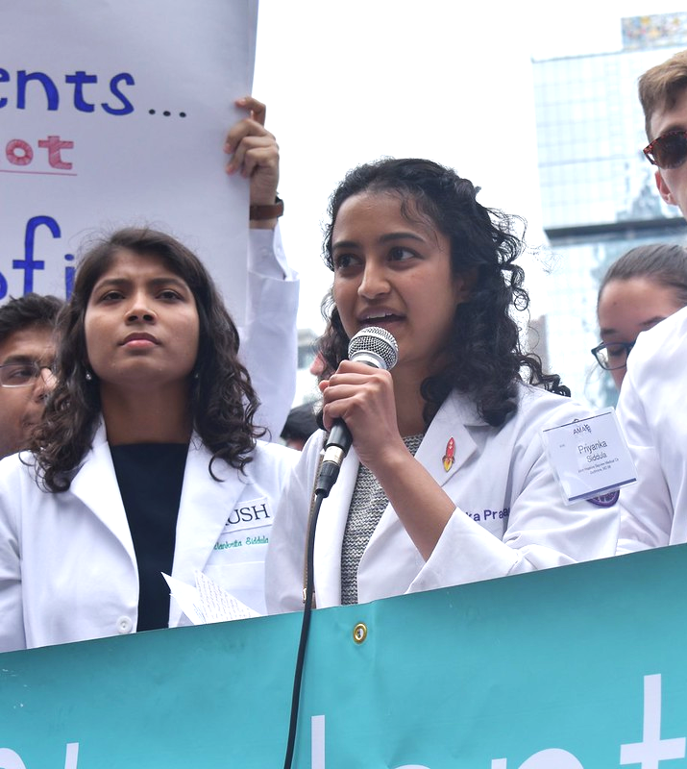
Talking with Reporters
Make bold, colorful statements & speak from a doctor’s perspective:
Use concrete examples from your own practice:
Patients waiting until it’s too late to seek care
Time wasted on billing
Insurance companies denying payment
Skyrocketing drug prices
Instead of, "Drug prices are a major concern for patients,” say, “One of my patient’s insulin costs went from $100 per month to $500 per month, and now she’s skipping doses in order to pay the rent!”

Slide 31
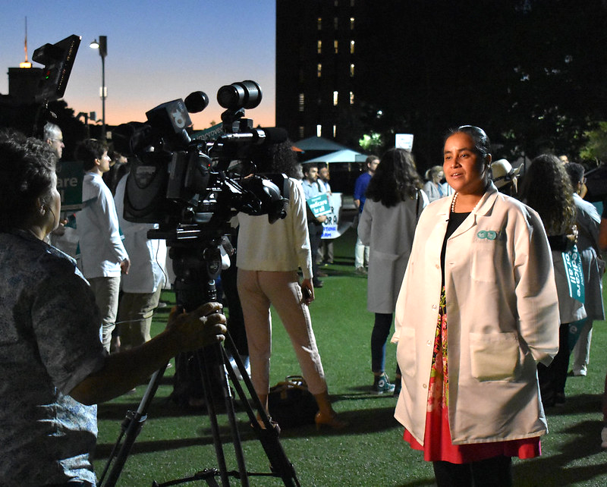
Talking with Reporters
Building long-term relationships: Journalists always seek new sources.
Email an introduction and offer expertise
Alert them about an event or study
Follow and interact with them on Twitter
Return phone calls ASAP
Refer them to other experts in your field
Introduce them to colleagues & patients
Push back when a reporter gets it wrong: Contact the reporter directly with a corrective. Stick to the facts and maintain a helpful tone. Offer new information or a different perspective.

Slide 32
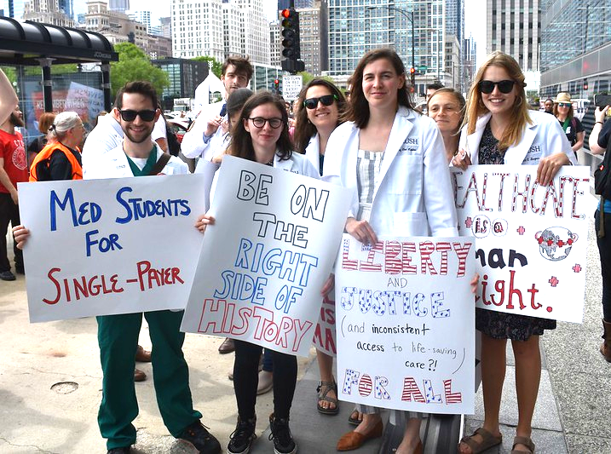
Need assistance?
Contact Clare Fauke, PNHP communications Specialist
Help with:
Editing & pitching letters & op-eds
Writing and pitching press releases
Developing a media plan
Preparing for interviews
clare@pnhp.org
312-782-6006

