Slide 1
Racism & For-Profit Healthcare in Pandemic Response Failures

Slide 2
Dr. Fegan has no financial disclosures

Slide 3
38,882 Deaths During 2019 Due to Uninsurance
State | % Uninsured | Excess Deaths
Texas | 18.1 | 6,731
California | 8.1 | 4,143
Florida | 14.5 | 3,999
Georgia | 14.6 | 1,989
North Carolina | 10.7 | 1,447
New York | 5.5 | 1,397
USA | 9.1% | 38,882
Woolhandler & Himmelsetin. Ann Int Med 2017;167:424
Based on best estimate from multiple studies of 1 death per 769 uninsured/year and number of uninsured at the time of the survey

Slide 4
Wages Are Not Keeping Up
Deductibles
150%
125%
100%
75%
50%
25%
0
Increase since 2009
Family premiums
Workers’ earnings
2009 | 2011 | 2013 | 2015 | 2017 | 2019
https://www.nytimes.com/2019/09/25/health/employer-health-insurance-cost.html Accessed Sept 27 2019

Slide 5
Under-Insurance Growing
Percent of Adults 19-64 under-insured*
Commonwealth Fund Health insurance Surveys 2003-2018
*Under-insurance is defined here as being insured all year, but out-of-pocket expenses were >10% of income (>5% of income if low income) or deductible was >5% of income

Slide 6
Uninsured and Under-Insured Delay Seeking Care for Heart Attacks
Odds ratio for delayed care*
Source: JAMA April 15, 2010. 303:1392
*Adjusted for age, sex, race, clin. charact., hlth status, social/psych fx, urban/rural.
Under-insured=had coverage but patient concerned about cost

Slide 7
Black Lives Are 3.5 Years Shorter than White Lives
78.8 Years
75.3 Years
Life Expectancy at Birth
(2017 data)
Black Americans
White Americans
https://www.cdc.gov/nchs/data/nvsr/nvsr68/nvsr68_07-508.pdf Accessed Jan 27 2020

Slide 8
Black Americans Die Younger Than White Americans
Across the USA: 4.5 years
In Illinois:
5.3 years
Life expectancy at birth (years)
https://mk0moaorgidkh7gsb4pe.kinstacdn.com/wp-content/uploads/2013/06/MOA-III.pdf
Based upon 2010 CDC data
Accessed Aug 28 2019

Slide 9
Early Death Among Blacks Is A Uniquely American Problem
1,200
1,000
800
600
400
200
0
Deaths per 100,000 people
Black Men USA
Black Men, 66 Countries
White Men USA
1980 | 1985 | 1990 | 1995 | 2000 | 2005
Am J Med. 2013 Jan;126(1):76-80

Slide 10
Until Age 65, Blacks Are 50% More Likely To Be Uninsured
Percent without health insurance,
ages 0-64.
2017 data
https://www.kff.org/report-section/key-facts-on-health-and-health-care-by-race-and-ethnicity-coverage-access-to-and-use-of-care/ Accessed Jan 27 2020

Slide 11
Medicare Means
Healthier Americans
1
3
5
7
9
11
13
15
17
USA
Rank
Age 65
Women
Men
0-1 | 1-4 | 5-9 | 10-14 | 15-19 | 20-24 | 25-29 | 30-34 | 35-39 | 40-44 | 45-49 | 50-54 | 55-59 | 60-64 | 65-69 | 70-74 | 75-79 | 80-84 | 85-89 | 90-94 | 95-99
Institute of Medicine. Shorter Lives, Poorer Health.
Fig 1-9: Ranking of US mortality rates by age group among 17 peer countries, 2006-2008. 2013
Peer nations are Australia, Austria, Canada, Denmark, Finland, France, Germany, Italy, Japan, Norway, Portugal, Spain, Sweden, Switzerland, Netherlands, United Kingdom
Age

Slide 12
Universal Healthcare Means
Racial Disparities Nearly Disappear
Dialysis
Americans on dialysis get Medicare
Blacks survive longer than whites
VA System
VA access does not depend on race
Blacks survive longer than whites
Age 65+
Aging into Medicare does not depend on race
Mortality rates quickly match across races
Dialysis: https://www.ncbi.nlm.nih.gov/pmc/articles/PMC2601720/ Accessed Sept 30 2017
VA: http://www.latimes.com/science/sciencenow/la-sci-sn-health-racial-disparities-va-20150922-story.html
DOI: 10.1161/CIRCULATIONAHA.114.015124; Kovesdy, Norris, Boulware, et. al, Circulation, Sept 18, 2015
Medicare:Thielke, Stephen, et al. J Pers Med 2015;5(4):440-451 doi: 10.3390/jpm5040440 Accessed Oct. 4, 2017

Slide 13
Race/Ethnicity and Maternal Mortality Every group in the US does worse than Canadians
Maternal
deaths / 100,000 live births, 2016
MMWR September 2019 and OECD

Slide 14
Pregnancy Is Particularly Dangerous for Black Women in America
Maternal deaths per 100,000 live births
2011-2016
63% of
pregnancy-related deaths were preventable
https://www.cdc.gov/reproductivehealth/maternal-mortality/pregnancy-mortality-surveillance-system.htm?CDC_AA_refVal=https%3A%2F%2Fwww.cdc.gov%2Freproductivehealth%2Fmaternalinfanthealth%2Fpregnancy-mortality-surveillance-system.htm
https://reviewtoaction.org/sites/default/files/national-portal-material/Report%20from%20Nine%20MMRCs%20final_0.pdf

Slide 15
Medical Conditions Shorten Black Lives
86% are amenable to
medical prevention
and treatment
Months of Adult Black Lives Lost as Compared to Whites
Ratios from MMWR May 2, 2017
Years assume a 4-year total difference for adults
Note: “Other” includes conditions (e.g., diabetes) for which Black death rates are higher and some (e.g., COPD, cirrhosis) for which Black death rates are lower.

Slide 16
Driving While Black More Likely to Be Searched, Less Likely to Be Found with Contraband
Black Rate / White Rate
(1.0 = Equally Likely)
Car Searched
Contraband Found Among Those Searched
NY Times 10/25/15

Slide 17
Police More Likely to Kill Minority Men
Police killings per day in USA: 2.8
Police killings account for
8% of all USA homicides
Police killings per 100,000 men
Source: AJPH 2018;108:1241

Slide 18
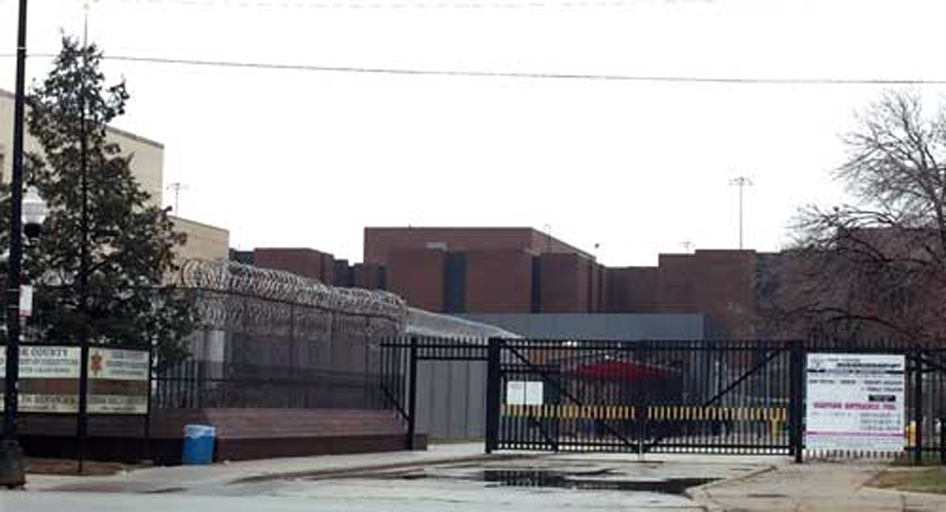

Slide 19
Now is the time, what are you waiting for?
What are you willing to do about it?
Who is your congressman?
Does your congressman support Single Payer?
Have you ever visited your congressman?
Have you ever written your congressman?
Have you ever called your congressman?
Are you willing to host an educational meeting?
When are you going to do it?

Slide 20
Medicare for All
is the answer.

