Slide 1
Find the Common Ground Policy Example: Medicare for All
Ed Weisbart MD, CPE, FAAFP
Physicians for a National Health Program
Chair, MO Chapter
pnhpMO@gmail.com

Slide 2
Subtle Differences in Words Matter
“How important is it to you…”
Turnout rate among registered voters; 2008 presidential election
“…to vote?”
“…to be a voter?”
Boyd, Christopher. Proceedings of the National Academy of Sciences USA, sited in Scientific American Mind Jan/Feb 2012 p.9.

Slide 3
Subtle Differences in Words Matter
“I”
“We”
“You”
Personal ownership
“I will build your HVAC system for you…”
Amorphous and distancing
Sounds like the “Big State”
Engaging ala Rush Limbaugh
“You know…”
Brings people inside
Worst use of pronouns:
“Let me explain this to you…”
Rush’s pronouns:
“You’re smart; you know that…”

Slide 4
Heads: You lose $100.
For you to agree to play,
how much do you need
to win on heads?
Losses are generally
worth double
of gains.

Slide 5
“95% chance of success”
“5% chance of failure”
This is
loss aversion.
“Outcomes? I don’t really track them.”

Slide 6
Medicare for All Focused on Loss Aversion
Gain Centric Messages
Loss Centric Messages
Save money for the other things you want.
See any doctor you want.
Live longer and healthier.
Stop wasting your money.
Don’t let anyone take away your choice of doctor.
Don’t die younger than you need to.

Slide 7
We Each Have Different Comfort Zones
Efficiency, financials, performance, measurements
Methods, regulation, quality, control, timing, policies
Facts
Forms
Manny Elkind
“Whole Brain Model”
Futures
Feelings
Concepts, vision, purpose, strategy, global
Relationships, communication, culture, values
Manny Elkind, Mindtech Inc.

Slide 8
Medicare for All from the Four Quadrants
Edit, re-edit, and edit again.
Take only your best shots.
Could add to Social Security Admin
Two live bills in Congress
Facts
Forms
Futures
Feelings
A healthcare system that is more fair, just, prudent, effective and accessible
Personal stories
Connect the dots to policy
Manny Elkind, Mindtech Inc.

Slide 9
“Liberals and conservatives each have different
deep narratives.”
Russell Hochschild, Arlie. Strangers in Their Own Land. 2018. pg 228

Slide 10
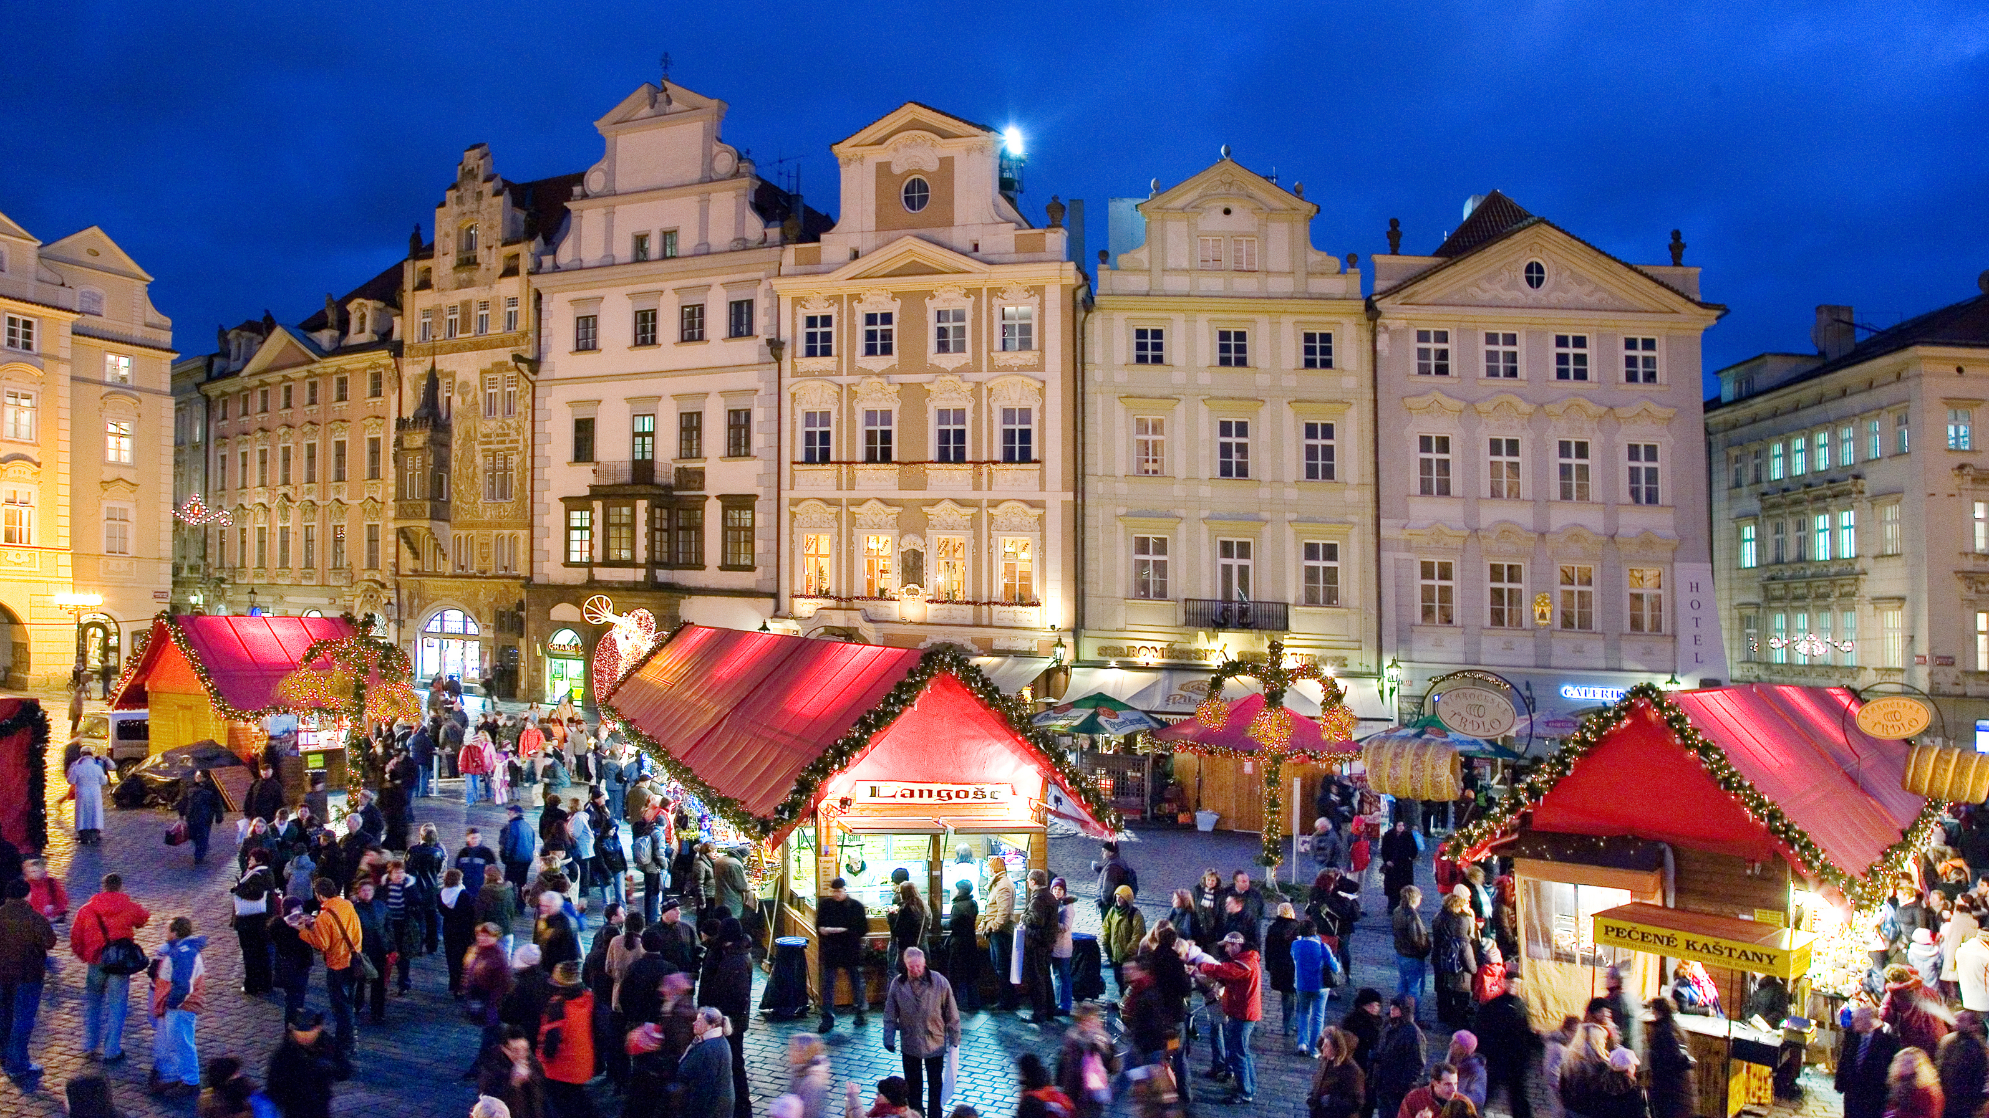
Liberal Deep Narrative
“We’re proud of this public square – we built it!”
“Marauders are invading it and dismantling it.”
“Their McMansions are built with our public bricks!”
Russell Hochschild, Arlie. Strangers in Their Own Land. 2018.

Slide 11
Conservative Deep Narrative
Waiting in line for the American Dream
Proud to wait patiently – but the line’s not moving
Government is escorting line-cutters to the head of the line.
Russell Hochschild, Arlie.
Strangers in Their Own Land. 2018.

Slide 12
“While economic self-interest is never entirely absent,
what I discovered was the profound importance of
emotional
self-interest.”
It’s all about the narrative.
Abstract data
does not address
real-life frustrations.
Russell Hochschild, Arlie. Strangers in Their Own Land. 2018. pg 228

Slide 13
Liberals and Conservatives Often Think Differently
George Lakoff
“Moral Politics”

Slide 14
Lakoff Identified Two Cognitive Models
Nurturant
Mother
Two-Framed
Strict
Father
Equality
Diversity
Helping hand
Both frames are active
Policies vary
Hierarchical
Social Darwinism
Consequences
20% of Americans
60% of Americans
20% of Americans
Liberals
Independents
Conservatives

Slide 15
Lakoff Identified Two Cognitive Models
Personal freedom, consequences of your actual choices, and prudence
Nobody should take away your choice of doctor
Less wasteful to buy insulin than dialysis
Use stories to activate nurturing frame.
Show the personal relevance of policies
Address gaps and misinformation.
Ask for commitment and action.
Liberals
Independents
Conservatives

Slide 16
Moral Foundations Questionnaire
Jonathan Haidt
“The Righteous Mind”
Online survey of 132,000 Americans
Identified five moral pillars
Compared individual scores with where people stood on the political spectrum
Haidt, Jonathan. The Righteous Mind. 2013.

Slide 17
Five Moral Pillars
Fairness
Reciprocal altruism, justice, rights, autonomy
Caring
Cherish, nurture, and protect others
Loyalty
Patriotism, self-sacrifice, “one for all, all for one”
Authority
Deference to leadership, respect for traditions
Sanctity
Bodies are temples desecrated by immorality
Haidt, Jonathan. The Righteous Mind. 2013.

Slide 18
Our Personal Moral Pillars Vary With Our Politics
Strongly
Endorse
Fairness
Caring
Both sides believe
they hold the
moral high ground.
“You heartless
bastards don’t care.”
“Your lack of morals will destroy our society.”
Loyalty
Authority
Sanctity
Strongly
Reject
Very Liberal | Slightly Liberal
Moderate
Slightly Conservative | Very Conservative
Chart from Haidt, Jonathan. The Righteous Mind. 2013.
(Commentary by Ed Weisbart)

Slide 19
Five Moral Pillars of “Cover Everybody”
Do not expect
these two arguments
to persuade conservatives.
Fairness
Healthcare is a human right
Caring
Protect the vulnerable
Loyalty
Poor outcomes but plenty of reasons for national pride
Authority
Sanctity

Slide 20
Medicare Means
Healthier Americans
1
3
5
7
9
11
13
15
17
USA
Rank
Age 65
Women
Men
0-1 | 1-4 | 5-9 | 10-14 | 15-19 | 20-24 | 25-29 | 30-34 | 35-39 | 40-44 | 45-49 | 50-54 | 55-59 | 60-64 | 65-69 | 70-74 | 75-79 | 80-84 | 85-89 | 90-94 | 95-99
Institute of Medicine. Shorter Lives, Poorer Health.
Fig 1-9: Ranking of US mortality rates by age group among 17 peer countries, 2006-2008. 2013
Peer nations are Australia, Austria, Canada, Denmark, Finland, France, Germany, Italy, Japan, Norway, Portugal, Spain, Sweden, Switzerland, Netherlands, United Kingdom
Age

Slide 21
Five Moral Pillars of “Cover Everybody”
Fairness
Healthcare is a human right
Caring
Protect the vulnerable
Loyalty
Poor outcomes but plenty of reasons for national pride
Mention, but don’t over-emphasize, your sources.
Refer to the support among physicians and faith leaders.
Authority
Sanctity
Medicare keeps us from poverty and extends our lives

Slide 22
Take Advantage of Tribalism
“Our brains were
designed for tribal life,
for getting along with
a select group of others (Us) and for
fighting off everyone else (Them).”

Slide 23
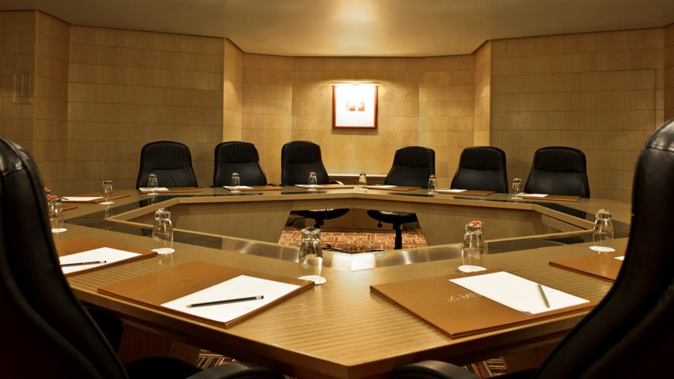
Take Advantage of Tribalism
“Moral Tribes”
Joshua Greene
“Cubs or Cards???”

Slide 24
Take Advantage of Tribalism
The
Common Ground
No.
But we could meet you this far…
Yes.
Here’s what that could look like…
Tribalism
working against you.
Knocking on the
door of the tribe.
Weaponized empathy.

Slide 25
Take Advantage of Tribalism
One good example
Translation:
“I’m in your tribe”
Lakoff frames:
Nurturing + hierarchy
Moral Pillars:
Loyalty and Authority
“Most of you know me as the neighborhood pediatrician
but you may not realize
I also run a
small business.”
Amy Evans MD at a PNHP workshop, Nov. 3, 2017

Slide 26
Is Healthcare a Human Right?
Liberal mantra answer: Yes
WHO Constitution:
“…the highest attainable
standard of health as a fundamental right of every human being.”
www.who.int/mediacentre/factsheets/fs323/en/

Slide 27
Is Healthcare a Human Right?
Liberal mantra answer: Yes
Conservative reaction: Not so fast, Bub.
“Where is that in the US constitution?”
“Where is that in the bible?”
“So my patients have a human right to wake me up whenever they want?”

Slide 28
Is Healthcare a Human Right?
COMMON GOOD
Fairness? Caring?
Try tapping into
Loyalty
Prudence
Common Good
The American Dream

Slide 29
The Big Trap
Watch out for power words:
“Abolish”
“Private”
“Government-run”
“Healthcare”
”Who wants to abolish private insurance for a government-run healthcare?”

Slide 30
Try These On Instead
Insurance is
not “private”
No one loves
their insurance
Stop wasting
our money
Your insurance is corporate-run, selected by your employer, outside of your control, and changes every 18 months.
The health insurance industry is the 4th most hated in the USA, according to Forbes Magazine.
Medicare for All
is far less expensive than the status quo, according to the Koch Brothers.
https://www.nationofchange.org/2020/01/21/seven-pointed-questions-for-corporate-media-about-their-biases/?fbclid=IwAR1NRaEgcQ0gJImpynmorK0Llk-hRLn7OBJKoV_sQ_8oMYPBrwNNRz15M38
https://www.forbes.com/sites/blakemorgan/2018/10/16/top-5-most-hated-industries-by-customers/#7064c60d90b5
Accessed Jan 22 2020

Slide 31
Seven Key Tools
Careful use of terms like “Human Rights”
Make tribalism work for you
Use your listener’s moral pillars
Early on, activate the frame you want
Speak in the matching quadrant
“Yes, but” instead of “No, except”
“Loss Aversion” instead of “Gain Centric”

Slide 32
Physicians for a National Health Program
Join us at PNHP.org
Sign up for emails: Free
Med students: Join for Free
Residents $40/year
Attendings: $180/year
Facebook:
DoctorsForSinglePayer

