Slide 1
The end of Traditional Medicare?
Direct Contracting Entities
Ed Weisbart MD, CPE, FAAFP
Physicians for a National Health Program
Chair, MO Chapter

Slide 2
To understand why money is pouring into DCEs,
First Understand “Medicare Advantage”
Traditional Medicare
(No intermediaries)
Providers (Physicians, hospitals,
ACOs, etc.)
Medicare Advantage
(Insurance intermediaries in Medicare)

Slide 3
Medicare Advantage Is a Money Machine
PCPs submit more codes
MA Plan submits
more codes to CMS
PCP coding
has become a
business imperative for Wall Street.
Medicare Trust Fund pays more to MA
CMS pays
more to MA Plan
Seniors pay higher Part B premiums
Slight improvements
in MA Plan products
More members
join MA Plan
Higher dividends, stock buy-backs
MA Plan grows
More profits for practice owners

Slide 4
Physician coding drives “Risk Scores”
Risk Scores Drive MA Reimbursements
Healthy 76F | HCC
Baseline for age | .45
No extra codes | 0
 | 0
 | 0
 | 0
 | 0
 | 0
 | 0
Typical Coding | HCC
Baseline for age | .45
Obesity | 0
Type 2 Diabetes | .104
Major Depression | 0
CHF | .323
Asthma | 0
Ulcer, unspecified | 0
CHF*DM | .154
Detailed Coding | HCC
Baseline for age | .45
Morbid Obesity | .273
DM w/ retinopathy | .318
MD, Sing Ep, Mild | .395
CHF, Class 3 | .323
COPD | .328
Ulcer, stage 3 | 1.204
CHF*DM,COPD | .154, .19
Risk Score = 0.45
CMS pays MA $4,000
Risk Score = 1.03
CMS pays MA $9,000
Risk Score = 3.63
CMS pays MA $32,000
Source: https://downloads.healthcatalyst.com/wp-content/uploads/2019/04/HCC-coding.png
Notes:
5 Ways to Improve HCC Coding Accuracy and Risk Adjustment (healthcatalyst.com)

Slide 5
Higher coding = Risk Score Gaming
A Suite to Optimize Business Results
Incessantly search for more codes
  Home care visits, annual Wellness exams, monthly PCP office visits
  Data-mining of electronic health records (falls within HIPAA TPO exceptions)
  Artificial Intelligence and Machine Learning software tools
Incent providers to submit more and better codes
  Incentives for business metrics (“HCC Gap Closure” and “RAF Recapture Rate”)
  Direct financial incentives
Strategic pricing to optimize Plan financial results
  Interface of profitability, growth, and member benefits

Slide 6
Risk Score Gaming
Has Created New Industry Segments
Home Visit companies to document codes
Analytic start-ups to drive identification of codes
EHR modules to drive capture of codes
Artificial Intelligence & Machine Language coding software
Primary Care MA-focused start-ups
Strategic bidding actuarial support
Designed to improve outcomes – financial, not clinical
https://www.health.harvard.edu/blog/medicare-advantage-when-insurance-companies-make-house-calls-201512168844

Slide 7
Because Risk Scores are worth so much money,
MA Plans Have Become Masters of Coding
1.08
1.06
1.04
1.02
0
.98
.96
.94
.92
.90
Average risk score of
MA plan members vs Traditional Medicare
“Mortality rates, MCBS surveys, Rx drugs, and other data show
little if any change in real relative risk.”
2007 | 2008 | 2009 | 2010 | 2011 | 2012 | 2013 | 2014 | 2015
https://www.healthaffairs.org/do/10.1377/hblog20200127.293799/full/

Slide 8
PCPs are the most immediate path to higher scores, so
Plans Incentivize Them in 3 Ways
1. Plan pays PCPs more for coding
2. “Value Based Care” contracts share a percentage of the Plan’s risk-adjusted premiums with network PCPs
3. Plan purchases PCP practices and internalizes the profits of gaming the risk scores

Slide 9
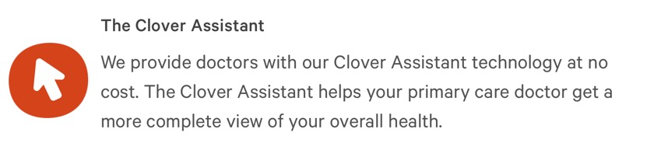
Incentive Type 1:
Incent PCPs to Code More
Example:
Clover Health -- A Medicare Advantage PPO Plan in AZ, GA, MS, NJ, PA, SC, TN, and TX, established in 2013
https://www.cloverhealth.com/en/ accessed July 11 2021

Slide 10
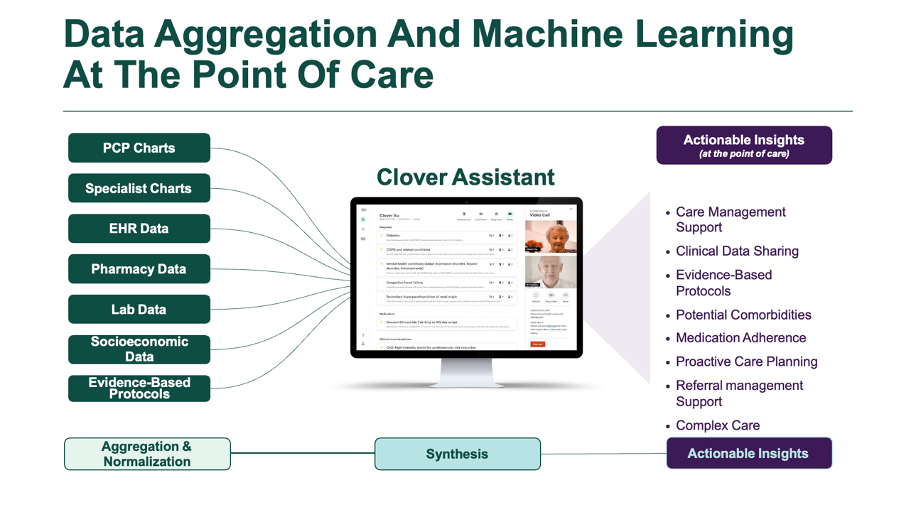

Slide 11
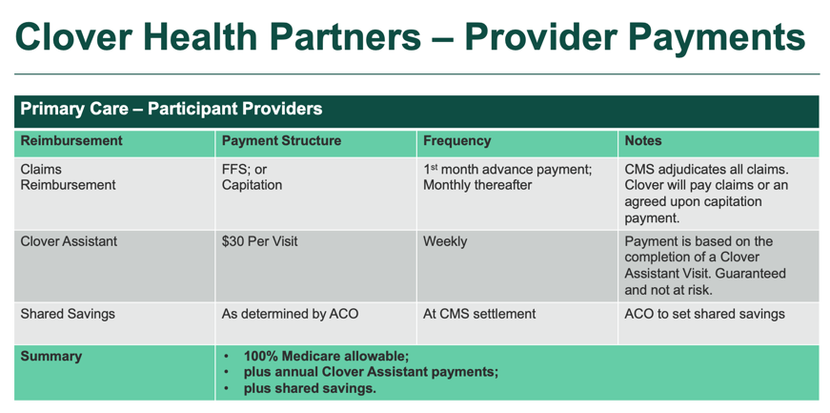

Incentive Type 1:
Incent PCPs to Code More

Slide 12
Incentive Type 1:
Incent PCPs to Code More
Example: encourage PCPs to order carotid ultrasounds on MA patients with no symptoms

Slide 13

Ad in NY in 2020
Everybody wins.
Patient gets stroke prevention
Vascular surgeons and hospital can bill for more services
MA Plans get higher codes from CMS
The market is aligned
with public health.
Right?
https://shopping.buffalonews.com/places/view/31057/catholic_health_vascular_health_screening_january_18_2020_.html Accessed Aug. 25 2021

Slide 14
Incentive Type 1:
Incent PCPs to Code More
Example: encourage PCPs to order carotid ultrasounds on MA patients with no symptoms
  USPSTF recommends against Carotid Artery Ultrasounds as screening studies. Category D recommendation 2014 and 2021.
Find any evidence of plaque in artery – submit the Dx code
Get credit for coding HCC 108 (Vascular Disease)
CMS pays the MA Plan $2,800 more per year for the rest of the patient’s life in that MA Plan
Screening increased MA Plan’s wealth – and patient’s risk of stroke
https://jamanetwork.com/journals/jama/fullarticle/2775719
Accessed Aug. 25 2021

Slide 15
Incentive Type 2:
Share Risk Score Payments
“Overall, physicians in value-based agreements with Humana earn 2.5 times on average more than Medicare’s fee schedule.
“Those physicians in the most advanced stage of Humana’s value-based primary care continuum – global value – earn on average four and a half times more than Medicare’s fee schedule.”
CMS PCP Cap FFS Equivalent = $44 PMPM
2.5 times more = $110 PMPM
4.5 times more = $198 PMPM
Humana 2020 Value Based Care Report

Slide 16

Incentive Type 3:
Purchase PCPs, Internalize the Value
April 2021:
Humana introduced CenterWell, its new brand for the PCP practices it owns
“The first Humana-owned care services to adopt the new brand will be its senior-focused primary care facilities that have operated as “Partners in Primary Care” in several states and as “Family Physicians Group” in the Orlando area.”
Business Wire 03/26/21

Slide 17
Although Medicare Advantage is growing quickly,
Traditional Medicare Is a Bigger “Opportunity”
Medicare Enrollment, Millions
Enter the new kid on the block:
“Direct Contracting Entities”
Brought to you by CMMI
Advantage
Traditional
https://www.kff.org/medicare/state-indicator/total-medicare-beneficiaries/?activeTab=graph&currentTimeframe=0&startTimeframe=10&selectedDistributions=original-medicare--medicare-advantage--total&selectedRows=%7B%22wrapups%22:%7B%22united-states%22:%7B%7D%7D%7D&sortModel=%7B%22colId%22:%22Location%22,%22sort%22:%22asc%22%7D Accessed July 10 2021

Slide 18

The most important department of CMS you probably never heard of
The Medicare Innovation Center (“CMMI”)
Congressional approval
is not required
to roll out CMMI innovations
CMMI was created by the ACA to “overcome anti-reform inertia”
A CMMI pilot can roll out across Medicare if HHS believes it:
Reduces spending without decreasing quality, or improves quality without increasing spending
Does not deny or limit coverage or provision of benefits
Guterman S, Davis K, Stremikis K, Drake H (June 2010). "Innovation in Medicare and Medicaid will be central to health reform's success". Health Aff (Millwood). 29 (6): 1188–93. doi:10.1377/hlthaff.2010.0442. PMID 20530353.

Slide 19
Emerging CMMI innovation:
Direct Contracting Entities
Traditional Medicare
(No intermediaries)
Direct Contracting Entities
(New intermediaries in Traditional Medicare)
Providers (Physicians, hospitals,
ACOs, etc.)
Medicare Advantage
(Insurance intermediaries in Medicare)

Slide 20
Three Flavors of Direct Contracting Entities
“GloPro”
“High Needs”
“Geo”
  Global/Professional capitation at a variety of risk levels
  Very similar to Managed Care, e.g., MA
  Not previously allowed in Traditional Medicare
  People with high health care costs depleting their assets
  Currently or soon-to-be dual eligibles
  Compulsory enrollment of entire geographic regions
  “Paused” due to concerns by stakeholders

Slide 21
Several “Sponsors” of DCEs
The relatively small number
of insurer-DCEs
belies their large size

Slide 22
The six Insurer DCEs are operating in 19 states with
57% of Medicare’s Entire FFS Population
 | States | Total Medicare Lives in State
No DCE in state | CO, ID, IL, KY, MT, ND, OK, SD, TN, UT, WV, WY | 5,137,584
 | States | Total Medicare Lives in State
No DCE in state | CO, ID, IL, KY, MT, ND, OK, SD, TN, UT, WV, WY | 5,137,584
Non-insurer DCE | AL, AK, AR, CT, DE, HI, IN, IA, MA, MD, ME, MI, MN, MS, OH, NH, NE, NM, PR, OR, WI | 10,469,276
 | States | Total Medicare Lives in State
No DCE in state | CO, ID, IL, KY, MT, ND, OK, SD, TN, UT, WV, WY | 5,137,584
Non-insurer DCE | AL, AK, AR, CT, DE, HI, IN, IA, MA, MD, ME, MI, MN, MS, OH, NH, NE, NM, PR, OR, WI | 10,469,276
Insurer- DCE | AZ,CA,DC,FL, GA, KS, LA, MO, NJ, NV, NC, PA, RI, SC, RI, VT, VA, WA | 20,567,809
Medicare FFS enrollment data as of 4/21/2021

Slide 23
DCE Puts Medicare’s Entire
Book-of-Business Into Play
2019 Total Medicare
$600 Billion
2025 Total Medicare
$1.25 Trillion
Clover’s Pitch to Investors
Bigger pie: 10,000 new baby boomers join Medicare every day
Bigger slice: MA members will rise from 36% to 50%
Strong bipartisan support
$270B MA
$330B FFS
$590B MA
$660B
DCE
Paraphrased from the Clover/IPO Investor slide deck
5
Notes:
I like this slide but would want to actually put your header on the top and make the slide the picture in the body of the email. Message – Direct contracting going to increase the amount of medicare spend that is eligible for this type of arbitrage

Slide 24
Clover’s IPO Health Growth Projections
600,000
500,000
400,000
300,000
200,000
100,000
Direct Contracting
Medicare Advantage
2020E | 2021E | 2022E | 2023E
Source – CLOVER/IPO Deck
Note identified in Clover’s slides: Projections based on internal company analysis
49

Slide 25
Clover Is Just One of Many Recent IPOs
Oct 2020
Dec 2020
  HCARU SPAC $300M IPO
  Oak Street value jumps from $5B to $12.9B
Nov 2020
Jan 2021
  CanoHealth $4.4B IPO
  Walgreens $1B VillageMD invest in Primary Care Clinics
Nov 2020
  Arsenal Capital Partners Acquires BestValue Healthcare (PCPs in South FL)
Jan 2021
  Clover Health $3.5B
Nov 2020
Feb 2021
  Sun Capital Partners Affiliate acquires Miami Beach Medical Group
  SignifyHealth IPO valuation of $7.12 B
SPAC – Special Purpose Acquisition Company

Slide 26
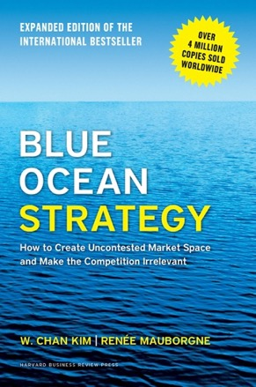
DCE is a prime example of a
Blue Ocean Strategy
Head-to-head competition creates a “red ocean” of rivals fighting over a shrinking profit pool.
“Blue oceans” are “uncontested market spaces ripe for growth, unleashing new demand.”
“Reconstruct market boundaries, focus on the big picture, reach beyond existing demand…
Medicare Advantage is still growing quickly,
but DCE taps a new blue ocean.
Harvard Business School Press

Slide 27
Who Can Stop the DCE Train and
Save Medicare?
Your US representative and senators
Xavier Becerra (HHS Secretary)
Chiquita Brooks-LaSure (CMS Administrator)
Elizabeth Fowler (Director of CMMI)

Slide 28
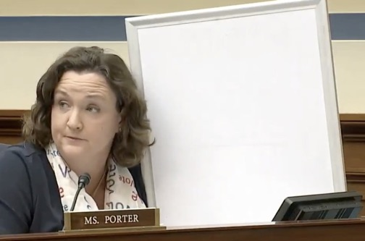
Save the date for a free webinar about DCE
Thurs. Sept. 23 9:00 EST
Co-sponsored by:
PNHP
Public Citizen
Social Security Works
UAW Region 1A Retirees
…and many others
Featuring US Rep.
Katie Porter
D-Calif.
Trudy Lieberman (Columbia Journalism Review)
David Lipschutz JD (Center for Medicare Advocacy)
Ed Weisbart MD (PNHP)

Slide 29

Physicians for a National Health Program
Students for a
National Health Program
  PNHP.org
  @PNHP
  Facebook.com/ DoctorsForSinglePayer
  Free student memberships at student.PNHP.org

