Slide 1
Data Update 2022 PNHP National Conference
Adam Gaffney, MD MPH
Past President, PNHP
Assistant Professor, Harvard Medical School
Pulmonary & Critical Care Medicine, Cambridge Health Alliance

Slide 2
I. Health

Slide 3
Steady Rise in US Life Expectancy Until 2020
USA Life Expectancy at Birth
(Years)
1960-2018:NCHS Data Visualization Gallery - Mortality Trends in the United States. 2020. https://www.cdc.gov/nchs/data-visualization/mortality-trends/index.htm
2019: Kochanek KD, Xu J, Arias E. Mortality in the United States, 2019. 2020 Dec;(395):8.
2020-2021: Arias E, Tejada-Vera B, Kochanek K, Ahmad F. Provisional Life Expectancy Estimates for 2021.
NVSS Vital Statistics Rapid Release. 2022 Aug;(23):16.

Slide 4
Uneven Decline in USA Life Expectancy Between 2019 and 2021
Decline in life expectancy
(years)
Data from: Arias E, Tejada-Vera B, Kochanek K, Ahmad F. Provisional Life Expectancy Estimates for 2021.
NVSS Vital Statistics Rapid Release. 2022 Aug;(23):16.

Slide 5
Excess deaths in the US vs. other wealthy nations, 2019-2021: “Missing Americans”
Excess deaths in USA
Data from: Bor J, Stokes AC, Raifman J, Venkataramani A, Bassett MT, Himmelstein D, et al.
Missing Americans: Early Death in the United States, 1933-2021 [Internet]. medRxiv; 2022 [cited 2022 Nov 3]. p. 2022.06.29.22277065.
https://www.medrxiv.org/content/10.1101/2022.06.29.22277065v2

Slide 6
II. Health Spending

Slide 7
National Health Expenditures Rose by $365 Billion to $4.1 Trillion from 2019 to 2020
$4 Trillion
$3 Trillion
$2 Trillion
$1 Trillion
Structures + Equipment
Personal Healthcare
Total Admin + Net Cost of Health Insurance
Public Health Activity
Research
Center for Medicare and Medicaid Services, National Health Expenditures Account.

Slide 8
Private health insurance administrative (including privatized Medicare and Medicaid) Expenditures Rose to $300 Billion
$300 Billion
$200 Billion
$100 Billion
Non-CMS health insurance admin
Privatized CMS program admin
Data from: Center for Medicare and Medicaid Services, National Health Expenditures Account.
CMS = Centers for Medicare and Medicaid Services

Slide 9
III. Coverage, Access, Healthcare Use, and Medical Debt

Slide 10
Landmark legislation Has Driven Down Uninsurance
1965: Medicare
and Medicaid
2010: Affordable Care Act
Source for data before 2010: Council of Economic Advisers, “Methodological Appendix: Methods Used to Construct a Consistent Historical Time Series of Health Insurance Coverage,” 2014, https://obamawhitehouse.archives.gov/sites/default/files/docs/longtermhealthinsuranceseriesmethodologyfinal.pdf.
Source for data from 2010 – 2021: Early Release Estimates from the National Health Interview Survey, multiple years. Available at: https://www.cdc.gov/nchs/data/nhis/earlyrelease.pdf. Note that there was a change in survey methodology in 2019.

Slide 11
Among workers with employer-sponsored single coverage, Deductibles Are Now the Norm
Percentage of workers with single coverage and a general deductible
Kaiser Family Foundation Annual Survey, 2006-22
Oct 27 P, 2022. 2022 Employer Health Benefits Survey [Internet]. KFF. 2022 [cited 2022 Nov 2].
Available from: https://www.kff.org/health-costs/report/2022-employer-health-benefits-survey/
Notes:
85% have deductible in 2018

Slide 12
Among workers with employer-sponsored single coverage Deductibles Are Steadily Rising
Data source: Kaiser Family Foundation. 2020 Employer Health Benefits Survey [Internet]. 2020 [cited 2021 Jan 22]. Available from: https://www.kff.org/health-costs/report/2020-employer-health-benefits-survey/.
Average general annual deductible for all covered workers (single coverage)
Notes:
85% have deductible in 2018

Slide 13
Rate of Underinsured Among the Insured 2022 data for ages 19-64
Family Income as a Percentage of Federal Poverty Level
Collins S, Haynes L, Masitha R. The State of U.S. Health Insurance in 2022.
Commonwealth Fund [Internet]. 2022 Sep 29 [cited 2022 Nov 2];
https://www.commonwealthfund.org/publications/issue-briefs/2022/sep/state-us-health-insurance-2022-biennial-survey

Slide 14
1.3 million American adults in 2021 Rationed Insulin Due to Cost
Data inclusive of all adults with diabetes who use insulin in 2021
Gaffney A, Himmelstein DU, Woolhandler S. Prevalence and Correlates of Patient Rationing of Insulin in the United States: A National Survey. Ann Intern Med [Internet]. 2022 Oct 18 [cited 2022 Oct 17];
http://www.acpjournals.org/doi/10.7326/M22-2477

Slide 15
Transition to High-Deductible Health Plan causes Delays in Retinopathy Care
Months
of Delay
Commercially insured adults with diabetes
Wharam JF, Wallace J, Argetsinger S, et al.
Diabetes Microvascular Disease Diagnosis and Treatment After High-Deductible Health Plan Enrollment.
Diabetes Care [Internet] 2021.

Slide 16
18.8% of privately-insured families received a Surprise Medical Bill After a Delivery
Estimated average liability per potential surprise bill
Chua K-P, Fendrick AM, Conti RM, Moniz MH. Prevalence and Magnitude of Potential Surprise Bills for Childbirth. JAMA Health Forum 2021;2(7):e211460–e211460.

Slide 17
Wisconsin Hospital Lawsuits for Medical Bills
$3,939
$2,522
2001
2018
2001
2018
2001
2018
Wisconsin data, 2001-2018. “Residents” refers to entire state population.
Cooper Z, Han J, Mahoney N. Hospital Lawsuits Over Unpaid Bills Increased By 37 Percent In Wisconsin From 2001 To 2018. Health Affairs. 2021 Dec;40(12):1830–5

Slide 18
White Americans spend More Time Face-to-face With Physicians
Annual minutes of face time with office based physicians
“Disparity driven by differences in visit rates, not mean visit length, and in the provision of specialist but not primary care.”
Combined data of 2014, 2015, 2016, and 2018 from Gaffney A, Himmelstein DU, Dickman S, McCormick D, Cai C, Woolhandler S. Trends and Disparities in the Distribution of Outpatient Physicians’ Annual Face Time with Patients, 1979–2018. J Gen Intern Med [Internet]. 2022 Jun 6.

Slide 19
Medicare Advantage’s networks guide patients Away From Top-ranked Cancer Hospitals
Cancer surgeries at top-ranked hospital
MA compared to TM
Daeho Kim et al. “Comparison of the Use of Top-Ranked Cancer Hospitals Between Medicare Advantage and Traditional Medicare,” The American Journal of Managed Care 27, no. 10 (October 2021)
https://www.ajmc.com/view/comparison-of-the-use-of-top-ranked-cancer-hospitals-between-medicare-advantage-and-traditional-medicare

Slide 20
Medicare Advantage Plans that spend more and cover more Have Lower Mortality
Quasi-experimental effects of Medicare Advantage Plan characteristics on enrollee mortality
Data from: Abaluck J, Bravo MC, Hull P, Starc A. Mortality Effects and Choice Across Private Health Insurance Plans.
Q J Econ 2021;136(3):1557–610.

Slide 21
IV. COVID-19 and US Medical Care

Slide 22
Average facility OOP costs for COVID-19 Hospitalization Among Those with Cost-Sharing
“OOP” = “out-of-pocket”
Data from: Chua K-P, Conti RM, Becker NV. Trends in and Factors Associated With Out-of-Pocket Spending for COVID-19 Hospitalizations From March 2020 to March 2021.
JAMA Network Open 2022;5(2):e2148237.

Slide 23
Secret Shopper Study of 24 Urgent Care Clinics in 10 states % Charging Uninsured Patients for COVID Testing
Yousman LC, Khunte A, Hsiang W, Jain S, Forman H, Wiznia D. Urgent care center wait times increase for COVID-19 results in August 2020, with rapid testing availability limited. BMC Health Services Research 2021;21(1):318.

Slide 24
In 2020, uninsured adults were less likely to be tested for COVID
But More Likely to Test Positive
p<0.05 for each comparison. Gaffney A, Woolhandler S, Himmelstein DU. COVID-19 Testing and Incidence Among Uninsured and Insured Individuals in 2020: a National Study. J GEN INTERN MED 2022. Adults 18-64, 2020

Slide 25
A recommendation from a health care provider Increases the Uptake of COVID-19 Vaccination
Nguyen KH, Yankey D, Lu P-J, et al. Report of Health Care Provider Recommendation for COVID-19 Vaccination Among Adults, by Recipient COVID-19 Vaccination Status and Attitudes - United States, April-September 2021.
MMWR Morb Mortal Wkly Rep 2021;70(50):1723–30.

Slide 26
The more PCPs in a county, The Higher the County’s Vaccination Rate
Difference in vaccination rate (adjusted)
Reference
Decile of PCPs per Capita in County
Multivariable model adjusted for demographic factors, urbanicity, SES, and political leaning. Data from: Lo C-H, Chiu L, Qian A, et al. Association of Primary Care Physicians Per Capita With COVID-19 Vaccination Rates Among US Counties. JAMA Network Open 2022;5(2):e2147920.

Slide 27
Among the “COVID vaccine-willing” in USA and UK, Vaccination Rates by February 2021
USA
UK
Vaccination Odds Ratio (adjusted)
Data from: Nguyen LH, Joshi AD, Drew DA, Merino J, Ma W, Lo C-H, et al. Self-reported COVID-19 vaccine hesitancy and uptake among participants from different racial and ethnic groups in the United States and United Kingdom.
Nat Commun. 2022 Feb 1;13(1):636. Odds Ratio is age-adjusted.

Slide 28
Americans are spending less time annually With a Primary Care Doctor
40
30
20
10
Primary Care
Annual Minutes per Capita
Medical Specialties
Surgical Specialties
2005 | 2007 | 2009 | 2011 | 2013 | 2015 | 2017
Data from: Gaffney A, Himmelstein DU, Dickman S, McCormick D, Cai C, Woolhandler S. Trends and Disparities in the Distribution of Outpatient Physicians’ Annual Face Time with Patients, 1979–2018. J Gen Intern Med [Internet]. 2022 Jun 6.

Slide 29
Oral antiviral prescriptions in 2022 by ZIP Code “Vulnerability” Index
Data from: Gold JAW. Dispensing of Oral Antiviral Drugs for Treatment of COVID-19 by Zip Code–Level Social Vulnerability — United States, December 23, 2021–May 21, 2022.
MMWR Morb Mortal Wkly Rep [Internet]. 2022 [cited 2022 Aug 21];71.

Slide 30
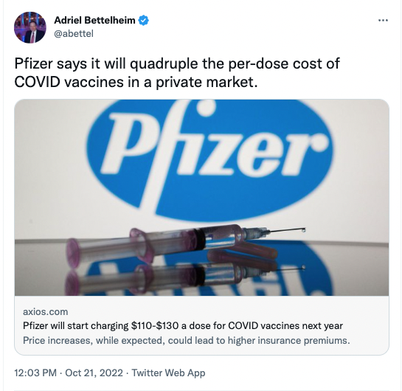
Oct. 21, 2022:
“Pfizer says it will
quadruple
the per-dose cost
of COVID vaccines
in a private market”

Slide 31
2020-21: Lower rates of adverse COVID-19 outcomes in Unionized vs. Non-Unionized Nursing Homes
Relative incident rate ratios
Data from: Dean A, McCallum J, Kimmel SD, Venkataramani AS. Resident Mortality And Worker Infection Rates From COVID-19 Lower In Union Than Nonunion US Nursing Homes, 2020–21. Health Affairs. 2022 May;41(5):751–9.

Slide 32
“To meet the challenge of enduring spread in the years to come, we must prioritize primary care and community health over the profit-driven status quo.”
Adam Gaffney MD
PNHP Past President

Slide 33
V. Reproductive Healthcare

Slide 34
National Federation of Independent Business v. OSHA
Invalidated OSHA’s COVID-19 standard
New York State Rifle and Pistol Inc. v. Bruen
Voided state restrictions on handgun carry
Dobbs v. Jackson Women’s Health Organization
Overturned Roe v. Wade
West Virginia v. the EPA
Weakened authority of the EPA to regulate carbon emissions
Not analyzed given uncertainties from Inflation Reduction Act (IRA) provisions

Slide 35
Dobbs decision by the Supreme Court Increased Travel Time to Nearest Abortion Provider
Reproductive Age Females
>60 Minutes from Abortion Facility
Mean Travel Time (Minutes)
Data from: Rader B, Upadhyay UD, Sehgal NKR, Reis BY, Brownstein JS, Hswen Y. Estimated Travel Time and Spatial Access to Abortion Facilities in the US Before and After the Dobbs v Jackson Women’s Health Decision. JAMA [Internet]. 2022 Nov 1 [cited 2022 Nov 2]; Available from: https://doi.org/10.1001/jama.2022.20424

Slide 36
Change in travel time to closest abortion provider after Dobbs in Two States with Largest Increases
7.2
hours
7.0
hours
Increase in travel time to closest abortion provider
Data from: Rader B, Upadhyay UD, Sehgal NKR, Reis BY, Brownstein JS, Hswen Y. Estimated Travel Time and Spatial Access to Abortion Facilities in the US Before and After the Dobbs v Jackson Women’s Health Decision. JAMA [Internet]. 2022 Nov 1 [cited 2022 Nov 2]; Available from: https://doi.org/10.1001/jama.2022.20424

Slide 37
Change in county abortion rate post TX-SB8 as a function of Distance to Nearest Abortion Provider
Percentage change in abortions
Note: Reference = <50 miles
Data from: Lindo JM, Myers CK, Schlosser A, Cunningham S. How Far Is Too Far? New Evidence on Abortion Clinic Closures, Access, and Abortions. J Human Resources. 2020 Oct 2;55(4):1137–60. Estimates generated from difference-in-difference model examining implementation of Texas law SB8, which led to closure of almost half of clinics in the state.

Slide 38
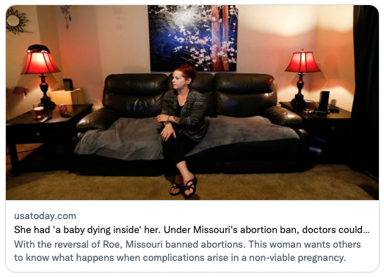
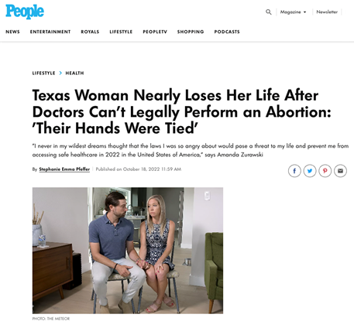
Changed obstetrical management: Elimination of Termination as Treatment for Previable Premature Rupture Of Membranes (PPROM)

Slide 39
Morbidity among pregnant women at <22 weeks after abortion ban in two Texas hospitals led to 100% “Expectant Management” For Previable PROM
Data from: Nambiar A, Patel S, Santiago-Munoz P, Spong CY, Nelson DB. Maternal morbidity and fetal outcomes among pregnant women at 22 weeks’ gestation or less with complications in two Texas hospitals after legislation on abortion. American Journal of Obstetrics and Gynecology. 2022 Jul;S0002937822005361. Selected measures.

Slide 40
VI. Privatization, Corporatization, and Financialization of US Healthcare

Slide 41
Likelihood of offering a profitable (vs. unprofitable) Service by Hospital Ownership
Data from: Horwitz JR, Nichols A. Hospital Service Offerings Still Differ Substantially By Ownership Type.
Health Affairs. 2022 Mar;41(3):331–40.

Slide 42
Percent of health systems with high relative levels of “Overuse” of Low-Value Services
”High” levels of overuse as defined by following authors, who noted that hospitals in the fourth and fifth category of their overuse index (>=0.5 SD over mean) can be considered to be “health systems that are overusing relative to the average health system.”
Segal JB, Sen AP, Glanzberg-Krainin E, Hutfless S. Factors Associated With Overuse of Health Care Within US Health Systems: A Cross-sectional Analysis of Medicare Beneficiaries From 2016 to 2018. JAMA Health Forum. 2022 Jan 14;3(1):e214543.

Slide 43
Largest insurer in the nation⁴
26M US privately-insured
19M Medicare/Medicaid
5M global privately-insured
3M Medicare Part D standalone
Healthcare Provision
Largest employer of physicians (~60,000) in the nation
101M patients^{1,3}
Consulting / analytics
270M lives of claims data
Manages $75B in annual billings²
PBM / Mail-Order Pharmacy
1.4B Rxs filled annually³
1 https://www.optum.com/about-us/optum-care.html
2 Overview Optum Insight. https://www.unitedhealthgroup.com/content/dam/UHG/PDF/investors/2021/conference/IC21_OptumInsight_overview_highlights.pdf
3 https://www.unitedhealthgroup.com/who-we-are/businesses/optum.html
4 UnitedHealth Group Reports Second Quarter 2022 Results

Slide 44
UnitedHealthcare health insurance Revenue by Category of Product
Private
Medicare
Medicaid
Source: SEC Annual Reports, multiple years

Slide 45
960 locations in 37 states
$2.2 billion in revenue
Pifer. UnitedHealth to buy home health business LHC for $5.4B.
Healthcare Dive [Internet]. 2022 Mar 30 [cited 2022 Oct 11];
Available from: https://www.healthcaredive.com/news/unitedhealth-buy-home-health-business-lhc/621249/

Slide 46
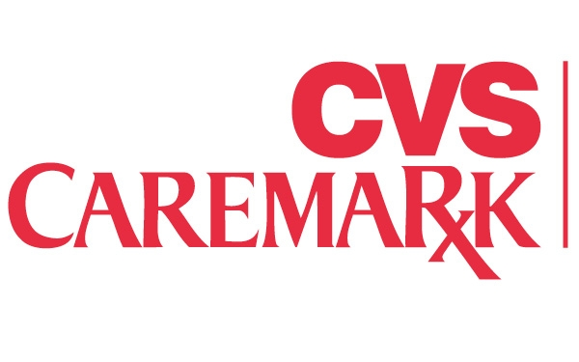
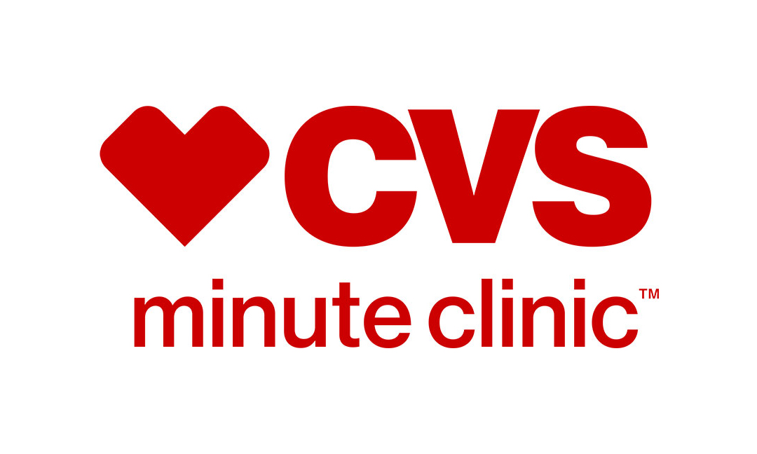
Others
Brick-and-mortar pharmacies
9,900+ locations¹
Mail order pharmacy / Pharmacy Benefits Manager
103M members²
46M mail-order prescriptions²
Health Insurer
Acquired 2018
17M privately-insured
3.2M Advantage
1.3M Medicare supp
2.9M Medicaid¹
Urgent Care store clinic network
50M visits¹
1,100 locations
1 https://www.cvshealth.com/about-cvs-health/our-company-at-a-glance
2 https://www.caremark.com/about-us.html
3 SEC. Quarterly Report 10-Q [Internet]. SEC.report. [cited 2022 Oct 11]. Available from: https://sec.report/Document/0000064803-22-000029/

Slide 47
10,000 more clinicians
brought under CVS’ control
Pifer R. CVS nabs home healthcare company Signify for $8B following bidding war.
Healthcare Dive [Internet]. [cited 2022 Oct 11]
Available from: https://www.healthcaredive.com/news/cvs-signify-amazon-unitedhealth-acquisition-home-health/631200/

Slide 48
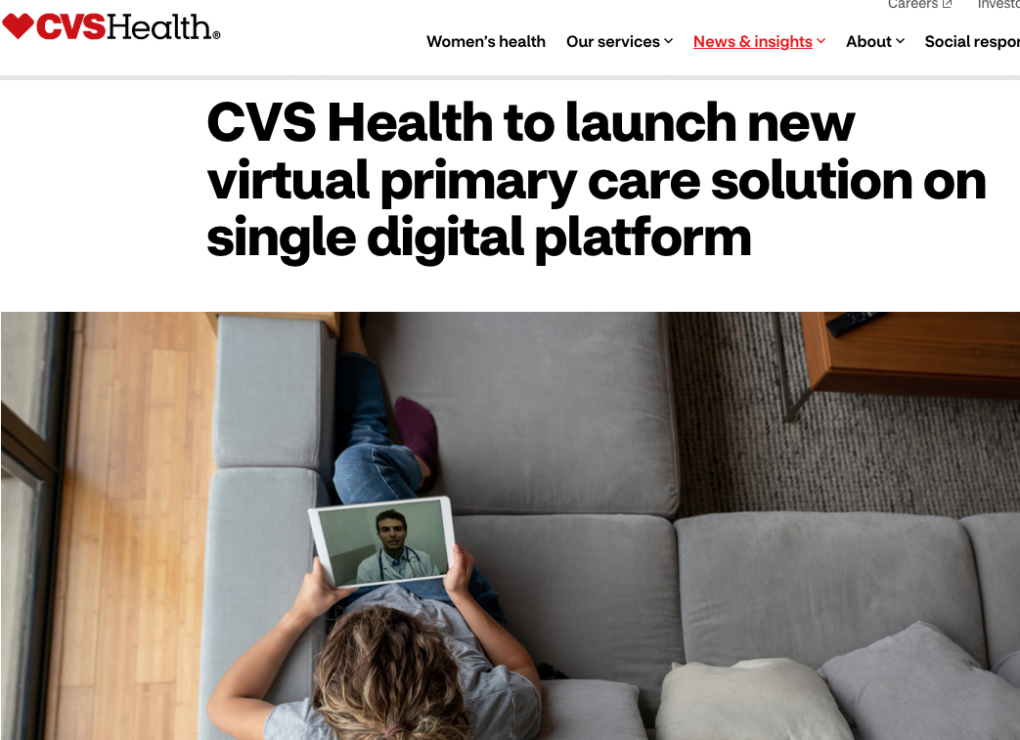
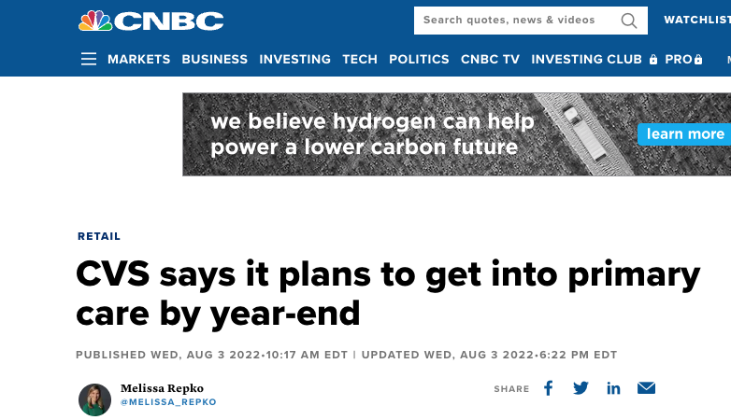

Slide 49
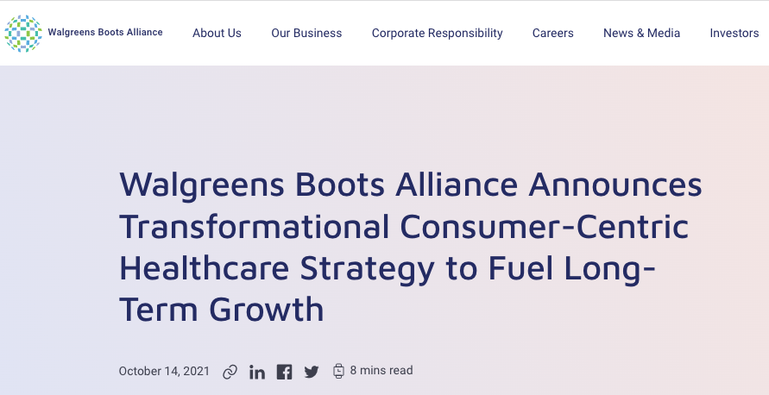

Slide 50
Home care company with
19 million members via
7,400 provider locations
Pifer R. Walgreens completes majority stake acquisition in CareCentrix.
Healthcare Dive [Internet]. 2022 Aug 31 [cited 2022 Oct 11]
Available from: https://www.healthcaredive.com/news/walgreens-acquires-CareCentrix-home-care/630918/

Slide 51
Walmart
Health insurance unit sells Medicare supplemental, Advantage, and Part D plans
Partnership with Oak Street Health (primary care)
Acquired MeMD (rebranded as “Walmart Health Virtual Care”), a telehealth company
Walmart, Amazon and CVS’ plan to disrupt healthcare services could benefit PE and VC [Internet]. [cited 2022 Oct 12]. Available from: https://pitchbook.com/news/articles/walmart-amazon-cvs-healthcare-services

Slide 52
Hypercapitalism in healthcare: The Private Equity Invasion
Private equity firms pool funds from themselves (2%), investors (20-30%), and debt (70-80%) to purchase a company
“2 and 20”: PE firms manage the company, extracting high management fees (~2%) and profit shares (~20%)
After acquisition, businesses can take on large amounts of debt and sell assets
Short-term investment: typically flip at 4-7 years
Model incentivizes risk-avidity, short-term profit maximization, consolidation, cost-cutting, and asset stripping
Little public oversight

Slide 53
Global Private Equity deals peaked at $151 Billion in 2021
Global healthcare buyout deal value ($B)
Figure reproduced from: Global Healthcare Private Equity & M&A Report 2022. Bain & Company [Internet].
[cited 2022 Nov 3]; Available from: https://www.bain.com/insights/topics/global-healthcare-private-equity-ma-report/

Slide 54
“Overdoses, bedsores, broken bones: What happened when a private-equity firm sought to care for society’s most vulnerable”
2007: Carlyle Group acquires ManorCare
2011: ManorCare sells almost all real estate.
$1.3 billion to investors, but cost $472 in rent costs for nursing homes
2013-2017: Layoffs, cost-cutting, soaring violations
2018: Files for bankruptcy
Source: Peter Whoriskey and Dan Keating, Washington Post, November 25, 2018.
Available at: https://www.washingtonpost.com/business/economy/opioid-overdoses-bedsores-and-broken-bones-what-happened-when-a-private-equity-firm-sought-profits-in-caring-for-societys-most-vulnerable/2018/11/25/09089a4a-ed14-11e8-baac-2a674e91502b_story.html

Slide 55
2021 healthcare property ownership by Real Estate Investment Trusts (REITS)
Data from: Bruch JD, Katz T, Ramesh T, Appelbaum E, Batt R, Tsai TC. Trends in Real Estate Investment Trust Ownership of US Health Care Properties. JAMA Health Forum. 2022 May 13;3(5):e221012.

Slide 56
Effect of Private Equity acquisition of nursing homes on Quality and Costs
Data from: Braun RT, Jung HY, Casalino LP, Myslinski Z, Unruh MA. Association of Private Equity Investment in US Nursing Homes With the Quality and Cost of Care for Long-Stay Residents.
JAMA Health Forum. 2021 Nov;2(11):e213817.

Slide 57
Effect of Private Equity ownership on Nursing Home Medicare Patients
Data from: Gupta A, Howell ST, Yannelis C, Gupta A.
Does Private Equity Investment in Healthcare Benefit Patients? Evidence from Nursing Homes.
National Bureau of Economic Research; 2021. doi:10.3386/w28474

Slide 58
Private Equity acquisition of hospitals led to Fewer Nurses and Higher Profits
4.38% drop in FTEs
1.78% growth in operating margin
Data from: Cerullo M, Lin YL, Rauh-Hain JA, Ho V, Offodile II AC. Financial Impacts And Operational Implications Of Private Equity Acquisition Of US Hospitals. Health Affairs. 2022 Apr;41(4):523–30. Sample of n=176 PE-acquired hospitals (2005-2014) vs. non-acquired controls.

Slide 59
Share of US physicians practicing in Private Equity-Acquired Practices
Singh Y, Zhu JM, Polsky D, Song Z. Geographic Variation in Private Equity Penetration Across Select Office-Based Physician Specialties in the US. JAMA Health Forum 2022;3(4):e220825.

Slide 60
Private Equity-owned Pinnacle Dermatology Email to Employees
“Don’t forget the August bonus incentive
for all patients scheduled in August!
That’s the easiest money you can make.
Get that money!!”
Quote from: https://www.nbcnews.com/health/health-care/get-money-dermatologist-says-patient-care-suffered-private-equity-back-rcna9152

Slide 61
Changes in physician billing After Practice Acquisition by Private Equity
Data from: Singh Y, Song Z, Polsky D, Bruch JD, Zhu JM. Association of Private Equity Acquisition of Physician Practices With Changes in Health Care Spending and Utilization. JAMA Health Forum 2022;3(9):e222886.

Slide 62
Lobbying by healthcare firms Doubled from 2000 to 2020
$ Millions
(inflation adjusted for 2020)
Data from: Schpero WL, Wiener T, Carter S, Chatterjee P. Lobbying Expenditures in the US Health Care Sector, 2000-2020. JAMA Health Forum. 2022 Oct 28;3(10):e223801. Dollars are inflation adjusted (2020 dollars).

Slide 63
Physicians for National Health Program
Join us!
www.PNHP.org
info@PNHP.org
facebook.com/DoctorsForSinglePayer

