Slide 1
Why do most physicians want Medicare for All?

Slide 2
Moral contempt
is a far greater
indignity and insult
than any kind of crime.
Friedrich Nietzsche

Slide 3
USA Physician Satisfaction Is Low
Percent of primary care doctors saying they are satisfied or very satisfied
http://www.commonwealthfund.org/interactives-and-data/chart-cart/in-the-literature/2012-a-survey-of-primary-care-doctors-in-ten-countries/physician-satisfaction-with-practicing-medicine Accessed Aug 5, 2016

Slide 4
We’d Rather Spend Our Time With Our Patients
Figures exclude
1-2 hours per night
of home EHR and
other desk work
Source: Sinsky et al. Ann Int Med 9/6/2016 – based on time/motion observation + home diary
Ann Intern Med. 2016;165(11):753-760. DOI: 10.7326/M16-0961
Note: Figures are percent of office hours – exclude the 1-2 hrs/night of home EHR/desk work

Slide 5
EPIC EHR Notes Count
Number of Institutions
USA
Canada, UK, Australia,
Netherlands, Singapore,
United Arab Emirates
Average Number of Characters per Ambulatory Note in Epic
Source: Ann Intern Med 2018; 169:51
13 international organizations represent 140,000 notes
254 organizations within the United States represent 10 million notes.

Slide 6
An Average Week of Family Medicine in Canada
Activity | Hours
Direct patient care | 29.4
Direct patient care with teaching | 4.4
Teaching without patient care | 1.2
Indirect patient care | 7.4
Health facility committees | 0.7
Administration | 2.4
Research | 0.7
Managing practice | 1.7
Continued professional development | 3.3
Other | 0.8
Canadian FPs average
2.4 hours
per week
on non-clinical administration
Includes GPs; Excludes on-call hours
2013 National Physician Survey. CFPC, CMA, Royal College
www.cma.ca/Assets/assets-library/document/en/advocacy/Family-e.pdf
Accessed April 6 2015

Slide 7
Canadian Physicians’ Incomes Average gross clinical payments per physician, 2018-2019
Specialty | Income
Family Medicine | $279,929
Internal Med (all) | $407,171
Pediatrics | $296,010
Psychiatry | $281,614
Neurology | $319,000
Specialty | Income
OB-GYN | $392,115
General Surgery | $465,707
Neurosurgery | $557,925
Ophthalmology | $791,466
Avg All Canada | $347,353
Source: Canadian Institute for Health Information
https://www.cihi.ca/sites/default/files/document/physicians-in-canada-report-en.pdf Accessed Sept. 22 2021
Figures are in Canadian $

Slide 8
Canadian Family Physicians Retain More of Their Earnings
Medical Practice
Net Income v Overhead
55%
Overhead
71.8%
Net Income
45%
Net Income
28.2%
Overhead
2014 data; Canadian dollars
Source: Canadian Medical Protective Association
www.cmpa-acpm.ca
http://medicaleconomics.modernmedicine.com/medical-economics/content/tags/2013-salary-survey/competition-driving-malpractice-premiums-down?page=full
http://www.merritthawkins.com/pdf/2008-mha-survey-primary-care.pdf

Slide 9
Malpractice Insurance Costs, 2019
Specialty | Ontario* | Quebec | BC & Alberta | Missouri
Family Med | $4,908 | $1,583 | $3,420 | $12,379
Psychiatry | $4,908 | $1,583 | $3,420 | $10,291
Cardiology | $8,448 | $2,248 | $5,028 | $18,991
Anesthesia | $12,948 | $3,139 | $8,472 | $16,129
*Government reimburses physicians for premiums above 1986 level. All figures in Canadian $s.
Canadian Medical Protective Association www.cmpa-acpm.ca
https://www.gallaghermalpractice.com/state-resources/missouri-medical-malpractice-insurance/ (Dec 28 2019)

Slide 10
Medicine Is Hard Enough Practice Is Really Tough
More than
$200,000
Accounts Receivable
for a typical
single physician practice
Why should physicians donate
interest-free loans to insurers?
Average physician
Accounts Receivable
aging balance:
Nearly
12 Months
Personal communication with Missouri State Medical Association. April 12, 2013

Slide 11
Most Physicians Want Medicare for All
Psychiatry
Peds Specialties
Emergency Med
General Peds
General Int. Med
Med Specialties
Family Med
OB-Gyn
General Surgery
Surg Specialties
Radiology
0 | 25% | 50% | 75% | 100%
Percent supporting National Health Insurance
2007 detail of surveys of random samples of US physicians.
Carroll and Ackerman. Ann Int Med 2008;148:566

Slide 12
American Physicians Are Moving to Canada
American Physicians Practicing in Canada
https://www.cma.ca/Assets/assets-library/document/en/advocacy/10-phys-by-country.pdf
Accessed Dec 9 2018

Slide 13
Canadian Physicians Are Going Back Home
Net loss
(number moving abroad –
number returning)
A negative number indicates that more physicians returned from abroad then moved abroad
Source: Canadian Institute for Health Information

Slide 14
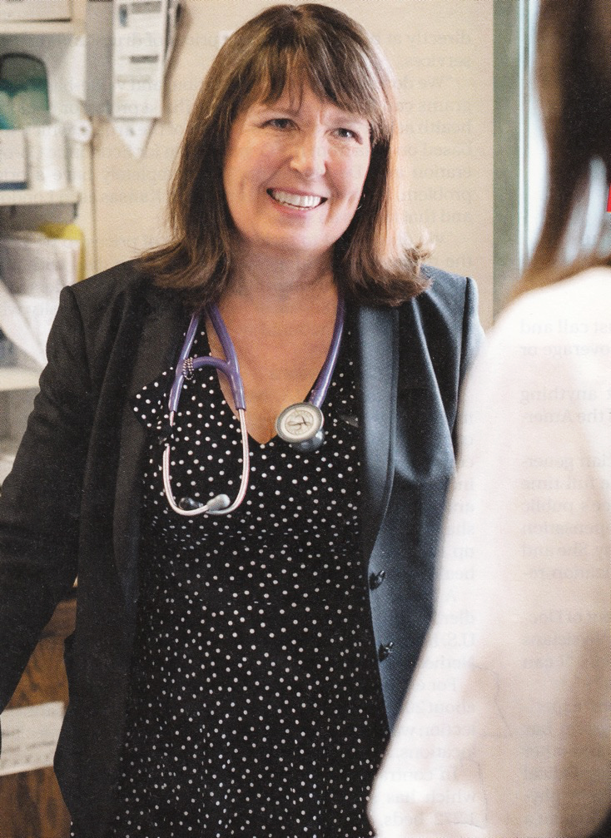
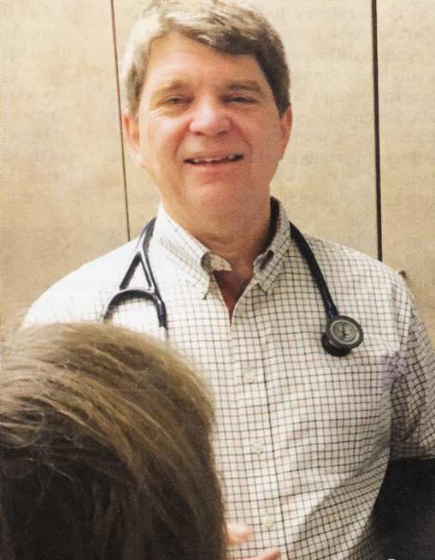
“It’s not a big hassle.
I can focus on patient issues,
not administrative issues.”
Dr. Trina Larsen Soles
Doctors of British Columbia
2017-2018 President
“It’s an incredible bureaucratic mess to get anything done for patients.”
Dr. John Cullen
American Academy of Family Physicians
2018-2019 President
Source: Modern Healthcare 4/9/18

Slide 15
Physicians for a National Health Program
Students for a
National Health Program
PNHP.org
@PNHP
Facebook.com/ DoctorsForSinglePayer
Free student memberships at student.PNHP.org

