Slide 1
Around the World and Back Searching for a better healthcare system
Ed Weisbart MD
Physicians for a National Health Program
National Board Secretary and Chair, MO Chapter
Missouri@PNHP.org

Slide 2
“Every system has toxic side effects.
Our job is to decide
what poisons
we want to live with.”
John Potter
Dreyer Medical Clinic
President

Slide 3
American Physicians Are Not Satisfied
Percent of primary care doctors satisfied with practicing medicine
2019
https://www.statista.com/statistics/1097249/proportion-primary-physicians-satisfied-with-practicing-medicine-select-countries-worldwide/ Accessed Nov 16 2022

Slide 4
1970 – 2020: USA Drifts Further and Further Off Course
30 High-Income Countries
2020
Some form of national health insurance
Life Expectancy at Birth
USA
2010
2015
2020
2005
ACA
DCE
Medicare Advantage
REACH
2000
Medicare + Choice
HMO Act
1970
Healthcare Expenditure per capita (US$)
Chart modified from one produced by Charlie Swanson using World Bank data
https://data.worldbank.org/indicator/SH.XPD.CHEX.PC.CD
Notes:
2002 IOM 2002: Care without Coverage
https://doi.org/10.17226/10367
2004 Health Affairs
https://www.healthaffairs.org/doi/full/10.1377/hlthaff.23.4.223
2008 AJPH
https://ajph.aphapublications.org/doi/10.2105/AJPH.2008.157685
2008 Update to IOM
https://www.urban.org/sites/default/files/publication/31386/411588-Uninsured-and-Dying-Because-of-It.PDF
2020 Lancet review article
https://doi.org/10.1016/S0140-6736(19)33019-3

Slide 5
Common Finance Models
Natl Health Service
Public funding, public delivery (Socialized Medicine)
US: Veterans Administration
Natl Health Insurance
Public funding, private delivery
US: Medicare
Mixed funding, private delivery
US: Parallel to the ACA marketplace
Bismarck
“All Payer”
Multi-payer
Mixed funding, mixed delivery
Schema from http://www.aafp.org/content/dam/AAFP/documents/about_us/congress/restricted/2017/BoardReportF-SinglePayerHealthCareSystem.pdf Accessed Aug. 30 2017

Slide 6
Population Coverage
Natl Health Service
Natl Health Insurance
Bismarck
“All Payer”
Multi-payer
2018 OECD data accessed Feb 15 2021

Slide 7
Health Expenditures Per Person
Natl Health Service
Average = $4,631
Natl Health Insurance
Average = $5,271
Bismarck
“All Payer”
Average = $6,588
Multi-payer
Data from 2021 (or 2020 if 2021 not available) and adjusted for purchasing power parity
https://stats.oecd.org Accessed March 15 2023

Slide 8
Life Expectancy at Birth
Natl Health Service
Natl Health Insurance
Bismarck
“All Payer”
Multi-payer
Data from 2021 or most recent year available
https://stats.oecd.org Accessed March 16 2023

Slide 9
Physicians per 1,000 Population
Natl Health Service
Natl Health Insurance
Bismarck
“All Payer”
Multi-payer
Data from 2021 or most recent year available
https://stats.oecd.org Accessed March 16 2023

Slide 10
MRI Scanners per Million Population
Natl Health Service
Natl Health Insurance
Bismarck
“All Payer”
Multi-payer
Data from 2020 or most recent year available
https://stats.oecd.org Accessed March 12 2022

Slide 11
The Choice Is Our Own
Natl Health Service
“Socialized Medicine”
~65% less expensive than USA; other results excellent
Natl Health Insurance
“Medicare for All”
~55% less expensive than USA; other results excellent
“ACA on steroids”
~45% less expensive than USA; other results excellent
Bismarck
“All Payer”
Multi-payer
Most expensive, most uninsured, shortest life expectancies
Data from 2020 or most recent year available and adjusted for purchasing power parity
https://stats.oecd.org Accessed March 12 2022

Slide 12
United Kingdom: National Health Service
10% of Individuals
100% of Taxpayers
Primary care is mostly capitation plus incentives for performance
Nearly all specialists are employed at NHS
Voluntary supplemental insurance for faster access to elective care
Government
100% of people have automatic free care through NHS
3% of national
health expenditures
Providers
2016 data, accessed March 26 2022
https://www.commonwealthfund.org/international-health-policy-center/countries/england

Slide 13
Canada: National Health Insurance
~67% of Individuals
100% of Taxpayers
Most primary care and specialists directly bill Medicare FFS
Some are salaried by hospitals
Voluntary supplement
Federal Govmt
30% of expenses are for non-NHI benefits
(e.g., vision, dental, Rx, private hospital room, rehab, etc.)
Provincial Govmt
Hospital and
physician care
Providers
“Provincial” used here as shorthand to include ”Territorial” governments
https://www.commonwealthfund.org/international-health-policy-center/countries/canada

Slide 14
Germany: “Bismarck”
88% of people (mandatory if <$78,000)
11% of people
Centralized Statutory Health Insurance
Funded by 14.6% of gross wages (up to a ceiling)
Substitutive Private Insurance Option
underwriting once, at entry
regulated rate increases
broader benefits
attracts younger / wealthier
Distributed among “Sickness Funds”
110 non-profit non-governmental risk-adjusted
capitated plans competing on a national exchange
Regardless of funding, same providers in private practices
Federally determined fee schedules (set higher for private insurance)
https://www.commonwealthfund.org/international-health-policy-center/countries/germany
Notes:
In Germany, they have what are called Sickness Funds
This is a highly regulated network of not-for-profit insurers who operate the HC system
As you can see, employees and employers pay in – and where they can’t the govt steps in and pays.
A highly regulated network of not-for-profit insurers is called a Bismarck system and it works quite well in Germany. (click)
The full disclosure is that there are some young, healthy people with high paying jobs who purchase private insurance because it is less expensive

Slide 15
Singapore: “Multipayer”
MediShield Life
Universal basic health insurance paid by premiums
Significant copays and deductibles
Does not report health data to OECD
Life expectancy 84 years
Per capita spending 2019: $2,633 USD
Premiums based on income and age
41% of care is publicly funded
80% of primary care through solo FFS clinics that set their own fee schedules
Specialty care mixed public and private
MediSave
Mandatory payroll deductions by all working people
Savings account for out-of-pocket payments
Integrated Shield
Optional purchase for extra benefits and amenities
MediFund
Low-income additional support for out-of-pocket
https://www.macrotrends.net/countries/SGP/singapore/healthcare-spending
https://www.commonwealthfund.org/sites/default/files/2020-12/International_Profiles_of_Health_Care_Systems_Dec2020.pdf
Accessed March 15 2023

Slide 16
USA: “Multipayer”
Medicare
Medicaid
Indian Health Services
Active Military
Tricare
Veterans Affairs
Postal Service
Federal Employees
Business tax credits

Slide 19
It’s not just bewildering; Our Complexity Is Expensive
$12,120
Annual $ per capita (2020 data)
US public includes benefit costs for government employees and tax subsidies for private insurance
OECD 2021; NCHS; AJPH 2016;106:449 (updated by Himmelstein and Woolhandler); data are for 2020
www.citizen.org/article/powerpoint-presentations-on-health-policy-issues-relevant-to-health-care-reform-and-a-national-single-payer-health-system/

Slide 20
EPIC EHR Notes Count
Number of Institutions
USA
Canada, UK, Australia,
Netherlands, Singapore,
United Arab Emirates
Average Number of Characters per Ambulatory Note in Epic
Source: Ann Intern Med 2018; 169:51
13 international organizations represent 140,000 notes
254 organizations within the United States represent 10 million notes.

Slide 21
The Grand Experiment
1973
USA
HMO Act signed into law
1971 Health Care
USA and Canada
Same % of GDP
Similar Life Expectancies
1971
Canada
Medicare for All fully implemented

Slide 22
The Grand Experiment
HMO Act Passed
USA
Health costs
% of GDP
Canadian Medicare Fully Implemented
Canada
Pre-1970 data from Statistics Canada, Canadian Inst. for Health Inf., and NCHS/Commerce Dept.
1970+ data from Data from 2021 or most recent year available https://stats.oecd.org Accessed March 16 2023

Slide 23
Insurance Overhead Is Often Hidden
http://stats.oecd.org/index.aspx?DataSetCode=HEALTH_STAT
https://www.bls.gov/oes/current/naics3_622000.htm#13-0000

Slide 24
Duke Medical Center
University of Toronto
957 beds
(3 hospitals)
1,600 billing clerks
1,272 beds
(University Health Network)
7 billing clerks
JAMA. 2018;319(7):691-697. doi:10.1001/jama.2017.19148
Jan 17 2019 note from Alex Radkewycz, Senior Public Affairs Advisor, UHN

Slide 25
More administrators and Fewer Healthcare Workers
Hospital employees per 1,000 population
USA
2018 data (2017 for USA); KFF analysis of OECD data
https://www.healthsystemtracker.org/indicator/quality/hospital-resources/ Accessed March 27 2022

Slide 26
Surgery Waiting Times British Columbia
https://swt.hlth.gov.bc.ca/swt/ Accessed March 23 2022

Slide 27
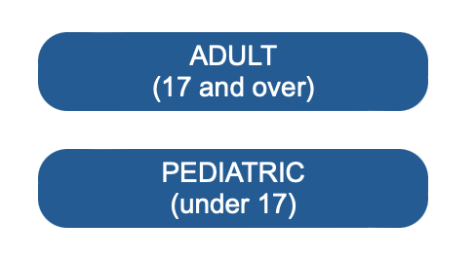
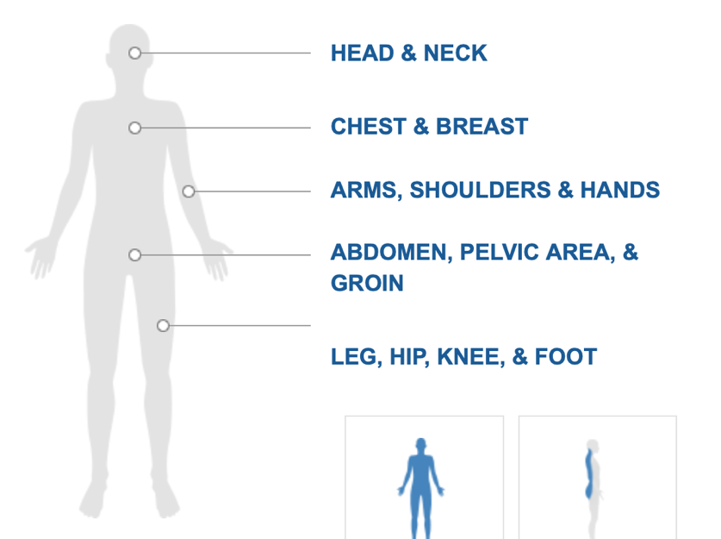
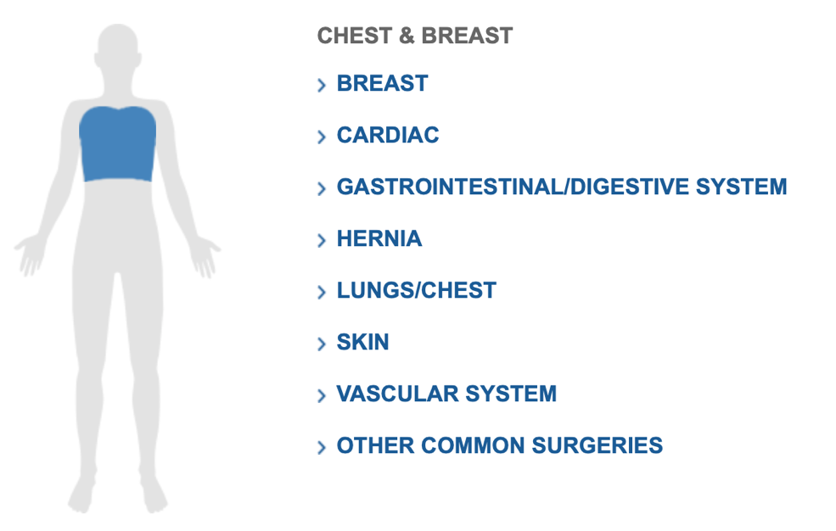
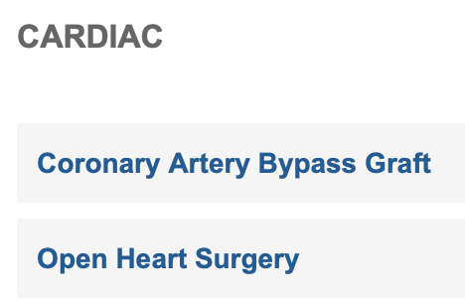
Surgery Waiting Times British Columbia
https://swt.hlth.gov.bc.ca/swt/ Accessed March 23 2022

Slide 28
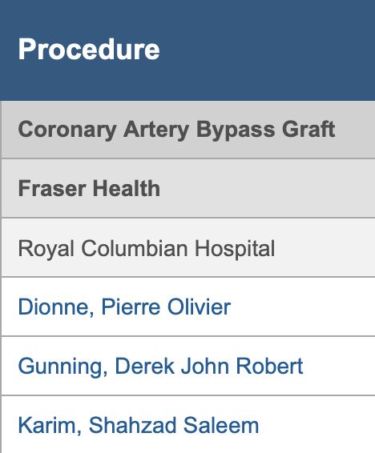
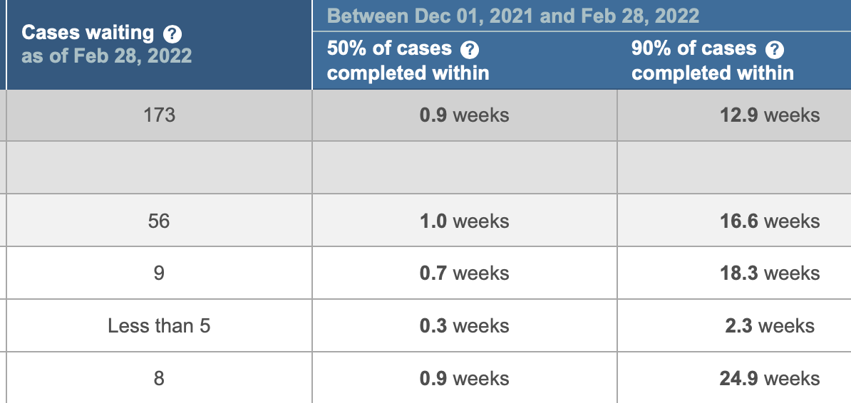
Surgery Waiting Times British Columbia
https://swt.hlth.gov.bc.ca/swt/ Accessed March 23 2022

Slide 29
British Columbia Is Not Unique
Median time to wait for
appointment in every specialty
in every CA province:
Less than 4 months
No comparable USA data
Liddy, C. Canadian Fam Physician, 2020 Jun; 66(6):434-444
https://www.ncbi.nlm.nih.gov/pmc/articles/PMC7292524/ Accessed March 17 2022

Slide 30
The Grand Experiment
Life Expectancy Gap
(CA minus US)
(years)
Source: http://stats.oecd.org/index.aspx?DataSetCode=HEALTH_STAT#
Accessed March 15 2023

Slide 31
An Average Week of Family Medicine in Canada
Activity | Hours
Direct patient care | 29.4
Direct patient care with teaching | 4.4
Teaching without patient care | 1.2
Indirect patient care | 7.4
Health facility committees | 0.7
Administration | 2.4
Research | 0.7
Managing practice | 1.7
Continued professional development | 3.3
Other | 0.8
Canadian FPs average
2.4 hours
per week
on non-clinical administration
Includes GPs; Excludes on-call hours
2013 National Physician Survey. CFPC, CMA, Royal College
www.cma.ca/Assets/assets-library/document/en/advocacy/Family-e.pdf
Accessed April 6 2015

Slide 32
Average Annual Income, 2021, USD
Specialty | Canada | USA
Derm | $364,000 | 394,000
Fam Med | $249,000 | 236,000
GI | $370,000 | 406,000
Neuro | $268,000 | 290,000
OB-GYN | $355,000 | 312,000
Specialty | Canada | USA
Ophtho | $660,000 | 379,000
Peds | $272,000 | 221,000
Psych | $239,000 | 275,000
Surg (Gen) | $405,000 | 373,000
Urology | $429,000 | 427,000
https://invested.mdm.ca/md-articles/physician-salary-canada#by%20specialty
All data in USD with a 0.75 exchange rate
https://www.statista.com/statistics/250160/median-compensation-earned-by-us-physicians-by-specialty/
All data accessed Nov 16 2022

Slide 33
Malpractice Insurance Costs ($US)
Specialty | Ontario | Quebec | BC & Alberta | LA (average filed rates)
Family Med | $3,681 | $1,187 | $2,565 | $7,154
Psychiatry | $3,681 | $1,187 | $2,565 | $5,985
Cardiology | $6,336 | $1,686 | $3,771 | $10,647
Anesthesia | $9,711 | $2,354 | $6,354 | $10,143
Canadian dollars converted to USD at 0.75 exchange rate (average for 2019)
Canadian Medical Protective Association www.cmpa-acpm.ca
https://www.gallaghermalpractice.com/state-resources/louisiana-medical-malpractice-insurance/ (Mar 14, 2023)

Slide 34
The Grand Experiment
Compared to Canadians, Americans now
spend 50% more per person and
live nearly 5 years shorter

Slide 35
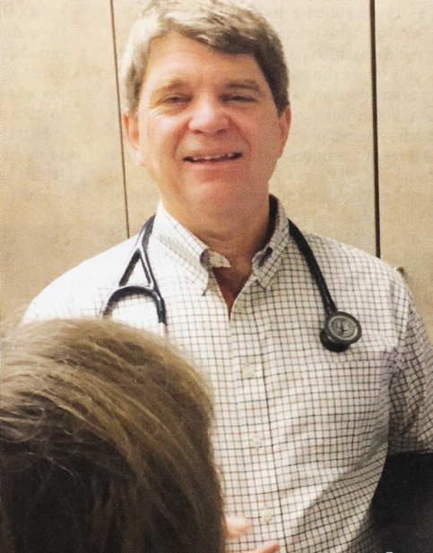
“It’s not a big hassle.
I can focus on patient issues,
not administrative issues.”
Dr. Trina Larsen Soles
Doctors of British Columbia
2017-2018 President
“It’s an incredible bureaucratic mess to get anything done for patients.”
Dr. John Cullen
American Academy of Family Physicians
2018-2019 President
Source: Modern Healthcare 4/9/18

Slide 36
Physicians for a
National Health Program
Students for a
National Health Program
PNHP.org
@PNHP
Facebook.com/ DoctorsForSinglePayer
Free memberships for health professional students at student.PNHP.org

