Slide 1
Why Neurosurgeons
Should support
Medicare for All
George Bohmfalk, MD; past TANS Director; founder, Neurosurgical Associates of Texarkana

Slide 3
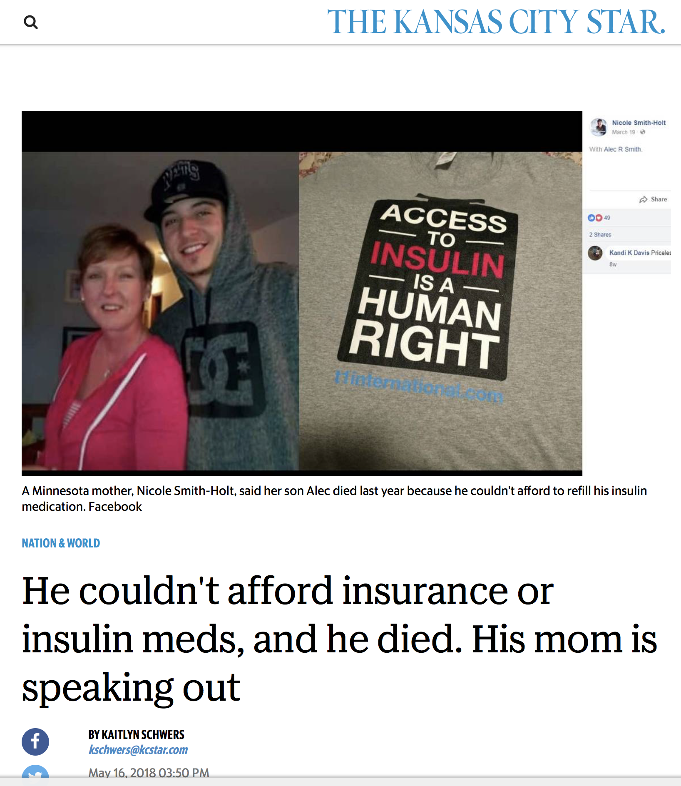
Notes:
26, aged out of parents’ coverage
Young people dying for lack of insulin

Slide 4
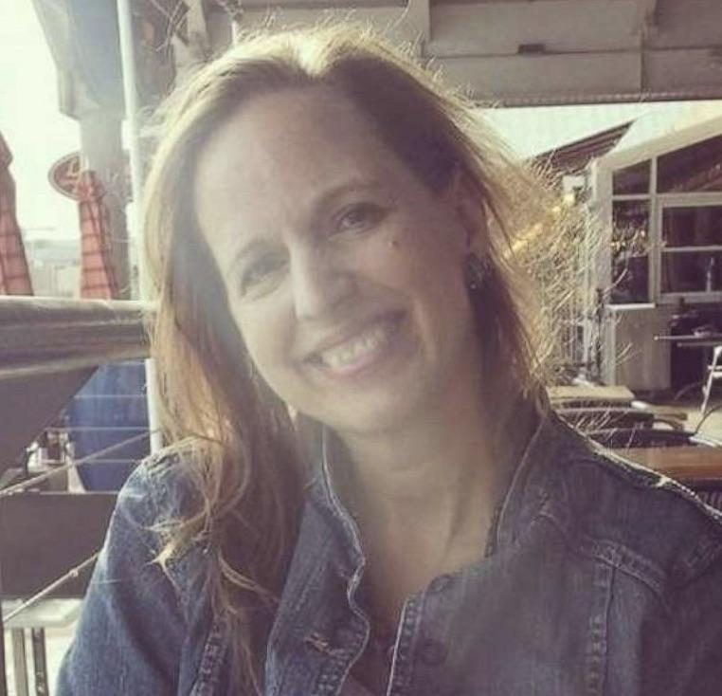
Lee-Ellen Macon
Special Ed teacher, Baton Rouge

Slide 5
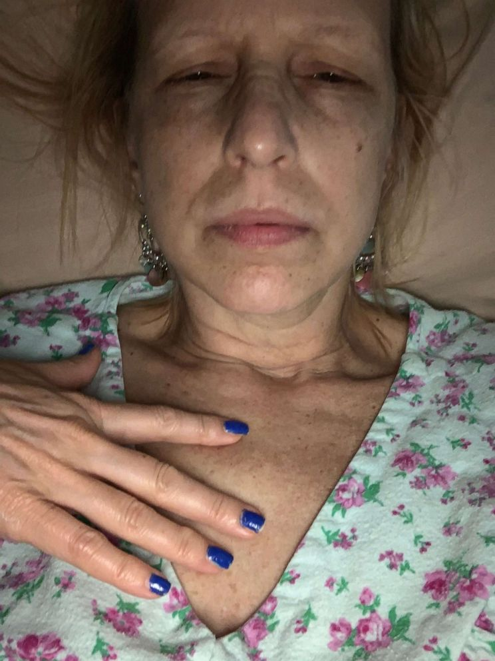
Lee-Ellen had beaten breast cancer once.
Her deductible was $4000.
Bills piled up fast.
By June she was out of money.
Her sister started a GoFundMe campaign.

Slide 6
Total 2020 US Healthcare spending $4.1 Trillion = $12,530 pp
The Elephant in the room:
Total Healthcare administrative cost
34% = > $1 Trillion
Insurance companies – 12-20% overhead
Hospital billing depts = 25% of expenses
Physician offices - $85-100K/doc
CMS.gov
Himmelstein, Campbell, and Woolhandler, Annals of Internal Medicine, Jan 2020
Notes:
Elephant = 30% system admin overhead = $1T

Slide 7
Medicare for All Would Cover Everyone and Cost Less
Savings:
Administrative costs $600B
Drug & device negotiation 150B
Total savings $750B
Net savings:
$425 Billion
Savings:
$750 B
New Costs:
$325 B
Himmelstein, Campbell, and Woolhandler, Annals of Internal Medicine, Jan 2020
Notes:
Key to all real M4A proposals = eliminating admin overhead = eliminating myriad insurance companies, plus drug price negotiation

Slide 9
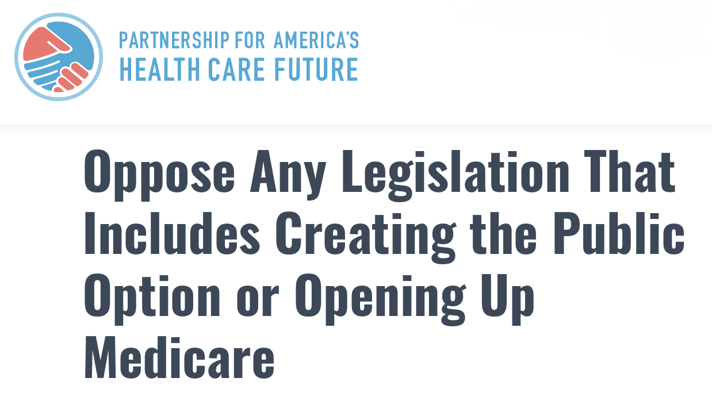

Slide 12
Three requests:
Withdraw AANS & CNS from PAHCF
Offer presentations on Medicare for All at AANS & CNS meetings, in journals
Join PNHP.org

