Slide 1
Two inequality problems
Source: Calculations from Survey of Consumer Finances, 2016

Slide 2
We have to confront the whole.
A just economy delivers high-quality services for the most vulnerable
Education, livable wages, a career, home ownership, child care, health care
Poor, black, brown, segregated communities
Hard when one guy owns media, a few families own retail, fossil fuels have license to kill, banks write mortgage rules, insurers design health access, and the DoE owns a growing share of 45 million Americans’ future wages.
Notes:
We all need high quality education instead of the scramble we now face; decent wages instead of exploitation, a career instead of the same, home ownership instead of rents so damn high people have to move around all the time, good quality enriching affordable child care because that’s what children need, affordable health care including LTC.
If we design an economy where the most vulnerable- the PBS have it, we can also rest assured that our parents and our kids will. Let the most vulnerable guide us.
All of that is hard to do when the institutions that govern our basic needs are all privatized, lack collective decision making, heavily concentrated.

Slide 3
Inequities don’t end themselves
Covid cases by zip code
Maternal mortality by zip code

Slide 4
US healthcare is highly inequitable
Had medical problem, did not visit doctor because of cost, past one year
Source: MIRROR, MIRROR ON THE WALL How the Performance of the U.S. Health Care System Compares Internationally. Commonwealth.
Average Across: AUS, CAN, FRA, GER, NETH, NZ, NOR, SWE, SWIZ, UK
“Low Income” is below that country’s avg
Notes:
https://www.commonwealthfund.org/sites/default/files/documents/___media_files_publications_fund_report_2014_jun_1755_davis_mirror_mirror_2014.pdf

Slide 5
US healthcare is outstandingly inefficient
Source: Multinational Comparisons of Health Systems Data, 2019
Commonwealth Fund

Slide 6
US healthcare is outstandingly inefficient
Source: Multinational Comparisons of Health Systems Data, 2019
Commonwealth Fund

Slide 7
Americans are paying more each year, even as quality is falling
Deductibles are growing faster wages
Wage concessions are made in order to keep healthcare
Explicit (union negotiations) or implicit (employers’ records on total compensation per employee)
Every US industry is taxed by healthcare
Labor costs less when healthcare costs less
For large businesses, it’s cheaper to pool risks, so they can better attract top talent
So many pieces to the administrative puzzle, each costs money

Slide 8
Growth of deductibles, premiums higher than wage growth between 2008 and 2018.
Source: Sara R. Collins, David C. Radley, and Jesse C. Baumgartner. Trends in Employer Health Care Coverage, 2008-18: Higher Costs for Workers and Their Families (Commonwealth Fund, Nov. 2019).

Slide 10
The Affordable Care Act
Notes:
Huge, sweeping reform, more 20 million gained coverage
Major shortcoming is in affordability
Majority of those uninsured prior to the law, remain uninsured today.
They cite unaffordability as the primary reason

Slide 11
More in Medicaid, Fewer in Private Exchanges than Anticipated

Slide 12
Economic gains from Medicaid expansion
Zewde, N., & Wimer, C. (2019).
Antipoverty Impact of Medicaid Growing with State Expansions over Time. Health Affairs, 38(1), 132–138.
Zewde, N., Eliason, E., Allen, H., & Gross, T. (2019). The Effects of the ACA Medicaid Expansion on Nationwide Home Evictions and Eviction-Court Initiations: United States, 2000–2016. AJPH, 109(10), 1379–1383.

Slide 13
Nearly one quarter pay less for bankruptcy than subsidized deductible
Cost Sharing
Total OOP
Zewde, N. (2020). Did Marketplace coverage really offer financial protection? Financial gains from the Affordable Care Act’s private insurance policies among the previously uninsured. Journal of Risk and Insurance. https://doi.org/10.1111/jori.12325
(Right includes premium).
Notes:
They don’t have much to protect in the way of financial assets. These high deductible plans might not offer the kind of financial protection that’s relevant for this population.
The median deductible is $4,000!

Slide 14
Public option?
Senate Special Committee on Aging, 1962
Rejected the public option for Medicare on the grounds that:
“It is obvious that commercial insurers cannot offer equivalent benefits at a lower cost… even if they were to forego all profits-a very unlikely possibility.
"Free choice”… of less protection or charging higher premiums than the Government plan lacks all meaning...”

Slide 15
Problems with the public option
Best case scenario, it destabilizes the private market
Consumers are highly price sensitive for insurance
Offering a high- quality, low-cost alternative will attract most consumers
States are working to design plans that minimize disruption
Still inefficient
Still inequitable
Roosevelt Report:
State Insurance Reforms and the Trade-offs of a Public Option

Slide 16
Problems with the public option
Best case scenario, it destabilizes the private market
Still inefficient
Does not address massive administrative inefficiencies that set the US system apart
Simply adds one more puzzle piece
Still inequitable
Roosevelt Report:
State Insurance Reforms and the Trade-offs of a Public Option

Slide 17
Problems with the public option
Best case scenario, it destabilizes the private market
Still inefficient
Still inequitable
How will individuals pay for the coverage? Will we still have deductibles?
Public option appears based on ACA Marketplaces with median deductible > $4,000
Roosevelt Report:
State Insurance Reforms and the Trade-offs of a Public Option
Notes:
Under the status quo, the burden of spending is regressive; under a tax-financed system, it could be rationally planned and could be progressive instead of regressive.

Slide 18
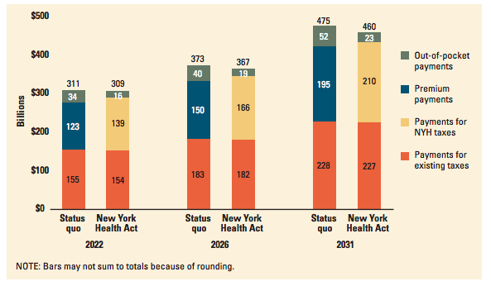
A unified system is more equitable and more efficient
Notes:
We can afford to cover everything, for everyone, without allocating more resources towards healthcare.
It’s a win win for the 99%

Slide 19
Health economists agree
Unified, tax-financed system can solve the outstandingly inefficient, inequitable US healthcare system
Major barrier: “Those ideas will never win”
A collective rejection of the idea that things can be better

Slide 20
One in every 555 African Americans has died of COVID
Also our systems are not designed to protect us from collective threats.
Two distinct, inseparable problems

