Slide 1
Lessons from COVID-19 in Caring for Underserved Patients and Communities
Nicte I. Mejia, MD MPH FAAN
Claudia Fegan, MD CHCQM FACP

Slide 2
The COVID-19 pandemic

Slide 3
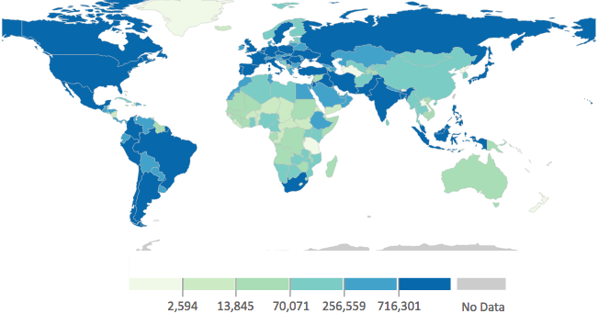
The COVID-19 pandemic
https://covid.cdc.gov/covid-data-tracker/#global-counts-rates
Notes:
Since January 2020, our world has witnessed over 182 million COVID19 cases and close to 4 million COVID19 related deaths.
With this, we’ve witnessed the magnification of longstanding health and healthcare disparities including in neurology.

Slide 4
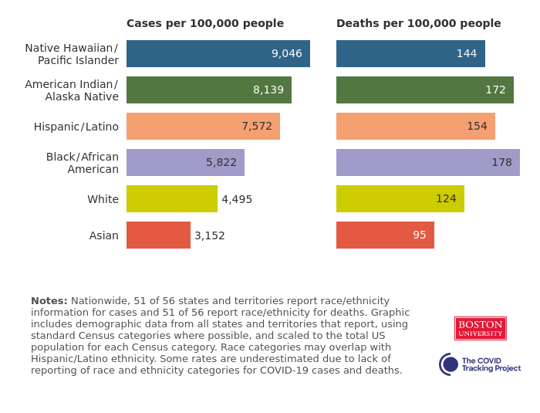
Inequitable COVID-19 risk
https://covidtracking.com/race/infection-and-mortality-data
Notes:
Marginalized communities around the world continue to be disproportionally affected by COVID-19.
In the US, the Native American, Black, and Latino communities have the largest proportion of cases and deaths per 100,000 people.

Slide 5
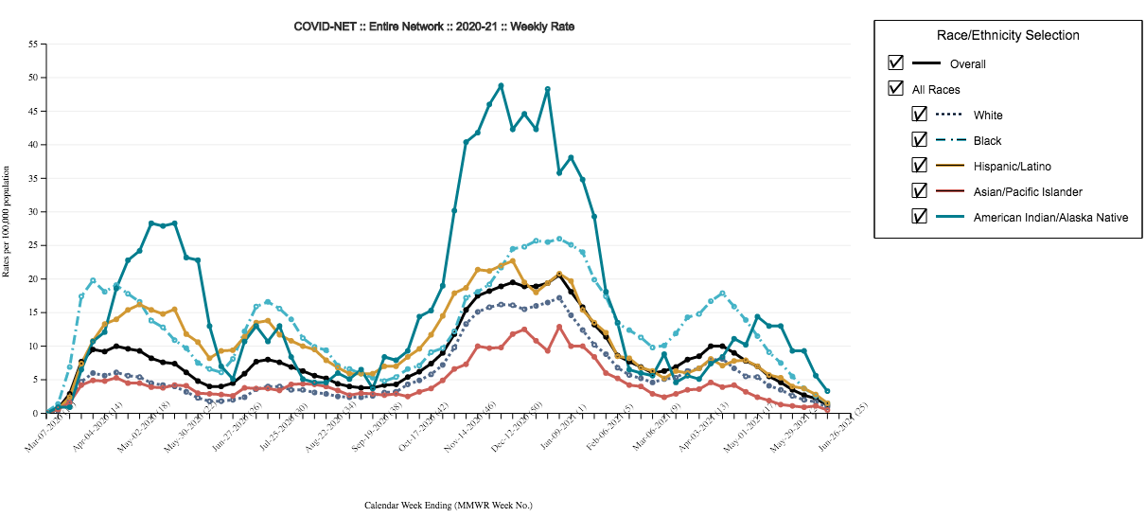
Disparate COVID-19 hospitalization rates
https://covid.cdc.gov/covid-data-tracker/#covidnet-hospitalization-network
Notes:
People of color experience higher COVID-19 hospitalization rates.
Indigenous, Black, and Latino patients remain 3-4 x more likely to be hospitalized for COVID-19 care.

Slide 6
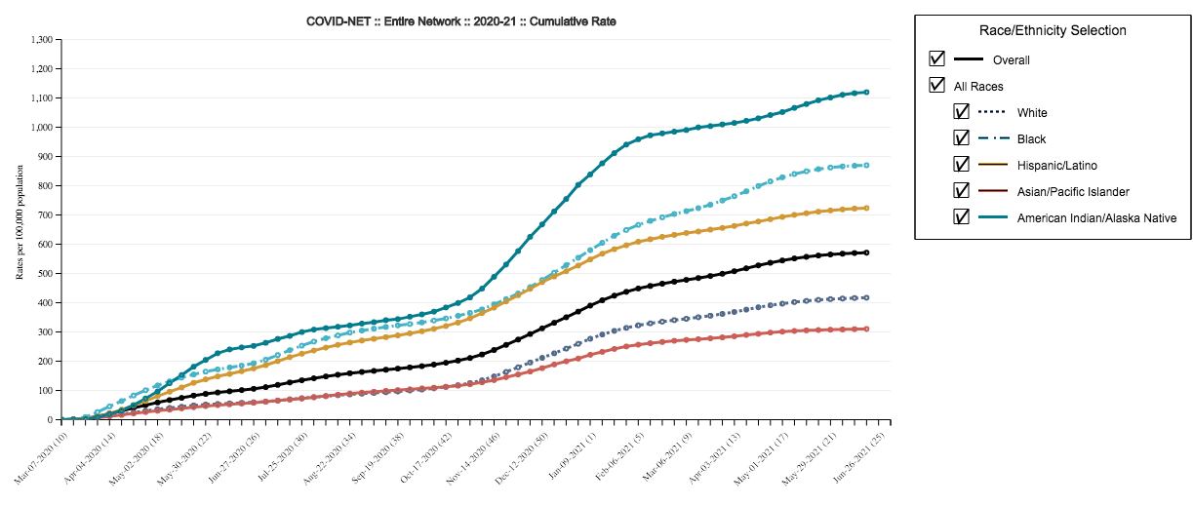
Disparate COVID-19 hospitalization rates
https://covid.cdc.gov/covid-data-tracker/#covidnet-hospitalization-network
Notes:
Same data with a different visual, emphasizing the higher proportion of hospitalized patients among people in Black, Latino, and Indigenous communities.

Slide 7
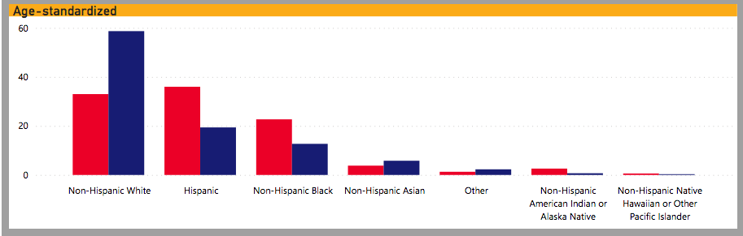
Disparities in COVID-19 mortality
https://www.cdc.gov/nchs/nvss/vsrr/covid19/health_disparities.htm
Notes:
Mortality is the most significant COVID19 related disparity.
There have been >600k deaths in the US, with Black, Latino, and Indigenous patients having 2-3x deaths compared to their proportion of the population

Slide 8
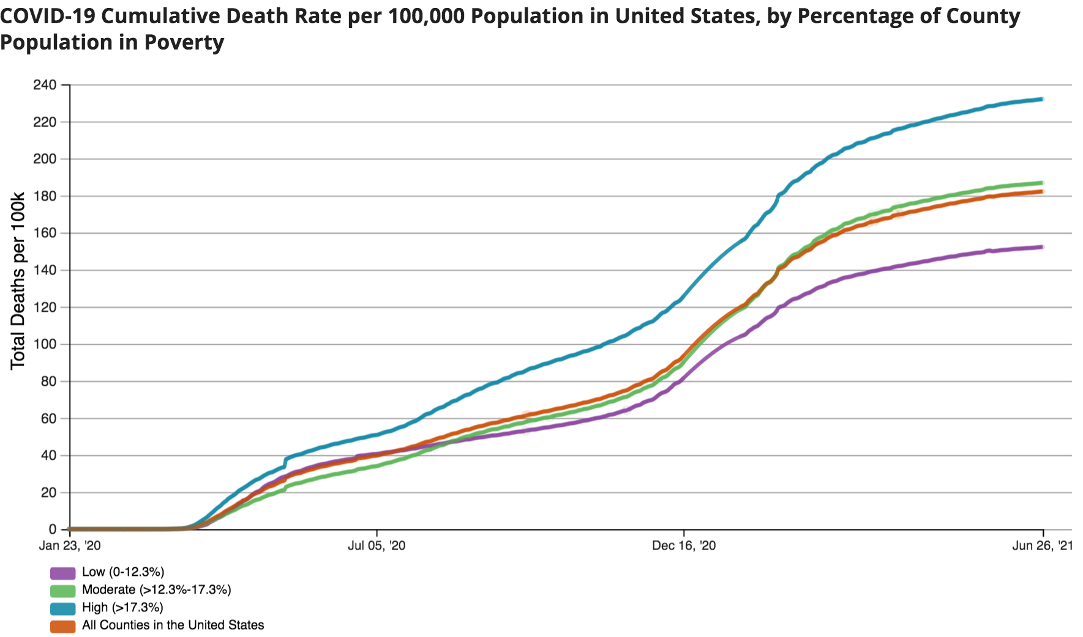
Disparities in COVID-19 mortality
https://covid.cdc.gov/covid-data-tracker/#pop-factors_totaldeaths
Notes:
A greater burden of COVID-19 mortality also exists for people experiencing poverty.

Slide 9
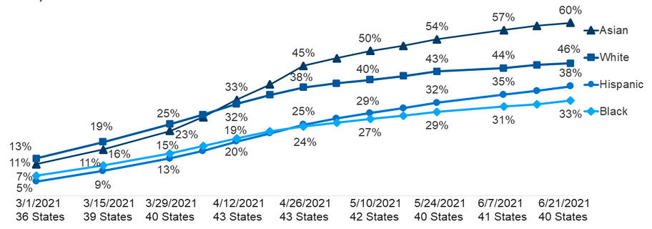
COVID-19 vaccinations
https://www.kff.org/coronavirus-covid-19/issue-brief/latest-data-on-covid-19-vaccinations-race-ethnicity/

Slide 10
Long lasting COVID-19 consequences
Mortality
Disability
Missed healthcare
Economic hardship
Poor quality of life
Unemployment
Hunger
Homelessness
Violence
Stress
Substance use
Trauma
Stigma
Mistrust

Slide 11
Pathways to COVID-19 disparities

Slide 12
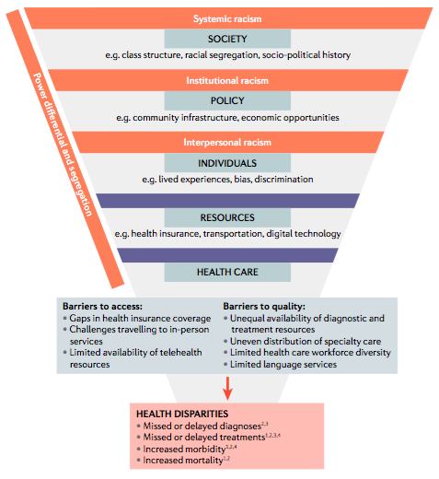

In the context of COVID-19
Nolen L and Mejia N, Inquities in neurology amplified by the COVID-19 pandemic. Nature Rev Neurology, 2021.

Slide 13
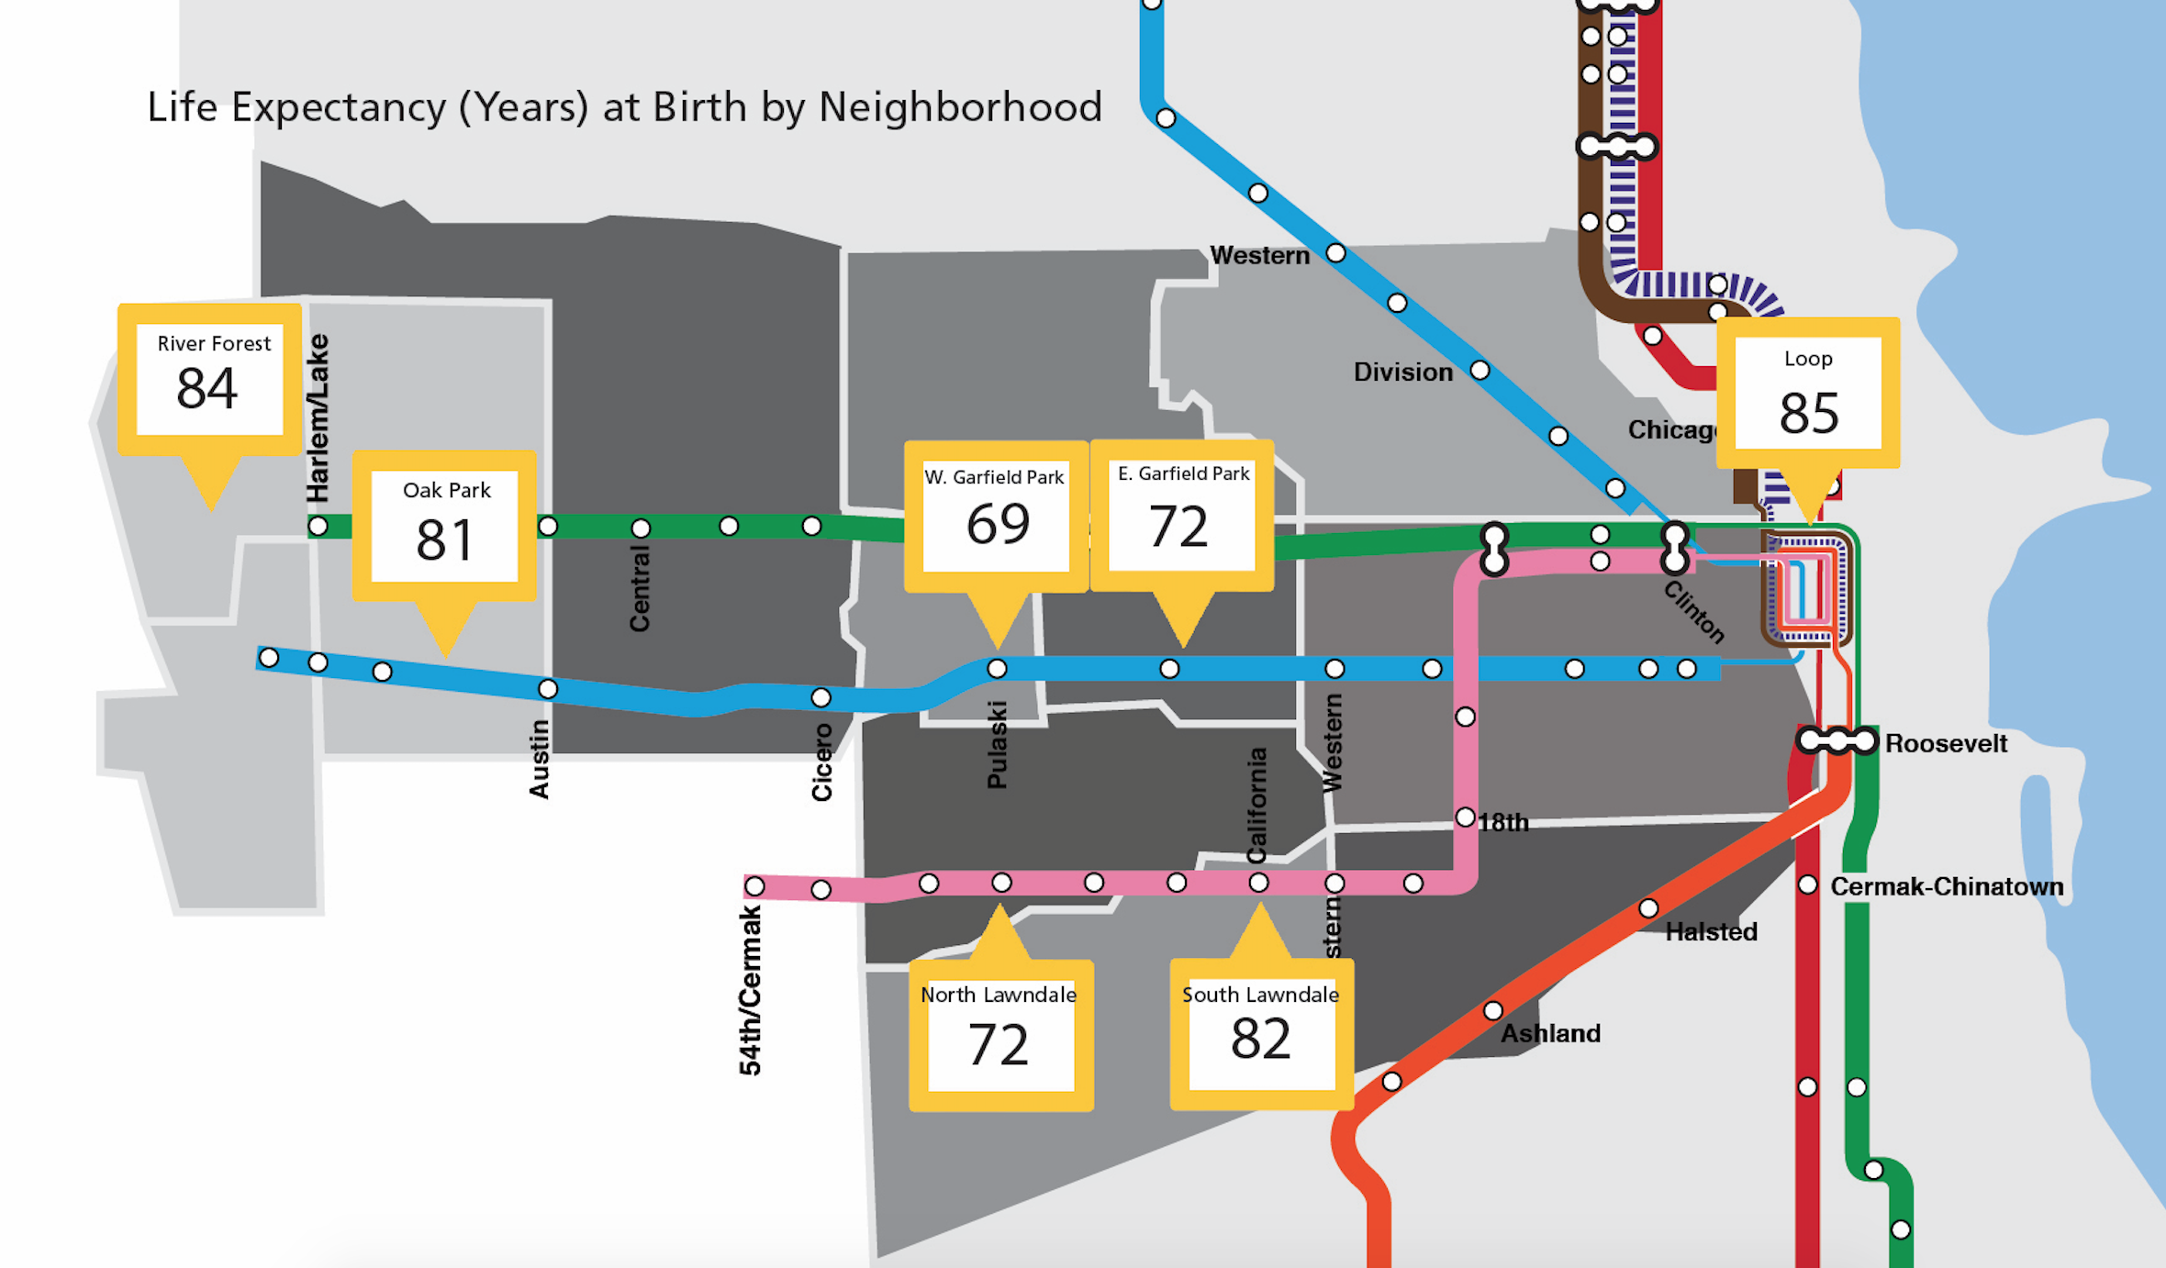
Segregation & health
Segregation – City-Level

Slide 14
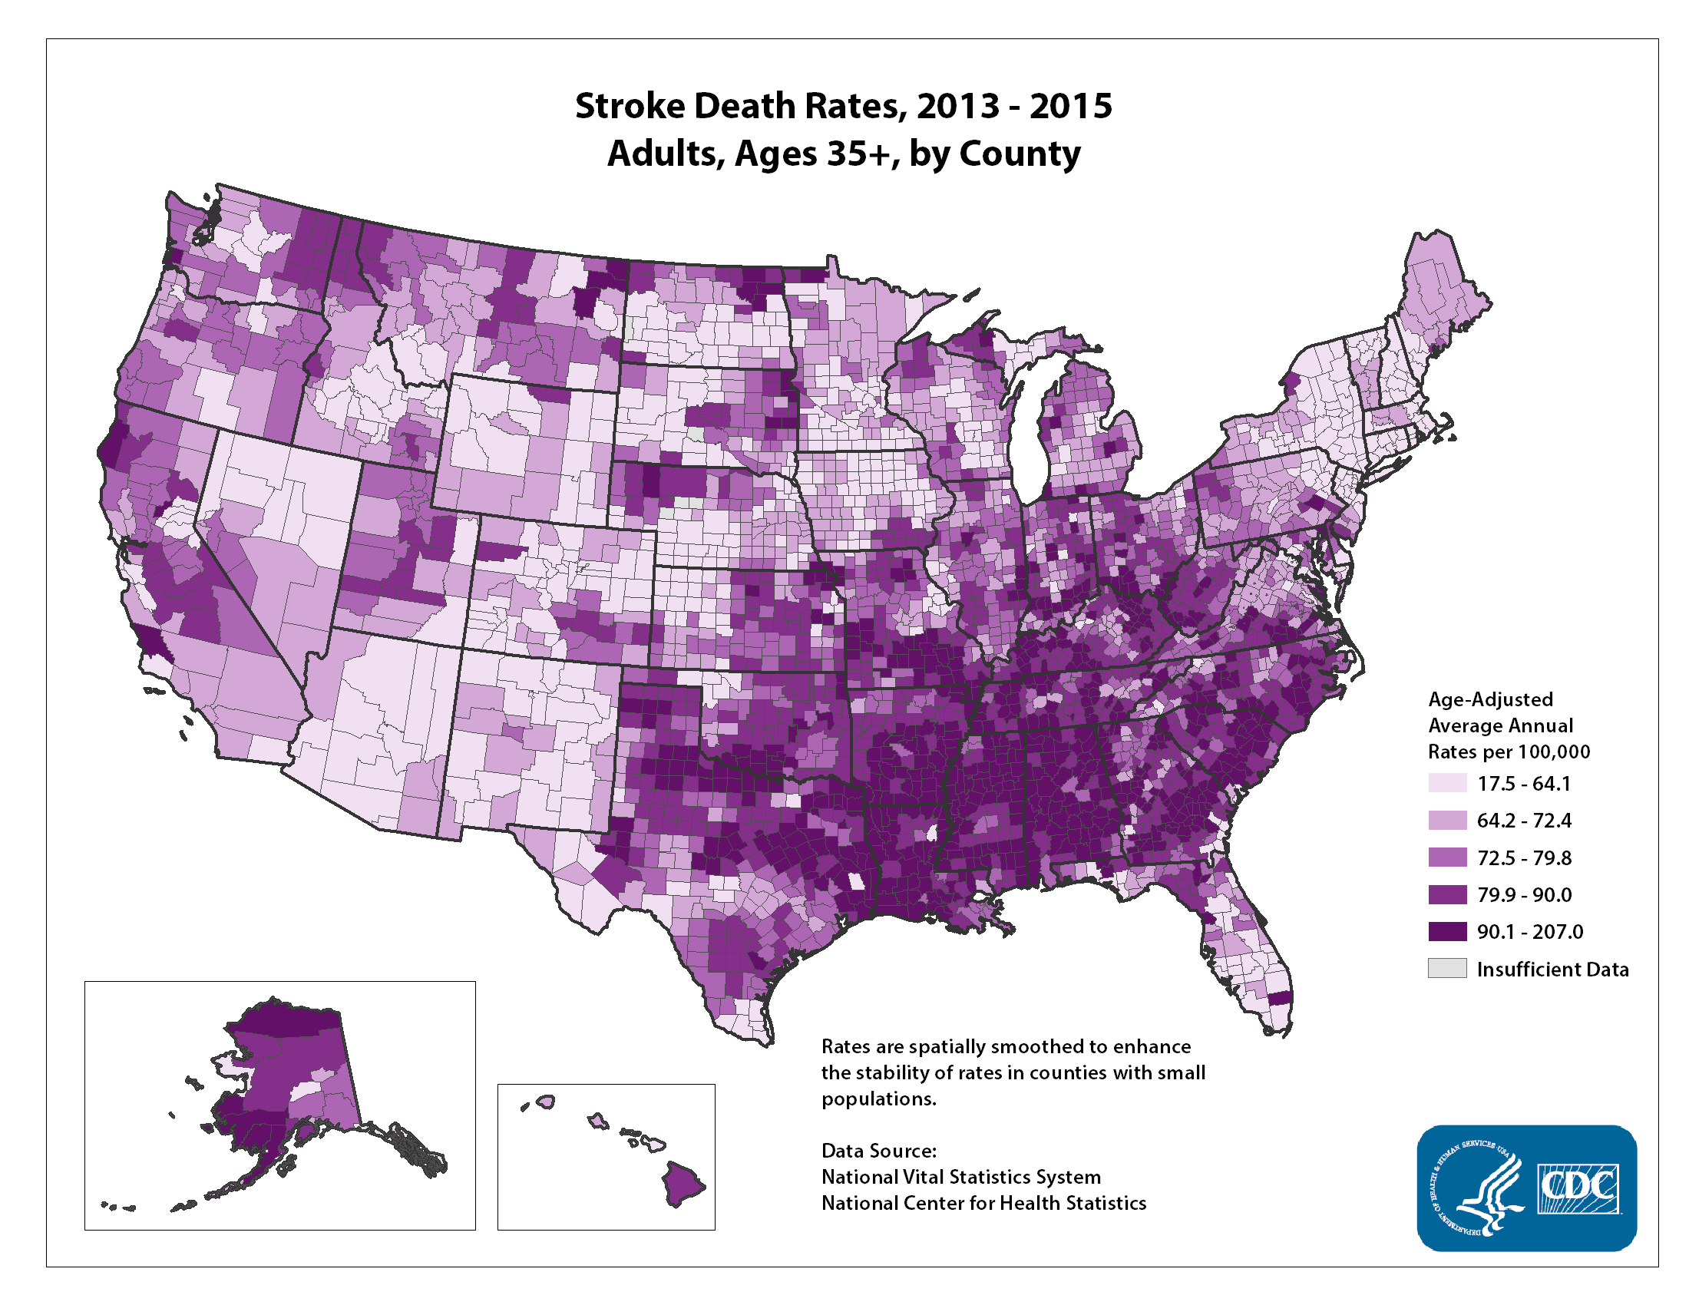
Segregation & health
Segregation - National

Slide 15
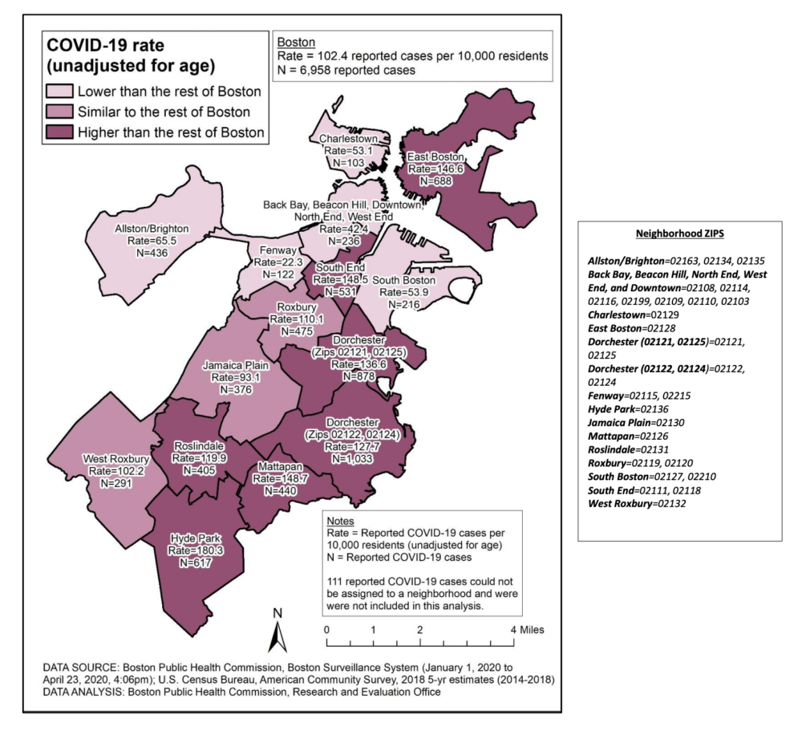
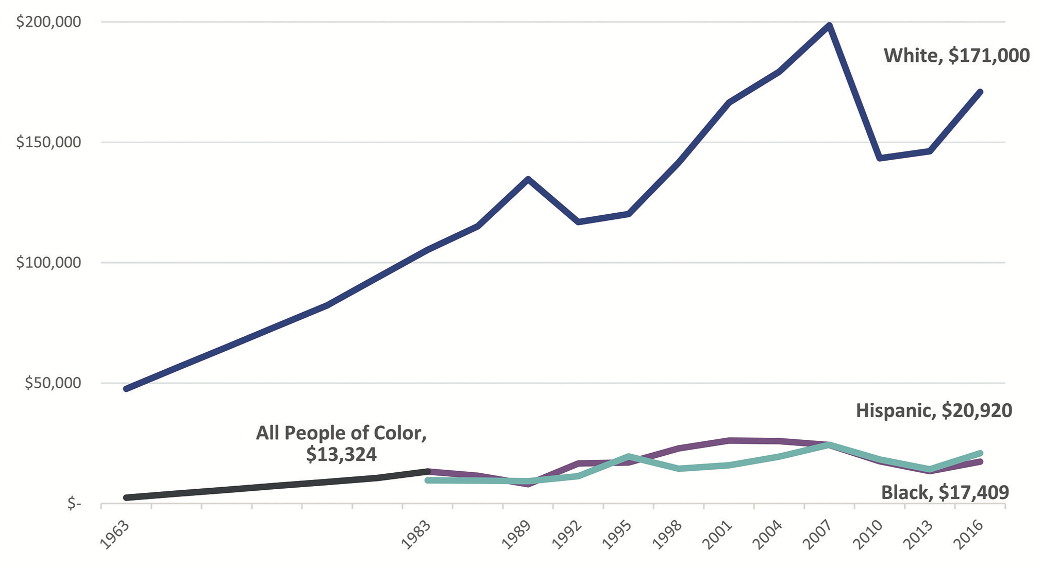
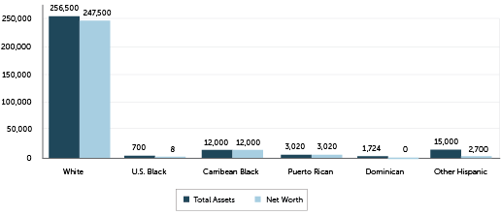
BOSTON

Slide 16
Poverty

Slide 17
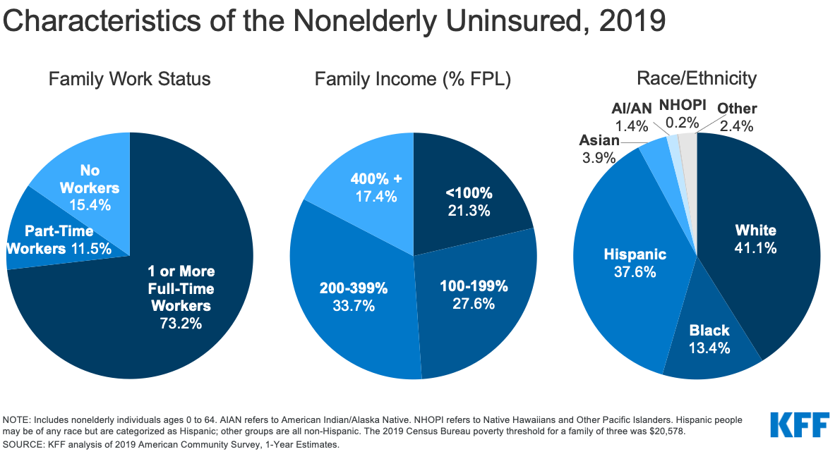
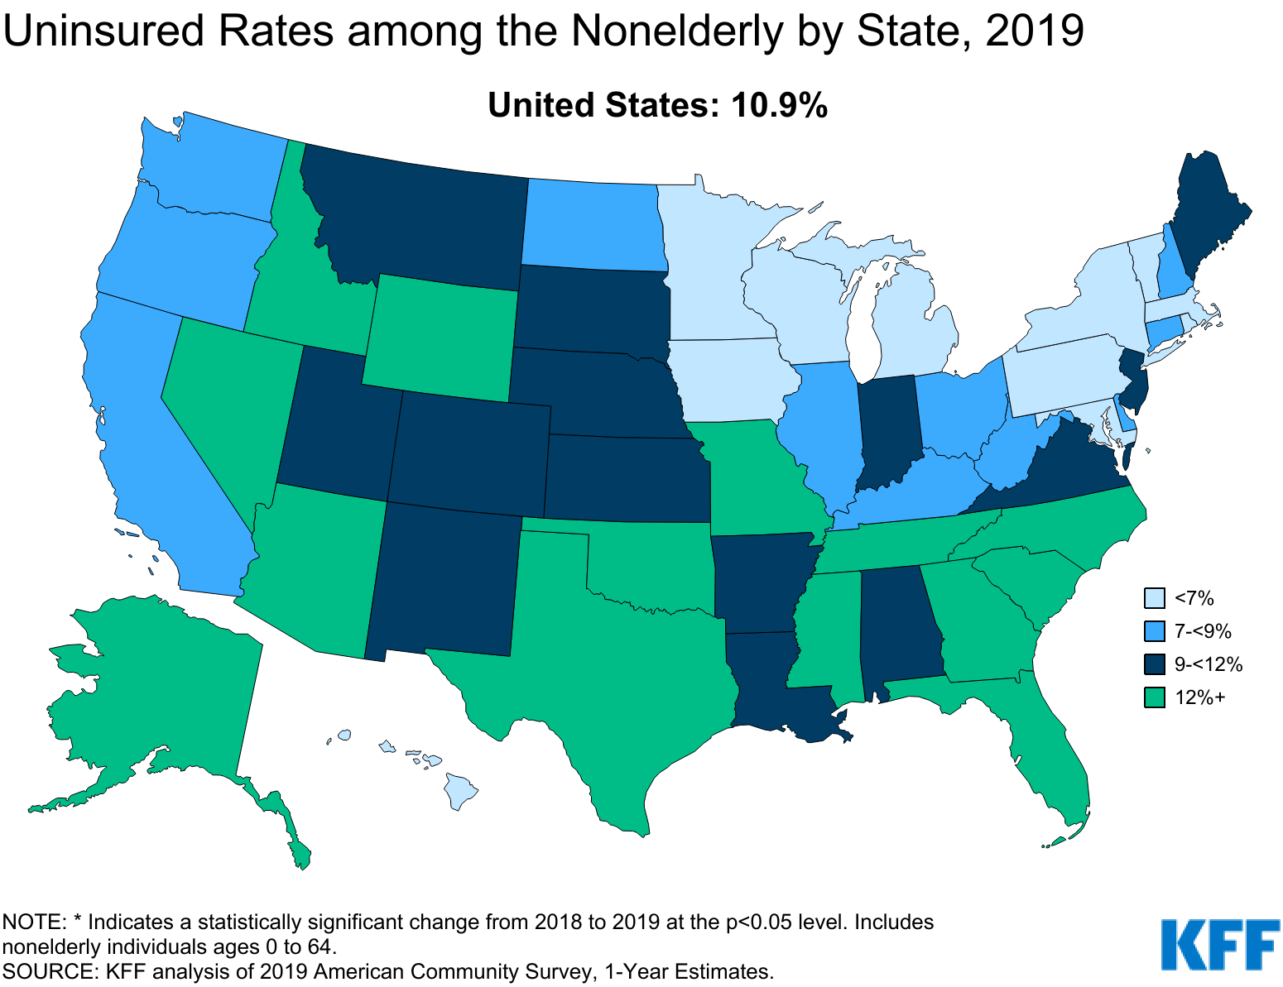
Changing the context
Lack of health insurance

Slide 18
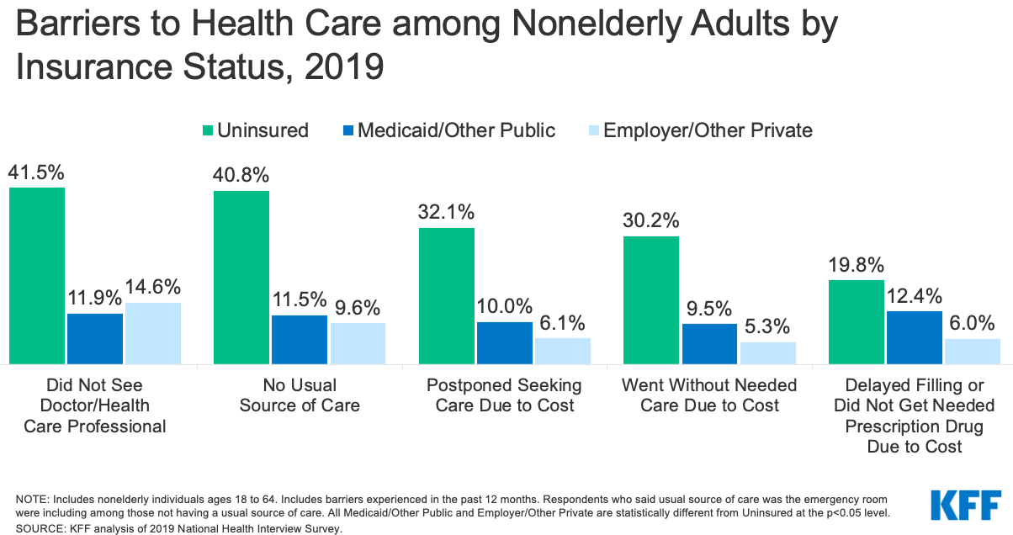
Changing the context
Lack of health insurance

Slide 19
Approach for the future

Slide 20
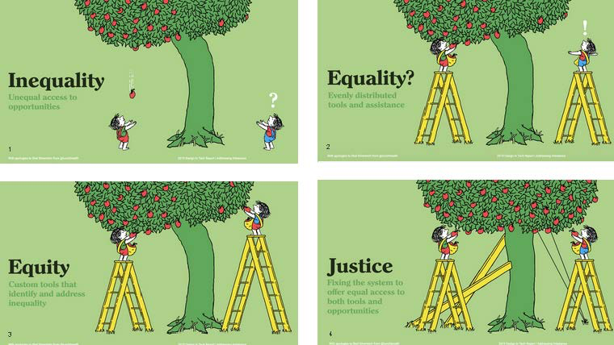
Structural racism
Image credit: Tony Ruth for Design in Tech Report at Paper Pinecone..
Notes:
Structural or institutional racism (also known as structural or institutional discrimination, structural inequality) occurs in a society "when an entire network of rules and practices disadvantages less empowered groups while serving at the same time to advantage the dominant group”.

Slide 21
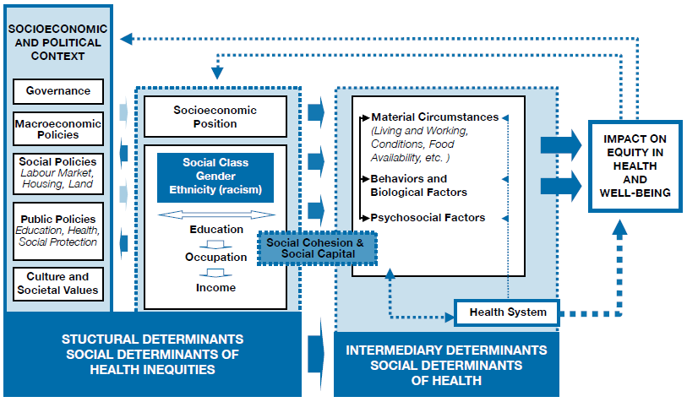
Determinants of Health
World Health Organization, 2010.

Slide 22
Health equity
Health equity means that everyone has a fair and just opportunity to be as healthy as possible. This requires removing obstacles to health such as poverty, discrimination, and their consequences, including powerlessness and lack of access to good jobs with fair pay, quality education and housing, safe environments, and health care.
For the purposes of measurement, health equity means reducing and ultimately eliminating disparities in health and its determinants that adversely affect excluded or marginalized groups.
Braveman P, Arkin E, Orleans T, Proctor D, and Plough A.
What Is Health Equity? And What Difference Does a Definition Make?
Princeton, NJ: Robert Wood Johnson Foundation, 2017.

Slide 23
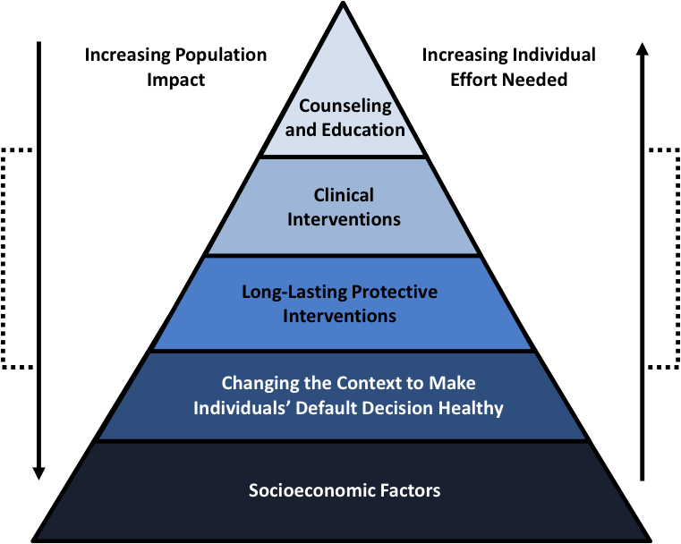
Framework for Action
Source: Frieden, T. A Framework for Public Heath Action: The Health Impact Pyramid. Am J Public Health. 2010; April; 100(4): 590–595.

Slide 24
Clinical interventions
Counseling and education
Messenger
Trust
Message

Slide 25
Clinical interventions
Clinical interventions
Access to therapeutics
Access to a more diverse & inclusive workforce
Access to diagnostics

Slide 26
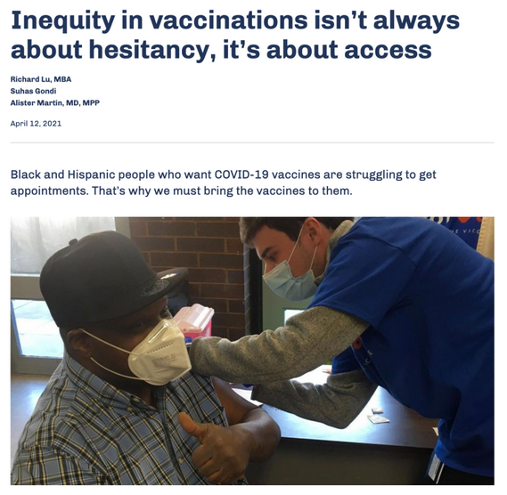
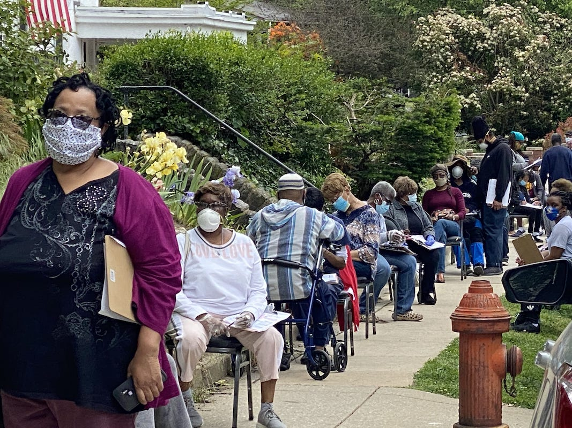
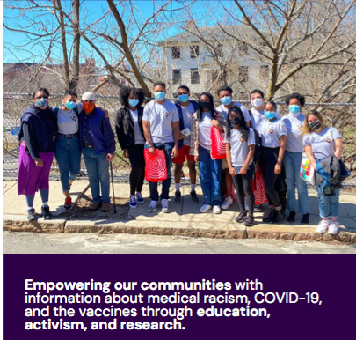



Long lasting protective interventions:
vaccination

Slide 27
Changing the context
Universal healthcare
Telemedicine licensing reform
Public health infrastructure

Slide 28
Socioeconomic factors
Quality education
Living wage
Residential desegregation
Reparations

Slide 29
Questions or comments?
Thank you!

