Slide 1
Don't Let Naked Profiteering Destroy Our Medicare
Ed Weisbart MD
Physicians for a National Health Program
National Board Secretary
Missouri@PNHP.org

Slide 2
“A milestone in finding better ways to improve well-being”
News you might have missed…
The HMO Act of 1973
“A financial incentive to keep its subscribers healthy”
“Shift the emphasis to the prevention of illness”
“Test in all parts of the country”
“Adequately tested in medically underprivileged”
https://www.nytimes.com/1973/12/30/archives/president-signs-bill-for-reform-in-medical-care-act-will-aid.html?searchResultPosition=1
Accessed Apr 11 2022

Slide 3
1970 – 2020: USA Drifts Further and Further Off Course
30 High-Income Countries
2020
Some form of national health insurance
Life Expectancy at Birth
USA
2010
2015
2020
2005
ACA
DCE
Medicare Advantage
REACH
2000
Medicare + Choice
HMO Act
1970
USA models rely on markets and enable profiteering
Healthcare Expenditure per capita (US$)
Chart modified from one produced by Charlie Swanson using World Bank data
https://data.worldbank.org/indicator/SH.XPD.CHEX.PC.CD
Notes:
2002 IOM 2002: Care without Coverage
https://doi.org/10.17226/10367
2004 Health Affairs
https://www.healthaffairs.org/doi/full/10.1377/hlthaff.23.4.223
2008 AJPH
https://ajph.aphapublications.org/doi/10.2105/AJPH.2008.157685
2008 Update to IOM
https://www.urban.org/sites/default/files/publication/31386/411588-Uninsured-and-Dying-Because-of-It.PDF
2020 Lancet review article
https://doi.org/10.1016/S0140-6736(19)33019-3

Slide 4
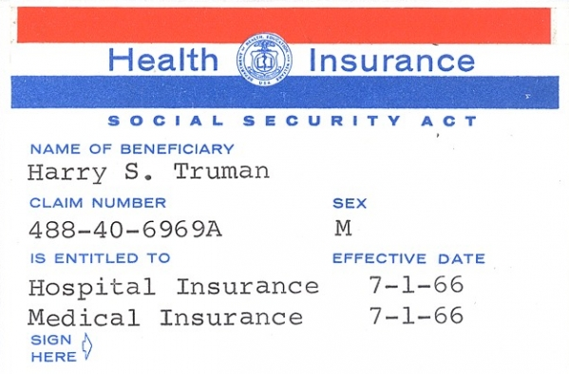
As with any endangered species, We Need to Protect Medicare
Desegregated American hospitals
Fewest barriers, broadest networks
Lean and efficient
Effective (longer, healthier lives)

Slide 5
Medicare Desegrated Our Hospitals
Claudia Fegan MD FACP
Chief Medical Officer of
Cook County Health
National Coordinator of Physicians for a National Health Program
Smith, D. The Power to Heal. 2016.
https://loc.gov/pictures/resource/cph.3b22541/

Slide 6
Medicare Has the
Broadest National Network
Accept Medicare?
Yes
No
https://www.kff.org/medicare/issue-brief/most-office-based-physicians-accept-new-patients-including-patients-with-medicare-and-private-insurance/
Data from survey in June 2022 by KFF, accessed Sept. 2 2022

Slide 7
Medicare Is
Lean, Efficient, and Effective
60%
40%
20%
52.6%
Commercial Health Insurance
Cumulative growth in per-enrollee spending
21.5%
Medicare
2008 | 2010 | 2012 | 2014 | 2016 | 2018
https://www.axios.com/health-insurance-costs-private-medicare-medicaid-c40bb6f1-c638-4bc3-9a71-c1787829e62e.html Accessed March 7 2023

Slide 8
Medicare Is
Lean, Efficient, and Effective
Traditional
Medicare
2% overhead:
It’s difficult to imagine a
more efficient healthcare program
than Traditional Medicare
98%
Patient Care
Overhead
Medicare overhead drawn from Medicare Trust Fund reports over multiple years

Slide 9
Medicare Means
Healthier Americans
1
3
5
7
9
11
13
15
17
USA
Rank
Age 65
Women
Men
0-1 | 1-4 | 5-9 | 10-14 | 15-19 | 20-24 | 25-29 | 30-34 | 35-39 | 40-44 | 45-49 | 50-54 | 55-59 | 60-64 | 65-69 | 70-74 | 75-79 | 80-84 | 85-89 | 90-94 | 95-99
Institute of Medicine. Shorter Lives, Poorer Health.
Fig 1-9: Ranking of US mortality rates by age group among 17 peer countries, 2006-2008. 2013
Peer nations are Australia, Austria, Canada, Denmark, Finland, France, Germany, Italy, Japan, Norway, Portugal, Spain, Sweden, Switzerland, Netherlands, United Kingdom
Age

Slide 10
2% “overhead” means Traditional Medicare Is Simple and Efficient

Slide 11
Medicare Advantage Is Complicated and Inefficient
Fundamentally complicated
HMO-style tools
(Prior Authorizations, etc.)
Smaller “networks”
Shun the sick,
seek the well
High overhead
and profits
Accusations, fines, settlements for fraud

Slide 12
Medicare Advantage continues to Take Over Medicare
2022 Letter to CMS from 346 members of Congress
“Older adults on Medicare Advantage report
consistent satisfaction with their
coverage and quality of care.”
Percent of Medicare beneficiaries in MA
Congress might as well have said:
“The market has spoken.
MA is growing because
MA is better and seniors love it.”
https://www.medpac.gov/wp-content/uploads/2023/03/Ch11_Mar23_MedPAC_Report_To_Congress_SEC.pdfaccessed March 19 2023
https://bettermedicarealliance.org/wp-content/uploads/2022/01/final_2022_house_ma_letter_.pdf

Slide 13
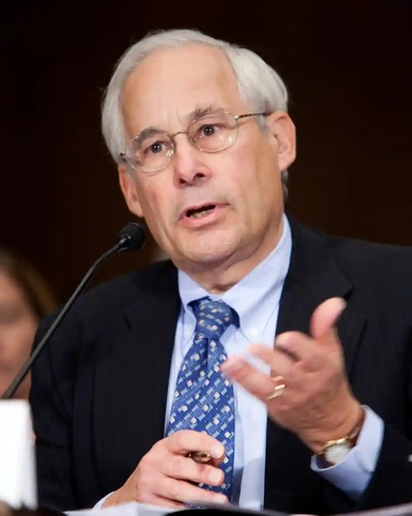
Medicare Advantage continues to Take Over Medicare
“If an ice cream firm can offer ice cream for free because of a subsidy,
its market share will of course grow against firms that charge for ice cream.
The cause is not better ice cream;
it is free ice cream.”
Don Berwick MD
https://www.healthaffairs.org/do/10.1377/forefront.20220602.413644 Accessed June 8 2022

Slide 14
Medicare has been consistently Overpaying Medicare Advantage
18%
16%
14%
12%
10%
8%
6%
4%
2%
Per MedPAC,
this chart
underestimates
the overpayments
MA payments as a % above FFS Medicare spending
2004 | 2006 | 2008 | 2010 | 2012 | 2014 | 2016 | 2018 | 2020 | 2022
https://www.medpac.gov/wp-content/uploads/2023/03/Mar23_MedPAC_Report_To_Congress_SEC.pdf
Pg 344 Fig 11-4. Accessed Mar 27 2023

Slide 15
Medicare Advantage Opened the Public Door to Profiteers
Traditional
Medicare
Medicare
Advantage
15%
98%
85%
Patient Care
Overhead and Profit
Commercial insurance overhead defined as the inverse of the Medical Loss Ratio (1-medical benefits/premiums) as calculated by Himmelstein and Woolhandler at https://www.citizen.org/article/powerpoint-presentations-on-health-policy-issues-relevant-to-health-care-reform-and-a-national-single-payer-health-system/
Medicare overhead drawn from Medicare Trust Fund reports over multiple years
MedPAC reports repeatedly identify the absence or limitations of data from MA

Slide 16
The Business of Medicare Advantage
Fraud
Settlements and fines without admissions of guilt
Cherry picking
Get paid for an average person but attract the healthiest
Lemon dropping
Expensive illnesses turn members into liabilities
Upcoding
Get paid for more diagnoses that don’t need to be treated
https://www.medpac.gov/wp-content/uploads/2023/03/Ch11_Mar23_MedPAC_Report_To_Congress_SEC.pdf

Slide 17
Just the upcoding in Medicare Advantage Drains Billions of Dollars from Medicare
“Medicare Advantage has never generated savings relative to Traditional Medicare.
In fact, the opposite is true.”
– Kaiser Family Foundation
$ billions paid to MA plans based on differences in dx coding
https://www.medpac.gov/wp-content/uploads/2023/03/Ch11_Mar23_MedPAC_Report_To_Congress_SEC.pdf 2022 and 2023 estimated by MedPAC
Accessed March 19 2023
https://www.kff.org/medicare/issue-brief/higher-and-faster-growing-spending-per-medicare-advantage-enrollee-adds-to-medicares-solvency-and-affordability-challenges/?utm_campaign=KFF-2021-Medicare&utm_medium=email&_hsmi=2&_hsenc=p2ANqtz--NbWFYepJ3_bF07nVVqdBF1nXFKwXuVn9L66uGcqn5hPdz7Tiot2L7eMwnyN0vSl6Bnbb1hZiyrztywKa3saASppissA&utm_content=2&utm_source=hs_email

Slide 18
Overbilling in Medicare Advantage Exceeds Entire Agency Budgets
Estimated between $12B – $25B
https://www.medpac.gov/wp-content/uploads/2023/03/Ch11_Mar23_MedPAC_Report_To_Congress_SEC.pdf
Figures represent outlays in 2020 fiscal year.
https://www.nytimes.com/2022/10/08/upshot/medicare-advantage-fraud-allegations.html Accessed Oct 26 2020

Slide 19
https://www.finance.senate.gov/imo/media/doc/Deceptive%20Marketing%20Practices%20Flourish%20in%20Medicare%20Advantage.pdf
Accessed Nov 4 2022

Slide 20
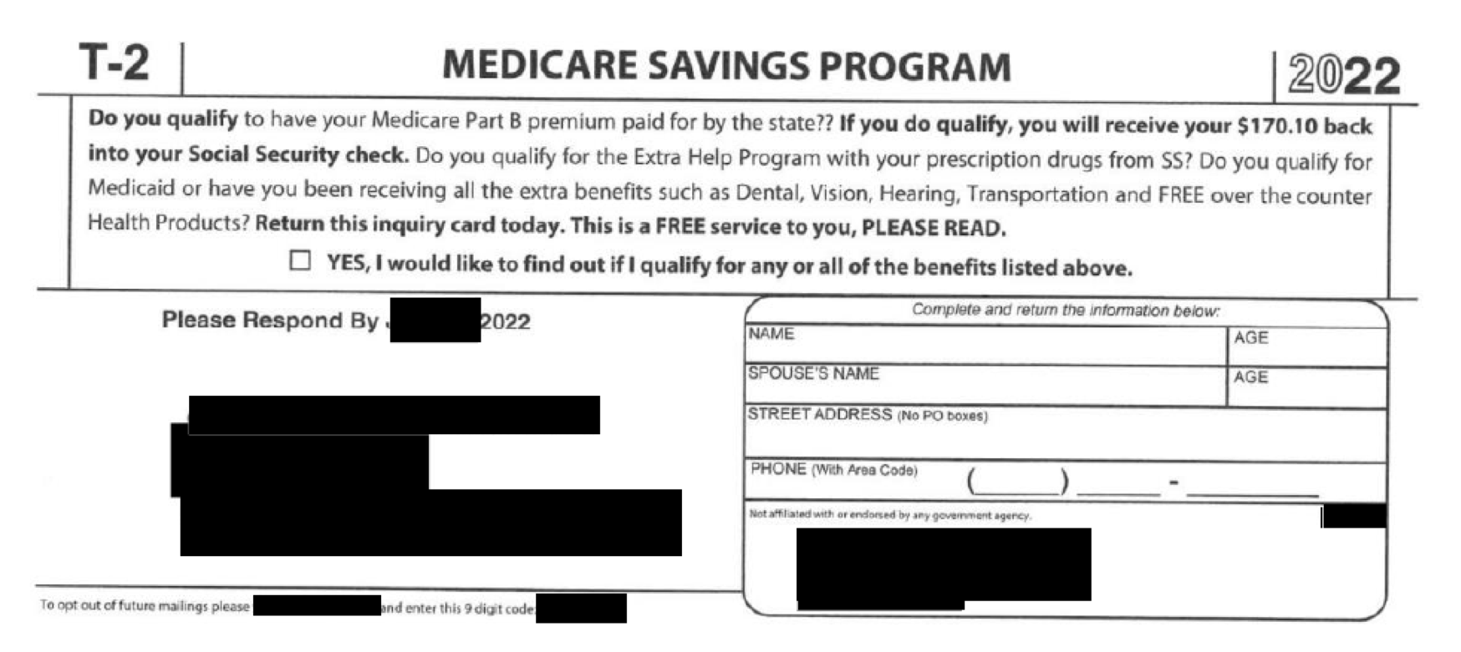
https://www.finance.senate.gov/imo/media/doc/Deceptive%20Marketing%20Practices%20Flourish%20in%20Medicare%20Advantage.pdf
Accessed Nov 4 2022

Slide 21
Insurance agents are increasingly rewarded for Promoting Medicare Advantage
1st Year Commissions
Agents often receive annual commissions
at ~50% of first year level
until the patient changes plans or brokers
Some variation by state
https://www.commonwealthfund.org/blog/2021/agent-commissions-medicare-and-impact-beneficiary-choice?utm_source=alert&utm_medium=email&utm_campaign=Achieving+Universal+Coverage
Accessed Oct 27 2022

Slide 22
CMS “Secret Shoppers” of insurance agent calls with clients in 2022: 80% of Calls Were Inaccurate or Insufficient
One example of many…
“If your medication is not on the formulary,
your doctor could tell the plan
and the plan would simply add it.”
Published by CMS May 9, 2022
https://www.documentcloud.org/documents/23169211-agent-broker-marketing-faqs
https://www.medpagetoday.com/special-reports/exclusives/101348

Slide 23
Medicare Advantage Plans are allowed to create their own Secret Rules to Reject Necessary Care
18%
18% of the claims denied by Medicare Advantage plans in 2019 would have been approved by Traditional Medicare.
Seems almost quaint today when Artificial Intelligence now writes and reviews many of these claims.
15 selected MAOs during June 1-7 2019, reported by OIG April 2022
https://oig.hhs.gov/oei/reports/OEI-09-18-00260.pdf

Slide 24
New AI / MA profiteers profiting from Making Profiteers More Profitable
2010
Tom Scully bought an AI algorithm for $6M
Between 2020 and 2022:
The number of appeals filed to
contest MA denials shot up 58%
2022:
150,000 denial reviews filed
2012
Rebranded it NaviHealth and sold it for $50M
2015
Sold to Cardinal Health for $410M
2018
Sold to private equity firm for $1.3B
2020
Sold to UnitedHealth for $2.5B
https://www.statnews.com/2023/03/13/medicare-advantage-plans-denial-artificial-intelligence/ Accessed Mar 13 2023

Slide 25
A brave new world of profiteering opportunities AIs Addressing AIs
“Review your policy…
“Gather supporting documentation…
“Write a clear and concise letter…
“Use specific language…
“Be polite and professional…
“Submit your appeal on time…
“Follow up with your insurance company…
“Good luck with your appeal!”
Profiteers profiting from the profiteers profiting from the profiteers
I asked ChatGPT:
“What should I say
when I appeal
a denial from
Medicare Advantage?”
https://chat.openai.com/chat
Interaction with Ed Weisbart MD on Mar 14, 2023. Emphasis added to last statement.

Slide 26
If it’s so bad, why do so many people sign up for Medicare Advantage?
Traditional Medicare
Is Imperfect
Three options for
Medicare members
20% outpatient “coinsurance”
$1,600 hospital deductible (2023)
No out-of-pocket limits
Premiums for Part B, Part D, and a Medigap plan
TM and nothing more (exposure to bankruptcy in a major illness)
Give up TM for MA
Add Medigap to TM. Maybe.
https://www.cms.gov/files/document/mm12903-medicare-deductible-coinsurance-premium-rates-calendar-year-2023-update.pdf Accessed Oct 27 2022

Slide 27
If it’s so bad, why do so many people sign up for Medicare Advantage?
 | Medigap (Plan G example) | Medicare Advantage
Premiums
Out-of-Pocket
Benefits
Networks
Utilization Management
~$200 average per month
Average $18/month in 2023
Zero out-of-pocket after the Part B deductible ($226 per year)
$12,450 combined in-network and out-of-network ($8,300 in-network)
Often includes additional benefits (Rx, hearing, vision, dental, gym clubs, etc)
No additional benefits beyond TM
Smaller variable lists of “in-network” physicians and hospitals
Identical to Traditional Medicare
Rare and only as required in TM (e.g., some hospital outpatient items)
Typically has proprietary “Prior Authorizations”, “Step Therapy”, etc.
https://www.cms.gov/files/document/opd-services-require-prior-authorization.pdf
2023 benefit designs
https://www.hhs.gov/about/news/2022/09/29/biden-harris-administration-announces-lower-premiums-for-medicare-advantage-and-prescription-drug-plans-in-2023.html
https://www.kff.org/medicare/issue-brief/medicare-advantage-in-2022-premiums-out-of-pocket-limits-cost-sharing-supplemental-benefits-prior-authorization-and-star-ratings/ Accessed Oct 27 2022

Slide 28
If it’s so bad, why do so many people sign up for Medicare Advantage?
 | Medigap (Plan G example) | Medicare Advantage (Plan C)
Premiums
Out-of-Pocket
Benefits
Networks
Utilization Management
“I’ll start with a free Advantage Plan
and pay the extra for Medigap if
the Advantage Plan won’t let me see
the doctors and hospitals I want.”

Slide 29
Federal protections for
people pre-existing conditions
end after 6 months in Medicare Part B
or 12 months in Medicare Advantage.
After 12 months, you may be
trapped in Medicare Advantage.
Few people realize they’re making that decision.
https://www.kff.org/medicare/issue-brief/medigap-enrollment-and-consumer-protections-vary-across-states/
https://www.medicare.gov/supplements-other-insurance/when-can-i-buy-medigap#
Accessed Dec. 14 2020

Slide 30
Why Does Medicare Have These “Gaps”?
“The Moral Hazard” vs
“Skin in the Game”
“We don’t have to worry about unleashing a stampede for free leg amputations or free liver transplants.” (McCanne)
Nyman, J. Jnl Health Polit Policy Law (2007) 32 (5): 759–783. https://doi.org/10.1215/03616878-2007-029
https://pnhp.org/news/urgent-message-reprising-john-nymans-new-theory-of-moral-hazard/
Hartmann, Thom. The Hidden History of American Healthcare. 2021. Pg 9

Slide 31
The Failure of “Skin in the Game”
US adults who would pay out-of-pocket
Wouldn’t Pay
Don’t Know
Would Pay
https://morningconsult.com/2023/03/08/affordable-care-act-polling-data/ Accessed March 20 2023

Slide 32
Why Does Medicare Have These “Gaps”?
“The Moral Hazard” vs
“Skin in the Game”
“We don’t have to worry about unleashing a stampede for free leg amputations or free liver transplants.” (McCanne)
Crreate a niche
for commercial insurance
Ensure a market for commercial insurance companies (and their support) by limiting the value of Medicare
The Southern Strategy
(aka Racism)
“A 20% copay guaranteed that poor Black people would avoid medical care.” (Hartmann)
Nyman, J. Jnl Health Polit Policy Law (2007) 32 (5): 759–783. https://doi.org/10.1215/03616878-2007-029
https://pnhp.org/news/urgent-message-reprising-john-nymans-new-theory-of-moral-hazard/
Hartmann, Thom. The Hidden History of American Healthcare. 2021. Pg 9

Slide 33
Whatever the reason that Medicare includes copays and deductibles, The “Gaps” Created a Niche for Profiteering
Traditional
Medicare
Medicare
Advantage
Medicare
Supplemental
My monthly Medigap premium for 2 people:
$400
Annual total premium:
$4,800
I pay Medigap for
overhead and profit:
$1,056
15%
22%
98%
85%
78%
Patient Care
Overhead and Profit
2021 data reported by the National Association of Insurance Commissioners at
https://content.naic.org/sites/default/files/2021-Annual-Health-Insurance-Industry-Analysis-Report.pdf Accessed Mar 6 2023
Notes:
First, how do they maximize revenues from Medicare? DC and REACH middlemen are similar to commercial Medicare Advantage plans in that they are paid a monthly lump sum payment per enrollee. Each enrollee’s payment is based on an estimate of their potential medical needs. But, REACH middlemen can increase those payments by making patients LOOK sicker than they really are, regardless of how much is spent on actual medical care. This is called upcoding.

Slide 34
Medicare Advantage continues to grow;
Traditional Medicare Is Even Larger
Traditional Medicare has been
an untapped opportunity for investors
Medicare Enrollment
Traditional
Advantage
Percentage of MA-eligible population
https://www.medpac.gov/wp-content/uploads/2023/01/MedPAC-MA-status-report-Jan-2023.pdf
Accessed Jan 17 2023

Slide 35
Traditional Medicare is large The Profiteers Want In
Traditional Medicare
(Medicare-managed administrators)
ACO REACH (formerly DCE)
(New risk-bearing profiteers)
Providers (Physicians, hospitals,
ACOs, etc.)
Medicare Advantage
(Risk-bearing profiteers)

Slide 36
“Accountable Care Organizations Realizing Equity, Access, and Community Health” ACO REACH
New profiteers (“REACH ACOs”) in Traditional Medicare
Medicare is assigning people to their primary care physician’s REACH ACO
Medicare prepays that REACH ACO for a range of services
The less services patients get, the more profitable the REACH ACO becomes
The only way for patients to get out is to find a new primary care physician
Without Congressional oversight, transforming Medicare
2.1 million Medicare members were automatically assigned in 2023
30 million in Traditional Medicare were to be assigned to something like REACH by 2030
Public outcry forced Medicare to stop growing REACH beyond today’s 2.1 million people
https://innovation.cms.gov/media/document/aco-reach-model-fs-jan2023 Accessed Jan 24, 2023

Slide 37
The privatization of Medicare Diverts Public Funds to Investors
Traditional
Medicare
Medicare
Advantage
Medicare
Supplemental
Medicare
REACH
15%
22%
25%
or more
98%
85%
78%
75%
Patient Care
Overhead and Profit
2021 data reported by the National Association of Insurance Commissioners at
https://content.naic.org/sites/default/files/2021-Annual-Health-Insurance-Industry-Analysis-Report.pdf Accessed Mar 6 2023
Notes:
First, how do they maximize revenues from Medicare? DC and REACH middlemen are similar to commercial Medicare Advantage plans in that they are paid a monthly lump sum payment per enrollee. Each enrollee’s payment is based on an estimate of their potential medical needs. But, REACH middlemen can increase those payments by making patients LOOK sicker than they really are, regardless of how much is spent on actual medical care. This is called upcoding.

Slide 38
To get to Medicare for All, Medicare’s privatization must be Stopped and Driven Back
Protect Medicare
Eliminate the MA overpayments
Ban its secret rules
Require MA to
cover the full
Medicare network
Exclude bad actors
Expand the benefits (hearing, vision, Rx, dentistry, etc.)
Cap (or eliminate) out-of-pocket expenses
Ensure equitable access to Medigap
Sour the
Milk for
Medicare Advantage
Sweeten
the Juice
of Traditional
Medicare
We remain on guard against “REACH 2.0”

Slide 39
To protect Medicare, privatization must be Stopped and Driven Back
We demand
Medicare to keep its promise of no further growth in REACH
Our opposition is formidable
but not invincible
We
will fight
Any signs of REACH growing
or metastasizing
We will protect
Traditional Medicare, the foundation for Medicare for All

Slide 40
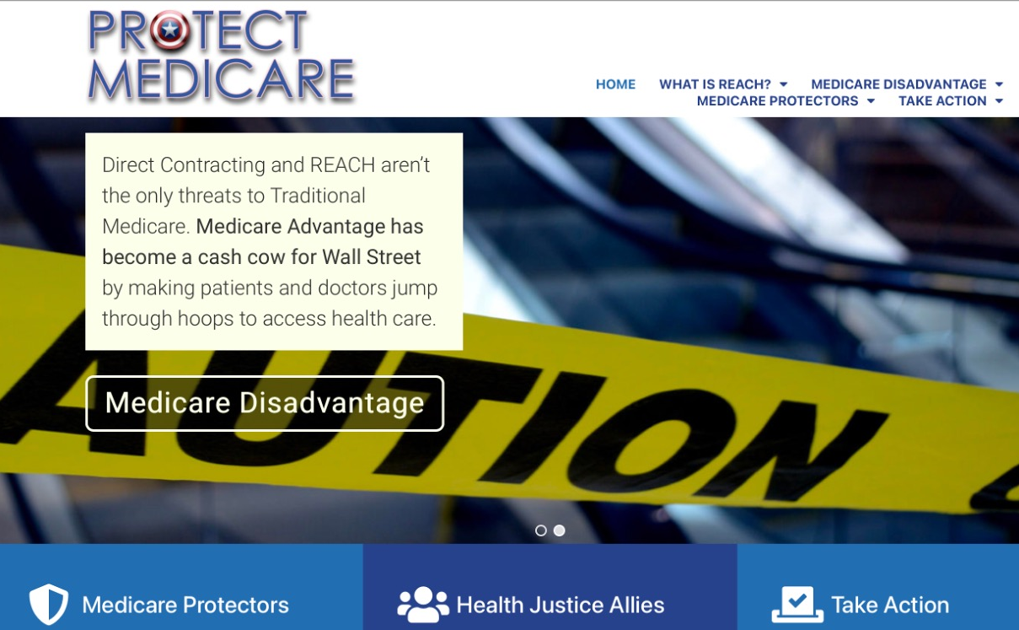
More information and action steps at
ProtectMedicare.net

