Slide 1
Health Policy Issues Relevant to
Health Care Reform and a
National Single-Payer Health System
2023 updates prepared by
Drs. Steffie Woolhandler and David Himmelstein,
posted at Public Citizen, and modified by Ed Weisbart MD
Modified version of slides prepared by Drs. Steffie Woolhandler and David Himmelstein. Originals available at https://www.citizen.org/article/updated-powerpoint-presentations-on-health-policy-issues-relevant-to-health-care-reform-and-a-national-single-payer-health-system/ (accessed Apr 12 2023)

Slide 2
Table of Contents
These set of slides is a resource library from which subsets can be selected for specific presentations.
3. COVID-19
10. Neoliberalism
14. Public Health Capacity
17. Economic Inequality
32. Uninsured
39. Medicaid
47. Under-insurance
76. Racism
100. Immigrant Health
108. Low-value care
112. Administrative overhead
116. Investor-owned care239.
150. Pharmaceuticals
164. Insurers
173. Medicare Advantage
204. ACOs
214. Pay for Performance
227. VA
233. ACA
239. Finance
243. International
263. Canada
292. Medicare for All

Slide 3
Life expectancy shortened by COVID-19
Deeper and Longer in USA Than Europe
Source: Scholey et al. “Bounce back amid continued losses: Life expectancy changes since 2019”
Modified version of slides prepared by Drs. Steffie Woolhandler and David Himmelstein. Originals available at https://www.citizen.org/article/updated-powerpoint-presentations-on-health-policy-issues-relevant-to-health-care-reform-and-a-national-single-payer-health-system/ (accessed Apr 12 2023)

Slide 4
Why was the USA
So Vulnerable to COVID-19?
Deteriorating health status
Weakened public health capacity
Increasing economic inequality
Racism that harms people of color and erodes support for safety-net programs
Wasteful health care system that prioritizes profitability over needs
Modified version of slides prepared by Drs. Steffie Woolhandler and David Himmelstein. Originals available at https://www.citizen.org/article/updated-powerpoint-presentations-on-health-policy-issues-relevant-to-health-care-reform-and-a-national-single-payer-health-system/ (accessed Apr 12 2023)

Slide 5
Progress on Mortality Slowed,
Even Before COVID-19
Age-adjusted mortality/100,000
Source: NCHS
Modified version of slides prepared by Drs. Steffie Woolhandler and David Himmelstein. Originals available at https://www.citizen.org/article/updated-powerpoint-presentations-on-health-policy-issues-relevant-to-health-care-reform-and-a-national-single-payer-health-system/ (accessed Apr 12 2023)

Slide 6
US Life Expectancy Has Fallen Off Norm
Comparable countries, average
Life Expectancy at Birth
United States
Notes: Comparable countries include: Australia, Austria, Belgium, Canada (except for 2021), France, Germany, Japan, the Netherlands, Sweden, Switzerland, and the U.K.
Source: KFF analysis of CDC, OECD, Japanese Ministry of Health, Labour, and Welfare, Australian Bureau of Statistics, and UK Office for Health Improvement and Disparities data
https://www.healthsystemtracker.org/chart-collection/u-s-life-expectancy-compare-countries/#Life%20expectancy%20at%20birth%20in%20years,%201980-2021
Accessed Apr 13 2023

Slide 7
Blood pressure control among US adults with
Hypertension Is Getting Worse
Percent of US adults with hypertension whose blood pressure was uncontrolled
Source: JAMA 2020;324:1190. Worsening control was seen in virtually every demographic group
Note: On average, 35.3% of US adults had hypertension during the study perio
Modified version of slides prepared by Drs. Steffie Woolhandler and David Himmelstein. Originals available at https://www.citizen.org/article/updated-powerpoint-presentations-on-health-policy-issues-relevant-to-health-care-reform-and-a-national-single-payer-health-system/ (accessed Apr 12 2023)

Slide 8
Diabetes Care Is Deteriorating
Percent of diabetic Americans with Hgb A1c <7.0%
Source: NEJM 2021;384:2219. Note: Data are 4-year averages ending in year shown
Modified version of slides prepared by Drs. Steffie Woolhandler and David Himmelstein. Originals available at https://www.citizen.org/article/updated-powerpoint-presentations-on-health-policy-issues-relevant-to-health-care-reform-and-a-national-single-payer-health-system/ (accessed Apr 12 2023)

Slide 9
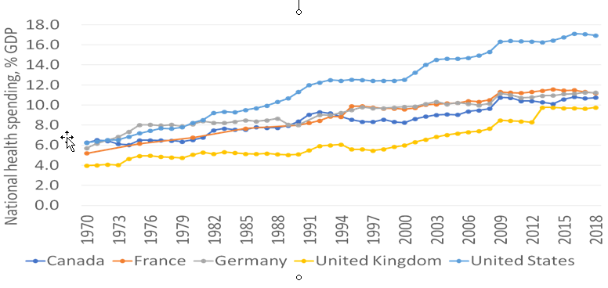
US Health Expenditures Started
Diverging from Other Nations’ ~1980
18%
16%
14%
12%
10%
8%
6%
4%
2%
0
National health spending
(% of GDP)
USA
Canada
France
Germany
UK
USA
1970 | 1976 | 1982 | 1988 | 1994 | 2000 | 2006 | 2012 | 2018
Source: A. Gaffney based on OECD data, 2020
Modified version of slides prepared by Drs. Steffie Woolhandler and David Himmelstein. Originals available at https://www.citizen.org/article/updated-powerpoint-presentations-on-health-policy-issues-relevant-to-health-care-reform-and-a-national-single-payer-health-system/ (accessed Apr 12 2023)

Slide 10
Why Did US Longevity Stall and Health Costs Soar
Starting in ~1980?

Slide 11
Neoliberalism explained…
(AKA Market Fundamentalism)
Markets regulate themselves
  They give everyone what they deserve
  Unions distort markets, impede formation of merit-based hierarchy
Government is incompetent
  Taxes and regulation should be cut
  Public services should be privatized
Seeking equality is counterproductive and morally corrosive
Background photo from The American Prospect
Modified version of slides prepared by Drs. Steffie Woolhandler and David Himmelstein. Originals available at https://www.citizen.org/article/updated-powerpoint-presentations-on-health-policy-issues-relevant-to-health-care-reform-and-a-national-single-payer-health-system/ (accessed Apr 12 2023)

Slide 12

Corporate Social Responsibility?
“Few trends could so thoroughly undermine the very foundations of our free society as the acceptance by corporate officials of a social responsibility other than to make as much money for their shareholders as possible.”
Source: Milton Friedman – Capitalism & Freedom, 1962
Modified version of slides prepared by Drs. Steffie Woolhandler and David Himmelstein. Originals available at https://www.citizen.org/article/updated-powerpoint-presentations-on-health-policy-issues-relevant-to-health-care-reform-and-a-national-single-payer-health-system/ (accessed Apr 12 2023)
Notes:
12
12

Slide 13

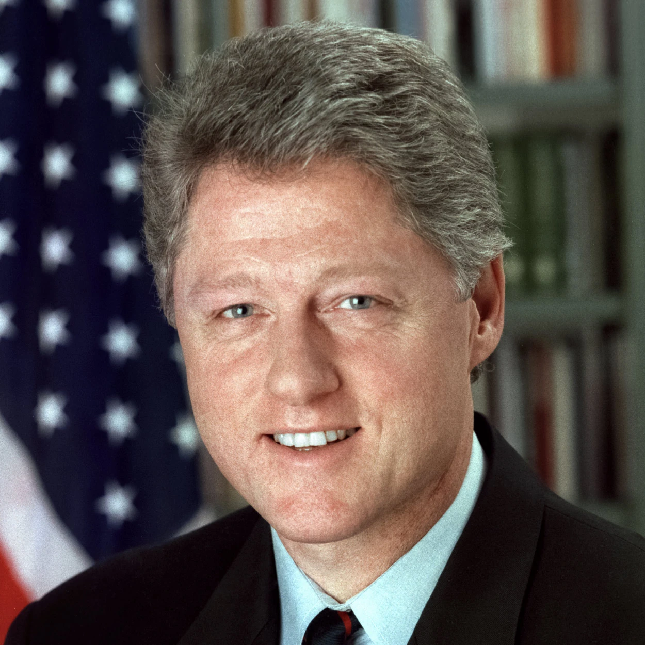
Many Democrats Joined
The Neoliberal Bandwagon
“The era of
big government
is over”
President Bill Clinton
“The most terrifying words in
the English language are:
‘I’m from the government
and I’m here to help’ ”
President Ronald Reagan
Presidential photos from whitehouse.gov
Modified version of slides prepared by Drs. Steffie Woolhandler and David Himmelstein. Originals available at https://www.citizen.org/article/updated-powerpoint-presentations-on-health-policy-issues-relevant-to-health-care-reform-and-a-national-single-payer-health-system/ (accessed Apr 12 2023)

Slide 14
Weakened
Public Health Capacity

Slide 15
Public health’s falling share of total health spending
Left the US Vulnerable to COVID-19
Percent of total health spending
Note: public health’s share in Canada = 6.2%
https://www.cms.gov/research-statistics-data-and-systems/statistics-trends-and-reports/nationalhealthexpenddata/nationalhealthaccountshistorical
Modified version of slides prepared by Drs. Steffie Woolhandler and David Himmelstein. Originals available at https://www.citizen.org/article/updated-powerpoint-presentations-on-health-policy-issues-relevant-to-health-care-reform-and-a-national-single-payer-health-system/ (accessed Apr 12 2023)

Slide 16
Public Health Workforce Declined 20%
Frontline personnel to fight epidemics
Number of personnel employed by state/local health departments
Source: Am J Preventive Med 2018;54:334
Modified version of slides prepared by Drs. Steffie Woolhandler and David Himmelstein. Originals available at https://www.citizen.org/article/updated-powerpoint-presentations-on-health-policy-issues-relevant-to-health-care-reform-and-a-national-single-payer-health-system/ (accessed Apr 12 2023)

Slide 17
Increasing Economic Inequality

Slide 18
Mean Family Income for Each Fifth
Source: https://www.census.gov/library/publications/2022/demo/p60-276.html
Income in 2021 dollars
Modified version of slides prepared by Drs. Steffie Woolhandler and David Himmelstein. Originals available at https://www.citizen.org/article/updated-powerpoint-presentations-on-health-policy-issues-relevant-to-health-care-reform-and-a-national-single-payer-health-system/ (accessed Apr 12 2023)

Slide 19
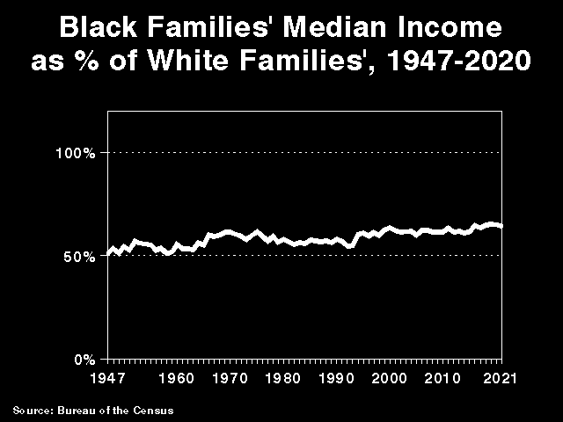
Black Families’ Median Income
As % of White Families’ Income
100%
75%
50%
25%
1947 | 1957 | 1967 | 1977 | 1987 | 1997 | 2007 | 2017
Source: Bureau of the Census https://www.census.gov/library/publications/2021/demo/p60-273.html accessed Apr 12 2023
Modified version of slides prepared by Drs. Steffie Woolhandler and David Himmelstein. Originals available at https://www.citizen.org/article/updated-powerpoint-presentations-on-health-policy-issues-relevant-to-health-care-reform-and-a-national-single-payer-health-system/ (accessed Apr 12 2023)

Slide 20
Tax Rate Has Fallen for the
Super-Rich and Risen for Others
Taxes as share of income
Income group
Source: Saez and Zucman (Saez’s website, 2020)
Modified version of slides prepared by Drs. Steffie Woolhandler and David Himmelstein. Originals available at https://www.citizen.org/article/updated-powerpoint-presentations-on-health-policy-issues-relevant-to-health-care-reform-and-a-national-single-payer-health-system/ (accessed Apr 12 2023)

Slide 21
Women Health Workers’ Low Pay
1.7 million of them and their children live in poverty
Source: Himmelstein K. Am J Public Health 2019;109:198
Note: 34.9% of the 14.1 million women health care workers earn < $15/hour
Modified version of slides prepared by Drs. Steffie Woolhandler and David Himmelstein. Originals available at https://www.citizen.org/article/updated-powerpoint-presentations-on-health-policy-issues-relevant-to-health-care-reform-and-a-national-single-payer-health-system/ (accessed Apr 12 2023)

Slide 22
Unionized Nursing Homes:
Fewer COVID-19 Deaths, Infections, and PPE Shortages
Difference between union and non-union facilities
Source: Dean, Venkataramani, Kimmel. Health Aff 2020;39:11:1
Note: Data are from nursing homes in NY State – adjusted for resident, NH, and county characteristics
Modified version of slides prepared by Drs. Steffie Woolhandler and David Himmelstein. Originals available at https://www.citizen.org/article/updated-powerpoint-presentations-on-health-policy-issues-relevant-to-health-care-reform-and-a-national-single-payer-health-system/ (accessed Apr 12 2023)

Slide 23
Income Inequality Worst in USA (2021*)
Top 1% Income Share
Source: World Inequality Database
*Data are for 2021 or most recent available
Modified version of slides prepared by Drs. Steffie Woolhandler and David Himmelstein. Originals available at https://www.citizen.org/article/updated-powerpoint-presentations-on-health-policy-issues-relevant-to-health-care-reform-and-a-national-single-payer-health-system/ (accessed Apr 12 2023)

Slide 24
US Income Inequality Was Less in 1981
Top 1% Income Share
Source: World Inequality Database
Modified version of slides prepared by Drs. Steffie Woolhandler and David Himmelstein. Originals available at https://www.citizen.org/article/updated-powerpoint-presentations-on-health-policy-issues-relevant-to-health-care-reform-and-a-national-single-payer-health-system/ (accessed Apr 12 2023)

Slide 25
Incarceration Rates
Prisoners per 100,000 population
Source: Walmsley – World Prison Population List, 13th Ed.
*Figure for China includes only sentenced prisoners
Modified version of slides prepared by Drs. Steffie Woolhandler and David Himmelstein. Originals available at https://www.citizen.org/article/updated-powerpoint-presentations-on-health-policy-issues-relevant-to-health-care-reform-and-a-national-single-payer-health-system/ (accessed Apr 12 2023)

Slide 26

Prisoners Face Copays for Care
Prison healthcare copays are common
  42 states and the federal prison system charge copays for a visit
The copays may sound reasonable
  Average copay = $3.47/visit
Not so trivial if you’re a prisoner
  In Oklahoma, prisoners earning 5 cents/hr face a $4 copay
  One visit copay requires the income of 80 hours of prison work
  This is the equivalent of a copay of $580 for a minimum wage worker
Source: The Marshall Project, May 30, 2018
Modified version of slides prepared by Drs. Steffie Woolhandler and David Himmelstein. Originals available at https://www.citizen.org/article/updated-powerpoint-presentations-on-health-policy-issues-relevant-to-health-care-reform-and-a-national-single-payer-health-system/ (accessed Apr 12 2023)

Slide 27
Outsourcing Jail Medical Care = More Deaths
Annual deaths per 10,000 inmates
Source: Szep J. Reuters, Oct 26 2020
Modified version of slides prepared by Drs. Steffie Woolhandler and David Himmelstein. Originals available at https://www.citizen.org/article/updated-powerpoint-presentations-on-health-policy-issues-relevant-to-health-care-reform-and-a-national-single-payer-health-system/ (accessed Apr 12 2023)

Slide 28
Increasing Economic Inequality Harms Health

Slide 29
Lower Income, Shorter Lives
Percent of people aged 51-61 in 1992 still alive in 2014
Mid-Career Income
GAO – Income and Wealth Disparities Continue Through Old Age. Aug 2019 (data from HRS)
Modified version of slides prepared by Drs. Steffie Woolhandler and David Himmelstein. Originals available at https://www.citizen.org/article/updated-powerpoint-presentations-on-health-policy-issues-relevant-to-health-care-reform-and-a-national-single-payer-health-system/ (accessed Apr 12 2023)

Slide 30
Widening Gap in Life Expectancy Between High and Low Earners
Remaining Life Expectancy for Men Turning 60
Source: Waldron. ORES, Social Security Admin, #108, 2007

Slide 31
Growing Gap in Life Expectancy by Income
Dramatic gains for the wealthy, losses for lower income
Remaining life expectancy at age 50
Source: Growing Gap in Life Expectancy by Income, National Academy of Sciences, 2015
Modified version of slides prepared by Drs. Steffie Woolhandler and David Himmelstein. Originals available at https://www.citizen.org/article/updated-powerpoint-presentations-on-health-policy-issues-relevant-to-health-care-reform-and-a-national-single-payer-health-system/ (accessed Apr 12 2023)

Slide 32
The Uninsured

Slide 33
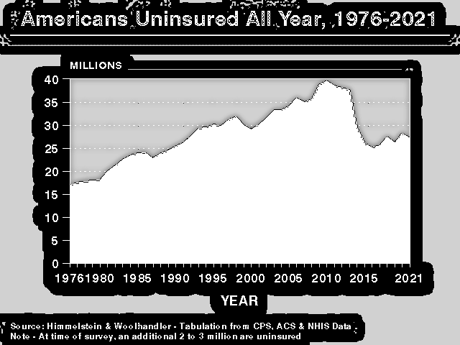
Uninsured All Year
40
35
30
25
20
15
10
5
Millions
1976 | 1981 | 1986 | 1991 | 1996 | 2001 | 2006 | 2011 | 2016 | 2021
Source: Himmelstein & Woolhandler – Tabulation from CPS, ACS, and NHIS data
Note: At time of survey, an additional 2 to 3 million were uninsured
Modified version of slides prepared by Drs. Steffie Woolhandler and David Himmelstein. Originals available at https://www.citizen.org/article/updated-powerpoint-presentations-on-health-policy-issues-relevant-to-health-care-reform-and-a-national-single-payer-health-system/ (accessed Apr 12 2023)

Slide 34
Percent Uninsured by Race/Ethnicity, 2021
Source: CPS
Modified version of slides prepared by Drs. Steffie Woolhandler and David Himmelstein. Originals available at https://www.citizen.org/article/updated-powerpoint-presentations-on-health-policy-issues-relevant-to-health-care-reform-and-a-national-single-payer-health-system/ (accessed Apr 12 2023)

Slide 35
Percent Uninsured by Age Group
Source: CPS
Modified version of slides prepared by Drs. Steffie Woolhandler and David Himmelstein. Originals available at https://www.citizen.org/article/updated-powerpoint-presentations-on-health-policy-issues-relevant-to-health-care-reform-and-a-national-single-payer-health-system/ (accessed Apr 12 2023)

Slide 36
Many Frontline Health Workers Are Uninsured
Percent uninsured, 2019
Source: Himmelstein & Woolhandler, Analysis of data from the 2019 Current Population Survey
Note: 663,000 hospital, nursing home and home care workers were uninsured.
70% of New York home care agencies do not provide PPE to employees
Modified version of slides prepared by Drs. Steffie Woolhandler and David Himmelstein. Originals available at https://www.citizen.org/article/updated-powerpoint-presentations-on-health-policy-issues-relevant-to-health-care-reform-and-a-national-single-payer-health-system/ (accessed Apr 12 2023)

Slide 37
36,355 Deaths During 2021
Due to Uninsurance
State | % Uninsured | Excess Deaths
Texas | 18.0 | 6,793
California | 7.0 | 3,528
Florida | 12.1 | 3,378
Georgia | 12.6 | 1,741
North Carolina | 10.4 | 1,402
New York | 5.2 | 1,325
USA Total | 8.6 | 36,771
Woolhandler & Himmelsetin. Ann Int Med 2017;167:424
Based on best estimate from multiple studies of 1 death per 769 uninsured/year and number of uninsured at the time of the survey
Modified version of slides prepared by Drs. Steffie Woolhandler and David Himmelstein. Originals available at https://www.citizen.org/article/updated-powerpoint-presentations-on-health-policy-issues-relevant-to-health-care-reform-and-a-national-single-payer-health-system/ (accessed Apr 12 2023)

Slide 38
Medicare Coverage Improves
Cancer Detection and Outcomes
Rate per 100,000 women/year
Cancer diagnoses rise
and deaths fall at age 65
NBER Working Paper 26292, Sept 2019
*Breast, colorectal, or lung cancer

Slide 39
Medicaid: Poor Access, But Better Than Nothing

Slide 40
Medicaid Enrollment
90 million
70 million
50 million
30 million
10 million
1987 | 1994 | 2001 | 2008 | 2015 | 2022
Source: Kaiser Foundation- Figures are for mid year
Modified version of slides prepared by Drs. Steffie Woolhandler and David Himmelstein. Originals available at https://www.citizen.org/article/updated-powerpoint-presentations-on-health-policy-issues-relevant-to-health-care-reform-and-a-national-single-payer-health-system/ (accessed Apr 12 2023)

Slide 41
Many Specialists Won’t See
Kids With Medicaid
% of Clinics Scheduling
Appointments for Children
Bisgaier J, Rhodes KV.
N Engl J Med 2011;364:2324-2333
Notes:
41
Figure 2 Clinics Scheduling Specialty Care Appointments for Children, According to Type of Insurance. Public insurance was reported by callers as the Illinois Medicaid–Children's Health Insurance Program (CHIP) umbrella program; private insurance was reported by callers as Blue Cross Blue Shield. Each of the 273 clinics was called twice (for a total of 546 calls) by the same caller, with only insurance coverage varying between the two calls: once reporting Medicaid–CHIP coverage and once reporting private coverage. Calls were made 1 month apart, and the order of the reported insurance status was randomly assigned. Asthma clinics included 38 allergy–immunology clinics and 6 pulmonary disease clinics.

Slide 42
Medicaid Helps
An RCT in Oregon
Source: NEJM May 2, 2013
Note: Catastrophic medical costs = out-of-pocket spending >30% of income. Depression = screened positive for depression using PHQ8
Modified version of slides prepared by Drs. Steffie Woolhandler and David Himmelstein. Originals available at https://www.citizen.org/article/updated-powerpoint-presentations-on-health-policy-issues-relevant-to-health-care-reform-and-a-national-single-payer-health-system/ (accessed Apr 12 2023)

Slide 43
Medicaid Improved Access and Hypertension Control for the Poor
Odds ratio for Medicaid vs Uninsured
Christopher, Wilper, Himmelstein, Woolhandler, McCormick – AJPH 2015
Odds ratios are adjusted for sex, age, race/ethnicity, presence of chronic conditions, disability

Slide 44
Medicaid Managed Care Enrollment Soaring
Millions of Enrollees
Source: Sanofi Public Payer Digest, 2016 and 2020
Note: Medicaid payments to mgd care firms, 2019=$279.1 billion; MLR=88.6 (overhead=$9 billion).
No evidence of cost savings; some evidence of worse quality
Modified version of slides prepared by Drs. Steffie Woolhandler and David Himmelstein. Originals available at https://www.citizen.org/article/updated-powerpoint-presentations-on-health-policy-issues-relevant-to-health-care-reform-and-a-national-single-payer-health-system/ (accessed Apr 12 2023)

Slide 45
A major revenue source for insurers in 2020:
Medicaid Managed Care
Arizona | $11.1 billion |  | Pennsylvania | $21.4 billion
Illinois | $15.0 billion |  | Texas | $24.5 billion
Ohio | $15.6 billion |  | New York | $42.7 billion
Florida | $15.9 billion |  | California | $43.0 billion
2020 USA total
Medicaid managed care spending
$322.8 Billion
Source: Kaiser Family Foundation, 2022
Note: Per Milliman, average overhead + profit = 11.4% of revenues (~$37 billion)
Modified version of slides prepared by Drs. Steffie Woolhandler and David Himmelstein. Originals available at https://www.citizen.org/article/updated-powerpoint-presentations-on-health-policy-issues-relevant-to-health-care-reform-and-a-national-single-payer-health-system/ (accessed Apr 12 2023)

Slide 46
Medicaid Managed Care Patients
Can’t Get Appointments
Won’t take new plan patient
8%
Offered appt >2 wks
24%
HHS OIG survey of
1800 physicians listed on managed care rosters finds
majority are unavailable
Offered appt <2 wks
25%
Not participating
43%
Source: HHS Inspector General’s Report. 12/2014. OEI-02-00670

Slide 47
Under-Insurance

Slide 48
Average Deductibles Are Rising
Average Deductible for Covered Workers
(Single Coverage)
Source: Kaiser/HRET Survey of Employer-Sponsored Benefits
Modified version of slides prepared by Drs. Steffie Woolhandler and David Himmelstein. Originals available at https://www.citizen.org/article/updated-powerpoint-presentations-on-health-policy-issues-relevant-to-health-care-reform-and-a-national-single-payer-health-system/ (accessed Apr 12 2023)

Slide 49
ACA Exchange Plans’ Deductibles
Higher than Average Job-Based Plan
Average deductible (single coverage)
Source: KFF and Kaiser Foundation 2022 Employer Health Benefits Survey
Modified version of slides prepared by Drs. Steffie Woolhandler and David Himmelstein. Originals available at https://www.citizen.org/article/updated-powerpoint-presentations-on-health-policy-issues-relevant-to-health-care-reform-and-a-national-single-payer-health-system/ (accessed Apr 12 2023)

Slide 50
Many Plans Now Pay Nothing for
Out-of-Network Care
Percent with any out-of-network benefit
RWJF 10/4/2018

Slide 51
Out-of-Network Bills Are Rising
Emergency Department
Inpatient Hospitalization
Percent receiving out-of-network bill
Mean out-of-network bill for ED
rose from $220 to $628
Mean out-of-network bill for inpatients
rose from $804 to $2,040
Source: JAMA IM 2019;179:1543
Modified version of slides prepared by Drs. Steffie Woolhandler and David Himmelstein. Originals available at https://www.citizen.org/article/updated-powerpoint-presentations-on-health-policy-issues-relevant-to-health-care-reform-and-a-national-single-payer-health-system/ (accessed Apr 12 2023)

Slide 52
Medical Bill and Debt Problems
Now worse than in 2005
Percent of adults 19-64 reporting medical bill / debt problems
Source: Commonwealth Fund Biennial Health Insurance Surveys 2005, 2010, 2012, 2014, 2016, 2018, 2021
Modified version of slides prepared by Drs. Steffie Woolhandler and David Himmelstein. Originals available at https://www.citizen.org/article/updated-powerpoint-presentations-on-health-policy-issues-relevant-to-health-care-reform-and-a-national-single-payer-health-system/ (accessed Apr 12 2023)

Slide 53
Access to Care Problems Increasing
Percent of adults 19-64 reporting access problems
Source: Commonwealth Fund Biennial Health Insurance Surveys 2003-2022
Modified version of slides prepared by Drs. Steffie Woolhandler and David Himmelstein. Originals available at https://www.citizen.org/article/updated-powerpoint-presentations-on-health-policy-issues-relevant-to-health-care-reform-and-a-national-single-payer-health-system/ (accessed Apr 12 2023)

Slide 54
Who Pays for Long Term Care?
Woolhandler/Himmelstein analysis of NCHS data
Modified version of slides prepared by Drs. Steffie Woolhandler and David Himmelstein. Originals available at https://www.citizen.org/article/updated-powerpoint-presentations-on-health-policy-issues-relevant-to-health-care-reform-and-a-national-single-payer-health-system/ (accessed Apr 12 2023)

Slide 55
Under-Insurance
Impedes Care,
Worsens Health

Slide 56
High Deductible Coverage (HDHP) Compromises Finances and Access
Percent of Adults 18-64
Cohen & Zammitti, NCHS, June, 2017 – Based on 2016 NHIS data
Note: Of people with job-based coverage, 26.9% had HDHP in 2011, rising to 39.6% in 2016
Note: HDHP = >$1200/$2400 single/family deductible in 2011. $1300/$2600 in 2016

Slide 57
Many Families Lack Assets
To Pay High Deductibles
Median Financial Assets
Income Quintile or Decile
Federal Reserve Survey of Consumer Finance, 2019
Modified version of slides prepared by Drs. Steffie Woolhandler and David Himmelstein. Originals available at https://www.citizen.org/article/updated-powerpoint-presentations-on-health-policy-issues-relevant-to-health-care-reform-and-a-national-single-payer-health-system/ (accessed Apr 12 2023)

Slide 58
High Deductibles Cut All Kinds of Care
150,000 employees lost “Cadillac” coverage
No evidence that patients shifted to “Higher Value” care
Utilization Reduction
Source: Brot-Goldberg et al, 6/2015 – http://eml.berkeley.edu/~bhandel/wp/BCHK.pdf
Note: Findings closely resemble those of Rand Health Insurance Experiment
Note: Study found no evidence that patients shopped for lower prices

Slide 59
Drug Deductible Reduced Needed Medication Use
Comparison at Firms That Added vs Didn’t Add Drug Deductible
Percent change in days of medication use after drug deductible implemented
Source: Huckfeldt et al. NBER W20927 – 2/2015

Slide 60
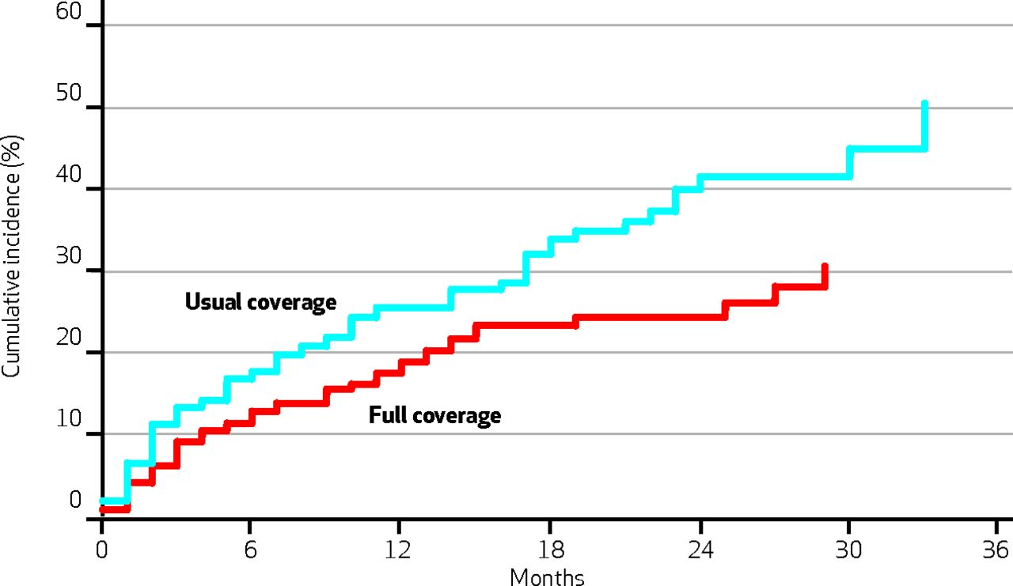
Medication Co-pays Increased Post-MI Vascular Events in Minorities – An RCT
50%
40%
30%
20%
10%
Cumulative Incidence
Co-Pay Group
Free Med Group
0 | 6 | 12 | 18 | 24 | 30 | 36
Months
Source: Health Aff 2014:33:863
https://www.healthaffairs.org/doi/full/10.1377/hlthaff.2013.0654
Modified version of slides prepared by Drs. Steffie Woolhandler and David Himmelstein. Originals available at https://www.citizen.org/article/updated-powerpoint-presentations-on-health-policy-issues-relevant-to-health-care-reform-and-a-national-single-payer-health-system/ (accessed Apr 12 2023)

Slide 61
Drug Copayments Kill
Quasi-experimental analysis of Medicare Part D copays
% change with $10.40 (34%) increase in copay per drug
Source: “The Health Costs of Cost Sharing”. NBER #28439, Feb, 2021
Many patients stopped all drugs; reductions in use largest in patients on many drugs
Modified version of slides prepared by Drs. Steffie Woolhandler and David Himmelstein. Originals available at https://www.citizen.org/article/updated-powerpoint-presentations-on-health-policy-issues-relevant-to-health-care-reform-and-a-national-single-payer-health-system/ (accessed Apr 12 2023)

Slide 62
RCT: Free Meds Improved
Compliance and Outcomes
Difference: Free meds vs. control group
Source: JAMA IM 2020;180:27
Modified version of slides prepared by Drs. Steffie Woolhandler and David Himmelstein. Originals available at https://www.citizen.org/article/updated-powerpoint-presentations-on-health-policy-issues-relevant-to-health-care-reform-and-a-national-single-payer-health-system/ (accessed Apr 12 2023)

Slide 63
High Deductible Plans
Delayed Breast Cancer Care
Extra delay (months) for high vs. low deductible
Health Affairs 2019;38:408

Slide 64
Uninsured and Under-Insured
Delay Seeking Care for Heart Attacks
Odds ratio for delayed care*
Source: JAMA April 15, 2010. 303:1392
*Adjusted for age, sex, race, clin. charact., hlth status, social/psych fx, urban/rural.
Under-insured=had coverage but patient concerned about cost

Slide 65
Higher Medication Co-Pays =
Worse Pediatric Asthma Outcomes
Children age 5-18
Source: JAMA 2012;307:1284

Slide 66
200 Euro Copayment Cut Routine Psych Visits
And Increased Crisis Care in Holland
Change in visit rates after copay added
Source: JAMA Psychiatry 2017;74:932
Note: Copay was not applied to children, whose use rates remained stable
Modified version of slides prepared by Drs. Steffie Woolhandler and David Himmelstein. Originals available at https://www.citizen.org/article/updated-powerpoint-presentations-on-health-policy-issues-relevant-to-health-care-reform-and-a-national-single-payer-health-system/ (accessed Apr 12 2023)

Slide 67
Under-Insurance:
A Leading Cause of Financial Distress and Ruin

Slide 68
²/₃ of Bankruptcy Filers Cite Medical Bills or Illness-Related Work Loss as a Cause
“Work Loss” defined here as “Work loss due to illness”
National Survey of Debtors, 2013-2016
Source: Himmelstein, Thorne, Lawless, Foohey, Woolhandler. AJPH 2019;109:431

Slide 69
Most of the Medically Bankrupt Had Insurance at the Onset of Their Illness
Source: Himmelstein et al. Am J Med: August, 2009

Slide 70
Medical Bills Are Most Common Reason for Collection Calls
Percent of Consumers Receiving Collection Calls with Specific Type of Debt
Medical collection calls were the only category which did not differ by income
Consumer Financial Protection Bureau, January 2017

Slide 71
Health Costs Force Millions into Debt
And to Forego Other Essentials
Total borrowing to pay health costs: $88 billion
Percent of adults who borrowed money or reduced spending due to health care costs
Westhealth/Gallup. Public Perceptions of the US Healthcare System - 2019

Slide 72
Insured Cancer Survivors’
High Out-of-Pocket Costs
Mean annual out-of-pocket medical costs
1,409 cancer survivors above age 50; Median household income was $51,371
Source: JAMA Oncology 2017;3:753. Based on analysis of data from Health and Retirement Study

Slide 73
Dementia in US =
High Out-of-Pocket Costs
Average annual out-of-pocket spending by people with dementia
Source: Medical Care 2021;59:543
Modified version of slides prepared by Drs. Steffie Woolhandler and David Himmelstein. Originals available at https://www.citizen.org/article/updated-powerpoint-presentations-on-health-policy-issues-relevant-to-health-care-reform-and-a-national-single-payer-health-system/ (accessed Apr 12 2023)

Slide 74
Despite Medicare, U.S. Seniors Have More Cost-Related Access Problems
Percent of persons >65 reporting cost-related access problems in past year
Source: Health Affairs 2017;36:2123

Slide 75
Medicare Needs Improvement
Percent of seniors spending at least 20% of income on premiums and out-of-pocket costs
For many seniors,
medical costs consume
more than 1/5th of income
Income Group (% of Federal Poverty Level)
Commonwealth Fund, May 12, 2017

Slide 76
Racism Harms Health

Slide 77
Black and Native Americans Die Younger
But life expectancy for every group is shorter than other G7 nations
Life Expectancy, Years
Source: Andrasfay and Goldman Demographic Research 7/27/2022 and MedRxiv pre-print July 19 2022
Other G7 nations = Canada, France, Germany, Italy, Japan, and UK
Modified version of slides prepared by Drs. Steffie Woolhandler and David Himmelstein. Originals available at https://www.citizen.org/article/updated-powerpoint-presentations-on-health-policy-issues-relevant-to-health-care-reform-and-a-national-single-payer-health-system/ (accessed Apr 12 2023)

Slide 78
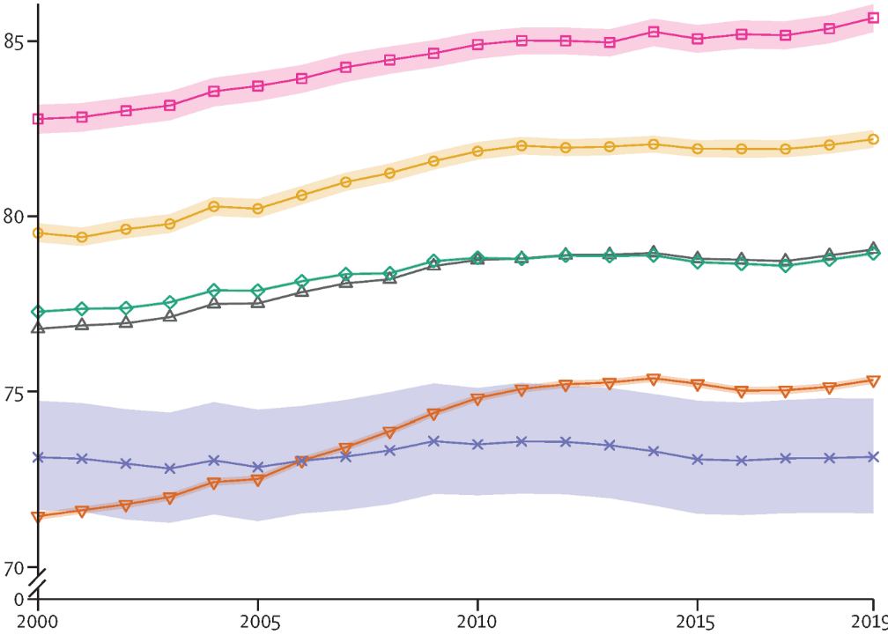
Native Americans Die Youngest
85
80
75
70
Asian
Life
Expectancy
Hispanic
White
US Total
American Indian /
Alaska Native
Black
2000 | 2005 | 2010 | 2015 | 2019
Source: Lancet 2022;400:25
Modified version of slides prepared by Drs. Steffie Woolhandler and David Himmelstein. Originals available at https://www.citizen.org/article/updated-powerpoint-presentations-on-health-policy-issues-relevant-to-health-care-reform-and-a-national-single-payer-health-system/ (accessed Apr 12 2023)

Slide 79
Reparations Payments Could
Close the Racial Life Expectancy Gap
Percent of middle-aged adults (50+) surviving
Source: K. Himmelstein et al – JAMA Network Open 2022
Survival analysis based on Health & Retirement Study data, with modeling of reparations equal to mean White wealth
Modified version of slides prepared by Drs. Steffie Woolhandler and David Himmelstein. Originals available at https://www.citizen.org/article/updated-powerpoint-presentations-on-health-policy-issues-relevant-to-health-care-reform-and-a-national-single-payer-health-system/ (accessed Apr 12 2023)

Slide 80
COVID-19 Sharply Reduced
Black and Latinx Life Expectancy
Life Expectancy, Years
Source: NCHS, 2021
Modified version of slides prepared by Drs. Steffie Woolhandler and David Himmelstein. Originals available at https://www.citizen.org/article/updated-powerpoint-presentations-on-health-policy-issues-relevant-to-health-care-reform-and-a-national-single-payer-health-system/ (accessed Apr 12 2023)

Slide 81
Native Americans’ Life Expectancy Plummeted During COVID-19
Life Expectancy at Birth
Source: Goldman and Andrasfay. Demographic Research July 27, 2022
Modified version of slides prepared by Drs. Steffie Woolhandler and David Himmelstein. Originals available at https://www.citizen.org/article/updated-powerpoint-presentations-on-health-policy-issues-relevant-to-health-care-reform-and-a-national-single-payer-health-system/ (accessed Apr 12 2023)

Slide 82
Causes of Black/White Disparity
In Adult Mortality
MMWR May 2, 2017
Note: “Other” includes conditions (e.g., diabetes) for which Black death rates are higher and some (e.g., COPD, cirrhosis) for which Black death rates are lower.

Slide 83
People of Color Get Less Care
Total health care received
$s per capita, age adjusted
Source: JAMA 2021;326:649-59
Modified version of slides prepared by Drs. Steffie Woolhandler and David Himmelstein. Originals available at https://www.citizen.org/article/updated-powerpoint-presentations-on-health-policy-issues-relevant-to-health-care-reform-and-a-national-single-payer-health-system/ (accessed Apr 12 2023)

Slide 84
Uninsured and People of Color Have Worse Blood Pressure Control
Percent of adults with hypertension whose BP was controlled
2016-2017
Source: JAMA 2020;324:1190 “None”= uninsured
Modified version of slides prepared by Drs. Steffie Woolhandler and David Himmelstein. Originals available at https://www.citizen.org/article/updated-powerpoint-presentations-on-health-policy-issues-relevant-to-health-care-reform-and-a-national-single-payer-health-system/ (accessed Apr 12 2023)

Slide 85
Black- and Latinx-Serving Hospitals
Have Less Funding for Buildings and Equipment
Value of buildings and equipment
$s per bed day
Source: Gracie and Kathryn Himmelstein. Int. J Health Services 2020
Black- and Latinx-serving = 10% of US hospitals with highest percent of Black/Latinx patients
Modified version of slides prepared by Drs. Steffie Woolhandler and David Himmelstein. Originals available at https://www.citizen.org/article/updated-powerpoint-presentations-on-health-policy-issues-relevant-to-health-care-reform-and-a-national-single-payer-health-system/ (accessed Apr 12 2023)

Slide 86
Black- and Latinx-Serving Hospitals
Offer Fewer High-Tech Services
Values <1.0 mean the service is less available
in hospitals serving Black- and Latinx-
Odds that service is available
Minority-serving vs other hospitals
Source: Gracie and Kathryn Himmelstein. Int. J Health Services 2020
Black- and Latinx-serving = 10% of US hospitals with highest percent of Black/Latinx patients
Modified version of slides prepared by Drs. Steffie Woolhandler and David Himmelstein. Originals available at https://www.citizen.org/article/updated-powerpoint-presentations-on-health-policy-issues-relevant-to-health-care-reform-and-a-national-single-payer-health-system/ (accessed Apr 12 2023)

Slide 87
Black-Serving Hospitals Get Paid Less
Structural racism in hospital financing
Reimbursement per inpatient day
Profit per inpatient day
Source: Gracie & Kayty Himmelstein and Joniqua Ceasar – submitted for publication
Note: “Black Serving” = 10% of hospitals with largest proprortion of Black patients (i.e., >25.8%)
Note: Data are means, 2016-2018
Modified version of slides prepared by Drs. Steffie Woolhandler and David Himmelstein. Originals available at https://www.citizen.org/article/updated-powerpoint-presentations-on-health-policy-issues-relevant-to-health-care-reform-and-a-national-single-payer-health-system/ (accessed Apr 12 2023)

Slide 88
Indian Health Service:
Grossly Underfunded
Medical spending 2017 per user
Source: National Tribal Budget Formulation Workgroup, April 2018
Note: Estimated spending shortfall, including facility upgrades = $36.83 billion

Slide 89
Poorer Regions, Fewer ICU Beds
50%
40%
30%
20%
10%
0
Share of hospital service areas with no ICU
$0 - $34,999 | $35,000 - $54,999 | $55,000 - $89,999 | $90,000+
Median Household Income of Service Area
Source: Health Aff 2020;39:1362 https://www.healthaffairs.org/doi/epdf/10.1377/hlthaff.2020.00581
Modified version of slides prepared by Drs. Steffie Woolhandler and David Himmelstein. Originals available at https://www.citizen.org/article/updated-powerpoint-presentations-on-health-policy-issues-relevant-to-health-care-reform-and-a-national-single-payer-health-system/ (accessed Apr 12 2023)

Slide 90
Black Enrollment in
U.S. Medical Schools, 1976-2022/23
AAMC Goal:
11.7%
Percent Blacks in 1st Year Medical School Class
RWJ Fdn. 1987; AAMC; JAMA Annual Medical Education Special Issue
Modified version of slides prepared by Drs. Steffie Woolhandler and David Himmelstein. Originals available at https://www.citizen.org/article/updated-powerpoint-presentations-on-health-policy-issues-relevant-to-health-care-reform-and-a-national-single-payer-health-system/ (accessed Apr 12 2023)

Slide 91
Black Men More Often Followed a
Black Doctor’s Advice: An RCT
Even though they gave Black and White doctors the same ratings
Percent following prevention advice (or recommending the doctor)
Source: American Economic Rev 2019;109:4071
Authors estimate that universal availability of Black doctors could cut B:W CV mortality gap by 19%
*Liked = would recommend doctor to others
Modified version of slides prepared by Drs. Steffie Woolhandler and David Himmelstein. Originals available at https://www.citizen.org/article/updated-powerpoint-presentations-on-health-policy-issues-relevant-to-health-care-reform-and-a-national-single-payer-health-system/ (accessed Apr 12 2023)

Slide 92
Blacks in Health Organizations
Blacks as percent of occupational group
US Workforce Average
11.6%
HRSA based on data from American Community Survey 2011-2015
Modified version of slides prepared by Drs. Steffie Woolhandler and David Himmelstein. Originals available at https://www.citizen.org/article/updated-powerpoint-presentations-on-health-policy-issues-relevant-to-health-care-reform-and-a-national-single-payer-health-system/ (accessed Apr 12 2023)

Slide 93
Hispanics in Health Organizations
US Workforce Average
16.1%
Hispanics as percent of occupational group
HRSA based on data from American Community Survey 2011-2015
Modified version of slides prepared by Drs. Steffie Woolhandler and David Himmelstein. Originals available at https://www.citizen.org/article/updated-powerpoint-presentations-on-health-policy-issues-relevant-to-health-care-reform-and-a-national-single-payer-health-system/ (accessed Apr 12 2023)

Slide 94
Black and Female Physicians Earn Less
Annual Income
Source: Ly et al. BMJ 2016;353:2923
Note: Figures are adjusted for hours worked, specialty, age, years in practice, practice type, percent of revenue from Medicare/Medicaid

Slide 95
Minority Children and Youth
Get Few Psychiatrist Visits
Psychiatrist visits per year per 1,000 population
Source: Marrast, Himmelstein, Woolhandler. Int J Hlth Serv 2016

Slide 96
Growing Wealth Gap for Minorities
Median household net worth (2013 $s)
Kochhar-Pew Research Center, 12/12/14 – Based on Federal Reserve Data

Slide 97
Job Discrimination Persists
Experimental Study of the Impact of “Whitening” Resumes
Callback rate after resume submitted
Black Applicant
Asian Applicant
Source: Kang SK, et al. Admin SciQ, 2016 – Job ads with pro-diversity language yielded same result
*e.g., change “Lamar J. Smith” to “L. James Smith” or “Lei Zhange” to “Luke Zhang”
** e.g., change “Aspiring Asian Business Leaders” to “Aspiring Business Leaders”

Slide 98
Driving While Black
More Likely to Be Searched, Less Likely to Be Found with Contraband
Black Rate / White Rate
(1.0 = Equally Likely)
Car Searched
Contraband Found Among Those Searched
NY Times 10/25/15

Slide 99
Police Killings Target People of Color
Police killings per 100,000 population
Source: Lancet 2021;398:1239
Note: The rate of police killings rose 38.4% between the 1980s and 2010s
Modified version of slides prepared by Drs. Steffie Woolhandler and David Himmelstein. Originals available at https://www.citizen.org/article/updated-powerpoint-presentations-on-health-policy-issues-relevant-to-health-care-reform-and-a-national-single-payer-health-system/ (accessed Apr 12 2023)

Slide 100
Protecting Immigrants’
Right to Health Care

Slide 101
Low Birth Weight Increased in Iowa
After a Massive Immigration Raid
Relative Risk of Low Birth Weight
Int J Epidemiol 2017;839
Note: 2008 Postville, Iowa raid was the largest single-site immigration raid in history. 900 agents handcuffed and chained all Latinos at meatpacking plant.

Slide 102
Low Birth Weight Rose Among
Arabic-Named Women in California After 9/11
Relative risk of Low Birth Weight post- vs. pre- 9/11
Source: Demography 2006;43:185
*Mother’s name Arabic, infant’s name not ethnically distinctive **Mother’s name Arabic, infant’s name ethnically distinctive
Modified version of slides prepared by Drs. Steffie Woolhandler and David Himmelstein. Originals available at https://www.citizen.org/article/updated-powerpoint-presentations-on-health-policy-issues-relevant-to-health-care-reform-and-a-national-single-payer-health-system/ (accessed Apr 12 2023)

Slide 103
Preterm Latinx Births Increased
After President Trump’s Election
Number of preterm births to Latina women
11/2016 – 7/2017
2,337 excess preterm births during 9 months post-election
Source: Gemmill et al, JAMA Network Open July 19 2019
Note: Expected number calculated based on trends, 2009 – Oct 2016

Slide 104
Immigrants Get Little Care
Total Health Care
ED Care
Children
Health Care
$ per capita
*Adjusted for ethnicity, poverty, age, insurance status, patient/parent-reported health status
Source: Mohanty et al. Am J Public Health 2005;95:1431

Slide 105
Immigrants Keep Medicare Afloat
$3.7 Billion
$10.1 Billion
Net contribution to Medicare Trust Fund, 2009
-$30.9 Billion
Source: Zallman et al, Health Affairs 2013;32:1153

Slide 106
Immigrants Subsidize Native-Born in Private Insurance
$17.0 Billion
Net contribution to private insurance, 2014
(premiums
minus benefits)
$7.7 Billion
US Born
Documented Immigrants
Undocumented Persons
-$24.7 Billion
Source: Zallman et al. Health Affairs October, 2018

Slide 107
Immigrants Play Vital Roles in
US Care, Science, and Education
Foreign medical graduates’ share of total
Source: Ann Int Med 2017;157:584
Modified version of slides prepared by Drs. Steffie Woolhandler and David Himmelstein. Originals available at https://www.citizen.org/article/updated-powerpoint-presentations-on-health-policy-issues-relevant-to-health-care-reform-and-a-national-single-payer-health-system/ (accessed Apr 12 2023)

Slide 108
While Many Go Without Vital Services,
Others Get Low- or No-Value Care

Slide 109
Many Elective PCIs Are Inappropriate
Uncertain
41.3%
Appropriate
33.9%
Inappropriate
22.0%
JAMA IM 2014;174:1630
Based on 1,225,562 patients in PCI Cath Registry

Slide 110
Urgent Care Centers Raise Costs
Extra Urgent Care visits outweigh decreased ED visits
37
  Additional Urgent Care visits associated with reduction of a single lower-acuity ED visit
$4,681
  Net increase in overall spending for each ED visit avoided by 37 new Urgent Care visits
Source: Health Affairs 2021;40:587
Modified version of slides prepared by Drs. Steffie Woolhandler and David Himmelstein. Originals available at https://www.citizen.org/article/updated-powerpoint-presentations-on-health-policy-issues-relevant-to-health-care-reform-and-a-national-single-payer-health-system/ (accessed Apr 12 2023)

Slide 111
Free-Standing ERs in Texas
Avoid Areas of Greatest Need
Urgicenter
No Urgicenter
Source: Health Affairs 2017;36:1712
Note: Presence of hospital ED not predictive
Modified version of slides prepared by Drs. Steffie Woolhandler and David Himmelstein. Originals available at https://www.citizen.org/article/updated-powerpoint-presentations-on-health-policy-issues-relevant-to-health-care-reform-and-a-national-single-payer-health-system/ (accessed Apr 12 2023)

Slide 112
Administrative
Overhead Rising

Slide 113
Growth of Physicians and Administrators
1970 – 2022
Growth since 1970
Bureau of Labor Statistics; NCHS; Himmelstein/Woolhandler analysis of CPS
Managers shown as moving average of current year and two previous years
Modified version of slides prepared by Drs. Steffie Woolhandler and David Himmelstein. Originals available at https://www.citizen.org/article/updated-powerpoint-presentations-on-health-policy-issues-relevant-to-health-care-reform-and-a-national-single-payer-health-system/ (accessed Apr 12 2023)

Slide 114
Doctors Spend Twice as Much Time on
EHR/Desk Work as With Patients
Source: Sinsky et al. Ann Int Med 9/6/2016 – based on time/motion observation + home diary
Note: Figures are percent of office hours – exclude the 1-2 hrs/night of home EHR/desk work

Slide 115
EPIC EHR Notes Count
Number of Institutions
USA
Canada, UK, Australia,
Netherlands, Singapore,
United Arab Emirates
Average Number of Characters per Ambulatory Note in Epic
Source: Ann Intern Med 2018; 169:51
13 international organizations represent 140,000 notes
254 organizations within the United States represent 10 million notes.

Slide 116
Investor-Owned Care:
Inflated Costs, Inferior Quality

Slide 117
Extent of For-Profit Ownership
Commerce Dept. Service Annual Surveys & MedPac. Data are 2020 or most recent available.
* Data are for non-government-owned hospitals
** Data are for share of establishments
Modified version of slides prepared by Drs. Steffie Woolhandler and David Himmelstein. Originals available at https://www.citizen.org/article/updated-powerpoint-presentations-on-health-policy-issues-relevant-to-health-care-reform-and-a-national-single-payer-health-system/ (accessed Apr 12 2023)

Slide 118
Health Industry Profits, 2021
Pharmaceuticals | $117.1 Billion
Insurers | $28.3 Billion
Equipment / Supplies | $20.3 Billion
Pharmacy / Lab / Benefit Managers | $18.6 Billion
Providers | $10.1 Billion
Source: Fortune 500, 2022
Note: Excludes firms not in Fortune 500 which account for substantial pharma profits
Modified version of slides prepared by Drs. Steffie Woolhandler and David Himmelstein. Originals available at https://www.citizen.org/article/updated-powerpoint-presentations-on-health-policy-issues-relevant-to-health-care-reform-and-a-national-single-payer-health-system/ (accessed Apr 12 2023)

Slide 119
Health Care CEOs’ Pay, 2020
CEO | Firm | Total Pay
Leonard Schleifer | Regeneron | $453 million
Joe Hogan | Align Technology | $113 million
Mike Pykosz | Oak Street Health | $92.5 million
David Cordani | Cigna | $91.2 million
David Schlanger | Progyny | $80.4 million
Michael Mussallem | Edwards Life Sci. | $76.7 million
Helmy Eltoukhy | Guardant Health | $75.6 million
Tim Walbert | Horizon Therapeutics | $70.1 million
Steve MacMillan | Hologic | $68.5 million
Neil Kumar | BridgeBio Pharma | $62.8 million
Source: Herman et al, STAT+ 7/18/2022
Modified version of slides prepared by Drs. Steffie Woolhandler and David Himmelstein. Originals available at https://www.citizen.org/article/updated-powerpoint-presentations-on-health-policy-issues-relevant-to-health-care-reform-and-a-national-single-payer-health-system/ (accessed Apr 12 2023)

Slide 120
Health Insurer CEI Compensation
2012 – 2021
Firm | Total Pay
Cigna | $365,959,592
UnitedHealth | $349,470,281
Centene | $322,619,510
CVS-Aetna | $265,741,187
Humana | $187,880,631
Anthem/Wellpoint | $166,515,815
Molina | $112,148,401
Source: Stat News 5/12/22
Note: Excludes UnitedHealth’s severance pay of $142 million to Dave Wichmann in 2021
Modified version of slides prepared by Drs. Steffie Woolhandler and David Himmelstein. Originals available at https://www.citizen.org/article/updated-powerpoint-presentations-on-health-policy-issues-relevant-to-health-care-reform-and-a-national-single-payer-health-system/ (accessed Apr 12 2023)

Slide 121
The Profits of “Non-Profit” Health Systems
Health System | 2020 Profit | 2019 Profit
Kaiser | $2,217 million | $2,732 million
UPMC | $836 million | $27 million
Intermountain | $743 million | $506 million
Mayo | $728 million | $1,063 million
AdventHealth | $694 million | $829 million
Indiana U. Health | $656 million | $679 million
Baylor Scott & White | $558 million | $725 million
Houston Methodist | $402 million | $651 million
Source: Modern Healthcare July 19, 2021:44
Modified version of slides prepared by Drs. Steffie Woolhandler and David Himmelstein. Originals available at https://www.citizen.org/article/updated-powerpoint-presentations-on-health-policy-issues-relevant-to-health-care-reform-and-a-national-single-payer-health-system/ (accessed Apr 12 2023)

Slide 122
“Non-Profit” Health Systems
Becoming Speculative Investors
Organization | Hedge Fund Investments | Private Equity | Total Investments
Kaiser | $2,820 billion | $10,180 billion | $35,486 billion
Ascension | $1,357 billion | $3,424 billion | $22,002 billion
Mayo | $3,421 billion | $3,869 billion | $14,320 billion
MGH/Brigham | NA | $1,140 billion | $12,914 billion
Cleveland Clinic | $3,335 billion | $2,061 billion | $12,880 billion
Advocate Aurora | $2,115 billion | $1,959 billion | $12,192 billion
Indiana U. Health | $1,218 billion | $802 billion | $7,839 billion
Sutter | $1,132 billion | $414 billion | $7,812 billion
Source: Modern Healthcare 5/3/2021
Modified version of slides prepared by Drs. Steffie Woolhandler and David Himmelstein. Originals available at https://www.citizen.org/article/updated-powerpoint-presentations-on-health-policy-issues-relevant-to-health-care-reform-and-a-national-single-payer-health-system/ (accessed Apr 12 2023)

Slide 123
Non-Profit Leaders Collecting Big Paydays from Pharma
Name | Position | Company | Board Pay 2017 | Share Value
Robert Alpern | Dean, Yale | AbbVie | $335,929 | $4.3 million
Peter McDonnell | Dir. Hopkins/Wilmer Eye | Allergan | $449,941 | $700,000
Tyler Jacks | Dir. MIT Koch Inst | Amgen | $343,998 | $1.1 million
Julia Haller | Chief, Wills Eye Hosp | Celgene | $525,470 | $86.5 million
Marshall Rung | Dean, U Mich | Lilly | $279,000 | $1.1 million
Kevin Lotton | CEO, Catholic Hlth Init | Gilead | $415,803 | $1.8 million
Laurie Glimcher | CEO, Dana Farber | Glaxo | $101,000 | $100,000
Mary Beckerle | CEO, Huntsman Cancer | J&J | $324,893 | $700,000
Mark McClellan | Dir. Duke Hlth Pol | J&J | $284,893 | $1.2 million
A E Washington | CEO, Duke | J&J | $284,893 | $2.3 million
John Noseworthy | CEO, Mayo | Merck | $234,167 | $300,000
Charles Sawyers | Chair, MSKCC | Novartis | $367,000 | $700,000
Dennis Ausiello | Dir. MGH Crt | Pfizer | $375,000 | $1.9 million
Joseph Goldstein | Chair, U Tx Southwest | Regeneron | $1,307,211 | $4.2 million
Source: BioPharma Dive – “Directors who hold board seats and lead non-profits”
Modified version of slides prepared by Drs. Steffie Woolhandler and David Himmelstein. Originals available at https://www.citizen.org/article/updated-powerpoint-presentations-on-health-policy-issues-relevant-to-health-care-reform-and-a-national-single-payer-health-system/ (accessed Apr 12 2023)

Slide 124
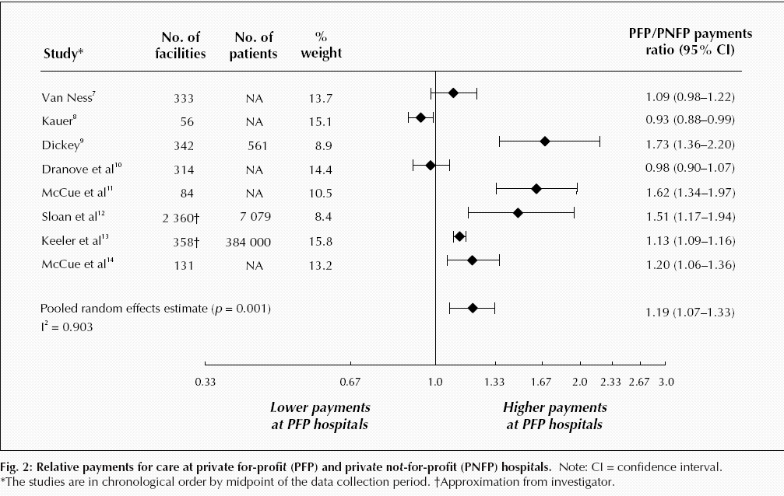
For-profit hospitals cost 19% more
Relative payments for care at private for-profit (PFP) and private not-for-profit (PNFP) hospitals
Source: CMAJ Devereaux et al. 170 (12): 1817.

Slide 125
For-Profit Hospitals’
Administrative Costs Are Higher
Percentage spent on administration
Himmelstein and Woolhandler Analysis of Medicare hospital cost reports + Ann Int Med 2020
Modified version of slides prepared by Drs. Steffie Woolhandler and David Himmelstein. Originals available at https://www.citizen.org/article/updated-powerpoint-presentations-on-health-policy-issues-relevant-to-health-care-reform-and-a-national-single-payer-health-system/ (accessed Apr 12 2023)

Slide 126
For-Profit Hospitals, Larger Systems
Deliver More Low/No-Value Care
Teaching hospitals and those with more primary care delivery less
Overuse index
(expressed as standard deviations from mean)
Source: JAMA Health Forum 2022;3:e214543
Note: Overuse Index is summary measure based on volume of 17 low/no value services
*Highest tertile of primary care physician supply
Modified version of slides prepared by Drs. Steffie Woolhandler and David Himmelstein. Originals available at https://www.citizen.org/article/updated-powerpoint-presentations-on-health-policy-issues-relevant-to-health-care-reform-and-a-national-single-payer-health-system/ (accessed Apr 12 2023)

Slide 127
Doctors at For-Profits
Take More Pharma Money
Proportion of doctors receiving drug company payments
Source: Pro Publica 6/29/2016
Modified version of slides prepared by Drs. Steffie Woolhandler and David Himmelstein. Originals available at https://www.citizen.org/article/updated-powerpoint-presentations-on-health-policy-issues-relevant-to-health-care-reform-and-a-national-single-payer-health-system/ (accessed Apr 12 2023)

Slide 128
For-Profit Hospitals
Avoid Vital but Unprofitable Services
% of hospitals offering service
Source: JAMA 2022;327:2145
Other unprofitable services showed similar pattern; for-porofits were more likely to offer profitable services. Differences persisted after adjustment for multiple hospital and community characteristics
Modified version of slides prepared by Drs. Steffie Woolhandler and David Himmelstein. Originals available at https://www.citizen.org/article/updated-powerpoint-presentations-on-health-policy-issues-relevant-to-health-care-reform-and-a-national-single-payer-health-system/ (accessed Apr 12 2023)

Slide 129
For Profit Hospitals Have Highest Readmission Rates for Every Condition
Readmission
rate adjusted
for severity
(Expected
rate = 1.0)
Source: PLOS One 9/18/2018 – based on Medicare data 2012-2015

Slide 130
For-Profit Dialysis Clinics’
Death Rates Are 7% Higher
3800 excess
deaths annually
Source: Dickman, Mirza, et al. Int J Health Serv 2021;51:371
Modified version of slides prepared by Drs. Steffie Woolhandler and David Himmelstein. Originals available at https://www.citizen.org/article/updated-powerpoint-presentations-on-health-policy-issues-relevant-to-health-care-reform-and-a-national-single-payer-health-system/ (accessed Apr 12 2023)

Slide 131
Investor-Owned Dialysis Clinics Discourage Transplants
Percent of dialysis patients placed on transplant list
Investor-owned
Non-Profit
Source: JAMA 2019;322:957 (article corrected 4/21/2020)
Modified version of slides prepared by Drs. Steffie Woolhandler and David Himmelstein. Originals available at https://www.citizen.org/article/updated-powerpoint-presentations-on-health-policy-issues-relevant-to-health-care-reform-and-a-national-single-payer-health-system/ (accessed Apr 12 2023)

Slide 132
Kids at For-Profit Dialysis Centers
Less Likely to Get Transplants
Likelihood of kidney transplant (for-profit dialysis clinics vs non-profit)
For dialysis centers,
Transplants = Lost customers
Source: JAMA 2022;328:451
Modified version of slides prepared by Drs. Steffie Woolhandler and David Himmelstein. Originals available at https://www.citizen.org/article/updated-powerpoint-presentations-on-health-policy-issues-relevant-to-health-care-reform-and-a-national-single-payer-health-system/ (accessed Apr 12 2023)

Slide 133
VA Kidney Care:
Less Dialysis, Better Survival
Percent of patients with new kidney failure
Source: JAMA IM 2018; 178:657
Kidney failure defined as eGFR<15
Non-VA defined as Medicare-paid, mostly delivered by investor-owned facilities

Slide 134
For Profit Home Care: Lower Quality
Source: Cabin, Siman, Himmelstein & Woolhandler.
Health Affairs 8/2014

Slide 135
For Profit Home Care: Higher Cost
Annual Cost per Patient
Source: Cabin, Siman, Himmelstein & Woolhandler.
Health Affairs 8/2014

Slide 136
For-Profit Nursing Homes:
Less Nursing Care
A National Study
Nursing staff hours per patient day
Health Affairs 2019;38:1095

Slide 137
For-Profit Nursing Homes (SNFs):
More Deaths and Hospital Readmissions
Percent of patients dying or readmitted within 30 days of hospital discharge
Source: JAMA 2014;312:1552
Modified version of slides prepared by Drs. Steffie Woolhandler and David Himmelstein. Originals available at https://www.citizen.org/article/updated-powerpoint-presentations-on-health-policy-issues-relevant-to-health-care-reform-and-a-national-single-payer-health-system/ (accessed Apr 12 2023)

Slide 138
Private Equity Nursing Home Takeovers Harm Patients and Raise Costs
% change with private equity acquisition
Source: “Does Private Equity Investment in Healthcare Benefit Patients” NBER #28474, Feb 2021.
Note: Study used a within-facility DinD analysis + instrumental variable control for pt. factors
Modified version of slides prepared by Drs. Steffie Woolhandler and David Himmelstein. Originals available at https://www.citizen.org/article/updated-powerpoint-presentations-on-health-policy-issues-relevant-to-health-care-reform-and-a-national-single-payer-health-system/ (accessed Apr 12 2023)

Slide 139
Hospice Goes For-Profit
Percent of hospices under for-profit ownership
 | For-Profits | Non-Profits
Profit Rate | 19.2% | 6.0%
Length of stay | 115 days | 73 days
Source: MedPAC Annual Report, 2022 and previous
Modified version of slides prepared by Drs. Steffie Woolhandler and David Himmelstein. Originals available at https://www.citizen.org/article/updated-powerpoint-presentations-on-health-policy-issues-relevant-to-health-care-reform-and-a-national-single-payer-health-system/ (accessed Apr 12 2023)

Slide 140
For-Profit Hospices Avoid
Unprofitable Patients
Likelihood of accepting all patients, regardless of care needs
(and profitability)
Source: Health Affairs 2012;31:2690
Note: Based upon accepting patients on chemo, TPN, transfusions, tube feeds, intrathecal cath, palliative radiation, or living alone

Slide 141
For-Profit Hospices
Minimize Care, Maximize Payment
Offer narrower range of services
Employ less skilled staff
Choose patients needing less care with longer life expectancies
More complaints and deficiencies
Less charity care, research, and training
More ED and hospital use
More discharges of patients with dementia
Account for 90% of hospices with lowest spending on care
Source: JAMA IM 2021;181:1113
Modified version of slides prepared by Drs. Steffie Woolhandler and David Himmelstein. Originals available at https://www.citizen.org/article/updated-powerpoint-presentations-on-health-policy-issues-relevant-to-health-care-reform-and-a-national-single-payer-health-system/ (accessed Apr 12 2023)

Slide 142
For-Profits in Africa Less Likely to Give Children Appropriate Dehydration Treatment
More likely to give ineffective treatments
Probability of treatment
SourceL Am J Trop Med Hyg 2014;90:939
Note: Study included treatment at any health/pharmacy faciliy
Note: More than 700,000 children die from diarrhea annualy. ORT is life-saving
Modified version of slides prepared by Drs. Steffie Woolhandler and David Himmelstein. Originals available at https://www.citizen.org/article/updated-powerpoint-presentations-on-health-policy-issues-relevant-to-health-care-reform-and-a-national-single-payer-health-system/ (accessed Apr 12 2023)

Slide 143
Private Equity Health Care Takeovers
$749 Billion, 2010 – 2020
Estimated value of deals
($ Billions)
Source: Scheffler et al. “Soaring private equity investment in the healthcare sector” 5/18/2021
Modified version of slides prepared by Drs. Steffie Woolhandler and David Himmelstein. Originals available at https://www.citizen.org/article/updated-powerpoint-presentations-on-health-policy-issues-relevant-to-health-care-reform-and-a-national-single-payer-health-system/ (accessed Apr 12 2023)

Slide 144


Slide 145
When Private Equity Buys Practices, Prices (and Costs) Rise
$90
$60
$30
0
$-30
Difference from time 0 in allowed $s per claim
-12 | -9 | -6 | -3 | 0 | 3 | 6 | 9 | 12 | 15 | 18 | 21 | 24
Months Before/After PE Acquired Practice
Source: JAMA Health Forum 2022;2886
Note: Number of patient visits and total billings/revenues also increased after acquisition
Modified version of slides prepared by Drs. Steffie Woolhandler and David Himmelstein. Originals available at https://www.citizen.org/article/updated-powerpoint-presentations-on-health-policy-issues-relevant-to-health-care-reform-and-a-national-single-payer-health-system/ (accessed Apr 12 2023)

Slide 146
What Happens When Private Equity Buys a Dermatology Practice?
Push sales of cosmeceuticals
Offer bonuses for increasing elective procedures (and continued elective procedures throughout pandemic)
Pushed MDs to increase (e.g. double) visit #s
Mobile clinicians do frequent skin check and biopsies on demented nursing homes patients
Bring dermatopathology services “in house”, increasing biopsy rates and likely false positive melanoma Dxs
Extensive use of poorly-supervised PAs and NPs for skin checks and procedures
Skimp on supplies
Increase Medicare billings/taxpayer costs
Sources: Bloomberg Law 5/20/2020; NBC News 12/20/2021; NY Times 10/26/2018 & 11/20/2017
Modified version of slides prepared by Drs. Steffie Woolhandler and David Himmelstein. Originals available at https://www.citizen.org/article/updated-powerpoint-presentations-on-health-policy-issues-relevant-to-health-care-reform-and-a-national-single-payer-health-system/ (accessed Apr 12 2023)

Slide 147
Most Physicians Are Corporate Employees
Rapid growth during pandemic
2019
2022
Source: Avalere Health April 2022
Note: Data are for Medicare-participating physicians
Modified version of slides prepared by Drs. Steffie Woolhandler and David Himmelstein. Originals available at https://www.citizen.org/article/updated-powerpoint-presentations-on-health-policy-issues-relevant-to-health-care-reform-and-a-national-single-payer-health-system/ (accessed Apr 12 2023)

Slide 148
Private Equity Hospital Takeovers:
Falling Care, Rising Profits
Percent change after PE acquisition, compared to controls
Source: Health Affairs 2022;41:523
Modified version of slides prepared by Drs. Steffie Woolhandler and David Himmelstein. Originals available at https://www.citizen.org/article/updated-powerpoint-presentations-on-health-policy-issues-relevant-to-health-care-reform-and-a-national-single-payer-health-system/ (accessed Apr 12 2023)

Slide 149
Drug and Device Firms Inflate Prices,
Distort Priorities

Slide 150
US Prescription Drug Spending
Outpatient prescription drug spending,
Billions of dollars
Estimated
Source: CMS, Office of the Actuary
Note: 2021-2022 estimated
Modified version of slides prepared by Drs. Steffie Woolhandler and David Himmelstein. Originals available at https://www.citizen.org/article/updated-powerpoint-presentations-on-health-policy-issues-relevant-to-health-care-reform-and-a-national-single-payer-health-system/ (accessed Apr 12 2023)

Slide 151
If Medicare paid VA prices, it would have
Saved $71 Billion Over 6 Years
Spending for top 50 drugs ($s Billions)
Medicare Spending
Cost at VA Prices
JAMA IM 2019;179:431

Slide 152
Prices of Newly-Launched
Drugs Have Skyrocketed
Mean price/year of newly-launched drugs ($ thousands)
Source: JAMA 2022;327:2145
Modified version of slides prepared by Drs. Steffie Woolhandler and David Himmelstein. Originals available at https://www.citizen.org/article/updated-powerpoint-presentations-on-health-policy-issues-relevant-to-health-care-reform-and-a-national-single-payer-health-system/ (accessed Apr 12 2023)

Slide 153
Medicare Part D Drug Prices Are
Several-Fold Higher than in Other Nations
Average price of 79 single-source drugs
Purchasing these 79 drugs at the UK price
would have saved Medicare $41 billion in 2018
Health Affairs 2019;38:804

Slide 154
As With Drugs,
Device Prices Are Highest in the USA
Mean cost per device, 2014
(exchange rate adjusted $s)
Source: Health Affairs 2018;37:1570
Note: Devices account for 6% of U.S. health expenditures

Slide 155
What Goes Into a $6,000 Orthopedic Implant
Source: Modern Healthcare 2/5/2018

Slide 156
Drug Companies’ Cost Structure
Marketing
and Admin
35%
Manufacturing
27%
Profits
(After Taxes)
18%
R&D
13%
Taxes
7%
Source: Health Affairs 2001;20(5):136

Slide 157
Drug Company Profits
Return on Revenue (%)
Source: Fortune 500 rankings for 1995-2022
Modified version of slides prepared by Drs. Steffie Woolhandler and David Himmelstein. Originals available at https://www.citizen.org/article/updated-powerpoint-presentations-on-health-policy-issues-relevant-to-health-care-reform-and-a-national-single-payer-health-system/ (accessed Apr 12 2023)

Slide 158
Pharma Firms Have Paid $43.33 Billion in Penalties Since 2000
Despite fines, profits totaled ~$2 Trillion
Penalties since 2000 ($billions)
Source: GoodJobsFirst Violation Tracker – 8/2021 and JAMA 2020;323:834
Modified version of slides prepared by Drs. Steffie Woolhandler and David Himmelstein. Originals available at https://www.citizen.org/article/updated-powerpoint-presentations-on-health-policy-issues-relevant-to-health-care-reform-and-a-national-single-payer-health-system/ (accessed Apr 12 2023)

Slide 159
Goldman Sachs asks in biotech research report:
“Is Curing Patients a Sustainable Business Model?”
“The success of its [Gilead’s] hepatitis C franchise has gradually exhausted the available pool of treatable patients…
“In the case of infectious diseases such as hepatitis C, curing existing patients also decreases the number of carriers able to transmit the virus to new patients.”
Tae Kim, CNBC Investing. April 11 2018.
Modified version of slides prepared by Drs. Steffie Woolhandler and David Himmelstein. Originals available at https://www.citizen.org/article/updated-powerpoint-presentations-on-health-policy-issues-relevant-to-health-care-reform-and-a-national-single-payer-health-system/ (accessed Apr 12 2023)

Slide 160
Profits Dwarf Cancer Drug R&D Costs
Analysis of All Drugs Approved 2006 – 2015
From Firms With Only One Approved Drug
Mean Cost or Revenue per Drug
(Millions)
Prasad et al. JAMA IM, online 9/11/2017
* Costs of all company R&D, including their non-approved agents
** Total revenue from sales since approve – mean of 3.8 years

Slide 161
Drug Firms Spent More on Stock Buybacks and Dividends than on R&D
$ Billions
$522 billion for R&D
$578 billion for shareholders
Source: Congressional Committee on Oversight and Reform. July, 2021
Modified version of slides prepared by Drs. Steffie Woolhandler and David Himmelstein. Originals available at https://www.citizen.org/article/updated-powerpoint-presentations-on-health-policy-issues-relevant-to-health-care-reform-and-a-national-single-payer-health-system/ (accessed Apr 12 2023)

Slide 162
The US Government
Paid Twice for Vaccines
Funded most of the basic science research underlying mRNA vaccines and that characterized the spike protein.
Spent at least $18 billion subsidizing vaccine makers’ research and production, purchased all doses used in US.
Firms refused to share vaccine recipe, limiting global production capacity and leaving billions unprotected.
Cost to manufacture mRNA vaccine: ~$2/dose for Moderna, ~$1/dose for Pfizer. Sale price ~$25/dose.¹
“Pfizer, BioNTech and Moderna will make pre-tax profits of $34 billion this year between them, which works out as over a thousand dollars a second.”²
J Royal Soc Med 2021;114:502
Peoples Vaccine Alliance
Modified version of slides prepared by Drs. Steffie Woolhandler and David Himmelstein. Originals available at https://www.citizen.org/article/updated-powerpoint-presentations-on-health-policy-issues-relevant-to-health-care-reform-and-a-national-single-payer-health-system/ (accessed Apr 12 2023)

Slide 163
COVID-19 Vaccine Makers
Jack Up the Price
$ per dose of vaccine
Source: Light and Lexchin. J Royal Soc Med 2021;114:502
*Cost figure includes estimated cost of materials + capital + personnel
Modified version of slides prepared by Drs. Steffie Woolhandler and David Himmelstein. Originals available at https://www.citizen.org/article/updated-powerpoint-presentations-on-health-policy-issues-relevant-to-health-care-reform-and-a-national-single-payer-health-system/ (accessed Apr 12 2023)

Slide 164
Private Insurers:
Middlemen Who Add Costs But Not Value

Slide 165
Insurance Overhead, 2022
Source: SEC filings for second quarter, 2022 (figure for Cigna is for first quarter 2022)
Note: “Overhead” = percent of premiums not spent on medical services
Modified version of slides prepared by Drs. Steffie Woolhandler and David Himmelstein. Originals available at https://www.citizen.org/article/updated-powerpoint-presentations-on-health-policy-issues-relevant-to-health-care-reform-and-a-national-single-payer-health-system/ (accessed Apr 12 2023)

Slide 166
Private Insurers’ Overhead and Profit Per Enrollee
$ per enrollee/year
Source: Kaiser Family Foundation analysis of National Association of Insurance Commissioners’ data
Note: Data are for Jan. 1 – Sept 30, annualized
Modified version of slides prepared by Drs. Steffie Woolhandler and David Himmelstein. Originals available at https://www.citizen.org/article/updated-powerpoint-presentations-on-health-policy-issues-relevant-to-health-care-reform-and-a-national-single-payer-health-system/ (accessed Apr 12 2023)

Slide 167
COVID-19 Boosted Insurers’ Profits
Percent of premiums reported to SEC as overhead + profits
Source: SEC filings
Modified version of slides prepared by Drs. Steffie Woolhandler and David Himmelstein. Originals available at https://www.citizen.org/article/updated-powerpoint-presentations-on-health-policy-issues-relevant-to-health-care-reform-and-a-national-single-payer-health-system/ (accessed Apr 12 2023)

Slide 168
Insurers “Double Dip” to
Skirt Medical Loss Ratio Limits
“Profits swell when insurers are also your doctors”
UnitedHealth payments to providers it owns
($ billions)
Source: Bob Herman. Axios.. July 16, 2021
Modified version of slides prepared by Drs. Steffie Woolhandler and David Himmelstein. Originals available at https://www.citizen.org/article/updated-powerpoint-presentations-on-health-policy-issues-relevant-to-health-care-reform-and-a-national-single-payer-health-system/ (accessed Apr 12 2023)

Slide 169
61% of Private Insurers’ Revenues
Come from Government Payers
Source: AM Best 8/13/2018. Government workers’ benefit costs estimated from CMS data
Modified version of slides prepared by Drs. Steffie Woolhandler and David Himmelstein. Originals available at https://www.citizen.org/article/updated-powerpoint-presentations-on-health-policy-issues-relevant-to-health-care-reform-and-a-national-single-payer-health-system/ (accessed Apr 12 2023)

Slide 170
Employer Payments for Private Insurance, 2020
Source: NCHS 2020
Modified version of slides prepared by Drs. Steffie Woolhandler and David Himmelstein. Originals available at https://www.citizen.org/article/updated-powerpoint-presentations-on-health-policy-issues-relevant-to-health-care-reform-and-a-national-single-payer-health-system/ (accessed Apr 12 2023)

Slide 171
Insurers Risk Select Via Formulary Design
Put generics needed by sicker patients into high co-pay tier
Drugs of Choice | Illness | Plan 1 | Plan 2 | Plan 3
Anti-Retrovirals | HIV | No | No | No
Triptans | Migraines | No | No | No
Anti-Psychotics | Schizophrenia | No | No | No
Macrolides | Pneumonia | Yes | No | No
L-Dopa | Parkinson’s | Yes | No | No
Anti-Convulsants | Seizures | Yes | No | No
ACE Inhibitors | Hypertension | Yes | Yes | No
Metformin | Diabetes | Yes | Yes | No
Oster & Fendrick, Am J Managed Care 2014;9:693-4
Plan 3 = Harvard Pilgrim
“No” = No drug of choice available on Tier 1 (lowest co-pay)

Slide 172
Both Hospital and Insurer
Consolidations Raise Premium
Annual premium boost
Source: Health Affairs 2019;34:668
Difference between regions with most and least concentrated tertiles of ownership
** Difference associated with the presence of one fewer insurer in region
Modified version of slides prepared by Drs. Steffie Woolhandler and David Himmelstein. Originals available at https://www.citizen.org/article/updated-powerpoint-presentations-on-health-policy-issues-relevant-to-health-care-reform-and-a-national-single-payer-health-system/ (accessed Apr 12 2023)

Slide 173
Medicare Advantage:
The Only Working Model of
Competing Private Plans and a
Public Option (Traditional, FFS Medicare)

Slide 174
Medicare Advantage Plans’
High Overhead
Medical Services
97.8%
Medical Services
86.3%
Overhead
2.2%
Profit
4.5%
Overhead
9.1%
Sources: GAO 12/2013 and Medicare Trustees Report 2012 – Figures are for 2011
Note: MA overhead = $905/enrollee; profit = $447/enrollee
Total MA profit = $3.3 Billion

Slide 175
Medicare HMO Enrollment
Medicare HMO Enrollees (millions)
Source: CMS and Kaiser Foundation

Slide 176
Medicare Advantage Plans’ Narrow Networks
Traditional Medicare
More than a third of all Medicare Advantage plans lack an NCI cancer center.
49% of narrow networks exclude academic med centers.
Broad
100%
Medium
Small
31%
Medium
30%
Narrow
16%
Broad
23%
Sources: Kaiser Family Foundation June, 2016
Note: “Narrow” = <30% of hospitals; “Medium Small” = 20-49%; “Medium” = 50-69%; “Broad” = >69%

Slide 177
Three Ways Medicare Advantage Plans Outcompete Traditional Medicare
Outright
cheating
Cherry-picking and lemon-dropping
  Exclude hospitals/doctors attractive to high-cost patients
    Benefit/formulary design
      Hassle factor
Upcode and over-diagnose to game risk adjustment
Modified version of slides prepared by Drs. Steffie Woolhandler and David Himmelstein. Originals available at https://www.citizen.org/article/updated-powerpoint-presentations-on-health-policy-issues-relevant-to-health-care-reform-and-a-national-single-payer-health-system/ (accessed Apr 12 2023)

Slide 178
A Few Sick People
Account for Most Health Spending
Percent of total spending accounted for by each decile among non-institutionalized Americans
81.5%
Decile of Health Spending
Source: JAMA 2016;316:1348

Slide 179
Medicare Advantage Plans’
Strategy #1: Cherry Picking
Marketing
Network manipulation
Benefit design

Slide 180
Medicare Advantage Enrollees
Cost $1,253/year Less Before Enrolling
Medicare expenditures in prior year
(Risk-score adjusted)
Source: Kaiser Foundation. May 2019
Note: For example, difference for patients with asthma = $1,410; depression = $1,198; arthritis = $1,371

Slide 181
Medicare Advantage Plans’
Strategy #2: Lemon Dropping
Network manipulation
Benefit design
Hassle factor

Slide 182
MA Plans Eject Patients
Using Expensive Care
% switching from MA to Traditional Medicare
Source: Health Affairs 2021;40:469
Note: Data shown are for non-rural enrollees. Differences were similar for rural enrollees.
Modified version of slides prepared by Drs. Steffie Woolhandler and David Himmelstein. Originals available at https://www.citizen.org/article/updated-powerpoint-presentations-on-health-policy-issues-relevant-to-health-care-reform-and-a-national-single-payer-health-system/ (accessed Apr 12 2023)

Slide 183
Patients Acquiring New Disabilities
Switch Out of Medicare Advantage
Percent of newly disabled who switched
Source: Health Affairs 2020;39:809
Note: New functional disability = needs assistance with >1ADL
Modified version of slides prepared by Drs. Steffie Woolhandler and David Himmelstein. Originals available at https://www.citizen.org/article/updated-powerpoint-presentations-on-health-policy-issues-relevant-to-health-care-reform-and-a-national-single-payer-health-system/ (accessed Apr 12 2023)

Slide 184
Medicare Advantage Plans Disenroll
Dying (Expensive) Enrollees
% of MA enrollees who switched to FFS Medicare
Last-year-of-life switches raised taxpayers’ costs by $912 million.
Source: GAO June 28, 2021
Modified version of slides prepared by Drs. Steffie Woolhandler and David Himmelstein. Originals available at https://www.citizen.org/article/updated-powerpoint-presentations-on-health-policy-issues-relevant-to-health-care-reform-and-a-national-single-payer-health-system/ (accessed Apr 12 2023)

Slide 185
Most MA Plans Now Require
20% Co-Insurance for Chemotherapy
Percent of plans requiring 20%
co-insurance
for chemo
Source J Gen Intern Med 2019;34:1119

Slide 186
Medicare plans put generics into higher “tiers”, Boosting Copays by $6.2 Billion
Percent of generic drugs in each tier, Private Medicare Part D plans
Source: Avalere 5/22/2018

Slide 187
Medicare Advantage Cancer Patients:
Inferior Surgical Care
Medicare Advantage: Traditional Medicare
(Adjusted risk ratio)
Source: J Clin Oncol. Published online 11/2/2020
*>2 weeks between diagnosis and treatment
Modified version of slides prepared by Drs. Steffie Woolhandler and David Himmelstein. Originals available at https://www.citizen.org/article/updated-powerpoint-presentations-on-health-policy-issues-relevant-to-health-care-reform-and-a-national-single-payer-health-system/ (accessed Apr 12 2023)

Slide 188
Medicare Advantage Plans’ Narrow Patients’ Choice of Providers
% of Medicare participating providers in-network for ANY Medicare Advantage plan
Source: JGIM 2021;37:488
Modified version of slides prepared by Drs. Steffie Woolhandler and David Himmelstein. Originals available at https://www.citizen.org/article/updated-powerpoint-presentations-on-health-policy-issues-relevant-to-health-care-reform-and-a-national-single-payer-health-system/ (accessed Apr 12 2023)

Slide 189
Medicare Advantage Plans
Deny Needed Home Care
Pushing out unprofitably ill patients
Percent receiving home care
Source: JGIM 2021;36(8):2323-31
Receipt of home care among those whose hospital record indicated “discharged with home care”
Modified version of slides prepared by Drs. Steffie Woolhandler and David Himmelstein. Originals available at https://www.citizen.org/article/updated-powerpoint-presentations-on-health-policy-issues-relevant-to-health-care-reform-and-a-national-single-payer-health-system/ (accessed Apr 12 2023)

Slide 190
Medicare Advantage Plans Skimp on
Rehabilitation and Home Care
Decreased use relative to Traditional Medicare*
Source: Health Aff 2020;39:837
*Difference in share of patients receiving services in 90 days after discharge, adjusted for demographic, clinical, and hospital characteristics
Modified version of slides prepared by Drs. Steffie Woolhandler and David Himmelstein. Originals available at https://www.citizen.org/article/updated-powerpoint-presentations-on-health-policy-issues-relevant-to-health-care-reform-and-a-national-single-payer-health-system/ (accessed Apr 12 2023)

Slide 191
Medicare Advantage Plans’
Strategy #3: Cheating
Risk scores
Upcoding
Lying

Slide 192
Medicare Advantage Plans “Upcode”
Risk Scores spike immediately after patients enroll;
Biggest jump in HMOs that employ doctors
% increase in risk score vs. patients staying in FFS Medicare
Source: NBER Working Paper #21222
The 6.4% coding increases ups MA plans’ payments from Medicare by $10 billion per year; ~$650 per enrollee. It is equivalent to 6% of all enrollees become paraplegic or 39% becoming diabetic.

Slide 193
Medicare Advantage Plans’
Claims for Unsupported Diagnoses
$11.484
Billion
CMS estimate of overcharges to Medicare for diagnoses not supported in chart
$9.311
Billion
$9.095
Billion
CMS chart audit (but CMS only pursued recovery for 0.2% of projected overcharges)
Source: Kaiser Health News 7/16/2019

Slide 194
Advantage Plans Lie About Quality
M.A. Plans report few readmits
But audit shows rates higher than FFS Medicare
30-day readmission rate relative to Traditional Medicare
Annals of Internal Medicine 2019;171:99

Slide 195
95% of Plans Cheat on HEDIS Quality Measures
Medicare Advantage plans failing to cheat fall in rankings
Percent of elderly patients prescribed drugs that should be avoided
Annals of Internal Medicine 2013;159:456
Researchers compared reported HEDIS scores for high risk prescribing to actual Medicare Part D payment records for all enrollees and for enrollees sampled for HEDIS scoring

Slide 196
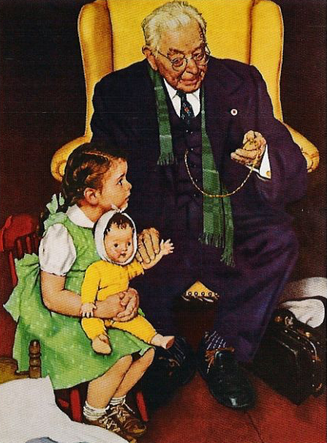
HMO “House Calls”:
A New Upcoding Scam
HMOs send their “house call doctor” – or one from Mobile Medical Examination Services Inc.
Doctor seeks out unimportant diagnoses, e.g. mild arthritis
No treatment offered
Extra diagnoses allow HMOs to upcode, adding >$3 billion/year to Medicare Advantage payments
Efforts to outlaw upcoding “house calls” were scrapped after industry lobbying blitz
Schulte, Center for Public Integrity, 2014

Slide 197
Profit-Driven Upcoding Makes Accurate Risk Adjustment Impossible:
High-cost providers inflate both reimbursement and quality scores by making patients look sicker on paper

Slide 198
Dr. Smith sees Ms. Jones, a 76-year-old Medicare beneficiary as a FFS patient, and simply submits the one or two diagnoses treated during any visit.
Dr. Smith dx sent to CMS | HCC
Baseline for age | .45
Obesity | 0
Type 2 Diabetes | .104
Major Depression | 0
CHF | .323
Asthma | 0
Ulcer, unspecified | 0
CHF*DM | .154
Risk Score = 1.03
FFS expected cost = $9,000
2019 schedules
Source: https://downloads.healthcatalyst.com/wp-content/uploads/2019/04/HCC-coding.png
Modified version of slides prepared by Drs. Steffie Woolhandler and David Himmelstein. Originals available at https://www.citizen.org/article/updated-powerpoint-presentations-on-health-policy-issues-relevant-to-health-care-reform-and-a-national-single-payer-health-system/ (accessed Apr 12 2023)

Slide 199
Ms. Jones joins an MA Plan which sends a nurse to her home, reviews her charts, suggests Dr. Smith record other diagnoses.
Dr. Smith dx sent to CMS | HCC
Baseline for age | .45
Obesity | 0
Type 2 Diabetes | .104
Major Depression | 0
CHF | .323
Asthma | 0
Ulcer, unspecified | 0
CHF*DM | .154
Med. Advtg. Coding | HCC
Baseline for age | .45
Morbid Obesity | .273
DM w/ retinopathy | .318
MD, Sing Ep, Mild | .395
CHF, Class 3 | .323
COPD | .328
Ulcer, stage 3 | 1.204
CHF*DM,COPD | .154, .19
Joining an MA plan increased the costs to CMS by 350%
Risk Score = 1.03
FFS expected cost = $9,000
Risk Score = 3.63
CMS pays MA $32,000
2019 schedules
Source: https://downloads.healthcatalyst.com/wp-content/uploads/2019/04/HCC-coding.png
Modified version of slides prepared by Drs. Steffie Woolhandler and David Himmelstein. Originals available at https://www.citizen.org/article/updated-powerpoint-presentations-on-health-policy-issues-relevant-to-health-care-reform-and-a-national-single-payer-health-system/ (accessed Apr 12 2023)

Slide 200
Medicare Advantage Plans Raise Costs
Less spending on care, more on overhead
Total: $767
Total: $720
Monthly cost per beneficiary*
Source: Am. Econ. J. Applied Econ 2019;11:302 – Data are for 2010
* Adjusted based on diagnoses and mortality risk

Slide 201
Medicare has been consistently
Overpaying Medicare Advantage
18%
16%
14%
12%
10%
8%
6%
4%
2%
Per MedPAC,
this chart
underestimates
the overpayments
MA payments as a % above FFS Medicare spending
2004 | 2006 | 2008 | 2010 | 2012 | 2014 | 2016 | 2018 | 2020 | 2022
https://www.medpac.gov/wp-content/uploads/2023/03/Mar23_MedPAC_Report_To_Congress_SEC.pdf
Pg 344 Fig 11-4. Accessed Mar 27 2023

Slide 202
Medicare Advantage Plans Cut
Both Needed and Unneeded Care
Difference in rate: Traditional Medicare – Medicare Advantage
Source: NBER Working Paper #23090. Jan. 2017
Modified version of slides prepared by Drs. Steffie Woolhandler and David Himmelstein. Originals available at https://www.citizen.org/article/updated-powerpoint-presentations-on-health-policy-issues-relevant-to-health-care-reform-and-a-national-single-payer-health-system/ (accessed Apr 12 2023)

Slide 203
Medicare Needs Improvement
Financial problems of seriously ill enrollees
Source: Health Aff 2019; 38:1801 Note: “Necessity” = food, heat, housing
Modified version of slides prepared by Drs. Steffie Woolhandler and David Himmelstein. Originals available at https://www.citizen.org/article/updated-powerpoint-presentations-on-health-policy-issues-relevant-to-health-care-reform-and-a-national-single-payer-health-system/ (accessed Apr 12 2023)

Slide 204


ACOs: Warmed Over Managed Care

Slide 205
High Risk HMO Patients
Fared Poorly in the RAND Experiment
Relative Risk of Dying
Diastolic Blood Pressure
Source: RAND Health Insurance Experiment, Lancet 1988;1:1017
Note: High Risk = 20% of population with lowest income + highest medical risk

Slide 206
ACOS Got Rid of Patients
In Deteriorating Health
Change, 2012-2013 in risk score (“Hierarchical Condition Code”)
For patients already enrolled in an ACO, upcoding doesn’t boost risk-adjusted payments, so ACOs “Lemon Drop” with increasing care needs.
Health Affairs 2019;38:253

Slide 207
ACOS Got Rid of High Cost Patients
For patients already enrolled in an ACO, upcoding doesn’t boost risk-adjusted payments, so ACOs “Lemon Drop” high cost patients to generate bonuses from fake savings.
Total annual spending per patient
Health Affairs 2019;38:253

Slide 208
ACOS Got Rid of High Cost Patients
By Ejecting Their Doctors
Percent of doctors leaving ACO
Doctors Rank According to cost of Their Patients
Ann Intern Med 2019;171:27

Slide 209
ACO savings across eight years:
$4.2 Billion = 0.59% of Spending on ACOs
$703.6 Billion
MedPAC estimate:
ACOs increased
administrative costs by
$12.8 billion
ACO savings, bonuses, and total payments ($ billions)
2013-2020
$10.5 Billion
$6.4 Billion
$4.2 Billion
Source: Himmelstein and Woolhandler analysis of CMS ACO Public Use Files, 8/2022 and MedPAC staff est.
Modified version of slides prepared by Drs. Steffie Woolhandler and David Himmelstein. Originals available at https://www.citizen.org/article/updated-powerpoint-presentations-on-health-policy-issues-relevant-to-health-care-reform-and-a-national-single-payer-health-system/ (accessed Apr 12 2023)

Slide 210
ACOs: No Savings, No Quality Improvement After Control for Selective Enrollment
Cost Savings
Diabetes Quality Score
Estimated difference, ACO vs non-ACO
(Per quarter)
$118 Apparent Savings
+2.2 Apparent
- $6 Corrected
-1.9 Corrected
Ann Intern Med 2019;171:27

Slide 211
McKinsey & Co, August 2020:
“The Math of ACOs”
~$9 million/year/ACA spent on new data/analytics
~1.25% of total revenues for care management: Success depends on curtailing patients’ use of care and steering enrollees to lower-price providers, not managing chronic conditions.
Additional costs for “executive director, head of real estate, head of care management, and lawyers and actuaries”
Source: McKinsey & Co.. August 2020
Modified version of slides prepared by Drs. Steffie Woolhandler and David Himmelstein. Originals available at https://www.citizen.org/article/updated-powerpoint-presentations-on-health-policy-issues-relevant-to-health-care-reform-and-a-national-single-payer-health-system/ (accessed Apr 12 2023)

Slide 212
Hot-spotting Didn’t Work – RCT
Much touted Camden Model failed
180-day post-discharge outcomes
$18,000
$16,000
9
10
Source: NEJM 2020;382:152
Modified version of slides prepared by Drs. Steffie Woolhandler and David Himmelstein. Originals available at https://www.citizen.org/article/updated-powerpoint-presentations-on-health-policy-issues-relevant-to-health-care-reform-and-a-national-single-payer-health-system/ (accessed Apr 12 2023)

Slide 213
Failure of Medicare HMO Risk Adjustment: Implications for ACOs
Despite decades-long effort, CMS has failed to stop cherry-picking
Intensive coding makes patients appear sicker on paper, ups risk-adjusted capitation fee and factitiously raises quality scores
ACOs that fail to cherry pick/upcode get low payments, and factitiously poor quality scores
Implications:
  No net savings, probable increased costs
  Resources transferred from sick to healthy
  Biggest cheaters are biggest winners
  ACOs that embrace problem patients driven from the market
Modified version of slides prepared by Drs. Steffie Woolhandler and David Himmelstein. Originals available at https://www.citizen.org/article/updated-powerpoint-presentations-on-health-policy-issues-relevant-to-health-care-reform-and-a-national-single-payer-health-system/ (accessed Apr 12 2023)

Slide 214
The Toxicity of
Pay for Performance (P4P)

Slide 215
Implicit Assumptions in
“Pay for Performance”
Performance can be accurately ascertained
Individual variation is caused by variation in motivation
Financial incentives will add to intrinsic motivation
Current payment system is too simple
Hospitals and physicians delivering poor quality care should get fewer resources
Modified version of slides prepared by Drs. Steffie Woolhandler and David Himmelstein. Originals available at https://www.citizen.org/article/updated-powerpoint-presentations-on-health-policy-issues-relevant-to-health-care-reform-and-a-national-single-payer-health-system/ (accessed Apr 12 2023)

Slide 216
Medicare Quality Scores
Penalize Doctors Caring for Poor Seniors
Mean MIPS “quality” score
MIPS score difference =
$15,000 lower Medicare payments
Share of Poor Patients in Practice
Source: JAMA 2020;324:975
Note: “Poor” is defined as dual (i.e., Medicaid) eligible
Modified version of slides prepared by Drs. Steffie Woolhandler and David Himmelstein. Originals available at https://www.citizen.org/article/updated-powerpoint-presentations-on-health-policy-issues-relevant-to-health-care-reform-and-a-national-single-payer-health-system/ (accessed Apr 12 2023)

Slide 217
Quality Scores Tell More
About Patients than Doctors
Harvard docs with poorer/minority patients score low
Patient characteristics in panels of high/low scoring physicians
Source: JAMA 9/8/2010:1107
Modified version of slides prepared by Drs. Steffie Woolhandler and David Himmelstein. Originals available at https://www.citizen.org/article/updated-powerpoint-presentations-on-health-policy-issues-relevant-to-health-care-reform-and-a-national-single-payer-health-system/ (accessed Apr 12 2023)

Slide 218
Medicare Value-Based Payment Program Penalizes Doctors Caring for High-Needs Patients
Percent of practices penalized*
Characteristics of Practices’ Patients
Source: JAMA 2017;318:453
* Note: Estimate based on simulation of penalties under mandatory Physicians Value-Based Payment Modifier Program

Slide 219

Pay for Performance?
“I do not think it’s true that the way to get better doctoring and better nursing is to put money on the table in front of doctors and nurses. I think that's a fundamental misunderstanding of human motivation.
“I think people respond to joy and work and love and achievement and learning and appreciation and gratitude – and a sense of a job well done. I think that it feels good to be a doctor, and better to be a better doctor.
“When we begin to attach dollar amounts to throughputs and to individual pay, we are playing with fire. The first and most important effect of that may be to begin to dissociate people from their work.”
– Don Berwick M.D.
Health Affairs. 1/12/2005

Slide 220
Performance Monitoring Increased Documentation of Alcohol Counseling, But Not Real Counseling Rate
Alcohol counseling rate among patients screening positive for unhealthy use
Source: JGIM 2017;33:268

Slide 221
$450 Incentive to Take Statins Improved Pill Bottle Openings but Not LDL-C Levels
Change from baseline
(% opening bottles or mg/dL)
Source: JAMA Network Open 2020;3(10):32019429 (RCT with 805 patients)
*Percent of first 180 days with pill bottle opening
Modified version of slides prepared by Drs. Steffie Woolhandler and David Himmelstein. Originals available at https://www.citizen.org/article/updated-powerpoint-presentations-on-health-policy-issues-relevant-to-health-care-reform-and-a-national-single-payer-health-system/ (accessed Apr 12 2023)

Slide 222
CHF and Pneumonia Death Rates Rose with Readmission Penalties
Big penalties for readmission; small penalties for mortality
Time trend in 30-day post-discharge mortality rate
JAMA 2018;320:2542

Slide 223
P4P Did Not Improve Mortality in England
World’s largest P4P program tied 25% of GP income to quality targets
Change in Deaths/100,000 From Pre to Post P4P Implementation
Source: Lancet 2016;388:268
Note: Data shows trends compared to developed nations without P4P

Slide 224
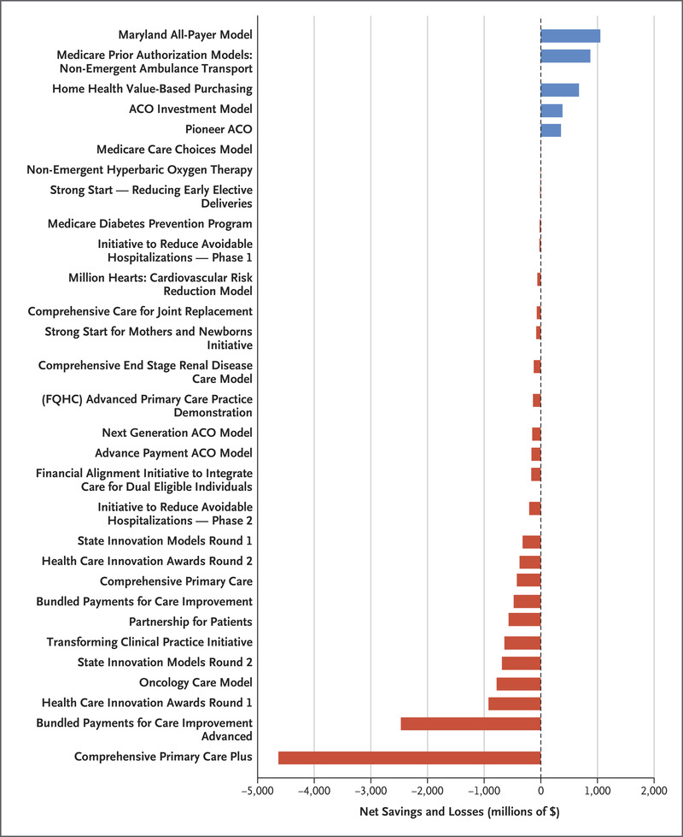
Net Losses
Net Savings
Most value-based payment programs
have flopped;
Costs exceed savings
Source: NEJM 2021;384:759
Modified version of slides prepared by Drs. Steffie Woolhandler and David Himmelstein. Originals available at https://www.citizen.org/article/updated-powerpoint-presentations-on-health-policy-issues-relevant-to-health-care-reform-and-a-national-single-payer-health-system/ (accessed Apr 12 2023)

Slide 225
Worksite Wellness Program – an RCT
No Benefit at 6 Months or 3 Years
Source: JAMA 2019;32:1491; Health Aff 2021;40:951. 6-month results show, 3 year almost identical
*PHQ-s>3 indicates likely depression; SF-8 Physical is a physical health score
Note: No significant differences in utilization of care or medical costs
Modified version of slides prepared by Drs. Steffie Woolhandler and David Himmelstein. Originals available at https://www.citizen.org/article/updated-powerpoint-presentations-on-health-policy-issues-relevant-to-health-care-reform-and-a-national-single-payer-health-system/ (accessed Apr 12 2023)

Slide 226
ACOs and P4P:
Implementation Without Evidence
P4P – Official Medicare policy, widely adopted by private payers
Implementing everywhere interventions which
have been proven nowhere
risks failure on a colossal scale
  No RCTs showing improved outcomes.
  No improvement in 3 largest programs.
  Negative side effects likely, e.g. increased CHF deaths.
  VA (no P4P) has better quality than hospitals paid P4P
ACOs – Newest health policy panacea
  No RCTs.
  No savings once bonuses factored in.
  Disturbing HMO experience.

Slide 227
Veterans Health Administration:
Better and Fairer Care

Slide 228
VA Hospitals Have Lower Mortality and Readmissions than Other Hospitals
Mortality
Readmissions
30 Day Mortality or readmissions per 100 patients
JAMA IM 2017;177:882
PNA = Pneumonia; All rates are risk-adjusted

Slide 229
VA vs. Non-VA Care for MI:
Fewer Deaths, Lower Costs
4.5%
  Improved 28-day mortality at VA vs non-VA
$2,548
  Total decrease in 28-day cost at VA vs non-VA
A quasi-randomized analysis based on ambulance transport
Source: “Is There a VA Advantage: Evidence From Dually Eligible Veterns.” NBER November 2020
Modified version of slides prepared by Drs. Steffie Woolhandler and David Himmelstein. Originals available at https://www.citizen.org/article/updated-powerpoint-presentations-on-health-policy-issues-relevant-to-health-care-reform-and-a-national-single-payer-health-system/ (accessed Apr 12 2023)

Slide 230
VA-Paid Knee Replacement:
Better at VA hospital than purchased private care
Conclusion:
VA privatization worsens care
Odds ratio for complication:
VA-purchased vs
VA-delivered surgery
Source: Health Affairs 2021;40:1312v- Figures are adjusted for multiple patient characteristics
Modified version of slides prepared by Drs. Steffie Woolhandler and David Himmelstein. Originals available at https://www.citizen.org/article/updated-powerpoint-presentations-on-health-policy-issues-relevant-to-health-care-reform-and-a-national-single-payer-health-system/ (accessed Apr 12 2023)

Slide 231
VA Hospitals Have Lower Mortality Than Nearby Hospitals
A comparison of VA and non-VA hospitals in 121 hospital market areas
30-day mortality rate
Ann Intern Med 2019;170:426

Slide 232
Blacks in VA: No Health Disadvantage
Odds ratio for Black vs White Vets
Odds ratio <1.0 indicates lower rate for Blacks
Kovesdy et al. Circulation 9/18/2015
Longitudinal study of 3,072,966 Vets cared for at VAs

Slide 233
Mandate Model Reform:
Keeping Private Insurers
In Charge

Slide 234

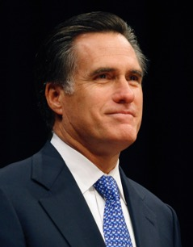

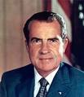
“Mandate Model” of Reform
Expanded Medicaid-like program
  Free for the poor
  Subsidies for low income
  Buy-in without subsidies for others
Employer Mandate +/- Individual
Insurance Exchanges
Notes:
234

Slide 235
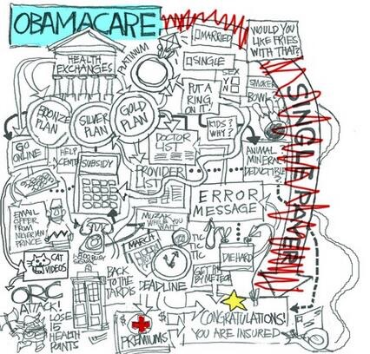




Slide 236
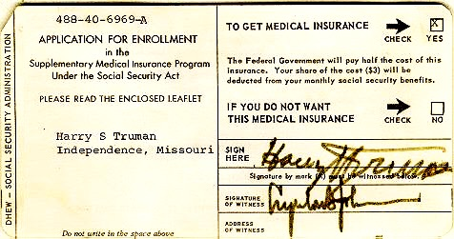


Medicare’s “Software”
18.9 million seniors enrolled within 11 months

Slide 237
ACA Decreased Incidence of Unmet Medical Needs Due to Cost
Better, but still not good.
Percent of adults
Ages 18-64 reporting an unmet health need in past 12 months
Income as Percent of Federal Poverty Level
Health Affairs 2017;36:1656

Slide 238
Under-Insurance Increased After ACA
Percent of adults 19-64 under-insured*
Source: Commonwealth Fund Health Insurance Surveys 2003-2022
*Under-insurance: Insured all year but OOP >10% of income (>5% if low income) or deduct >5% of income
Modified version of slides prepared by Drs. Steffie Woolhandler and David Himmelstein. Originals available at https://www.citizen.org/article/updated-powerpoint-presentations-on-health-policy-issues-relevant-to-health-care-reform-and-a-national-single-payer-health-system/ (accessed Apr 12 2023)

Slide 239
American Taxpayers Already Pay More Than People in Nations With National Health Insurance

Slide 240
²/₃ of Our Healthcare Spending
Comes From Our Taxes
Tax Funded
65%
Source: Himmelstein & Woolhandler – Analysis of NCHS data

Slide 241
Tax-Financed Share of
Total Health Spending
Tax-financed share as % of NHE
Source: Woolhandler & Himmelstein – Health Aff July /Aug 2002 & AJPH March, 2016 – Updated
Tax-financed = govt. health programs + govt. employees’ benefit costs + tax subsidy for private insurance
Modified version of slides prepared by Drs. Steffie Woolhandler and David Himmelstein. Originals available at https://www.citizen.org/article/updated-powerpoint-presentations-on-health-policy-issues-relevant-to-health-care-reform-and-a-national-single-payer-health-system/ (accessed Apr 12 2023)

Slide 242
US Public Spending per Capita for Health Exceeds Total Spending in Other Nations
2020 USA Total:
$13,030
Total Spending
USA Public
USA Private
Note: “Public” includes benefit costs for gvt employees and tax subsidies for private insurance
OECD 2021; NCHS; AJPH 2016;106:449 (updated) – Data are for 2020
Modified version of slides prepared by Drs. Steffie Woolhandler and David Himmelstein. Originals available at https://www.citizen.org/article/updated-powerpoint-presentations-on-health-policy-issues-relevant-to-health-care-reform-and-a-national-single-payer-health-system/ (accessed Apr 12 2023)

Slide 243
The U.S. Trails Other Nations on Health

Slide 244
USA Patients Skip Care More Often
Patients skipping a consultation, test, treatment, Rx, or follow-up due to cost in the past 12 months
Commonwealth Fund Survey, 2016

Slide 245
Life Expectancy
Years
Source: OECD 2022. Note: Data are for 2021
Modified version of slides prepared by Drs. Steffie Woolhandler and David Himmelstein. Originals available at https://www.citizen.org/article/updated-powerpoint-presentations-on-health-policy-issues-relevant-to-health-care-reform-and-a-national-single-payer-health-system/ (accessed Apr 12 2023)

Slide 246
Infant Mortality
Deaths in the first year of life / 1000 live births
Source: OECD 2022. Note: Data are for 2021 or most recent year available
Modified version of slides prepared by Drs. Steffie Woolhandler and David Himmelstein. Originals available at https://www.citizen.org/article/updated-powerpoint-presentations-on-health-policy-issues-relevant-to-health-care-reform-and-a-national-single-payer-health-system/ (accessed Apr 12 2023)

Slide 247
Even Wealthy White Americans
Have High Infant Mortality
Deaths in the first year of life / 1000 live births
Source: JAMA IM 2021;181:339 (note data are for 2015)
*White people living in the wealthiest 1% of US counties
Modified version of slides prepared by Drs. Steffie Woolhandler and David Himmelstein. Originals available at https://www.citizen.org/article/updated-powerpoint-presentations-on-health-policy-issues-relevant-to-health-care-reform-and-a-national-single-payer-health-system/ (accessed Apr 12 2023)

Slide 248
US Mothers at Risk
Black women at highest risk, but all fare poorly
Maternal deaths / 100,000 live births
Source: CDC, Feb 25, 2022 and OECD 2021
Modified version of slides prepared by Drs. Steffie Woolhandler and David Himmelstein. Originals available at https://www.citizen.org/article/updated-powerpoint-presentations-on-health-policy-issues-relevant-to-health-care-reform-and-a-national-single-payer-health-system/ (accessed Apr 12 2023)

Slide 249
Race/Ethnicity and Maternal Mortality
Every group in the US does worse than Canadians
Maternal deaths / 100,000 live births
2016
Source: MMWR Sept 2019 and OECD
Modified version of slides prepared by Drs. Steffie Woolhandler and David Himmelstein. Originals available at https://www.citizen.org/article/updated-powerpoint-presentations-on-health-policy-issues-relevant-to-health-care-reform-and-a-national-single-payer-health-system/ (accessed Apr 12 2023)

Slide 250
High U.S. Costs Don’t
Result From Bad Health Habits, Aging or
Overuse of Care

Slide 251
Smoking Prevalence
% of population >15 who smoke daily
Source: OECD 2022 (Data are for 2021 or more recent year available)
Modified version of slides prepared by Drs. Steffie Woolhandler and David Himmelstein. Originals available at https://www.citizen.org/article/updated-powerpoint-presentations-on-health-policy-issues-relevant-to-health-care-reform-and-a-national-single-payer-health-system/ (accessed Apr 12 2023)

Slide 252
Percent Elderly
% of population > age 64
Source: OECD 2022 (Data are for 2021 or more recent year available)
Modified version of slides prepared by Drs. Steffie Woolhandler and David Himmelstein. Originals available at https://www.citizen.org/article/updated-powerpoint-presentations-on-health-policy-issues-relevant-to-health-care-reform-and-a-national-single-payer-health-system/ (accessed Apr 12 2023)

Slide 253
Hospital Inpatient Days per Capita
Days / person / year
Source: OECD 2022 (Data are for 2021 or more recent year available)
Modified version of slides prepared by Drs. Steffie Woolhandler and David Himmelstein. Originals available at https://www.citizen.org/article/updated-powerpoint-presentations-on-health-policy-issues-relevant-to-health-care-reform-and-a-national-single-payer-health-system/ (accessed Apr 12 2023)

Slide 254
Physician Visits per Capita
Physician Visits / person / year
Source: OECD 2022 (Data are for 2021 or more recent year available)
Modified version of slides prepared by Drs. Steffie Woolhandler and David Himmelstein. Originals available at https://www.citizen.org/article/updated-powerpoint-presentations-on-health-policy-issues-relevant-to-health-care-reform-and-a-national-single-payer-health-system/ (accessed Apr 12 2023)

Slide 255
Number of Nurses per 1,000 Population
Nurses / 1,000 population
Source: OECD 2022 (Data are for 2021 or more recent year available)
Modified version of slides prepared by Drs. Steffie Woolhandler and David Himmelstein. Originals available at https://www.citizen.org/article/updated-powerpoint-presentations-on-health-policy-issues-relevant-to-health-care-reform-and-a-national-single-payer-health-system/ (accessed Apr 12 2023)

Slide 256
PET Scan Units / Million Population
PET Scanners per Million Population
Source: OECD 2022 (Data are for 2021 or more recent year available)
Modified version of slides prepared by Drs. Steffie Woolhandler and David Himmelstein. Originals available at https://www.citizen.org/article/updated-powerpoint-presentations-on-health-policy-issues-relevant-to-health-care-reform-and-a-national-single-payer-health-system/ (accessed Apr 12 2023)

Slide 257
Fewer US Renal Failure Patients Receive Transplants
% of ESRD patients with functioning transplant
Source: US Renal Data System Annual Reort, 2020 & 2021 – Data are for 2019 or most recent available
Modified version of slides prepared by Drs. Steffie Woolhandler and David Himmelstein. Originals available at https://www.citizen.org/article/updated-powerpoint-presentations-on-health-policy-issues-relevant-to-health-care-reform-and-a-national-single-payer-health-system/ (accessed Apr 12 2023)

Slide 258
Other Countries Provide More
Long-Term Care at Home
Percent of total population receiving home care
Source: OECD 2022 (Data are for 2021 or more recent year available)
Modified version of slides prepared by Drs. Steffie Woolhandler and David Himmelstein. Originals available at https://www.citizen.org/article/updated-powerpoint-presentations-on-health-policy-issues-relevant-to-health-care-reform-and-a-national-single-payer-health-system/ (accessed Apr 12 2023)

Slide 259
Medical Journal Articles per Capita
Number of clinical medicine articles 1992-2002 per thousand population
Source: Lancet 2004;363:250

Slide 260
Out-of-Pocket Payments
USD per capita, PPP-adjusted
Source: OECD 2022 and NCHS (Data are for 2021 or more recent year available; figures adjusted for Purchasing Power Parity)
Modified version of slides prepared by Drs. Steffie Woolhandler and David Himmelstein. Originals available at https://www.citizen.org/article/updated-powerpoint-presentations-on-health-policy-issues-relevant-to-health-care-reform-and-a-national-single-payer-health-system/ (accessed Apr 12 2023)

Slide 261
Insurance Overhead
$ per Capita
Source: OECD 2022; NCHS; CIHI (Data are for 2021 or more recent year available; figures adjusted for Purchasing Power Parity)
Modified version of slides prepared by Drs. Steffie Woolhandler and David Himmelstein. Originals available at https://www.citizen.org/article/updated-powerpoint-presentations-on-health-policy-issues-relevant-to-health-care-reform-and-a-national-single-payer-health-system/ (accessed Apr 12 2023)

Slide 262
Private Insurance:
High Overhead Everywhere
Percent overhead
Int. J Health Planning and Management 2018;e:263 and NCHS

Slide 263
Canada’s Single Payer
National Health Insurance Program

Slide 264
Minimum Standards for
Canada’s Provincial Programs
Universal
  Universal coverage that is not impeded, either directly or indirectly, whether by charges or otherwise, reasonable access
Portable
  Portability of benefits from province to province
Comprehensive
  Coverage for all medically necessary services
Public
  Publicly administered, non-profit program

Slide 265
Free Care in Quebec Increased Physician Care for Serious Symptoms
Biggest impact on poor and middle class
Percent
of serious symptoms for which physician was seen
Source: NEJM 1973;289:1174

Slide 266
Free Care in Quebec
Improved Maternal/Infant Care
Percent with visit
Source: NEJM 1974;291:649
Modified version of slides prepared by Drs. Steffie Woolhandler and David Himmelstein. Originals available at https://www.citizen.org/article/updated-powerpoint-presentations-on-health-policy-issues-relevant-to-health-care-reform-and-a-national-single-payer-health-system/ (accessed Apr 12 2023)

Slide 267
Quality of Care Slightly Better in Canada than in the USA
A meta-analysis of patients treated for same illnesses
 | High-Quality Studies | Low-Quality Studies
Results favored USA | 2 | 3
Results favored Canada | 5 | 9
Mixed or equivocal results | 3 | 16
Source: Guyatt et al, Open Medicine, April 19, 2007. Table 1.

Slide 268
Cystic Fibrosis Patients
Live Longer in Canada
Uninsured in USA die youngest
Hazard Ratio
for death.
USA vs Canadian
CF patients
(Canada = 1.0)
Ann Int Med 2017;166:537
Note: Hazard Ratios are adjusted for multiple genetic and clinical characteristics

Slide 269
Infant Mortality, USA and Canada
Deaths per 1,000 Live Births
First province implements NHP
USA
Canada
Statistics Canada, Canadian Institute for Healtb Information, Natl Ctr for Health Statistics
Modified version of slides prepared by Drs. Steffie Woolhandler and David Himmelstein. Originals available at https://www.citizen.org/article/updated-powerpoint-presentations-on-health-policy-issues-relevant-to-health-care-reform-and-a-national-single-payer-health-system/ (accessed Apr 12 2023)

Slide 270
Infant Deaths by Income, Canada 2011
Even poor Canadians do as well as average Americans
Infant mortality per 1,000
Income quintiles, Canada
Source: CDC and StatCan

Slide 271
Life Expectancy Falling for Lower-Income Americans, Rising for All Canadians
Change in life expectancy at age 50 over past 3 decades
Source: Growing Gap in Life Expectancy by Income. NAS; Rich man Poor Man, CD Howe Institute
Data is non-weighted average of male and female figures
Data are for Canadians turning 50 in 2000 vs 1970, and for Americans turning 50 in 2010 vs 1980

Slide 272
US Medicare Coverage
Much Worse than Canada’s
Percent of Seniors’ Total Medical Expenses Covered
Note: Not comparable to figures for employer coverage because of high LTC needs in elderly
Source: EBRI and Himmelstein/Woolhandler analysis of Health Canada data

Slide 273
Healthcare Costs as a % of GDP
Canada’s NHP Enacted
USA
Health costs
% of GDP
NHP Fully Implemented
Canada
Sources: Statistics Canada, Canadian Inst. for Health Inf., and NCHS/Commerce Dept.
Modified version of slides prepared by Drs. Steffie Woolhandler and David Himmelstein. Originals available at https://www.citizen.org/article/updated-powerpoint-presentations-on-health-policy-issues-relevant-to-health-care-reform-and-a-national-single-payer-health-system/ (accessed Apr 12 2023)

Slide 274
How Canada Controls Costs
Low administrative costs (16.7% of health spending vs. 31.0% in USA)
Lump-sum, global budgets for hospitals
Stringent controls on capital spending for new buildings and equipment
Single buyer purchasing reins in drug/device prices
Low litigation and malpractice costs
Emphasis on primary care
Exclusion of private insurers (private plans overcharge U.S. Medicare by tens of billions annually)
Source: Himmelstein & Woolhandler, Arch Intern Med, December, 2012

Slide 275
Insurance Overhead, 2022
$ per Capita
Source: NCHS and CIHI
Modified version of slides prepared by Drs. Steffie Woolhandler and David Himmelstein. Originals available at https://www.citizen.org/article/updated-powerpoint-presentations-on-health-policy-issues-relevant-to-health-care-reform-and-a-national-single-payer-health-system/ (accessed Apr 12 2023)

Slide 276
Hospital Billing and Administration, 2022
$ per Capita
PPP adjusted
Source: Himmelstein, Campbell, Woolhandler – Ann Int Med 2020 (updated)
Modified version of slides prepared by Drs. Steffie Woolhandler and David Himmelstein. Originals available at https://www.citizen.org/article/updated-powerpoint-presentations-on-health-policy-issues-relevant-to-health-care-reform-and-a-national-single-payer-health-system/ (accessed Apr 12 2023)

Slide 277
Hospital Financing:
Medicare vs. Medicare
American Medicare
Canadian Medicare
  Per-patient payments
  Capital and operating payments intermixed
  New investments funded from surplus/profit
  For-profits thrive
  Global budgets
  Separate payment for capital and operations
  New investments funded by government grants
  Eliminates opportunity for profitmaking

Slide 278


American Association of Professional Coders: “Over 200,000 Members and Growing”
https://www.aapc.com/?utm_medium=ppc&utm_source=adwords&utm_term=american%20association%20of%20professional%20coders&utm_campaign=Search_Google_Brand_AAPC-Core_Exact&hsa_cam=6492563249&hsa_tgt=kwd-317454627105&hsa_kw=american%20association%20of%20professional%20coders&hsa_ver=3&hsa_ad=474840609737&hsa_acc=8669576186&hsa_grp=77939806076&hsa_src=g&hsa_net=adwords&hsa_mt=e&gclid=CjwKCAjw6IiiBhAOEiwALNqncSncKTulqHSI4SGuxg0hhw1N-IQta7AY_zYLz6dKCFRBFwoGP7WXBhoCQpwQAvD_BwE Accessed Apr 21 2003
Modified version of slides prepared by Drs. Steffie Woolhandler and David Himmelstein. Originals available at https://www.citizen.org/article/updated-powerpoint-presentations-on-health-policy-issues-relevant-to-health-care-reform-and-a-national-single-payer-health-system/ (accessed Apr 12 2023)

Slide 279
Cleveland Clinic: 210 Million Prices
“Compounding the complexity, we have many different payers and multiple different products within each payer.
“Specifically we estimate that we have 3,000 contracted rate schedules across the Cleveland Clinic…system.
“Further, our chargemaster reflects over 70,000 lines….
“Thus, the number of data points needed to be posted would exceed 210 million….”
Cleveland Clinic comment to CMS quoted in Modern Healthcare 9/30/2019

Slide 280
Duke Medical Center:
957 beds
1,600 billing clerks
Source: JAMA 2018;319:691
Notes:
Duke: 957 beds, 1,600 billing clerks

Slide 281
Physicians’ Billing-Related Expenses, 2022
$ per capita
PPP adjusted
Source: Woolhandler/Campbell/Himmelstein Ann Int Med 2020 (updated)
Note: Excludes dentists and other non-physician office-based practitioners; excludes non-billing-related costs for document compliance, etc.
Modified version of slides prepared by Drs. Steffie Woolhandler and David Himmelstein. Originals available at https://www.citizen.org/article/updated-powerpoint-presentations-on-health-policy-issues-relevant-to-health-care-reform-and-a-national-single-payer-health-system/ (accessed Apr 12 2023)

Slide 282
Duke Medical Center
costs to send bills for
one primary care physician:
$99,000 annually
Source: JAMA 2018;319:691
Notes:
Duke: 957 beds, 1,600 billing clerks

Slide 283
Overall Administrative Costs, 2022
$ per capita
Source: Himmelstein/Campbell/Woolhandler – Ann Int Med 2020 (updated)
Modified version of slides prepared by Drs. Steffie Woolhandler and David Himmelstein. Originals available at https://www.citizen.org/article/updated-powerpoint-presentations-on-health-policy-issues-relevant-to-health-care-reform-and-a-national-single-payer-health-system/ (accessed Apr 12 2023)

Slide 284
Few Canadian Physicians Emigrate
Net Loss
(# moving abroad minus # returning)
2021
Source: Canadian Institute for Health Information
Note: A negative number indicates that more physicians returned from abroad than moved abroad
Modified version of slides prepared by Drs. Steffie Woolhandler and David Himmelstein. Originals available at https://www.citizen.org/article/updated-powerpoint-presentations-on-health-policy-issues-relevant-to-health-care-reform-and-a-national-single-payer-health-system/ (accessed Apr 12 2023)

Slide 285
Canadian Physicians’ Incomes
Average Clinical Payments per Physician, 2019/2020
Specialty | Income
Family Medicine | $287,326
Internal Med | $414,126
Pediatrics | $316,265
Psychiatry | $280,078
Dermatology | $398,522
Specialty | Income
OB-GYN | $394,684
General Surgery | $472,415
Thoracic Surgery | $594,141
Ophthalmology | $804,945
Avg All Canada | $354,487
Source: Canadian Institute for Health Information; Figures are in Canadian $
Modified version of slides prepared by Drs. Steffie Woolhandler and David Himmelstein. Originals available at https://www.citizen.org/article/updated-powerpoint-presentations-on-health-policy-issues-relevant-to-health-care-reform-and-a-national-single-payer-health-system/ (accessed Apr 12 2023)

Slide 286
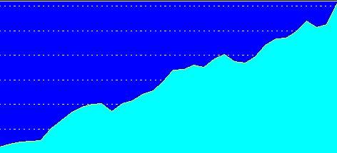
Trends in Canadian Physician Incomes
Mean physician income as multiple of all Canadian
full time employees
Source: Grant and Hurley, U Calgary School of Public Pol. Research Papers. July 2013, Vol 6, Iss 22.

Slide 287
Canadian Malpractice Insurance Costs, 2022
Specialty | Ontario* | Quebec | BC & Alberta
Family Med | $3,540 | $445 | $2,568
Psychiatry | $3540 | $445 | $2,568
Cardiology | $5,904 | $549 | $3,552
Anesthesia | $8,472 | $667 | $5,304
Neurosurgery | $17,304 | $903 | $27,000
Obstetrics | $50,532 | $2,354 | $31,416
*Government reimburses physicians for premiums above 1986 level. All figures in Canadian $s.
Source: Canadian Medical Protective Association www.cmpa-acpm.ca
Modified version of slides prepared by Drs. Steffie Woolhandler and David Himmelstein. Originals available at https://www.citizen.org/article/updated-powerpoint-presentations-on-health-policy-issues-relevant-to-health-care-reform-and-a-national-single-payer-health-system/ (accessed Apr 12 2023)

Slide 288

“It’s not a big hassle. I can focus on patient issues, not administrative issues.”
Dr. Trina Larsen Soles
President of Doctors of BC
Represents physicians in British Columbia
Source: Modern Healthcare 4/9/18

Slide 289

“It’s an incredible bureaucratic mess to get anything done for patients.”
Dr. John Cullen
President-Elect
American Academy of Family Physicians
Source: Modern Healthcare 4/9/18

Slide 290
What’s OK in Canada?
Compared to the USA…
Life expectancy 2 years longer
Infant deaths 25% lower
Universal comprehensive coverage
More physician visits, hospital care; less bureaucracy
Quality of care equivalent to insured Americans’
Free choice of doctor and hospital
Health spending half of USA level

Slide 291
What’s the Matter in Canada?
The wealthy lobby for private funding and tax cuts; they resent subsidizing care for others.
Result: government funding cuts (e.g., 30% of hospital beds closed during the 1990s) causing dissatisfaction and waits for care.
USA and Canadian firms seek profit opportunities in health care privatization
Conservative foes of public services own many Canadian newspapers
Misleading waiting list surveys by right wing Fraser Institute

Slide 292
Medicare for All
Enjoys Wide Support

Slide 293
Most Favor Phasing Out Private Plans if They Can Keep Their Doctor/Hospital
Percent supporting Medicare for All with…
Source: Morning Consult July, 2019
Note: Question asked about choice of doctor and hospital

Slide 294
Increasing Support for Single Payer
“All Americans would get their insurance from a single government plan”
Source: Kaiser Family Foundation Polls
Modified version of slides prepared by Drs. Steffie Woolhandler and David Himmelstein. Originals available at https://www.citizen.org/article/updated-powerpoint-presentations-on-health-policy-issues-relevant-to-health-care-reform-and-a-national-single-payer-health-system/ (accessed Apr 12 2023)

Slide 295
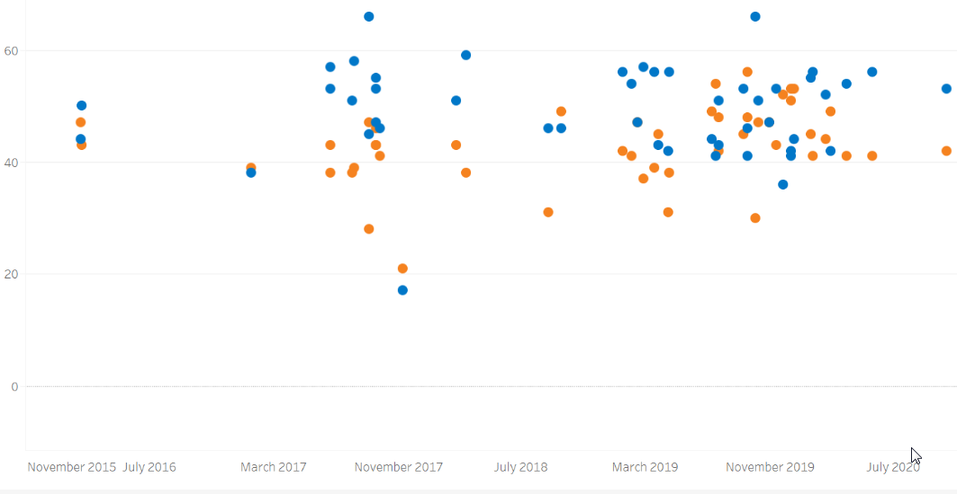
Consistent Support for Medicare for All
60%
40%
20%
0
Support
Oppose
Nov 2015 | July 2016 | Mar 2017 | Nov 2017 | July 2018 | Mar 2019 | Nov 2019 | July 2020
Source: Kaiser Family Foundation October 2020
Modified version of slides prepared by Drs. Steffie Woolhandler and David Himmelstein. Originals available at https://www.citizen.org/article/updated-powerpoint-presentations-on-health-policy-issues-relevant-to-health-care-reform-and-a-national-single-payer-health-system/ (accessed Apr 12 2023)

Slide 296
2021 Poll: 60% Want Medicare for All
“Do you support/oppose changing our health care system so that all Americans would get health insurance from Medicare…
paid for by taxpayers…
often called Medicare for All?”
Source: Commonwealth Fund/Harvard Public Health School Survey January 2021
Modified version of slides prepared by Drs. Steffie Woolhandler and David Himmelstein. Originals available at https://www.citizen.org/article/updated-powerpoint-presentations-on-health-policy-issues-relevant-to-health-care-reform-and-a-national-single-payer-health-system/ (accessed Apr 12 2023)

Slide 297
Most Doctors Favor Single Payer
Support Has Sharply Increased
2008
2017
Source: Merritt Hawkins surveys of physicians

Slide 298
A National Health Program for the U.S.

Slide 299
National Health Insurance
Universal – covers everyone
Comprehensive – all needed care, no co-pays
Single, public payer – simplified reimbursement
No investor-owned HMOs, hospitals, etc.
Improved health planning
Public accountability for quality and cost, but minimal bureaucracy
Proposal of the Physicians Working Group for Single Payer NHI. JAMA 2003;290:798
Modified version of slides prepared by Drs. Steffie Woolhandler and David Himmelstein. Originals available at https://www.citizen.org/article/updated-powerpoint-presentations-on-health-policy-issues-relevant-to-health-care-reform-and-a-national-single-payer-health-system/ (accessed Apr 12 2023)

Slide 300
Funding for the NHP
Revenue Sources
Recipients of Money
NHP
Fund
Medicare and Medicaid
Hospital Operating Costs
Hospital Capital Costs
State / Local Governments
HMOs
Employers
Fee-for-Service Physicians
Private Insurance Revenues
Home Care Agencies
New Taxes
Long-Term Care
NEJM 1989;320:102

Slide 301
Hospital Payment Under an NHP
Hospitals remain privately owned
Capital purchases/expansion budgeted separately based on health planning goals
Negotiated global budget for operating costs. Operating funds cannot be diverted to capital
NEJM 1989;320:102

Slide 302
Global Operating Budgets:
Key to Single Payer Savings
Cuts hospital administrative costs
Eliminates disparities in profitability of patients
Banning hospitals from keeping surplus minimizes entrepreneurial incentives
Funding capital through explicit grants minimizes unneeded duplication of expensive services

Slide 303
Prescription Drugs and Single Payer
Full coverage, no deductibles/copays
Prices reduced by negotiations, national formulary, threat of patent revocation
Funding for public drug development, testing, and (when necessary) manufacture
Raise standards and FDA funding for drug approval, marketing and post-approval surveillance
Eliminate tax deductions for advertising; prohibit pharma-funded CME and guideline development
Source: Gaffney, Lexchin, Angell, Carome et al. BMJ 2018;361:K1039
Modified version of slides prepared by Drs. Steffie Woolhandler and David Himmelstein. Originals available at https://www.citizen.org/article/updated-powerpoint-presentations-on-health-policy-issues-relevant-to-health-care-reform-and-a-national-single-payer-health-system/ (accessed Apr 12 2023)

Slide 304
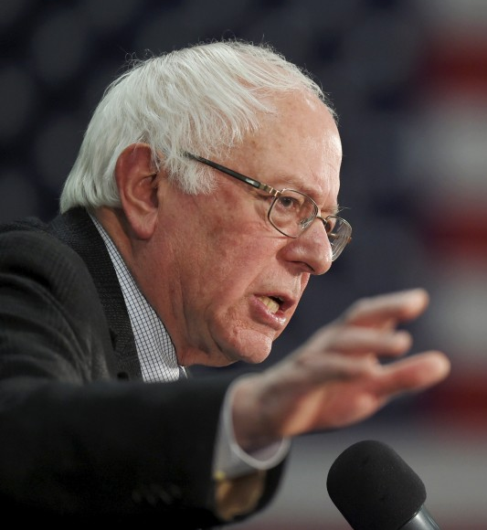

2022 House and Senate Bills
Strengths
Universal coverage, single public plan
Comprehensive acute care benefits
No copays for covered services
Bans duplicative private coverage
Exemption from Hyde Amendment
Drug formulary and price negotiations

Slide 305
2022 House and Senate Bills
Concerns
Both allow for-profit providers, with constraints
Senate bill: Adopts Medicare’s needlessly complex payment strategies, raising administrative burdens/costs and perpetuating incentives for upcoding etc., focusing on profitable services, etc.

Slide 306
Single Payer Transition:
For Displaced Clerical and Administrative Workers
All 400,000 health insurance workers and about ½ of the 2.6 million clerical/administrative employees in healthcare providers likely to be displaced – total 1.7 million.
Many likely to be redeployed in expanded clinical workforce.
Funding for income support and job retraining modeled on WWII GI Bill.
Job displacement is common in the US – 60 million/year, including 20 million who are fired: 1.7 million = number who are fired every 31 days. (source: People’s Policy Report)

Slide 307
66.1 Million US Workers
Separated from Jobs in 2018
Laid off
or fired
21.9 million
Job displacement
due to Single Payer
put into perspective
Quit
41 million
Other*
4.1 million
Source: Bureau of Labor Statistics – Job Opening and Labor Turnover Survey. January 2019
* ”Other” includes deaths, retirements, transfers, disability

Slide 308
Single Payer Transition:
For Patients
Every U.S. resident receives an insurance card.
Full coverage for all medically necessary care, no copayments, deductibles or coinsurance.
Prescription drug formulary, with alternatives covered when medically indicated
Free choice of any participating provider or hospital.

Slide 309
Medicare for All or
Medicare for More?

Slide 310
Single Payer and Private Coverage
Allowed
Banned
  Supplemental non-competing insurance
  Can only cover benefits not covered by the public plan
  Private insurance (including Medicare Advantage) duplicating public plan benefits
  Key to administrative savings

Slide 311
Public Option Rhetoric
“Don’t strip 150 million Americans of their private insurance; let them choose”
“M4A means a giant tax increase”
“If public is better, it will outcompete private insurance”
“There’s lots of ways to get to universal care”

Slide 312
Millions Lose Private Insurance Every Year
One in seven firms
switch coverage every year;
unknown millions affected
Millions affected
Source: Bruenig – Jacobin Blog Post. July 2019
Other reasons for involuntary switch: Employer stopped offering coverage; coverage too expensive; policy holder died; hours dropped

Slide 313
Transitioning to Germany
All funds are non-profit
One national fee schedule
Capital planning
Long term care
  Non-profit sickness fund boards:
  ½ unions and ½ employers
  All insurers pay same rates and include every doctor, every hospital
  States fund most hospital capital investment
  Single payer for long term care

Slide 314
Transitioning to Switzerland
All funds are non-profit
One national fee schedule
Capital planning
Expensive model
Mandatory coverage sold ONLY by non-profit insurers
  All insurers pay same rates and include every doctor, every hospital
  Cantons fund most hospital capital investment
Only the USA has higher health costs

Slide 315
Transitioning to Netherlands
Mixed
model
Unhappy physicians
Expensive model
Long term care
  Developed as German-style universal coverage
  Private insurers introduced 2006
  Doctors now complain of unbearable administrative burdens and rupture of cooperation
  Hospital administrative costs 2nd only to the USA
  Single payer for long term care

Slide 316
65% of Dutch GPs Sign Manifesto
“Everything must change”
“Insurers have too much power”
“Bureaucracy is growing”
The “Competition Act” forces each GP to negotiate individual contract with insurers
Manifesto calls for removing physicians from the Competition Act and make “cohesion through cooperation” the guiding principle in primary care
Source: “Competition Hurts Healthcare: Doctors” NL Times 4/17/15
Modified version of slides prepared by Drs. Steffie Woolhandler and David Himmelstein. Originals available at https://www.citizen.org/article/updated-powerpoint-presentations-on-health-policy-issues-relevant-to-health-care-reform-and-a-national-single-payer-health-system/ (accessed Apr 12 2023)

Slide 317
“Insurers in the Netherlands and Switzerland are not as a matter of public policy conceived of as private businesses and in important respects they are not allowed to function as private businesses. The Dutch and Swiss models--built on a uniform mandated benefit package, a limited menu of cost sharing, and provider rate regulation-- are not the models that private insurers in the United States are in fact advocating, but rather represent a quite different tradition based on social solidarity and not on market competition.”
“They have not, moreover, been successful in holding down costs or expanding access to insurance. Finally, their experience demonstrates again the tendency of insurers – even nonprofit insurers – to compete based on risk selection rather than cost, and the difficulty posed by trying to control this tendency through legal regulation.”
The Experience of Switzerland and the Netherlands with Individual Health Insurance Mandates: A Model for the United States? Timothy Stoltzfus Jost

Slide 318
Doctors in Multi-Payer Systems
Have More Insurance Hassles
Percent of doctors reporting that time spent on insurance/claims is “major problem”
Multi-payer
Single-payer
Source: Commonwealth Fund Physician Survey, 2015
Modified version of slides prepared by Drs. Steffie Woolhandler and David Himmelstein. Originals available at https://www.citizen.org/article/updated-powerpoint-presentations-on-health-policy-issues-relevant-to-health-care-reform-and-a-national-single-payer-health-system/ (accessed Apr 12 2023)

Slide 319
Public Option = High Costs
Less savings than single payer on insurers’ overhead
Multiple payers = no savings on billing and administration
Private insurers will tilt the playing field (as under Medicare Advantage) raising system-wide costs and perpetuating network restrictions, cherry-picking, lemon dropping etc.
Higher system-wide costs (compared to single payer) assure political pressure for benefit cuts

Slide 320
For Any Level of Spending,
Single Payer Would Purchase More Care and Less Administration Than Public Option

Slide 321
Single Payer Would Cost $631 Billion Less
Than a Universal Multi-Payer Reform
$3.636 Trillion
Total health expenditures / year
$3.005 Trillion
Source: Galvani and Fitzpatrick. Lancet 2020;395:1692
Modified version of slides prepared by Drs. Steffie Woolhandler and David Himmelstein. Originals available at https://www.citizen.org/article/updated-powerpoint-presentations-on-health-policy-issues-relevant-to-health-care-reform-and-a-national-single-payer-health-system/ (accessed Apr 12 2023)

Slide 322
Total Payments to ~1 Million Physicians
With and Without Medicare for All
Billion
Billion
Billion
Billion
Billion
Billion
Sources: Rand Corporation (2019), Urban Institute (2016), Mercatus Center (2018)
Note: Percentage estimates from original studies, applied to 2019 total physician expenditures
Note: Urban argued that “physician incomes would be squeezed” even as payments rose by >$100 billion

Slide 323
Total Payments to America’s ~5,500 Hospitals
With and Without Medicare for All
Billion
Billion
Billion
Billion
Billion
Billion
Sources: Rand Corporation (2019), Urban Institute (2016), Mercatus Center (2018)
Note: Percentage estimates from original studies, applied to 2017 total hospital payments
Note: Urban’s 2019 estimate is similar to 2016 estimate overall, but lacks detail
Modified version of slides prepared by Drs. Steffie Woolhandler and David Himmelstein. Originals available at https://www.citizen.org/article/updated-powerpoint-presentations-on-health-policy-issues-relevant-to-health-care-reform-and-a-national-single-payer-health-system/ (accessed Apr 12 2023)

Slide 324
Source: Cai et al, PLOS Medicine, 2020

Slide 325
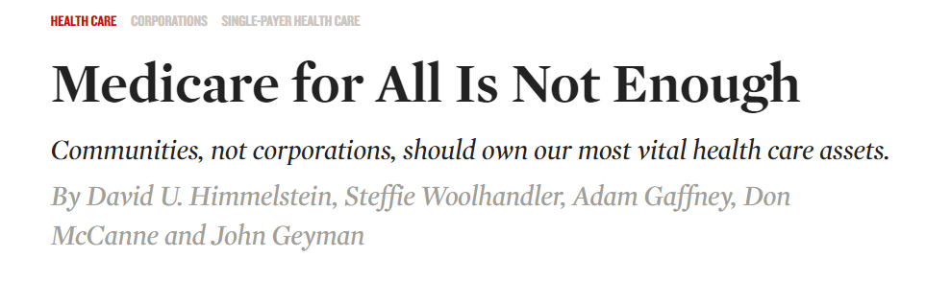




Modified version of slides prepared by Drs. Steffie Woolhandler and David Himmelstein. Originals available at https://www.citizen.org/article/updated-powerpoint-presentations-on-health-policy-issues-relevant-to-health-care-reform-and-a-national-single-payer-health-system/ (accessed Apr 12 2023)

Slide 326
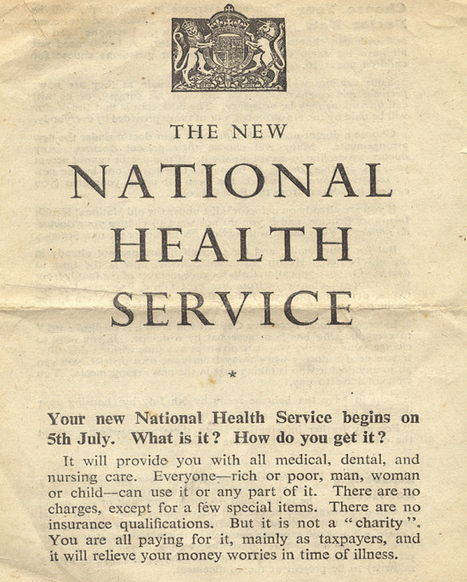
“…There are no charges, except for a few special items”
“…no insurance qualifications”
An equal right to healthcare
Source: http://museum.hackney.gov.uk/object9232
Modified version of slides prepared by Drs. Steffie Woolhandler and David Himmelstein. Originals available at https://www.citizen.org/article/updated-powerpoint-presentations-on-health-policy-issues-relevant-to-health-care-reform-and-a-national-single-payer-health-system/ (accessed Apr 12 2023)

