Slide 1
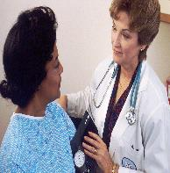
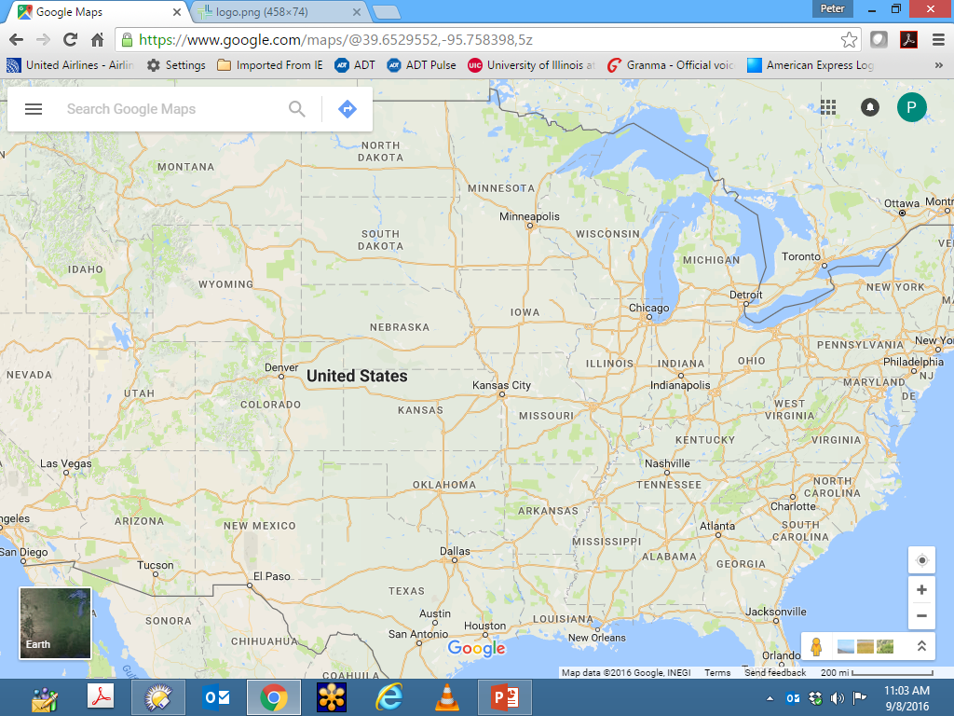

US Health Care 2023
Where Are We?
&
Why?
,
May 9, 2023
Peter Orris, MD, MPH, FACP, FACOEM
GRAND ROUNDS

Slide 2

BACKGROUND
Cook County Hospital has always been open to all patients, generally poor or destitute, and immigrants arrived in the city.
Raffensperger, John G., and Louis G. Boshes, eds. The Old Lady on Harrison Street: Cook County Hospital, 1833–1995. International Healthcare Ethics, vol. 3. 1997.
Cook County Hospital:
Internal Medicine Residency: 1975 – 1978
Preventive Medicine Residency in Occupational & Environmental Medicine 1977 - 1979
Attending Physician Internal Medicine: 1979 – 2009
Emergency Room: 1979 – 1980
Inpatient & Outpatient General Internal Medicine 1979 – 2009
President of the Medical Staff: 2001-2005
Medical Director Occupational Medicine Programs Mt. Sinai and Northwest Community Hospitals
Prof. Occupational and Environmental Health Sciences, UIC School of Public Health
Adj. Prof of Internal Medicine , Rush University College of Medicine
Adj. Prof of Preventive Medicine, Feinberg School of Medicine, Northwestern University.
Taught Comparative International Health Systems at Northwestern for ove 15 years.

Slide 3
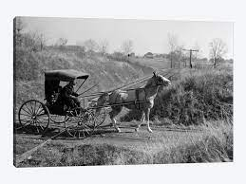
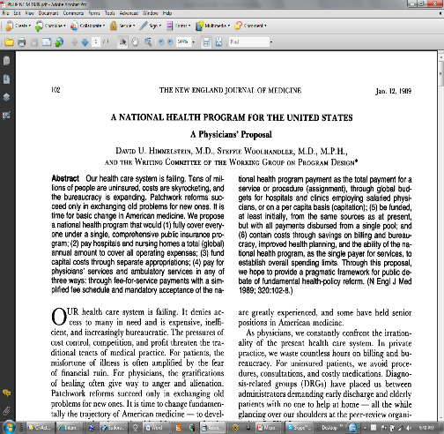
disclosures
Unless Otherwise Noted
All Opinions Expressed In This
Presentation
Are My Own
NB: as with all physicians in this country
I have many conflicts of interest in
presenting this lecture
both economic and ethical

Slide 4
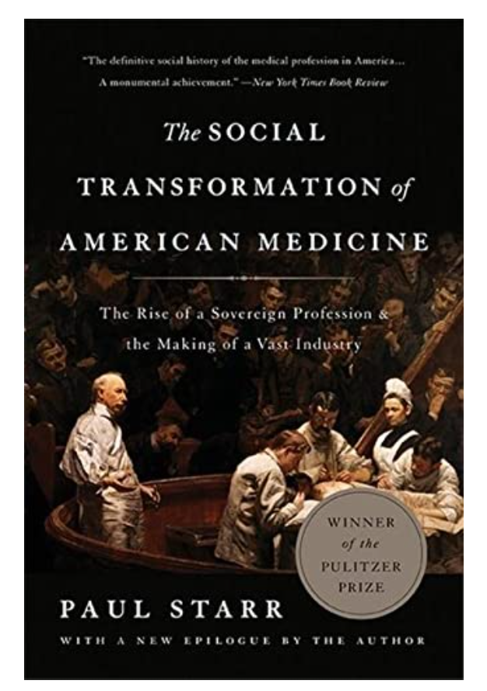

Slide 5
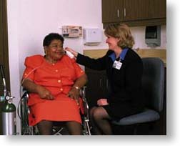
Health Care
Goals
Prevent prevalent conditions of ill health
Universal access to comprehensive care
Redress inequities in health status
Include social costs of disease

Slide 6

Utilize Market to Accomplish Health Care System Goals
Case Study:

Slide 7
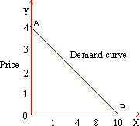
Market Defined Goals
Creation of medical care treatment service commodities for sale in a market based on demand.
Magnitude of market demand based on prevalence and severity of Illness, complexity of treatment, and
purchasing capacity of the consumer.
Purchasing power of the consumer based upon exchange value of the treatment when ill and the available expendable income, or banked expendable income based on the exchange value of the treatment when not ill.

Slide 8

DISCONNECT
Who Benefits and Who Suffers
SOCIETAL COST OF DISEASE
&
PROFITS DERIVED FROM PROVIDING MEDICAL CARE

Slide 9
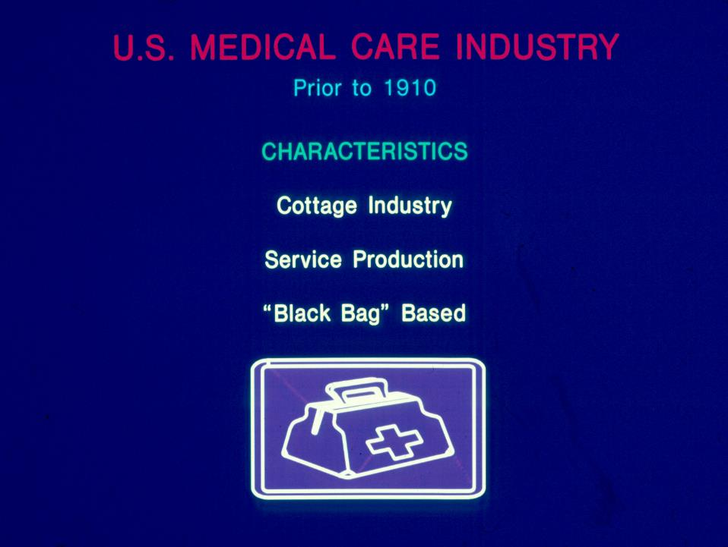

Slide 10
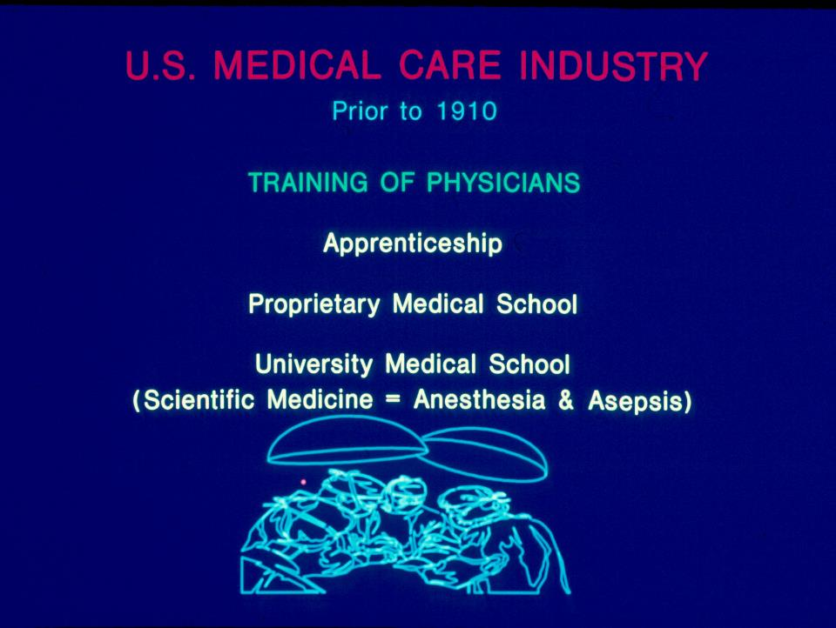

Slide 11
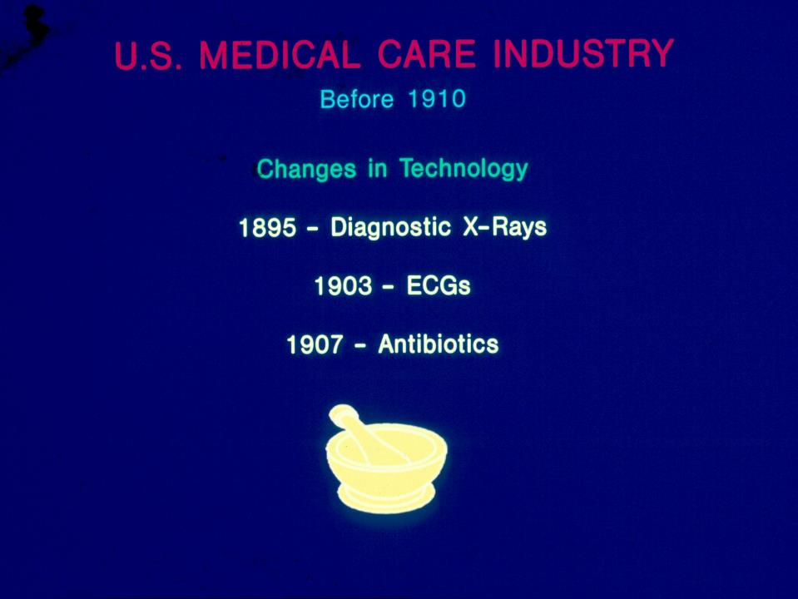

Slide 12
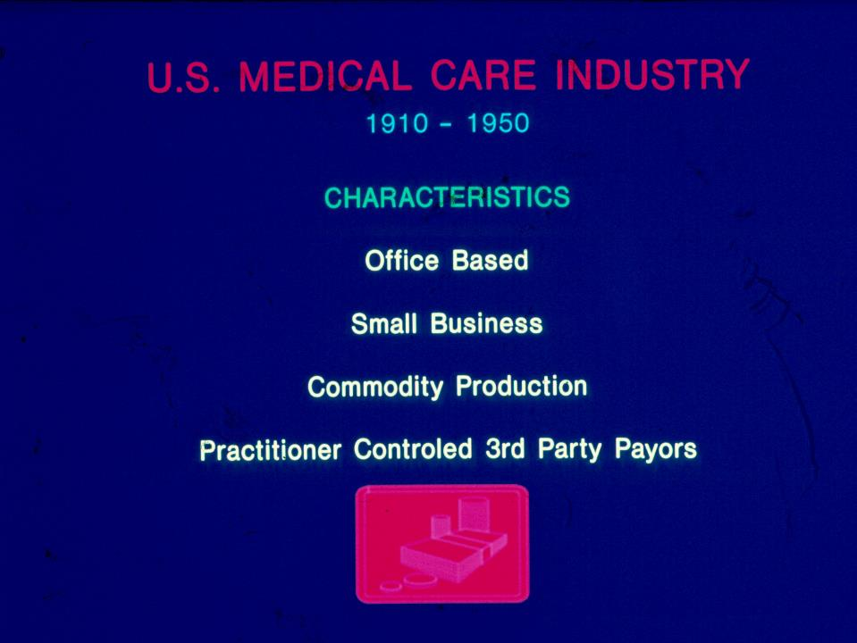

Slide 13
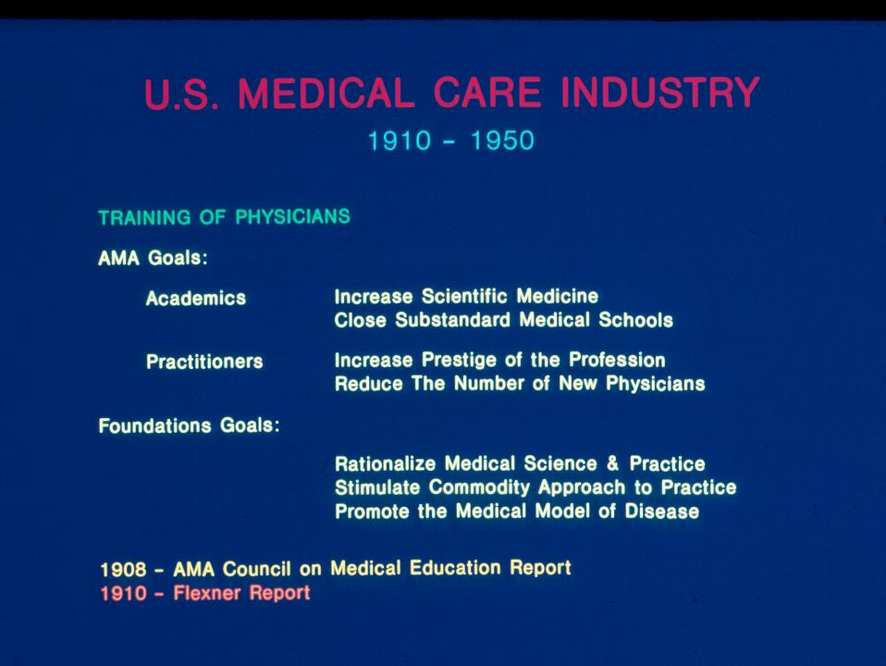

Slide 14
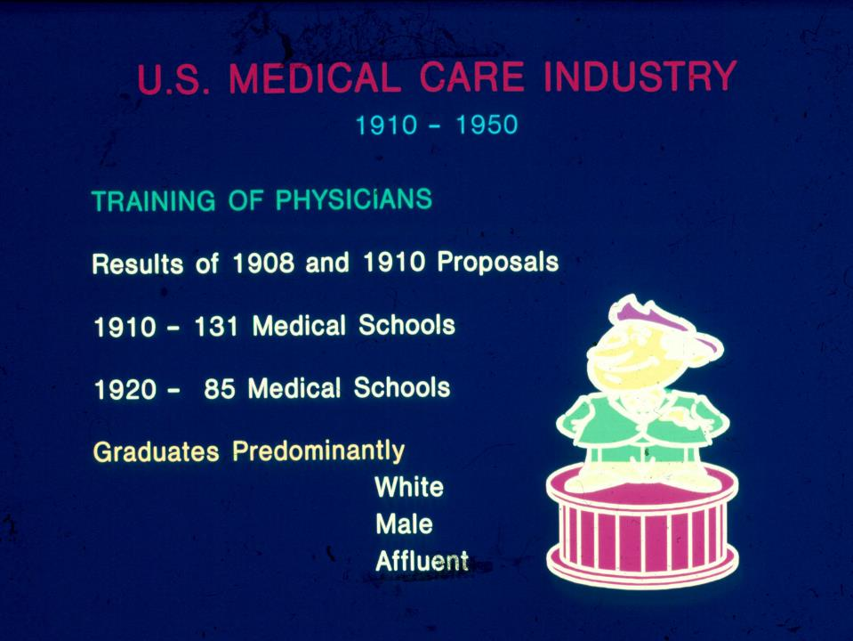

Slide 15
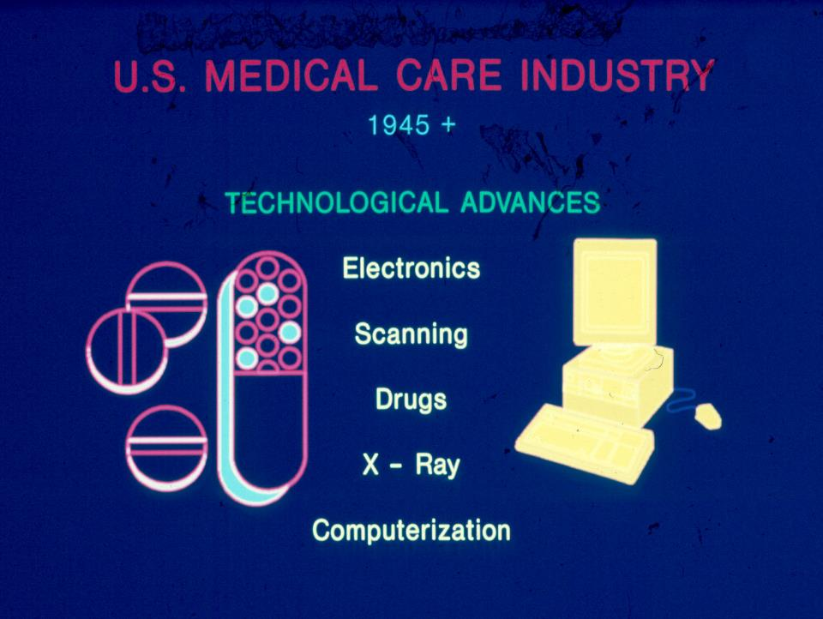

Slide 16
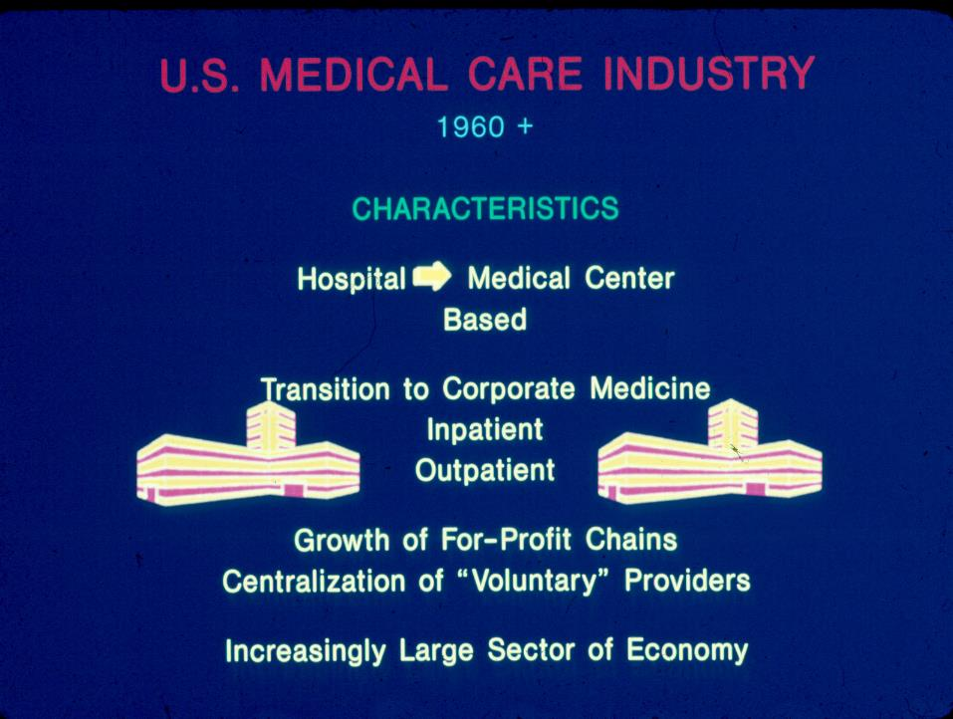

Slide 17
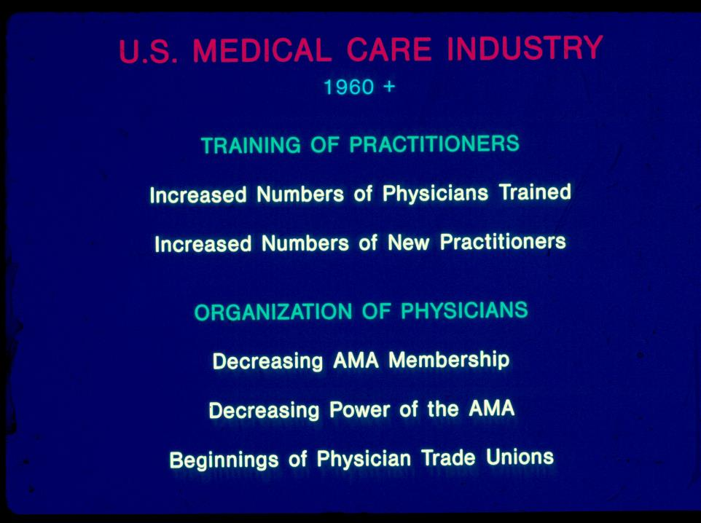

Slide 18
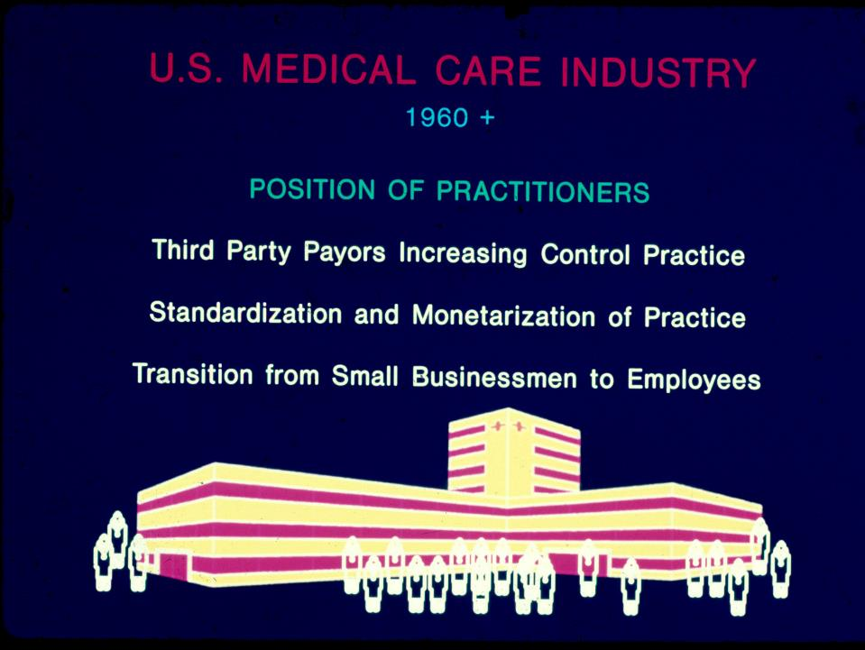

Slide 19
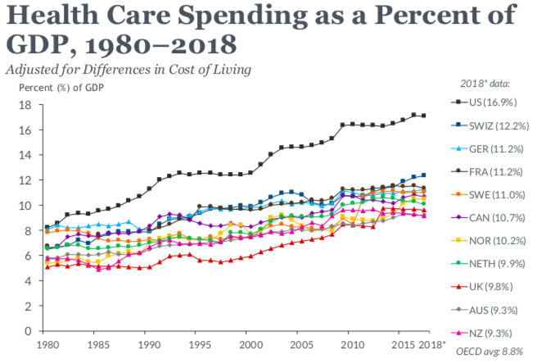
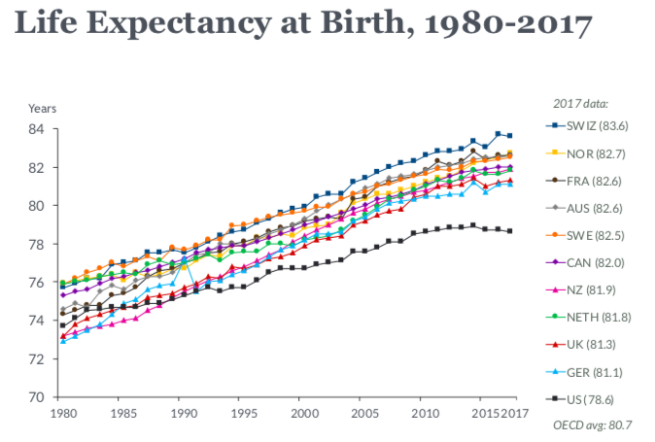
US healthcare is outstandingly inefficient
Source: Multinational Comparisons of Health Systems Data, 2019
Commonwealth Fund

Slide 20
National Health Expenditures Rose by
$365 Billion to $4.1 Trillion from 2019 to 2020
$4 Trillion
$3 Trillion
$2 Trillion
$1 Trillion
Structures + Equipment
Personal Healthcare
Total Admin + Net Cost of Health Insurance
Public Health Activity
Research
Center for Medicare and Medicaid Services, National Health Expenditures Account.

Slide 21
Growth of Physicians and Administrators
3000%
2500%
2000%
1500%
1000%
500%
Growth Since 1970
1970 | 1980 | 1990 | 2000 | 2014
Physicians
Administrators
Managers shown as 3-year moving average. Data updated through 2014
Bureau of Labor Statistics; NCHS; Himmelstein/Woolhandler analysis of CPS

Slide 22
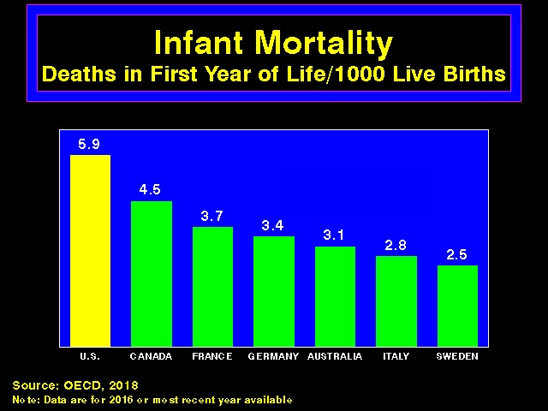

Slide 23
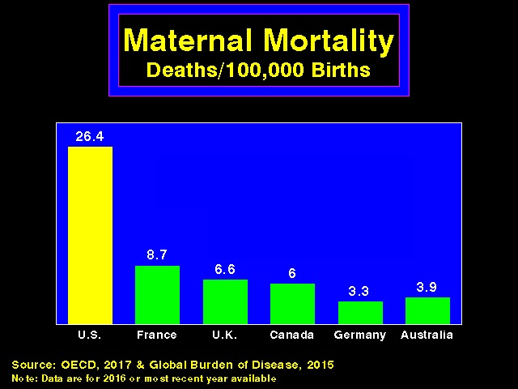

Slide 24
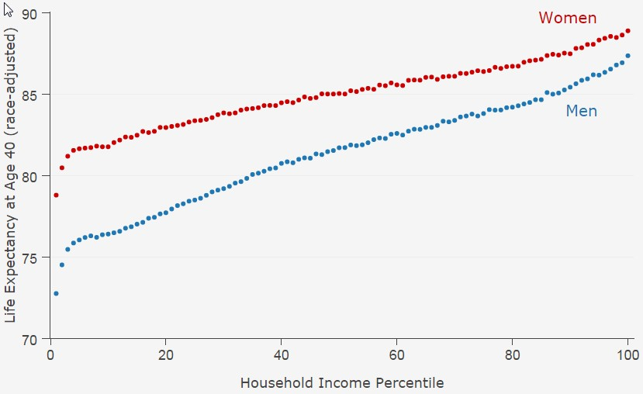
Life Expectancy Gap Between Richest and Poorest 1%:
10 yrs. for women, 15 yrs. for men
Source: Chetty et al. JAMA 2016;315:1750

Slide 25
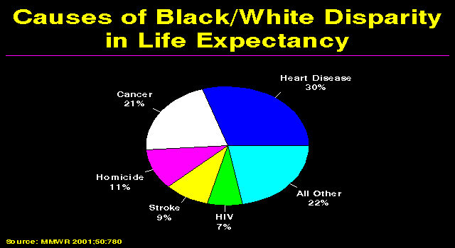

Slide 26
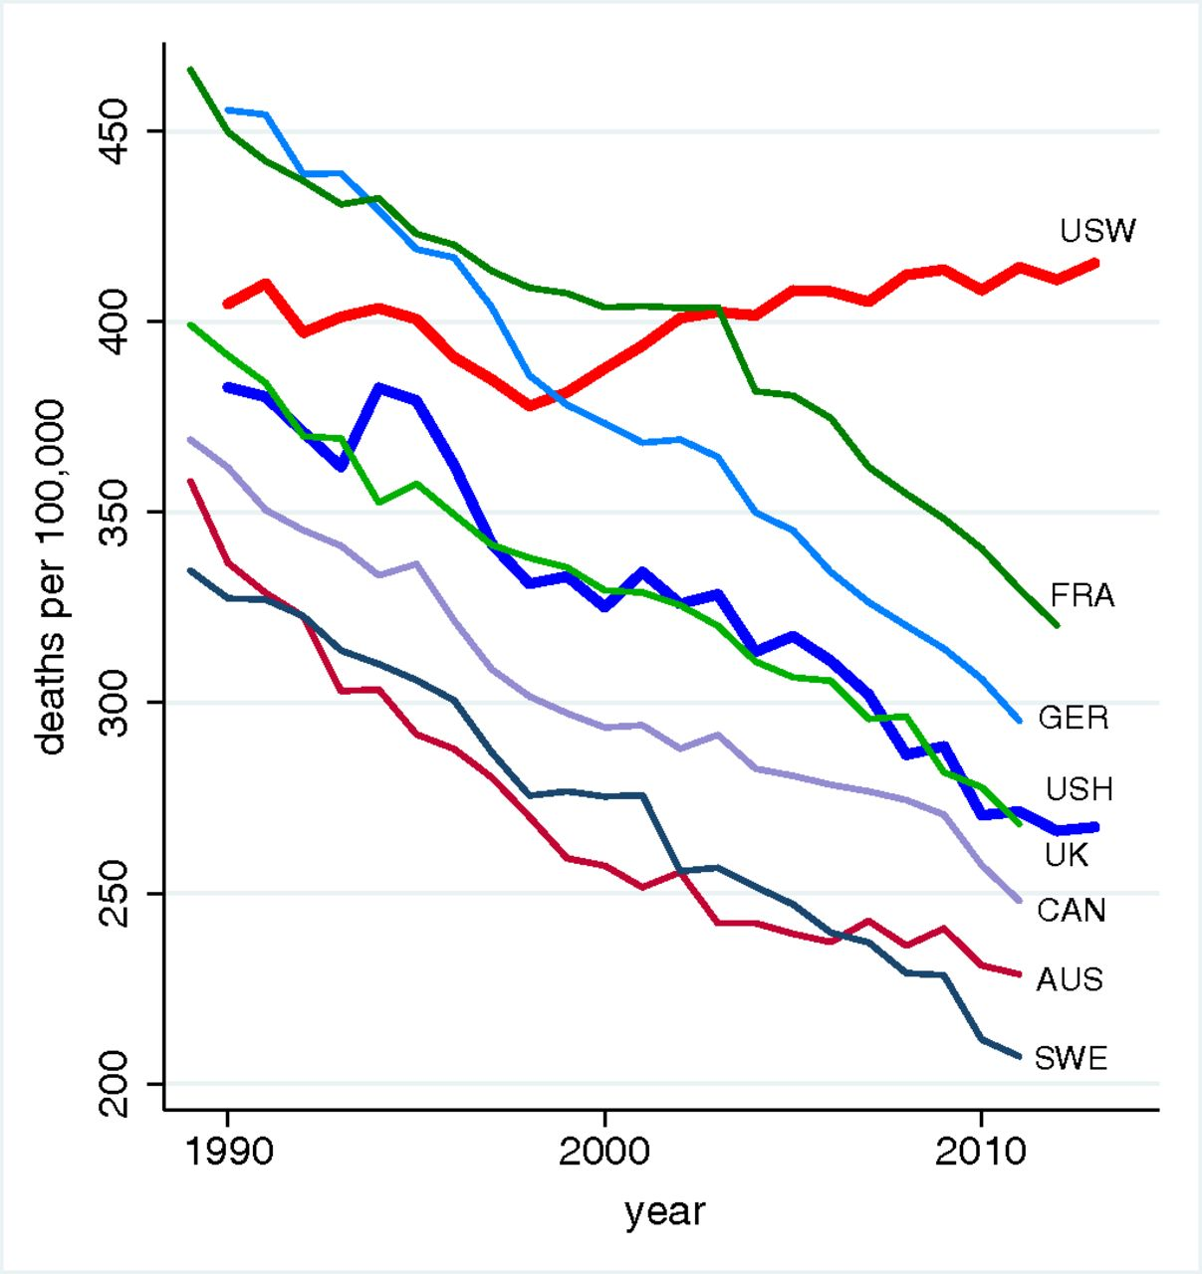
Rising Mortality For US Non-Hispanic Whites, 45-54
Source: Case & Deaton, PNAS 2016

Slide 27
Annual age-adjusted pneumonia hospitalization rate by
Race and Ethnicity
NIS 2001-2014. Data from: Hayes BH, Haberling DL, Kennedy JL, Varma JK, Fry AM, Vora NM. Burden of Pneumonia-Associated Hospitalizations. Chest 2018; 153: 427–37.

Slide 28
Community Acquired Pneumonia Hospitalization Rate per 100,000 Population: Children < 18 years
Lee GE, Lorch SA, Sheffler-Collins S, Kronman MP, Shah SS. National Hospitalization Trends for Pediatric Pneumonia and Associated Complications. Pediatrics 2010; 126: 204–13.

Slide 29
Steady Rise in US Life Expectancy Until 2020
USA Life Expectancy at Birth
(Years)
1960-2018:NCHS Data Visualization Gallery - Mortality Trends in the United States. 2020. https://www.cdc.gov/nchs/data-visualization/mortality-trends/index.htm
2019: Kochanek KD, Xu J, Arias E. Mortality in the United States, 2019. 2020 Dec;(395):8.
2020-2021: Arias E, Tejada-Vera B, Kochanek K, Ahmad F. Provisional Life Expectancy Estimates for 2021.
NVSS Vital Statistics Rapid Release. 2022 Aug;(23):16.

Slide 30
Uneven Decline in USA Life Expectancy
Between 2019 and 2021
Decline in life expectancy
(years)
Data from: Arias E, Tejada-Vera B, Kochanek K, Ahmad F. Provisional Life Expectancy Estimates for 2021.
NVSS Vital Statistics Rapid Release. 2022 Aug;(23):16.

Slide 31
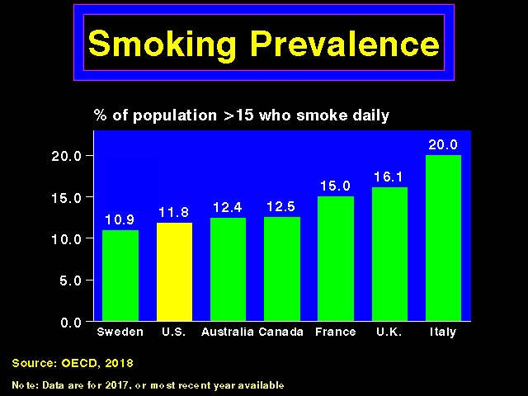

Slide 32
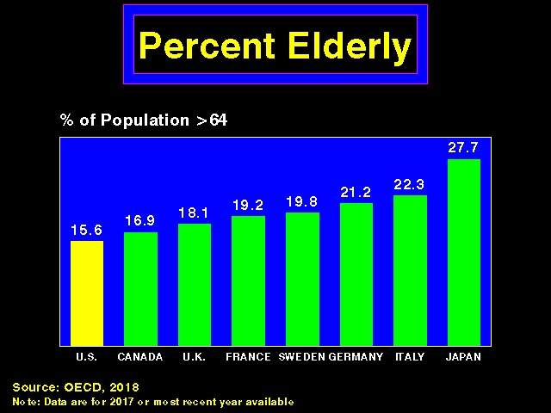

Slide 33
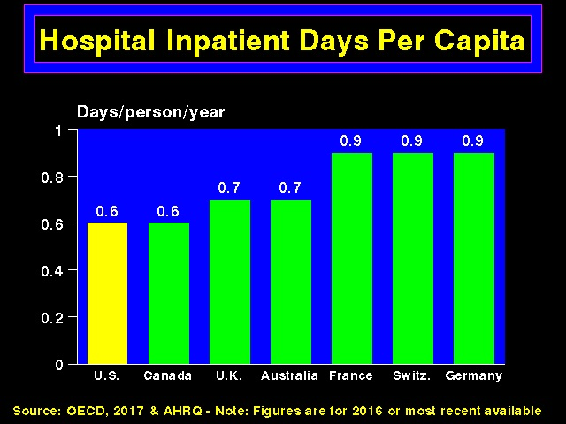

Slide 34
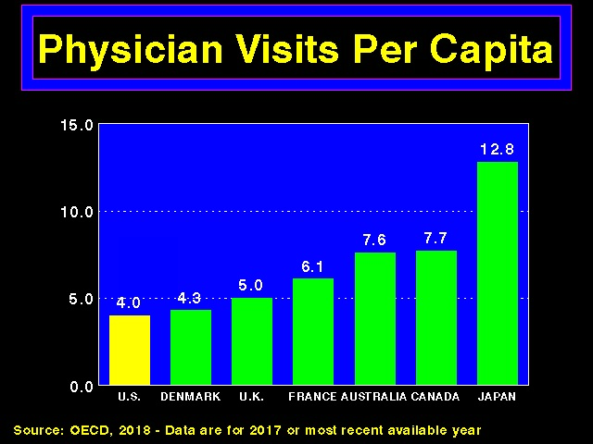

Slide 35
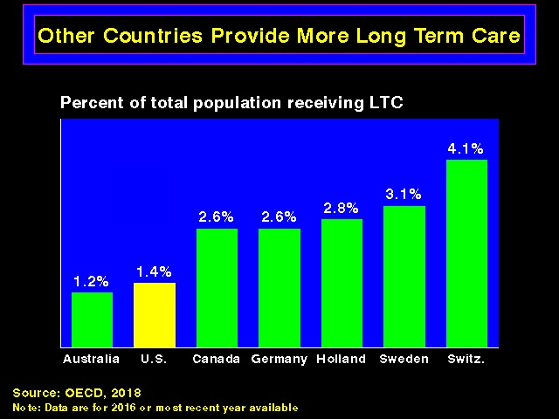

Slide 36
Rate of Underinsured Among the Insured
2022 data for ages 19-64
Family Income as a Percentage of Federal Poverty Level
Collins S, Haynes L, Masitha R. The State of U.S. Health Insurance in 2022.
Commonwealth Fund [Internet]. 2022 Sep 29 [cited 2022 Nov 2];
https://www.commonwealthfund.org/publications/issue-briefs/2022/sep/state-us-health-insurance-2022-biennial-survey

Slide 37
Among workers with employer-sponsored single coverage
Deductibles Are Steadily Rising
Data source: Kaiser Family Foundation. 2020 Employer Health Benefits Survey [Internet]. 2020 [cited 2021 Jan 22]. Available from: https://www.kff.org/health-costs/report/2020-employer-health-benefits-survey/.
Average general annual deductible for all covered workers (single coverage)
Notes:
85% have deductible in 2018

Slide 38
1.3 million American adults in 2021
Rationed Insulin Due to Cost
Data inclusive of all adults with diabetes who use insulin in 2021
Gaffney A, Himmelstein DU, Woolhandler S. Prevalence and Correlates of Patient Rationing of Insulin in the United States: A National Survey. Ann Intern Med [Internet]. 2022 Oct 18 [cited 2022 Oct 17];
http://www.acpjournals.org/doi/10.7326/M22-2477

Slide 39
Likelihood of offering a profitable (vs. unprofitable) Service by Hospital Ownership
Data from: Horwitz JR, Nichols A. Hospital Service Offerings Still Differ Substantially By Ownership Type.
Health Affairs. 2022 Mar;41(3):331–40.

Slide 40
Global Private Equity deals peaked at
$151 Billion in 2021
Global healthcare buyout deal value ($B)
Figure reproduced from: Global Healthcare Private Equity & M&A Report 2022. Bain & Company [Internet].
[cited 2022 Nov 3]; Available from: https://www.bain.com/insights/topics/global-healthcare-private-equity-ma-report/

Slide 41

“Overdoses, bedsores, broken bones:
What happened when a private-equity firm sought to care for society’s most vulnerable”
2007: Carlyle Group acquires ManorCare
2011: ManorCare sells almost all real estate.
$1.3 billion to investors, but cost $472 in rent costs for nursing homes
2013-2017: Layoffs, cost-cutting, soaring violations
2018: Files for bankruptcy
Source: Peter Whoriskey and Dan Keating, Washington Post, November 25, 2018.
Available at: https://www.washingtonpost.com/business/economy/opioid-overdoses-bedsores-and-broken-bones-what-happened-when-a-private-equity-firm-sought-profits-in-caring-for-societys-most-vulnerable/2018/11/25/09089a4a-ed14-11e8-baac-2a674e91502b_story.html

Slide 42
Changes in physician billing
After Practice Acquisition by Private Equity
Data from: Singh Y, Song Z, Polsky D, Bruch JD, Zhu JM. Association of Private Equity Acquisition of Physician Practices With Changes in Health Care Spending and Utilization. JAMA Health Forum 2022;3(9):e222886.

Slide 43
Narrow Network?
No Coverage at Academic Med Centers
Plans that exclude coverage at academic medical centers*
Source: Hospital Networks: Updated National View of Configs on Exchanges – McKinsey, 2014
Note: 15 of 19 top cancer hospitals were excluded by 1 or more plans (Zaldivar, 3/19/2014).
*Care at AMC neither covered nor count towards deductible or OOP limit

Slide 44
The Affordable Care Act Has Driven the Nation’s Uninsured Rate to its Lowest Level Ever
Share of Population without Health Insurance, 1963-2015:Q1
Percent
Creation of Medicare & Medicaid
Expansion of Medicare & Medicaid to People with Disabilities
ACA 1st Open Enrollment
20
15
10
5
0
1960 1965 1970 1975 1980 1985 1990 1995 2000 2005 2010 2015
Source: CEA analysis of NHIS; ASPE analysis of NHIS and Gallup-Healthways Well-Being Index data through March 4, 2015.
Note: Data are quarterly starting in 2014:Q1. Data for earlier years are generally either annual or bi-annual. The NHIS is the best tool for studying trends in insurance coverage, but
because NHIS data are not currently available after 2014:Q2, Gallup data are used to extrapolate the uninsured rate through 2015:Q1.
2

Slide 45
Impact of ACA
1,913,160
906,654
640,076
262,000
Source: Illinois Department of Public Health, Heartland Alliance Social Impact Center, Enroll America
Notes:
http://www.dph.illinois.gov/sites/default/files/publications/1-28-16-OHP-HIV-factsheet-Socio-Demographic-Characteristics.pdf
http://www.issuelab.org/resources/16629/16629.pdf
https://s3.amazonaws.com/assets.enrollamerica.org/wp-content/uploads/2016/11/11170303/ILCountyData_2016.pdf

Slide 46
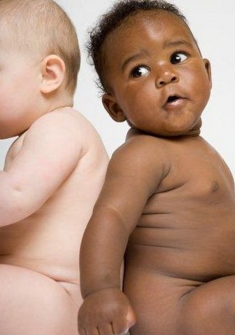
Persistent Racial Inequalities

Slide 47
Administrative Overhead Rising

Slide 48
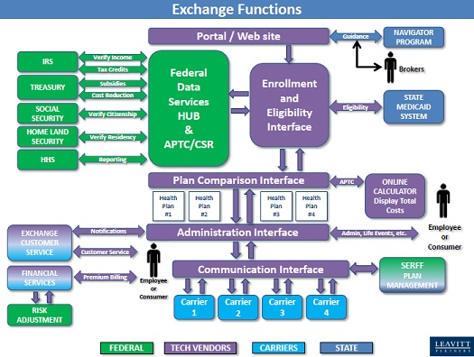

Slide 49
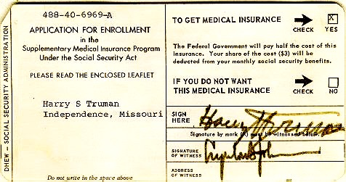
Medicare’s “Software”
18.9 million seniors enrolled within 11 months

Slide 51
Medicare Advantage continues to
Take Over Medicare
Percent of Medicare beneficiaries in MA
https://www.kff.org/medicare/press-release/medicare-advantage-is-close-to-becoming-the-predominant-way-that-medicare-beneficiaries-get-their-health-coverage-and-care/ Aug 25 2022 report
https://bettermedicarealliance.org/wp-content/uploads/2022/01/final_2022_house_ma_letter_.pdf

Slide 52
Unlike MA, Traditional Medicare spends 98% of its funds on
Actual Medical Care, Not Overhead/Profits
Insurance Overhead
and Profits
Commercial insurance overhead defined as the inverse of the Medical Loss Ratio (1-medical benefits/premiums) as calculated by Himmelstein and Woolhandler at https://www.citizen.org/article/powerpoint-presentations-on-health-policy-issues-relevant-to-health-care-reform-and-a-national-single-payer-health-system/
Medicare overhead drawn from Medicare Trust Fund reports over multiple years
MedPAC reports repeatedly identify the absence or limitations of data from MA

Slide 53
Medicare Advantage Plans are allowed to create their own
Proprietary Coverage Rules
15 selected MAOs during June 1-7 2019, reported by OIG April 2022
https://oig.hhs.gov/oei/reports/OEI-09-18-00260.pdf

Slide 54
If it’s so bad, why do so many people sign up for
Medicare Advantage?
 | Medigap (Plan G example) | Medicare Advantage
Premiums
Out-of-Pocket
Benefits
Networks
Utilization Management
~$200 average per month
Average $18/month in 2023
Zero out-of-pocket after the Part B deductible ($226 per year)
$12,450 combined in-network and out-of-network ($8,300 in-network)
No additional benefits beyond TM
Often includes additional benefits (Rx, hearing, vision, dental, gym clubs, etc)
Identical to Traditional Medicare
Smaller variable lists of “in-network” physicians and hospitals
Rare and only as required in TM (e.g., some hospital outpatient items)
Typically has proprietary “Prior Authorizations”, “Step Therapy”, etc.
https://www.cms.gov/files/document/opd-services-require-prior-authorization.pdf
2023 benefit designs
https://www.hhs.gov/about/news/2022/09/29/biden-harris-administration-announces-lower-premiums-for-medicare-advantage-and-prescription-drug-plans-in-2023.html
https://www.kff.org/medicare/issue-brief/medicare-advantage-in-2022-premiums-out-of-pocket-limits-cost-sharing-supplemental-benefits-prior-authorization-and-star-ratings/ Accessed Oct 27 2022

Slide 55
Protect Medicare and move closer to Medicare for All by
Leveling the Playing Field with MA
Improve Traditional Medicare
  Eliminate copays and deductibles
  Create an out-of-pocket maximum (ideally $0)
  Match or exceed MA benefits by including vision, hearing, dental, pharmacy, etc.
Expand ACA’s patient protections to Medigap
  Lifetime “Guaranteed Issue” in all states
  Lifetime “Community Rating” in all states
Strengthen patient protections in Medicare Advantage
  Prohibit the use of secret utilization rules in MA
  Exclude fraudulent companies from MA

Slide 56
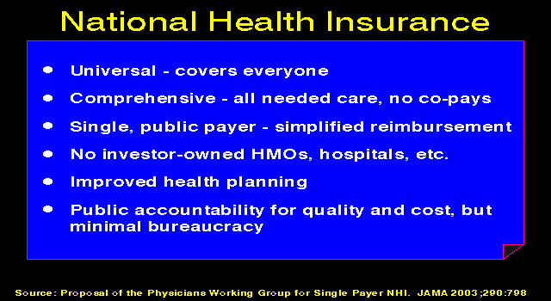

Slide 57
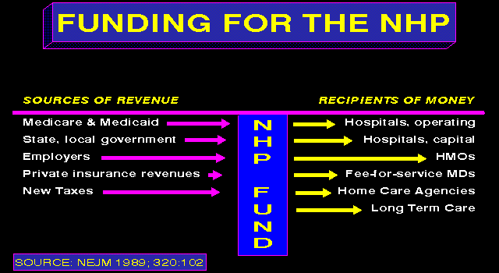

Slide 58
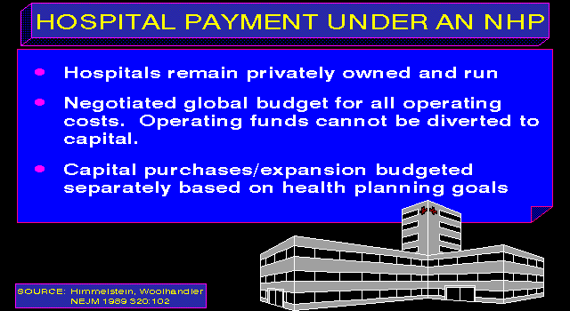

Slide 59

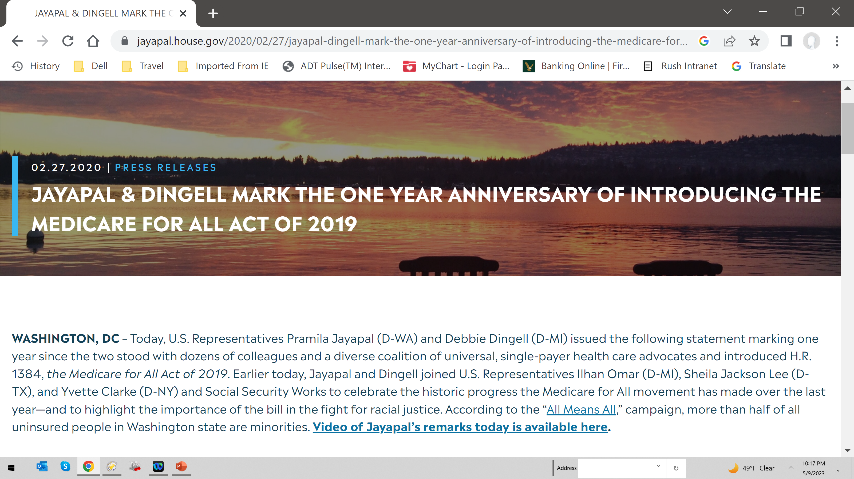

Slide 60
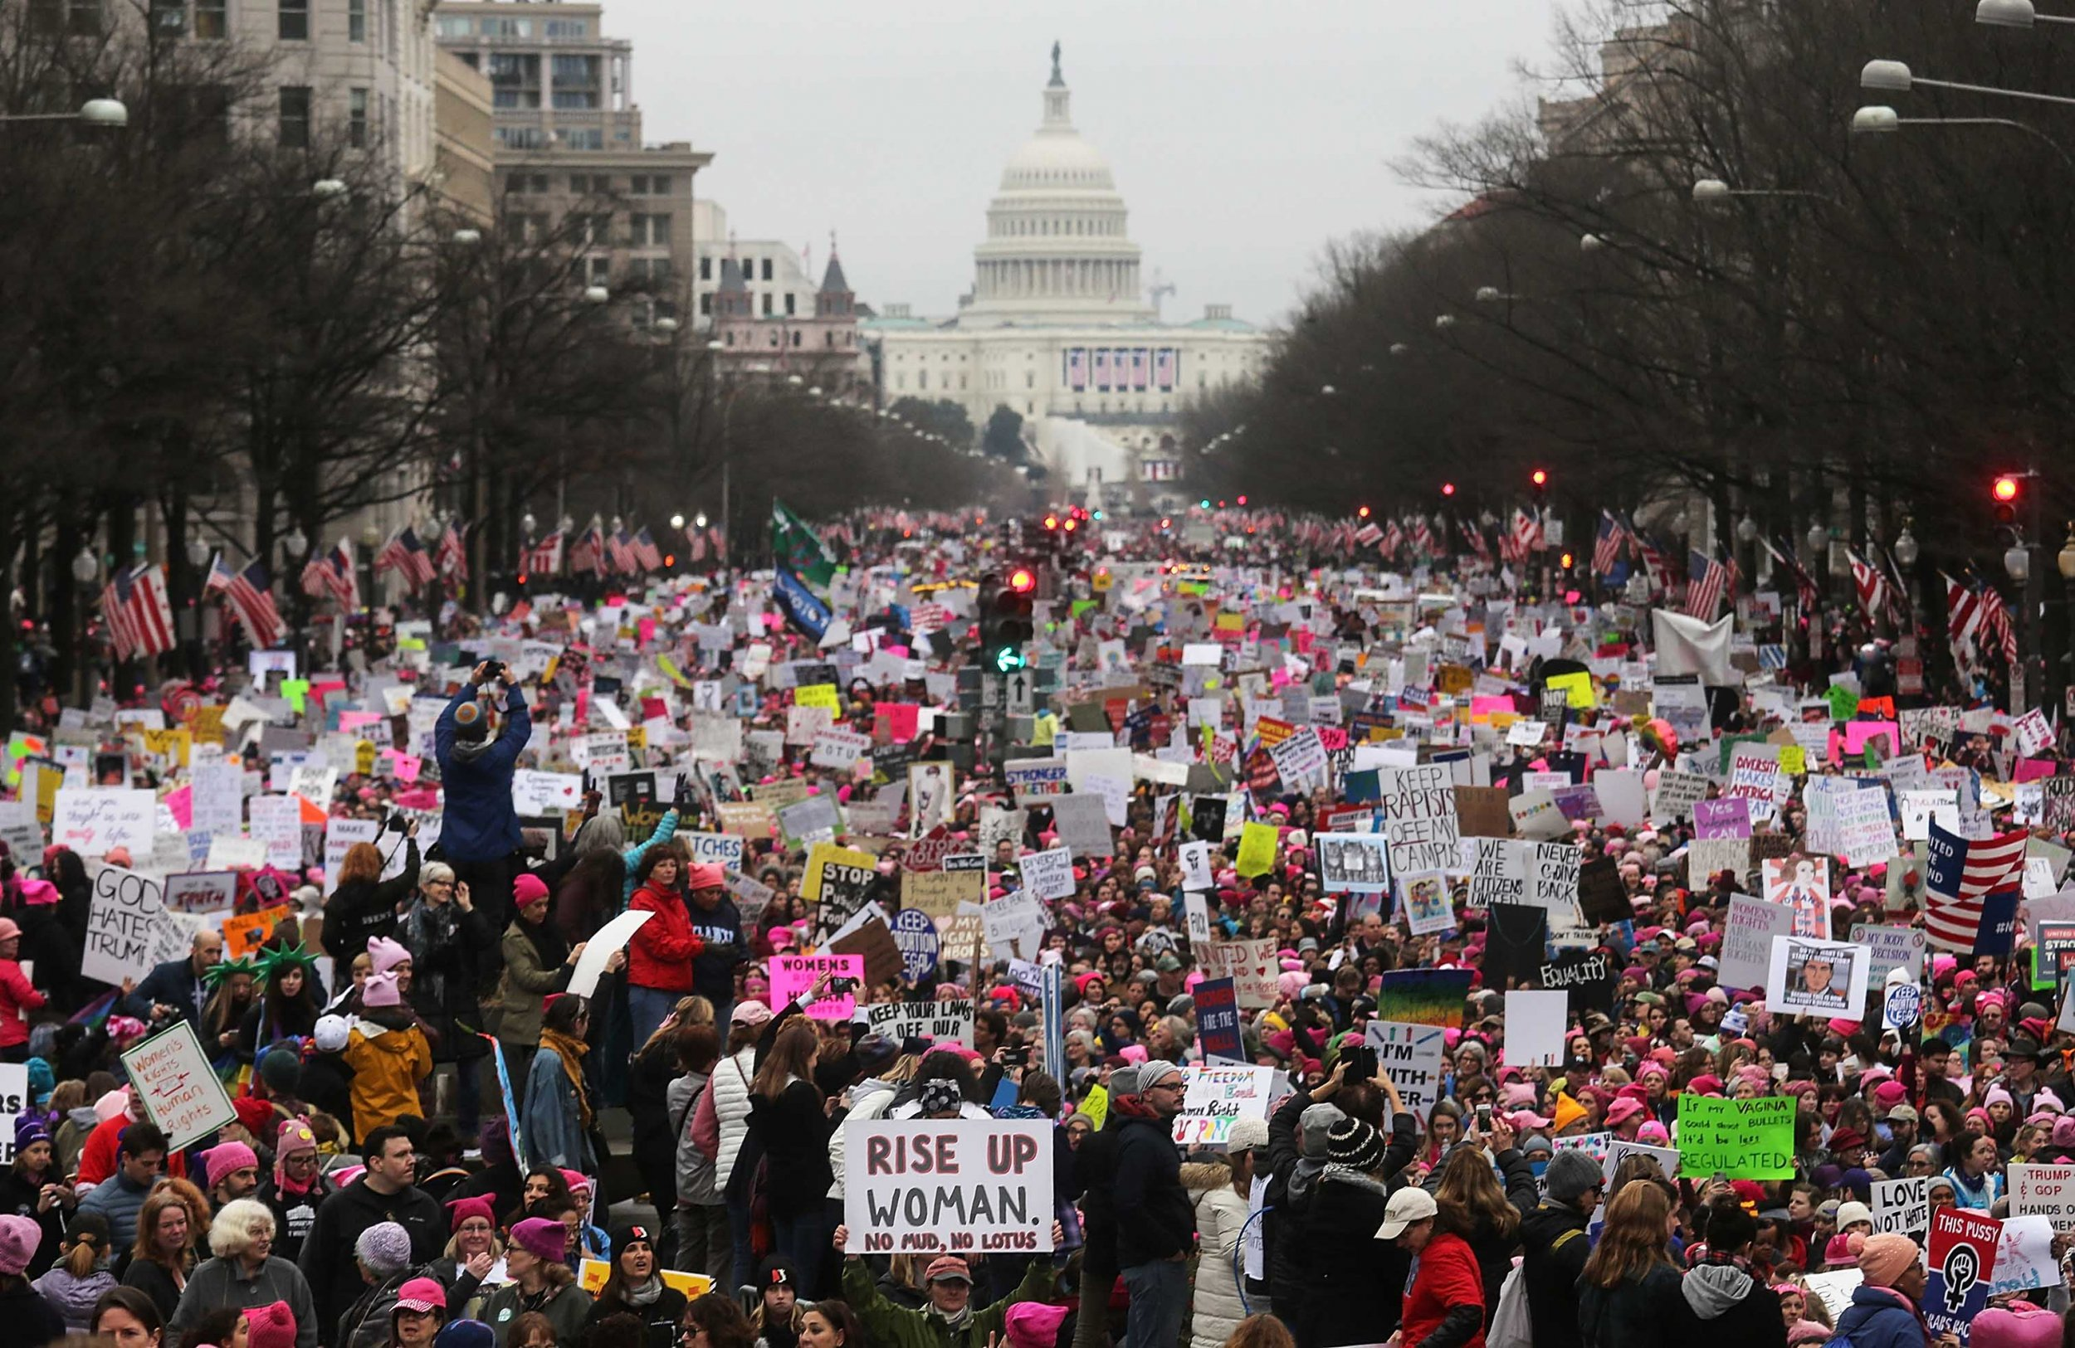
WHEN DO WE WANT IT ?
NOW

Slide 61

Acknowledgements
THANKS
To my many colleagues that have allowed
my appropriation and editing
of their slides
Including
Richard L. Dressler, M.D., M.P.H.
Josh.Faucher
Adam Gaffney, MD MPH
Ed Weisbart MD
Naiomi Swede
And to:
www.PNHP.org

