Slide 1
Talking about Medicare for All
It’s not about winning an argument:
It’s about encouraging people to join our campaign.

Slide 2
The three pillars along The Road to Medicare for All
Pass the Medicare for All legislation
Active bills in the US House and Senate
PNHP chapters worked hard (with our allies) to help get cosponsors all across the country
Improve Traditional Medicare
Eliminate all copays and deductibles
Plug the gaps of the missing benefits (dental, vision, hearing, pharmacy, long-term care, etc)
End the corporate takeover of Medicare
MA is the poster-child for profiteering – drains our public resources without adding real value
See PNHP’s Kitchen Table Campaign for more tools
Building the conditions to win on Medicare “Advantage”
also builds the conditions to win Medicare for All

Slide 3
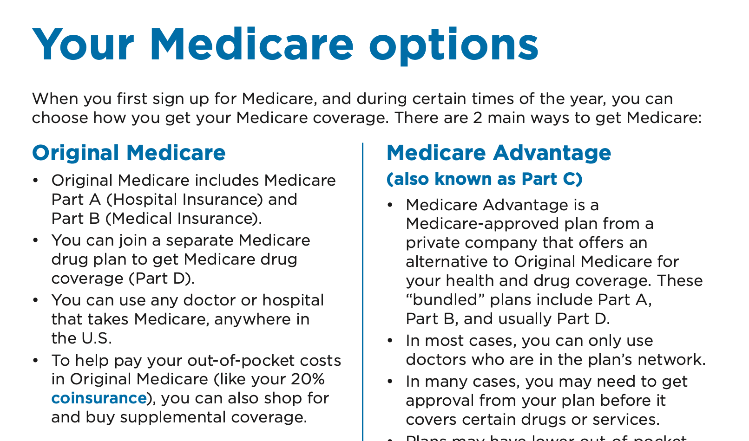
Languages Don’t Have Silver Bullets It’s not about finding the single exactly right word for every use
Traditional Medicare?
Medicare Advantage?
Original Medicare?
True Medicare?
Real Medicare?
Medicare Parts A and B?
“So-called” Advantage?
Dis-Advantage?
Privatized Medicare?
Fake Medicare?
It’s time to grow beyond “inside-baseball”
2023 Medicare Handbook at https://www.medicare.gov/publications/10050-Medicare-and-You.pdf
Accessed Aug 24 2023

Slide 4
Be A Hero and ASO Communications
Be A Hero engaged
ASO Communications to guide our messaging
as part of the fight for
Medicare for All.
Preliminary insights,
not yet refined with
focus groups etc.
Anat Shenker Osario
Ady Barkin
Jamila Headley
https://asocommunications.com/messaging-guides/
https://communitychange.org/wp-content/uploads/2017/08/C3-Messaging-This-Moment-Handbook.pdf
Accessed July 12 2023

Slide 5
Lead with Shared Values, not Problems
“Americans got 99 problems and they don’t want yours.”
“Conservatives get crushed in values-centered debates.”
Data supports focusing on family, community, fairness, and freedom.
Replace
“The gap between rich and poor is at historic levels.”
Embrace
“No matter our differences, most of us want pretty similar things.”
https://asocommunications.com/messaging-guides/
https://communitychange.org/wp-content/uploads/2017/08/C3-Messaging-This-Moment-Handbook.pdf
Accessed July 12 2023

Slide 6
Don’t Shield the Culprits from View
Describe who does what to whom.
If no active villain, no agent, no clear cause, then there is no obvious target for advocacy.
When possible, target specific health insurance corporations, not “privatization” or the MA program writ large.
Replace
“Our system is hopelessly fragmented and wasteful.”
Embrace
“Insurers have fragmented our system so they can funnel staggering sums of money into their own pockets.”
https://asocommunications.com/messaging-guides/
https://communitychange.org/wp-content/uploads/2017/08/C3-Messaging-This-Moment-Handbook.pdf
Accessed July 12 2023

Slide 7
Focus on Tangible Patient Harms
Narrow provider networks take away our choices and freedom.
Surprise medical bills bankrupt innocent patients.
Delays and denials of care are killing people.
Replace
Over-reliance on macro-level critiques of MA
Embrace
Your own narratives about the personal ways you’ve seen MA corporations harm your patients, friends, and family.
https://asocommunications.com/messaging-guides/
https://communitychange.org/wp-content/uploads/2017/08/C3-Messaging-This-Moment-Handbook.pdf
Accessed July 12 2023

Slide 8
Don’t Impugn the Good Guys
We often unwittingly impugn the government, the very entity we are asking people to trust for solutions.
Our language often places the onus on Medicare, making insurance corporations seem to be passive beneficiaries of Medicare’s incompetence.
Replace
“Medicare overpays MA plans.”
Embrace
“Corporations overbill and defraud our Medicare.”
https://asocommunications.com/messaging-guides/
https://communitychange.org/wp-content/uploads/2017/08/C3-Messaging-This-Moment-Handbook.pdf
Accessed July 12 2023
Notes:
test notes

Slide 9
Inspire Hope
It doesn’t have to be this way.
We are steadily moving forward along all milestones.
PNHP is actively developing the first-ever multi-year strategic plan to achieve Medicare for All. Fighting MA is a key component of that plan.
Replace
Multi-faceted descriptions of the problem
Embrace
Laying out the vision for improved TM / Medicare for All
https://asocommunications.com/messaging-guides/
https://communitychange.org/wp-content/uploads/2017/08/C3-Messaging-This-Moment-Handbook.pdf
Accessed July 12 2023
Notes:
test notes

Slide 10
The Work of Advocacy
We need to know the temperature.
But we are here to
change the temperature.
Be a thermostat,
not a thermometer.
https://asocommunications.com Accessed July 13 2023

Slide 11
Know What You’re Advocating For
Keep the big vision top-of-mind
Medicare for All – without the pernicious corporate takeovers by MA and others
This phase of the campaign: Reach out to your networks
Widely share our petition against privatization
Encourage all MA beneficiaries to fill out our patient survey
Encourage physicians treating MA patients to fill out our physician survey
Next stage of the campaign: Measure twice, cut once
PNHP is collaborating closely with multiple allied organizations in a national working group to develop the best long-term demands of this campaign

