Slide 1
Commodification and Other Afflictions of American Health Care: Is Single Payer the Solution?
Martin F. Shapiro, MD, PhD, MPH

Slide 2
Conflicts of interest
No financial conflicts of interest with ineligible companies

Slide 4
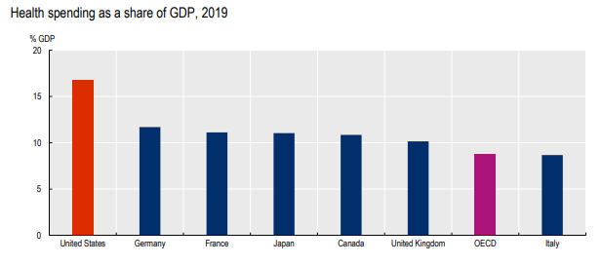
Health spending in the United States sits well above all other OECD countries Source: OECD Health Statistics 2021

Slide 6
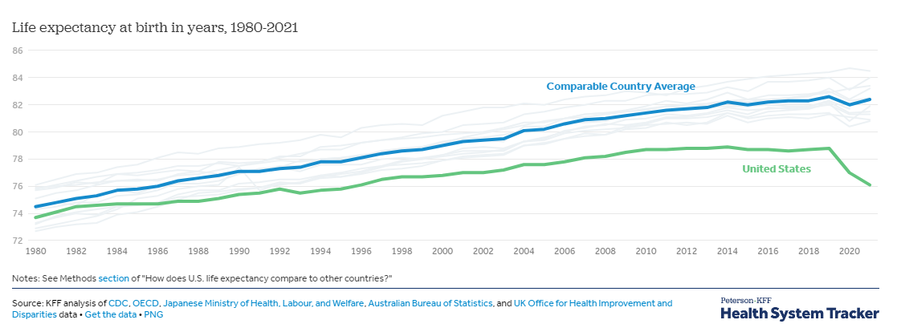
Trends in life expectancy 1980-2021 in the U.S. vs. comparable countries

Slide 7
Why haven’t we been able to pull the policy levers that can solve these problems?
The ways in which the groups of actors
conceptualize health and health care,
pursue their interests and perceived needs, and
interact accordingly
create impediments to a system that is rational, just, and efficient

Slide 8
Who stands in the way of an equitable, efficient, and effective health care system?
Physicians
Medical schools
Corporations
Hospitals/health systems
Dialysis, nursing homes, pharmacy chains
Manufacturers (medicines, machines, EMRs)
Insurers
Investors
Scientists
Government
Employers and employee groups
Patients, families, and many community organizations

Slide 9
Three phenomena shape the circumstances and experience of health care in contemporary society
The treatment of health care and health as commodities by actors within and without the system
The consciousness of actors–attitudes, values, perceived needs, expectations, interests, and capacities–which shape attitudes and behavior in relation to health care
The communication and relationships among these actors which reinforce existing arrangements

Slide 10
Health Systems and Medical Groups
“Sales”
Maximize market share of “covered lives”
Maximize reimbursement
Minimize risk (poor people with Medicaid or no
insurance)
Contract with healthy populations
Promote lucrative product lines and procedures
Seek 9-figure surpluses
Pay executives 7 to 8-figure salaries
(>30% financial performance-based bonuses)

Slide 11
Other Corporate Interests
Producers of Goods
Pharmaceuticals, Biologics
Machines, Devices, EMRs
Health Insurance Companies
Nursing Home, Dialysis and Pharmacy Chains
Single payer is an existential threat
Oppose expanding public coverage
Privatize lucrative parts of public programs
Maximize revenue through denials, copays, deductibles
Maintain revenue streams
Care without limits
Induce demand
Ads to consumers and providers
Maximize “price points”
Deter competition
Evergreening
Oppose price negotiation and importation
Induce sales by publicizing which hospitals have the latest gadgets
Oppose taxation
Prohibitive product pricing (EMR)
Investors
Maximize income from procedures Minimize services
Take quick profits

Slide 12
Clinicians and Specialty Societies
Economic interests
Block revisions in relative payment for procedures vs. cognitive services by dominating the RVU Update Committee (RUC)
Society guidelines do not threaten revenue flow
Minimize risk, optimize casemix & insurance type
“Run the till” as long as you can
Lub-dub

Slide 13
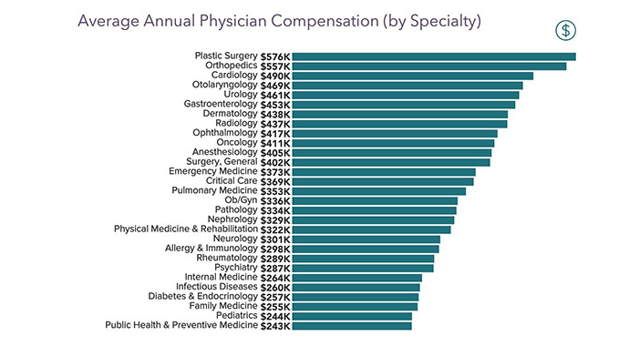
How much do doctors make by specialty? Source: Weatherby Healthcare

Slide 14
Clinicians and Specialty Societies
Economic interests
Attitudes, aptitudes, values
Successfully resist revisions in relative payment for procedural vs. cognitive services by dominating the RVU Update Committee (RUC)
Society guidelines do not threaten revenue flow
Minimize risk, optimize casemix & insurance type
“Run the till” as long as you can
Lub-dub
Not selected for comfort in providing “cognitive” services
Poor communication skills
Handle uncertainty poorly
Not well-trained to limit care
Avoid long-term relationships with patients
Prefer narrow tasks
Patients bear the consequences

Slide 15
The Medical Student
For “A Few Dollars More”?

Slide 16
Faber DA: JAMA Intern Med 2016;176:1561-3

Slide 17
“The good physician treats the disease; the great physician treats the patient with the disease.” ---William Osler

Slide 18
Can we change clinicians’ priorities and competencies?
Pay doctors for time, not piecework.
Specialty pay should differ only modestly to account for time in
training
Incentivize clinicians to seek psychotherapy to help them better relate to their patients’ needs and values
All physicians should have periodic training on
communication and negotiation with patients
ethics, morals, and social responsibilities
Mandate that proceduralists and administrators meet regularly to set targets to reduce use of low value care

Slide 19
Universities and medical schools: part of the problem Undergraduate medical education
Admission criteria emphasize grades and test scores,
not values and empathy
Admitted students,
69% biological & physical science majors, 4% humanities
Income : 13% in lowest 40%; 51% in top 20%; 28% in top 5%
13.4% Black or Hispanic (vs. 32% of U.S. population)
Curriculum is biologically reductionist; social sciences and humanities are an afterthought
White coat ceremonies as triumphalism
Negative socialization: loss of idealism as students advance
Students focus on specialty income from day one

Slide 20
Universities and medical schools: part of the problem Postgraduate medical education
Little modeling of cost constraint
Little exposure to humanities and social sciences
Little opportunity to address discomfort in
the clinician-patient relationship
Little emphasis on effective communication
Ambulatory experiences are generally awful
Little attention paid to effective communication

Slide 21
Universities and medical schools: part of the problem Academic practice
Academic practices often segregated by insurance type
Business plan is almost always to use clinical revenue to support other programs
Grow market share, avoid risk, “run the till”
The hidden curriculum: trainees learn lessons about (lack of) social responsibility by observing the behavior of faculty

Slide 22
Can we fix medical education?
Replace premedical science requirements with humanities, ethics, and social sciences (Lewis Thomas)
Select applicants who are altruistic, empathic, psychologically open, and have sound moral and ethical foundations
Members of underserved communities should nominate medical school matriculants
Ethics, morality, social responsibility, and communication skills should comprise up to half of the preclinical curriculum and be integrated into clinical training

Slide 23
Universities and medical schools: part of the problem Research in the medical school
Most research funding comes from Federal government and industry
Potential for patents and royalties and grant revenue affects hiring decisions
Social scientists and humanists disadvantaged, few are hired, limiting intellectual diversity
Promotion driven by funding, publication count; little attention to challenges of social and community- based research

Slide 24
Medical Research: Robert Merton’s Ethos of Science
Universalism: subject to verification; anyone can contribute
Communalism: findings of science are products of collaboration
and are assigned to the community; the ethos is incompatible
with technology defined as private property
Disinterestedness: objectivity about the outcome
Organized skepticism: suspension of judgment and detached
scrutiny of beliefs

Slide 25
Scientists
Basic researchers
Clinical researchers
Late translational/ policy researchers
Excited about discovery
Little education about social responsibilities of scientists
Since Bayh-Dole (1980), patents can be lucrative; for some they are “a consummation devoutly to be wished”
These priorities affect student attitudes towards what is important
When funded by industry, payments can be generous
However, priorities often are those of industry
Intellectual freedom may be quite limited
Most genuflect before the status quo in terms of health care organization
Few study substantial transformation; most focus on small changes and limited populations

Slide 26
NIH’s stated mission
“to seek fundamental knowledge about the nature and behavior of living systems and the application of that knowledge to enhance health, lengthen life, and reduce illness and disability” (emphasis added)
…Its programs are “designed to improve the health of the nation by conducting and supporting research…in the causes, diagnosis, prevention and cure of human diseases.”
They don’t treat all aspects of this mission equally

Slide 27
NIH and other scientific organizations/funders
Over-promise potential benefits of basic research
eradicate cancer and Alzheimer's disease
Pursuit of molecular explanations affects practice and public perceptions: disease is asocial
Advocate for a narrow vision of science
flavors of the decade: e.g., precision medicine
Often discount other kinds of research that may have larger impact on population health

Slide 28
Can medical science become more responsive to societal needs?
Training in social responsibility should be a substantial feature of scientific education.
Revenue from inventions funded by federal grants should accrue largely to government, not scientists, their institutions, or corporations
Research on bringing effective care to populations should be NIH’s highest priority. Revenue from inventions could support such research
Half of members of advisory councils of NIH institutes should be nominated by members of diverse communities

Slide 29
Government- not consistently part of the solution
Avoid policies that necessitate raising taxes
Susceptible to corporate and interest group pressures
Reluctant to limit care or offend constituencies
Ineffective regulation of FDA, Medicare fees, insurance products
Overpay for procedures compared to “cognitive” services
Policies promote specialization
Prefer “moonshots” (typically, asocial biological approaches) rather than societal programs that may do more good

Slide 30
General Population
Advocacy groups
Patients and their families
Often for Rx without limits
More care as a goal
Wanting their share of the goods
Unconstrained pursuit of autonomy
Unaware of impact of overuse on others or of experiences of the uninsured
Lack of communal perspective
Life dissatisfaction
Atomization/ isolation
Heart in a heartless world
Entitled attitude
Mistrust of medical authorities
Overestimate treatment benefits
Misled by scientists’ claims
Religious authorities
Reinforce use of futile care

Slide 31
Robert Bella et al.: Habits of the Heart
American individualism has become an autonomy dissociated from meaningful societal integration
“Many abandon any notion of finding meaning in relation to society as a whole…in the idea of the common good.”
Fractured imbalance between individualism and communitarianism

Slide 32
The Context: Societal Values and Consciousness
Acquisition/exploitation/inequity
Lack of communal concerns
Mistrust/atomization/lack of fulfillment
Greed is good/poverty is weakness
Decline of religion as a source of support
Failure of public discourse to address these issues
In health care, this manifests in both economic/political behavior of actors and their inner lives

Slide 33
Health Care as a Commodity
MANUFACTURERS
Increase demand
and prices
Do less
Charge more;
deny care
Do more; increase market share
INSURERS
HEALTH SYSTEMS
Sell expensive product lines; attract ”covered lives”
Do less
Avoid taxation;
minimize costs
GOVERNMENT
Do less
Pay less
PRACTICING MDs, SPECIALTY SERVICE PROVIDERS
Run the till; never say no
Do more
EMPLOYERS
Do more
Do what they can with available funding
SCIENTISTS, NIH
Develop treatments and patents
Do more
Get their share of care, live longer
Train more specialists; generate surplus
MED SCHOOLS & THEIR HOSPITALS
Do more
PUBLIC SECTOR SYSTEMS
PUBLIC, PATIENTS, EMPLOYEES, ADVOCACY GROUPS

Slide 34
When care is commodified
Disincentive to spend time relating to patients, getting to know them, caring for them
Incentive to do more procedures
Higher copays, costlier insurance, exacerbating disparities
Needless consumption of some resources, limiting others’ access to needed care
Few resources to address social determinants of disease and context in which patient experience disease and treatment
Diversion of resources from social services, education, infrastructure

Slide 35
Ethicist and economist perspectives on health care in a commodified marketplace
Edmund Pellegrino:
Putting clinicians at financial risk can lead to loss of professionalism
Market relationships end with sales: grave consequences in medicine
Only government will place public good above private interests
Kenneth Arrow:
Health care can’t be a perfectly-functioning market due to uncertainty about quality of products patients purchase; injury to some caused by unconstrained markets may not be offset by benefit to others
Pellegrino and Daniel Callahan:
Commodified health care is inherently unjust
The market-based US health care system is perhaps the least efficient, while producing poorer outcomes

Slide 36
Health care and consciousness
Clinicians:
Prefer concrete/short-
term acts
Avoid difficult
conversations
Poor communication skills
Little ability to empathize
Clinical corporations:
Little interest in societal
obligations or
community needs
Scientists:
Little interest in
societal problems
Passion for
discovery
No focus on social
responsibilities
The public:
Entitled
Isolated/lonely
Stressed, unfulfilled,
seek a heart in a
heartless world
Mistrust providers
Confused/
misinformed
Medical schools:
Generative of specialists
Emphasize grades and test
scores, not capacity
to care
Curriculum is biologically
reductionist
Politicians:
Magic bullets
Dramatic effects
Don’t offend
powerful
constituencies

Slide 37
Commodified discourse
Doctors sell procedures to patients
Provider systems advertise miracles
Professional societies guard their interests
Medical educators promulgate values of the status quo
Scientists and the NIH make extravagant promises
Corporate “speech” induces demand and blocks progress
Politicians prioritize “moonshots”
Media sensationalize reports of scientific advances
and rarely report on systemic problems in care
Health policy researchers rarely threaten the status quo
Any public intellectuals trying to balance the discourse are drowned out

Slide 38
Habermas’s theory of communicative action
Progress depends on common understanding and nature of interaction across:
Those who control capital and produce commodities
Policymakers
Individuals/groups seeking interpersonal influence
Values and beliefs of members of society
In general, capitalists communicate effectively with policymakers, but other elements are shut out
In health care, the power rests with capital, abetted by government and professional organizations
Absent common understanding, adversarial situations (malpractice suits, insurance denials, collection agencies), misdirected priorities (in research, clinical programs, and medical education), and poor communication in clinical encounters all ensue

Slide 39
Perspectives on why change is so difficult
Georg Lukacs: Consider the consciousness of actors
Karl Korsch: Transformation at philosophical and political
levels simultaneously
Antonio Gramsci: Values of dominant class drown out others
Herbert Marcuse: Societies provide just enough to render
people incapable of action
Jurgen Habermas: Problematic communication impedes
solutions of common interest
In health care, there are so many material goods at stake and
nonmaterial factors that mesh with current arrangements,
that all groups of actors are more inclined to “bear those ills
we have than fly to others that we know not of.”

Slide 40
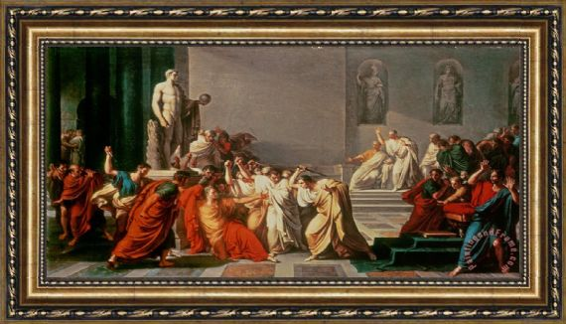
Vincenzo Camuccini: The Death of Julius Caesar (1806)

Slide 41
Barriers to Fixing American Health Care
HEALTH CARE AS A COMMODITY
PROBLEMATIC COMMUNICATION IN HEALTH CARE
HEALTH CARE AND CONSCIOUSNESS
Academic organizations that pursue “covered lives”
Insurers minimizing risk
Corporations inducing demand for products
Media distortion of implications of policy options
Wanting more care, longer life
Biological reductionism in medical education
Atomization, loneliness, and dissatisfaction with life
Clinicians running the till
Patient autonomy unbalanced by societal interests
Government reluctant to raise taxes to support reforms
Students more interested in doing well than doing good
Sensationalized reporting on scientific “breakthroughs”
Distrust of medical authorities
Discourse ignoring ethos of science
Employers minimizing their costs
Discourse ignoring disparities
Clinicians not trained to limit care
Docs who prefer procedures to relationships
”Non-profit” health systems that maximize surplus
Trainees choosing high-paying specialties
Corporate “speech” that blocks reform
Health system executives with 7-figure bonuses
Pharma financing FDA drug approval process
Negative socialization of students
Discourse misinforming patients about costs, effectiveness
Generative educators training too many specialists
Patients wanting their share of the goods
Educators using specialty trainees to increase revenue
Ethos of acquisition
Scientists who seek financial rewards of discovery
Government and scientists promising ”moonshots” and cures
Lack of a communal ethic
Scientists care about discovery, not the common good
Investors seeking fast profits

Slide 42
Changing policy will not be enough
Combination therapy is going to be needed!
Otherwise, innovations like the Affordable Care Act, although representing real progress, really are like treating a lymphoma or HIV with one drug:
make a difference for some,
but will be undone by the underlying malady

Slide 43
Can we achieve justice and equity in just one sector of society?
Actors in health care won’t embrace a non-commodified health sector when the rest of society is moving in a very different direction
But we need to think boldly and broadly about what it will take to achieve justice for all in health care and society
We must act both in our professional capacities and as citizens to promote these changes. “Silence is assent”

Slide 44
More needed changes: government and financing
Provide the same insurance coverage to everyone (single payer); separate is never equal
New treatments should be approved only after careful assessment of marginal benefit and cost to society
The National Academy of Medicine should convene a panel to propose revised budget priorities for NIH that gives far more emphasis to population health
If fees-for-service can’t be eliminated, radically revise the Medicare fee schedule

Slide 45
More needed changes: communication
Limit health system advertising to promotion of public health
Stop overselling of implications of biomedical science
Stop selling patients procedures they don’t need
Provide greater transparency about all medical prices, including about what the doctor earns by performing
a procedure

Slide 46
More needed changes: patients and the public
Provide the social services and financial and psychological resources needed to address problems best dealt with in those ways
Educate patients and the public about
the common good
fair distribution of limited medical resources
the limits of what medicine can accomplish
Train clinicians who can relate to diverse communities
Incorporate communities into all levels of decision making in research, education and clinical care

Slide 47
What will it take to change the trajectory of US health care and achieve justice for all?
Change in consciousness of all groups who see it as
a bundle of goods, rather than a societal resource
Transform discourse about health care and
relationships within it
Pursue a consensus that we are all in the same boat
Don’t give up with each failed effort at reform
“It is not your duty to finish the work, but neither
are you at liberty to neglect it.”—Rabbi Tarfon

Slide 48
Barriers to Fixing American Health Care
HEALTH CARE AS A COMMODITY
COLONIZED COMMUNICATION IN HEALTH CARE
HEALTH CARE AND CONSCIOUSNESS
Academic organizations that pursue “covered lives”
Insurers minimizing risk
Corporations inducing demand for products
Media distortion of implications of policy options
Wanting more care, longer life
Biological reductionism in medical education
Atomization, loneliness, and dissatisfaction with life
Clinicians running the till
Patient autonomy unbalanced by societal interests
Government reluctant to raise taxes to support reforms
Students more interested in doing well than doing good
Sensationalized reporting on scientific “breakthroughs”
Distrust of medical authorities
Discourse ignoring ethos of science
Employers minimizing their costs
Discourse ignoring disparities
Clinicians not trained to limit care
Docs who prefer procedures to relationships
”Non-profit” health systems that maximize surplus
Trainees choosing high-paying specialties
Corporate “speech” that blocks reform
Health system executives with 7- figure bonuses
Pharma financing FDA drug approval process
Negative socialization of students
Discourse with patients misinforming about costs, effectiveness
Generative educators training too many specialists
Patients wanting their share of the goods
Educators using specialty trainees to increase revenue
Ethos of acquisition
Scientists who seek financial rewards of discovery
Government and scientists promising ”moonshots” and cures
Lack of a communal ethic
Scientists care about discovery, not the common good
Investors seeking fast profits

Slide 49
Martin F. Shapiro, MD, Ph.D. MPH
mfs2004@med.cornell.edu
The Present Illness: American Health Care and Its Afflictions
Baltimore, Johns Hopkins University Press, 2023

