Slide 1
confronting racism denial
naming racism and moving to action
Camara Phyllis Jones, MD, MPH, PhD
Keynote Address
PNHP Annual Meeting 2023
Reclaiming Medicine: Pushing Out the Profiteers
Physicians for a National Health Program
Atlanta, Georgia
November 11, 2023

Slide 2
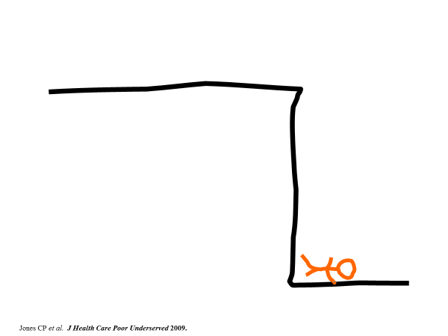
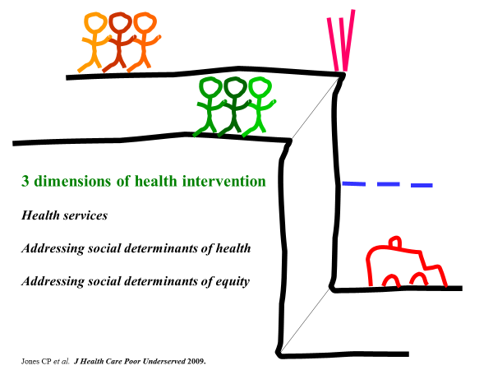
Levels of Health Intervention: A cliff analogy
Fallen
Health services
Addressing social
determinants of health
Addressing social
determinants of equity
Jones CP et al. Addressing the Social Determinants of Children’s Health: A Cliff Analogy. J Health Care Poor Underserved 2009;20(4 Suppl):1-12.

Slide 3
National Campaign Against Racism
Name racism
Jones CP. Toward the Science and Practice of Anti-Racism: Launching a National Campaign Against Racism. Ethnicity and Disease 2018;28(Suppl 1):231-234.

Slide 4
National Campaign Against Racism
Name racism
Ask “How is racism operating here?”
Jones CP. Toward the Science and Practice of Anti-Racism: Launching a National Campaign Against Racism. Ethnicity and Disease 2018;28(Suppl 1):231-234.

Slide 5
National Campaign Against Racism
Name racism
Ask “How is racism operating here?”
Organize and strategize to act
Jones CP. Toward the Science and Practice of Anti-Racism: Launching a National Campaign Against Racism. Ethnicity and Disease 2018;28(Suppl 1):231-234.

Slide 6
Racism exists
Racism is a system
Racism saps the strength of the whole society
We can act to dismantle racism
Four key messages
when naming racism

Slide 7
Dual Reality: A restaurant saga
Jones CP. The Nation’s Health, February 2016.
Notes:
My second story, “Dual Reality: A restaurant saga,” was inspired by an experience I had as a medical student.
Several friends and I had spent a long day studying.
It was now evening and we were now hungry, so we went into town to find a place to eat.

Slide 8
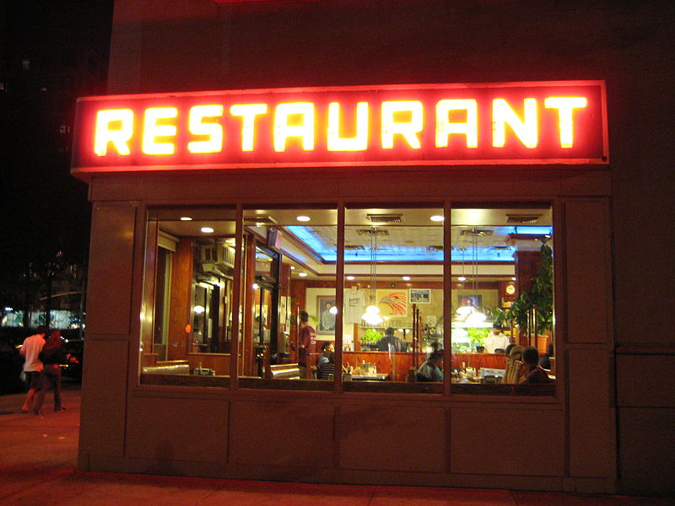
Jones CP. The Nation’s Health, February 2016.
Notes:
My second story, “Dual Reality: A restaurant saga,” was inspired by an experience I had as a medical student.
Several friends and I had spent a long day studying.
It was now evening and we were now hungry, so we went into town to find a place to eat.

Slide 9
DOOR
Jones CP. The Nation’s Health, February 2016.
I looked up and noticed a sign . . .
Notes:
We walked into a restaurant, sat down, ordered our food, the food was served, and we were eating.
Nothing remarkable so far. You have all probably had that experience!
But as I was eating, I looked up and noticed a sign, and seeing that sign was a revelation to me about racism.

Slide 10
OPEN
Jones CP. The Nation’s Health, February 2016.
Notes:
The sign said “Open”.
I could have thought no more about it. After all, I was sitting at the table of opportunity and eating with a sign proclaiming “Open” to me.
But I knew something about the two-sided nature of those signs. I realized that actually, the restaurant was now . . .

Slide 11
CLOSED
Jones CP. The Nation’s Health, February 2016.
Racism structures “Open/Closed” signs in our society.
Notes:
. . . “Closed”, and that hungry people just a few feet away from me, but on the other side of the sign, would not be able to come in and eat.
It is important to know about the two-sided nature of these signs.
Racism structures “Open/Closed” signs in our society.

Slide 12
DOOR
It is difficult
to recognize
a system of inequity
that privileges us.
Those on the outside are very aware of the two-sided nature
of the sign.
Jones CP. The Nation’s Health, February 2016.
Notes:
Two-sided signs create a dual reality, experienced differently depending on where you stand.
Those on the inside may not even be aware that there IS a sign.
It is difficult to recognize a system of inequity that privileges us.
However, those on the outside are very aware of the two-sided nature of the sign.

Slide 13
DOOR
“Is there really a two-sided sign?”
Hard to know, when only see “Open”.
A privilege not to HAVE to know.
Once DO know, can choose to act.
Jones CP. The Nation’s Health, February 2016.
Notes:
Back inside the restaurant, we realize:
It is hard to know there is a two-sided sign when you only see “Open”.
Indeed, it is a privilege for those inside, not to have to know.
But once they do know, those inside can choose to act.
Knowledge about the existence of two-sided signs is not scary. It is empowering.

Slide 14
What is racism?
A system
Jones CP. Confronting Institutionalized Racism. Phylon 2003;50(1-2):7-22.
Jones CP, Truman BI, Elam-Evans LD, Jones CA, Jones CY, Jiles R, Rumisha SF, Perry GS. Using “socially assigned race” to probe White advantages in health status.
Ethn Dis 2008;18(4):496-504.

Slide 15
What is racism?
A system of structuring opportunity and assigning value
Jones CP. Confronting Institutionalized Racism. Phylon 2003;50(1-2):7-22.
Jones CP, Truman BI, Elam-Evans LD, Jones CA, Jones CY, Jiles R, Rumisha SF, Perry GS. Using “socially assigned race” to probe White advantages in health status.
Ethn Dis 2008;18(4):496-504.

Slide 16
What is racism?
A system of structuring opportunity and assigning value based on the social interpretation of how one looks (which is what we call “race”)
Jones CP. Confronting Institutionalized Racism. Phylon 2003;50(1-2):7-22.
Jones CP, Truman BI, Elam-Evans LD, Jones CA, Jones CY, Jiles R, Rumisha SF, Perry GS. Using “socially assigned race” to probe White advantages in health status.
Ethn Dis 2008;18(4):496-504.

Slide 17
What is racism?
A system of structuring opportunity and assigning value based on the social interpretation of how one looks (which is what we call “race”), that
Unfairly disadvantages some individuals and communities
Jones CP. Confronting Institutionalized Racism. Phylon 2003;50(1-2):7-22.
Jones CP, Truman BI, Elam-Evans LD, Jones CA, Jones CY, Jiles R, Rumisha SF, Perry GS. Using “socially assigned race” to probe White advantages in health status.
Ethn Dis 2008;18(4):496-504.

Slide 18
What is racism?
A system of structuring opportunity and assigning value based on the social interpretation of how one looks (which is what we call “race”), that
Unfairly disadvantages some individuals and communities
Unfairly advantages other individuals and communities
Jones CP. Confronting Institutionalized Racism. Phylon 2003;50(1-2):7-22.
Jones CP, Truman BI, Elam-Evans LD, Jones CA, Jones CY, Jiles R, Rumisha SF, Perry GS. Using “socially assigned race” to probe White advantages in health status.
Ethn Dis 2008;18(4):496-504.

Slide 19
What is racism?
A system of structuring opportunity and assigning value based on the social interpretation of how one looks (which is what we call “race”), that
Unfairly disadvantages some individuals and communities
Unfairly advantages other individuals and communities
Saps the strength of the whole society through the waste of human resources
Jones CP. Confronting Institutionalized Racism. Phylon 2003;50(1-2):7-22.
Jones CP, Truman BI, Elam-Evans LD, Jones CA, Jones CY, Jiles R, Rumisha SF, Perry GS. Using “socially assigned race” to probe White advantages in health status.
Ethn Dis 2008;18(4):496-504.

Slide 20
What is [any system of structured inequity]?
A system of structuring opportunity and assigning value based on [fill in the blank]
Jones CP. Systems of Power, Axes of Inequity: Parallels, Intersections, Braiding the Strands. Medical Care 2014;52(10 Suppl 3):S71-S75.

Slide 21
What is [any system of structured inequity]?
A system of structuring opportunity and assigning value based on [fill in the blank], that
Unfairly disadvantages some individuals and communities
Unfairly advantages other individuals and communities
Saps the strength of the whole society through the waste of human resources
Jones CP. Systems of Power, Axes of Inequity: Parallels, Intersections, Braiding the Strands. Medical Care 2014;52(10 Suppl 3):S71-S75.

Slide 22
Many axes of inequity
“Race”
Gender
Ethnicity | indigenous status | history of colonization
Jones CP. Systems of Power, Axes of Inequity: Parallels, Intersections, Braiding the Strands. Medical Care 2014;52(10 Suppl 3):S71-S75.

Slide 23
Many axes of inequity
“Race”
Gender
Ethnicity | indigenous status | history of colonization
Relation to means of production | social class markers
Nationality | language | immigration status
Sexual orientation | gender identity | gender expression
Jones CP. Systems of Power, Axes of Inequity: Parallels, Intersections, Braiding the Strands. Medical Care 2014;52(10 Suppl 3):S71-S75.

Slide 24
Many axes of inequity
“Race”
Gender
Ethnicity | indigenous status | history of colonization
Relation to means of production | social class markers
Nationality | language | immigration status
Sexual orientation | gender identity | gender expression
Geography | age | religion | caste
Disability status | weight status
Incarceration history | substance use history | mental health history
Jones CP. Systems of Power, Axes of Inequity: Parallels, Intersections, Braiding the Strands. Medical Care 2014;52(10 Suppl 3):S71-S75.

Slide 25
value
Comfort
Notes:
Two-sided signs create a dual reality, experienced differently depending on where you stand.
Those on the inside may not even be aware that there IS a sign.
It is difficult to recognize a system of inequity that privileges us.
However, those on the outside are very aware of the two-sided nature of the sign.

Slide 26
value
Social Justice
Notes:
Two-sided signs create a dual reality, experienced differently depending on where you stand.
Those on the inside may not even be aware that there IS a sign.
It is difficult to recognize a system of inequity that privileges us.
However, those on the outside are very aware of the two-sided nature of the sign.

Slide 27
value
Comfort
value
Social Justice
Notes:
Two-sided signs create a dual reality, experienced differently depending on where you stand.
Those on the inside may not even be aware that there IS a sign.
It is difficult to recognize a system of inequity that privileges us.
However, those on the outside are very aware of the two-sided nature of the sign.

Slide 28
Benefitted by the status quo
They do NOT:
Wonder why no one else is entering
Want to examine the sign
Care to know what the “outsiders” are saying
Believe an “outsider” could add to their conversation
Wonder how the food they are eating gets there
Want to budge from their seats at the table
value
Comfort
Notes:
Two-sided signs create a dual reality, experienced differently depending on where you stand.
Those on the inside may not even be aware that there IS a sign.
It is difficult to recognize a system of inequity that privileges us.
However, those on the outside are very aware of the two-sided nature of the sign.

Slide 29
Know two things
They KNOW that:
There is a two-sided sign going on
The operation of that two-sided sign saps the strength of the whole society
Circumstances of birth do not completely determine values
value
Social Justice
Notes:
Two-sided signs create a dual reality, experienced differently depending on where you stand.
Those on the inside may not even be aware that there IS a sign.
It is difficult to recognize a system of inequity that privileges us.
However, those on the outside are very aware of the two-sided nature of the sign.
Circumstances of birth do not completely determine values:
Some born inside can wonder who others not entering; be curious about what the “outsiders” are saying; venture outside to see the “Closed” side of the sign and experience the different reality
Some born outside can find a way inside but then be seduced by the comfort and let the door lock behind them

Slide 30
value
Comfort
value
Social Justice
Notes:
Two-sided signs create a dual reality, experienced differently depending on where you stand.
Those on the inside may not even be aware that there IS a sign.
It is difficult to recognize a system of inequity that privileges us.
However, those on the outside are very aware of the two-sided nature of the sign.

Slide 31
value
Comfort
value
Social Justice
Notes:
Two-sided signs create a dual reality, experienced differently depending on where you stand.
Those on the inside may not even be aware that there IS a sign.
It is difficult to recognize a system of inequity that privileges us.
However, those on the outside are very aware of the two-sided nature of the sign.

Slide 32
value
Comfort
value
Social Justice
Notes:
Two-sided signs create a dual reality, experienced differently depending on where you stand.
Those on the inside may not even be aware that there IS a sign.
It is difficult to recognize a system of inequity that privileges us.
However, those on the outside are very aware of the two-sided nature of the sign.

Slide 33
value
Comfort
value
Social Justice
Notes:
Two-sided signs create a dual reality, experienced differently depending on where you stand.
Those on the inside may not even be aware that there IS a sign.
It is difficult to recognize a system of inequity that privileges us.
However, those on the outside are very aware of the two-sided nature of the sign.

Slide 34
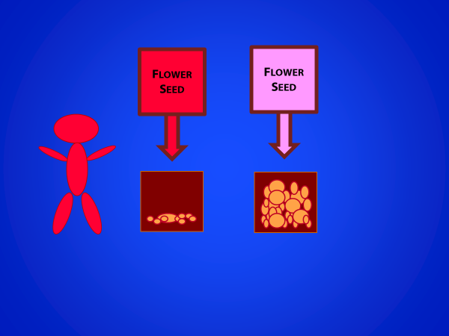
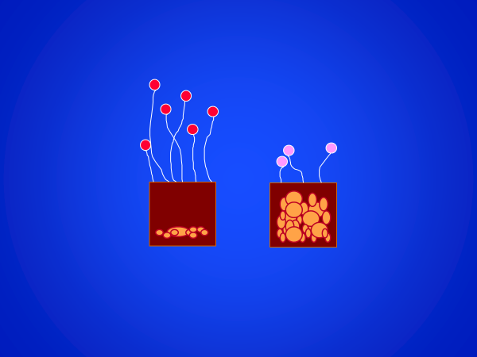
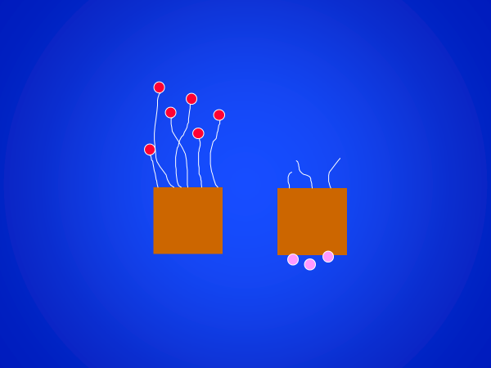
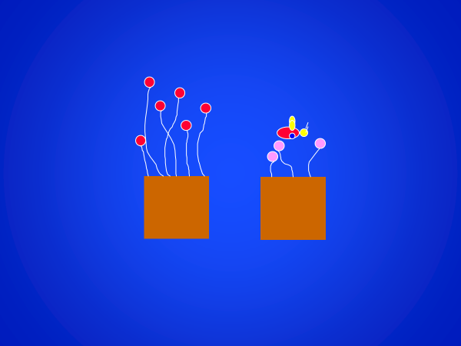
Levels of Racism: A Gardener’s Tale
Initial historical injustices
Structural racism
Personally-mediated racism
Internalized racism
Centers for Disease Control and Prevention. A discussion with Camara P. Jones, MD, MPH, PhD. See https://www.youtube.com/watch?v=1QFCcChCSMU.
Jones CP. Levels of Racism: A Theoretic Framework and a Gardener’s Tale. Am J Public Health 2000;90(8):1212-1215.

Slide 35
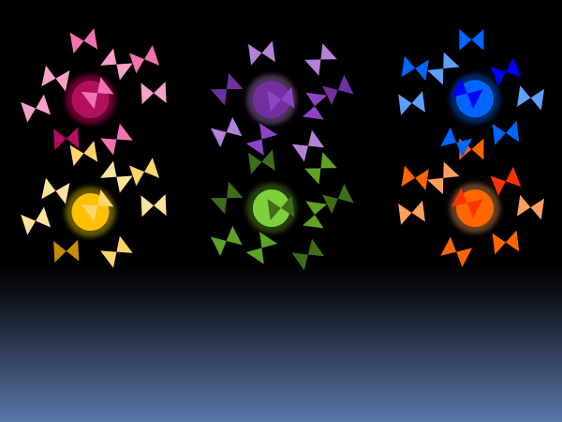
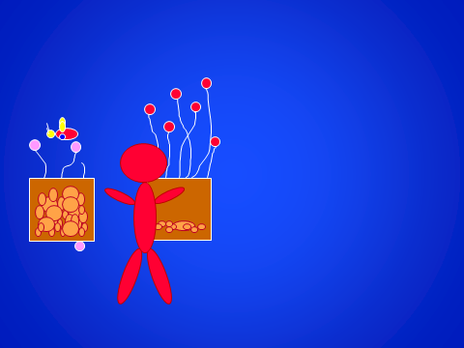
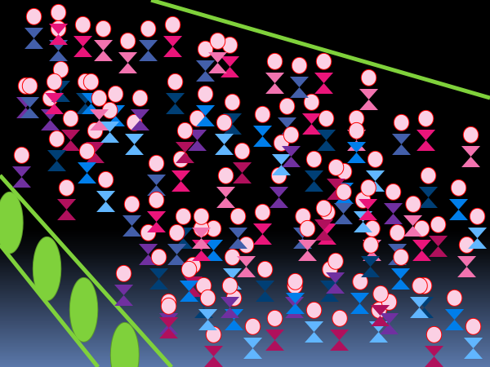
Telling Stories
Japanese Lanterns:
Colored Perceptions
Dual Reality:
A Restaurant Saga
Levels of Racism:
A Gardener’s Tale
Life on a Conveyor Belt:
Moving to Action
Jones CP. Telling Stories: Allegories on “Race” and Racism. TEDx Emory, April 12, 2014. See https://www.youtube.com/watch?v=GNhcY6fTyBM.

Slide 36
Telling Stories
Japanese Lanterns:
Colored Perceptions
Dual Reality:
A Restaurant Saga
Levels of Racism:
A Gardener’s Tale
Life on a Conveyor Belt:
Moving to Action
Jones CP. Telling Stories: Allegories on “Race” and Racism. TEDx Emory, April 12, 2014. See https://www.youtube.com/watch?v=GNhcY6fTyBM.

Slide 37
Telling Stories
Japanese Lanterns:
Colored Perceptions
Dual Reality:
A Restaurant Saga
Levels of Racism:
A Gardener’s Tale
Life on a Conveyor Belt:
Moving to Action
Jones CP. Telling Stories: Allegories on “Race” and Racism. TEDx Emory, April 12, 2014. See https://www.youtube.com/watch?v=GNhcY6fTyBM.

Slide 38
Telling Stories
Japanese Lanterns:
Colored Perceptions
Dual Reality:
A Restaurant Saga
Levels of Racism:
A Gardener’s Tale
Life on a Conveyor Belt:
Moving to Action
Jones CP. Telling Stories: Allegories on “Race” and Racism. TEDx Emory, April 12, 2014. See https://www.youtube.com/watch?v=GNhcY6fTyBM.

Slide 39
Telling Stories
Japanese Lanterns:
Colored Perceptions
Dual Reality:
A Restaurant Saga
Levels of Racism:
A Gardener’s Tale
Life on a Conveyor Belt:
Moving to Action
Jones CP. Telling Stories: Allegories on “Race” and Racism. TEDx Emory, April 12, 2014. See https://www.youtube.com/watch?v=GNhcY6fTyBM.

Slide 40
Cement Dust in Our Lungs
Jones CP. Cement Dust in Our Lungs. Acceptance speech, American Public Health Association Executive Director Citation Award.
See https://www.youtube.com/watch?v=BGmIXV859YQ&t=26s, October 27, 2020.

Slide 41
Cement Factory
Jones CP. Cement Dust in Our Lungs. Acceptance speech, American Public Health Association Executive Director Citation Award.
See https://www.youtube.com/watch?v=BGmIXV859YQ&t=26s, October 27, 2020.

Slide 42
Cement Factory
Jones CP. Cement Dust in Our Lungs. Acceptance speech, American Public Health Association Executive Director Citation Award.
See https://www.youtube.com/watch?v=BGmIXV859YQ&t=26s, October 27, 2020.

Slide 43
Cement Factory
Jones CP. Cement Dust in Our Lungs. Acceptance speech, American Public Health Association Executive Director Citation Award.
See https://www.youtube.com/watch?v=BGmIXV859YQ&t=26s, October 27, 2020.

Slide 44
Cement Factory
Jones CP. Cement Dust in Our Lungs. Acceptance speech, American Public Health Association Executive Director Citation Award.
See https://www.youtube.com/watch?v=BGmIXV859YQ&t=26s, October 27, 2020.

Slide 45
Cement Factory
Jones CP. Cement Dust in Our Lungs. Acceptance speech, American Public Health Association Executive Director Citation Award.
See https://www.youtube.com/watch?v=BGmIXV859YQ&t=26s, October 27, 2020.

Slide 46
Cement Factory
Jones CP. Cement Dust in Our Lungs. Acceptance speech, American Public Health Association Executive Director Citation Award.
See https://www.youtube.com/watch?v=BGmIXV859YQ&t=26s, October 27, 2020.

Slide 47
Cement Factory
Jones CP. Cement Dust in Our Lungs. Acceptance speech, American Public Health Association Executive Director Citation Award.
See https://www.youtube.com/watch?v=BGmIXV859YQ&t=26s, October 27, 2020.

Slide 48
Cement Factory
Jones CP. Cement Dust in Our Lungs. Acceptance speech, American Public Health Association Executive Director Citation Award.
See https://www.youtube.com/watch?v=BGmIXV859YQ&t=26s, October 27, 2020.

Slide 49
FOCUS
on the individual?
Jones CP. Cement Dust in Our Lungs. Acceptance speech, American Public Health Association Executive Director Citation Award.
See https://www.youtube.com/watch?v=BGmIXV859YQ&t=26s, October 27, 2020.

Slide 50
Cement Factory
Jones CP. Cement Dust in Our Lungs. Acceptance speech, American Public Health Association Executive Director Citation Award.
See https://www.youtube.com/watch?v=BGmIXV859YQ&t=26s, October 27, 2020.

Slide 51
Cement Factory
Jones CP. Cement Dust in Our Lungs. Acceptance speech, American Public Health Association Executive Director Citation Award.
See https://www.youtube.com/watch?v=BGmIXV859YQ&t=26s, October 27, 2020.

Slide 52
Cement Factory
Jones CP. Cement Dust in Our Lungs. Acceptance speech, American Public Health Association Executive Director Citation Award.
See https://www.youtube.com/watch?v=BGmIXV859YQ&t=26s, October 27, 2020.

Slide 53
Cement Factory
Jones CP. Cement Dust in Our Lungs. Acceptance speech, American Public Health Association Executive Director Citation Award.
See https://www.youtube.com/watch?v=BGmIXV859YQ&t=26s, October 27, 2020.

Slide 54
*
Cement Factory
Jones CP. Cement Dust in Our Lungs. Acceptance speech, American Public Health Association Executive Director Citation Award.
See https://www.youtube.com/watch?v=BGmIXV859YQ&t=26s, October 27, 2020.

Slide 55
Cleansing Spa
Cement Factory
Jones CP. Cement Dust in Our Lungs. Acceptance speech, American Public Health Association Executive Director Citation Award.
See https://www.youtube.com/watch?v=BGmIXV859YQ&t=26s, October 27, 2020.

Slide 56
Cleansing Spa
Cement Factory
Jones CP. Cement Dust in Our Lungs. Acceptance speech, American Public Health Association Executive Director Citation Award.
See https://www.youtube.com/watch?v=BGmIXV859YQ&t=26s, October 27, 2020.

Slide 57
Cleansing Spa
Cement Factory
Jones CP. Cement Dust in Our Lungs. Acceptance speech, American Public Health Association Executive Director Citation Award.
See https://www.youtube.com/watch?v=BGmIXV859YQ&t=26s, October 27, 2020.

Slide 58
Cleansing Spa
Cement Factory
Jones CP. Cement Dust in Our Lungs. Acceptance speech, American Public Health Association Executive Director Citation Award.
See https://www.youtube.com/watch?v=BGmIXV859YQ&t=26s, October 27, 2020.

Slide 59
Cleansing Spa
Cement Factory
Jones CP. Cement Dust in Our Lungs. Acceptance speech, American Public Health Association Executive Director Citation Award.
See https://www.youtube.com/watch?v=BGmIXV859YQ&t=26s, October 27, 2020.

Slide 60
Cleansing Spa
Cement Factory
Jones CP. Cement Dust in Our Lungs. Acceptance speech, American Public Health Association Executive Director Citation Award.
See https://www.youtube.com/watch?v=BGmIXV859YQ&t=26s, October 27, 2020.

Slide 61
ACKNOWLEDGE
the cloud?
Jones CP. Cement Dust in Our Lungs. Acceptance speech, American Public Health Association Executive Director Citation Award.
See https://www.youtube.com/watch?v=BGmIXV859YQ&t=26s, October 27, 2020.

Slide 62
Jones CP. Cement Dust in Our Lungs. Acceptance speech, American Public Health Association Executive Director Citation Award.
See https://www.youtube.com/watch?v=BGmIXV859YQ&t=26s, October 27, 2020.
Notes:
Start individual anti-racism journeys

Slide 63
Jones CP. Cement Dust in Our Lungs. Acceptance speech, American Public Health Association Executive Director Citation Award.
See https://www.youtube.com/watch?v=BGmIXV859YQ&t=26s, October 27, 2020.
Notes:
Make lots of masks? Baby sized masks? Old people masks?
Not yet fully developed ideas: Fan to blow the cloud? Vacuum to suck up the cloud? Very resistant—never clears!

Slide 64
DISMANTLE
the factory!
Jones CP. Cement Dust in Our Lungs. Acceptance speech, American Public Health Association Executive Director Citation Award.
See https://www.youtube.com/watch?v=BGmIXV859YQ&t=26s, October 27, 2020.
Notes:
The system creating and perpetuating the cloud of dust.

Slide 65
Jones CP. Cement Dust in Our Lungs. Acceptance speech, American Public Health Association Executive Director Citation Award.
See https://www.youtube.com/watch?v=BGmIXV859YQ&t=26s, October 27, 2020.
Notes:
Those who recognize the dust in our lungs and the cloud of dust in the air recognize that there is a system spewing cement dust. Those of us who have started on our individual anti-racism journeys by donning gas masks need to now move to action.
We need to name the dust as a common problem, not just dust in our individual lungs.
We need to ask, “How is this dust being spewed?”—”How is racism operating here?”
And then we need to organize and strategize to act

Slide 66
Jones CP. Cement Dust in Our Lungs. Acceptance speech, American Public Health Association Executive Director Citation Award.
See https://www.youtube.com/watch?v=BGmIXV859YQ&t=26s, October 27, 2020.

Slide 67
Jones CP. Cement Dust in Our Lungs. Acceptance speech, American Public Health Association Executive Director Citation Award.
See https://www.youtube.com/watch?v=BGmIXV859YQ&t=26s, October 27, 2020.

Slide 68
Jones CP. Cement Dust in Our Lungs. Acceptance speech, American Public Health Association Executive Director Citation Award.
See https://www.youtube.com/watch?v=BGmIXV859YQ&t=26s, October 27, 2020.

Slide 69
Cement Factory
Jones CP. Cement Dust in Our Lungs. Acceptance speech, American Public Health Association Executive Director Citation Award.
See https://www.youtube.com/watch?v=BGmIXV859YQ&t=26s, October 27, 2020.

Slide 70
Jones CP. Cement Dust in Our Lungs. Acceptance speech, American Public Health Association Executive Director Citation Award.
See https://www.youtube.com/watch?v=BGmIXV859YQ&t=26s, October 27, 2020.

Slide 71
Cement Factory
Jones CP. Cement Dust in Our Lungs. Acceptance speech, American Public Health Association Executive Director Citation Award.
See https://www.youtube.com/watch?v=BGmIXV859YQ&t=26s, October 27, 2020.

Slide 72
Cement Factory
Jones CP. Cement Dust in Our Lungs. Acceptance speech, American Public Health Association Executive Director Citation Award.
See https://www.youtube.com/watch?v=BGmIXV859YQ&t=26s, October 27, 2020.

Slide 73
Jones CP. Cement Dust in Our Lungs. Acceptance speech, American Public Health Association Executive Director Citation Award.
See https://www.youtube.com/watch?v=BGmIXV859YQ&t=26s, October 27, 2020.

Slide 74
How is racism operating here?
Structures
Policies
Practices
Norms
Values
These are the
elements of decision-making!
Jones CP. Confronting Institutionalized Racism. Phylon 2003;50(1-2):7-22.
Jones CP. Toward the Science and Practice of Anti-Racism: Launching a National Campaign Against Racism. Ethnicity and Disease 2018;28(Suppl 1):231-234.

Slide 75
How is racism operating here?
Structures: the who?, what?, when?, and where?
of decision-making
Jones CP. Confronting Institutionalized Racism. Phylon 2003;50(1-2):7-22.
Jones CP. Toward the Science and Practice of Anti-Racism: Launching a National Campaign Against Racism. Ethnicity and Disease 2018;28(Suppl 1):231-234.

Slide 76
How is racism operating here?
Structures: the who?, what?, when?, and where?
of decision-making
Policies: the written how?
Jones CP. Confronting Institutionalized Racism. Phylon 2003;50(1-2):7-22.
Jones CP. Toward the Science and Practice of Anti-Racism: Launching a National Campaign Against Racism. Ethnicity and Disease 2018;28(Suppl 1):231-234.

Slide 77
How is racism operating here?
Structures: the who?, what?, when?, and where?
of decision-making
Policies: the written how?
Practices: the unwritten how?
Norms: the unwritten how?
Jones CP. Confronting Institutionalized Racism. Phylon 2003;50(1-2):7-22.
Jones CP. Toward the Science and Practice of Anti-Racism: Launching a National Campaign Against Racism. Ethnicity and Disease 2018;28(Suppl 1):231-234.

Slide 78
How is racism operating here?
Structures: the who?, what?, when?, and where?
of decision-making
Policies: the written how?
Practices: the unwritten how? here and now
Norms: the unwritten how?
Jones CP. Confronting Institutionalized Racism. Phylon 2003;50(1-2):7-22.
Jones CP. Toward the Science and Practice of Anti-Racism: Launching a National Campaign Against Racism. Ethnicity and Disease 2018;28(Suppl 1):231-234.

Slide 79
How is racism operating here?
Structures: the who?, what?, when?, and where?
of decision-making
Policies: the written how?
Practices: the unwritten how? here and now
Norms: the unwritten how? embedded and expected
Jones CP. Confronting Institutionalized Racism. Phylon 2003;50(1-2):7-22.
Jones CP. Toward the Science and Practice of Anti-Racism: Launching a National Campaign Against Racism. Ethnicity and Disease 2018;28(Suppl 1):231-234.

Slide 80
How is racism operating here?
Structures: the who?, what?, when?, and where?
of decision-making
Policies: the written how?
Practices: the unwritten how? here and now
Norms: the unwritten how? embedded and expected
Values: the why?
Jones CP. Confronting Institutionalized Racism. Phylon 2003;50(1-2):7-22.
Jones CP. Toward the Science and Practice of Anti-Racism: Launching a National Campaign Against Racism. Ethnicity and Disease 2018;28(Suppl 1):231-234.

Slide 81
Anti-racism is a process
Name racism
Ask “How is racism operating here?”
Organize and strategize to act
These steps are sequential
and iterative
Jones CP. Toward the Science and Practice of Anti-Racism: Launching a National Campaign Against Racism. Ethnicity and Disease 2018;28(Suppl 1):231-234.

Slide 82
Anti-racism is a process
Name racism
Ask “How is racism operating here?”
Organize and strategize to act
These steps are sequential
and iterative
Jones CP. Toward the Science and Practice of Anti-Racism: Launching a National Campaign Against Racism. Ethnicity and Disease 2018;28(Suppl 1):231-234.

Slide 83
Anti-racism is a process
Name racism
Ask “How is racism operating here?”
Organize and strategize to act
These steps are sequential
and iterative
Jones CP. Toward the Science and Practice of Anti-Racism: Launching a National Campaign Against Racism. Ethnicity and Disease 2018;28(Suppl 1):231-234.

Slide 84
Anti-racism is a process
Name racism
Ask “How is racism operating here?”
Organize and strategize to act
These steps are sequential
and iterative
Jones CP. Toward the Science and Practice of Anti-Racism: Launching a National Campaign Against Racism. Ethnicity and Disease 2018;28(Suppl 1):231-234.

Slide 85
Anti-racism is a process
Name racism
Ask “How is racism operating here?”
Organize and strategize to act
These steps are sequential
and iterative
Jones CP. Toward the Science and Practice of Anti-Racism: Launching a National Campaign Against Racism. Ethnicity and Disease 2018;28(Suppl 1):231-234.

Slide 86
Anti-racism is a process
Name racism
Ask “How is racism operating here?”
Organize and strategize to act
These steps are sequential
and iterative
Jones CP. Toward the Science and Practice of Anti-Racism: Launching a National Campaign Against Racism. Ethnicity and Disease 2018;28(Suppl 1):231-234.

Slide 87
Anti-racism is a process
Name racism
Ask “How is racism operating here?”
Organize and strategize to act
These steps are sequential
and iterative
and may span generations
Jones CP. Toward the Science and Practice of Anti-Racism: Launching a National Campaign Against Racism. Ethnicity and Disease 2018;28(Suppl 1):231-234.

Slide 88
What can we do today?
Jones CP. The Nation’s Health, February 2016.
Notes:
Two-sided signs create a dual reality, experienced differently depending on where you stand.
Those on the inside may not even be aware that there IS a sign.
It is difficult to recognize a system of inequity that privileges us.
However, those on the outside are very aware of the two-sided nature of the sign.

Slide 89
Look for evidence of two-sided signs
Jones CP. The Nation’s Health, February 2016.
Notes:
Two-sided signs create a dual reality, experienced differently depending on where you stand.
Those on the inside may not even be aware that there IS a sign.
It is difficult to recognize a system of inequity that privileges us.
However, those on the outside are very aware of the two-sided nature of the sign.

Slide 90
Burst through bubbles to experience our common humanity
Jones CP. The Nation’s Health, February 2016.
Notes:
Two-sided signs create a dual reality, experienced differently depending on where you stand.
Those on the inside may not even be aware that there IS a sign.
It is difficult to recognize a system of inequity that privileges us.
However, those on the outside are very aware of the two-sided nature of the sign.

Slide 91
Be interested
Believe
Join in
The stories of others
Jones CP. The Nation’s Health, February 2016.
Notes:
Two-sided signs create a dual reality, experienced differently depending on where you stand.
Those on the inside may not even be aware that there IS a sign.
It is difficult to recognize a system of inequity that privileges us.
However, those on the outside are very aware of the two-sided nature of the sign.

Slide 92
See “the absence of”
Jones CP. The Nation’s Health, February 2016.
Notes:
Two-sided signs create a dual reality, experienced differently depending on where you stand.
Those on the inside may not even be aware that there IS a sign.
It is difficult to recognize a system of inequity that privileges us.
However, those on the outside are very aware of the two-sided nature of the sign.

Slide 93
Reveal inaction
in the face of need
Jones CP. The Nation’s Health, February 2016.
Notes:
Two-sided signs create a dual reality, experienced differently depending on where you stand.
Those on the inside may not even be aware that there IS a sign.
It is difficult to recognize a system of inequity that privileges us.
However, those on the outside are very aware of the two-sided nature of the sign.

Slide 94
Know our
power
Jones CP. The Nation’s Health, February 2016.
Notes:
Two-sided signs create a dual reality, experienced differently depending on where you stand.
Those on the inside may not even be aware that there IS a sign.
It is difficult to recognize a system of inequity that privileges us.
However, those on the outside are very aware of the two-sided nature of the sign.

Slide 95
Action is
power
Jones CP. The Nation’s Health, February 2016.
Notes:
Two-sided signs create a dual reality, experienced differently depending on where you stand.
Those on the inside may not even be aware that there IS a sign.
It is difficult to recognize a system of inequity that privileges us.
However, those on the outside are very aware of the two-sided nature of the sign.

Slide 96
Collective action is
power
Jones CP. The Nation’s Health, February 2016.
Notes:
Two-sided signs create a dual reality, experienced differently depending on where you stand.
Those on the inside may not even be aware that there IS a sign.
It is difficult to recognize a system of inequity that privileges us.
However, those on the outside are very aware of the two-sided nature of the sign.

Slide 97
Camara Phyllis Jones, MD, MPH, PhD
Commissioner
O’Neill-Lancet Commission on Racism, Structural Discrimination, and Global Health
Past President
American Public Health Association
Visiting Professor
King’s College London
Adjunct Professor
Rollins School of Public Health at Emory University
Senior Fellow and Adjunct Associate Professor
Morehouse School of Medicine
cpjones@msm.edu
+1 (404) 374-3198 mobile
@CamaraJones

