Slide 1
Update in Health Policy Physicians for a National Health Program 2023 Annual Conference
Adam Gaffney, MD MPH
Assistant Professor, Harvard Medical School
Pulmonary & Critical Care Medicine, Cambridge Health Alliance
Past President, Physicians for a National Health Program

Slide 2
I. Health

Slide 3
US Life Expectancy Disadvantage is Widening: Five High Income Nations, 1960 - 2021
Source of data: OECD.Stat, Accessed November 11, 2023.

Slide 4
US Disadvantage in "Treatable Mortality" Widens: 5 High-Income Nations, 2000 - 2020
Source: OECD.Stat, Accessed October 1, 2023. https://stats.oecd.org/Index.aspx?DataSetCode=HEALTH_STAT#

Slide 5
Class Differential in Death is Widening: Mortality among unincorporated business owners (UBOs), managers, workers, and those not-in-labor force (NLF) vs. Incorporated Business Owners (IBOs): 1986-1996 and 2001-2018
*
*
*
*
Data from: Eisenberg-Guyot J, Finsaas MC, Prins SJ. Dead Labor: Mortality Inequities by Class, Gender, and Race/Ethnicity in the United States, 1986–2019. Am J Public Health 2023;113(6):637–46.

Slide 6
II. Health Spending

Slide 7
Healthcare spending in five wealthy nations, 1970 - 2022
Source: OECD.stat. Available at: https://stats.oecd.org/Index.aspx?DataSetCode=SHA#. Accessed 09-29-23.

Slide 8
Private Insurance Overhead as a Share of National Health Expenditures (NHE) exceeds 6%
Source: CMS’ Historical National Health Expenditures Accounts, 1960-2021. Accessed 09-28-23.

Slide 9
Insurance Overhead by Payer
Source for Canada: Aliya Jiwani et al., “Billing and Insurance-Related Administrative Costs in United States’ Health Care: Synthesis of Micro-Costing Evidence,” BMC Health Services Research 14 (November 13, 2014).
Source for Traditional Medicare: Calculated from the 2023 Annual Report of the Board of Trustees of the Federal Hospital Insurance and Federal Supplementary Medical Insurance Trust Funds. Table II.B1. Excludes Medicare Part C and Part D Overhead and Expenditures.
Source for Private Insurance: Calculated from 2021 Historical National Health Expenditures Accounts, as net cost of health insurance for private health insurance divided by total NHE expenditures by private insurers.
Source for Medicare Advantage: Milliman, Medicare Advantage organizations financial results for 2021, Available at: https://www.milliman.com/en/insight/medicare-advantage-organizations-financial-results-for-2021. Figure is equal to 100 – MLR.

Slide 10
III. Healthcare Coverage, Access, Use, and Debt

Slide 11
Uninsured in the US: 1963 to 2022
Source for data before 2010: Council of Economic Advisers, “Methodological Appendix: Methods Used to Construct a Consistent Historical Time Series of Health Insurance Coverage,” 2014, https://obamawhitehouse.archives.gov/sites/default/files/docs/longtermhealthinsuranceseriesmethodologyfinal.pdf.
Source for data from 2010 – 2021: Early Release Estimates from the National Health Interview Survey, multiple years. Available at: https://www.cdc.gov/nchs/data/nhis/earlyrelease.pdf. Note that there was a change in survey methodology in 2019.

Slide 12
The ”Medicaid Unwinding”: Medicaid Enrollment, January 2014 - May 2023
ACA Medicaid Expansion in effect
”Continuous Coverage” Provision
Figure drawn from data from: Total Monthly Medicaid & CHIP Enrollment and Pre-ACA Enrollment [Internet]. KFF. [cited 2023 Sep 26];Available from: https://www.kff.org/health-reform/state-indicator/total-monthly-medicaid-and-chip-enrollment/

Slide 13
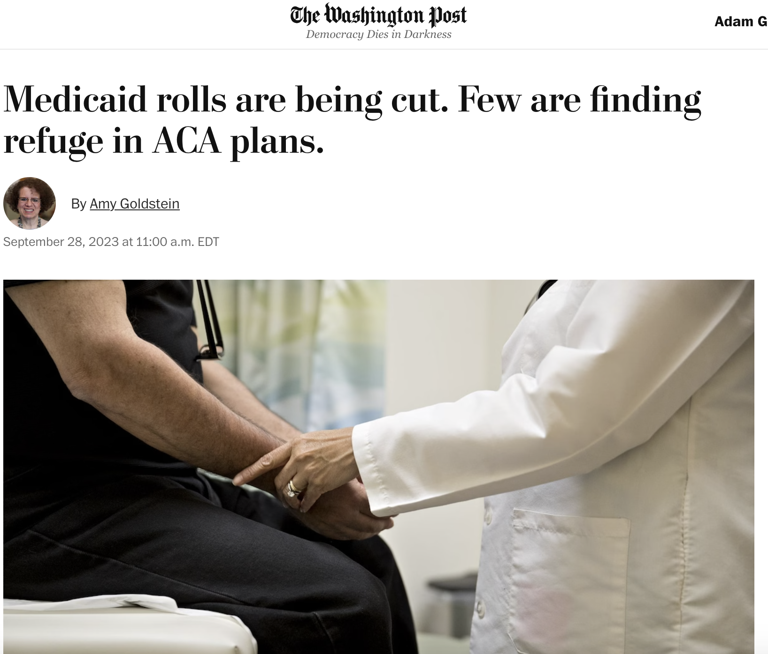
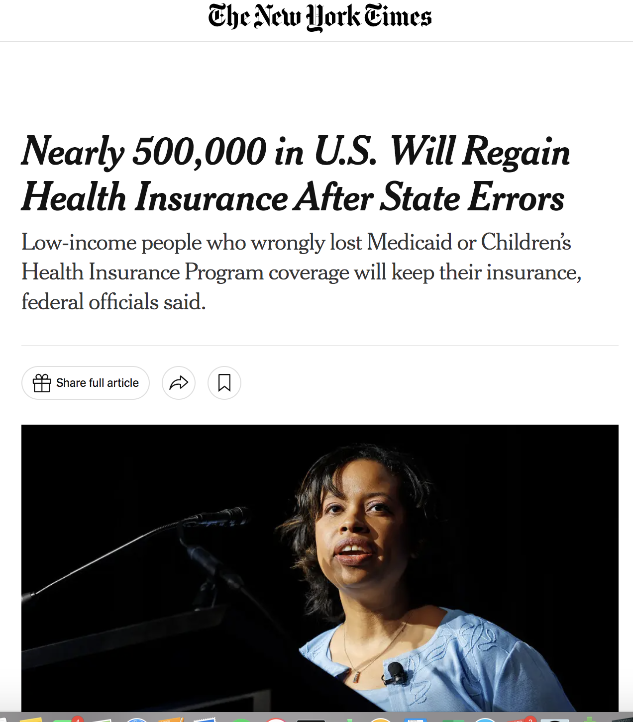

Slide 14
CBO Projects Number Uninsured will Rise from 23 million (2023) to 28 million (2027)
Data from: Hanson C, Hou C, Percy A, Vreeland E, Minicozzi A. Health Insurance For People Younger Than Age 65: Expiration Of Temporary Policies Projected To Reshuffle Coverage, 2023–33. Health Affairs 2023;42(6):742–52.

Slide 15
Continuity of Coverage after Enrollment in Medicaid: Michigan, 2011-2020
Data from: Ndumele CD, Lollo A, Krumholz HM, Schlesinger M, Wallace J. Long-Term Stability of Coverage Among Michigan Medicaid Beneficiaries. Ann Intern Med 2023;176(1):22–8.

Slide 16
Uninsured: Point of Time vs. Over Time, 2018-19
Data from: Einav L, Finkelstein A. The risk of losing health insurance in the United States is large, and remained so after the Affordable Care Act. Proceedings of the National Academy of Sciences 2023;120(18):e2222100120. Results are from these authors’ analysis of the 2018-2019 MEPS.

Slide 17
Effect of PCP Loss on Medicare Beneficiaries Use of Care
Data from: Sabety AH, Jena AB, Barnett ML. Changes in Health Care Use and Outcomes After Turnover in Primary Care. JAMA Internal Medicine 2021;181(2):186–94.

Slide 18
Effect of loss of longstanding PCP on healthcare utilization and mortality among Medicare beneficiaries
Data from: Sabety A. The value of relationships in healthcare. Journal of Public Economics 2023;225:104927.

Slide 19
A randomized trial of continuous vs. discontinuous providers in the VA among older men
Data from: Wasson JH, Sauvigne AE, Mogielnicki RP, et al. Continuity of outpatient medical care in elderly men. A randomized trial. JAMA 1984;252(17):2413–7.

Slide 20
Cost Barriers to Care Among Non-Elderly Adults, 1997-2022

Slide 21
Medical Debt and Bill Problems: US Adults 19-64, 2022
Source: Collins S, Haynes L, Masitha R. The State of U.S. Health Insurance in 2022. Commonwealth Fund [Internet]. 2022 Sep 29 [cited 2022 Nov 2]; Available from: https://www.commonwealthfund.org/publications/issue-briefs/2022/sep/state-us-health-insurance-2022-biennial-survey

Slide 22
Risk of new acquisition of medical debt, 2017 to 2018
Per $2,000 increase in OOP costs.
Data from: Himmelstein DU, Dickman SL, McCormick D, Bor DH, Gaffney A, Woolhandler S. Prevalence and Risk Factors for Medical Debt and Subsequent Changes in Social Determinants of Health in the US. JAMA Network Open 2022;5(9):e2231898.

Slide 23
Problems paying medical bills among post-partum women vs. other reproductive-age women.
Source: Cahn J, Sundaram A, Balachandar R, et al. The Association of Childbirth with Medical Debt in the USA, 2019–2020. J Gen Intern Med 2023;1–7.

Slide 24
Foregone Care Among Adults with and without a child in household with diabetes
Data from: Narm KE, Wen J, Sung L, Dar S, Kim P, Olson B, et al. Chronic Illness in Children and Foregone Care Among Household Adults in the United States: A National Study. Medical Care. 2022 Nov 4;10.1097/MLR.0000000000001791.

Slide 25
Out-of-Pocket Costs for the ICU Rose by About a Third from 2008-2019 for Adults with Employer-Sponsored Insurance
Figures are adjusted for inflation. ICU OOP costs shown for three conditions for illustrative purposes. Data from: Kannan S, Stevens J, Song Z. Growth In Patient Cost Sharing For Hospitalizations With And Without Intensive Care Among Commercially Insured Patients. Health Affairs 2023;42(9):1221–9.

Slide 26
COPD Medication Prescription Abandonment: Commercially Insured, 2017-19
Data from: Patel B, Mayne P, Patri T, Vandigo J, Yin PT, Bratti K, et al. Out-of-Pocket Costs and Prescription Filling Behavior of Commercially Insured Individuals With Chronic Obstructive Pulmonary Disease. JAMA Health Forum. 2022 May 27;3(5):e221167.

Slide 27
Most patients with ACA-compliant individual plans had same-day out-of-pocket costs as screening colonoscopy
Data from: Makhoul AE, Hatcher JB, Sulieman L, Johnson D, Anderson DM. Patient Cost Exposure And Use Of Preventive Care Among ACA-Compliant Individual Plans. Health Affairs 2023;42(4):531–6.

Slide 28
V. Reproductive Healthcare

Slide 29
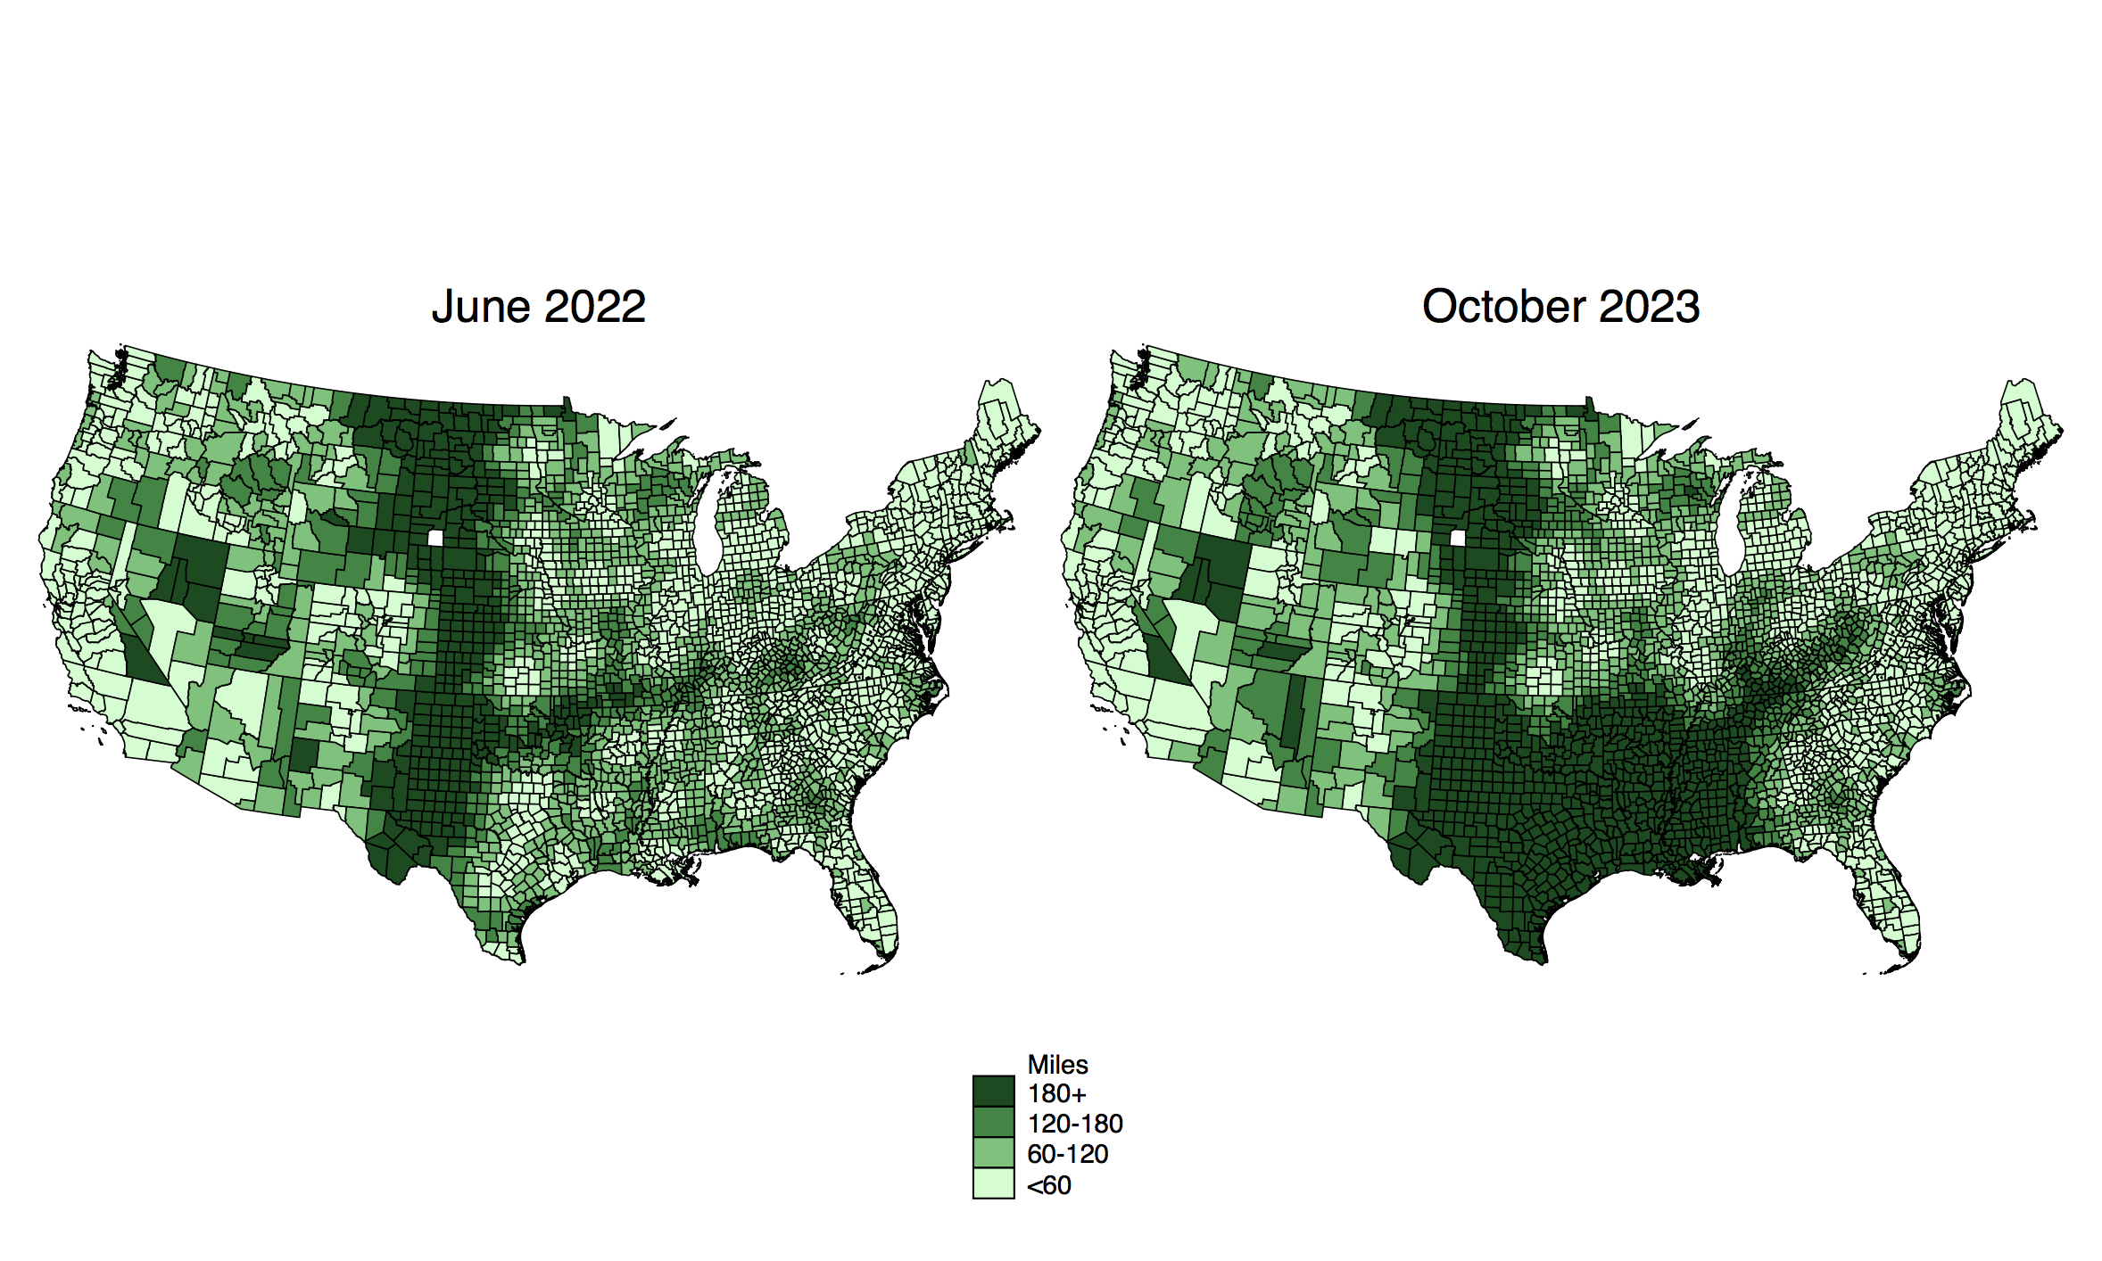
Distance to closest abortion provider before and after Dobbs
Data from the Myers Abortion Facility Database: Myers, C. K. (2023, November 2). Myers Abortion Facility Database. https://doi.org/10.17605/OSF.IO/8DG7R." Driving time equals the driving distance from the centroid of each county to the nearest abortion provider. Mapped by Adam Gaffney using Stata’s spmap command at cutoffs shown in legend.

Slide 30
Average driving distance to closest abortion provider before and after Dobbs: 2019 -2023

Slide 31
Projected Annual Health Outcomes from Repeal of Dobbs
Gaffney A, Himmelstein DU, Dickman S, et al. Projected Health Outcomes Associated With 3 US Supreme Court Decisions in 2022 on COVID-19 Workplace Protections, Handgun-Carry Restrictions, and Abortion Rights. JAMA Network Open 2023;6(6):e2315578.

Slide 32
Median Self-Pay Charges for Abortion Services in the US, 2017-2020
Data from: Upadhyay UD, Ahlbach C, Kaller S, Cook C, Muñoz I. Trends In Self-Pay Charges And Insurance Acceptance For Abortion In The United States, 2017–20. Health Affairs 2022;41(4):507–15.

Slide 33
VI . Medicare Advantage: A Brief Word

Slide 34
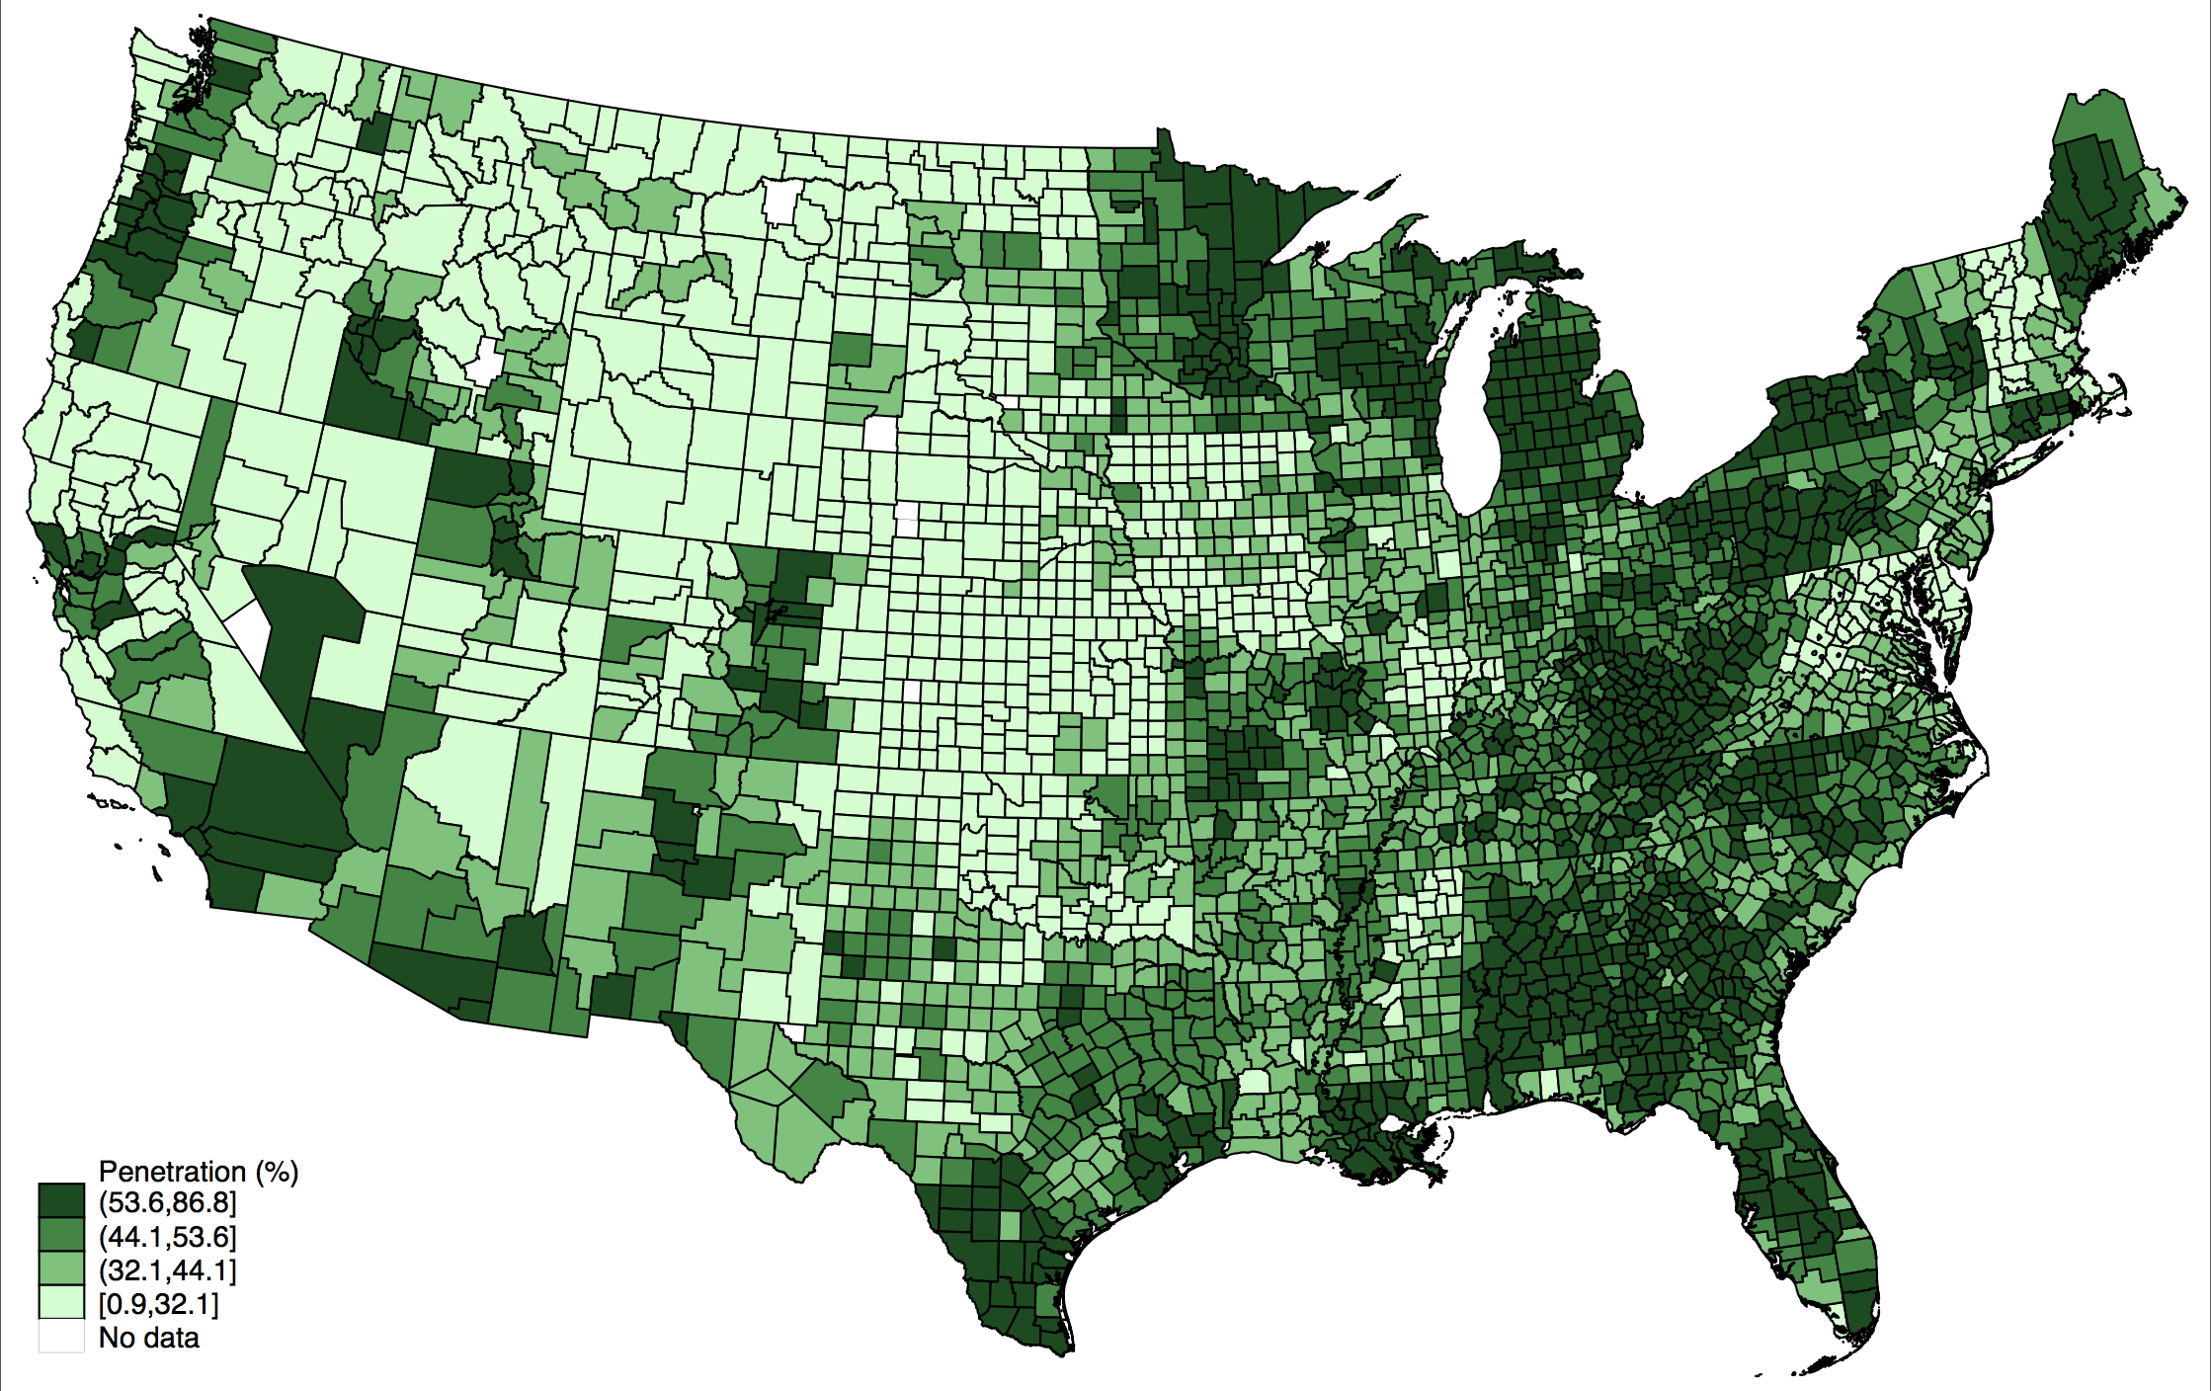
Medicare Penetration by County, October 2023
Data from: https://www.cms.gov/research-statistics-data-and-systems/statistics-trends-and-reports/mcradvpartdenroldata/ma-state/ma-state/county-penetration-2023-10. Mapped by Adam Gaffney using 2021 county shape files from IPUMS NHGIS.

Slide 35
Overpayments to Medicare Advantage approaching 20% or $88 billion in 2023
Coding intensity estimate is for 2021; source: MedPAC MA coding intensity 9.7.23. Accessed September 15, 2023. https://www.documentcloud.org/documents/23944726-medpac-ma-coding-intensity-9723. Favorable selection estimate is for 2019; source: June 2023 Report to the Congress: Medicare and the Health Care Delivery System. Accessed August 10, 2023. https://www.medpac.gov/document/june-2023-report-to-the-congress-medicare-and-the-health-care-delivery-system/=. $88 billion estimate is from applying 19.2% to 2023 projected Medicare Spending per Trustees’ projections.

Slide 36
Medicare Advantage Overpayments totaled $547.4 billion, 2008-2023
Amounts nominal, not inflation-adjusted. Coding intensity overpayment percentages are from March 2023 MedPac Report for 2008-2020, with year 2021 percentage from a recent MedPAC analysis that upwardly adjusted previous estimate of 4.9% for that year to 8.2%, which was carried forward to 2022-23. Favorable selection based on MedPAC’s June 2023 estimate for 2019, extrapolated to other years. Overpayment percentages multiplied by MA total actual or projected payments drawn from Medicare Trustees Reports. MedPAC based analysis by David Himmelstein, Steffie Woolhandler, and Adam Gaffney .

Slide 37
Relative difference in resource use by condition: MA vs. TM
Jung J, Carlin CS, Feldman R, Song G. Wide Variation In Differences In Resource Use Seen Across Conditions Between Medicare Advantage, Traditional Medicare. Health Affairs 2023;42(9):1212–20.

Slide 38
The Medicare Advantage “Paradox”
Lower care use among beneficiaries vs. TM
Similar payment rates to providers vs. TM
3. Much higher overall payments vs. TM
How to account for this apparent paradox?
4. Higher overhead (administration + profits) vs. TM.
Profits are only a minority of overhead;
however, administrative spending reduces utilization and is the motor of profit-generation

Slide 39
VI. Privatization, Corporatization, and Financialization

Slide 40
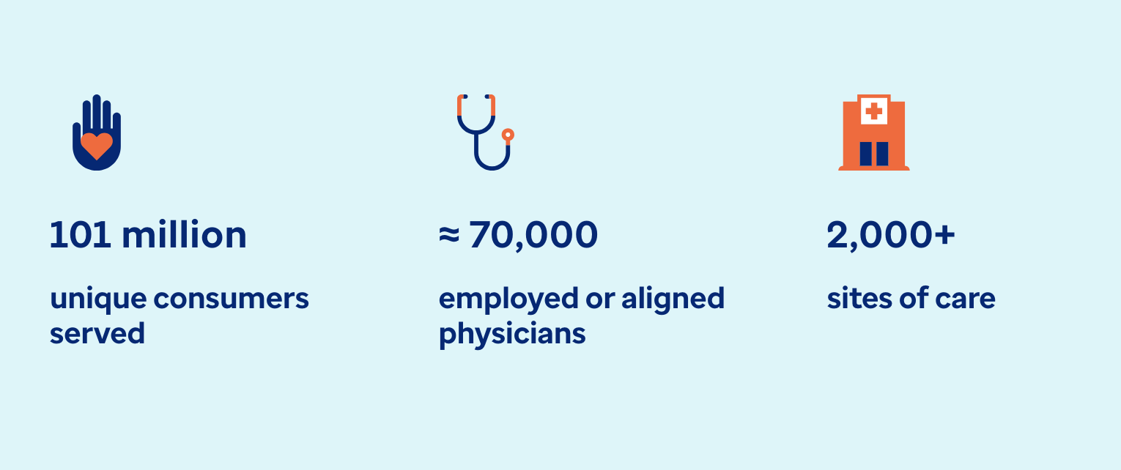
Optum Health
Source : https://www.optum.com/about-us/optum-health.html

Slide 41
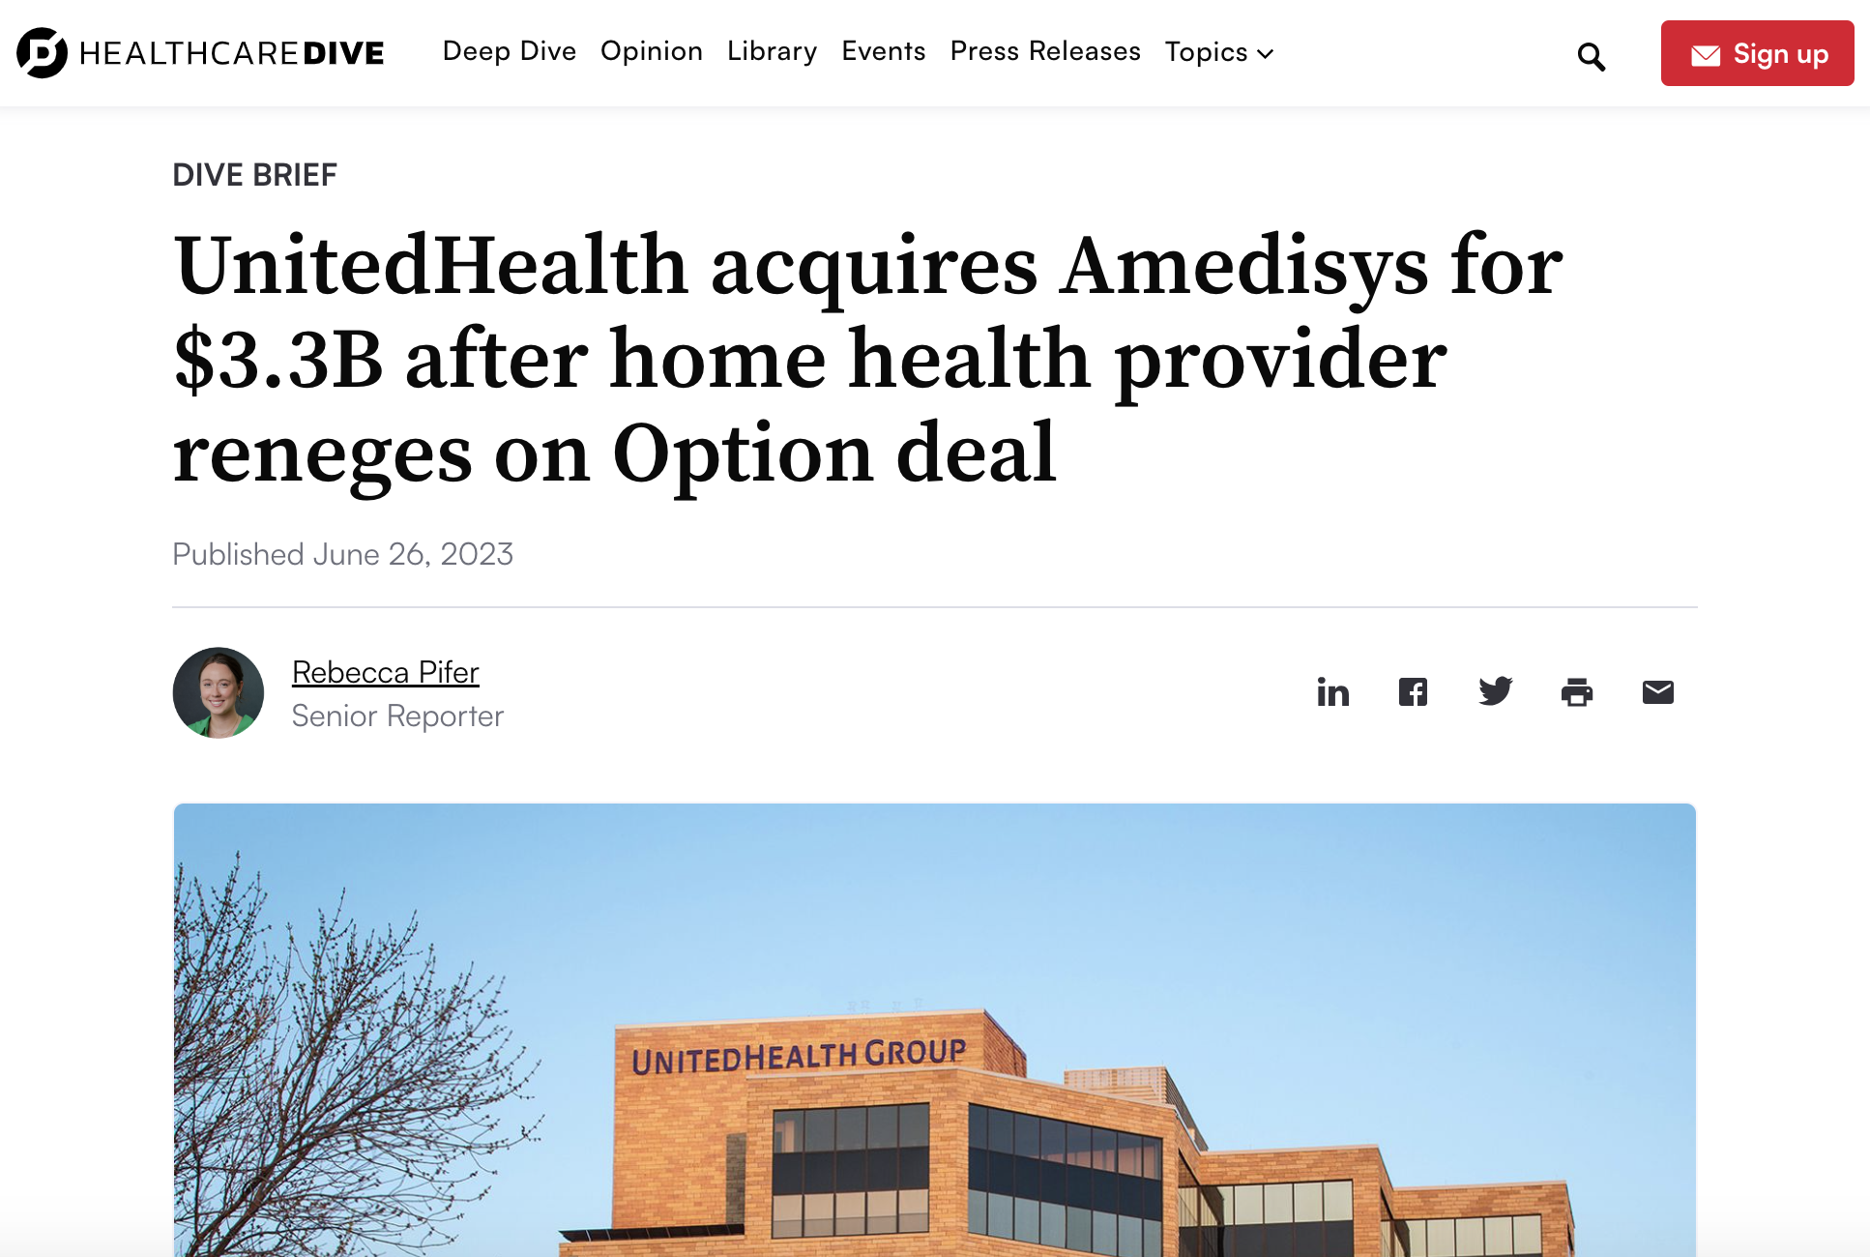
Screenshot from: https://www.healthcaredive.com/news/unitedhealth-optum-amedisys-acquisition-option-care/653870/

Slide 42
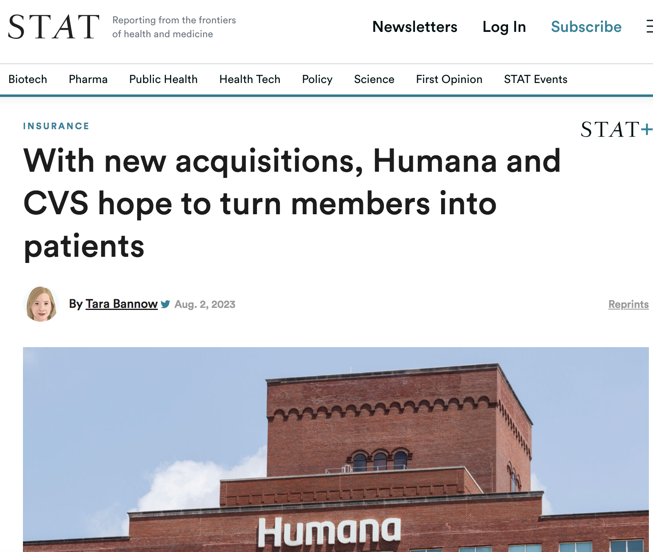
“Both Humana and CVS Health on Wednesday touted plans to aggressively scale their primary care clinics for seniors and funnel Medicare members into those clinics.”
“When insurers double as medical providers for their members, they effectively pay themselves, so they can generate enormous profit by lowering members’ health care costs.”
Source: https://www.statnews.com/2023/08/02/humana-cvs-senior-care/

Slide 43
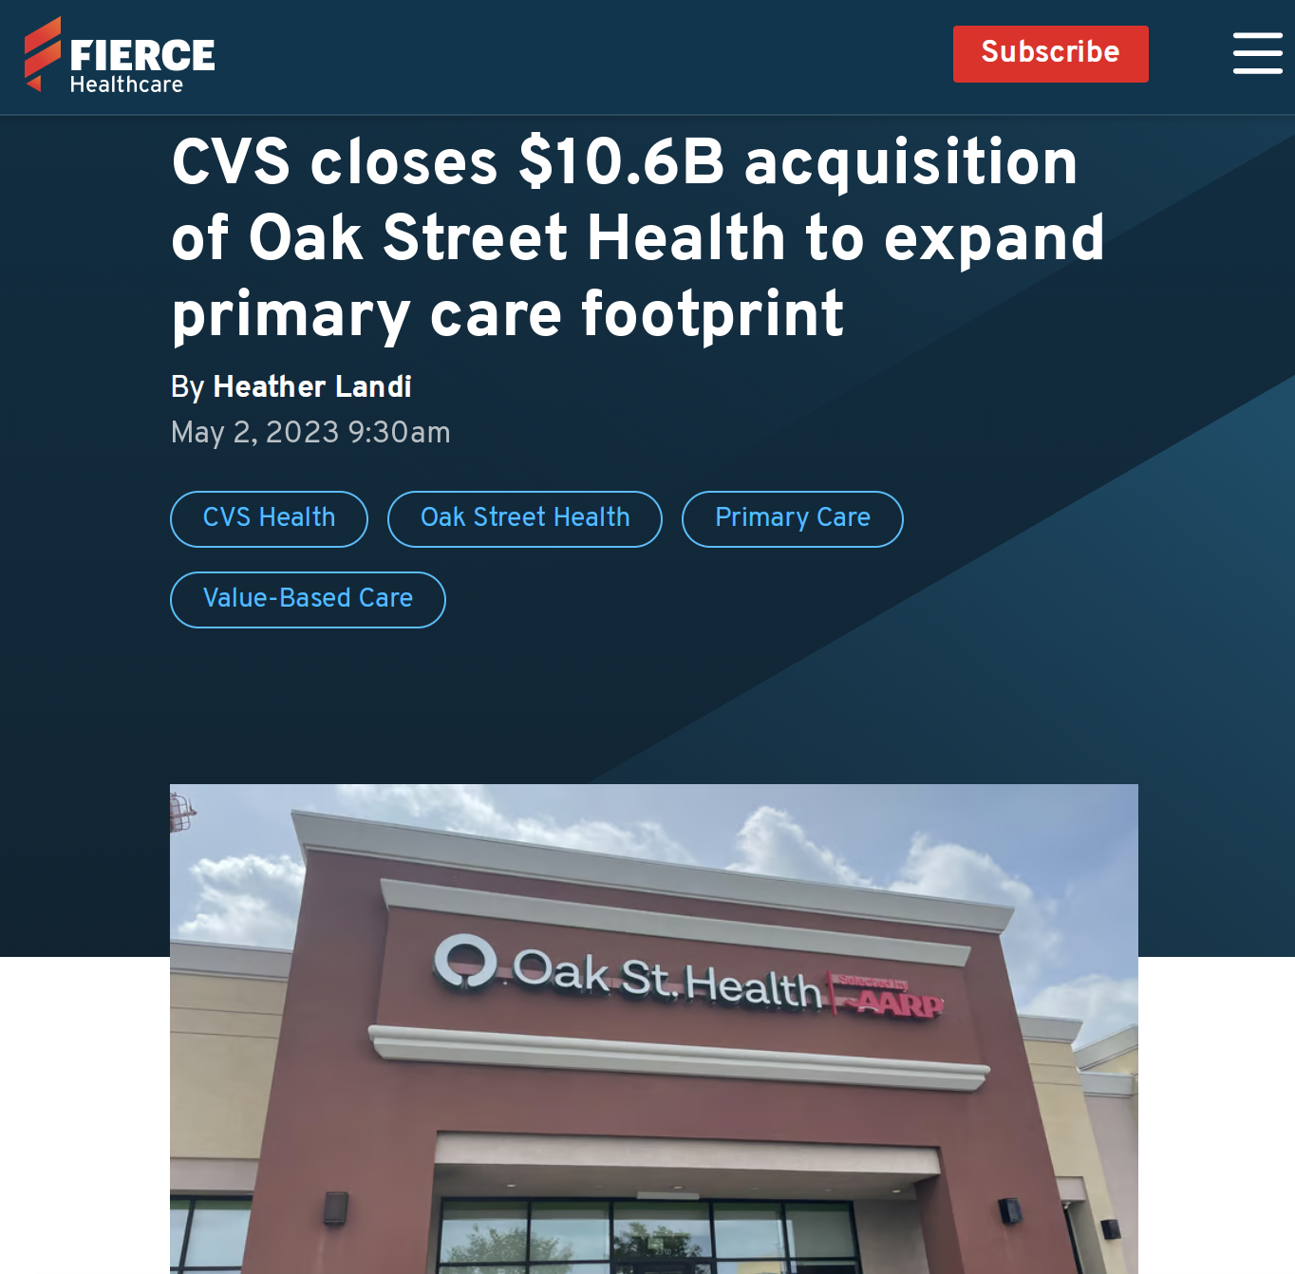
169 medical practices in 21 states
Source: https://www.fiercehealthcare.com/providers/cvs-closes-106b-acquisition-oak-street-health-expand-primary-care-footprint

Slide 44


Slide 45
Low-Performing Hospices by Profit Status Based on Family Assessments of Care
Low-performing defined as hospices with a CAHPS Hospice Survey score 3 points or more below the national average. Data from: Anhang Price R, Parast L, Elliott MN, et al. Association of Hospice Profit Status With Family Caregivers’ Reported Care Experiences. JAMA Internal Medicine 2023;183(4):311–8.

Slide 46
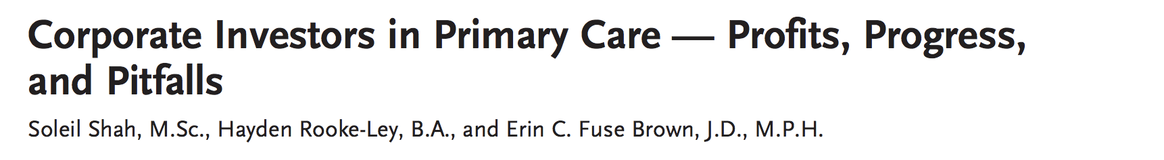
“An overarching revenue strategy underlies investors’ appetite for primary care … Primary care practices can generate substantial profits by growing their population of patients covered by Medicare Advantage (and other lucrative payers), maximizing the ‘budget’ for each patient’s care using risk adjustment and quality bonuses, minimizing their health expenditures with utilization management, and referring patients to other product and service offerings, such as pharmacy.”
Emphasis added. Shah S, Rooke-Ley H, Fuse Brown EC. Corporate Investors in Primary Care — Profits, Progress, and Pitfalls. New England Journal of Medicine 2023;388(2):99–101.

Slide 47

815,000 members
214 medical offices in 20 markets
Source: https://apnews.com/article/technology-amazoncom-inc-1life-healthcare-business-8440ff249f2af796d7b74b654eb86130

Slide 48
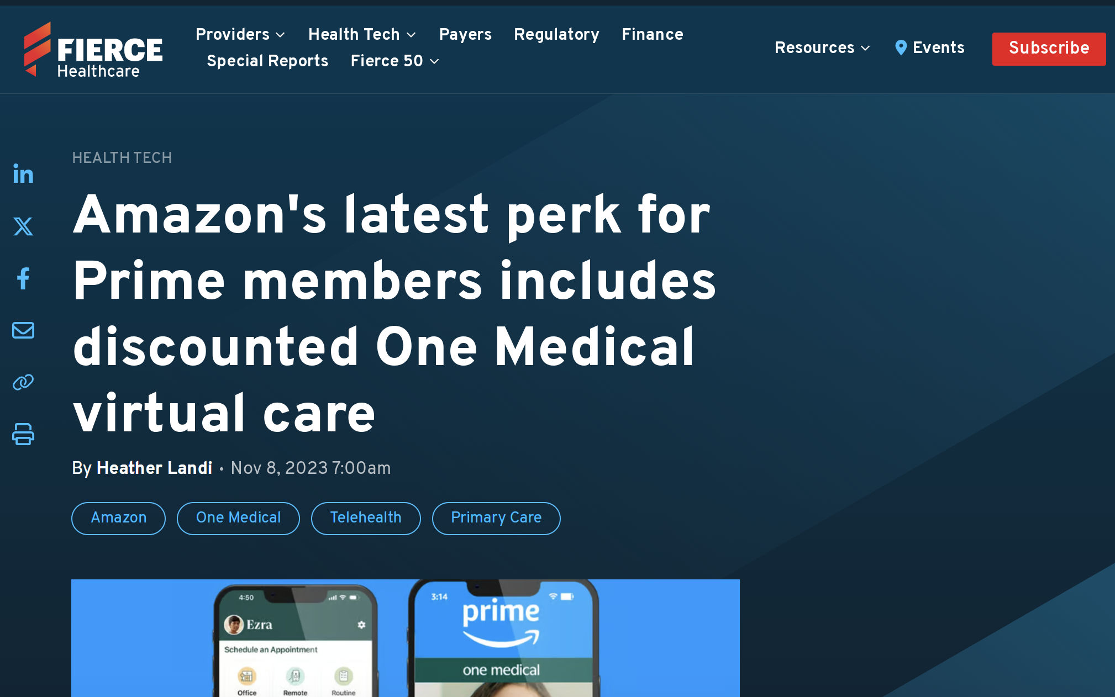
Source: https://www.fiercehealthcare.com/health-tech/amazon-offers-prime-members-access-one-medical-virtual-care-9-month

Slide 49
Global healthcare private equity deals in 2022: Down from 2021 peak but second highest on record
Redrawn figure from:
Bain & Company. Global Healthcare Private Equity and M&A Report 2023 [Internet]. [cited 2023 Nov 6]. Available from: https://www.bain.com/insights/topics/global-healthcare-private-equity-ma-report/

Slide 50
Oncology Clinics and Oncologists with Private Equity Affiliations
Tyan K, Lam MB, Milligan M. Private Equity Acquisition of Oncology Clinics in the US From 2003 to 2022. JAMA Internal Medicine 2023;183(6):621–3.

Slide 51
VII. Health Planning (or Lack Thereof)

Slide 52
Probability of Hospital Overcapacity during periods of load imbalance during COVID-19 by neighborhood characteristics
Data points are predicted probability of being overcapacity during periods of regional ICU load imbalance. From Exhibit 4 of Vohra et al.; predicted probability for quartiles 2-4 calculated by adding marginal effect to predicted probability of Quartile 1. Vohra AS, Khullar D, Kaushal R, Schpero WL. Many Intensive Care Units Were Overloaded While Nearby Hospitals Had Excess Capacity During The COVID-19 Pandemic. Health Affairs [Internet] 2023 [cited 2023 Jul 100].

Slide 53

Julian Tudor Hart: The “Inverse Care Law”
“…the availability of good medical care tends to vary inversely with the need of the population served.”
“The more health services are removed from the force of the market, the more successful we can be in redistributing care away from its ‘natural’ distribution in a market economy.”
Tudor Hart J. The Inverse Care Law. The Lancet 1971; 297: 405–12.

Slide 54
Mean Revenue and Profit per Patient Bed Day: Black-serving vs. other US Hospitals, 2016-18
Himmelstein G, Ceasar JN, Himmelstein KE. Hospitals That Serve Many Black Patients Have Lower Revenues and Profits: Structural Racism in Hospital Financing. J Gen Intern Med 2023;38(3):586–91.

Slide 55
Association between Perinatal Risk and Regional NICU Capacity in 1991 and 2017: Variance Explained
Davis R, Stuchlik PM, Goodman DC. The Relationship Between Regional Growth in Neonatal Intensive Care Capacity and Perinatal Risk. Medical Care 2023;61(11):729.

Slide 56
Effect of a 10-percentage point increase in share of nearby hospitals offering invasive cardiac services on odds of a hospital adding that service
Data from: Horwitz Jill R., Nichols Austin, Nallamothu Brahmajee K., Sasson Comilla, Iwashyna Theodore J. Expansion of Invasive Cardiac Services in the United States. Circulation 2013;128(8):803–10.

Slide 57
VII. Policy Advantages National Health of Insurance (NHI) and National Health Service (NHS) Systems

Slide 58
Quasi-Experimental Study: Effect of Being Taken by Ambulance to VA vs. Non-VA Hospital
Percent difference represents percentage point effect (from instrumental variable analysis) divided by outcome mean (Mortality/Spending relative effects reported by authors; data from Table 4 used to calculate relative changes for the utilization outcomes). Data from: Chan DC, Card D, Taylor L. Is There a VA Advantage? Evidence from Dually Eligible Veterans. American Economic Review 2023;113(11):3003–43.

Slide 59
Appointment Time for Veterans in the VHA and Private Sector
Feyman Y, Asfaw DA, Griffith KN. Geographic Variation in Appointment Wait Times for US Military Veterans. JAMA Network Open. 2022 Aug 25;5(8):e2228783.

Slide 60
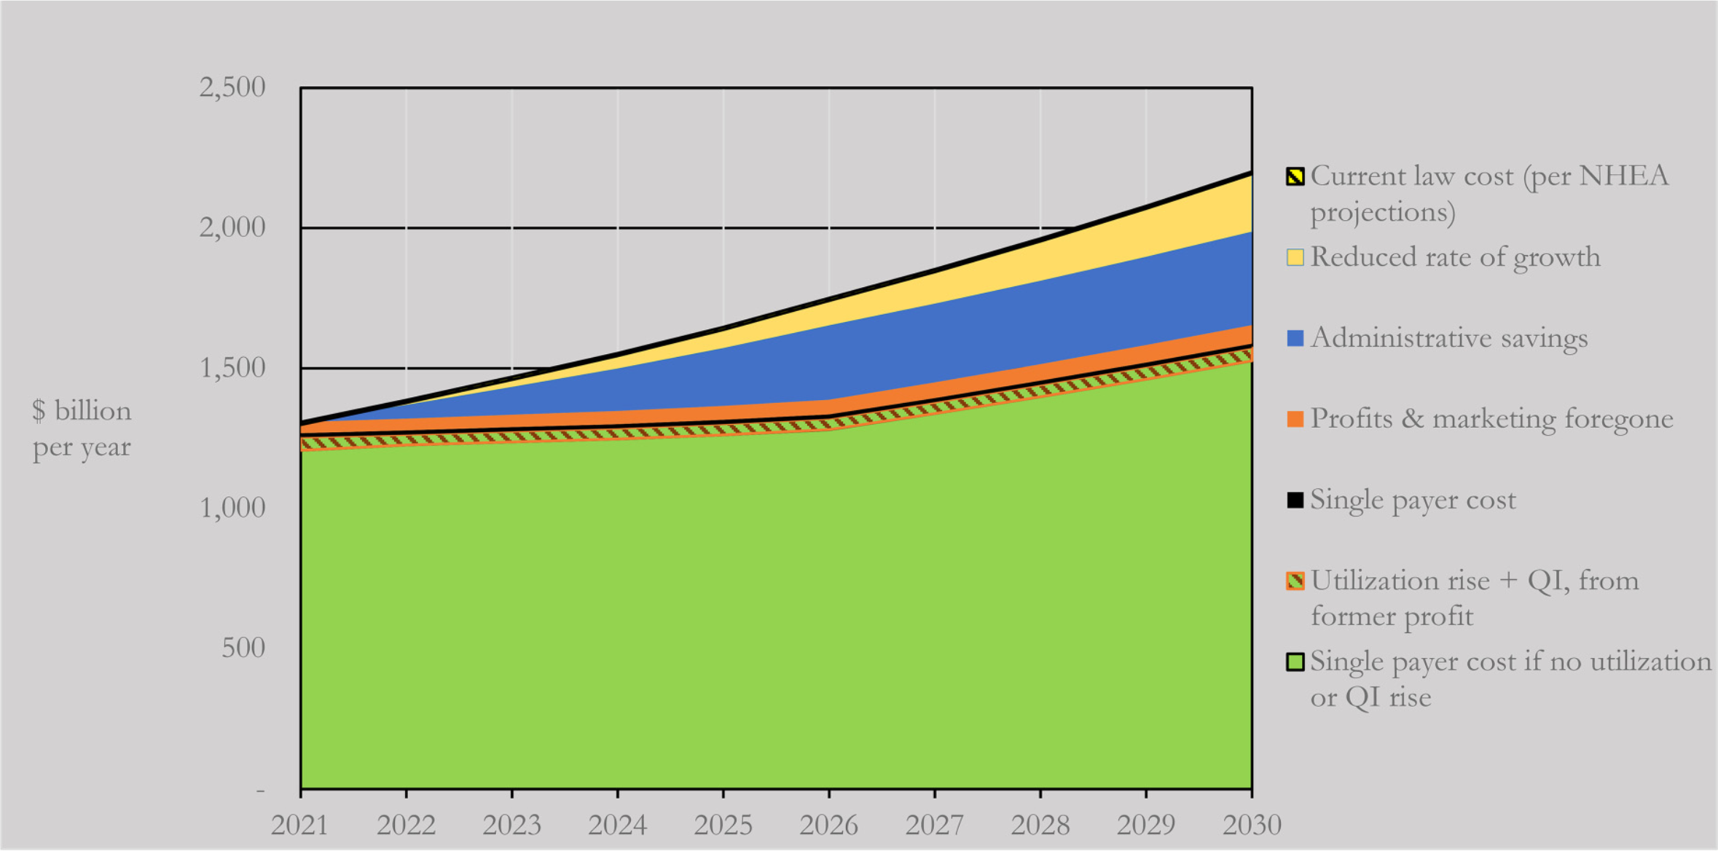
Single Payer with Global Budgets Could Reduce 10-Year Hospital Spending from $17.2 to $14.7 trillion
Gaffney AW, Himmelstein DU, Woolhandler S, Kahn JG. Hospital Expenditures Under Global Budgeting and Single-Payer Financing: An Economic Analysis, 2021–2030. International Journal of Social Determinants of Health and Health Services 2023;27551938231152750.

