Slide 1
Overcoming fear and building power
Lessons from the housestaff labor movement
Andrew Hyatt MD
SNaHP Summit November 11 2023
Special thanks to several CIR staff who helped with prior versions of this presentation, including Ira Washburn, Mica Rudich, Joon Kang, Eric Peterson, and Sejel Barbera

Slide 2
Agenda
Unions! What are they? How do I get one?
Labor organizing 101
Overcoming intimidation
A typical employer campaign
Building unity and protecting yourself
Lessons for single payer organizing
???
Win single payer by the end of the weekend
Notes:
Why does this matter? Unions are a crucible for building organizing power, and we need an organized working class to win
There are few things scarier than losing your job, especially in residency

Slide 3
Unions 101
Notes:
What do people know about unions? Anyone ever been in one or have family members active in the union?

Slide 4
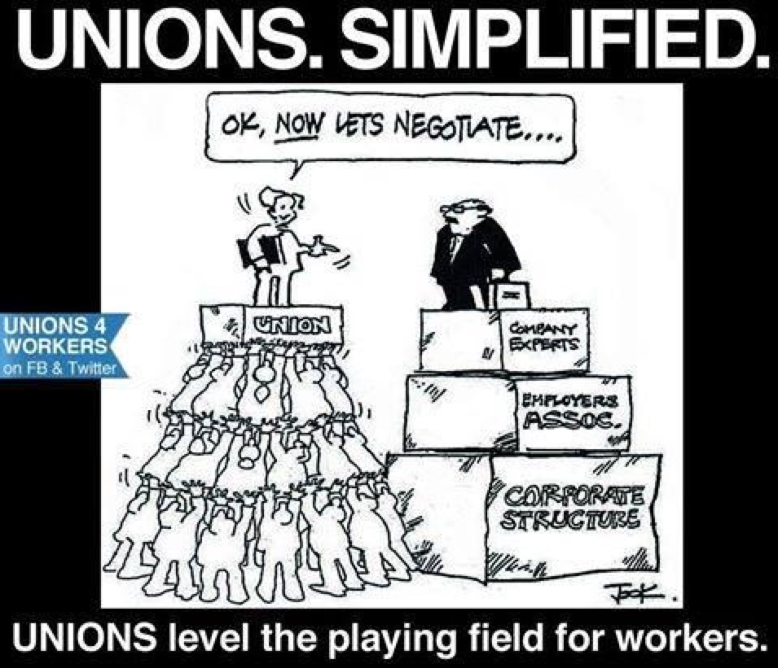
How do unions work?
A group of workers negotiating collectively with an employer
Use collective action to win gains
Funded by workers through dues
Standardized wages, working conditions, and benefits
Independent political action
Notes:
Put simply, a union is a group of people working together to improve our working conditions through unified action and collective bargaining. Collective bargaining means that instead of us individually asking the hospital for raises, improvements our working conditions, or improving patient safety, we negotiate as a group so that we have more leverage. We’re more likely to be heard and make improvements if we work together, than if we are on our own.

Slide 5
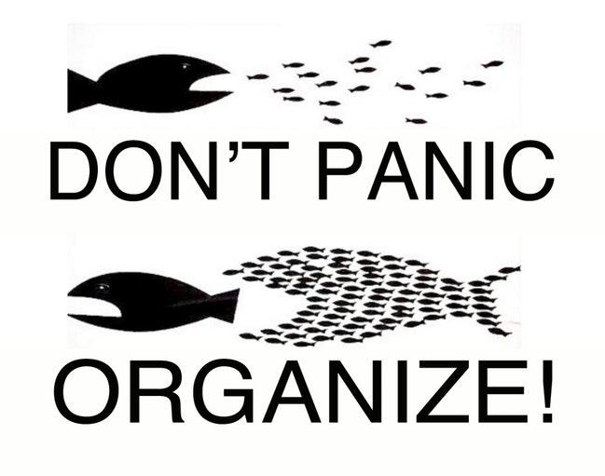
Why should all doctors unionize?
COLLECTIVE POWER!
Almost all physicians now employed, more decisions made by administrators
Leverage power to improve working conditions and patient care
Helps politicize and radicalize your coworkers
Notes:
Although physicians are thought to have a lot of political and social power, the fact is that increasingly few of us have a say in our hospitals. All residents and an increasing number of healthcare workers are employed by large hospitals and healthcare groups, who have other interests besides our well being or even the well being of our patients. This is true for all healthcare workers, including doctors.

Slide 6
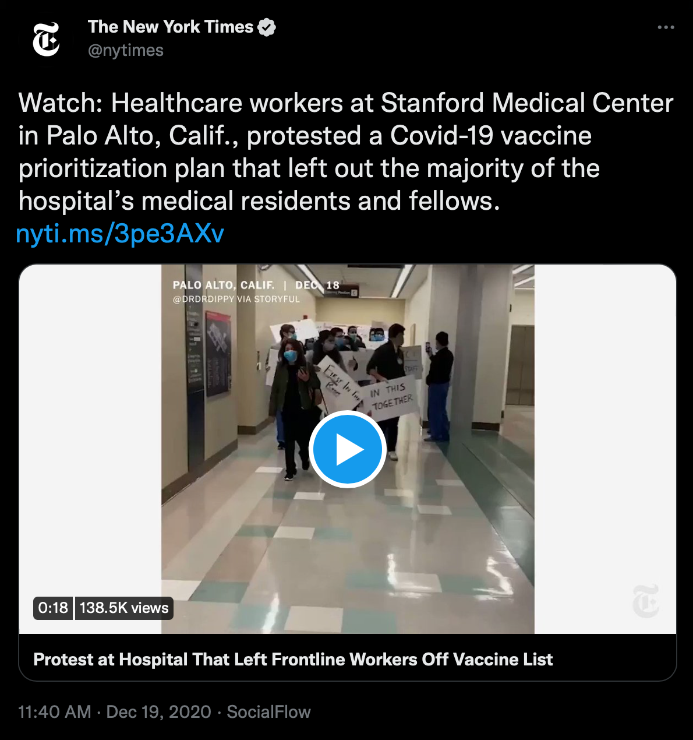
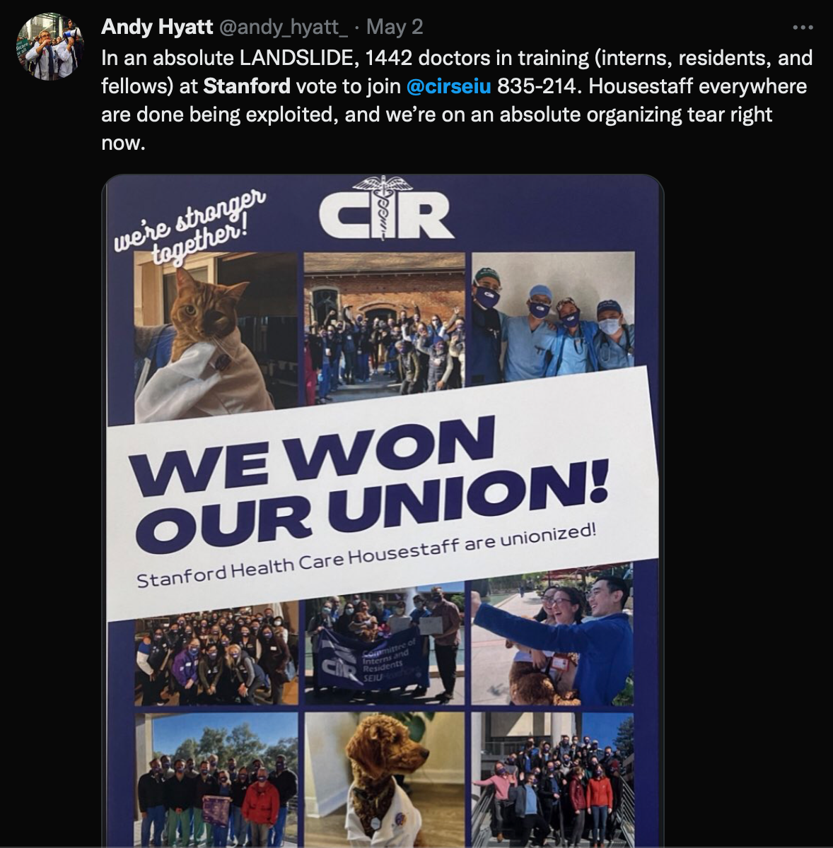
Housestaff unions protecting residents
Notes:
Fuck around and find out

Slide 7
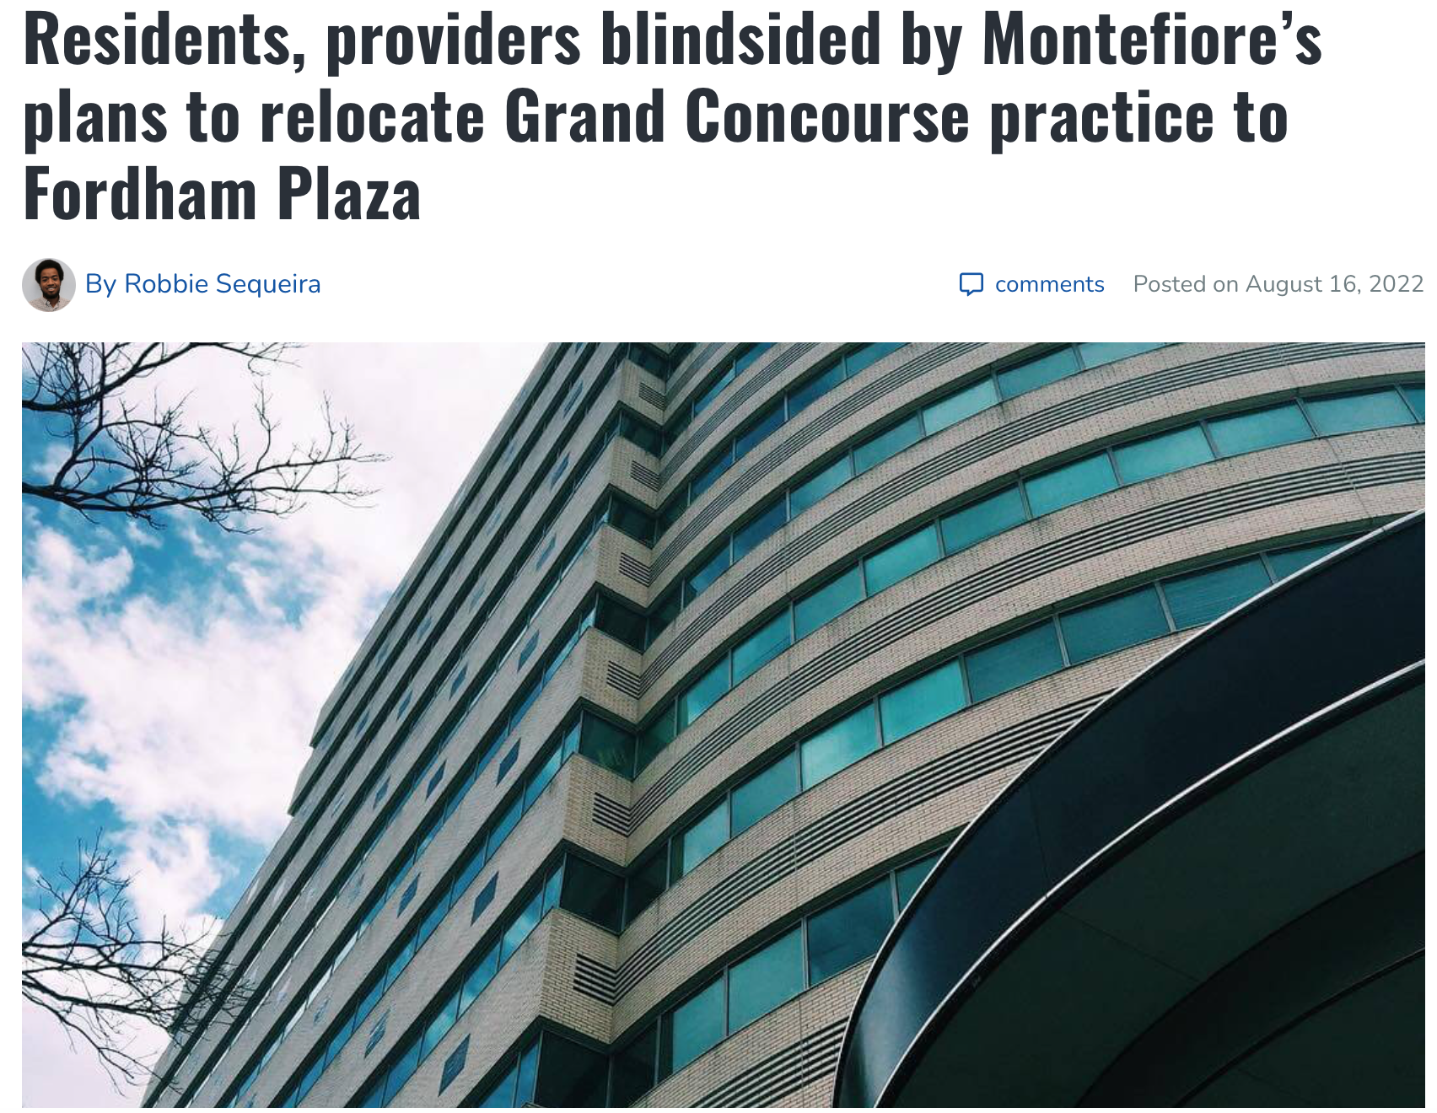
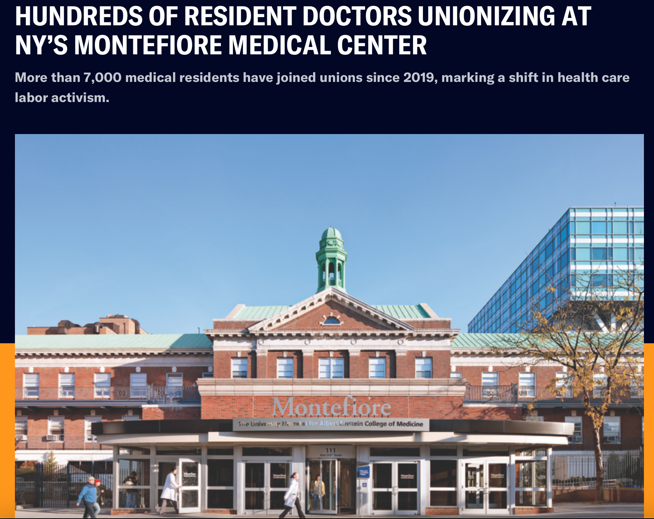
Housestaff unions and healthcare (dis)investment
https://perfectunion.us/hundreds-of-resident-doctors-unionizing-at-nys-montefiore-medical-center/
https://www.bxtimes.com/montefiores-relocate-grand-concourse-fordham-plaza/

Slide 8
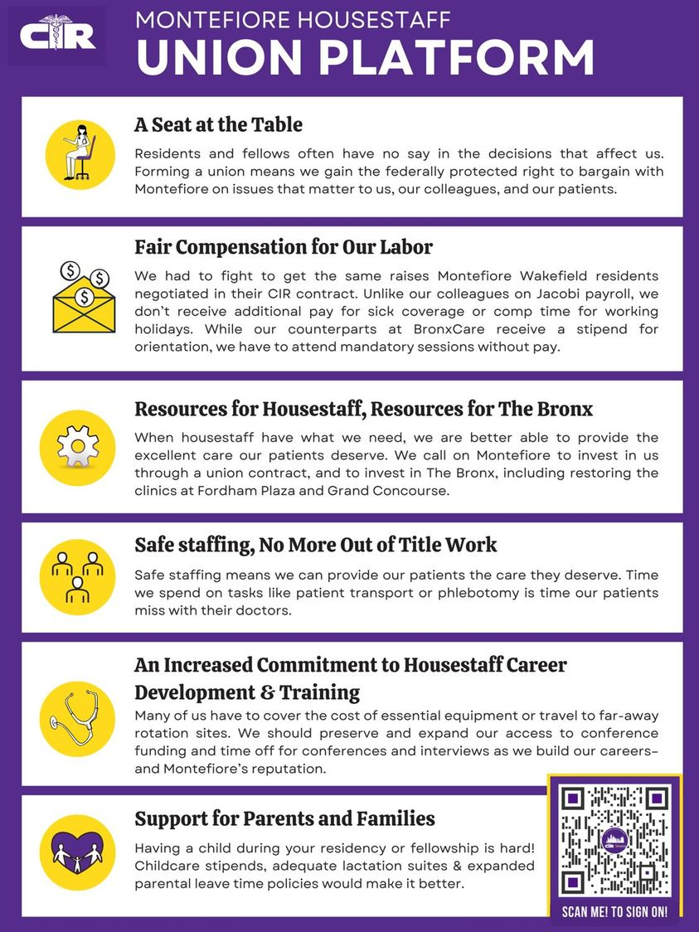

Slide 9
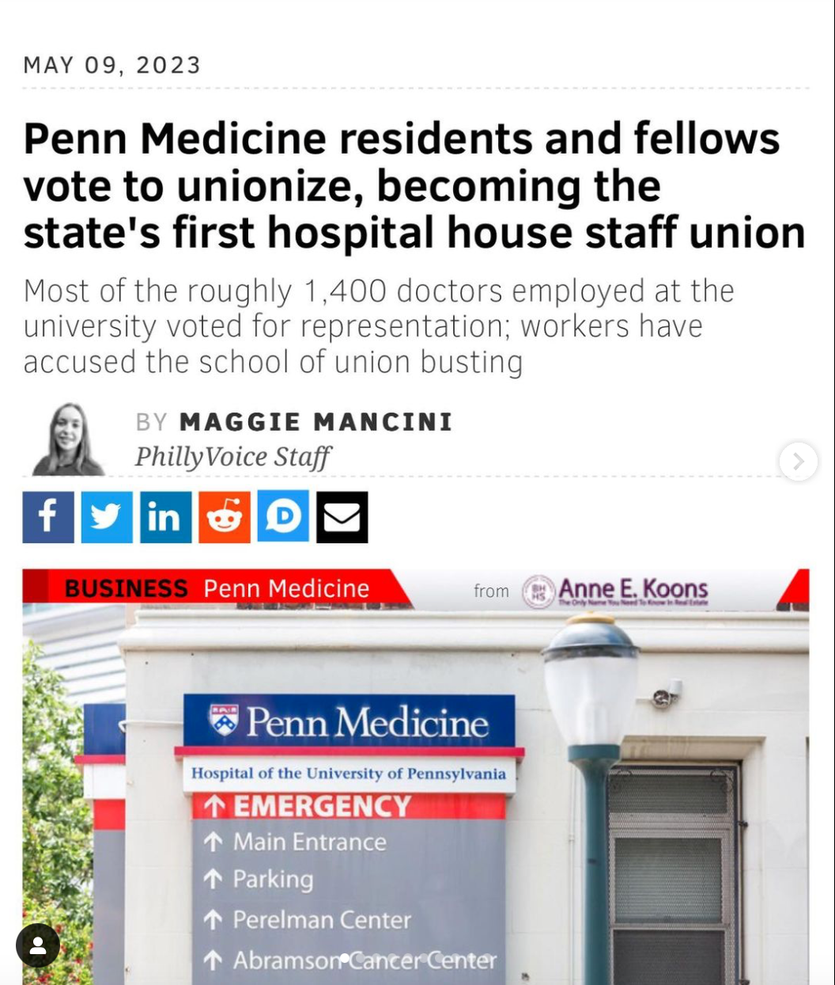
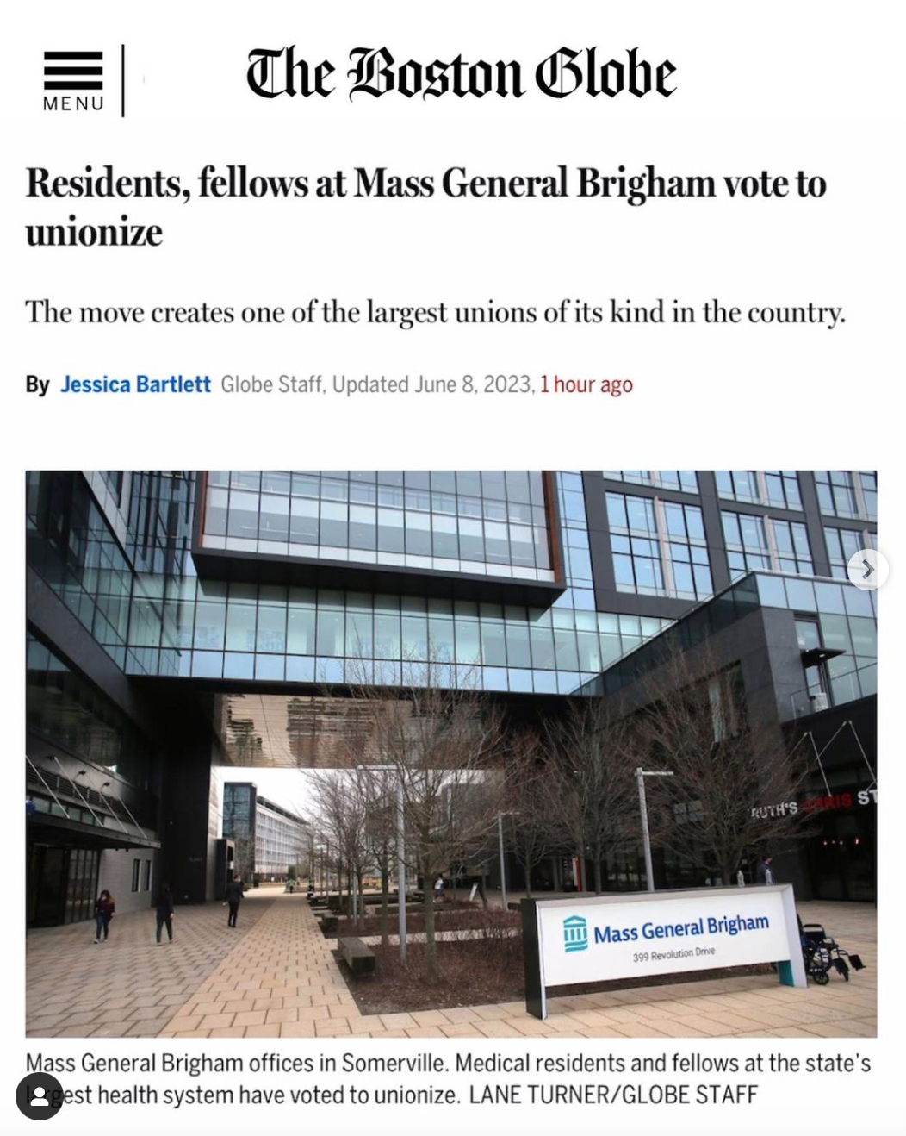

Slide 10
Facing down opposition

Slide 11
The employer campaign
No matter how “progressive,” hospital employers have almost universally opposed union drives
Bitter anti-union campaign is the norm not the exception
Why do people think this is?
What tactics have people heard of that employers (or others in power) will use to discourage organizing?
Notes:
It’s about power, not necessarily money (although money factors in too)
Hospitals don’t want to share decision making authority with their workers

Slide 12
Case study
Based on recent campaign Particularly intense as:
Employer found out early
Employer had $$$$$$$
Employer hates unions EVEN MORE than other hospitals
So this campaign was scary! But….
We won in a landslide anyways. How?

Slide 13
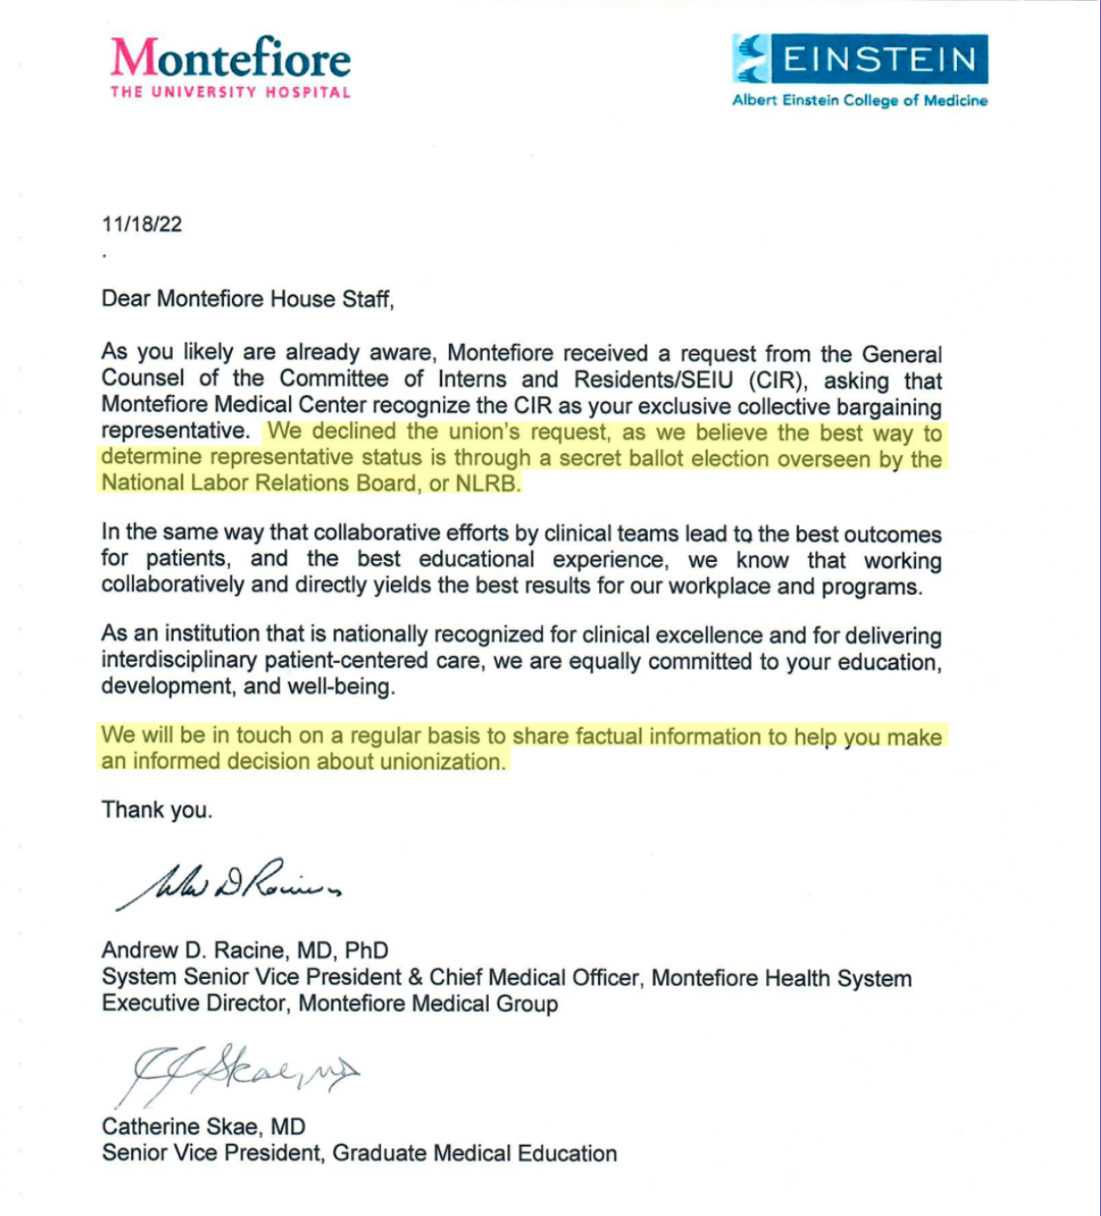
It starts early
Notes:
Couple of key anti-union points already being seeded here:
-”The union” did something. This is called “third partying.” The union is made up of its members (the housestaff at Monty), and hospitals will always try to make it seem like a foreign invader rather than an organized effort of their existing workers
-”Working collaboratively and directly.” This is another classic, implies that a union means everything will be hostile and that somehow we have a collaborative relationship already (lmao)
-We just want to give you “the fact” (anti-union propaganda) to get you to make an informed decision (vote no)

Slide 14
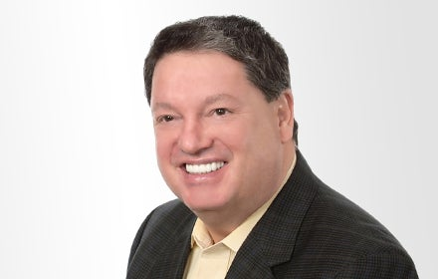
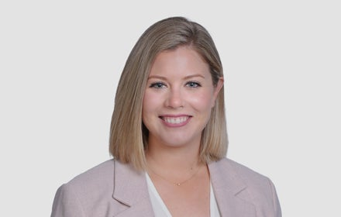
Gobs of money to anti-union consultants
Meet Jackson Lewis
Jeffrey J. Corradino
Principal
Berkeley Heights, NJ
Mary-Ann P. Czack
Associate
Long Island, NY
“[Jackson Lewis] is widely known as one of the most aggressively anti-union law firms in the U.S.”
Steven Greenhouse, New York Times

Slide 15
The anti-union consultant playbook
Union Busting Tactics:
Captive Audience Meetings
1:1 meetings with PDs
Repetition, Repetition, Repetition
They try to provoke these emotions:
Stress
Anxiety
Fear
Uncertainty
What will they say?
We will take away the benefits
You will forever change the relationship with your PDs
You will have to strike
You will lose all flexibility
Your smaller specialty won’t have a voice in the union
You will lose special program benefits
Notes:
Give some specific examples here

Slide 16
“The rhetoric of reaction”
Perversity
A union (or any progressive change) will actually make things worse not better
Futility
You are doomed to failure, so why even try?
Jeopardy
Doing this will endanger the privileges you already have
Notes:
Any KYE fans out there?
It’s all the same shit! This is exactly how anti-single payer talking points go, it’s all playing to fear

Slide 18
MGB Example
https://www.instagram.com/p/CtM4raAO0mK/?img_index=1

Slide 19
So how do we fight back?

Slide 20
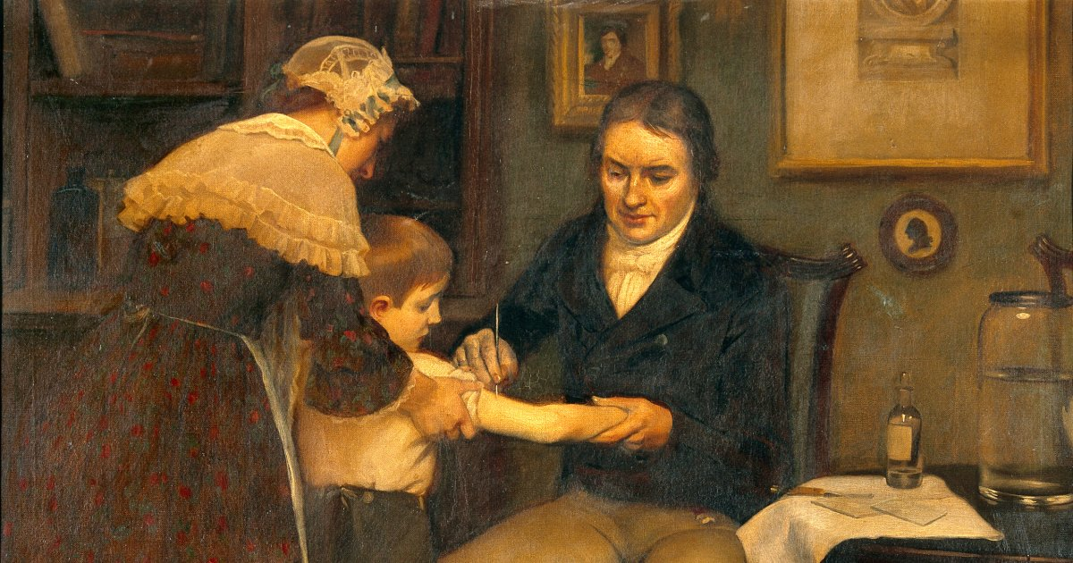
Notes:
INOCULATION BABY
We know EXACTLY what they’re going to say and do. None of this is a surprise. These talking points should be the subject of ridicule! Do they think we are literally children?
Nothing banishes fear faster than realizing your opponent is ridiculous (HP banishing a boggart etc etc)

Slide 21
Inoculation baby!
We know what they’re going to say!
Project air of confidence
Arm people to spot lies and attacks before they happen
Answer common talking points before they’re even said
Builds unity, can make your opponents seem silly instead of scary

Slide 22
Getting ahead of the boss

Slide 23
Getting ahead of the boss continued

Slide 24
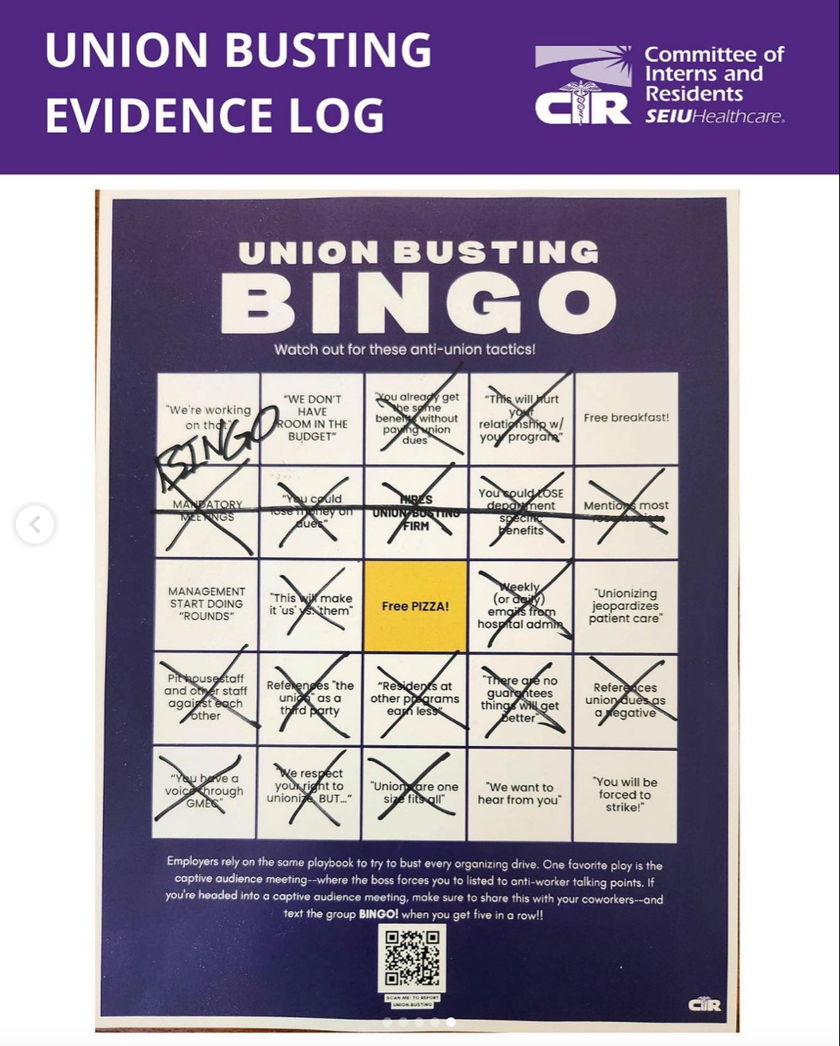

Slide 25
Our turn!! Anti-single payer bingo
 |  | COMMUNISM (free space)
Notes:
Let’s pretend we’re at the AMA this year trying to get the single payer resolution passed, and you want to inoculate your allies or people who might be wavering about the resolution

Slide 26
The good news? They’re actually so bad at this

Slide 27
Monty
https://www.instagram.com/p/Co-3zc7unNu/?img_index=4

Slide 29
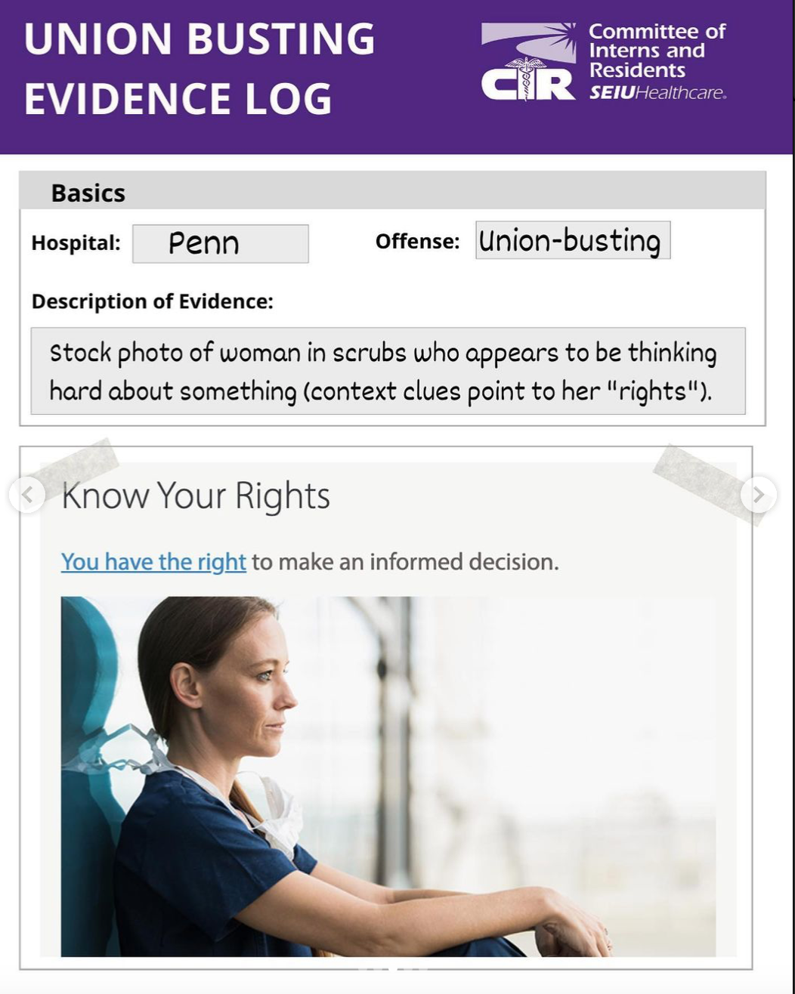
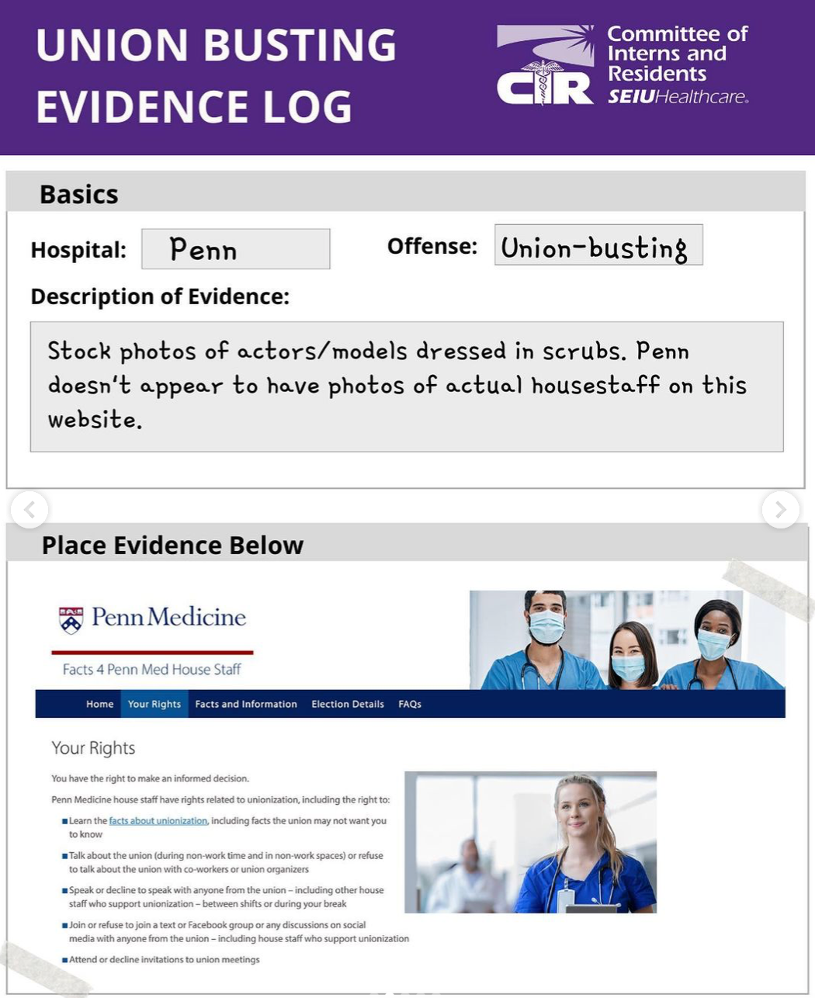

Slide 30
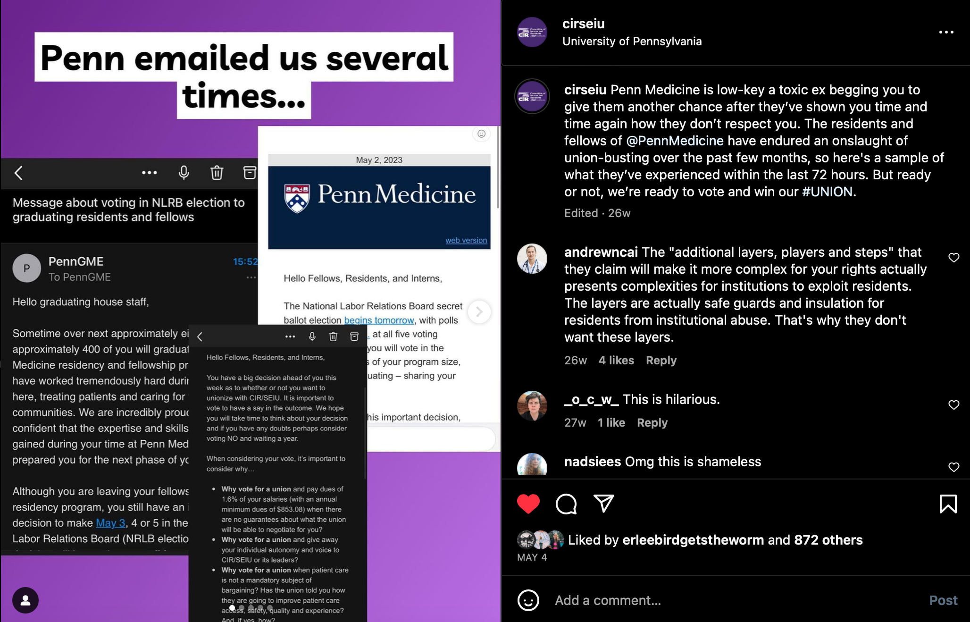

Slide 31
Fighting Back
Don’t need to respond to everything
If everyone thinks it’s stupid, laugh and move on!
Even if they’re lying
May need to respond more systematically if…
Boss or admin messaging is gaining traction
People are becoming afraid and seem less willing to engage with you
Notes:
So how should you address negative messaging from admin, boss, etc?

Slide 32
Affirm, Answer, Redirect
Affirm
I hear you, I don’t want to be retaliated against either.
Answer
Our boss may try to get us in trouble, but we have ways of fighting back together
Our organizing is “protected concerted activity” and it would be illegal to fire us for it
Redirect
If they’re so worried about our job security, why did they fire that resident last year during a mental health crisis?
Why do you think they’re talking to us so much now after ignoring us for so long

Slide 33
Practice!
Pick a worry or fear expressed by students in your school about organizing around single payer
Role play
Affirm
Answer
Redirect

Slide 34
What was that like?

Slide 35
Hope for the best, prepare for the worst
Lay out early that retaliation or threats could be coming
Explicitly predict what it could look like
We know the playbook!
Describe the steps if the powers that be retaliate or push back
Expose it
Document
Develop plan for collective action to protect each other
Divide and conquer bosses/admin from each other

Slide 36
What protects us?
Numbers
In med school, they’re terrified about their match lists and graduation rates. They can’t punish everyone!
In residency, the hospital shuts down without housestaff. They can’t fire all of us!
Publicity
Unity
Collective action

Slide 37
In summary
Collective action gets the goods
Solidarity is the antidote to fear
Inoculate!!!

Slide 38
“Nothing can defeat a union that sings”

Slide 39
Thanks so much!! Questions?
Email: Andrew.s.hyatt@gmail.com
Twitter: @andy_hotelchain

Slide 40
Resources
CIR: https://www.cirseiu.org/organize/
Labor Notes: https://labornotes.org/secrets
Workplace Organizing Committee: https://workerorganizing.org

