Slide 1
Medicare for All and The Carceral State
Mark Spencer, MD
Assistant Professor of Medicine
Emory University at Grady
General Internal Medicine

Slide 2
OUTLINE
The Carceral State
Incarceration in America today
Benefits and Limitations
Single Payer as Harm Reduction
Starving The Beast
Redefining Public Safety
Notes:
Overlapping interests of corporations and government that use policing, imprisonment, and surveillance as solutions to economic, social, and political problems

Slide 3
BRAINSTORM
2 Minutes
Notes:
Health vs Safety

Slide 4
The Carceral State
“Correctional facilities are not designed to treat illness but to punish and confine.”
- Dr. Carolyn Sufrin, Johns Hopkins University

Slide 5
A Note On Language
Terms to avoid
Inmate
Felon
Offender
Convict
Parolee
Probationer
Prisoner
“Justice”
Alternative Terms
Incarcerated individual, person or people
Person or people in prison or jail
Use individuals name when possible
“Terms are…devoid of humanness which identify us as things rather than as people.”
– Eddie Ellis, formerly incarcerated individual
Notes:
Goes both ways – avoid using criminal justice or justice involved. Lends credibility that is not deserved to the system. Criminal Legal or Criminal Punishment.

Slide 6
Definitions
Jail: Intended for short sentences (usually < 1 year) and people not convicted but held pre-trial. Operated by county government, usually under a Sheriff’s department. Local.
Prison: For people with sentences longer than a year. Operated by State or Federal government. Often far from where incarcerated person’s home is.
Other carceral institutions: Immigrant detention centers, youth detention centers, many psychiatric facilities
PIC: Overlapping interests of corporations and government that use policing, imprisonment, and surveillance as solutions to economic, social, and political problems

Slide 7
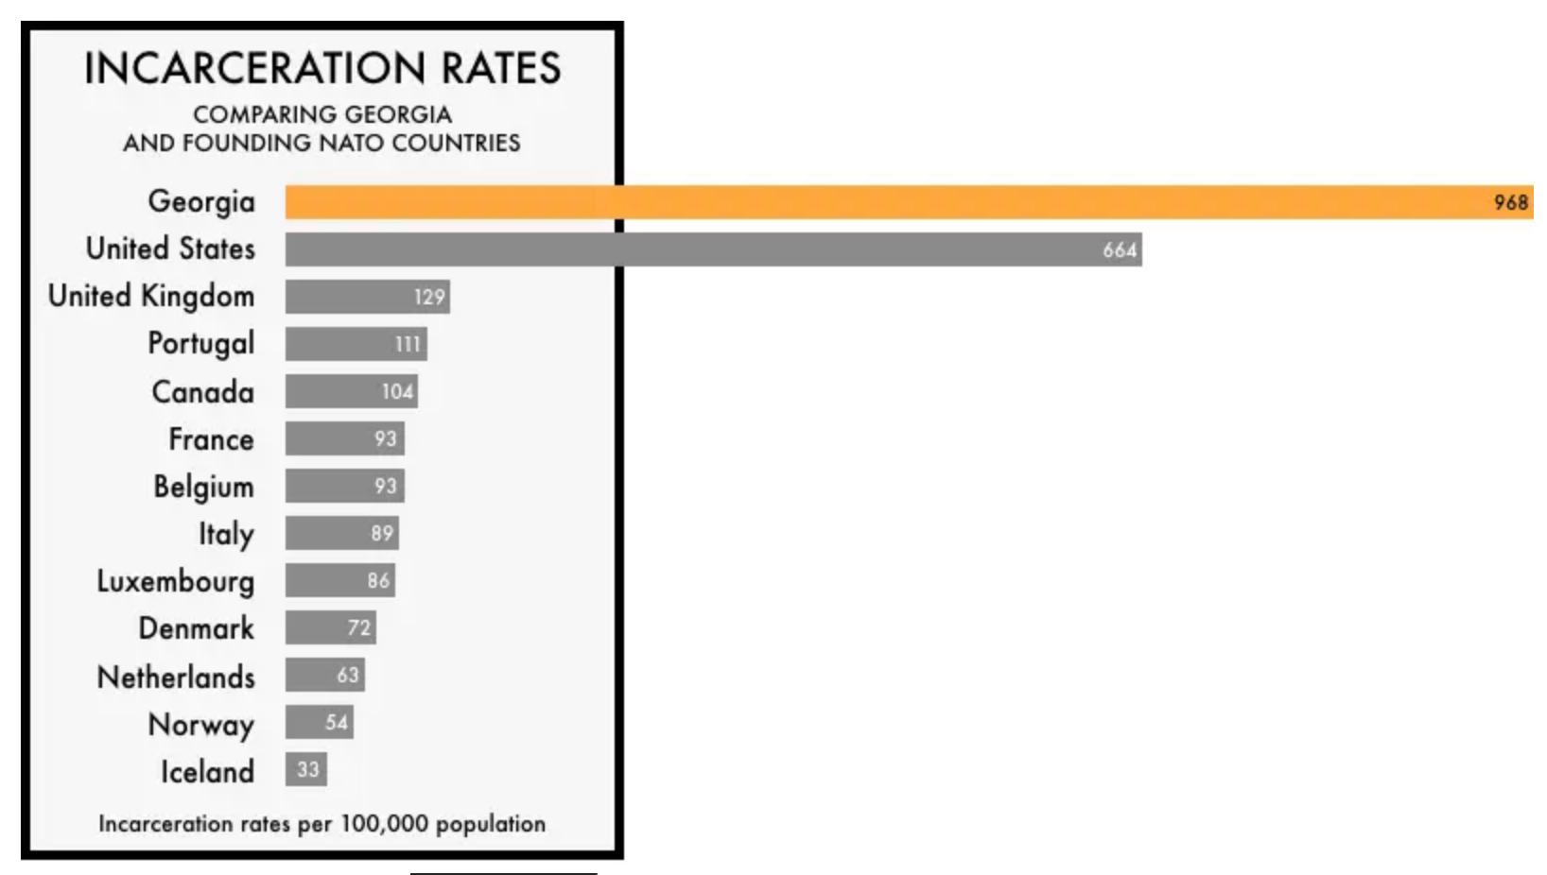
American Exceptionalism
> 1.9M Americans are currently incarcerated
> 10M incarcerated annually
77M have a criminal record
One in two adults have had an immediate family member incarcerated
Notes:
Half family member incarcerated ever: https://journals.sagepub.com/doi/10.1177/2378023119829332#_i8
https://everysecond.fwd.us/#chapter1-2
https://www.healthaffairs.org/content/forefront/mass-incarceration-makes-us-all-sick
https://www.healthaffairs.org/do/10.1377/hpb20210412.997570/full/
https://www.healthaffairs.org/content/forefront/incarceration-health-threat-why-isn-t-monitored-like-one
https://www.brennancenter.org/our-work/analysis-opinion/independent-oversight-essential-safe-and-healthy-prison-system

Slide 8
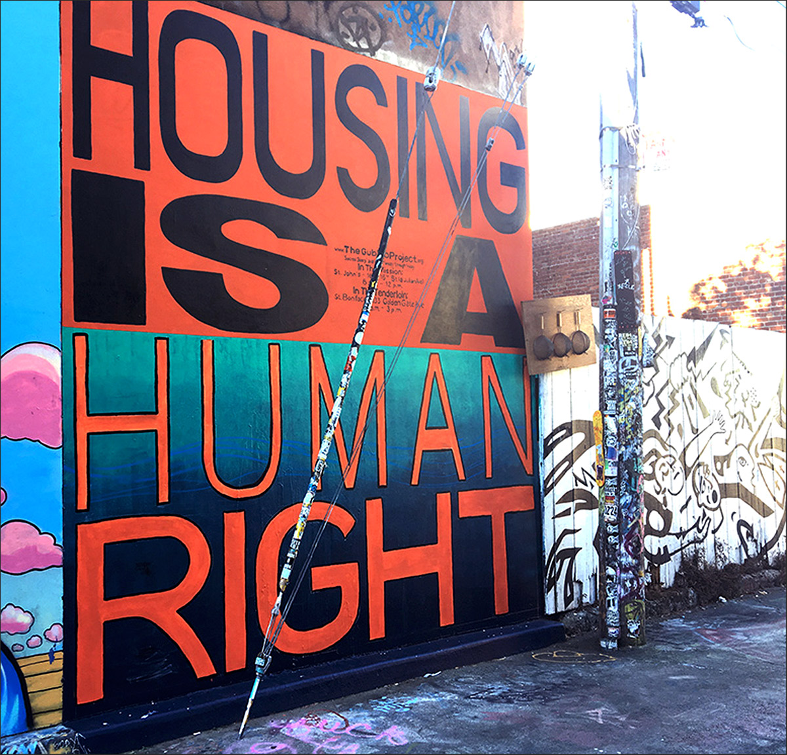
Incarceration: An experience for the vulnerable and marginalized
Nationally, Black individuals are incarcerated at five times the rate of white, and Hispanics at twice the rate of white
The average annual income for someone prior to prison: <$20,000
Half of those arrested more than once in a year earn < 10,000k annually
3X more likely unemployed, 25X more likely homeless prior to prison sentence
Notes:
https://scholarship.law.wm.edu/cgi/viewcontent.cgi?article=2032&context=wmborj
The Estelle court defined “deliberate indifference to serious medical needs” of prisoners as the “unnecessary and wanton infliction of pain” proscribed by the Eighth Amendment.29 Thus, a plaintiff challenging health conditions in a jail must show under that Eighth Amendment standard that, first, there was a sufficiently serious deprivation of medical care, and, second, that jail officials acted with a high level of intent, amounting to recklessness in depriving the individual of care, or deliberate indifference
Pretrial detention standards focus on the due process rights of arrestees, public safety and flight considerations of the government, and the liberty interests of the arrestee, but they do not clearly address health or public health concerns
A separate due process claim is also available to individuals confined pretrial in jails. In Bell v. Wolfish, the Court reaffirmed that the government cannot subject people in jails, prior to adjudication of guilt, to conditions that amount to punishment, and the Court set forth a due process rule used to distinguish punishment conditions from those that have a reasonable relationship to legitimate, non-punishing detention objectives
In Brown v. Plata, the Supreme Court ordered California to reduce overcrowding in prisons under the Eighth Amendment, noting the associated failure to provide healthcare to all inmates.35 In his majority opinion, Justice Kennedy referenced the lower court’s reasoning that overcrowding could lead to an “unconscionable degree of suffering and death,” and, along with Justices Ginsburg, Breyer, Sotomayor, and Kagan, ultimately affirmed the relief granted below
To successfully challenge jail practices under the ADA, a plaintiff must prove that they have a qualifying disability and that they were harmed by intentional discrimination, a disparate impact, or a failure to make a reasonable accommodation.39 Given the intentional discrimination showing that must be made under the statute, the ADA has not often been successfully used to challenge jail practices
the rapid spread of COVID-19 to people in jail and the surrounding communities, and judges declined to intervene under the relevant Fifth, Eighth and Fourteenth Amendments constitutional standards.45 In some cases, lower courts granted injunctions regarding constitutionally inadequate jail health protections.46 However, on three occasions, the U.S. Supreme Court rejected lower courts’ preliminary injunctions regarding jail conditions on its shadow docket, sending a strong message to lower courts that intervention was not warranted

Slide 9
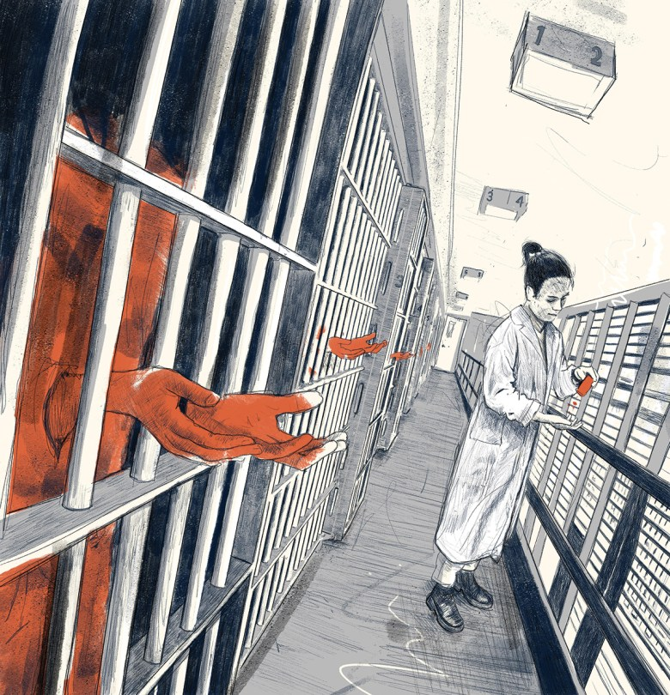
An experience for the vulnerable and marginalized
Roughly 50% in local jails and 40% in prisons have a diagnosed mental illness
Largest 3 facilities holding people with mental illness in the United States are jails
Despite multiple laws and guidelines, facilities routinely use solitary confinement at a higher rate for those with mental illness
During the COVID Pandemic, solitary use was increased 500%
Length often extends beyond International definitions of torture

Slide 10
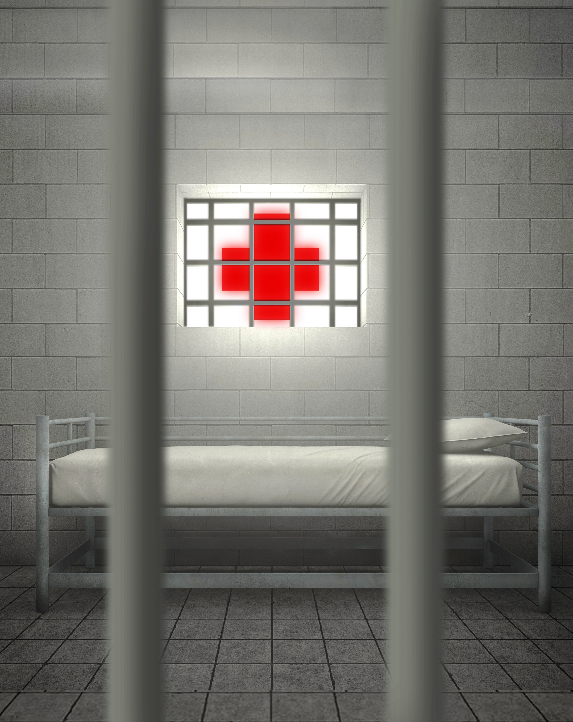
Incarcerated individuals have a high chronic disease burden
Including hypertension, diabetes, and kidney disease as well as infectious diseases including Hepatitis, TB, and HIV
3x higher rate of HIV in men, 9x in women. 20x higher rate of HCV
½ - 2/3 of those in jail have a substance use disorder
Majority of carceral facilities do not follow evidenced based recommendations for OAT/MOUD
Risk of overdose following incarceration extraordinarily high
Up to 120x higher than general population first two weeks following release, 12x higher risk death of any cause

Slide 11
Incarceration devastates entire communities
Individuals with incarcerated immediate family members have 2.6 years shorter life expectancy
Statistically significant lower ratings on physical health, mental health, social well being, and spiritual well being
2/3 of families with an incarcerated loved one have difficulty meeting basic needs
58% of women in prison and 80% in jails are mothers, vast majority primary care givers

Slide 12
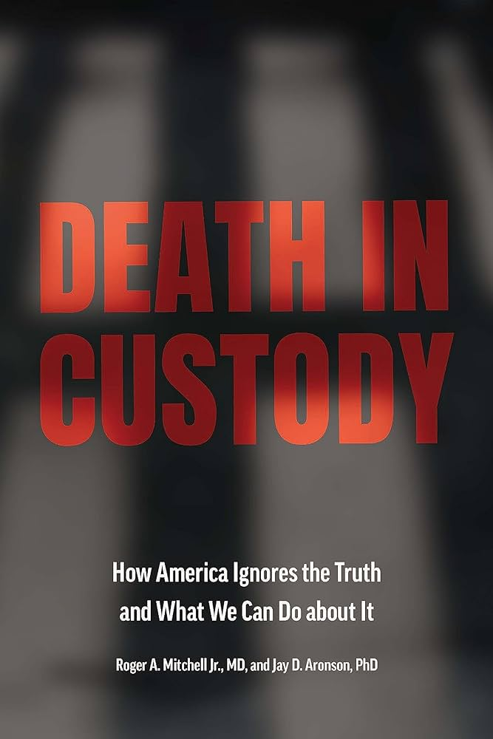
Incarceration produces premature death
Consistently documented over 1,000 deaths annually in jails
1,200 in 2019, 77% were not convicted of a crime
40% died held less than one week
Number one cause of death in jail is suicide, 3x more likely than general population
4,234 deaths in state or federal prison in 2019
Deaths increased 46% in prisons from 2019 to 2020 to over 6,000
One year spent incarcerated removes two years from an individual’s life expectancy
“Since October 2019, the DOJ has missed at least 18 percent of all deaths in state prisons, 39 percent of deaths in local jails, and between 62 and 71 percent of deaths in police custody…”
- September 2022 Report. Despite the Death in Custody Reporting Act (DCRA) of 2014

Slide 13
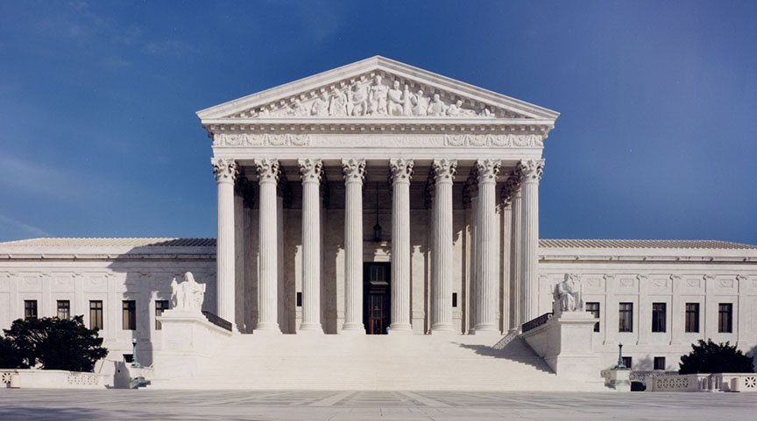
Estelle vs Gamble – Healthcare Rights
Incarcerated individuals have a constitutional right to healthcare stemming from a 1976 Supreme Court case that ruled “deliberate indifference to serious medical needs of prisoners” was inconsistent with the eight amendment right to no cruel and unusual punishment.
More recently, a 1987 case stated that an adequate level of care should be “reasonably commensurate with modern medical science.”
2015 UN Standard Minimum Rules for the Treatment of Prisoners (Nelson Mandela Rules) state, “healthcare of prisoners is a state responsibility, and should be on an equal standard to that available in the community…”
Notes:
In practice, the Estelle standard for establishing an Eighth Amendment violation is a very high bar to meet. Federal courts have stated that to constitute deliberate indifference, “treatment must be so grossly incompetent, inadequate, or excessive as to shock the conscience or to be intolerable to fundamental fairness”
In Helling v. McKinney (1993), the Court expanded on the Estelle decision, finding that the Eighth Amendment also “protect[ed] against future harm to in
The subjective component entailed assessing the prison authorities’ intent: Were they aware of allegedly dangerous jail conditions that they deliberately ignored? These two criteria remain the legal standard for correctional health care litigation.mates” — specifically, the risk associated with long-term exposure to environmental tobacco smoke

Slide 14
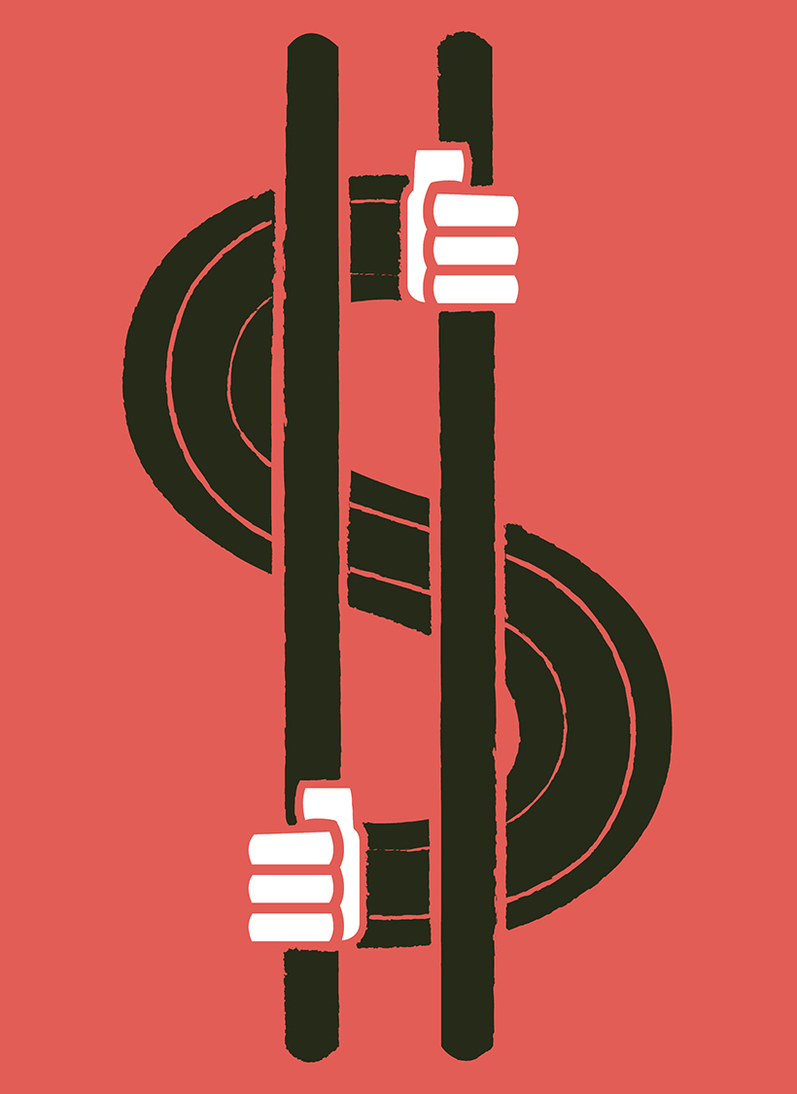
Rights vs. Reality
Overall lack of transparency and accountability
No national mandatory standards
Some voluntary accreditation
“Inmate Exclusion Clause”
Majority of the 3,000+ jails and state prisons have for-profit contractors
Deliberate indifference: “treatment…so grossly incompetent, inadequate, or excessive as to shock the conscience…”
WellPath (Correct Care), Corizon, Naphcare, Armor, Centurion
Over 13,000 lawsuits related to health from 1985 – 2022
NPR
Notes:
https://www.nejm.org/doi/full/10.1056/NEJMms2211252
A 2019 New Yorker article reported that 1500 lawsuits had been filed between 2013 and 2018 against two of the largest U.S. providers of jail health care (Corizon Health and Wellpath) for neglect, malpractice, or wrongful injury or death.¹⁶ Our own research yielded approximately 13,000 cases between 1985 and 2022 that cite Estelle and contain the search terms <“prisoner” or “inmate”> and <“healthcare” or “health care”>. These numbers reflect only incarcerated people who successfully filed a lawsuit, which is most likely a small proportion of potential litigants.
The primary statutory barrier is the Prison Litigation Reform Act (PLRA), which restricts a person’s ability to seek legal recourse while incarcerated.
The requirement that “administrative remedies” be “exhausted” before civil action may be pursued effectively requires that incarcerated people — many of whom have mental illnesses and cognitive disabilities, and who are on average less educated than the general population — comprehend and comply with exacting and varying grievance policies, such as filing handwritten complaints within a limited time after an alleged incident
The resulting injustice — high incarceration rates, unchecked neglect of incarcerated people’s health, and restrictions on legal redress — has prompted organizations and legislation, including the American Bar Association and provisions of House Resolution 702 (The People’s Justice Guarantee), to call for the PLRA’s amendment or repeal
https://blog.petrieflom.law.harvard.edu/2022/01/26/medicaid-inmate-exclusion-policy/
Inmate exclusion

Slide 15
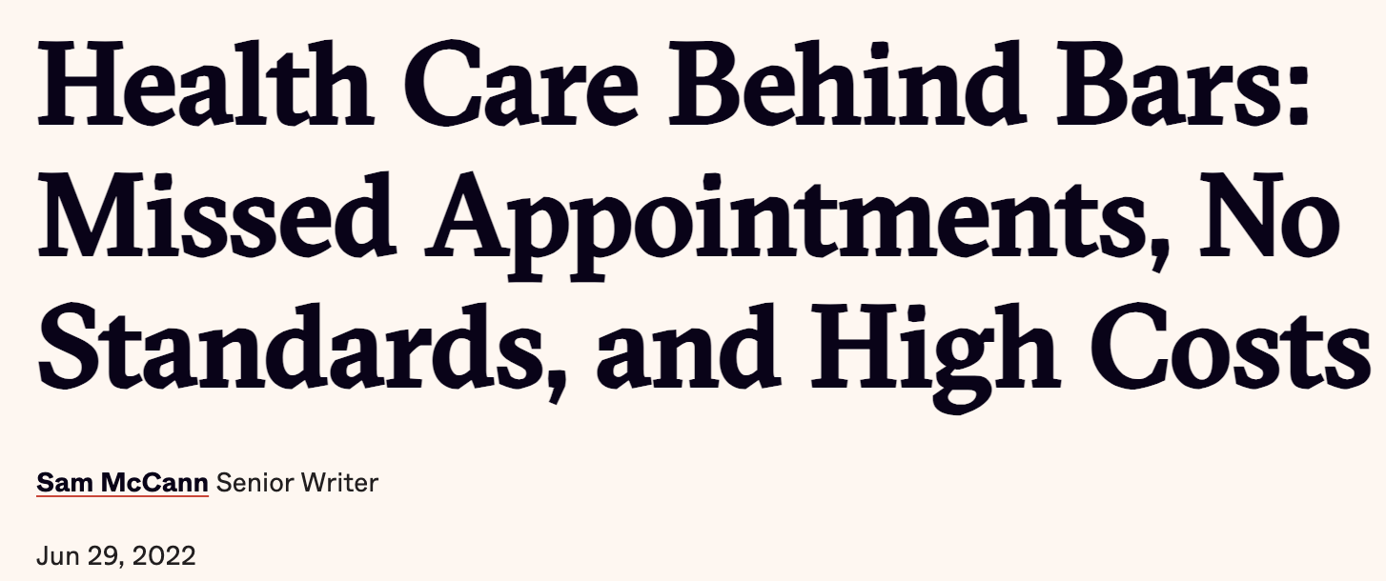
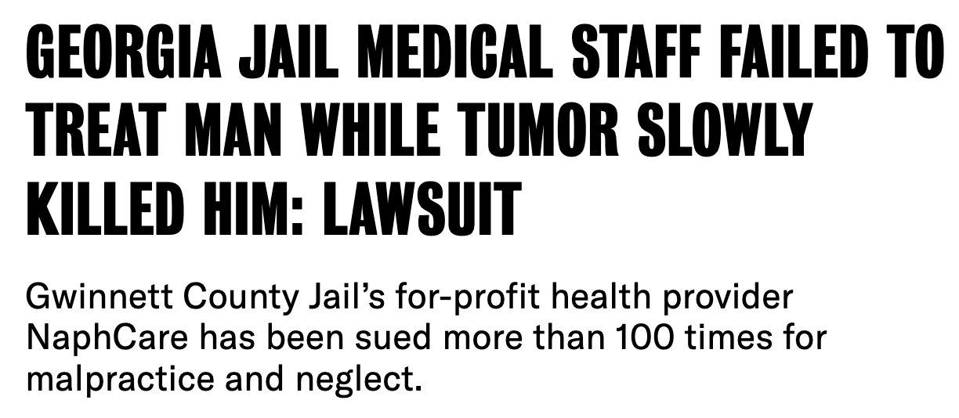
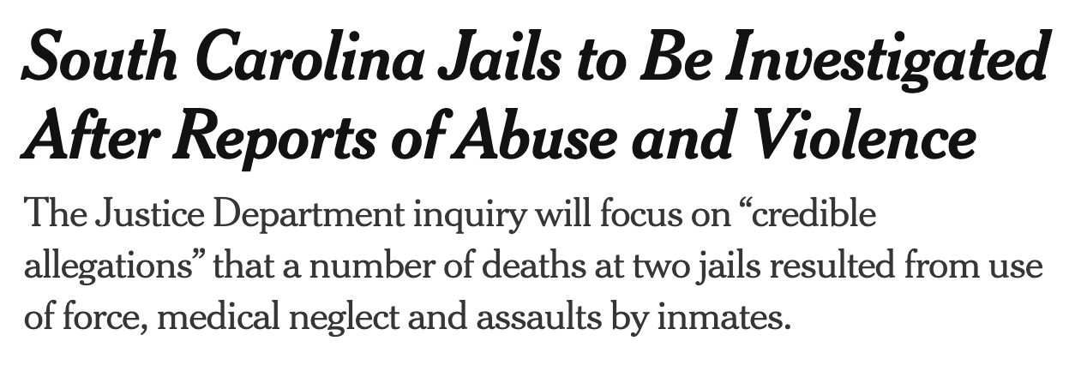
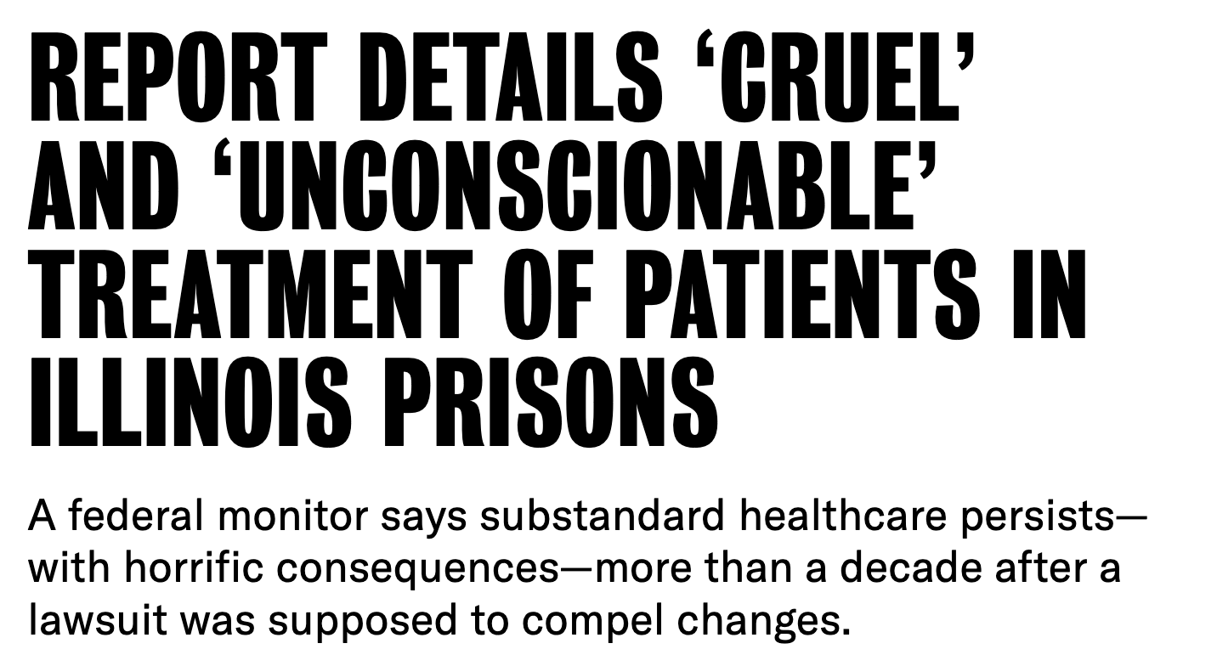
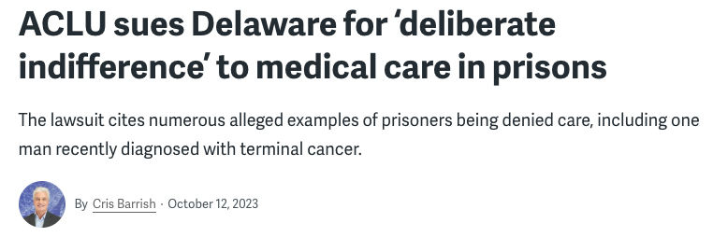

Slide 16
Challenges of Carceral Healthcare
Issue of Dual Loyalty
Security over health
Profit over health needs
Complex medical co-morbidities
Frequently low / unqualified / disinterested staff
Dehumanization and devaluation
Medical co-pays despite incarcerated hourly wages ranging from $0.00 - $0.68
Congregate settings
Direct and indirect exposure to physical and sexual violence
Poor nutrition
Extreme weather

Slide 17
OUTLINE
The Carceral State
Incarceration in America today
Benefits and Limitations
Single Payer as Harm Reduction
Starving The Beast
Redefining Public Safety

Slide 18
BRAINSTORM
2 Minutes
Notes:
What is on your “wishlist” for a single payer system? What do you want included? What other investments do you want tied to it beyond being an “insurance plan”?

Slide 19
Benefits and Limitations
“The…organizations that run the jails are focused on security, and their view of health care is extremely narrow and usually limited to preventing death and defending against lawsuits.”
-Homer Venters, former Chief Medical Officer NYC Jails

Slide 20
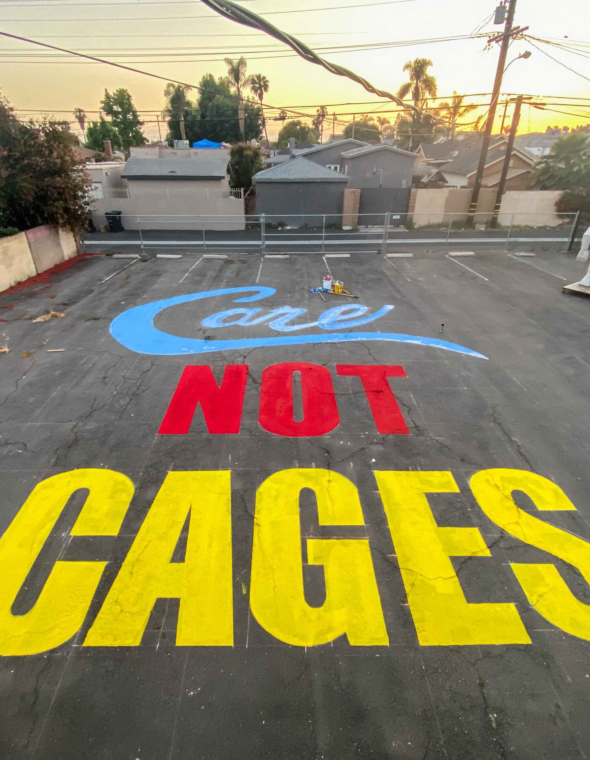
Single Payer as Harm Reduction
Reduces Cost Pressure
20% of all carceral related costs are healthcare related
Could eliminate profit incentives
Aging prison population high cost
Cover hospital-based care / transport
Provide ALL medications
Possibility of universal formulary

Slide 21
Single Payer as Harm Reduction
Mandatory Oversight
Standards from CMS
Universal formulary
Reporting deaths in custody (check-box)
Ex. Treatment of OUD (more guideline-based care less stigma based)
Improve Coordination of Care
Mandate EMR access (or even universal EMR)
New standards on release from jail or prison: Meds, Follow Up
No lapse in coverage
No co-payments
Notes:
CMS recently approved a first-of-its-kind Section 1115 demonstration amendment that allows Medicaid to fund limited services, including treatment for substance use disorders, for people who are incarcerated in California state prisons, jails, and juvenile detention centers up to 90 days before their release

Slide 22
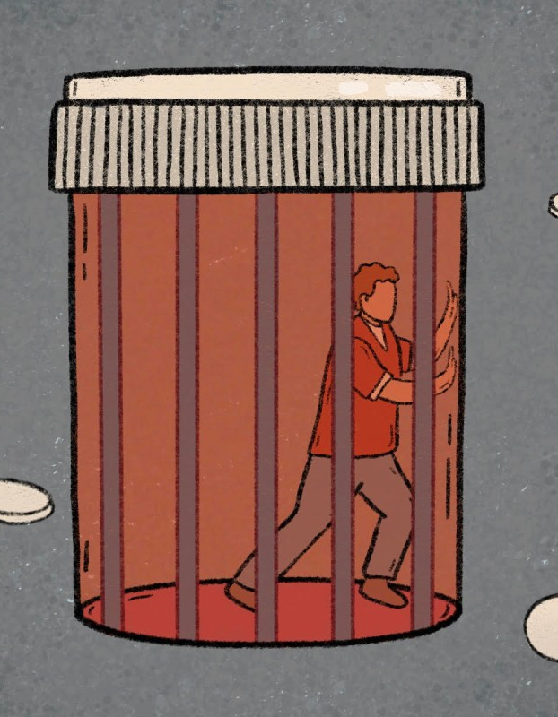
Limitations
It is not simply medical neglect that is killing patients but the institutions themselves
Will not, on its own, reduce number of incarcerated people
Academic focus on “improvements” and not ongoing harms or better alternatives
Will not address dual loyalty, stigma, dehumanization, violence, other environmental and cultural factors
Notes:
Extremely limited!!! The causes are not just due to the jail!!
--many deaths (“jail attributable”) are not from neglect but other causes and factors!
Not therapeutic environment

Slide 23
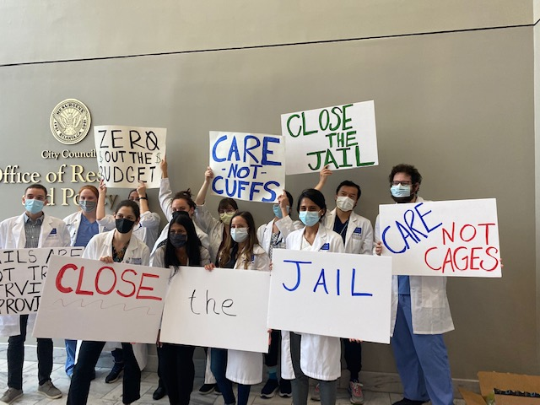
Limitations
Can feed argument that jails are effective service providers
“jail care” is failed care
Goal is not to simply provide “coverage” for incarcerated people
Technically already have this
Medical reforms will not happen willingly
Litigation limited tool for improvement: Difficult and lengthy process, reactive by nature, risk retaliation
Notes:
https://inquest.org/treating-unfreedom/
Limitation
In 2015, people incarcerated in Massachusetts state prisons filed a class-action lawsuit alleging that the Massachusetts Department of Correction (DOC) had violated their Eighth Amendment rights by denying treatment for hepatitis C with newer and more effective medications.²³ DOC records showed 3 incarcerated people undergoing treatment out of 1500 diagnosed with hepatitis C.²⁴ In a settlement, the DOC agreed to treat prisoners with direct-acting antiviral drugs, routinely test those with hepatitis C, and offer diagnostic testing to newly incarcerated people.²³ Though the settlement covered everyone with hepatitis C in Massachusetts state prisons, it had minimal impact outside the state. Furthermore, the court agreement and third-party monitoring of compliance expired after 30 months.²³
American Civil Liberties Union of Massachusetts and Goodwin Procter filed three lawsuits in 2018 and 2019 on behalf of five incarcerated persons, alleging that correctional authorities’ policies of denying medication for opioid use disorder (MOUD) violated the Eighth Amendment and Title II of the ADA.²⁵⁻²⁷ One lawsuit (Pesce v. Coppinger) ended in a preliminary federal injunction requiring Essex County to provide the plaintiff with continued access to methadone during his incarceration.²⁵ In settlements of the other two lawsuits (DiPierro v. Hurwitz and Sclafani v. Mici), the Federal Bureau of Prisons and the Massachusetts DOC agreed to provide plaintiffs with MOUD throughout their incarceration.^{26,27} These resolutions, however, apply only to the five plaintiffs.
April 2022, the U.S. Attorney’s Office in Massachusetts reviewed access to MOUD in Massachusetts state and county correctional facilities; it then affirmed that opioid use disorder is considered a disability under the ADA and stated that all Massachusetts correctional facilities must provide inmates access to all MOUD.²⁸ Although access to MOUD in Massachusetts has increased, the benefits are again limited to that state and apply only to persons who were already receiving MOUD before entering custody. These limitations exacerbate underlying inequality in access to substance use disorder treatment outside correctional facilities
^{Future risk:} Thus, a new interpretation of the Eighth Amendment that rejects consideration of evolving standards of decency seems a distinct possibility, given the confluence of a Supreme Court inclined to reevaluate long-standing precedent and multiple high-profile correctional health care cases related to Covid-19 currently working their way through the system

Slide 24
Carceral Humanism: The myth of a more humane cage
Frame “…the jailers as caring social service providers,” with the goal of locking in these services behind prison walls and creating public support for this institutionalization. – James Kilgore
Also includes investments in “kinder, gentler” forms of control
Electronic Monitoring, Drug Courts, Specialized Reform Centers, Mental Health Jails, Women-Specific Jails
All inevitably replicate the harmful environments framed as solutions to
Notes:
Carceral humanism extends beyond the push to see jails and prisons as legitimate social service providers. It can also be seen through other proposed tweaks to the criminal legal system that are framed as gentler, kinder forms of control, such as drug courts or electronic surveillance programs. In the end, these structures and practices often expand the net of criminalization and continue to rely on punitive systems that do not meet the needs of those they claim to serve. Likewise, carceral humanism is seen in the push to build special juvenile “reform centers,” mental health jails, and women’s jails, all of which end up replicating the harmful environments they were framed as solutions to.
This propaganda, or copaganda, primes us to view carceral humanism as “win-win”—more humane environments that also provide public safety benefits.

Slide 25
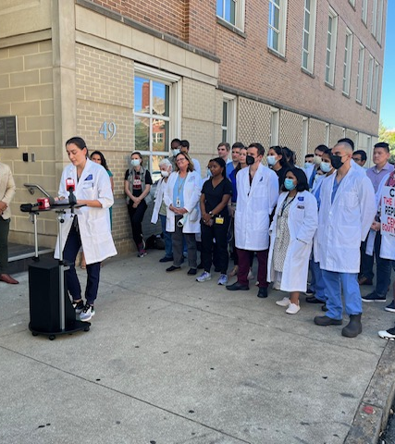
Carceral Spaces are not Life Affirming Institutions
“A locked treatment facility run by the Sheriff is not a life-sustaining resource of community support but just a façade for a jail.”
- Justice LA
“There is no healing inside of any cage.”
- Robyn Hasan, Women on the Rise
The myth of the “Win-Win” of carceral humanism: More humane environments that also provide public safety benefits!
Notes:
Happening now in Atlanta and across the country

Slide 26
OUTLINE
The Carceral State
Incarceration in America today
Benefits and Limitations
Single Payer as Harm Reduction
Starving The Beast
Redefining Public Safety

Slide 27
Starving The Beast
“Instead of asking whether anyone should be locked up or go free, why don’t we think about why we solve problems by repeating the kind of behavior that brought us the problem in the first place?”
- Professor Ruth Wilson Gilmore

Slide 28
“It is a sad irony that a political process that obsessively uses the rhetoric of public safety ends up producing so many policies that in fact undermine it.” - Professor Rachel Barkow

Slide 29
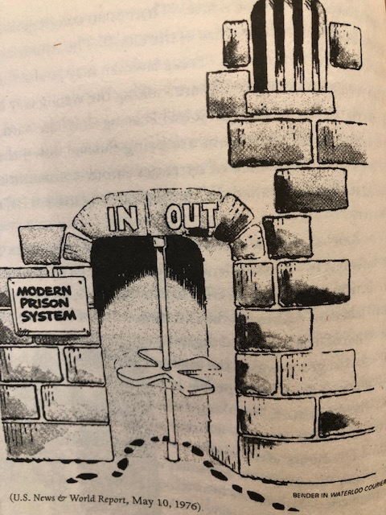
Public Safety Today
Meta-analysis of 116 studies found incarceration has no effect on reoffending or slightly increases risk of reoffending
”Incarceration cannot be justified on the grounds it affords public safety by decreasing recidivism”
Research consistently shows higher incarceration rates not associated with lower violent crime rates
More severe punishment repeatedly shown to have no effect on deterrence
2016 Brennan Center for Justice report: Nearly 40 percent of the U.S. prison population is incarcerated without any compelling public safety justification
Over 80% arrests for misdemeanors
Less than 5% police time on violent crime
Over 90% of 911 calls not related to violence
Notes:
https://time.com/6278659/how-community-health-workers-can-end-mass-incarceration-rebuild-public-safety/
Dr. Reinhart
--” I proposed the creation of a new federal Department of Community Safety and Repair to build a national community health and justice worker corps to end mass incarceration, build integrated public health and safety systems, and shrink reliance on notoriously reactive and ineffective U.S. policing and for-profit healthcare industries. As the basis of a new infrastructure for public safety and renewed public health workforce, I argued for an initial target of two million community health and justice workers—about half the number of public jobs provided by policing, prosecution, and prisons. I also argue that we should preferentially employ formerly incarcerated people in these positions in order to make use of dignified, gainful public jobs as a key means of enabling safe reintegration after incarceration and repairing social fabric in criminalized communities.”

Slide 30
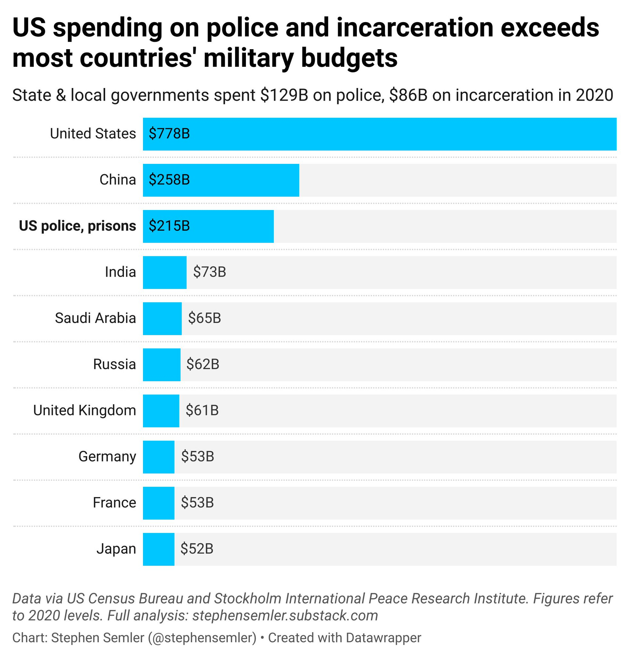
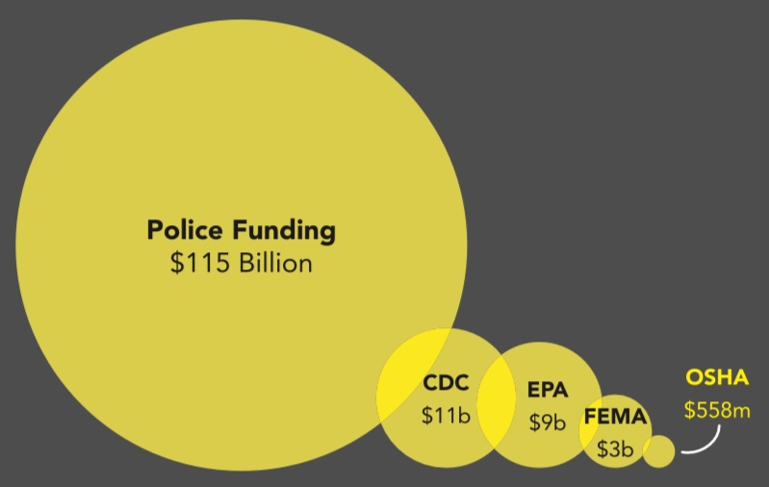

Slide 32
Right to Safety and Health: Values for Single Payer and a New Public Safety Paradigm
Focus on prevention
Reject idea that human beings are disposable
Discard the one size fits all model
Non-punitive responses to harm
Reconsider premise of punishment as justice
Reject false choice of policing and incarceration or nothing
Focus on Harm, not Crime
Address structural violence

Slide 33
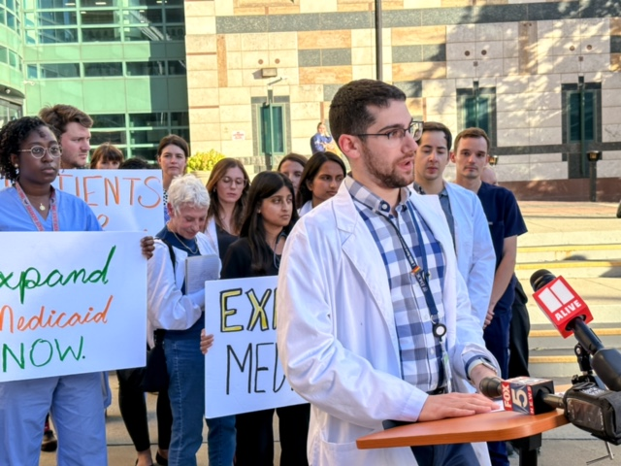
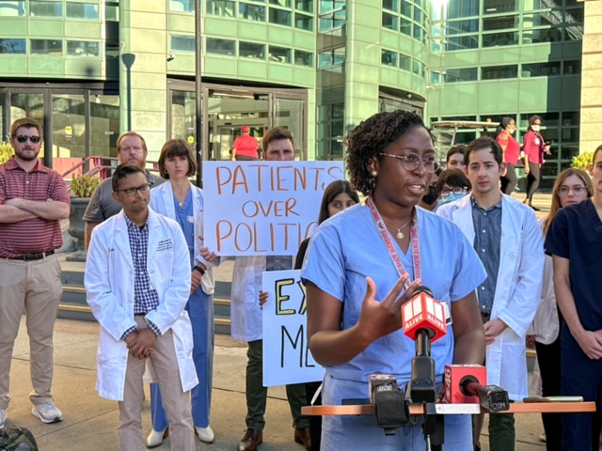
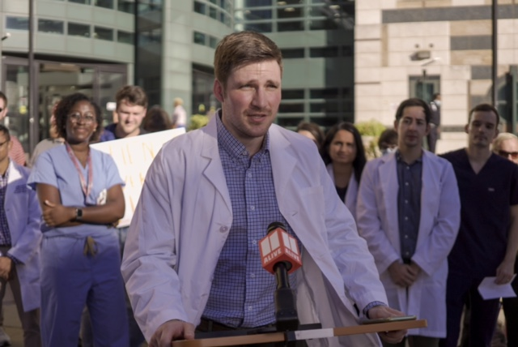
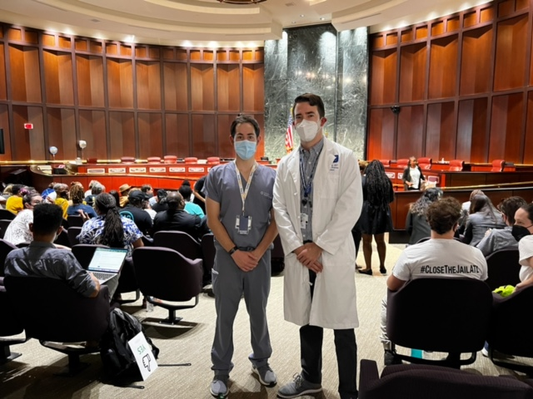
Single Payer Can Change…
Healthcare Workforce
Medical training
Community based care infrastructure
Childcare
Elder care
Housing
Patient outcomes
Responses to Harm in our hospitals
Responses to Harm in our communities
Responses to community concerns and needs
Public Health infrastructure
Public Safety
Hospital closures
Environmental protection
Reproductive rights
Labor rights
Notes:
Serve as ideological shift
Incarceration as one of the most expensive, ineffective interventions

Slide 34
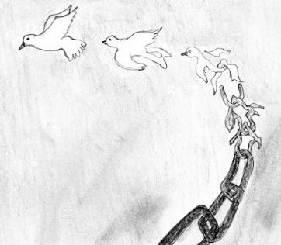
Public Safety For the Future:
Single Payer as Driving Force
Comparing countries, lower inequality is associated with lower rates of substance use disorders, mental health disorders, and homicide
Medicaid expansion alone shown to reduce violent and property crime and tied to reduced arrests, particularly drug-related ones
Review of 53 studies found evidence for non-carceral crime reduction from early childhood education, housing provision, healthcare, employment, social support, expansion of college in carceral facilities, re-entry programming
Removal of SSI associated with 20% increase in crime, majority with income generation primary motive. 60% higher chance incarceration
CBT found to lower crime
Notes:
https://inquest.org/policing-health/
Our results show that Medicaid expansion had a striking effect on arrests. We estimated a 20 to 32 percent negative difference in the rate of arrest in counties in expansion states compared to counties in non-expansion states, an effect that was persistent in all three years of expansion, controlling for a wide range of confounding factors. The largest negative differences were in drug arrests — our findings suggest a 25 to 41 percent negative difference in the three years following Medicaid expansion relative to non-expansion counties. We also observed a 19 to 29 percent negative difference in arrests for violence during this period, and a decrease in low-level arrests between 24 to 28 percent in expansion counties compared to non-expansion counties.

Slide 35
1. Diversion and Alternate Response
Notes:
Most important no interaction with police – not criminalized – not incarcerated
Mental health
Substance use
Poverty
Other

Slide 36
Notes:
Reimaging a system that defaults to dispatching police – ACLU
Getting smart of safety – civil rights corps
The appeal
VERA
Death of johnny hollman

Slide 37
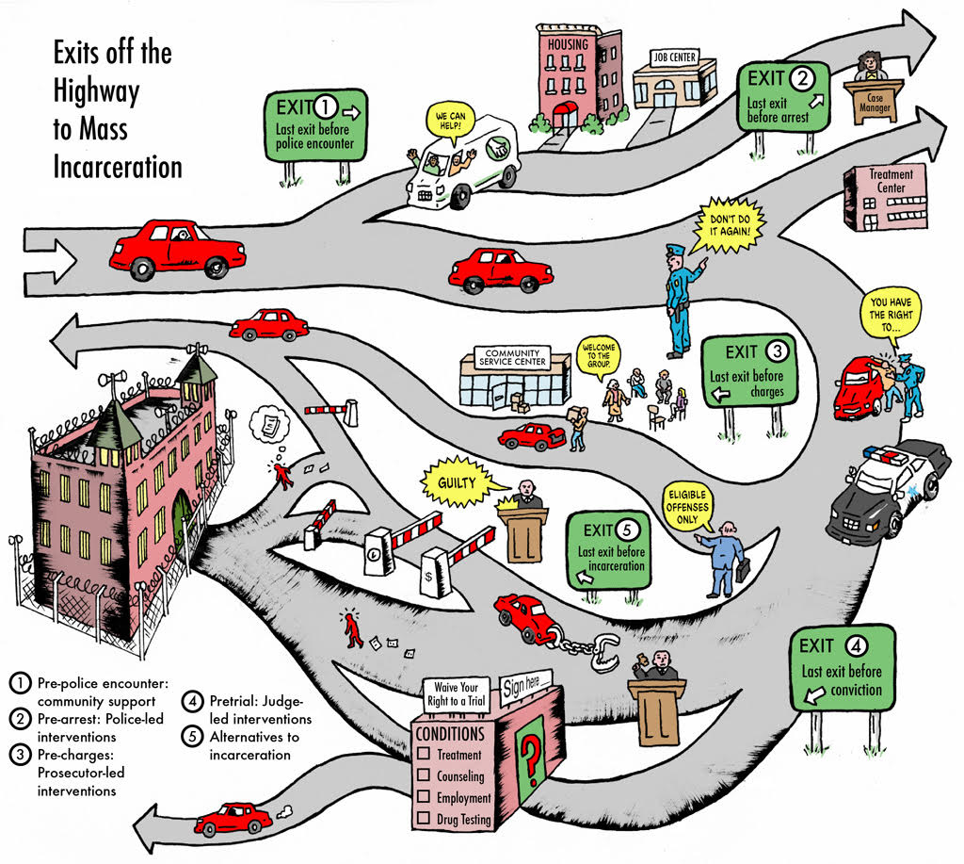
CAHOOTS (Crisis Assistance Helping Out On The Streets) – 2% police budget, 20% all 911 calls. 24,000 calls only 150 resulted in police presence
Notes:
Community violence interruption and intervention
Hospital based

Slide 38
Diversion and Alternate Response
Non-police control of dispatch
Qualifications for and make-up of response team
Ties to harm-reduction resources, including non-coercive mental health resources
Quality of training
Criteria for police involvement, if any
Accountability to most impacted individuals and communities
Credit: Interrupting Criminalization

Slide 39
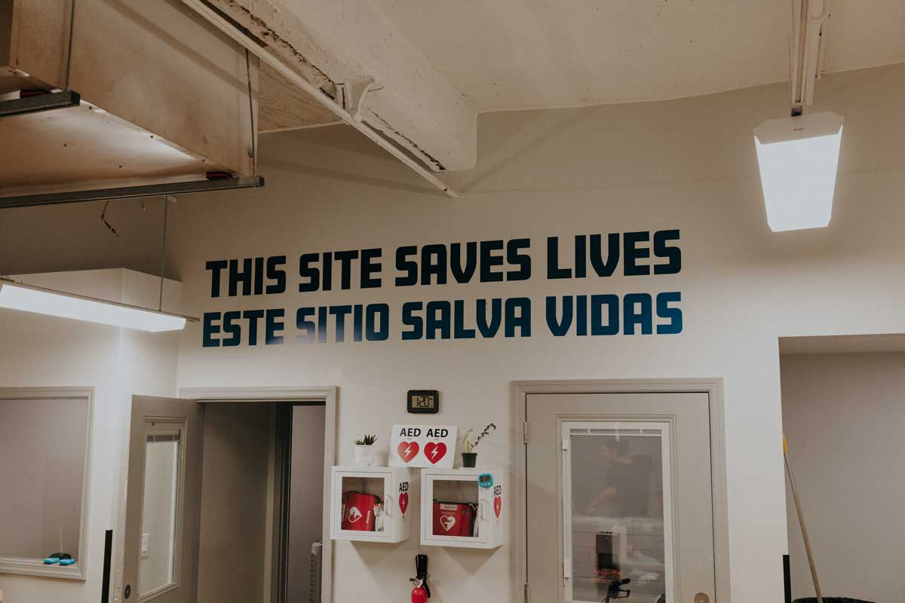
2. Decriminalization
Substance Use
From law enforcement (DEA to HHS)
Embrace harm reduction
Poverty and Housing Insecurity
Eliminate misdemeanors that drive cycle of jail, street, emergency rooms
No threat of medical debt
Mental Health
Access to affordable (free) mental health support
Accessible treatment in local community, less emergency room primary care
Alternate Crisis response (less need for crisis response)

Slide 40
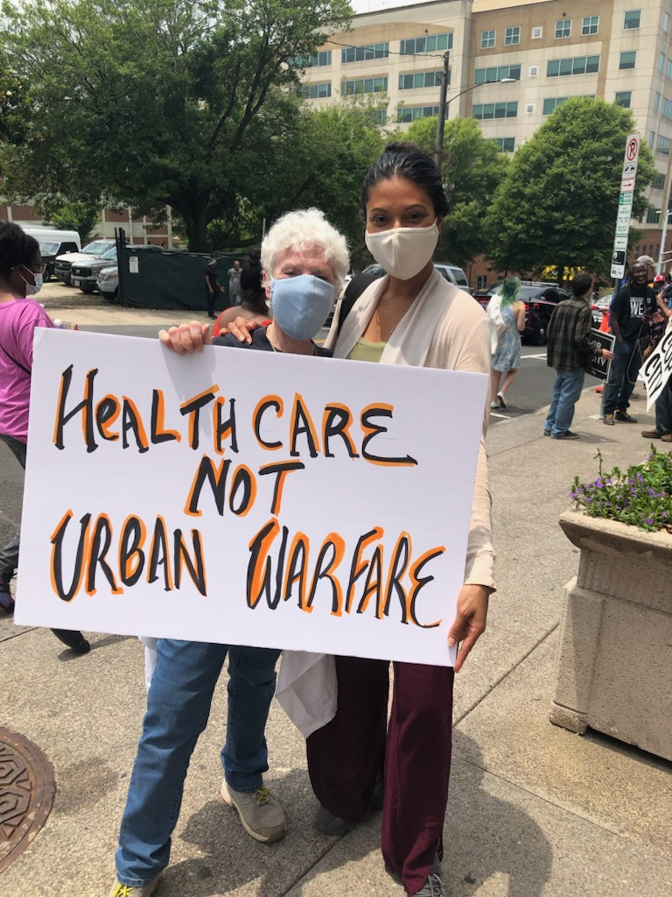
The War on Drugs: Crime vs Harm
Decriminalization
Every 23-25 seconds in the United States, someone is arrested for possessing drugs
Number one arrest remains drug possession
Increasingly volatile drug supply has led to over 100,000 deaths in the past year
Iron Law of Prohibition
“Most of the harm we tend to think of as being drug-related is actually drug-policy-related.”
- Maia Szalavitz
¹ HRW 2016
² DPA 2021

Slide 41
Criminalization: A Failed Intervention
“Incarceration is…limited as a tool because it treats violence as a problem of “dangerous’ individuals and not as a problem of social context and history…Poverty drives violence. Inequity drives violence. Lack of opportunity drives violence. Shame and isolation drive violence. And like so many conditions known all too well to public health professionals, violence itself drives violence.”
- Danielle Sered, Founder Common Justice

Slide 42
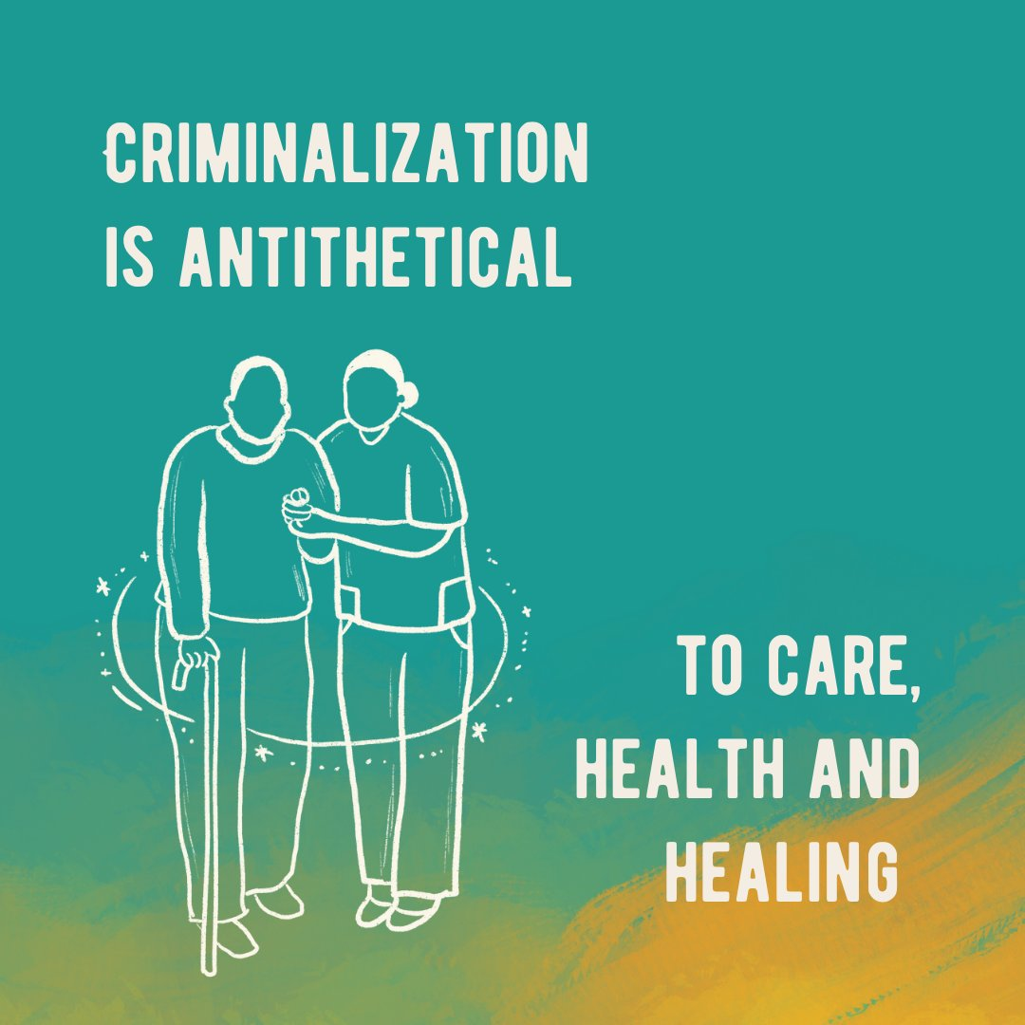
Addressing Harm when it occurs
Goal of prevention
Alleviate many structural policy harms that drive interpersonal harm
Restorative Justice
Transformative Justice
No formula, not one size fits all
Individualize context
“The state bears the responsibility for creating the conditions that perpetuate intracommunal violence, while simultaneously actively ignoring these conditions.” – Chicago Torture Justice Center
Credit: Amplify RJ
Notes:
Restorative – focuses on identifying impacts and needs, humanizing and collaborative language, building and repairing relationships as motive.
Vs. Punitive – focuses on blame and punishment, dehumanizing and adversarial language, controlling behavior using fear as motive.

Slide 43
Restorative Justice
Primary Questions asked:
Who has been hurt?
What are their needs?
Who is responsible for righting the harm?
What happened?
Legal system: What rules were broken? Who did it? What do they deserve?
Does not center victim or encourage accountability
Reduces recidivism 7-45%, more pronounced for violent offenses
91% victims would recommend process
Notes:
Howard zehr
These are processes that single payer bill and partner bills can fund!

Slide 44
3. Decarceration
Early Release
Mandatory review by release boards
Maximum sentence reform
Change configuration of release board
More medical release under purview of medical professionals
Elimination of Parole and collateral consequences
Ineffective and expensive
Drives cycles of incarceration from technical violations
Notes:
Parole grant rate dropping
Compassionate release rates very low

Slide 45
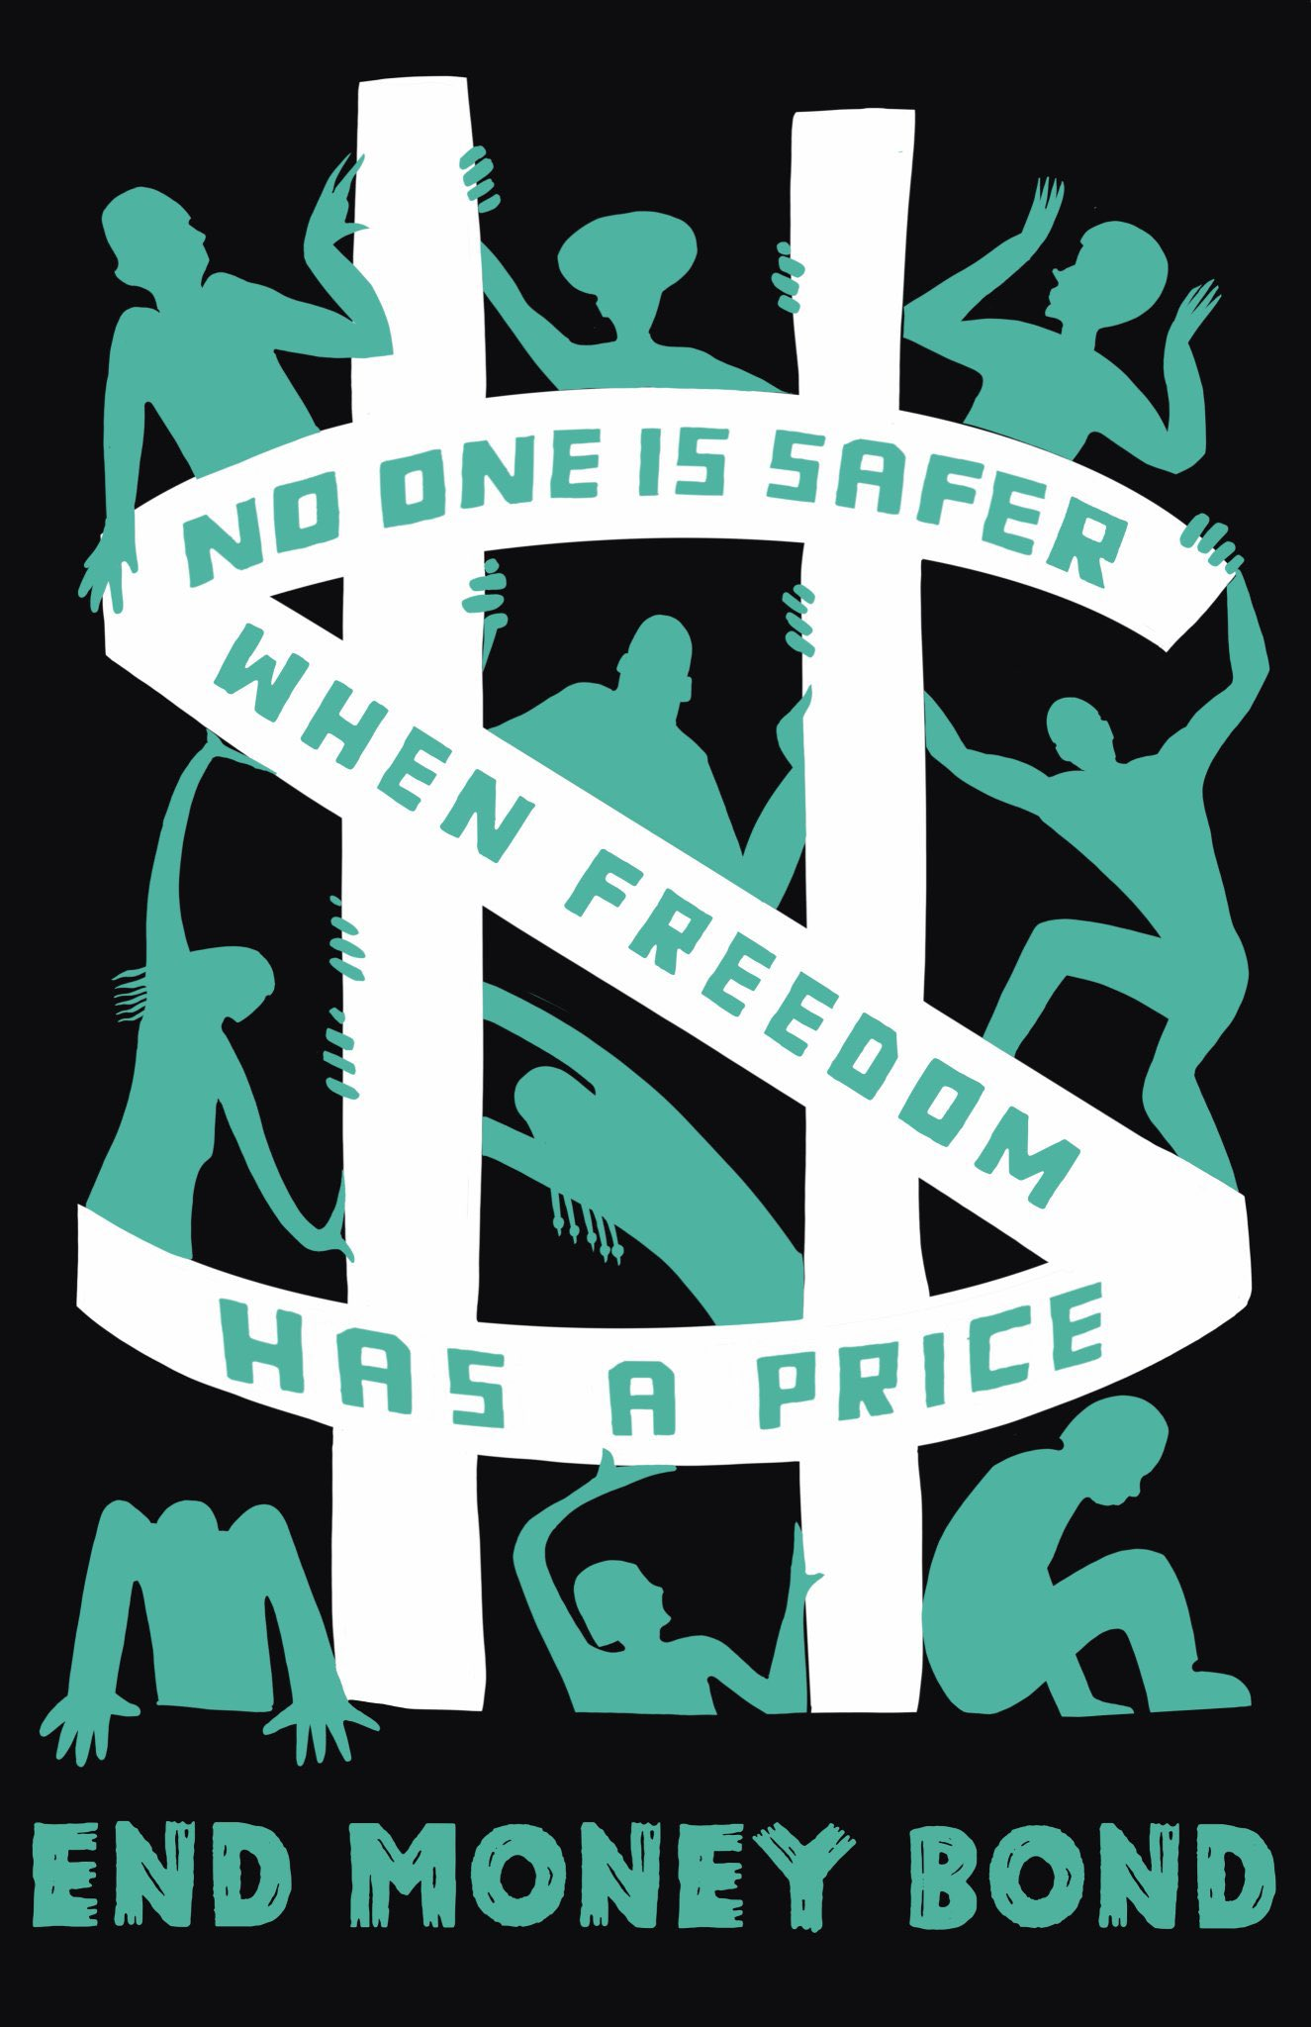
Decarceration
Elimination of Cash Bail
Does not promote safety, undermines it
Contributes to overcrowding, trauma, neglect, job loss, family separation
Build Alternatives to punishment, not alternative punishments
Avoid pitfalls of carceral humanism
“care not cuffs”, “care not cages”

Slide 46
“Approximately eight percent of adults in the United States have a felony conviction. The “collateral consequences” of criminal conviction (CCs) — legal disabilities imposed by legislatures on the basis of conviction, but not as part of the sentence — have relegated that group to permanent second class legal status.”
- Sandra Mayson, Professor of Law

Slide 47
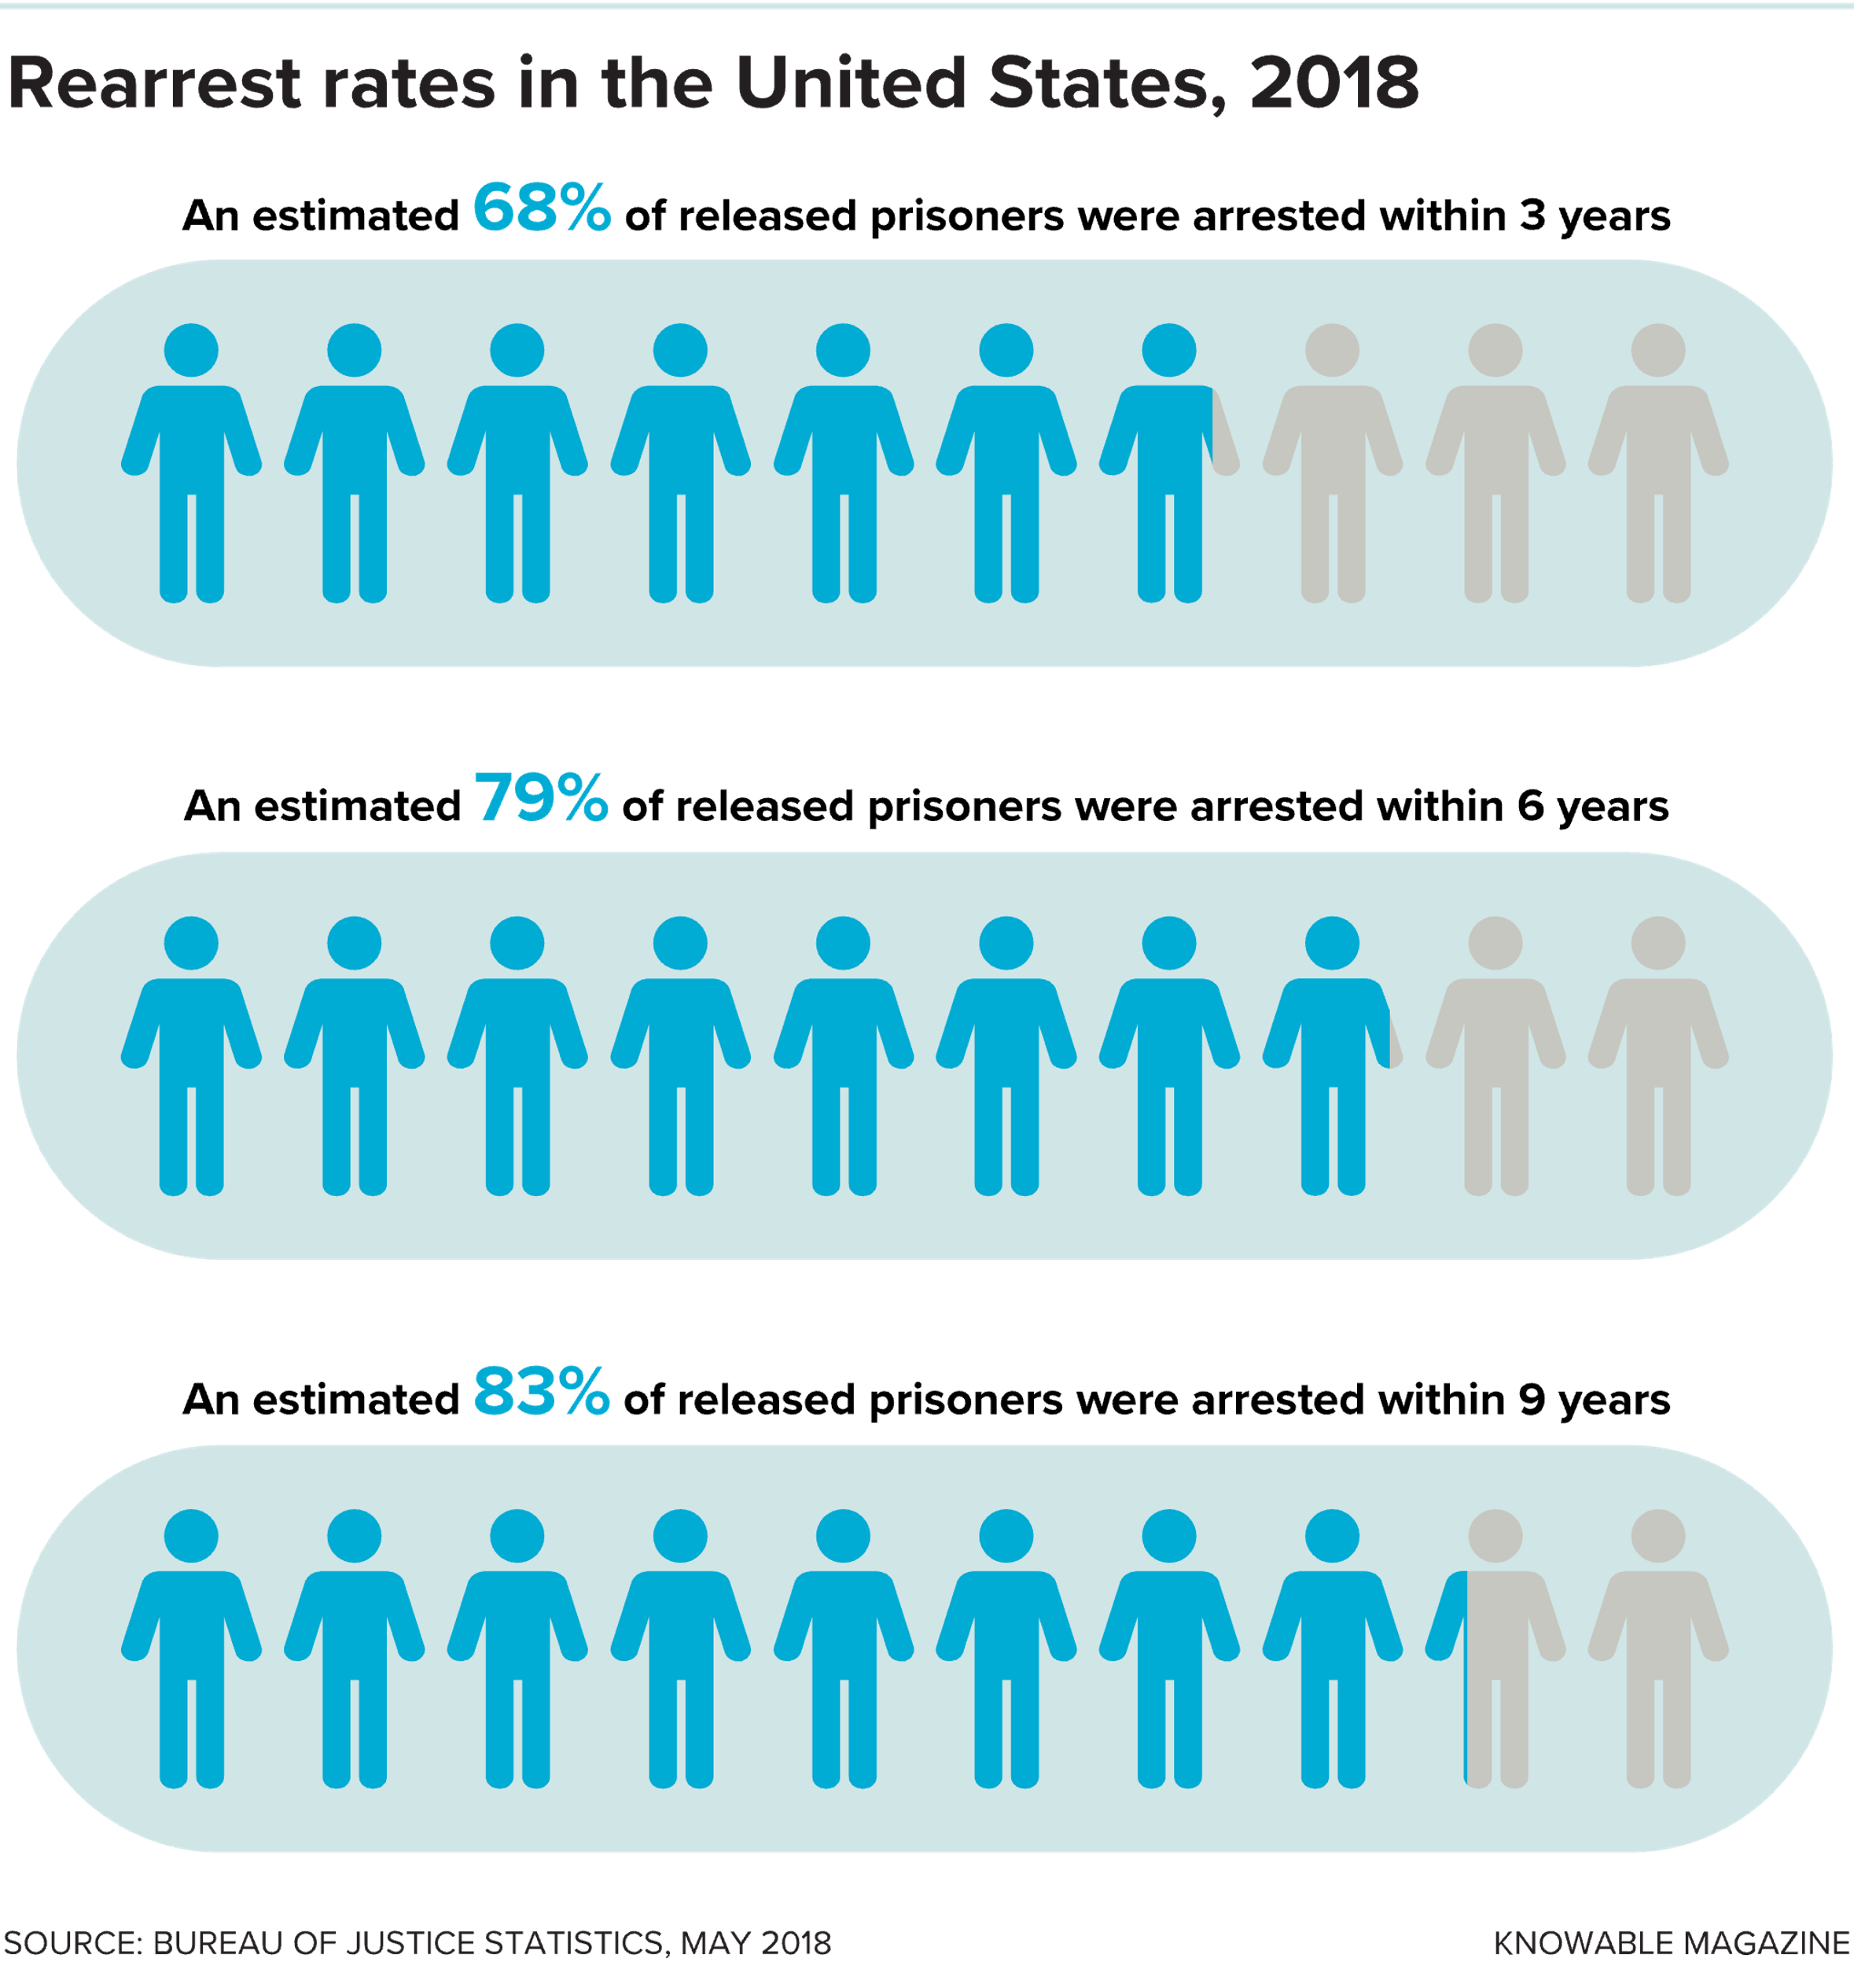
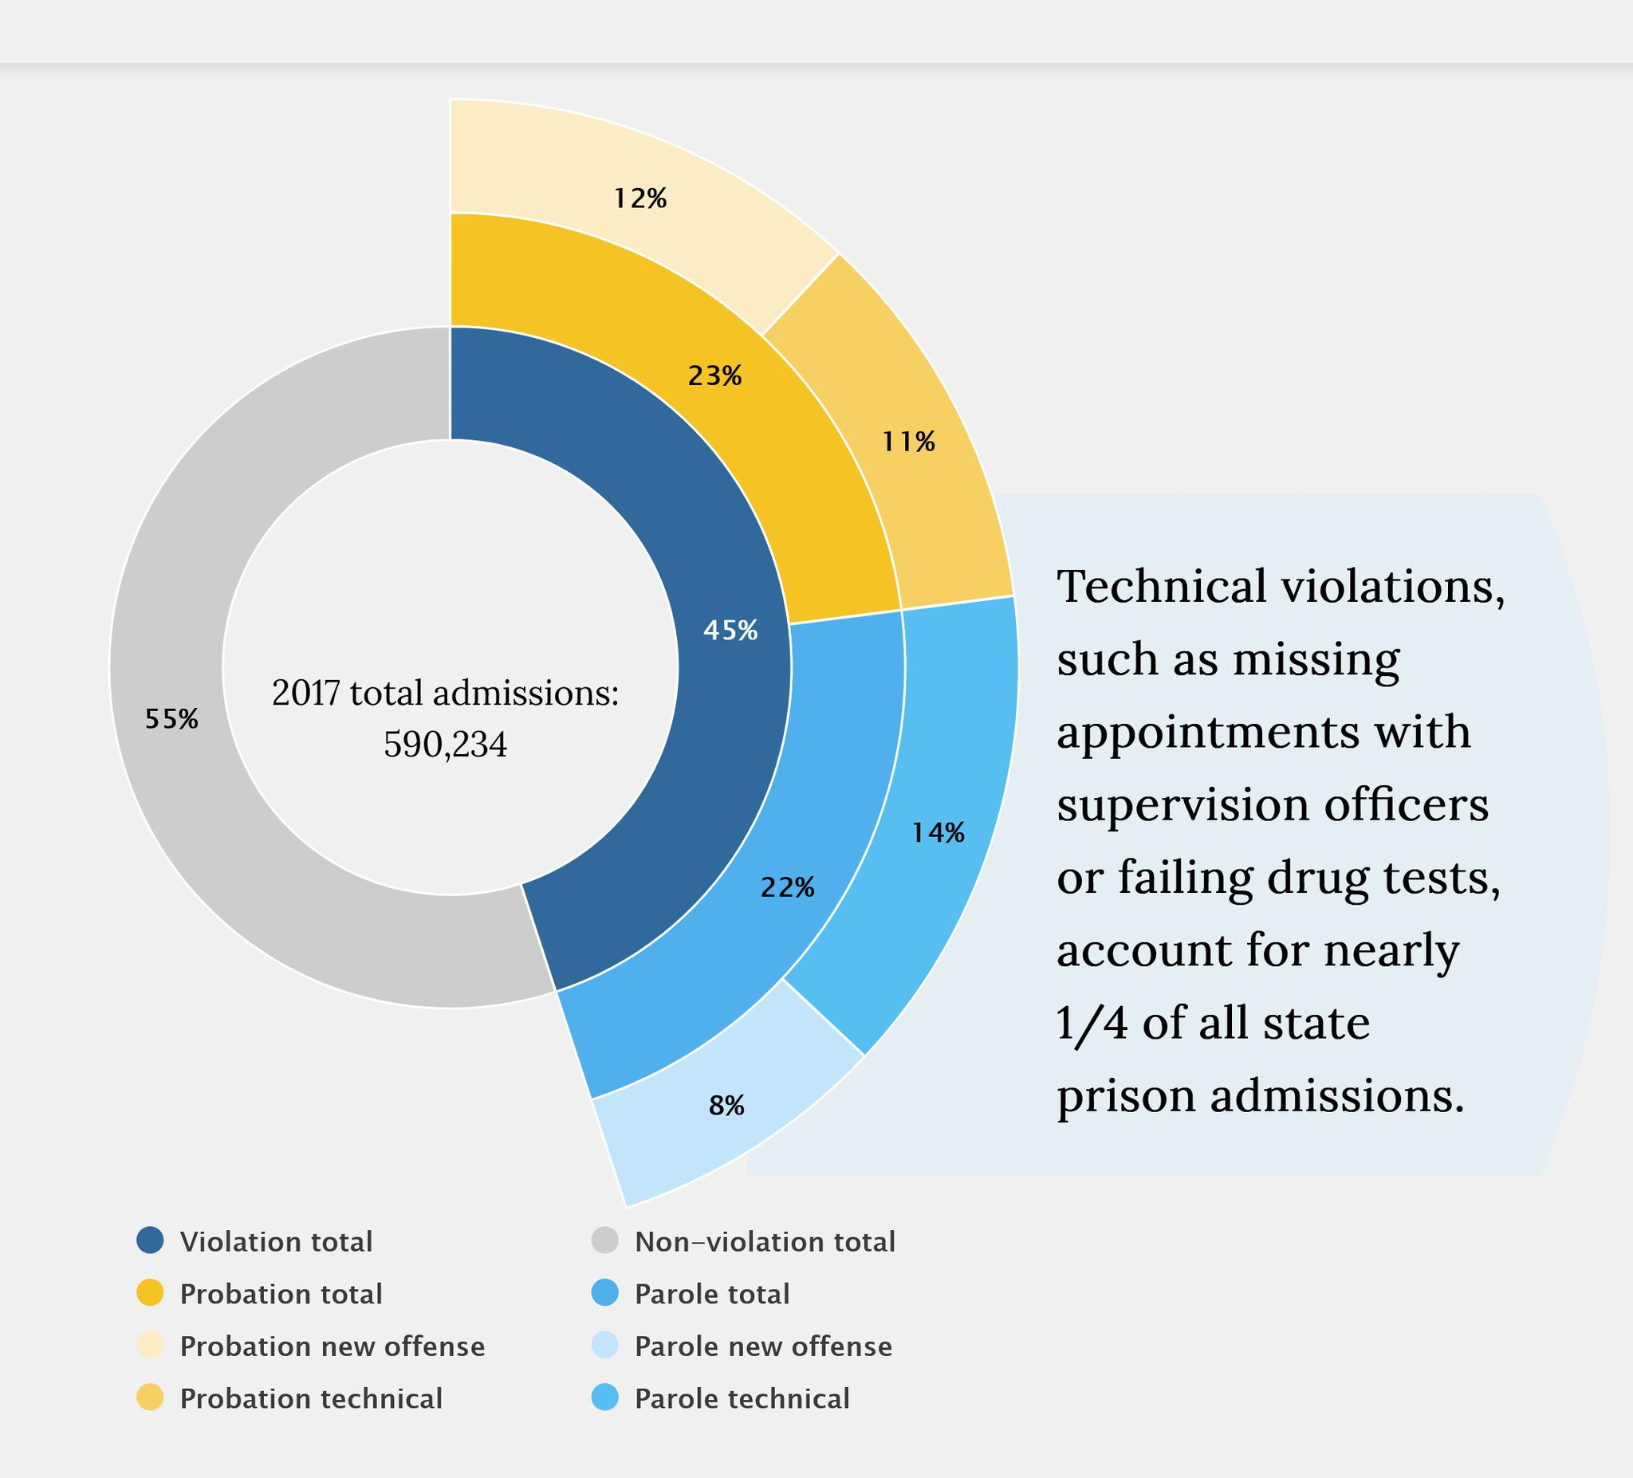
Georgia, has the largest probation population in the U.S. over 347,000
Notes:
Recidivism, or returning to prison after release, remains extraordinarily high due to the same reasons people are often incarcerated in the first place. Not only have no root causes been addressed, but these individuals now must navigate the added stigma and barriers of a criminal record - this nearly ensures the cycle of punishment continues.
https://knowablemagazine.org/article/society/2022/rethinking-prison-deterrent-future-crime
Each year, more than 500,000 people return home from state prisons.58 States struggle to reintegrate them back into their communities, and recidivism rates remain high.59 Within 10 years of release, 82 percent will be rearrested and 61 percent will return to prison for a parole or probation violation or a new sentence
-They often cannot vote; have scant access to education; face grim employment prospects; and are ineligible for public benefits, public housing, and student loans.61 States provide few social services to help people transition back into society.62 For example, underlying health issues such as substance abuse, mental health disorders, and chronic disease often go untreated.63 March 2018, https://www.apa.org/pi/ses/resources/ indicator/2018/03/prisons-to-communities; Wendy Sawyer, “Who’s Helping the 1.9 Million Women Released from Prisons and Jails Each Year?,” Prison Policy Initiative, July 19, 2019, https://www.prisonpolicy. org/blog/2019/07/19/reentry/; and Kuhn, “The U.S. Spends Billions to Lock People Up.” 63 Ebony N. Russ et al., “Prison & Jail Reentry & Health,” Health Affairs, October 2021, 2, https://www.healthaffairs.org/do/10.1377/ hpb20210928.343531/full/health-affairs-brief-prison-communityreentry-russ.pdf. 64 Susan Gibel and Leilah Gilligan, “A Rational Planning Process for a Learning Organization,” section 4 in Increasing Public Safety Through Successful Offender Reentry: Evidence-Based and Emerging Practices in Corrections, Madeline M. Carter et al., eds., Center for Effective Public Policy, 2007, 46, http://www.ct.gov/opm/lib/opm/cjppd/ cjresearch/forecastresearchworkgroup/resources/svori_cepp.pdf.

Slide 48
Re-Entry Support and Health Justice
Current Challenges
Collateral consequences and discrimination limit employment options
Parole tripwire
Accessing and qualifying for medical insurance and other benefits
Medication on re-entry, follow up on re-entry
New Economy of Care
Ex. Transitions Clinic Network: Formerly incarcerated Community Health Workers
Other potential programs: pipeline to professional schools (MD, NP, RN, etc.), phlebotomy, nursing tech, MA, elder care, community kitchens
Local context, relationship based

Slide 49
Federal Legislation
Peoples Response Act
Break the Cycle of Violence Act
Mental Health Justice Act
Breathe Act
Drug Policy Reform Act

Slide 50
Not a Prescription but an Invitation
Healthcare costs, under / uninsured, maternal mortality, wealth inequality
Murder by police, incarceration rate, correctional control, police budgets
If you designed a healthcare system it would look nothing like the one we have.
The same is true for the criminal legal system
Notes:
We can’t get single payer – how could we get all this and ask for more?!
Perhaps that is the problem. We haven’t yet connected with other struggles and identified the what it will take to live in the world we want.
Single payer alone will not get there ad not without other advocates we won’t get single payer. All of us or none of us.
Abolition is about the presence

Slide 51
“To be hopeful in bad times is not just foolishly romantic. It is based on the fact that human history is a history not only of cruelty, but also of compassion, sacrifice, courage, kindness.”
- Howard Zinn

Slide 52
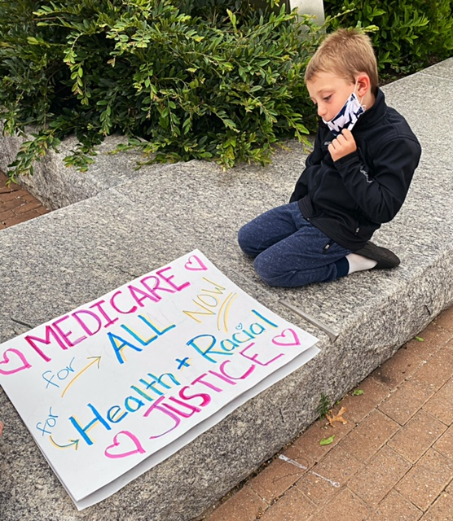
Thank You
“To approach harm systemically is to imagine that, if people’s most critical needs were met, the tensions that arise from deprivation and poverty could be mitigated. And when harm still occurs, because human beings have the propensity to hurt one another, nonlethal responses could attend to it—and also to the reasons for it.”
-Mariame Kaba & Keeanga Yamahtta Taylor
Notes:
https://www.nytimes.com/2020/06/12/opinion/sunday/floyd-abolish-defund-police.html
Mariame Kaba
We are not abandoning our communities to violence…People like me who want to abolish prisons and police, however, have a vision of a different society, built on cooperation instead of individualism”
https://www.theatlantic.com/ideas/archive/2020/07/how-i-became-police-abolitionist/613540/
Derecka Purnell
Police manage inequality by keeping the dispossessed from the owners, the Black from the white, the homeless from the housed, the beggars from the employed. Reforms make police polite managers of inequality. Abolition makes police and inequality obsolete
my old neighborhood still lacks quality food, employment, schools, health care, and air—all of which increases the risk of violence and the reliance on police
https://www.newyorker.com/news/our-columnists/the-emerging-movement-for-police-and-prison-abolition Keeanga Taylor and Miriame Kaba
Contrary to the beliefs of their critics, abolitionists are not impervious to the realities of crime and violence. But they have a fundamental understanding that crime is a manifestation of social deprivation and the reverberating effects of racial discrimination, which locks poor and working-class communities of color out of schooling, meaningful jobs, and other means to keep up with the ever-escalating costs of life in the United States. These problems are not solved by armed agents of the state or by prisons, which sow the seeds of more poverty and alienation, while absorbing billions of dollars that might otherwise be spent on public welfare. The police and prisons aren’t solving these problems: they are a part of the problem.
To approach harm systemically is to imagine that, if people’s most critical needs were met, the tensions that arise from deprivation and poverty could be mitigated. And when harm still occurs, because human beings have the propensity to hurt one another, nonlethal responses could attend to it—and also to the reasons for it.
“What does it mean to practice medicine in death-making institutions? Knowing that jails are fundamentally sites of harm, our work as physicians is best framed as harm reduction. Partly we try to prevent and mitigate the negative impact of illness in a population overburdened with health issues; partly we try to mitigate the negative impact of jail….Harm reduction, however, doesn’t dismantle. It can, to a limited degree, enable. And it cannot turn oppression into care.”
“It is a sad irony that a political process that obsessively uses the rhetoric of public safety ends up producing so many policies that in fact undermine it.” - Professor Rachel Barkow

Slide 53
“…geriatric and chronic health conditions present sooner in prisons, such that incarcerated individuals as young as 55 are medically considered “geriatric.” This is due to a phenomenon known as “accelerated aging,” in which poor quality of life, chronic stress, and the unstimulating environment of prison accelerate physical and cognitive decline.”
Notes:
Add the geriatric issue and how can help address it
https://www.healthaffairs.org/do/10.1377/forefront.20231010.271893/
The result is a large number of elderly, sick, and disabled people in prisons.

Slide 54
Private vs public healthcare
Notes:
https://www.nyulawreview.org/wp-content/uploads/2020/11/NYULawReview-Volume-95-Issue-5-Gelman.pdf
In 2015, New York City dropped Corizon as the city’s long-standing healthcare provider at Rikers Island, and entered into a contract with the government agency that runs the city’s public hospitals.19 New Jersey and Texas both partner with state universities to provide correctional health services.20 Other governments, like Delaware, have partnered with community-based health organizations.21
An estimated 40% of those incarcerated suffer from at least one chronic condition,24 and one estimate reports that “nearly 80% of inmates with chronic illnesses have never received routine medical care.”25 States collectively spend $8 billion on correctional healthcare, an average of about $5720 per inmate-patient per year.26
argues that public models are preferable, as they provide greater oversight, are not driven by shareholder interests, and more appropriately treat correctional health as a public health issue

Slide 55
Economic burden mass incarceration
Notes:
https://ijrd.csw.fsu.edu/sites/g/files/upcbnu1766/files/media/images/publication_pdfs/Economic_Burden_of_Incarceration_IJRD072016_0_0.pdf
https://static.prisonpolicy.org/scans/vera/the-price-of-prisons.pdf

