Slide 1
America’s Maternal Mortality Crisis Medicare for All is Part of the Solution
Notes:
In this presentation, I’ll describe the scope of America’s maternal mortality crisis, explain some of the root causes of this crisis, and then talk about how a national health program like Medicare for All could vastly improve maternal health and save thousands of lives. I also want to mention that when I say “maternal” health or “maternal” mortality, I’m referring to all pregnant and birthing people of any gender.

Slide 2
Maternal Mortality Much Higher in the U.S.
Maternal deaths per 100,000 live births
Maternal mortality: Death while pregnant or within 42 days of the end of pregnancy, irrespective of the duration and site of the pregnancy, from any cause related to or aggravated by the pregnancy or its management, but not from accidental or incidental causes. Used by the World Health Organization (WHO) in international comparisons. Date for 2021 or 2020 where available. Source: Trends in maternal mortality 2000 to 2020: estimates by WHO, UNICEF, UNFPA, World Bank Group and UNDESA/Population Division
Notes:
It’s not an exaggeration to say that the U.S. is in the midst of a maternal mortality crisis. Our maternal mortality rate is three times higher than the UK and Canada, nearly five times higher than Switzerland and New Zealand, and ten times higher than Australia and Norway.

Slide 3
Maternal Mortality More Than Quadrupled in U.S.
2021 = 33
Pregnancy-related deaths per 100,000 live births
1987 = 7
2021
Pregnancy-related death: Death during pregnancy or within one year of the end of pregnancy from a pregnancy complication, a chain of events initiated by pregnancy, or the aggravation of an unrelated condition by the physiologic effects of pregnancy. This CDC measure is used in the U.S. only.
https://www.cdc.gov/nchs/data/hestat/maternal-mortality/2021/maternal-mortality-rates-2021.htm; Accessed Sept. 6, 2023
Notes:
America’s maternal mortality crisis is quickly getting worse: The rate of pregnancy-related death in the U.S. is 4.5 times higher in 2021 than it was in 1987. By comparison, nearly every other country in the world has seen steadily decreasing mortality rates. In fact, the only two other nations besides the U.S. that have rising maternal mortality rates are Afghanistan and Sudan.

Slide 4
Maternal Mortality Compounded by Racial Inequities
Maternal deaths per 100,000 live births (2021)
Hoyert DL. Maternal mortality rates in the United States, 2021. NCHS Health E-Stats. 2023. DOI: https://dx.doi.org/10.15620/cdc:124678 Accessed Sept. 6, 2023
Notes:
Pregnancy and childbirth are much more deadly for parents of color in the U.S. In 2021, the maternal mortality rate for Black parents was more than two-and-a-half times the rate for White parents.

Slide 5
Infant Mortality Higher in the U.S.
Deaths in first year of life per 1,000 live births
Source: OECD 2022. Note: Data are for 2021 or most recent year available
Notes:
Not surprisingly, America’s infant mortality rate is also higher than other wealthy nations, more than twice as high as Italy and Sweden.

Slide 6
Infant Mortality Compounded by Racial Inequities
Infant Mortality per 1,000 live births, 2019
“AIAN” = American Indians and Alaskan Natives
“NHOPI” = Native Hawaiians and Other Pacific Islanders
https://www.cdc.gov/reproductivehealth/maternalinfanthealth/infantmortality.htm
Notes:
And similar to pregnancy related deaths, infant mortality is much higher for families of color in the U.S.: Black babies are nearly two-and-a-half times more likely to die in the first year of life compared to white babies, along with high rates of infant mortality among Native Americans and Native Hawaiian and other Pacific Islanders.

Slide 7
Maternal Mortality Is a Solvable Problem
84% of U.S.
Maternal Deaths
are Preventable
https://www.cdc.gov/reproductivehealth/maternal-mortality/erase-mm/data-mmrc.html
Notes:
The good news is the a vast majority of America’s maternal deaths are entirely preventable. [CLICK] [CLICK] And even better, they are preventable with basic primary, prenatal and postnatal care. The bad news is that so many parents in America don’t have access to even the most basic care needed to have a healthy pregnancy and birth. Medicare for All can change that.

Slide 8
U.S. Women Already Behind on Care
38% of women skipped medical care due to costs in past year.
44% of women report serious problems paying medical bills in past year.
https://www.commonwealthfund.org/publications/issue-briefs/2018/dec/womens-health-us-compared-ten-other-countries#append4 Data for 2018.
Notes:
Before we talk about pregnancy care, we need to acknowledge that women in the U.S. enter pregnancy with chronic health problems that could have been managed with regular care. [CLICK]. More than a third of women are skipping medical care due to cost, and [CLICK] nearly half of U.S. women have serious problems paying medical bills.
This lack of regular preventive care leaves them vulnerable to conditions that make pregnancy dangerous, such as hypertension, diabetes, and substance abuse.

Slide 9
Less than half of uninsured get early prenatal care
Started prenatal care in first trimester
https://www.macpac.gov/wp-content/uploads/2018/11/Pregnant-Women-and-Medicaid.pdf
Insurance status characterized by both prenatal care and delivery
Notes:
Once they are pregnant, early and regular prenatal care is important for expectant parents to manage existing medical conditions. But getting that care depends on coverage. Less than half of people without insurance coverage started prenatal care in the first trimester of pregnancy.

Slide 10
Racial Inequities in Prenatal Care
Late or no prenatal care
“AIAN” = American Indians and Alaskan Natives; “NHOPI” = Native Hawaiians and Other Pacific Islanders. Data for 2018
https://www.kff.org/report-section/racial-disparities-in-maternal-and-infant-health-an-overview-issue-brief/
Notes:
People of color are also less likely to receive early and continuous prenatal care. One in five Native Hawaiian and Pacific Islander parents goes without prenatal care, along with 13% of Native American parents and 10% of Black parents.

Slide 11
Increasing OOP Spending for Maternity Care
2008
2015
Data source: Moniz MH, Fendrick AM, Kolenic GE, Tilea A, Admon LK, Dalton VK. Out-Of-Pocket Spending For Maternity Care Among Women With Employer-Based Insurance, 2008–15. Health Affairs 2020;39(1):18–23.
Notes:
Commercial insurers have been increasing the copays and deductibles they require patients to pay out-of-pocket for care, and maternity care is no exception. By 2015, parents with commercial insurance paid an average of $4,300 for vaginal birth and more than $5,000 for a C-section, leaving many families with huge medical bills that take months or years to pay off.

Slide 12
Rural Counties Losing Hospital OB Services
641
591
Number of hospitals w/ OB services
7 Million U.S. women of child-bearing age live in counties with
no or limited maternity care
2004
2014
http://rhrc.umn.edu/wp-content/files_mf/1491501904UMRHRCOBclosuresPolicyBrief.pdf
https://www.marchofdimes.org/research/maternity-care-deserts-report.aspx
Notes:
In addition to the problem of health care costs, many families in rural areas are losing access to maternity services altogether. In the decade between 2004 and 2014, 10% of rural counties lost hospital-based obstetric services. [CLICK] By 2014, 54% of rural U.S. counties had NO obstetric services and 7 million women of childbearing age had virtually no access to care.

Slide 13
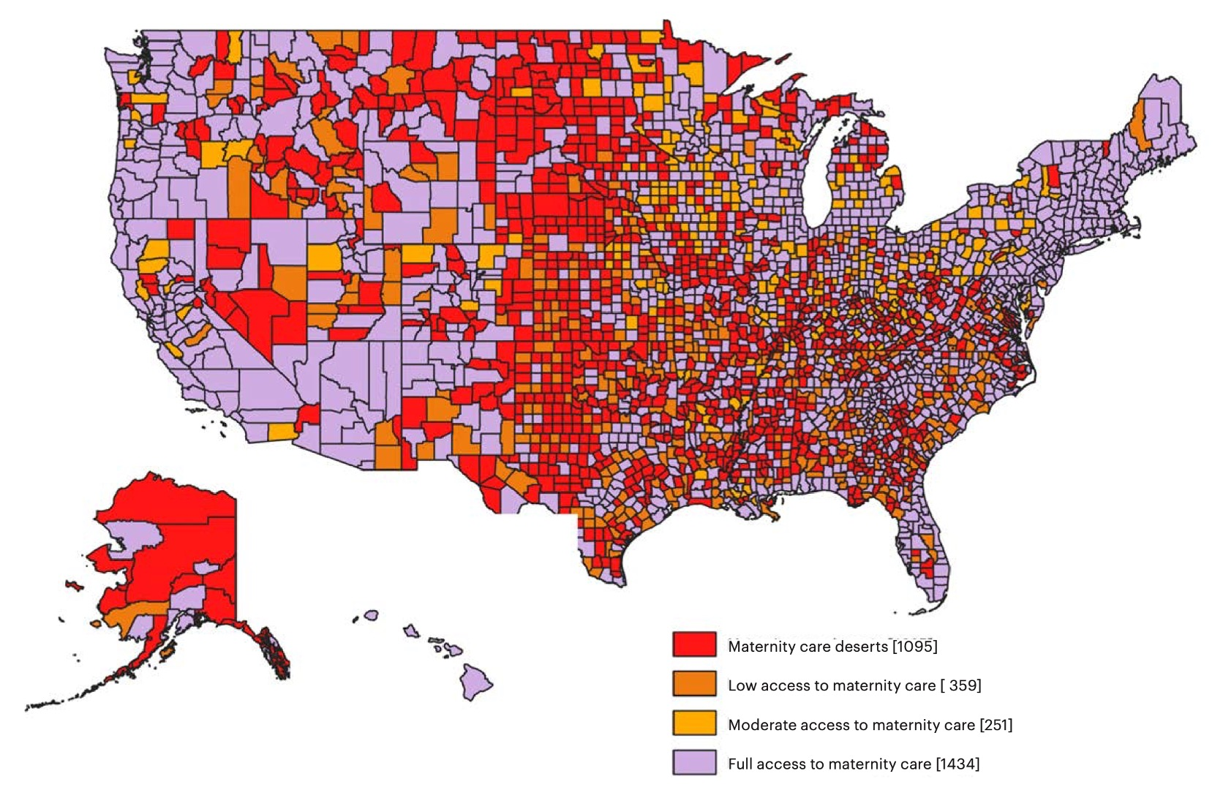
2.2 million women in counties with No OB, Hospital, or Birth Center
Maternity care “deserts”
Low access to maternity care
Moderate access to maternity care
Full access to maternity care
2020 report at https://www.marchofdimes.org/materials/2020-Maternity-Care-Report.pdf
Notes:
The counties in red indicate a maternity care “desert,” where more than 2 million women of childbearing age live with NO obstetric provider, NO hospital and NO birth center. Obstetrics, along with mental health and addiction care, is considered an unprofitable service, so many for-profit hospitals choose not to provide it, and many nonprofit hospitals can’t afford it.

Slide 14
When An Area Loses OB Services…
Out-of-hospital
births increase
Infant mortality
rate doubles
Preterm
births increase
https://www.ruralhealthweb.org/NRHA/media/Emerge_NRHA/Advocacy/Policy%20documents/01-16-19-NRHA-Policy-Access-to-Rural-Maternity-Care.pdf
Notes:
Not surprisingly, when a community loses these services, they see an increase in out-of-hospital and emergency department births, pre-term births, and a doubling of the rate of infant mortality.

Slide 15
Most Maternal Deaths Occur After Baby Is Born
% of maternal deaths
Data 2011-2015
https://www.commonwealthfund.org/publications/issue-briefs/2020/nov/maternal-mortality-maternity-care-us-compared-10-countries
Notes:
We’ve talked a lot about the importance of prenatal care, but 52% of maternal deaths happen after the baby is born. One-third of maternal deaths happen a full week or more after delivery, demonstrating the lifesaving importance of post-natal care.

Slide 16
Most Maternal Deaths Occur After Baby Is Born
4
W.H.O. recommends 4+ postpartum visits
1
U.S. parents typically have 1 office-based postpartum visit
0
40% of American births have no postpartum visits
https://journals.lww.com/greenjournal/Fulltext/2018/05000/ACOG_Committee_Opinion_No__736__Optimizing.42.aspx
Notes:
[CLICK] Even though the World Health Organization advises families to receive at LEAST four post-partum health visits, [CLICK] parents in the U.S. average about ONE office-based physician visit after the baby is born, [CLICK] and four in ten birthing parents have NO postpartum whatsoever.

Slide 17
Postpartum Home Visits Covered by National Health Plans
Germany | Daily if needed until day 10, plus 16 visits as needed until 8 weeks
Switzerland | Daily up to 10 days postpartum
Netherlands | Daily, starting day 1 and up to day 10; minimum of 4 hours per day
Australia | Within week 1, typically one to three visits
Canada | Contacted or visited within 24 – 48 hours
France | Starting within 24 hours, one to three visits
New Zealand | At least 5 visits over 6 weeks, starting within 48 hours
Sweden | First visit during week 1, then every 1-2 weeks until week 8
UK | At least until 10 days postpartum
U.S. | None required by law. Office visits covered by some insurers and state Medicaid programs
https://www.commonwealthfund.org/publications/issue-briefs/2020/nov/maternal-mortality-maternity-care-us-compared-10-countries
Notes:
Other wealthy nations recognize the importance of postpartum care, and provide new parents with regular home visits from health care providers, sometimes on a daily basis. [CLICK] In the U.S., postpartum health checks are not required, and are only covered by some insurers and Medicaid plans. And these are almost always office-based visits, which can be difficult for new parents.

Slide 18
Health Coverage Reduces Maternal Mortality
For every 100,000 people covered, Medicaid expansion states had:
4 fewer deaths among white parents
6 fewer deaths among Hispanic parents
16 fewer deaths among Black parents
https://www.whijournal.com/article/S1049-3867(20)30005-0/fulltext#fig1
Notes:
Prenatal and postpartum care really does save lives, and we saw this after the expansion of Medicaid coverage under the Affordable Care Act. While Medicaid has always provided some basic maternity care to very low-income parents, Medicaid expansion states expanded coverage to higher-income parents and added more prenatal and postpartum coverage. [CLICK] In states that expanded Medicaid, for every 100,000 people who got coverage they saw 4 fewer deaths among white birthing parents, 6 fewer deaths among Hispanic parents, and 16 fewer deaths for Black parents.

Slide 19
Medicaid a Band-aid, not a Cure
Among those who gave birth with Medicaid:
27% were uninsured before pregnancy
21% did not receive care in first trimester
22% uninsured again 2-6 months postpartum
Notes:
Medicaid expansion shows us that coverage saves lives. But know that it is not a real solution to our maternal mortality crisis [CLICK]. More than a quarter of people who gave birth with Medicaid coverage were uninsured before pregnancy, and more than one in five did not receive care in the first trimester, and more than one in five became uninsured again two to six months postpartum.

Slide 20
Medicare for All Can Help Solve Our Maternal Health Crisis
Racial inequities
Fragmented coverage
Poor access to OB providers
Lack of postpartum care
Notes:
Time for some good news. Medicare for All is a national health plan that can address the root problems of our maternal mortality and health crisis: [CLICK] Racial inequities, fragmented and unaffordable coverage, poor access to obstetrics providers, especially in low-income and rural areas, and lack of postpartum care for both the insured and uninsured.

Slide 21
Medicare for All: Addressing Racial Inequities
Provide equitable and universal coverage proven to improve outcomes for people of color
Invest significant resources in underserved communities
Provide training for health professionals to combat racial bias
Establish a national Office of Health Equity to fund research and data collection on racial inequity
Notes:
We know that pregnancy is incredibly dangerous for parents of color in the U.S. Medicare for All would address racial disparities in a number of ways:
[CLICK] First, it would provide equitable and universal coverage proven to improve outcomes for people of color; Next, [CLICK], it would Invest significant resources in underserved communities that often lack access to providers. [CLICK] Medicare for All would provide training and education for health providers to combat racial bias in care, and finally, it would [CLICK] establish a national Office of Health Equity to fund research and solutions on racial inequity

Slide 22
Medicare for All: Unifying Fragmented Health “System”
Provide everybody in the U.S. with seamless, lifelong coverage including preconception, pregnancy, & postpartum care.
Manage chronic conditions and prevent unintended pregnancies, improving pregnancy outcomes and overall health.
Notes:
Next, Medicare for All would fix our fragmented system by [CLICK] providing every single person in the U.S. with lifelong coverage including preconception, pregnancy, and postpartum care that is proven to reduce pregnancy complications and death. [CLICK] This type of guaranteed coverage allows people to manage or prevent the conditions that endanger pregnancies, and also helps patients avoid unintended pregnancies.

Slide 23
Medicare for All: Improving Access to OB Care
Providers would be attracted to under-served areas by creating an entire nation of people with insurance
Providers could spend more time in direct patient care (and be happier) because they’ll spend far less time dealing with insurance
Global budgets would fund hospitals in rural and low-income communities based on community needs
Notes:
The U.S. has far fewer maternity care provides compared to other nations, and that is especially evident in rural and other under-served areas.
Under Medicare for All, [CLICK], providers would no longer avoid low-income or rural areas because everyone would have the same insurance. [CLICK] Because they’re not dealing with insurance paperwork, providers will have much more time to spend on patient care, [CLICK] by funding hospitals through yearly global operating budgets (similar to the way we fund other public services like fire departments and schools), rural and low-income areas would have reliable funds for obstetrics and other community needs that are often the first services to get cut in a budget crunch.

Slide 24
Medicare for All: Covering All Postpartum Care
Postpartum care would be universally available (as would the rest of healthcare)
No insurance company would be able to get in the way of necessary care
Birth control options to prevent unwanted or closely-spaced pregnancies
Notes:
A majority of maternal deaths happen after the baby is born, but almost no Americans have access to quality postpartum care. Under Medicare for All, [CLICK] postpartum care, including home visits and lactation support, would be universally covered. Unlike Medicaid, coverage wouldn’t end after the baby is born. [CLICK] All medically necessary care would be covered without profit-minded commercial insurers denying care. [CLICK] Under Medicare for All, parents could receive safe and effective birth control post-partum to space births and avoid unwanted pregnancies.

Slide 25
Medicare for All addresses the Root Causes of U.S. Maternal Mortality Crisis
Today’s problems | Medicare for All’s solutions
Racial
inequities
Equitable universal coverage, track disparate outcomes, and promote care for today’s underserved
Fragmented coverage
Chronic conditions managed over a lifetime, not only during pregnancy. No copays or deductibles to get in the way
Lack of
providers
Universal coverage draws providers into underserved areas;
Global budgets protect rural hospitals.
Lack of post-partum care
Reliably covered for everybody, regardless of race, ethnicity, income, or geography. Coverage is lifelong and seamless.
Notes:
In summary, Medicare for All would substantially improve every problem that is contributing to our maternal mortality crisis. Remember that 84% of maternal deaths are preventable with comprehensive preconception, prenatal, and postpartum care, and that’s only possible with a universal, publicly funded national health care program.

