Slide 1
Medicare “Advantage”
James P. Waters
MS3, Cooper Medical School of Rowan University
Executive Board Member, Students for a National Health Program

Slide 2
Traditional Medicare Is Simple and Efficient
Notes:
Pay taxes, get insurance card, and medicare pays the doctors. No middle man.

Slide 3
Medicare Advantage Is Complicated and Inefficient
MA is not Medicare
Smaller “networks”
HMO-style tools
(Prior Authorizations, etc.)
Shun the sick,
seek the well
High overhead and
high profits
Drains public funds
from other uses
Notes:
Medicare pays all of the insurance companies. ALREADY more complicated. Then they pay their own contracts to doctors, and then limit their networks within their contracts so you can only go to certain doctors
MA is NOT Medicare NOR an advantage for all of these reasons, which is what we will discuss during this presentation.
BAD part is that MA is still growing

Slide 4
MA Plans Are Expensive to Operate
Overhead + profits
(% of revenues not spent on medical care)
Source: SEC filings for second quarter, 2022 (figure for Cigna is for first quarter 2022); multiple MedPAC reports over multiple years
Note: “Overhead” = percent of premiums not spent on medical services
Modified version of slides prepared by Drs. Steffie Woolhandler and David Himmelstein. Originals available at https://www.citizen.org/article/updated-powerpoint-presentations-on-health-policy-issues-relevant-to-health-care-reform-and-a-national-single-payer-health-system/ (accessed Apr 12 2023)
Notes:
Overhead (% of premium not spent on medical services) is dummy high. All the corporate machines we hate are here, and they’re doing nothing different in medicare advantage. Contrast these with TM, which only has a 2% overhead.

Slide 5
MA Is the Big Corporate Money-Maker
Gross Margins per Enrollee (2021)
https://www.kff.org/medicare/issue-brief/health-insurer-financial-performance/ Accessed Sept 10, 2023
Note: Gross margins include administrative costs, tax liability, and profits.
Notes:
Margins are basically the profit per enrollees. Humana cutting out lower margin business. Cutting out their individual market for public funded markets entirely, and trying to exclusively use their higher profit programs.
These gigantic margins are the big driver for MA to take over Traditional Medicare. It’s no wonder they’re trying to get people to join, resulting in crazy high numbers of enrollment.

Slide 6
Humana exiting employer group health insurance in 2023 Humana Is Following Their Money
“It is in line with [Humana’s] strategy to focus our health plan offerings primarily on Government-funded programs (Medicare, Medicaid and Military)….”
Bruce Broussard
President and CEO, Humana
Total compensation 2022: $17,198,844
Retiring Jan. 2024
https://press.humana.com/news/news-details/2023/Humana-to-Exit-Employer-Group-Commercial-Medical-Products-Business/default.aspx#gsc.tab=0
https://www.fiercehealthcare.com/special-reports/heres-what-ceos-major-national-payers-earned-last-year#:~:text=Bruce%20Broussard%2C%20Humana,-2022%20total%20compensation&text=Of%20his%20%2417%2C198%2C844%20in%20total,to%20the%20company%27s%20annual%20proxy.
Accessed Oct 17 2023

Slide 7
MA has now captured a Majority of Medicare Beneficiaries
Percent of Medicare beneficiaries in MA
2028
60%
2023
51%
Actual
CBO projections
2007
19%
https://www.kff.org/medicare/issue-brief/medicare-advantage-in-2023-enrollment-update-and-key-trends/
Accessed Nov. 5 2023
Notes:
From MedPAC: over half (51%) of eligible Medicare beneficiaries are now in MA plans. Trend speaks for itself. In less than 20 years, we’ve gone from 1 in 5 people to 1 in 2. Now projected to be even HIGHER in 2028. LOTS OF PEOPLE JOINING, YOULL SEE WHY THIS IS BAD

Slide 8
The Business of Medicare Advantage
Fraud
Settlements and fines without admissions of guilt
Cherry picking
Get paid for an average person but attract the healthiest
Lemon dropping
Expensive illnesses turn members into liabilities
Upcoding
Get paid for more diagnoses that don’t need to be treated
https://www.medpac.gov/wp-content/uploads/2023/03/Ch11_Mar23_MedPAC_Report_To_Congress_SEC.pdf

Slide 9
The MA “Benchmark-Bid” Scheme
$$$$$
CMS establishes a per-person “benchmark” based on
average cost of TM patients
Patients pay a premium for
plans that bid above benchmark
$$$$
MA plan keeps
2/3 of the difference
as a “rebate”
CMS keeps 1/3
MA plans may submit a bid
below the CMS benchmark
MA plans may submit a bid
above the CMS benchmark
$$$
“Rebates” are intended
to be used to add benefits
or reduce cost-sharing
$$
$
PNHP’s 2023 report on overpayments to Medicare Advantage
https://pnhp.org/system/assets/uploads/2023/09/MAOverpaymentReport_Final.pdf
Notes:
TAKE YOUR TIME HERE. SLOW DOWN.
First, let’s look at how Medicare Advantage is paid by Medicare. It begins with CMS creating an average cost of care per TM patient. That per-person average is the starting point for the per-person “benchmark” that MA plans have to compare to.
After the benchmark is determined, each MA plan submits a “bid” to CMS for how much they think they can deliver the same benefits as in TM. If they bid below the benchmark, they are allowed to retain roughly 2/3 of the gap as what’s called a “rebate”. CMS gets to keep the other 1/3. The MA plan is expected to use some of their rebate to either lower beneficiary out-of-pocket costs or to offer additional benefits.
If the MA plan bids above the CMS benchmark, they are required to charge a premium to patients to make up the difference.
The MA plan is thus incented to get their bids as low as possible. Turns out they’re getting pretty good at this.

Slide 10
Since 2018, MA Rebates Have More Than Doubled
MA monthly rebates per enrollee
MedPAC analysis of CMS enrollment files, July 2010-2022, Figure 11-2
https://www.medpac.gov/wp-content/uploads/2023/03/Mar23_MedPAC_Report_To_Congress_v2_SEC.pdf
Accessed Oct. 15 2023

Slide 11
MA plans are using less of their rebates to Reduce Out-of-pocket Expenses for Patients
Out-of-pocket expenses are barriers to care
Percentage of MA rebates spent on reducing member out-of-pocket expenses
Less barriers “induces utilization”
More barriers, less care, more profits for MA, worse for people
Based upon MA plan projections cited in 2023 MedPAC report (Accessed Oct. 15 2023)
MedPAC analysis of CMS enrollment files, July 2010-2022, Table 11-5
https://www.medpac.gov/wp-content/uploads/2023/03/Mar23_MedPAC_Report_To_Congress_v2_SEC.pdf
Notes:
What is that rebate actually used for?
SLOW DOWN HERE. TAKE YOUR TIME.
NOT REDUCING OUT OF POCKET EXPENSES. As you can see, the percentage of rebates going to reducing out of pocket expenses is decreasing!
MA plans know that reducing out-of-pocket expenses for beneficiaries removes financial barriers to healthcare and allows people to use more healthcare services. That is what they don’t want.
People getting healthcare costs them money, which is what we refer to as “induced utilization”. This is proof that MA companies like United Healthcare know that people will get the healthcare they need if they have lower copays and deductibles. BUT, they are instead using it for something else or keeping it for profit. We’ll refer back to this later when we review PNHP’s new report on overpayment.

Slide 12
Favorable Selection
Average TM spending in 2015
MA insurers are paid for the expense of an average TM patient but attract the healthiest (least expensive).
Sicker patients dislike narrow networks, prior authorizations, and care denials.
Healthier patients are attracted by low premiums, extra benefits, and targeted advertising.
https://www.kff.org/report-section/do-people-who-sign-up-for-medicare-advantage-plans-have-lower-medicare-spending-issue-brief/
PNHP’s 2023 report on overpayments to Medicare Advantage
https://pnhp.org/system/assets/uploads/2023/09/MAOverpaymentReport_Final.pdf
Notes:
Read first line.
TM pts from 2015 that stayed in TM into 2016 had higher medical expenses in 2015 than those that switched to MA. Shows that healthier people are the ones that switch into MA. Those plans have become really good at attracting healthier people into their system that use less benefits and are therefore less expensive to take care of.
The concepts of favorable selection and induced utilization are essential company strategies in gaming the system for more profits. The less money they spend on patients, the more they get to keep.

Slide 13
Compared to Traditional Medicare, MA patients get Many More Initial Home Care Visits
MA corporations use “home visits” to find diagnoses for upcoding
but deliver less actual home healthcare
Health Affairs 42 No. 9 (2023):119801202 DOI: 110.1377/hlthaff.2023.00376
Notes:
SWITCHING GEARS.
MA provides MORE initial home health visits, as you can see here. You would think you’d have a ton more continuing visits, right? SIKE, you don’t. They give a TON of initial home visits, while actually providing less ongoing healthcare. This one visit is NOT for the purpose of health, it’s for (you guessed it) creating profit for shareholders.
As you’ll find as a common theme throughout this presentation, this is a tactic to up code initial patient diagnoses and increase revenue and profits, while providing less actual health services overall.
This is another thing that we end up overpaying for in MA, again which will be mentioned in the new report.

Slide 14
Just the upcoding in Medicare Advantage Drains Billions of Dollars from Medicare
“Medicare Advantage has never generated savings relative to Traditional Medicare.
In fact, the opposite is true.”
– Kaiser Family Foundation
$ billions paid to MA plans based on differences in dx coding
https://www.medpac.gov/wp-content/uploads/2023/03/Ch11_Mar23_MedPAC_Report_To_Congress_SEC.pdf 2022 and 2023 estimated by MedPAC
Accessed Oct. 15 2023
https://www.kff.org/medicare/issue-brief/higher-and-faster-growing-spending-per-medicare-advantage-enrollee-adds-to-medicares-solvency-and-affordability-challenges/?utm_campaign=KFF-2021-Medicare&utm_medium=email&_hsmi=2&_hsenc=p2ANqtz--NbWFYepJ3_bF07nVVqdBF1nXFKwXuVn9L66uGcqn5hPdz7Tiot2L7eMwnyN0vSl6Bnbb1hZiyrztywKa3saASppissA&utm_content=2&utm_source=hs_email
Notes:
Background: medicare payments to MA plans are individual – based on the payment rate and the individual’s risk score, which accounts for differences in expected medical expenditures and are based on diagnoses that providers code.
FFS Medicare: little incentive for providers to record more dx codes than necessary to justify a service
MA: financial incentives to ensure that their providers record all possible dx bc they raise ind risk scores and result in higher payments to the plan. Reports even show that in the first year of switching from FFS Medicare to MA, risk scores sharply increase and continue to rise in subsequent years. This coding also undermines competition among plans by allowing larger rebates and offering more extra benefits than other plans.
2021 analysis: MA risk scores were about 10.8% higher than those for similar FFS beneficiaries. CMS by law, reduces the MA risk scores to be similar to FFS but has never reduced them more than the minimum amount. As a result, MA risk scores are still 4.9% higher than FFS.
This results in excess payments to MA, which reached $17 billion in 2021, and are projected to reach $23 billion in 2023. KEEPS RISING

Slide 15
MA Plans Delay and Deny Access to Care
Percentage of MA Patients Required To Get Prior Authorization (2023)
https://www.kff.org/medicare/issue-brief/medicare-advantage-in-2023-premiums-out-of-pocket-limits-cost-sharing-supplemental-benefits-prior-authorization-and-star-ratings/ Accessed Sept 4 2023
Notes:
Nearly all MA enrollees are in plans that require prior authorization for some services
Part B drugs, skilled nursing stays, inpatient hospital stays, hearing and eye exams, mental health, substance abuse services
All of these are services where over half of MA enrollees are in plans that require prior auth to receive them. THIS MAKES OUR JOB DIFFICULT.
Fairly unique to MA and commercial insurance. TM DOES NOT USE prior auth except for a handful of services (examples to come)

Slide 16
MA Network Collapse Disorder
Scripps Health (CA)
St. Charles Health System (OR)
Southeast Georgia Health System (GA)
Adena Regional Medical Center (OH)
Samaritan Health System (OR)
Cameron Regional Medical Center (MO)
Stillwater Medical Center (OK)
Brookings Health System (SD)
Baptist Health Medical Group (KY)
Scripps
“It’s become a game of delay, deny, and not pay”
SE Georgia
“Unreasonable denials”
Stillwater
“22% prior authorization denial rate for MA plans, compared to a 1% denial rate for traditional Medicare”
https://www.beckershospitalreview.com/finance/hospitals-are-dropping-medicare-advantage-left-and-right.html#:~:text=Medical%20Center%20ended%20all%20in,1%2C%202023. Accessed Oct 14, 2023
Notes:
Along with how patients and physicians, hospitals are struggling with the delays and denials that are rampant in MA. In the past few months, we’ve seen a rapid exodus of hospitals from MA.
Part of this crisis is in part due to the aggressive rate negotiations empowered by the increased market penetration of MA. As MA plans gain market share, they become the gorilla at the bargaining table, and they’re not bargaining with our public health interests.
[CLICK]
But on top of that, look at what the departing hospital networks are saying. It’s not just about the negotiated rates, it’s about the fundamental business model of MA companies denying necessary medical care. As Stillwater said, this is unheard of in TM but rampant in MA.
The collapse of MA hospital networks is a new emerging disaster, a direct consequence of the MA business model, and one more thing that single payer would eliminate.

Slide 17
Congress Is Hearing a Different Story
“MA is hurting
our patients”
“MA relieves inequities”
Notes:
PNHP has been telling multiple members of Congress and their staff about all of the things we just discussed.
[CLICK]
The most common response is that legislators are also hearing from the insurance industry lobby group “AHIP” (formerly known as America’s Health Insurance Plans). The industry lobbyists are warning legislators that attacking MA would worsen healthcare for racial minorities and low-income Americans. The friendlier members of Congress are asking us how they should respond.
First, let’s look at how groups like AHIP can claim to be the solution to healthcare inequities.

Slide 18
AHIP: “MA is a vital source of coverage for Low Income and Diverse Populations”
% of Medicare beneficiaries in MA
% with Income <$25,000
https://www.ahip.org/resources/medicare-advantage-demographics Accessed Oct. 15 2023
Notes:
AHIP isn’t lying when tell Congress say that their plans have a higher share of people of color and of those with low income. That’s true, as this data shows you.
[CLICK]
But they’re wrong when they use this as proof that it means they are the solution to our nation’s inequities. In fact, it actually means the opposite. In short, it really means that the usual disenfranchised groups of Americans are being left with no choice but to accept a product with major problems that wealthier Americans are less likely to tolerate.
The higher rates of Black, Hispanic, and low-income Americans is not evidence of a solution – it’s evidence of the very problem they say they address. Let me show you what I mean with some slides that you can use to educate your elected officials.

Slide 19
Medicare Advantage Plans are allowed to create their own Secret Rules to Reject Necessary Care
18%
18% of the claims denied by Medicare Advantage plans in 2019 would have been approved by Traditional Medicare.
Seems almost quaint today when Artificial Intelligence now writes and reviews many of these claims.
15 selected MAOs during June 1-7 2019, reported by OIG April 2022
https://oig.hhs.gov/oei/reports/OEI-09-18-00260.pdf
Notes:
MA plans reject prior auth requests for services that were medically necessary by applying internal clinical criteria that are not contained in Medicare coverage rules, as long as they are deemed to be “not as restrictive” as traditional Medicare criteria
Example from OIG report: deny a CT because they needed an X-ray first. TM does not have any criteria about other imaging before a CT – meaning that they would have paid. However, by applying their own clinical criteria, MA can deny this request by describing their criteria in a way that is “no more restrictive” than TM.
Last couple of years, there have been legislative attempts to outlaw these “secret rules” but they are still going on.
Traditional medicare relies more on the clinician’s judgement and doesn’t get in the way, but MA does and denies necessary care.

Slide 20
Medicare Advantage beneficiaries have More Cost-Related Problems
Percentage with cost-related problems accessing care
June 2021 issue brief from KFF accessed Oct 26 2022
https://www.kff.org/medicare/issue-brief/cost-related-problems-are-less-common-among-beneficiaries-in-traditional-medicare-than-in-medicare-advantage-mainly-due-to-supplemental-coverage/
Notes:
First, all MA beneficiaries experience significantly more cost-related problems in accessing care, and this is more pronounced in minority populations.
[CLICK]
DON’T USE NUMBERS. JUST COMMENT ON TREND.
While the difference in race in both TM and MA is indicative of a larger systemic problem, the fact that MA is exacerbating the differences tells you that MA is not the solution to inequity.

Slide 21
Medicare Advantage beneficiaries have More Cost-Related Problems
Percentage who report problems with medical bills or medical debt
Lower Income = <200% of FPL; Medium Income = 200-399% of FPL; Higher Income = 400%+ of FPL
https://www.commonwealthfund.org/publications/issue-briefs/2023/sep/medicare-affordability-problem-cost-burdens-biennial?utm_campaign=Improving%20Health%20Care%20Quality&utm_medium=email&_hsmi=274919857&_hsenc=p2ANqtz--qavpgRK4kMxxFnruP06k0ly0_eIh16i_KBNoQ_FE5OdVSz3bzu8QvbHRJ0HoEmG7zO0q9eJZDMATt9x56tNEfTlhjvw&utm_source=alert
Accessed Sept 19 2023
Notes:
The same thing is true across income groups – people in MA have more problems with medical bills and medical debt than do people in TM. With one exception (you guessed it)
[CLICK]
People in the higher income brackets don’t have this problem.
Again, MA is not the solution to equity.

Slide 22
MA usually includes a dental benefit, but MA Patients Can’t Get Dental Care
Percentage unable to access dental care because of cost
https://www.commonwealthfund.org/publications/issue-briefs/2023/sep/medicare-affordability-problem-cost-burdens-biennial?utm_campaign=Improving%20Health%20Care%20Quality&utm_medium=email&_hsmi=274919857&_hsenc=p2ANqtz--qavpgRK4kMxxFnruP06k0ly0_eIh16i_KBNoQ_FE5OdVSz3bzu8QvbHRJ0HoEmG7zO0q9eJZDMATt9x56tNEfTlhjvw&utm_source=alert Accessed Sept 19 2023
Notes:
Third, one of the more important reasons people opt into MA is they are desperate to get dental care. MA promises to provide them with that, but as you can see here, people in MA have more – not less – problems accessing dental care for financial reasons.
This data is a little confounded as it doesn’t adjust for income, and I just showed you that people in MA skew towards lower income groups. But the false promise that MA will include good access to dental care is clearly misleading.
Again, MA is not a solution to equity.

Slide 23
Cancer patients in MA have Longer Delays from Diagnosis to Treatment
Longer than 2 weeks from diagnosis to therapy
Traditional Medicare
Medicare Advantage
Note: Postoperative mortality for lung resection was unchanged between TM and MA
https://ascopubs.org/doi/pdf/10.1200/JCO.21.01359?role=tab Accessed Oct. 19 2023
Notes:
And of course, it’s not just dental care that’s hard for people in MA. It’s a particularly big deal, a life-threatening deal, for people dealing with cancer.
[CLICK]
To start with, this data shows that people in MA have to wait longer for cancer surgery. The difference in the wait time for pancreatic cancer is particularly terrible when you consider how deadly it is.

Slide 24
Cancer patients in MA are Less Likely to Use Recognized Cancer Centers
Surgery done at an NCI-designated cancer center
Traditional Medicare
Medicare Advantage
Note: Postoperative mortality for lung resection was unchanged between TM and MA
https://ascopubs.org/doi/pdf/10.1200/JCO.21.01359?role=tab Accessed Oct. 19 2023
Notes:
On top of having to wait longer than people in TM, cancer patients in MA are far less likely to use an NCI-designated center of excellence. In other words, they are more likely to have their surgery done at hospitals that are not recognized and likely far less experienced in these complex surgeries.
It turns out that these delays of getting to treatment, and this redirection to less-experienced hospitals, is leading to increased mortality rates.

Slide 25
Cancer patients in MA have Higher Death Rates After Surgery
30-day post-operative mortality (risk adjusted)
Traditional Medicare
Medicare Advantage
Note: Postoperative mortality for lung resection was unchanged between TM and MA
https://ascopubs.org/doi/pdf/10.1200/JCO.21.01359?role=tab Accessed Oct. 19 2023
Notes:
Delays in getting treated and being shunted away from America’s best cancer hospitals is taking its toll on people in MA, resulting in higher mortality rates. These policies are literally killing people with cancer! The fuck are we doing!
Nobody warns people about this when they sign up for MA. They pay a much smaller premium than they would if they stayed in TM and had to buy Medigap and Part D, but they’re literally gambling that they’ll stay healthy.

Slide 26
In their final year of life Patients Leave Medicare Advantage
“Among other reasons, beneficiaries in the last of year life may disenroll because of
potential limitations accessing specialized care under Medicare Advantage.”
Percentage of MA beneficiaries who switched to TM
June 2021 GAO report based upon 2017 data, accessed Oct. 26 2022
https://www.gao.gov/assets/gao-21-482.pdf
Notes:
These costs and restrictions are such a burden, that MA beneficiaries are switching to TM in their final year of life, many times limitations to specialized care as a factor.
Emphasize that this is a small number. It is just WORSE in MA, so you are more likely to experience these problems in the last year of life. Realistically, both of these numbers should be ZERO. Insurance plans should be fired into the sun and everyone should get the care they need without worrying about what plan they need. SINGLE PAYER WOOOOOOOO

Slide 27
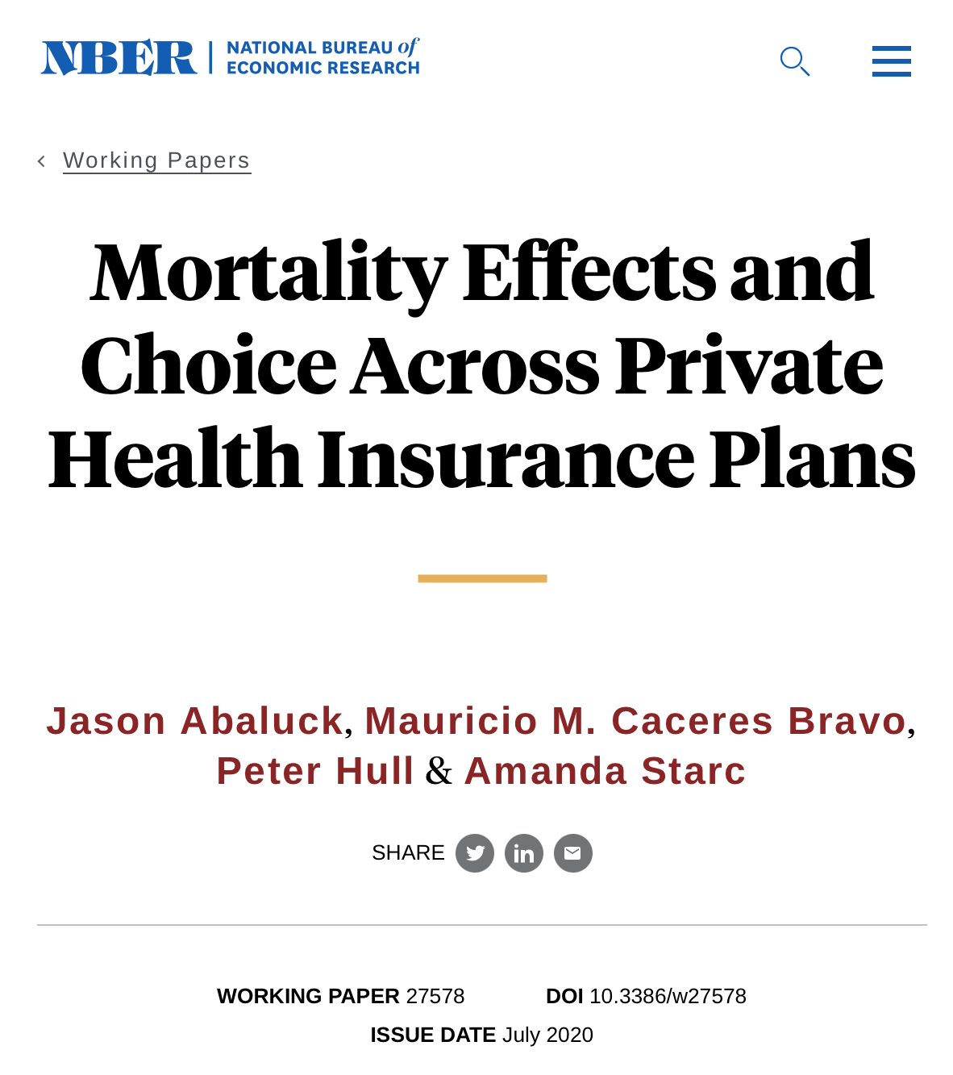
MA quality bonuses based on “Star Ratings” are Unrelated to Variations in MA Plan Mortality
“Large differences in the mortality rates of MA plans within local markets”
MA quality bonuses subsidize plans that score better on measures like star ratings, which are uncorrelated with causal mortality effects.
Abaluck, J et al. “Mortality Effects and Choice Across Private Health Insurance Plans.” NBER Working Paper Series. Page 40. July 2020
http://www.nber.org/papers/w27578
Notes:
CMS has tried to correct for some of this by introducing bonuses to MA plans that have higher quality measures. This sounds great but has unfortunately become yet another boondoggle for profiteering. (Make a joke about Ed Weisbart’s language before you say it)
This report with the National Bureau of Economic Research has shown that these quality measures have no correlation with important health outcomes, like the impact of the MA quality measures on the mortality rate of its beneficiaries. LITERALLY NOTHING. Bunch of bologna bonuses for squat.
As you’ll see in our report in a few minutes, these bonuses are another powerful set of tools for MA plans to collect additional funding without important improvements in the health of Medicare members.

Slide 28
https://www.finance.senate.gov/imo/media/doc/Deceptive%20Marketing%20Practices%20Flourish%20in%20Medicare%20Advantage.pdf
Accessed Nov 4 2022
Notes:
Take a breather.
The Senate Finance Committee has started looking at the outrageously egregious ways that MA corporations mislead Americans. They issued a major report last year about these deceptive marketing practices, and in October of this year they held another hearing on this. People are starting to understand that they’re being lied to, they’re angry, and angry seniors know exactly how to call Congress.

Slide 29
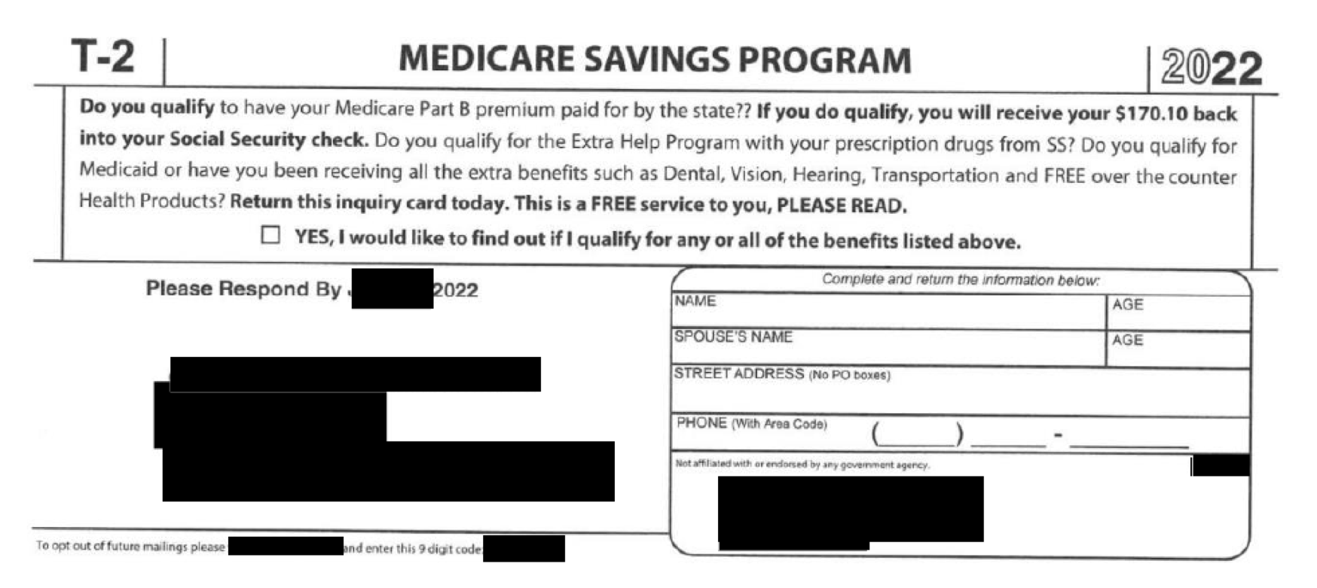
https://www.finance.senate.gov/imo/media/doc/Deceptive%20Marketing%20Practices%20Flourish%20in%20Medicare%20Advantage.pdf
Accessed Nov 4 2022
Notes:
Example of a note from a MA program that looks like a federal agency. Does anyone see the words “medicare advantage” together on this slide?
Seniors receive mailers that look like official business from a Federal agency, yet the mailer is a marketing prompt from an MA plan or its agent or broker. Often seniors don’t even realize they just switched to MA and find out months later at a PCP visit. Cartoonishly evil. Wiley Coyote drawing the tunnel on the wall.
At the end of the day, we as physicians have to manage this problem, when patients come in to us and find out we’re not in-network anymore. So the burden falls to us.

Slide 30
The ads look like Medicare but they’re not.
Phone numbers looks like Medicare but they’re not.
https://www.kff.org/medicare/report/how-health-insurers-and-brokers-are-marketing-medicare/ Accessed Sept 20 2023
Notes:
Widespread television advertisements that claim that seniors are missing out on benefits, including higher Social Security payments, in order to prompt seniors to call MA plan agent or broker hotlines.
Show of hands: how many people haven’t seen these ads? Does anyone see medicare advantage on any of these? NO! MISLEADING!

Slide 31
CMS “Secret Shoppers” of insurance agent calls with clients in 2022: 80% of Calls Were Inaccurate or Insufficient
One example of many…
“If your medication is not on the formulary,
your doctor could tell the plan
and the plan would simply add it.”
Published by CMS May 9, 2022
https://www.documentcloud.org/documents/23169211-agent-broker-marketing-faqs
https://www.medpagetoday.com/special-reports/exclusives/101348
Notes:
CMS deployed “secret shoppers” to record calls and determine the accuracy of broker statements. They found that EIGHTY PERCENT of these calls provided inaccurate or insufficient information, misleading seniors into their plans. Read example. Look through report for examples and pick a different one.
All are documented examples of deceptive MA marketing practices that this report from the US Senate Committee on Finance. This erodes trust in the program and undermines access to care within the Medicare program. And while CMS has taken steps to help with these matters, Medicare oversight deteriorated significantly during the Trump administration, which led to key protections against these predatory practices being taken away.
Just last month, there was a hearing in the Senate Finance Committee regarding the marketing in MA. It appears that Congress is paying more attention to this problem, in part because we’re causing a lot of hoopla. So, we should do more of the same to really apply the pressure.

Slide 32
Insurance agents are increasingly rewarded for Promoting Medicare Advantage
2024
Insurance Broker Commissions
https://www.ritterim.com/blog/2024-maximum-broker-commissions-for-medicare-advantage-medicare-part-d/#agent-survival-kit
https://nccagent.com/blog/retire-selling-medicare/#:~:text=Medicare%20Supplement%20Commissions,for%20at%20least%20six%20years.
Accessed Oct 18 2023
Notes:
If these predatory practices weren’t enough, brokers that help beneficiaries choose the right coverage are incentivized to bring seniors to MA. However, these commissions are significantly higher in MA when compared to other coverages, and is increasing, while the others are decreasing. Showing the profit incentive runs deep
About a third of seniors turn to brokers for their insurance. They claim to be non-biased, but they don’t disclose the profit incentives, which is further evidence of corruption.
Note: The difference in commission of like $100 is a drop in the bucket for these individual brokers compared to the absurd profits and overpayment that MA companies like cigna, united healthcare, etc. are receiving. Another thing we will talk about in the PNHP report.

Slide 33
If it’s so bad, why do so many people sign up for Medicare Advantage?
Traditional Medicare
Is Imperfect
Three options for
Medicare members
20% outpatient “coinsurance”
$1,600 hospital deductible (2023)
No out-of-pocket limits
Premiums required for Part B, Part D, and a Medigap plan
Keep Traditional Medicare, do nothing else, risk bankruptcy
Leave Traditional Medicare and sign up for “Advantage”
Keep Traditional Medicare and purchase Medigap. Maybe.
https://www.cms.gov/files/document/mm12903-medicare-deductible-coinsurance-premium-rates-calendar-year-2023-update.pdf Accessed Oct 27 2022
Notes:
Why do people sign up?
TM is imperfect! There is a 20% outpatient coinsurance charge, a $1600 hospital deductible, and no set out-of-pocket limits that burden seniors when they make their much-needed visits. In addition, they need to purchase multiple parts of Medicare, each with their own premiums.
So, left with 3 options: Keep TM, do nothing. They can purchase Medigap, or they leave for advantage.

Slide 34
If it’s so bad, why do so many people sign up for Medicare Advantage?
2024 | Medigap (Plan G example) | Medicare Advantage
Benefits
Out-of-Pocket
Utilization Management
Networks
Monthly Premiums
Often includes additional benefits (Rx, hearing, vision, dental, gym clubs, etc)
No additional benefits beyond TM
Zero out-of-pocket after the Part B deductible ($240 per year)
$8,850 maximum for in-network approved services
Rare and only as required in TM (e.g., some hospital outpatient items)
Typically has proprietary “Prior Authorizations”, “Step Therapy”, etc.
Smaller variable lists of “in-network” physicians and hospitals
Identical to Traditional Medicare
$175 for Part B, $200 for Plan G, and $55 for Part D ($5,160 per year)
$175 for Part B and $18 for MA, usually with a drug benefit ($2,316 per year)
https://www.cms.gov/newsroom/fact-sheets/2024-medicare-parts-b-premiums-and-deductibles
https://www.kiplinger.com/retirement/medicare/what-youll-pay-for-medicare
Notes:
CLICK THROUGH SLOWER. MATCH TRANSITIONS TO WHAT YOU’RE SAYING.
Just read through the slide. A standard insurance user may not know about these types of disadvantages like we do and switch to MA out of a relative lack of knowledge.
Real deciding factor for most people is the monthly premium, so that’s where they decide to go to MA. Some people might not have enough money to pay for TM and Medigap, so switch to MA. Our ultimate goal (as a single-payer organization, duh) is to have no premiums. We can talk about how to accomplish that later.

Slide 35
If it’s so bad, why do so many people sign up for Medicare Advantage?
2024 | Medigap (Plan G example) | Medicare Advantage (Plan C)
Benefits
Out-of-Pocket
Utilization Management
Networks
Monthly Premiums
Traditional Medicare with D, G: $5,160 per year
Medicare Advantage: $2,316 per year but concerns
“I’ll start with MA and only go back to TM if the
MA plan won’t let me see the doctors and hospitals I want…
What’s the worst that could happen?”

Slide 36
Federal protections for
people pre-existing conditions
end after 6 months in Medicare Part B
or 12 months in Medicare Advantage.
After 12 months, people may be
trapped in Medicare Advantage.
https://www.kff.org/medicare/issue-brief/medigap-enrollment-and-consumer-protections-vary-across-states/
https://www.medicare.gov/supplements-other-insurance/when-can-i-buy-medigap#
Accessed Dec. 14 2020
Notes:
People might get stuck!. After 12 months in MA, federal protections for pre-existing conditions end. People get trapped with all of the problems mentioned before, and don’t even realize it. And this is because of 2 issues in insurance
.

Slide 37
Welcome to Medicare. By the way… Pre-existing Conditions Are Back
Guaranteed Issue (“GI”) is required for the first six months on Part B
After that, Medigap insurers can refuse to sell due to pre-existing conditions
GI is extended to 12 months for a “trial” of MA
Community Rating of Medigap plans ends at the same time as GI
Everyone enrolling in a plan during the initial period of GI pays the same premium
After that, they charge higher premiums for people with pre-existing conditions
https://www.kff.org/medicare/issue-brief/medigap-enrollment-and-consumer-protections-vary-across-states/
https://www.medicare.gov/supplements-other-insurance/when-can-i-buy-medigap#
Accessed Sept 9 2023
Notes:
Due to the ACA marketplace protections, if you buy insurance on the marketplace, insurance agencies have to sell you insurance (GI) at the same rate as everybody else (Community rating) under age 65. However, after age 65, this protection disappears after 12 months, and you don’t have those protections and there is no guarantee that you can get medigap coverage because they will send you a health questionnaire to either deny or upcharge your care.
If someone gets sick after 13 months on MA (ex: cancer, needs procedures and constant visits), switching back to TM may be financially unrealistic due to the disappearance of these 2 protections.
There are a few states that have extended these protections, but it’s very few, and they did it DECADES ago. Nothing new has happened.

Slide 38
After an initial period in Medicare, Two Federal Medigap Protections Disappear
“Guaranteed Issue” and “Community Rating” are required during your first six months on Part B (12 months on Medicare Advantage)
CT, MA, ME, and NY extend Guaranteed Issue protections for life
CT, MA, ME, NY, AR, MN, VT, and WA extend Community Rating for life
After 12 months, you may be trapped in Medicare Advantage.
Few people realize they’re making that decision.
https://www.kff.org/medicare/issue-brief/medigap-enrollment-and-consumer-protections-vary-across-states/
https://www.medicare.gov/supplements-other-insurance/when-can-i-buy-medigap#
Accessed Dec. 14 2020
Notes:
These are state exceptions to the previous rule. Caution on advocating for this issue because we would rather see advocacy work focusing on improving TM by eliminating or putting a maximum on out-of-pocket expenses. Example at the end of this discussion.

Slide 39
Why Does Medicare Have These “Gaps”?
Problem: The Moral Hazard
Better coverage will make people use more healthcare
Solution: Skin in the Game
Paying part of the cost will make prudent consumers
Notes:
Switching back to Medicare: why are there gaps?
The solution is that having consumers pay part of the cost will have them use less healthcare, leading to lower payments.

Slide 40
The Failure of “Skin in the Game”
US adults who would pay out-of-pocket
Wouldn’t Pay
Don’t Know
Would Pay
https://morningconsult.com/2023/03/08/affordable-care-act-polling-data/ Accessed March 20 2023
Notes:
However, this is a problem. Most people won’t pay out of pocket for things! Even for something as (seemingly) simple as smoking cessation, 60% will not pay. This changes a bit when more serious screenings are involved, but the point here is that preventative services go down the drain.

Slide 41
Why Does Medicare Have These “Gaps”?
“The Moral Hazard” vs
“Skin in the Game”
“We don’t have to worry about unleashing a stampede for free leg amputations or free liver transplants.” (McCanne)
Create a niche
for commercial insurance
Ensure a market for commercial insurance companies (and their support) by limiting the value of Medicare
The Southern Strategy
(aka Racism)
“A 20% copay guaranteed that poor Black people would avoid medical care.” (Hartmann)
Nyman, J. Jnl Health Polit Policy Law (2007) 32 (5): 759–783. https://doi.org/10.1215/03616878-2007-029
https://pnhp.org/news/urgent-message-reprising-john-nymans-new-theory-of-moral-hazard/
Hartmann, Thom. The Hidden History of American Healthcare. 2021. Pg 9
Notes:
More reasons: just read the quotes and let people react
Make sure Don McCanne is referenced as a PNHP legend
Lot of opposition from commercial insurance companies to medicare because “how will we get money”. They like this point because this is a solution for commercial insurance companies for M4A. They know that their industry would disappear, so they either fiercely oppose M4A or want to make it so bad that their companies still have a role.
Southern Strategy: since a higher percentage of low SES populations are of racial and ethnic minority backgrounds, copays can guarantee that minorities don’t get care (Racism).

Slide 42
Whatever the reason that Medicare includes copays and deductibles, The “Gaps” Created a Niche for Profiteering
Traditional
Medicare
Medicare
Advantage
Medicare
Supplemental
15%
22%
98%
85%
78%
Patient Care
Overhead
and Profit
2021 data reported by the National Association of Insurance Commissioners at
https://content.naic.org/sites/default/files/2021-Annual-Health-Insurance-Industry-Analysis-Report.pdf Accessed Mar 6 2023
Notes:
First, how do they maximize revenues from Medicare? DC and REACH middlemen are similar to commercial Medicare Advantage plans in that they are paid a monthly lump sum payment per enrollee. Each enrollee’s payment is based on an estimate of their potential medical needs. But, REACH middlemen can increase those payments by making patients LOOK sicker than they really are, regardless of how much is spent on actual medical care. This is called upcoding.

Slide 43
PNHP.org/MAReport
PNHP’s 2023 report on overpayments to Medicare Advantage
https://pnhp.org/system/assets/uploads/2023/09/MAOverpaymentReport_Final.pdf
Notes:
THE BIG KAHUNA. A lot of the previous slides show who MA hurts, but here we’re showing who it helps. (spoiler alert, CEOs and shareholders)
[CLICK]
You can get the full report at pnhp.org/MAReport or by pointing your phone at this QR code right now.

Slide 44
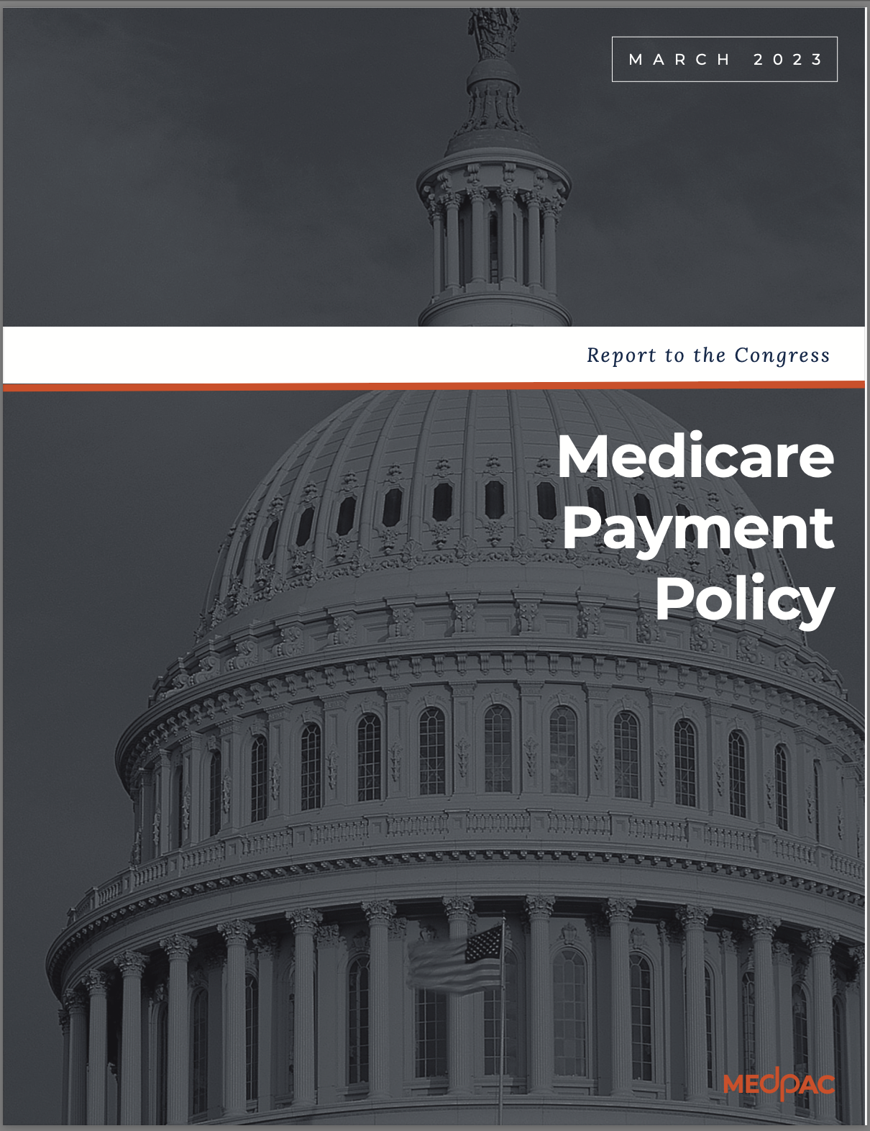
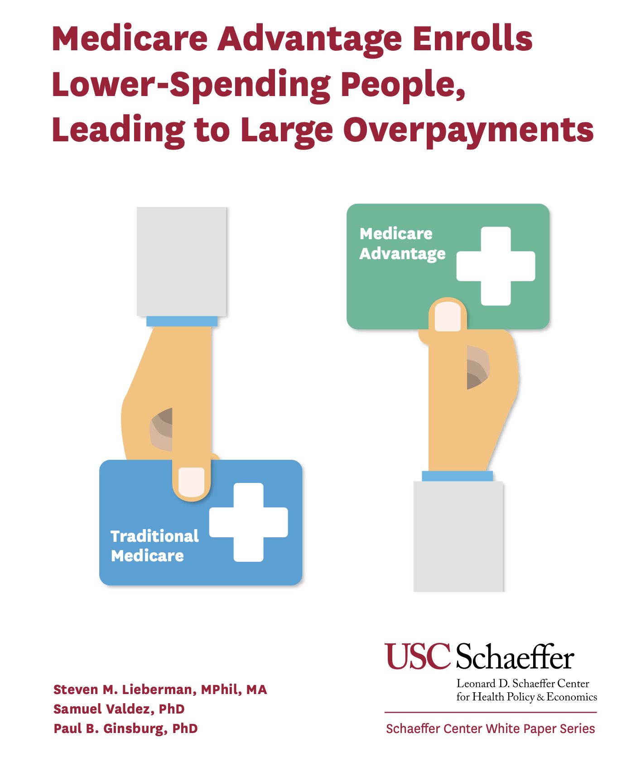
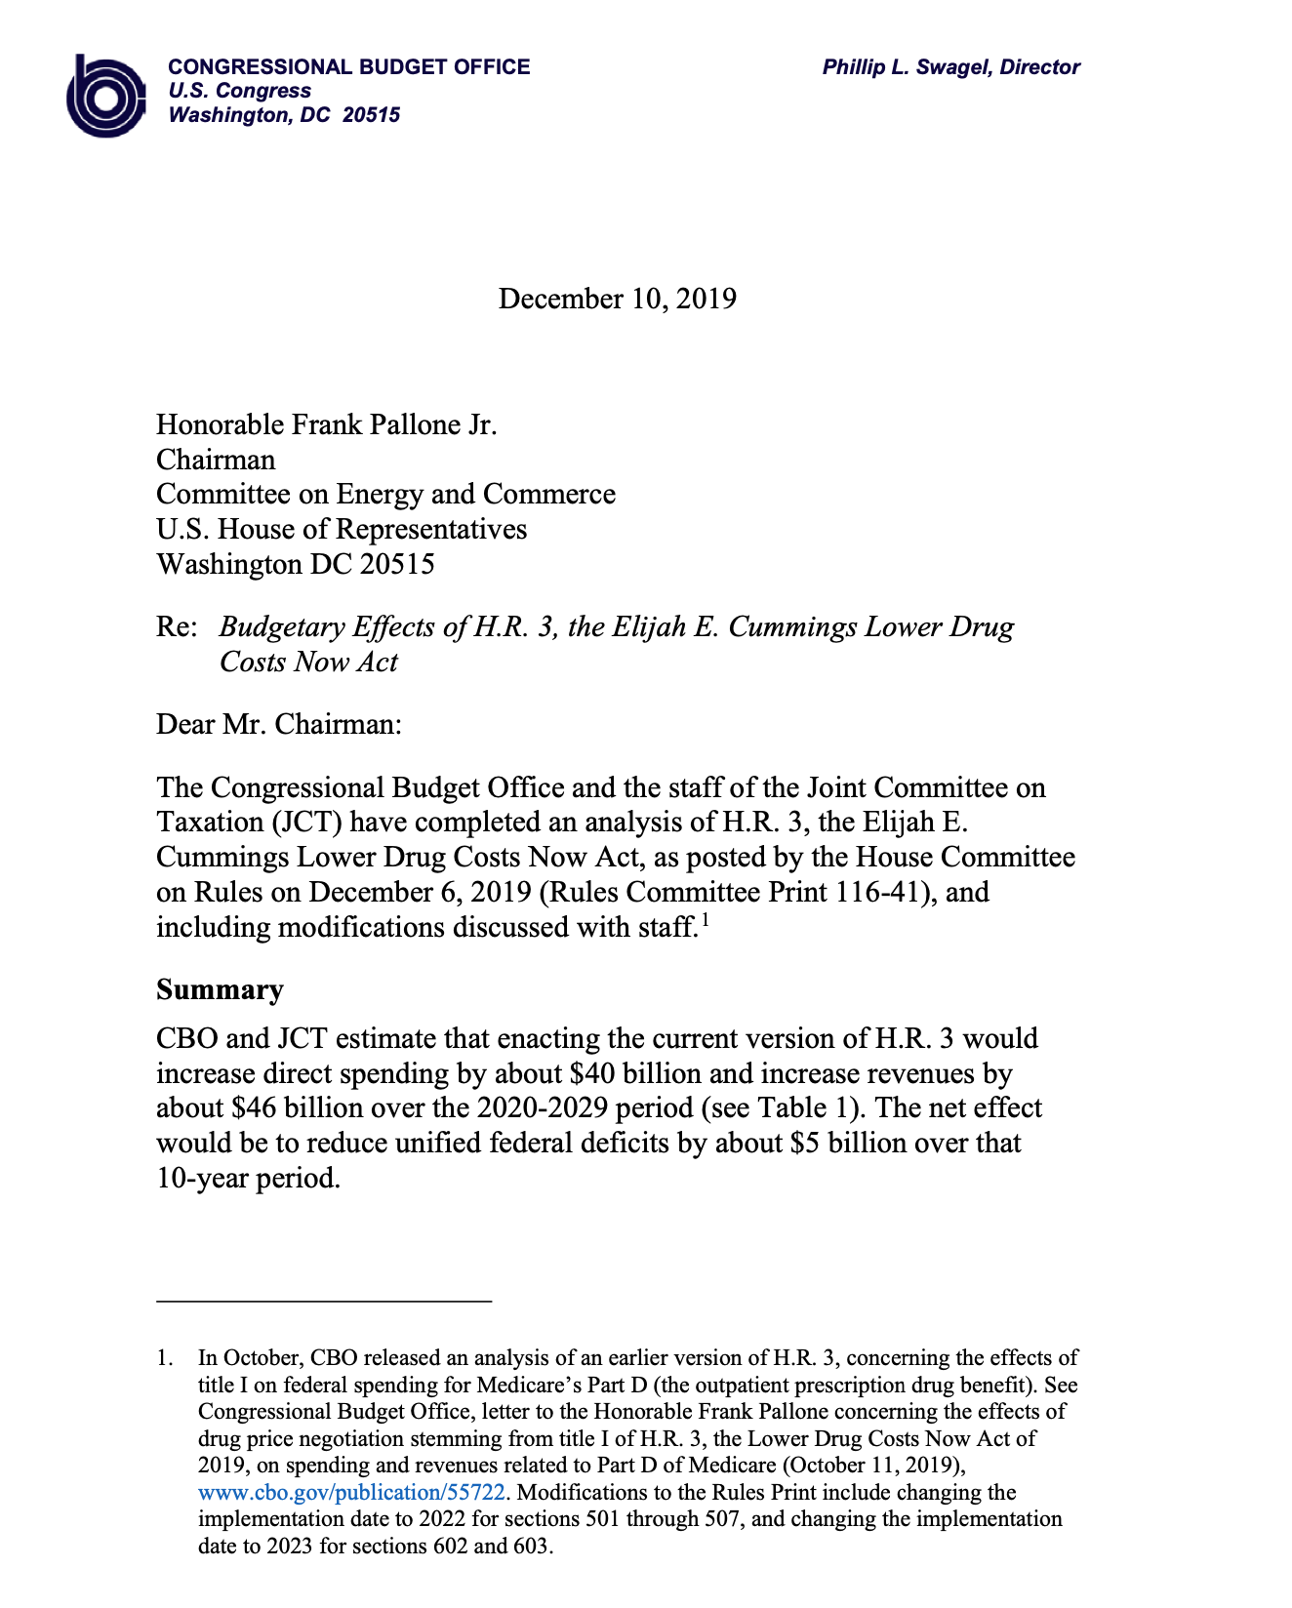
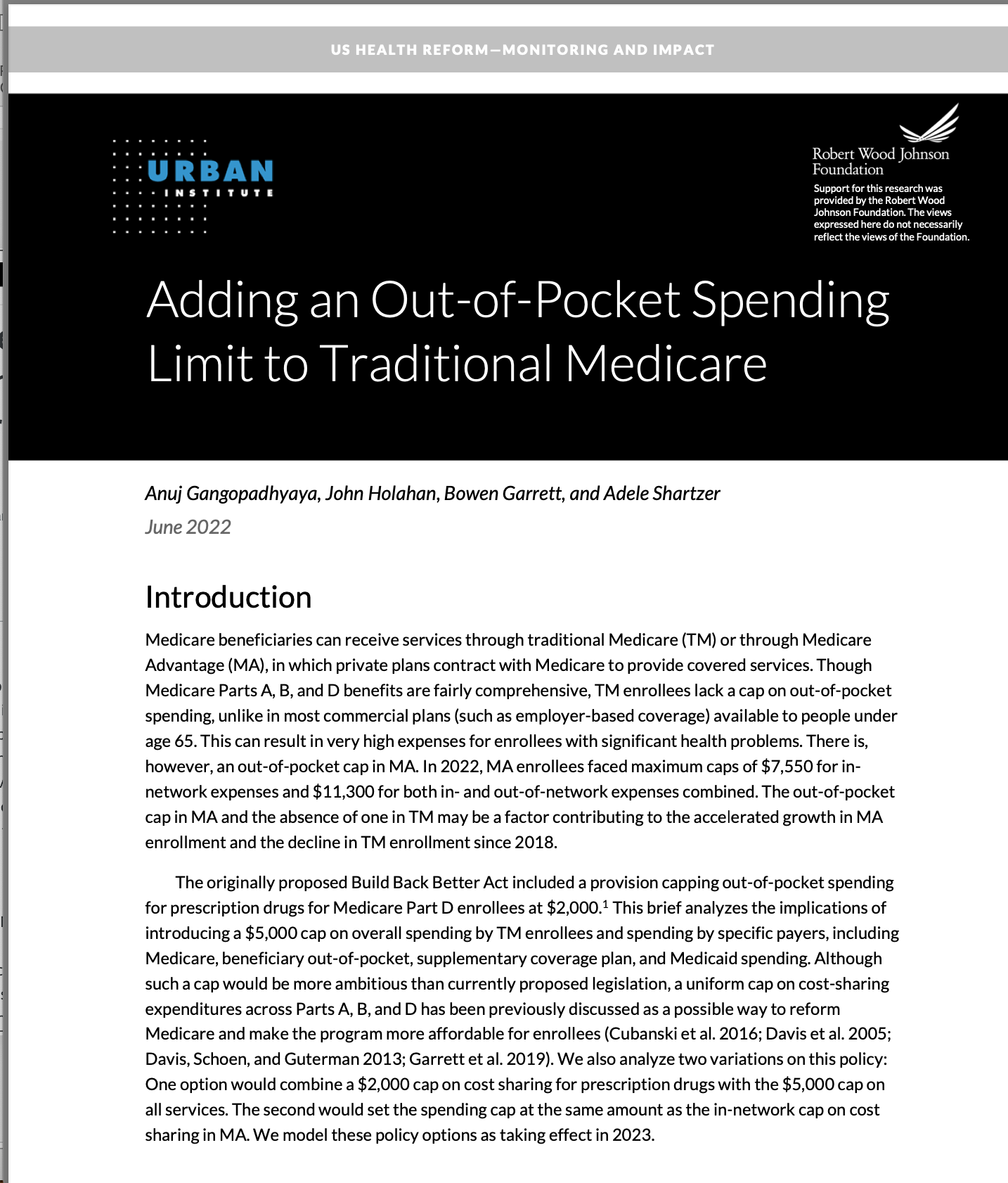
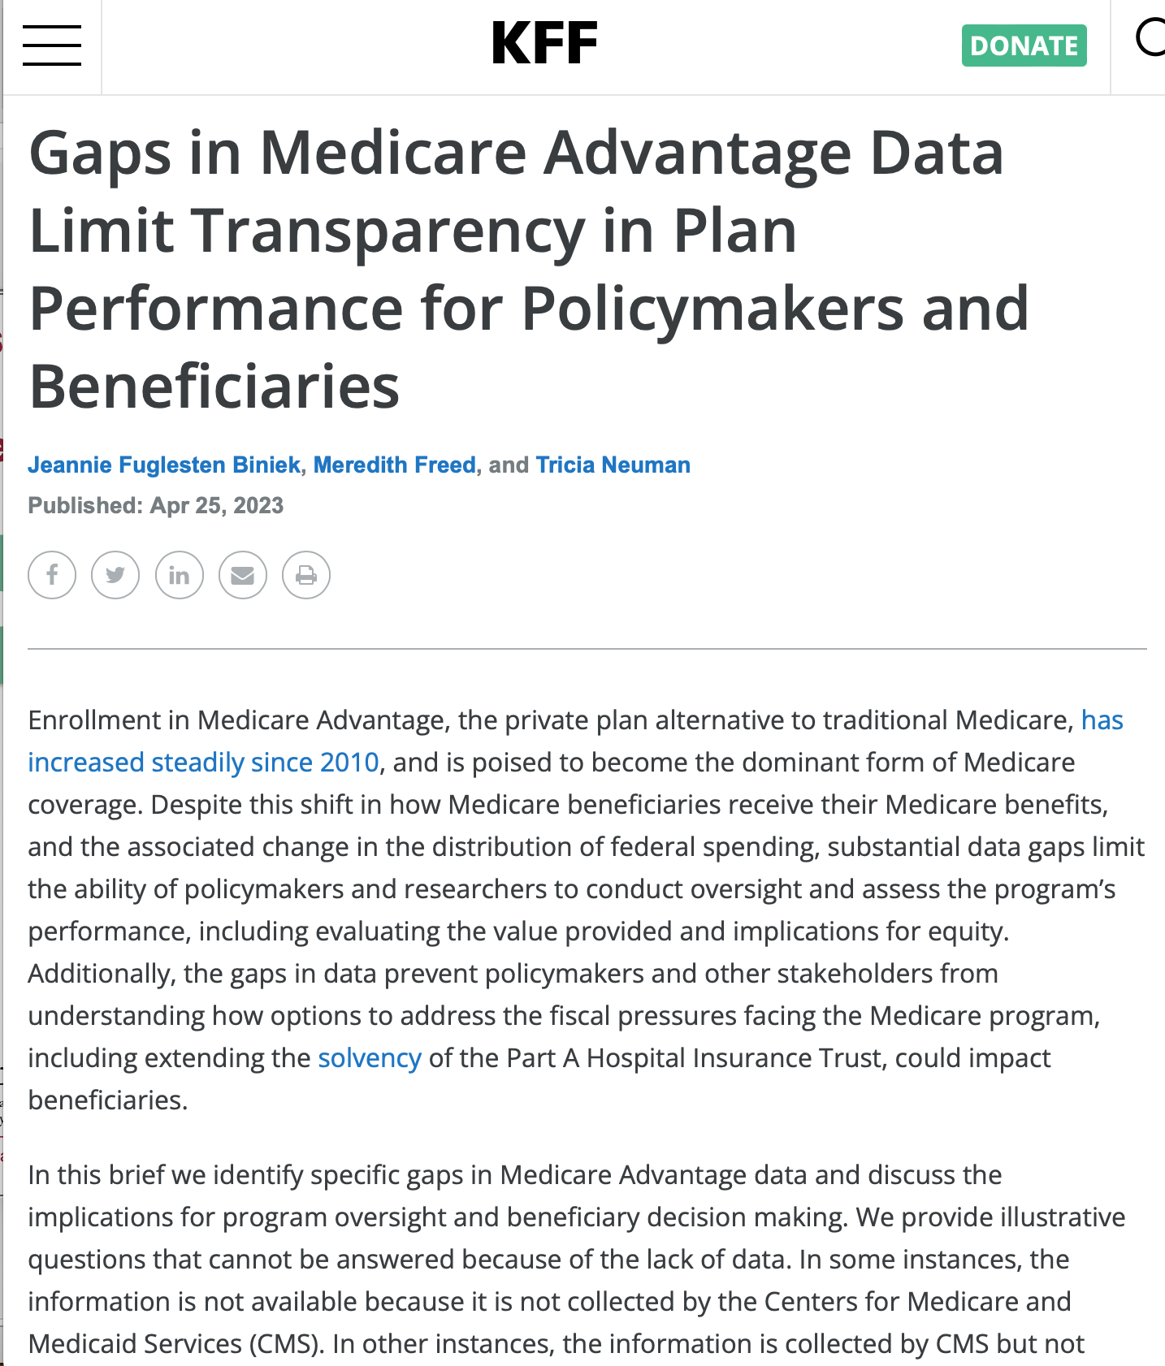
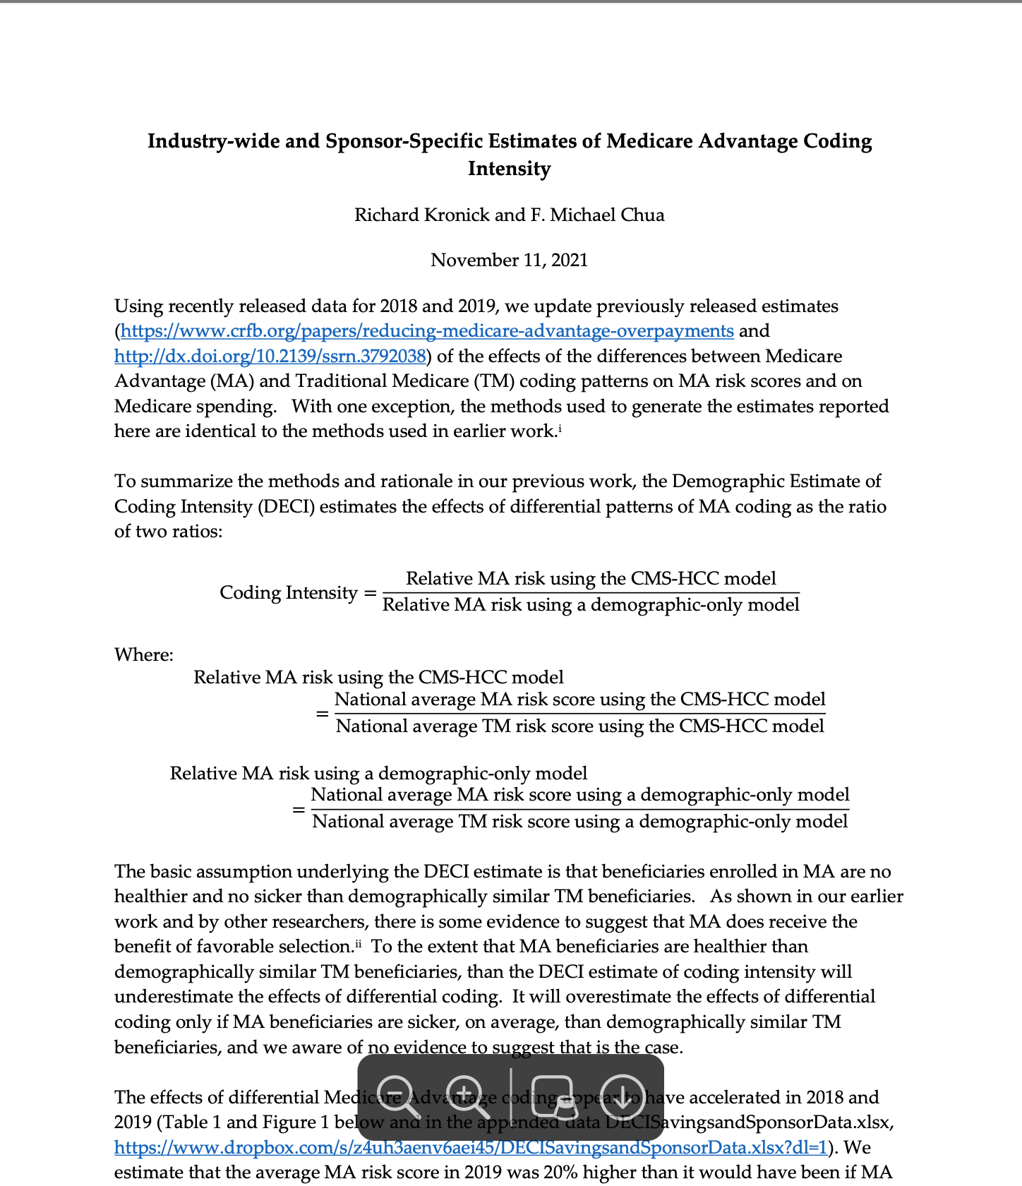
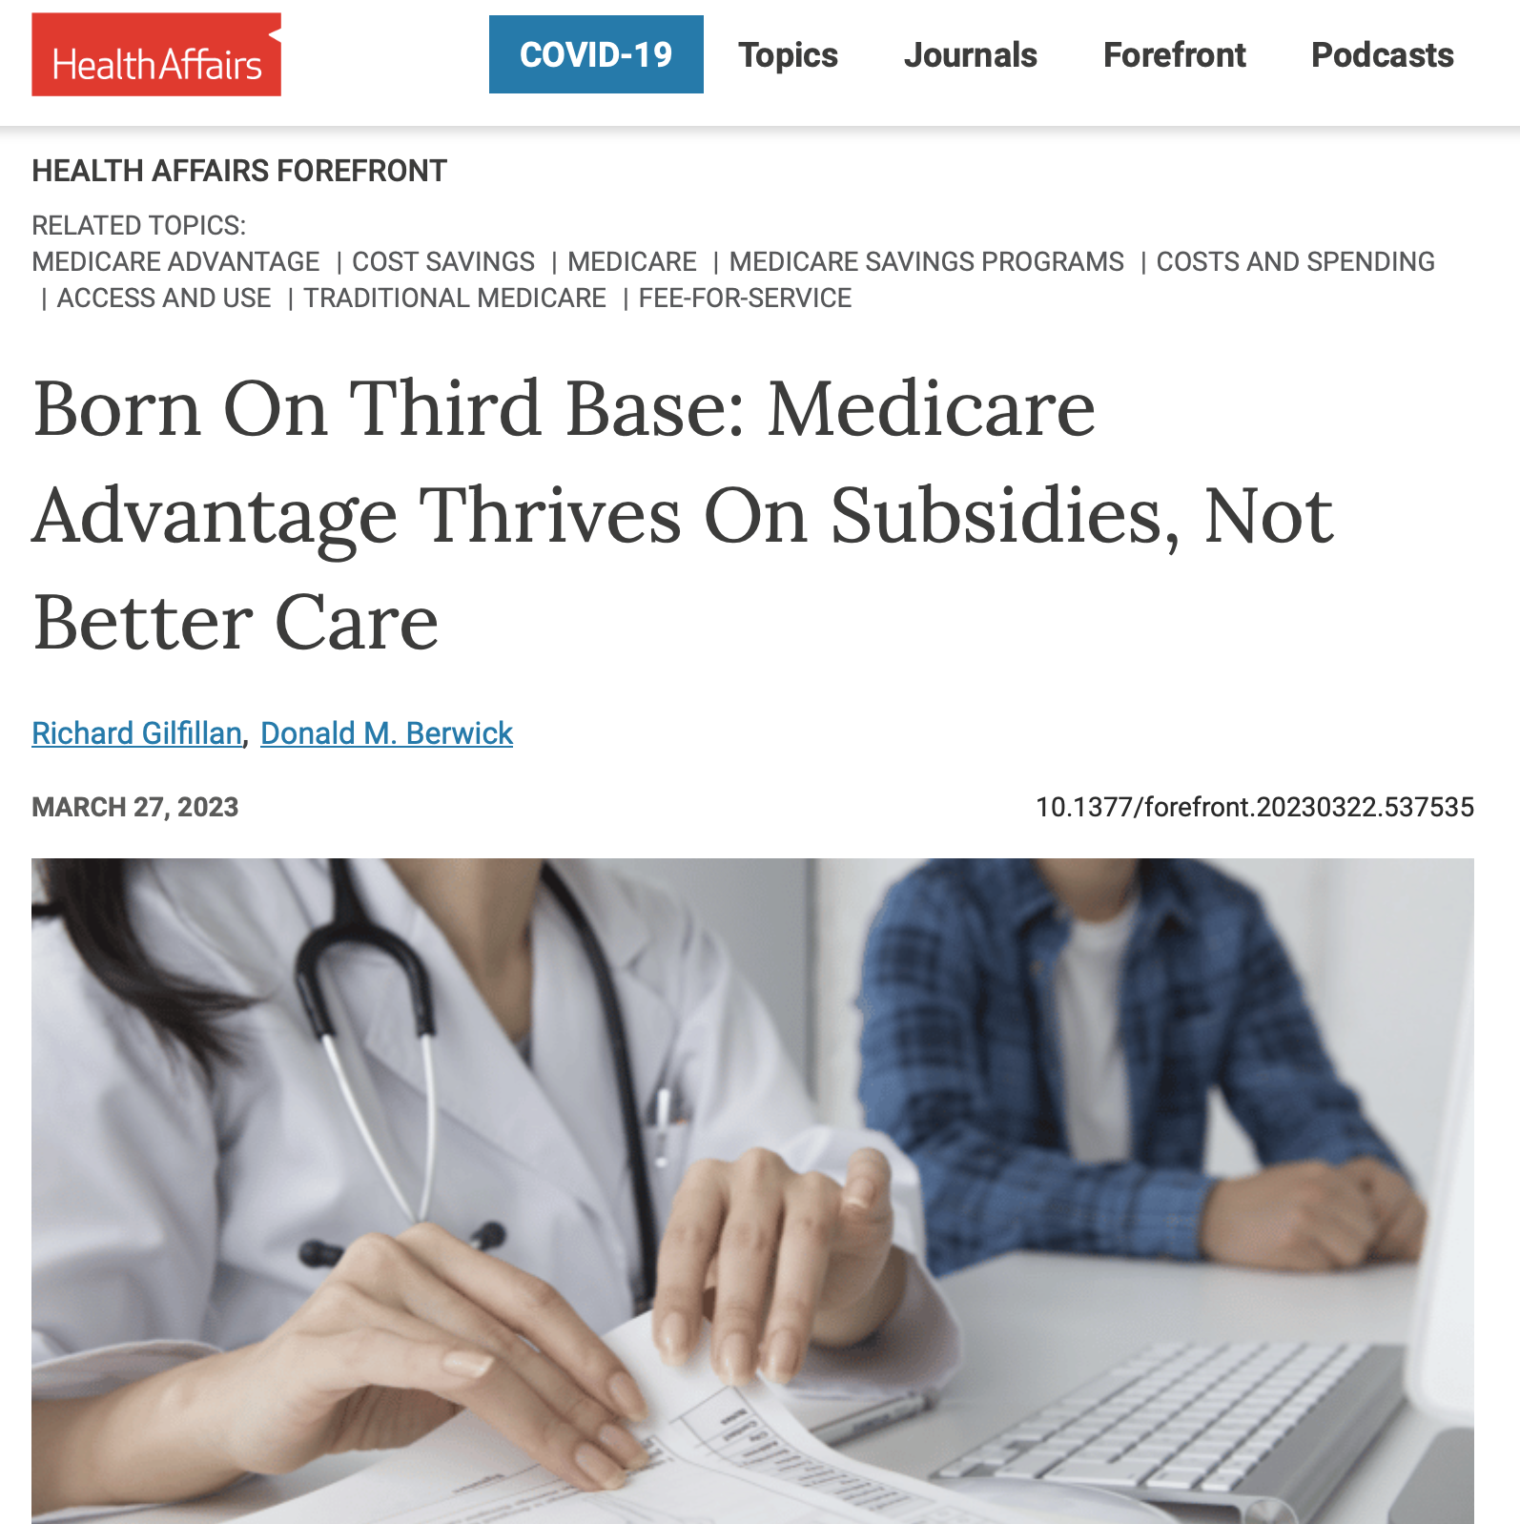
Why PNHP did this study:
Notes:
We decided to do this study after noticing a gap in the literature. We saw many studies identifying individual components of the ways that MA plans are overpaid. But we’d not found any place where all of these factors were rolled up together into one overall calculation, so it was impossible to grasp the real scope and context of the economic havoc being wrought by MA. Without a combined number, it’s nearly impossible to grasp the enormity of the problem.

Slide 45
Why PNHP did this study:
“Medicare Advantage has never generated savings relative to Traditional Medicare.
In fact, the opposite is true.”
– Kaiser Family Foundation
2021 report
https://www.kff.org/medicare/issue-brief/higher-and-faster-growing-spending-per-medicare-advantage-enrollee-adds-to-medicares-solvency-and-affordability-challenges/?utm_campaign=KFF-2021-Medicare&utm_medium=email&_hsmi=2&_hsenc=p2ANqtz--NbWFYepJ3_bF07nVVqdBF1nXFKwXuVn9L66uGcqn5hPdz7Tiot2L7eMwnyN0vSl6Bnbb1hZiyrztywKa3saASppissA&utm_content=2&utm_source=hs_email Accessed Oct. 6 2023
Notes:
We have seen many statements like this one from Kaiser and others from MedPAC, consistently describing the failure of MA to save money and in fact only increasing the cost of healthcare within Medicare.
So we decided to not recreate any of the robust primary literature that dug deeply into CMS claims databases, but instead to determine the scope and context that has been missing from the national dialogue.

Slide 46
Source | Percentage of Overpayment | Amount in $ per year (based on 2022 MA spending)
Favorable Selection | 11-14% | $44-56 Billion
Upcoding | 5% | $20 Billion
County Benchmarks and Quality Bonuses | 6-7% | $24-28 Billion
Subtotal | 22-26% | $88-104 Billion
Induced Utilization | 9% | $36 Billion
Total (Including Induced Utilization) | 31-35% | $124-140 Billion
Source | Percentage of Overpayment | Amount in $ per year (based on 2022 MA spending)
Favorable Selection | 11-14% | $44-56 Billion
Upcoding | 5% | $20 Billion
County Benchmarks and Quality Bonuses | 6-7% | $24-28 Billion
Subtotal | 22-26% | $88-104 Billion
Induced Utilization | 9% | $36 Billion
Source | Percentage of Overpayment | Amount in $ per year (based on 2022 MA spending)
Favorable Selection | 11-14% | $44-56 Billion
Upcoding | 5% | $20 Billion
County Benchmarks and Quality Bonuses | 6-7% | $24-28 Billion
Subtotal | 22-26% | $88-104 Billion
Source | Percentage of Overpayment | Amount in $ per year (based on 2022 MA spending)
Favorable Selection | 11-14% | $44-56 Billion
Upcoding | 5% | $20 Billion
County Benchmarks and Quality Bonuses | 6-7% | $24-28 Billion
Source | Percentage of Overpayment | Amount in $ per year (based on 2022 MA spending)
Favorable Selection | 11-14% | $44-56 Billion
Favorable Selection | 11-14% | $44-46 Billion
Source | Percentage of Overpayment | Amount in $ per year (based on 2022 MA spending)
Upcoding | 5% | $20 Billion
Source | Percentage of Overpayment | Amount in $ per year (based on 2022 MA spending)
Adding inactive diagnoses to increase capitation rates
Pre-paid for “average” patients but attracting the healthiest
Extra payments without clear value for patients
Overpaying MA plans as if they removed financial
barriers to care, despite that not being true.
PNHP’s 2023 report on overpayments to Medicare Advantage
https://pnhp.org/system/assets/uploads/2023/09/MAOverpaymentReport_Final.pdf

Slide 47
WWYD with $140,000,000,000 per year?
High estimate
$140
Medicare plus Medicaid combined
$ Billions per year
Low estimate
$88
MA Over-Payments
Part B
Premiums
Part D
Federal Spending
$5,000
Max Out-of-Pocket
Dental
Hearing
Vision
PNHP’s 2023 report on overpayments to Medicare Advantage
https://pnhp.org/system/assets/uploads/2023/09/MAOverpaymentReport_Final.pdf
Notes:
SLOW THIS DOWN A BIT.
So PNHP’s estimate of dozens of economic analyses reveals a range from $88B to a reasonable upper level of $140B. For all the reasons I’ve said earlier, I think the $140B number itself is pretty conservative and likely lowball.
Is $140B a large number in the scope of something as enormous as a federal budget? For me, that question is like asking whether Mars is closer than Venus. Whenever I see numbers this big, it helps to have a context of other numbers.
[CLICK]
To start, a shocking number emerged when we looked at the premiums paid by virtually all seniors and people with disabilities for Medicare Part B. Most pay about $170 a month, and most just have it taken out of their Social Security check. They know they do it, but they usually don’t see it. Nearly invisible.
[CLICK]
If you add up all of those monthly $170 payments by millions of people, that’s $131B across the country every year. That’s less than the money being grifted by MA corporations. Medicare members all pay that because they’ve been told that’s the only way the federal government can afford to provide a Part B benefit. I believe they would be pretty angry if they realized that MA profiteers are diverting all of those premium dollars being taken out of their Social Security checks every month. Increasing their Social Security checks by $170 a month would be a big win for people on Medicare, and frankly for the politicians who made it happen. One of PNHP’s projects is to make sure this is widely understood. People would be angry about this, if they knew.
[CLICK]
Or, remember all the controversy and fighting over Medicare Part D? The entire federal spend on Part D is less than our estimate of the overpayments to MA.
[CLICK]
Or one of the things we really need to do to improve Traditional Medicare and level the playing field against MA – put in a maximum out-of-pocket cap. Those copays and deductibles can quickly bankrupt people, and there’s no limit to that in TM today. That’s why people have to buy Medigap if they can afford to, or go into MA and risk not getting the healthcare they need. So if we limited the out-of-pocket risk in TM, we’d help people avoid MA. PNHP would of course like to see that out-of-pocket max set at zero, but the Urban Institute modeled out a more modest out-of-pocket maximum of $5,000 per year. That would cost a tiny fraction of what MA drains from us, and would go a long way towards leveling the playing field.
[CLICK]
Finally, we could add the missing benefits that most people really want like dental, hearing, and vision. MA corporations market the heck out of that, people join MA to get those benefits, and then later find out how limited the benefits really are. It turns out that adding dental, hearing, and vision – not just to Medicare but even to all of Medicaid – would cost less than our lowest estimate of the overpayments.

Slide 48
WWYD with $140,000,000,000 per year?
Eliminate all medical debt
in 18 months
(USA total = $195,000,000,000)
Buy 70 billion
slices of pizza
($2 per slice)
https://www.kff.org/health-costs/press-release/1-in-10-adults-owe-medical-debt-with-millions-owing-more-than-10000/#:~:text=The%202020%20survey%20suggests%20Americans,variation%20from%20year%20to%20year.
Accessed Oct 30 2023

Slide 49
PNHP.org/MAReport
PNHP’s 2023 report on overpayments to Medicare Advantage
https://pnhp.org/system/assets/uploads/2023/09/MAOverpaymentReport_Final.pdf

