Slide 1
America’s Mental Health Care Crisis
Medicare for All is part of the Solution

Slide 2
America’s Growing Mental Health Crisis
% of U.S. adults with mental illness, 2021
SAMHSA, Center for Behavioral Health Statistics and Quality, National Survey on Drug Use and Health, 2021. samhsa.gov/data/sites/default/files/reports/rpt39441/NSDUHDetailedTabs2021/NSDUHDetailedTabs2021/NSDUHDetTabsSect6pe2021.htm
Notes:
More than one in five adult Americans – 50 million people -- experienced some type of mental illness in 2021. Millions more suffered from severe mental illness, including thoughts of suicide.

Slide 3
America’s Growing Mental Health Crisis
% adults reporting symptoms of anxiety, depression
2019
2023
U.S. Census Household Pulse Survey https://www.cdc.gov/nchs/covid19/pulse/mental-health.htm
Notes:
The Covid-19 pandemic had devastating consequences for Americans’ mental health. Compared to 2019, adults today report three times the rate of depression and anxiety symptoms.

Slide 4
America’s Growing Mental Health Crisis
% of U.S. adults with substance use disorder, 2021
SAMHSA, Center for Behavioral Health Statistics and Quality, National Survey on Drug Use and Health, 2021. https://www.samhsa.gov/data/sites/default/files/reports/rpt39441/NSDUHDetailedTabs2021/NSDUHDetailedTabs2021/NSDUHDetTabsSect6pe2021.htm
Notes:
More than 17% of U.S. adults report a substance use disorder involving either drugs or alcohol, or sometimes both.

Slide 5
America’s Growing Mental Health Crisis
110,757
Overdose deaths in the U.S.
52,623
Provisional drug overdose death counts, National Center for Health Statistics, 2023.
https://www.cdc.gov/nchs/nvss/vsrr/drug-overdose-data.htm
Notes:
[CLICK] Overdose deaths have more than doubled in the U.S. since 2015, [CLICK] with no sign of slowing down.

Slide 6
America’s Growing Mental Health Crisis
U.S. suicide rate per 100,000
https://www.cdc.gov/suicide/suicide-data-statistics.html
Notes:
Suicide rates have increased by 37% since 2000. Suicide is now the twelfth (12th) leading cause of death overall in the U.S., but the second leading cause of death among children aged 10-14 and young adults aged 25-34 , and the third leading cause of death for young people aged 15-24.

Slide 7
America’s Growing Mental Health Crisis
% of U.S. youth with mental illness
https://www.cdc.gov/childrensmentalhealth/data.htm Data for 2019
Notes:
An alarming percentage of youth age 12-17 struggle with depression, hopelessness, and thoughts of suicide. This data is from 2019, and we know that the pandemic has only made these struggles worse.

Slide 8
America’s Growing Mental Health Crisis
% increase in suicide by age, 2011 to 2021
https://www.kff.org/mental-health/issue-brief/a-look-at-the-latest-suicide-data-and-change-over-the-last-decade/
Notes:
While rates of death by suicide have increased across nearly all age groups, they have reached crisis levels for young people, with an increase of nearly 50% for adolescents. To say we are in a crisis is an understatement.

Slide 9
Consequences of Untreated Mental Illness
Develop chronic conditions
Utilize high-cost health services
Increased morbidity and mortality
Chronic conditions: https://www.ncbi.nlm.nih.gov/pmc/articles/PMC5333921/ High-cost services: https://mhanational.org/sites/default/files/2023-State-of-Mental-Health-in-America-Report.pdf Mortality: https://jamanetwork.com/journals/jamapsychiatry/fullarticle/2110027
Notes:
Timely and consistent treatment for mental health conditions is about far more than managing specific symptoms. When Americans with mental illness can’t get the care they need, [CLICK] they are more likely to develop chronic conditions like arthritis, chronic pain, heart disease, stroke, hypertension, diabetes, and cancer; [CLICK] more likely to utilize high-cost health services like emergency departments, and [CLICK] experience increased morbidity and mortality.

Slide 10
Barriers to Mental Health Care
% of adults with mental illness who received treatment
SAMHSA, Center for Behavioral Health Statistics and Quality, National Survey on Drug Use and Health, 2021. samhsa.gov/data/sites/default/files/reports/rpt39441/NSDUHDetailedTabs2021/NSDUHDetailedTabs2021/NSDUHDetTabsSect6pe2021.htm
Notes:
Despite increasing awareness of the U.S. mental health crisis, the majority of adults suffering from mental illness do not receive treatment.

Slide 11
Barriers to Mental Health Care
% of youth with major depression receiving treatment
https://mhanational.org/sites/default/files/2023-State-of-Mental-Health-in-America-Report.pdf
Notes:
Children and youth have similar – and slightly worse – levels of treatment access for mental health.

Slide 12
Barriers to Mental Health Care
% of adults with substance use disorder who received treatment
https://mhanational.org/sites/default/files/2023-State-of-Mental-Health-in-America-Report.pdf Accessed Sept. 21, 2023
Notes:
Almost ALL adults who struggle with substance use disorder cannot access treatment, which is especially alarming given the rise in overdose deaths in the U.S.

Slide 13
Barriers to Mental Health Care
% of adults with mental illness with insurance
https://mhanational.org/sites/default/files/2023-State-of-Mental-Health-in-America-Report.pdf Accessed Sept. 21, 2023
Notes:
You may assume that the reason the vast majority of Americans suffering with mental illness cannot get the care they need is because they DON’T have health insurance. [CLICK] However, the opposite it true [CLICK], only 11% of adults with mental illness are uninsured. For comparison, about 12% of all working-age adults (under 65) are uninsured in the U.S. (Source for all U.S. working-age adults): https://www.cdc.gov/nchs/data/nhis/earlyrelease/insur202305_1.pdf

Slide 14
Barriers to Mental Health Care
Reason did not receive mental health services
Any mental illness
Serious mental illness
SAMHSA, Center for Behavioral Health Statistics and Quality, National Survey on Drug Use and Health, 2021. https://www.samhsa.gov/data/sites/default/files/reports/rpt39441/NSDUHDetailedTabs2021/NSDUHDetailedTabs2021/NSDUHDetTabsSect6pe2021.htm
Notes:
So, if the vast majority of Americans with mental health needs have insurance coverage, why are they still not getting care? The most common barriers to mental health care are cost and insurance problems. [CLICK] More than 40% of adults with mental illness and [CLICK] 55% of adults with serious mental illness said cost prevented them from getting care; [CLICK][CLICK] and a third of those with serious illness said that insurance problems kept them from getting care.

Slide 15
Commercial insurance Creates Barriers to Care
Notes:
Those numbers still don’t totally explain why the vast majority of Americans don’t get the care they need. [CLICK] For that, we need to dig deeper into the ways that commercial insurance companies create complex barriers to care.
Note that commercial insurance companies don’t just sell private, marketplace, and employer-sponsored plans, they also manage a majority of state’s Medicaid plans and about half of all Medicare plans. These companies only profit if they are able to pay out less for health services than they collect from premiums, and they’ve figured out that skimping on mental and behavioral health is an easy way to do that.

Slide 16
Commercial Insurance = Barriers to Care
Pay less
Pay mental health providers far less
Limit choice
Offer few (or no) local providers
Deny care
Restrict or deny common treatments
Notes:
Legally, commercial health insurers are not allowed to deny coverage for mental and behavioral health care outright. What they CAN do is create barriers to care that make it all but impossible for our patients to navigate, forcing those with illness to simply give up. These barriers are often complex enough that they are difficult to track or enforce. Here’s the three main barriers that we’ll discuss: [CLICK] Paying less for mental health, limiting choice of providers, and denying coverage for care.

Slide 17
Commercial Insurers Pay Less for Mental Health
Insurance reimbursement for similar services “in-network”
https://ps.psychiatryonline.org/doi/full/10.1176/appi.ps.201700271
Notes:
One way that insurance companies discriminate against mental health care is by underpaying mental health providers. Psychiatrists were paid a median of 13% to 20% less than non-psychiatrist physicians for the same in-network services, depending on severity of the diagnosis.

Slide 18
Commercial Insurers Pay Less for Mental Health
In 11 states, PPOs paid mental health providers 50% less than PCPs
Insurance reimbursement for similar services, PPO plan
https://ps.psychiatryonline.org/doi/full/10.1176/appi.ps.201700271
Notes:
Looking specifically at PPO plans, researchers found that for every $1 that insurance companies reimbursed primary care physicians, they reimbursed behavioral health professionals only 76 cents. [CLICK] In some states, they paid 50% less.

Slide 19
Commercial Insurers Pay Less for Mental Health
Percentage of providers who accept commercial insurance plans
https://jamanetwork.com/journals/jamapsychiatry/fullarticle/1785174
Notes:
These low in-network payments are proven to discourage psychiatrists and other mental health providers from contracting with insurers, thus shrinking the pool of covered providers for commercial plans.
Only 55% of psychiatrists accept commercial insurance, compared to 90% of other physicians.

Slide 20
Pay Disparities Cause Provider Shortages
Provider availability for non-metro counties
https://www.ajpmonline.org/article/S0749-3797(18)30005-9/fulltext
Notes:
This type of discrimination and payment disparity discourages mental health providers from staying in the profession, or from practicing in areas where they are needed most. Here we see that outside of major cities, nearly two-thirds of counties have no psychologists, and 80% have no psychiatrists available to provide care.

Slide 21
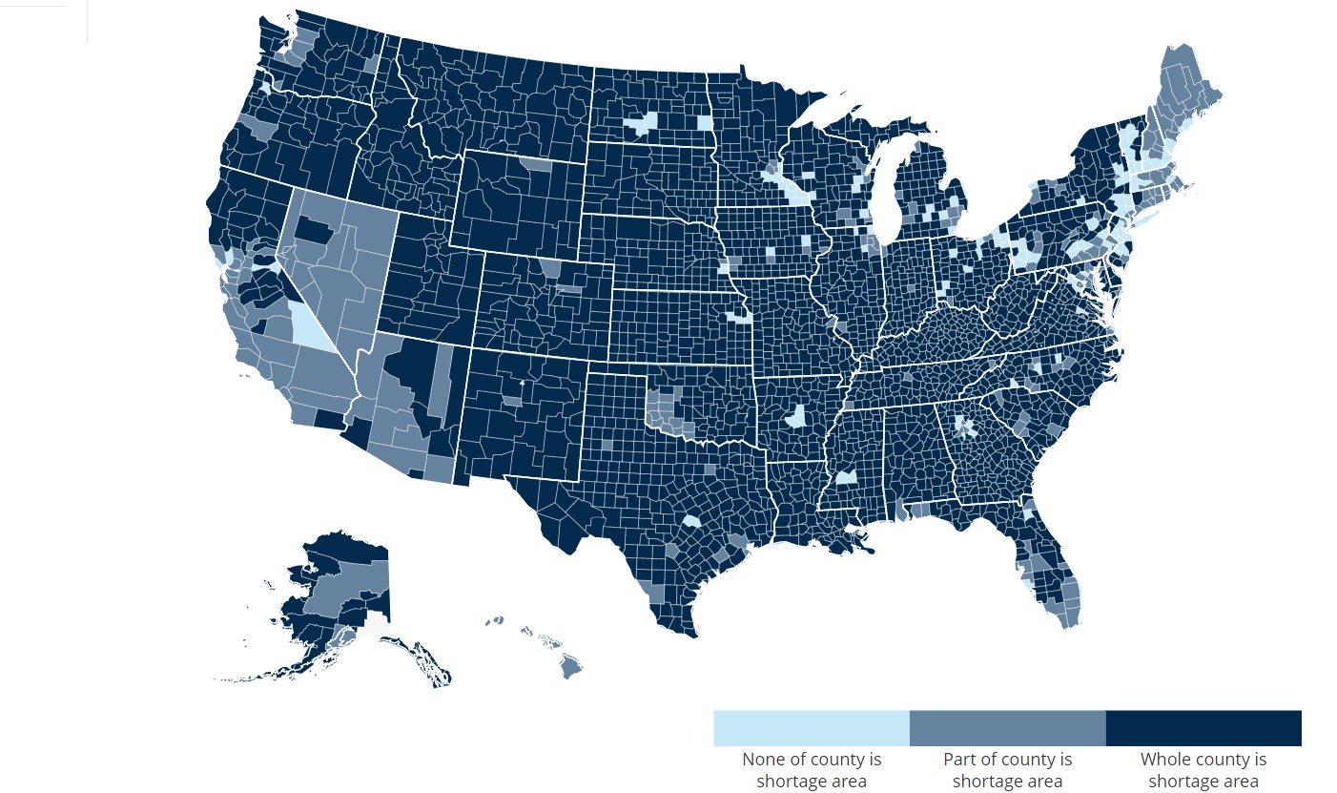
Mental Health Professional Shortage Areas by County, 2023
Source: data.HRSA.gov, May 2023
Notes:
What does a mental health professional shortage look like? This map shows that the vast majority of the nation is in a provider desert, with only a handful of counties – mostly in affluent urban areas – having an adequate supply of providers. Combined with the narrow networks imposed by commercial plans, families are often forced to travel hundreds of miles for care.

Slide 22
Commercial Insurers Limit Choice for Mental Health
Participation in any ACA Marketplace Plan network by type of provider (2016)
https://www.healthaffairs.org/doi/10.1377/hlthaff.2017.0325 Non-MD providers include: psychologists; advanced practice nurse practitioners; physician assistants; and behavioral specialists, counselors, and therapists with master’s or doctoral degrees
Notes:
Commercial insurers severely limit the choice of providers available to their enrollees by offering very narrow networks of covered providers, which create huge barriers to care.
A study of ACA Marketplace Plans found that only 43% percent of psychiatrists and 19% of nonphysician mental health providers (such as psychologists, counselors, and advance practice nurse practitioners) participate in any Marketplace plan network, compared with 58% of primary care providers.

Slide 23
Commercial Insurers Limit Choice for Mental Health
No provider in insurance network: Medical vs. Mental Health
https://www.nami.org/Support-Education/Publications-Reports/Public-Policy-Reports/A-Long-Road-Ahead/2015-ALongRoadAhead
Notes:
Given the limited number of mental health professionals participating in commercial insurance networks, it’s no surprise that a high percentage of commercial insurance enrollees were not able to find counselors, psychiatrists or other mental health prescriber in their plan network. Patients were five times as likely to report not finding a mental health provider compared to a primary care provider in their network.

Slide 24
Commercial Insurers Limit Choice for Mental Health
% “out-of-network” visits by type of provider
2017 PPO data
https://www.milliman.com/-/media/milliman/importedfiles/ektron/addictionandmentalhealthvsphysicalhealthwideningdisparitiesinnetworkuseandproviderreimbursement.ashx
Notes:
Because of extremely limited mental health provider networks offered by commercial insurance, enrollees were forced to go out-of-network for behavioral and mental health care more than four times more often than for medical care. Going out-of-network means that patients are forced to pay full price (or close to it) for their care.

Slide 25
Commercial Insurers Deny Care for Mental Health
Rate of insurance denials for provider- recommended care
https://www.nami.org/Support-Education/Publications-Reports/Public-Policy-Reports/A-Long-Road-Ahead/2015-ALongRoadAhead
Notes:
Even when patients are able to find a provider that is covered by their commercial insurance plan, insurance bureaucrats often refuse to cover the care that is recommended by the provider.
In a survey of Americans with commercial insurance, nearly one in three said their plan denied mental health services recommended by their providers because they were deemed “not medically necessary,” which is twice the rate of denials for medical services.

Slide 26
Commercial Insurers Deny Care for Mental Health
Insurance out-of-pocket cost is barrier to care: Medical vs. Mental health
https://www.nami.org/Support-Education/Publications-Reports/Public-Policy-Reports/A-Long-Road-Ahead/2015-ALongRoadAhead (2015)
Notes:
Even if a patient is able find a provider and get approval for the care they need, the insurance plan puts up another barrier to care: high copays, deductibles and co-insurance rates. Patients were nearly three times more likely to report that insurance cost-sharing prevented them from accessing counseling for mental health or substance use compared to both inpatient and outpatient medical care.

Slide 27
Commercial Insurers Deny Care for Mental Health
In 2019, United Behavioral Health was found guilty of denying 67,000 claims for mental health care based on financial — not medical — reasons.
https://casetext.com/case/wit-v-united-behavioral-health-8
Notes:
Recently a subsidiary of United Healthcare was found guilty of doing exactly this – making coverage decisions based on profits instead of medical necessity, impacting tens of thousands of patients.

Slide 28
Commercial Insurers’ Barriers for Mental Health:
- Wait weeks or months for appointments
- Travel long distances
- Pay full price for out-of-network providers
Many patients simply give up.
Notes:
Given all the barriers imposed by commercial insurers, [CLICK for each line] many patients in desperate need of care simply give up. [CLICK] This is unacceptable.

Slide 29
Medicare for All = Mental Health Care for All
Notes:
So that was a lot of bad news about the state of mental health care in the U.S., and the barriers to care imposed by commercial insurance. But there is a simple solution that would address the root problems of this crisis: Single-payer Medicare for All. You’ve probably heard of it before, but here’s a quick overview of how Medicare for All would work. [CLICK] Similar to how Medicare works today, we all pay into the program through progressive taxes, based on each person’s ability to pay. Individuals can visit any hospital or provider in the nation. Medicare covers all medically necessary care, including prescription drugs, and pays providers directly for your care. No middleman skimming money off the top or imposing barriers to care.

Slide 30
Medicare for All = Mental Health Care for All
Covers everybody for all medically necessary care, including prescriptions and services for behavioral & mental health and substance use disorder.
Coverage is lifelong with no interruptions in care.
Provides free choice of any hospital and provider, including psychiatrists, psychologists, and licensed counselors.
Care is free at the point of service with no copays or deductibles.
Notes:
What does mental health care look like under Medicare for All?
[CLICK] First, it would cover all medically necessary care, both for medical care, and for mental and behavioral health and substance use disorders.
[CLICK] Coverage is lifelong and seamless, nobody would ever experience a gap in coverage.
[CLICK] Patients have free choice of ANY hospital, clinic, or provider, including psychiatrists, psychologists and counselors.
[CLICK] Patients receive care without any cost-sharing. Cost will never get in the way of care.

Slide 31
Commercial Insurance
Medicare for All
X Narrow networks of covered hospitals & providers
✔ Free choice of any hospital or provider in the nation
X Unaffordable premiums, deductibles, and copays
✔ All care & drugs provided free at the point of service
X Denials of provider- recommended care
✔ All medically necessary care covered without delay
X Coverage changes with age, marriage, job status, etc.
✔ Lifelong coverage with no interruption in care
Notes:
Here’s a side-by-side comparison of what we have today with commercial insurance and what we would get with Medicare for All.
[CLICK through to list commercial insurance then MFA]

