Slide 1
Changing the Narrative
Fostering Relationships with Legislators
Max Brockwell, Rebecca Cerese

Slide 2
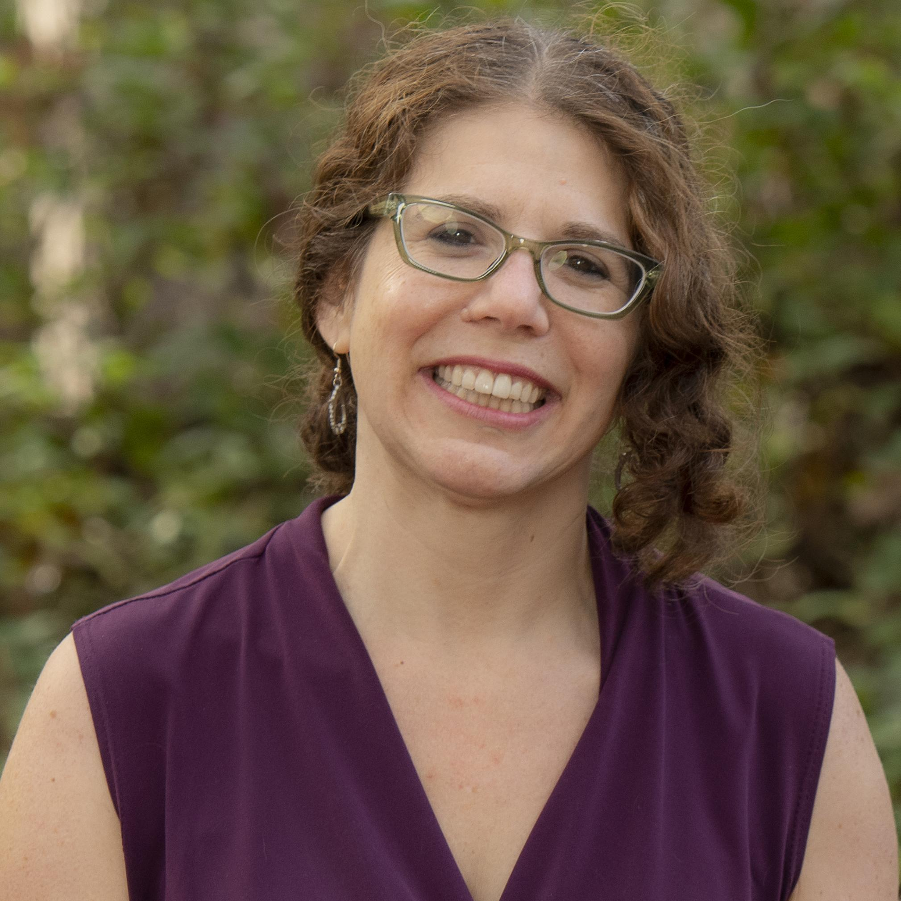
Max Brockwell
MS3 NEOMED
SNaHP National Political Advocacy Committee
SNaHP Ohio Chair of Resolution Committee
Rebecca Cerese
Health Policy Advocate
NC Justice Center
NC Medicare For All Coalition
Founding Member
Health Care For All NC
Board Member

Slide 3
Objectives
01
02
03
04
Highlight avenues of advocacy
Explore building relationships with lawmakers
Making the media work for you
Know your advocacy toolkit

Slide 4
$4.1 Billion
Notes:
Amount spent on Federal Lobbying 2022

Slide 5
Different levels of advocacy
Local Government
Medical Debt Relief
City/County Resolutions
State Government
Medicaid Expansion
Investigative Studies
State Single Payer
Federal
National Single Payer
Notes:
More local legislators likely more accessible

Slide 6
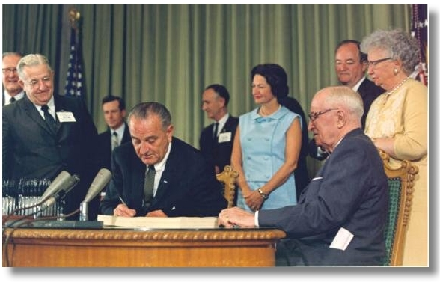
Medicare + Medicaid

Slide 7
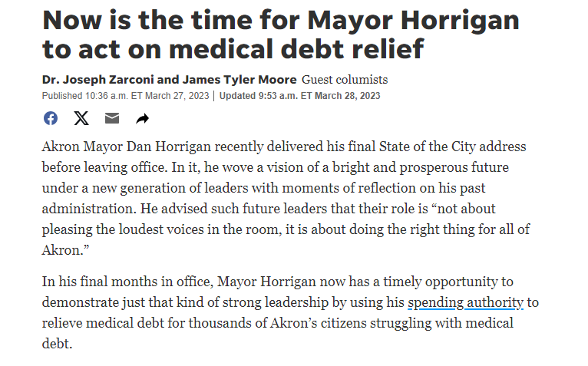
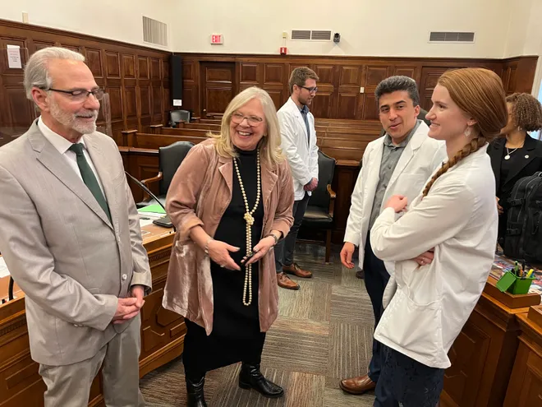
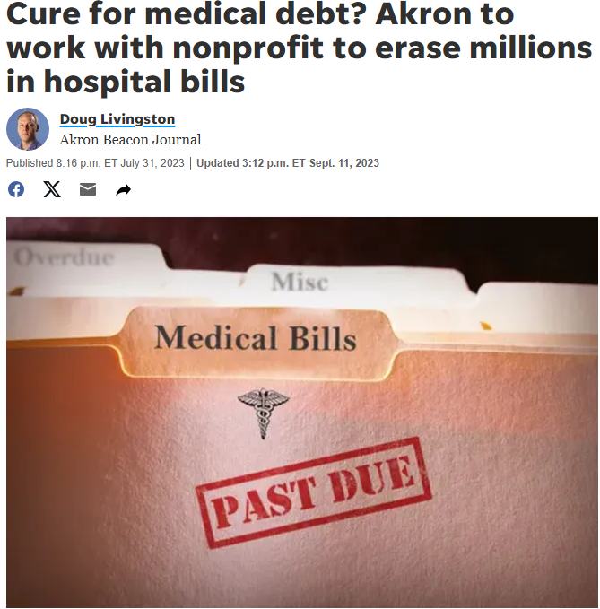
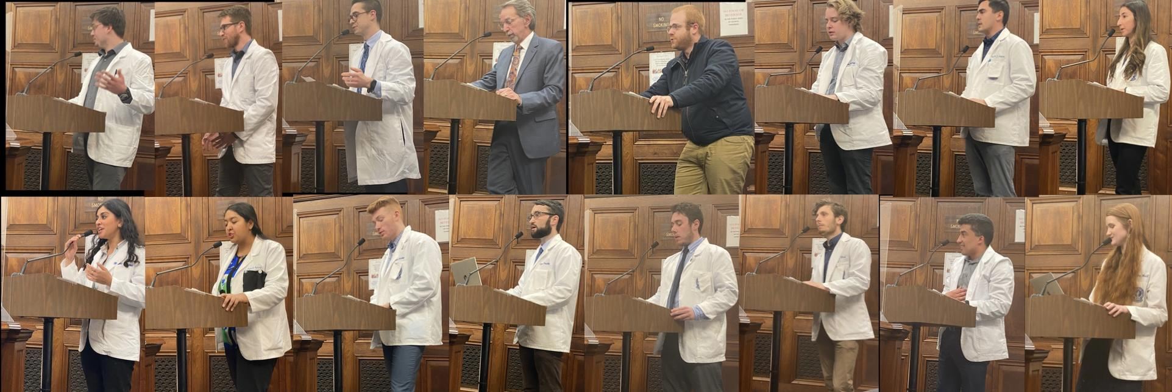

Slide 8
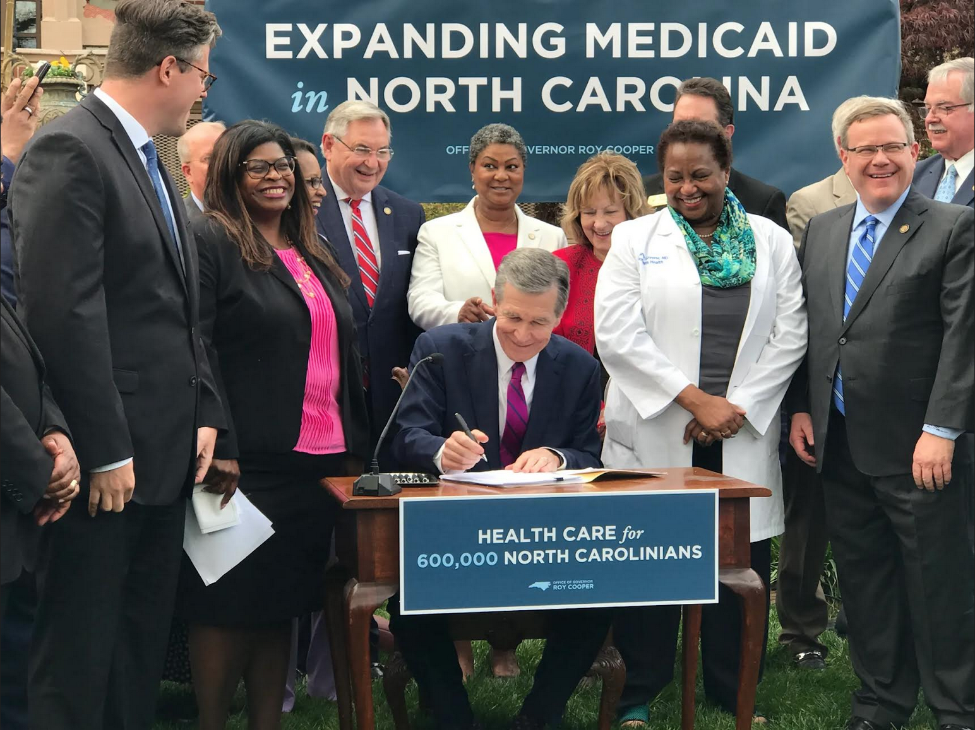
North Carolina expands Medicaid
After 10 years of advocacy efforts, we are expanding healthcare in a complicated and hostile political environment.
How did we do it?
Building a grassroots movement that included unlikely partners
Effectively Utilizing Personal Stories
Creating relationships with elected officials in both parties
Being strategic and able to evaluate and pivot
Finding effective messages and then having message discipline
Working with reporters to share personal stories that reinforce our narrative framing

Slide 9
Advocacy is Storytelling
Lawmakers are just people
They have personal experiences with the healthcare system
Make a connection and tell stories on shared ground

Slide 11
Building your Coalition
Providers
Experts
Patients
Altruistic, seen as advocates for patients
Professional to refer to for tough policy questions
People with life altering stories, living proof of why the system needs change
Advocacy Tip: Take an inventory of your team’s strengths/weaknesses when creating a strategy for your meeting.
Notes:
It is important to know your team’s strengths. Who is good at what - creating your plan for the meeting around that.

Slide 12
Find Your Allies in Office
Speak with your own elected officials
Organize constituents in allied officials districts’
Find people who can work across the aisle
Do your research!
How has this representative voted before?
What are their personal experiences
Work with people who will work with you!

Slide 13
Setting up meetings
Aid/Staffers
Lawmakers
Often first person you meet, frequently the most well informed on issues
Hold the power to vote on and introduce bills
The Media
Advocates
Potential friend or your enemy. We must work hard to ensure our narrative gets through
Ensure a cohesive front both internally and externally

Slide 14
Make that Connection!
Email is alright for initial arrangement, especially if you are being introduced
Phone calls are better for subsequent follow up
The gold standard remains speaking to legislators and advocate alike in person

Slide 15
Direct
Lobbying
Person to person is always better than phone/email for meetings
Lawmakers are just people
Serious insight, who
is your best messengers?
Persistent, but…

Slide 17
Triage Legislator Convo’s
01
02
03
04
Story-telling by far the most effective
Key components/talking points of policy
Data to backup your claims (least important in conversation)
Make your ask at the beginning, in the middle, and at the end
Notes:
Use your research on the elected official. Be strategic. The facts are on our side and we are asking for fiscally responsible good policy

Slide 18
Making “the ask”
A good ask
A weaker ask
Direct, succinct, clear
Room to negotiate but firm on what you want
Ex. Single Payer Reso
Ex. USA Healthcare
No clear and specific outcome described
Wishy-washy with your more important ask
Ex. Support better healthcare!

Slide 19
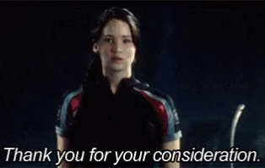
For your Consideration
Lower Medicare eligibility to 55
Expand Medicare to include dental, hearing, vision
Cap out of pocket costs
Allow Medicare negotiation of drug prices
End Medicare Advantage/ACO Reach
Notes:
For our purposes, always have a single payer universal healthcare system be the primary ask. This is a ladder to move downward and keep us on the path to our big goal

Slide 20
Healthcare “USA”
Universal
Simple
“Everybody in, nobody out”
Complicated = Inefficient
Patriotic Messaging
Affordable
Many conservatives agree with these principles
Everybody deserves healthcare without facing bankruptcy
Notes:
Thinking strategically, effective messaging. If you know the person will shut down when you say Medicare for All, don’t use it. We must be nimble and flexible. This dejargonizes it, we are still talking about single payer, but it is more palatable

Slide 21
Common Pitfalls
Deviating from your primary topic
Engaging in discussion of politics
Use of jargon and assuming the legislator has an advanced level of knowledge
Difference between private discussions and public forum
“Lost to follow-up”

Slide 22
Public Testimony
A chance to plead your case

Slide 23
Discuss
What made this strong testimony?
Personal with how it affected the family
Specific with details of the encounter
Harsh reality and a real impact

Slide 24
Engaging the Media

Slide 25
Paths to the Media
Earned Media
Op-Ed’s
Social Media
Articles written about your movement by the media
Stories that you write about your effort, aims to strengthen public support
Hard to pull off, but very effective at spreading the word

Slide 26
Paths to the Media
Media Advisory
Press Release
Press Conference
Announce to the press that a news-worthy event is approaching
Article you prepare for a news agency to publish about your victory!
An opportunity for you and elected officials to shape the story
Notes:
Helps hold politicians accountable

Slide 27
Where to Start?
Identify target publications/media?
Major papers, channels, blogs
Who are the reporters that cover this content area?
Health editor, Political editor, etc
How can you get in contact?
Info on website?
Are submissions accepted?

Slide 28
Making the Media Work for YOU
Op-Ed’s increase awareness of movement to the public
Fosters broader discussion
Applies pressure to legislators
Can be used as materials during meetings

Slide 29
Advocacy Toolkit

Slide 30
The Nuts and Bolts of our Trade
Legislative Reform
Policy Briefs
Resolutions
Present as an expert before a governmental body
Build your local base and make an impact
High effort, High impact
Media
Letter Writing Campaigns
Allied Projects
Publicize the cause, increase support
Reproductive rights, medical debt, environmental reform
Good intro to advocacy, broad base -> lawmaker

Slide 31
General Talking Points
DO
DON’T
Expand & improve Medicare
You can see any doctor in-network
Includes dental, vision, mental health, long term care
Everybody in, nobody out
Current system is for profit not people
Replace Medicare with a new and improved system
Your plan wouldn’t stop you from seeing your doctor
Eliminates premiums, co-pays, deductibles
One government plan

Slide 32
Strategic Communication
with Conservatives
Bipartisan support will be necessary
Fine tune messaging based on concerns
Healthcare USA effective
Meet people where they’re at
PNHP Conservative Case to Single Payer
Know when to cut losses

Slide 33
Sample Messaging
“Healthcare is a human right, yet somehow many Americans struggle to pay for life saving medications and treatment. As providers we constantly struggle between providing our patients with the best care possible and therapies they can afford without facing bankruptcy. No one should have to choose between heart failure medications and feeding their family. In the wealthiest country in the world, we must provide universal, simple, and affordable coverage for all Americans. Anything else will amount to doctors failing their patients.”

Slide 34
Breakout
Groups
Form groups of 3-4 people
Pick somebody to keep notes and report back
Work together to think strategically about your meeting with a legislator
Practice a conversation with the legislator
What worked well in your group?
What was difficult about the scenario?
Report back with your results

Slide 35
Let’s Debrief

Slide 36
Resources
Toolkits | Media | Educational
Healthcare-Now M4A Act 2023 Sponsor Drive | Harvard Guide on Speaking to the Media | Single Payer PNHP handout (slightly outdated, principles remain)
Medicare for All Resolutions Toolkit | The Op-Ed Project | Sanders M4A 2023 Fact Sheet
League of Women Voters Healthcare Reform Toolkit | Global Health Advocacy Incubator - Thorough Media Guide | Public Citizen FAQ on M4A
 | Talking Points for Local Government Officials and Media

Slide 37
—Eva Marie Lewis
“To be an activist is to speak. To be an advocate is to listen. Society can’t move forward without both.”

Slide 38
Thanks!
Max Brockwell
mbrockwell@neomed.edu
Rebecca Cerese
rcerese@gmail.com

Slide 39
Let’s
Organize!

