Slide 1
Reproductive Health and Medicare for All

Slide 2
U.S. Maternal Mortality Crisis
Maternal deaths per 100,000 live births
Maternal mortality: Death while pregnant or within 42 days of the end of pregnancy, irrespective of the duration and site of the pregnancy, from any cause related to or aggravated by the pregnancy or its management, but not from accidental or incidental causes. Used by the World Health Organization (WHO) in international comparisons. Date for 2021 or 2020 where available. Source: Trends in maternal mortality 2000 to 2020: estimates by WHO, UNICEF, UNFPA, World Bank Group and UNDESA/Population Division
Notes:
Before we talk about reproductive health care, we need to acknowledge that for women and birthing people in the U.S., reproductive care is not a luxury, it’s a matter of life and death. The U.S. maternal mortality rate is three times higher than the UK and Canada, nearly five times higher than Switzerland and New Zealand, and ten times higher than Australia and Norway.

Slide 3
Maternal Mortality More Than Quadrupled in U.S.
2021 = 33
Pregnancy-related deaths per 100,000 live births
1987 = 7
2021
Pregnancy-related death: Death during pregnancy or within one year of the end of pregnancy from a pregnancy complication, a chain of events initiated by pregnancy, or the aggravation of an unrelated condition by the physiologic effects of pregnancy. This CDC measure is used in the U.S. only.
https://www.cdc.gov/nchs/data/hestat/maternal-mortality/2021/maternal-mortality-rates-2021.htm;
Notes:
America’s maternal mortality crisis is quickly getting worse: The rate of pregnancy-related death in the U.S. is 4.5 times higher in 2021 than it was in 1987. By comparison, nearly every other country in the world has seen steadily decreasing mortality rates. In fact, the only two other nations besides the U.S. that have rising maternal mortality rates are Afghanistan and Sudan.

Slide 4
Maternal Mortality Compounded by Racial Inequities
Maternal deaths per 100,000 live births (2021)
Hoyert DL. Maternal mortality rates in the United States, 2021. NCHS Health E-Stats. 2023. DOI: https://dx.doi.org/10.15620/cdc:124678 Accessed Sept. 6, 2023
Notes:
Pregnancy and childbirth are much more deadly for parents of color in the U.S. In 2021, the maternal mortality rate for Black parents was more than two-and-a-half times the rate for White parents.

Slide 5
Maternal Mortality Is a Solvable Problem
84% of U.S.
Maternal Deaths
are Preventable
https://www.cdc.gov/reproductivehealth/maternal-mortality/erase-mm/data-mmrc.html
Notes:
The good news is the a vast majority of America’s maternal deaths are entirely preventable. [CLICK] [CLICK] And even better, they are preventable with basic primary, prenatal and postnatal care. The bad news is that so many parents in America don’t have access to even the most basic care needed to have a healthy pregnancy and birth. Medicare for All can change that.

Slide 6
U.S. Women Already Behind on Care
38% of women skipped medical care due to costs in past year.
44% of women report serious problems paying medical bills in past year.
https://www.commonwealthfund.org/publications/issue-briefs/2018/dec/womens-health-us-compared-ten-other-countries#append4 Data for 2018.
Notes:
Before we talk about reproductive care specifically, we need to acknowledge that women in the U.S. struggle to afford health care of any kind. [CLICK]. More than a third of women are skipping medical care due to cost, and [CLICK] nearly half of U.S. women have serious problems paying medical bills.

Slide 7
Cost is Barrier to Reproductive Care
% of OB-GYNs reporting cost issues for patients
Cost of treatment comes up always or often
Cost of reproductive care is burden for low-income patients
https://www.kff.org/womens-health-policy/report/obgyns-and-the-provision-of-sexual-and-reproductive-health-care-key-findings-from-a-national-survey/
Notes:
More than half of OB-GYNs said the issue of affordability comes up always or often when they recommend tests or treatments to patients. Nearly all reported that the cost of reproductive health care poses a burden for low-income patients in their practices.

Slide 8
Many can’t afford contraceptive care
% of women not using preferred method of birth control
https://www.kff.org/womens-health-policy/issue-brief/womens-sexual-and-reproductive-health-services-key-findings-from-the-2020-kff-womens-health-survey/
Notes:
More than a quarter of uninsured and low-income women are not using their preferred method of birth control, mostly because of cost.

Slide 9
High costs = less effective contraceptives
% method used by women age 18–49 at risk for unintended pregnancy (2017-2019)
https://www.cdc.gov/mmwr/volumes/70/wr/mm7025a2.htm
Notes:
61% of women of child-bearing age need contraceptive services to avoid pregnancy. [CLICK] However, of this group, only 15% used the most effective reversible method, a long-acting contraceptive such as an IUD or implant, 25% used a short-acting reversible method such as a pill, patch, or vaginal ring; 30% used a less effective “barrier” method such as a condom, withdrawal, or emergency contraception; and an additional 30% were not using ANY method of contraception at all. Studies show that decisions to use less effective contraceptive methods are almost always due to cost.

Slide 10
Commercial Insurance = Barriers to Contraceptive Care
May only cover ONE product in each category of contraceptive
Must prove contraceptive is “medically necessary”
31% of pill users missed days because of insurance delays
https://khn.org/news/article/contraception-free-options-for-women-cost-sharing/ https://www.kff.org/womens-health-policy/issue-brief/womens-sexual-and-reproductive-health-services-key-findings-from-the-2020-kff-womens-health-survey/
Notes:
Even those with commercial insurance face huge barriers to contraceptive care. [CLICK] Commercial insurers are only required by law to cover one single product in each of 18 categories of contraception methods approved by the FDA. As any OBGYN or user of contraceptives will tell you, there is a huge variation between products.
In addition, [CLICK] many commercial health plans discourage use of established and reliable methods by requiring providers to get the insurer’s approval before prescribing them, forcing providers to submit documentation that the product is “medically necessary.” And, [CLICK] nearly one-third of oral contraceptive users say they have missed taking their birth control because they were not able to get their next supply in time, mostly due to insurance delays.

Slide 11
Doesn’t the ACA Require Contraceptive Coverage?
X
Plans that were grandfathered in
X
Religious nonprofits
X
Companies that “object” to contraceptive care
https://www.kff.org/report-section/ehbs-2019-section-13-grandfathered-health-plans/ https://www.commonwealthfund.org/blog/2020/supreme-court-excuses-organizations-religious-or-moral-objections-covering-workers-birth
Notes:
You may have heard that the Affordable Care Act solved these problems by requiring insurers and employer plans to cover contraceptive care. But if you read the fine print, many employer health plans are exempt from ACA requirements to cover contraceptive services, including [CLICK] pre-ACA plans that were “grandfathered” (these plans covered 13% of workers with a job-based plan in 2019);
[CLICK] Religious nonprofits (which can include large employers like hospitals and schools); and [CLICK] employers that simply object to contraception, a category that covers nearly three million women.

Slide 12
U.S.: High Rate of Unintended Pregnancy
% of Intended vs. Unintended Pregnancies in U.S.
https://www.guttmacher.org/regions/northern-america/united-states
Notes:
Given these tremendous barriers to contraceptive care, it’s no surprise that the U.S. has one of the highest rates of unintended pregnancy in the developed world. In fact, nearly half of all pregnancies in the U.S. are unplanned.

Slide 13
Higher Rate of Unintended Pregnancy for Low-Income Americans
% of Unintended Pregnancies in U.S. by income level
https://www.nejm.org/doi/full/10.1056/nejmsa1506575
Notes:
And given the cost barriers, it’s not surprise that the rate of unintended pregnancies is MUCH higher for women in poverty. In fact, for people living at or below the poverty line, the rate of unintended pregnancy is twice as high as those with incomes of 200% or more of the poverty line. Note that the poverty line in 2023 is $30,000 for a family of four.

Slide 14
Providing low-cost contraceptive services to 1,000 women prevents:
288 unplanned pregnancies
141 unplanned births
104 elective abortions
https://www.guttmacher.org/report/contraceptive-needs-and-services-2014-update#6
Notes:
Comprehensive contraceptive care is proven to reduce unplanned pregnancies: Research shows that providing low-cost contraceptive services to 1,000 women will prevent [CLICK] an estimated 288 unintended pregnancies, [CLICK] 141 unplanned births, and [CLICK] 104 elective abortions.

Slide 15
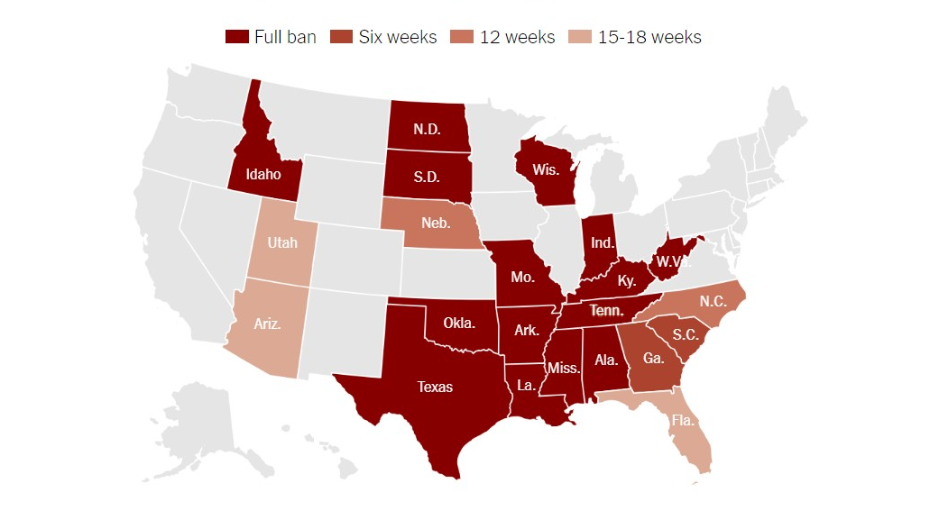
22 States Ban or Restrict Abortion Care
Source: New York Times https://www.nytimes.com/interactive/2022/us/abortion-laws-roe-v-wade.html
Notes:
Considering most Americans’ poor access to reproductive and contraceptive care, it is even more important to ensure access to safe abortion care. However, since the Supreme Court overturned Roe v. Wade in 2022, twenty-two states now ban abortion or restrict the procedure earlier in pregnancy than the standard set by Roe v. Wade.

Slide 16
Texas Abortion Ban Made Trip to Legal Abortion Provider 14x longer
One-way driving distance (miles) to legal abortion provider
Data from: Impact of Texas’ Abortion Ban: A 14-Fold Increase in Driving Distance to Get an Abortion [Internet]. Guttmacher Institute. 2021 [cited 2021 Oct 23];Available from: https://www.guttmacher.org/article/2021/08/impact-texas-abortion-ban-14-fold-increase-driving-distance-get-abortion
Notes:
How do these bans impact women’s access to safe abortion care? [CLICK] In Texas, patients now have to drive an additional 230 miles EACH way -- more than 500 additional miles roundtrip – to access legal abortion care.

Slide 17
Travel Time to Nearest Abortion Provider
Reproductive Age Females
>60 Minutes from Abortion Facility
Mean Travel Time (Minutes)
Data from: Rader B, Upadhyay UD, Sehgal NKR, Reis BY, Brownstein JS, Hswen Y. Estimated Travel Time and Spatial Access to Abortion Facilities in the US Before and After the Dobbs v Jackson Women’s Health Decision. JAMA [Internet]. 2022 Nov 1 [cited 2022 Nov 2]; Available from: https://doi.org/10.1001/jama.2022.20424
Notes:
What does 500 miles mean in terms of time? [CLICK] In a study of reproductive-age females in states that enacted abortion bans or restrictions after the Supreme Court’s Dobbs decision, the mean travel time to an abortion provider more than tripled, rising by more than an hour. [CLICK] After Dobbs, one-third of U.S. women are more than an hour away from the nearest legal provider.

Slide 18
Travel Time to Nearest Abortion Provider
7.2
hours
7.0
hours
7 million reproductive- aged women in Texas and Louisiana
Increase in travel time to closest legal abortion provider
Data from: Rader B, Upadhyay UD, Sehgal NKR, Reis BY, Brownstein JS, Hswen Y. Estimated Travel Time and Spatial Access to Abortion Facilities in the US Before and After the Dobbs v Jackson Women’s Health Decision. JAMA [Internet]. 2022 Nov 1 [cited 2022 Nov 2]; Available from: https://doi.org/10.1001/jama.2022.20424
Notes:
When we break out the states with the largest increases in travel time, the outlook is even more alarming – an INCREASE of more than seven hours to the nearest legal abortion provider in Texas and Louisiana. [CLICK] There are more than seven million women of reproductive age living in these two states.

Slide 19
TX: Change in Abortion Rate as Function of Distance to Nearest Legal Provider
Percentage change in abortions
Note: Reference = <50 miles
Data from: Lindo JM, Myers CK, Schlosser A, Cunningham S. How Far Is Too Far? New Evidence on Abortion Clinic Closures, Access, and Abortions. J Human Resources. 2020 Oct 2;55(4):1137–60. Estimates generated from difference-in-difference model examining implementation of Texas law SB8, which led to closure of almost half of clinics in the state.
Notes:
Not surprisingly, the rate of legal abortions in Texas has dropped along with the distance required to travel. [CLICK four times to show percentages]

Slide 20
One in 14 women self-induce abortion without medical assistance
Notes:
Researchers estimate that 7% of women in the U.S. will attempt to give themselves an abortion, without medical assistance, at some point in their lives. [CLICK] That’s one in 14 women. Black and Hispanic women, as well as those living below the federal poverty level, are more likely to attempt an abortion on their own. This data is from BEFORE the recent Supreme Court decision, so the rate of self-induced abortions is likely to spike.

Slide 21
Abortion Bans = Maternal Mortality
Increase in State’s Maternal Mortality Rate
https://www.ajpmonline.org/article/S0749-3797(19)30419-2/fulltext
Notes:
Recent research on past statewide abortion restrictions shows a strong correlation between abortion restrictions and increased maternal mortality. [CLICK] For example, states that reduced the proportion of Planned Parenthood clinics by 20% [CLICK] increased their maternal mortality rate by 8%. And states that enacted abortion restrictions based on gestational age [CLICK] saw an increase in their maternal mortality rate by a whopping 38%.

Slide 22
Abortion Bans = Maternal Mortality
Maternal Mortality per 100,000 (2017)
https://www.contraceptionjournal.org/article/S0010-7824(21)00090-1/fulltext
Notes:
Between 1995 and 2017, the maternal mortality rate increased in states that enacted the most restrictive abortion laws; by 2017 [CLICK] the most restrictive states’ maternal mortality rates were nearly double [CLICK] the rates in states that protected abortion access.

Slide 23
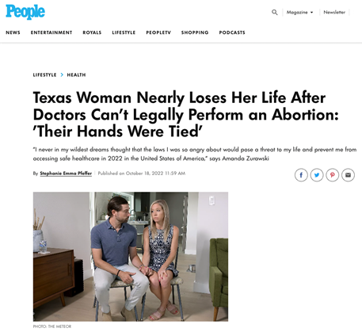
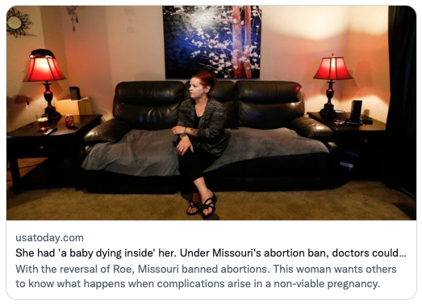
Elimination of Termination as Treatment for Previable Premature Rupture Of Membranes (PPROM)
Notes:
In this new environment, providers in states with severe restrictions are afraid to initiate care for pregnancy complications. Specifically, providers cannot terminate a pregnancy for women experiencing pre-viable PROM, meaning the water breaks very early in the pregnancy, before the fetus is viable. [CLICK] Ever since the TX abortion ban, providers are now barred from terminating a previable PROM pregnancy until the fetus literally dies, even if the fetus has zero chance of survival and the mother’s life is in danger. [CLICK] This is despite all of the medical consequences to the mother such as sepsis, hemorrhaging, blood transfusions, ICU care, etc.

Slide 24
Texas Abortion Ban: Dangerous Consequences for Pregnant People
Morbidity rate among pregnant women <22 weeks with previable PROM (2 Texas hospitals)
Data from: Nambiar A, Patel S, Santiago-Munoz P, Spong CY, Nelson DB. Maternal morbidity and fetal outcomes among pregnant women at 22 weeks’ gestation or less with complications in two Texas hospitals after legislation on abortion. American Journal of Obstetrics and Gynecology. 2022 Jul;S0002937822005361. Selected measures.
Notes:
We’re already seeing the dangers of Texas’ extreme abortion ban on those facing complications in early pregnancy. [CLICK]
In a study of two Texas hospitals, more than a third of women with pre-viable PROM are now having severe infections; 7% experience placental abruption which can lead to deadly hemorrhaging, 4% end up in the ICU, nearly one in five require a blood transfusion, and nearly 60% experience AT LEAST one of these complications.

Slide 25
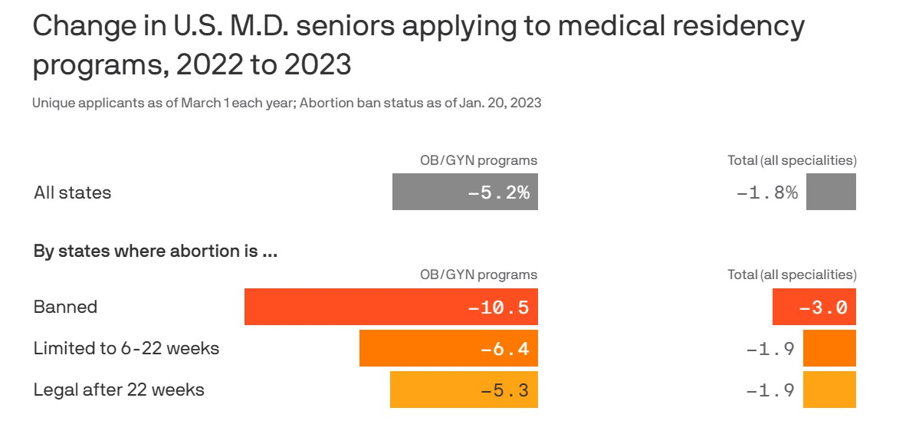
Future Reproductive and Maternity Care Crisis
Notes:
Many doctors in states with new abortion restrictions feel they can’t provide proper care for their patients, and that if they do, they could face huge fines or even a prison sentence. [CLICK and pause] As a result, many doctors are fleeing states with restrictive bans on abortion, [CLICK and pause] and many medical students won’t apply to OBGYN residencies in those states. [CLICK] Long-term, residents of those states will likely face a major shortage of reproductive and maternity care providers.

Slide 26
Medicare for All = Reproductive Care for All
Notes:
So that was a lot of bad news about the state of reproductive health in the U.S.. The good news is that there is a plan that would address many of today’s barriers to reproductive care: Single-payer Medicare for All. You’ve probably heard of it before, but here’s a quick overview of how Medicare for All would work. [CLICK] Similar to how Medicare works today, we all pay into the program through progressive taxes, based on each person’s ability to pay. Individuals can visit any hospital or provider in the nation. Medicare covers all medically necessary care, including reproductive care, and pays providers directly for your care, without any interference from employers or insurance companies.

Slide 27
Medicare for All = Reproductive Care for All
Covers everybody for all medically necessary care, including contraception, prenatal and postnatal care, and abortion care.
Coverage is lifelong with no interruptions in care.
Provides free choice of any hospital and provider.
Care is free at the point of service with no copays or deductibles.
Notes:
What does mental health care look like under Medicare for All?
[CLICK] First, it would cover all medically necessary care, including all reproductive care.
[CLICK] Coverage is lifelong and seamless, nobody would ever experience a gap in coverage.
[CLICK] Patients have free choice of ANY hospital, clinic, or provider [CLICK] Patients receive care without any cost-sharing. Cost will never get in the way of care.

Slide 28
Medicare for All Improves Reproductive Health Care
Today’s Problems
High rate of maternal mortality
High rate of unintended pregnancy
Dangerous state-level abortion restrictions
Employer opposition to contraceptive care
Commercial insurance barriers to care
Lifelong coverage for all medically necessary services, including preconception, prenatal, and postnatal care
Covers all FDA-approved contraceptives without costs, empowering patients to choose methods that work best
Provides abortion care without cost, regardless of location
Keeps reproductive health decisions between individuals and their doctors
Covers all reproductive care without costs, preapprovals, or denials
Notes:
Let’s look specifically at how Medicare for All would address the problems we’ve discussed today.
[CLICK] First, Medicare for All would reduce maternal mortality by covering EVERYBODY for all medically necessary care, before, during and after pregnancy – regardless of race, income, or state of residence.
[CLICK] Next, Medicare for All would go a long way to reduce America’s high rate of unintended pregnancies by covering all FDA-approved contraceptive methods without costs or prior approval, empowering patients to work with their providers to find a method that works best for them.
[CLICK] Medicare would cover abortion care without cost or other barriers.
[CLICK] Decisions about family planning and other reproductive care would be made solely between a patient and her doctor, without interference from her employer.
[CLICK] Finally, unlike commercial insurance companies, Medicare for All would cover all reproductive health care without copays, deductibles, preapprovals, denials or other barriers to care.
[CLICK] Finally, Medicare for All would reduce maternal mortality and injury by covering abortion care in every state, without costs to the patient or arbitrary restrictions that keep our patients from getting the care they need.

