Slide 1
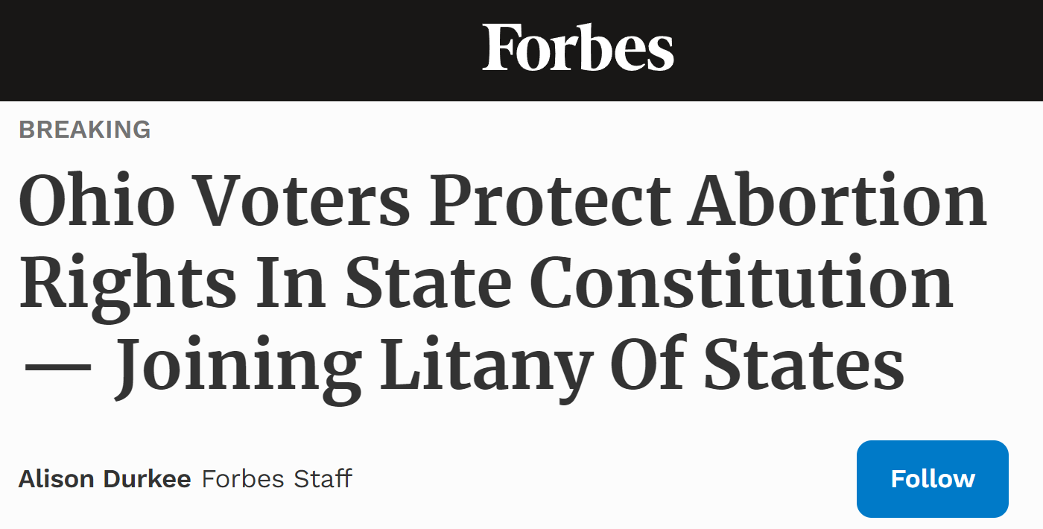
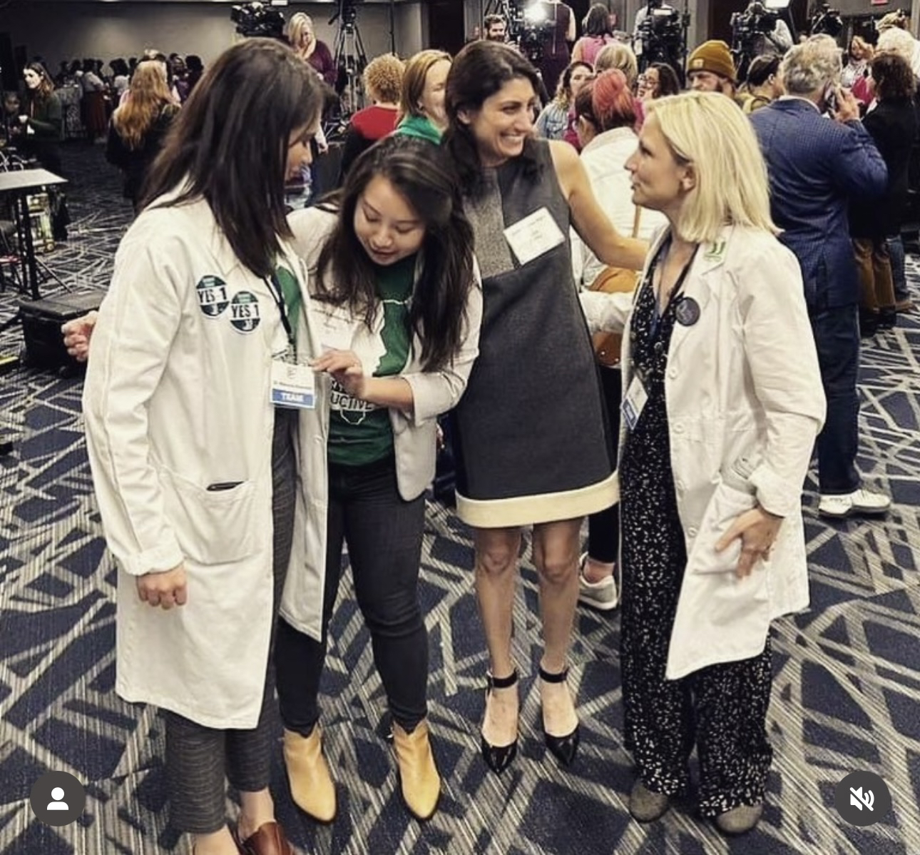
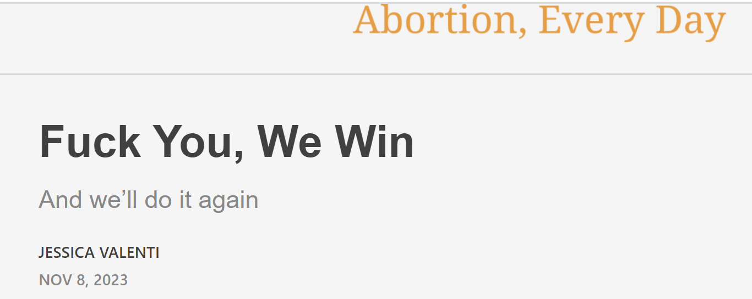

Slide 2
Case Report from Ohio: Base-Building - Reproductive Advocacy
Through connections → Invited to do Instagram Live with Repro Rights group
Invited to support Ohio Ballot Initiative Process
Organize students at NEOMED Organize students in SNaHP Ohio
New recruits, more energy Officially partnering & fundraising for initiative
Collecting Signatures, making more connections

Slide 3
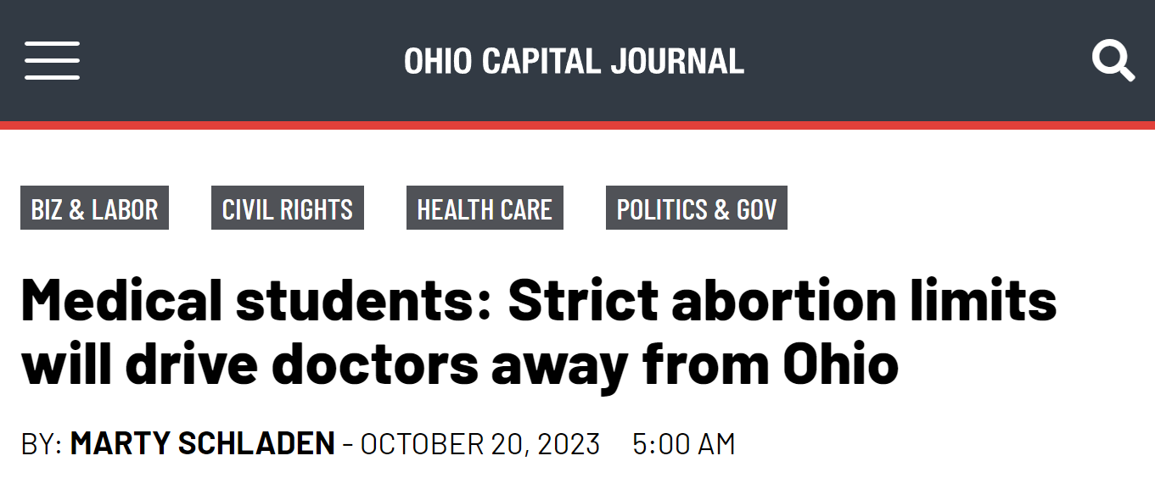
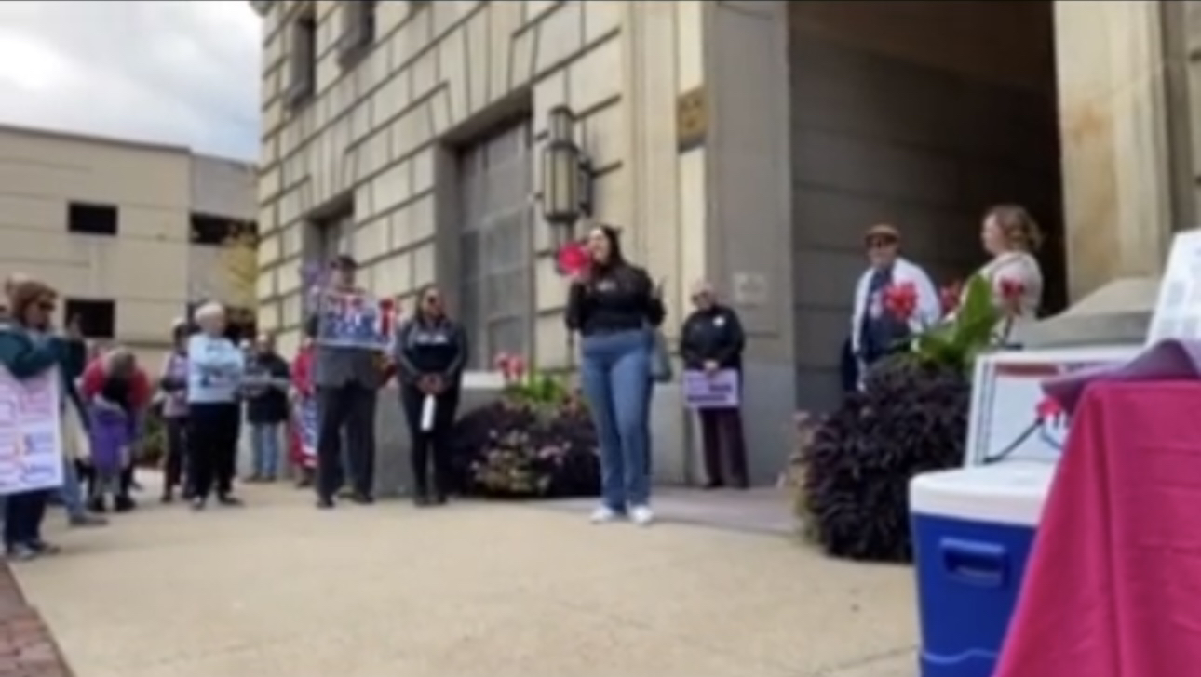
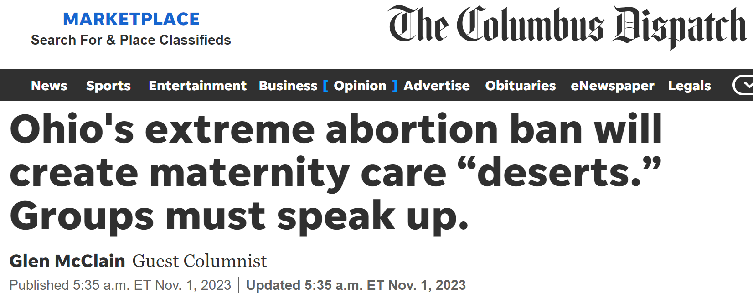
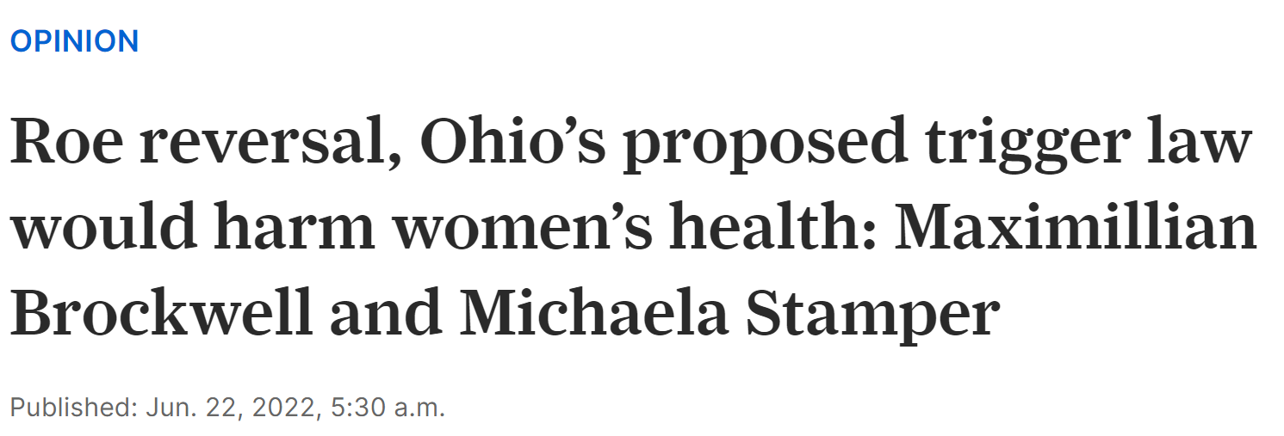
Medical students making a difference!

Slide 4
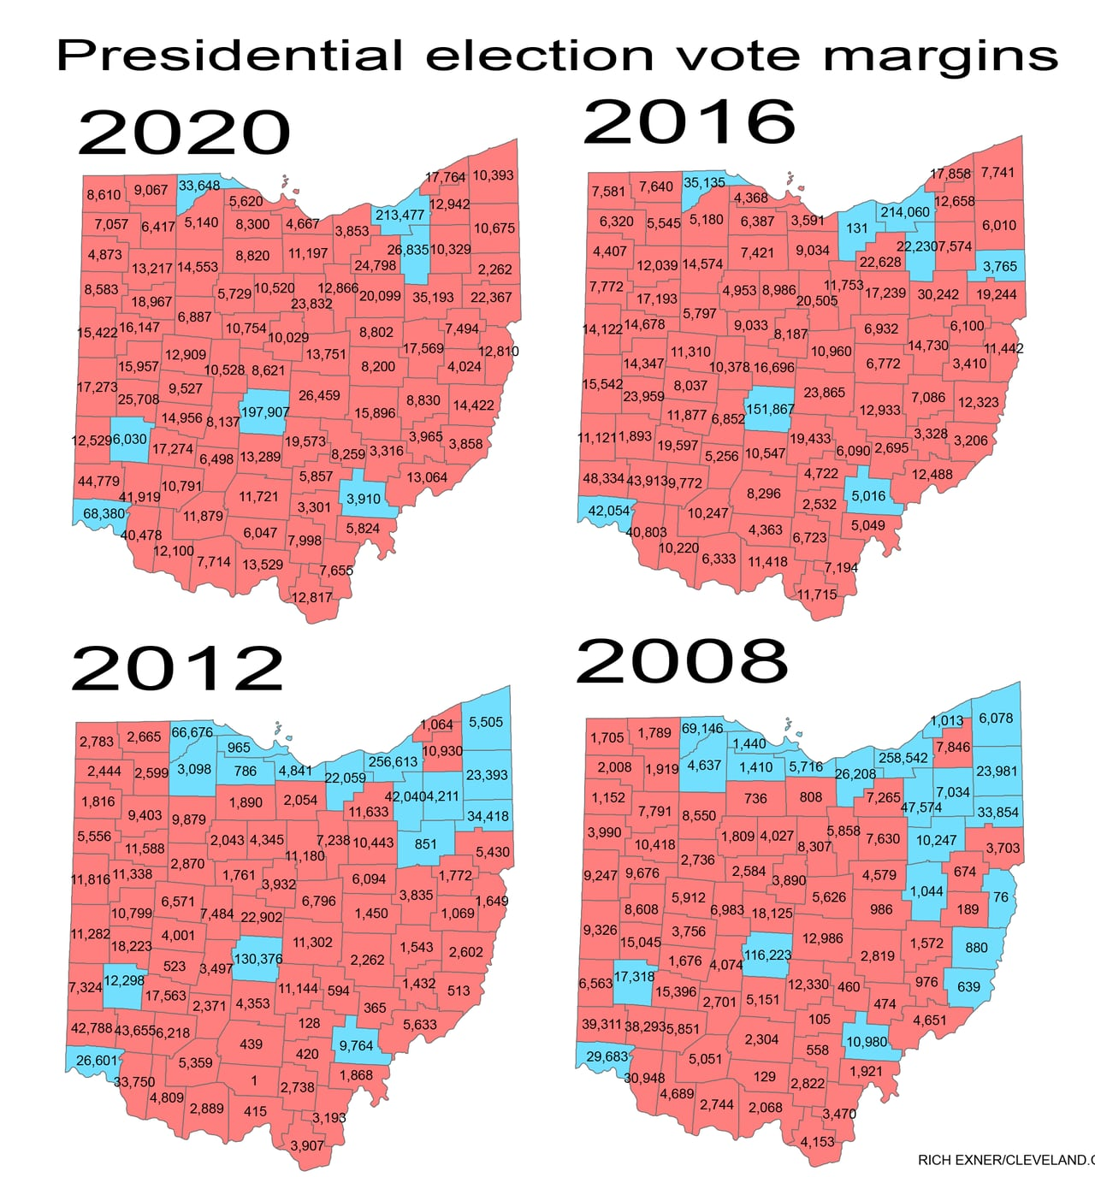
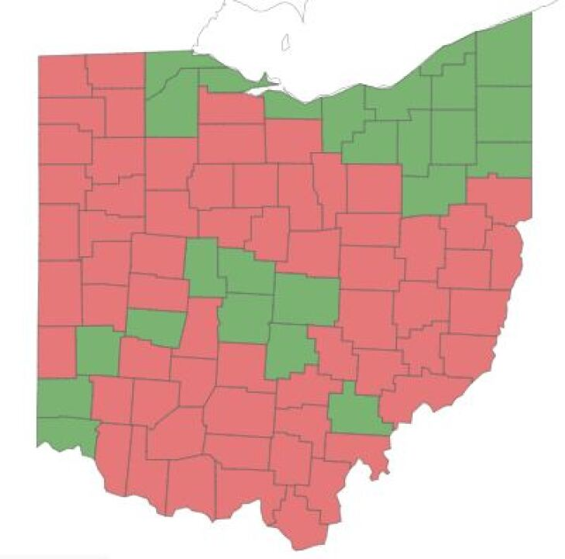
How Ohio voted on Issue 1

Slide 5
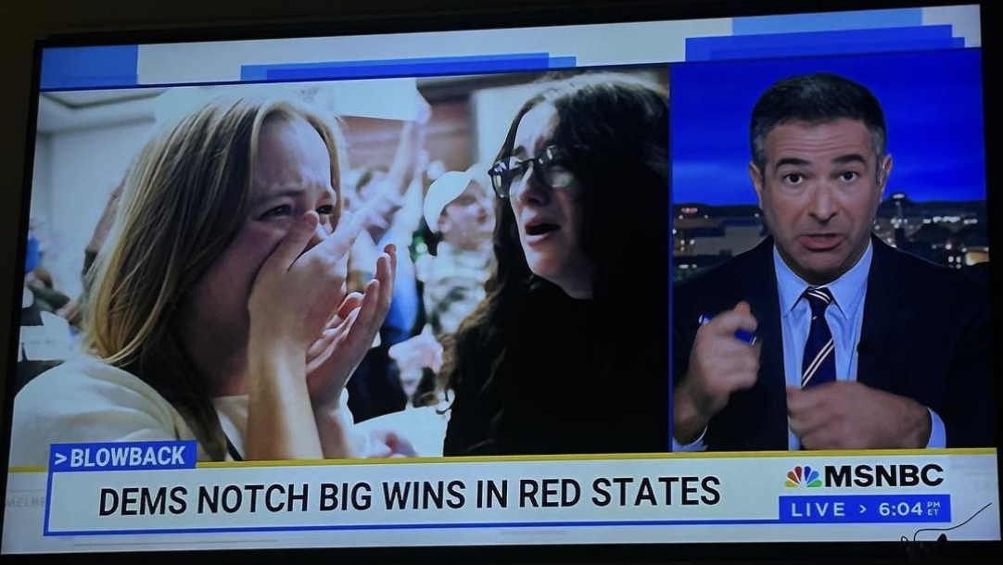
Lessons from Ohio & Updates
- Can really make a difference for these campaigns
- Joining these efforts → Increase in recruitment & new leaders
- Largely benefitted to have a state organization, SNaHP Ohio, to endorse a state campaign
- Collaborate & Network with VERY effective organizers
- Advice: Do not be afraid to use your voice as a Doctor or Medical Student
Updates:
- 2 new classes added to NEOMED’s on reproductive advocacy
- Organized by our SNaHP chapter, taught by a leader of OPRR

