Slide 1
Building Power
Resolutions as a Game Changer
Max Brockwell, Joey Ballard

Slide 2
Our team
Max Brockwell
MS3 NEOMED
SNaHP National Political Advocacy Committee
SNaHP Ohio Chair of Resolution Committee
Joey Ballard
MS4 IU SOM
Former SNaHP President IU SOM

Slide 3
Objectives
01
02
03
04
Resolutions + organized medicine, where you fit
Strategic approaches to resolutions
Building your base, growing strength
Capitalizing on momentum to strengthen your chapter

Slide 4
What is Organized Medicine?
PNHP + SNaHP
AMA +
AMA MSS
Specialty Societies

Slide 5
Breaking it down
 | Membership | Lobbying power | Vibes
AMA | 271,660 physicians from across the country | #7 largest lobbying organization in the country (2022) with $21 million + 57 employed lobbyist | Continuing to improve
Real priorities: scope creep and physician compensation
Notes:
-interesting position with the AMA getting more progressive - alienating GOP lawmakers, as they continue to plunge further into madness (somewhat strategically tricky because it will make it harder to work on issues, but they are not good faith actors…)
-Recent years, the AMA has declared gun violence a public-health crisis, opposed the Pentagon’s ban on transgender troops in the military, and opposed the Trump Admin’s decision to end DACA (few examples for context)

Slide 6
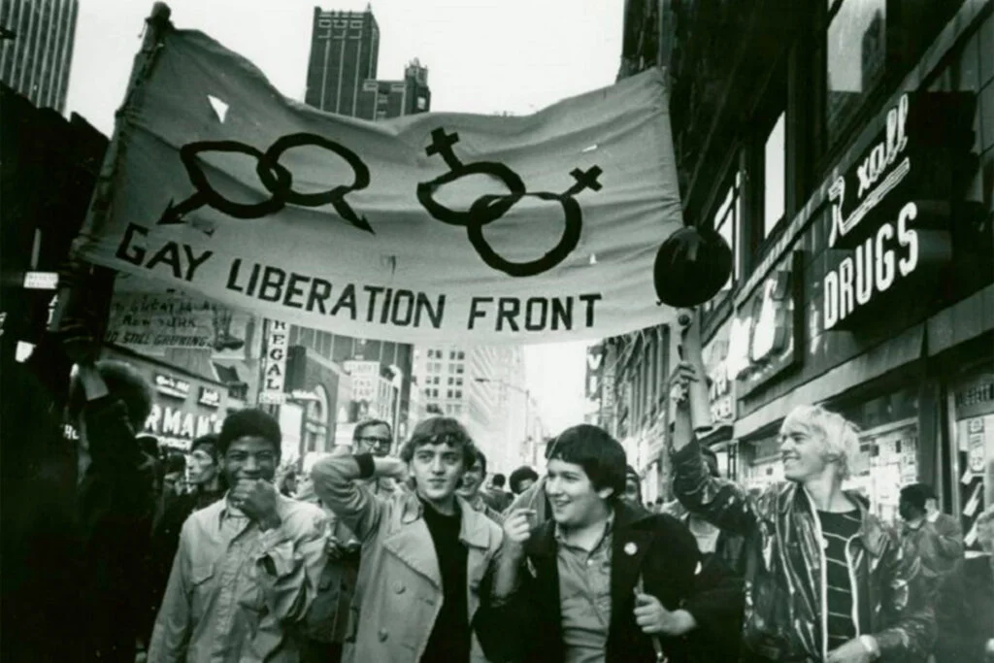
Assimilation vs Liberation
Assimilation/Reform
Liberation/Revolution
Achieve queer liberation by reforming/adapting society to inclusion through assimilation with the general population
Modify the old society
Views society as fundamentally oppressive → need to overthrow existing power structures
Take a stand for the establishment of a new society
(ex: Stonewall)
(ex: rainbow capitalism)
Notes:
-fundamental divide that has existed throughout queer history
-with assimilation to the extreme - give up so much of your own identity/values that nothing changes
-sometimes with liberation, become so disillusioned, give up the fight and become separatists and may disengage with society (like with AMA/PNHP)
-but if you don’t engage with government/existing power structures, hard to get enough power to enact change you want to effect
-concept isn’t exclusive to queer history
-see with movements, like socialism
-balance of the two: assimilate some in order to get power to change society (feels like how I view myself with these organizations - want to infiltrate and change them from within)

Slide 7
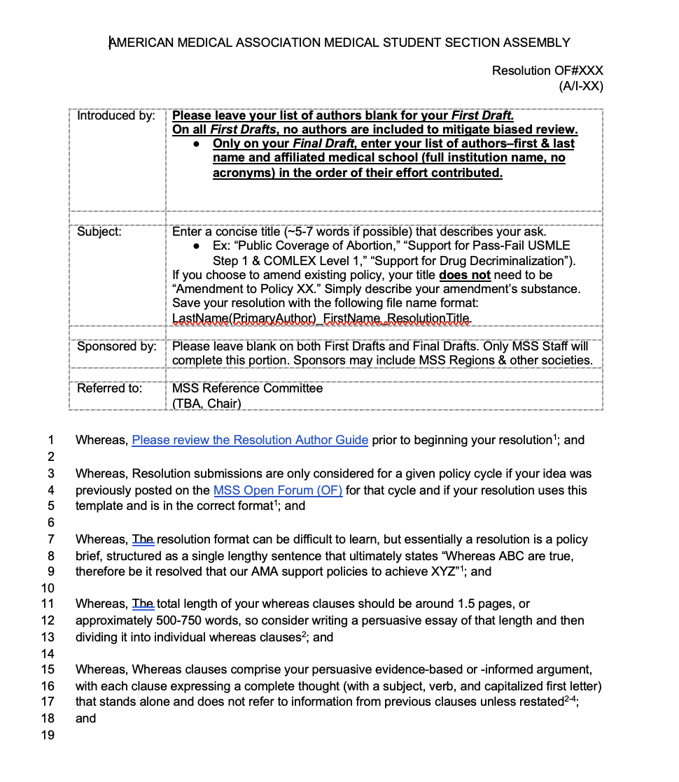
What is a resolution?
Mechanism for members (including MSS) to propose topics
Voted on by HOD > become official policy to guide action/advocacy efforts

Slide 8
Anatomy of a resolution
Resolution
Whereas clauses
Resolved clauses
Sources
Relevant Policy
Provides context, explains the issue with citations. Not included if adopted
Action item for organization. Word choice matters: support vs study vs amend vs oppose vs seek legislation
Ideal to be from the last 5 years, AMA format for citations
ISMA, AMA HoD, or AMA-MSS existing policy

Slide 9
Resolution Considerations
Existing policy
AMA-MSS
AMA policy finder
Internal or external; pending transmittals
Impact
MSSAI
Novel? Coherent? Evidence-based? Feasible? Impact? Within scope? Timely?
AMA I-23 Microbrick
Resolution alternative
“All hail the Microbrick”
Notes:
-Before you get too far, make sure you review existing policy, to make sure your goals hasn’t already been accomplished
-May need to try to amend existing policy if it is inconsistent with your goals
-great MSS leadership at AMA and ISMA levels!

Slide 10
AMA Convention Timelines
Jan | Feb | Mar | Apr | May | Jun | Jul | Aug | Sep | Oct | Nov | Dec
Open Forum |  | 1st draft | Final draft | VRC | A-23
 |  |  |  |  |  | Open Forum | 1st Draft | Final Draft | VRC | I-23
A-23
I-23
VRC = virtual reference committee
Notes:
-policy is passed during convention meetings - this is the only time that resolutions are considered for adoption
-timelines included are what you have to follow to get something submitted as a medical student) - takeaway is that you have to be prepared MONTHS ahead of time to even have a resolution available to be considered (lots of work and preparation)
-obviously, this is a lot to take on - requires lots of time management, especially if you are managing multiple resolutions
-need to prepare to give testimony ahead of time (virtually and at the in person meetings)

Slide 11
Convention Considerations
Coalition Building
Ref Com
Tactics
Physicians + regions
Recommendations, consent calendar, and extractions
Resolution goal, working with physicians
Parli Pro
Testimony
AMA resource
AMA guide
Notes:
-some may already be familiar with Parliamentary procedure - set of rules used during House of Delegates sessions (allows group to stay in order, make motions to amend, refer, end debate, etc)
-somewhat hard to explain in the abstract, will make sense once you see it in action
-ideal to have Ref Com on board, so you have smoother sailing
-PNHP as a built in way to have physician allies
-note risk of AMA-MSS extractions
-resolution goal - may be to start a conversation (can benefit from having other controversial ones early - tire out opposition, less willing to speak later on)
-may need to work with physicians to submit if ISMA continues trying to limit MSS resolutions (we have a big impact!)
-testimony:
-Helpful to tie to organization’s mission statement
-Honestly better to have multiple smaller pieces of testimony prepared compared to a single long one
-Can be intimidating, but you have put in a lot of work - should speak on the issue with authority and provide our perspective!

Slide 12
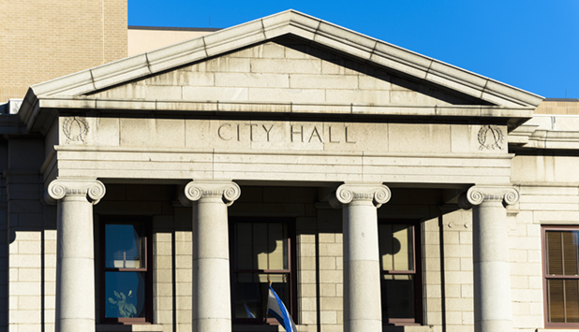
Local Government
Builds a grassroots movement in community
Faster time table than medical societies
Utility as professionals as respected messengers

Slide 13
Building Your Base
Resolutions present a unique opportunity to build strength internally and meet other advocates

Slide 14
Kotter principles
Urgency
Short term victories
Endpoint with a tangible result
Builds momentum and opportunities for direct lobbying
Consolidate Gains
Leadership Development
Media, future projects
Bring people to the next level of engagement and training

Slide 15
Spectrum of Engagement
Member
Advocate
Project Lead
Organizer
Testing the waters and learning
Applying learned skills in ongoing project
Orchestrating advocacy efforts to move our cause forward
Develops leaders to accomplish goals

Slide 16
Resolutions Escalate Enagement
Medical students are CV hounds
An opportunity to tangibly accomplish a goal
Builds excitement around future projects
Develops knowledge around single payer and advocacy skills

Slide 17
Roles in Resolution Team
Primary Authors | Project Leads, future chapter leadership
Secondary Authors | Organizers, Current chapter leadership
Testimony | All involved, but particularly good for membed -> advocate -> leader transition
Open Forum Posts | Everybody is welcome! Great for bringing people into the movement
Networking | Crucial for all members, gain respect in multiple socitieis

Slide 18
Learn the lay of the land
PNHP + SNaHP
AMA +
AMA MSS
Specialty Societies

Slide 19
MSS Leadership
MSS Leadership is welcoming and receptive to new advocates
Attend meetings + Group Chat
Knowledge on history and inner workings of their society

Slide 20
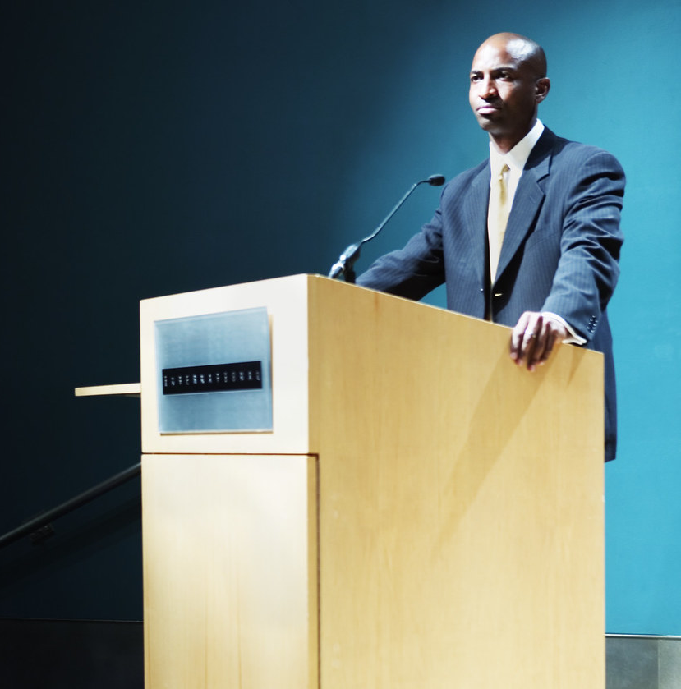
Navigating Local Government
Identify a champion that will share insights
RESEARCH
Work across the aisle
Pivot

Slide 21
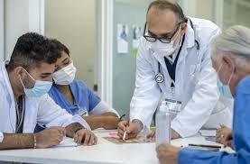
Student + Physician Alliance
Similarities to mentor + mentee relationship
Combination of connections and energy are synergistic
Who are the docs working on health care reform?

Slide 22
Where do you go next?
Celebrate, relax. Then act
Follow up!
Take projects to new parts of your community (county, neighboring district)
Become more engaged in medical societies

Slide 23
Our Experiences
Opposition, Barriers
An opportunity to tangibly accomplish a goal
Builds excitement around future projects
Develops knowledge around single payer and advocacy skills
01
02
03
04

Slide 24
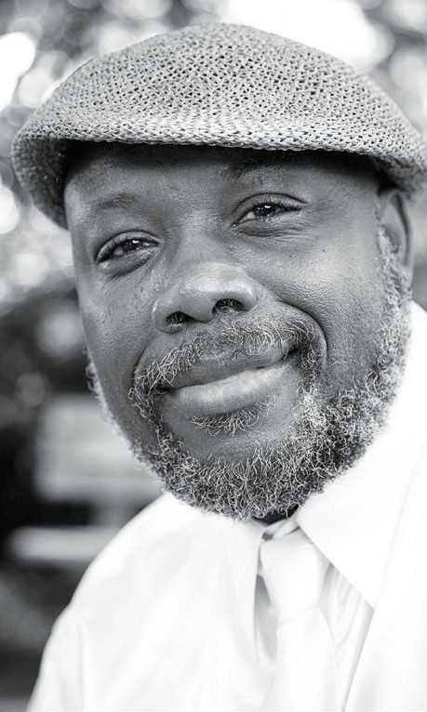
—Aberjhani
“It can be difficult to speak truth to power. Circumstances, however, have made doing so increasingly necessary.”

Slide 25
Thanks!
Max Brockwell
mbrockwell@neomed.edu
Joey Ballard
jballar@iu.edu

