Slide 1
Notes:
Start by asking why people have come to this workshop
Environmental – not controversial
Anti-democratic – not controversial
Policing as public health threat – most controversial, worth spending the most time on
Medicaid crime reduction benefits (see study)
Read: https://www.jstor.org/stable/20027362

Slide 2
Why are you here?
Notes:
Motivations for caring about single payer
Interest in cop city as it relates to single payer

Slide 3
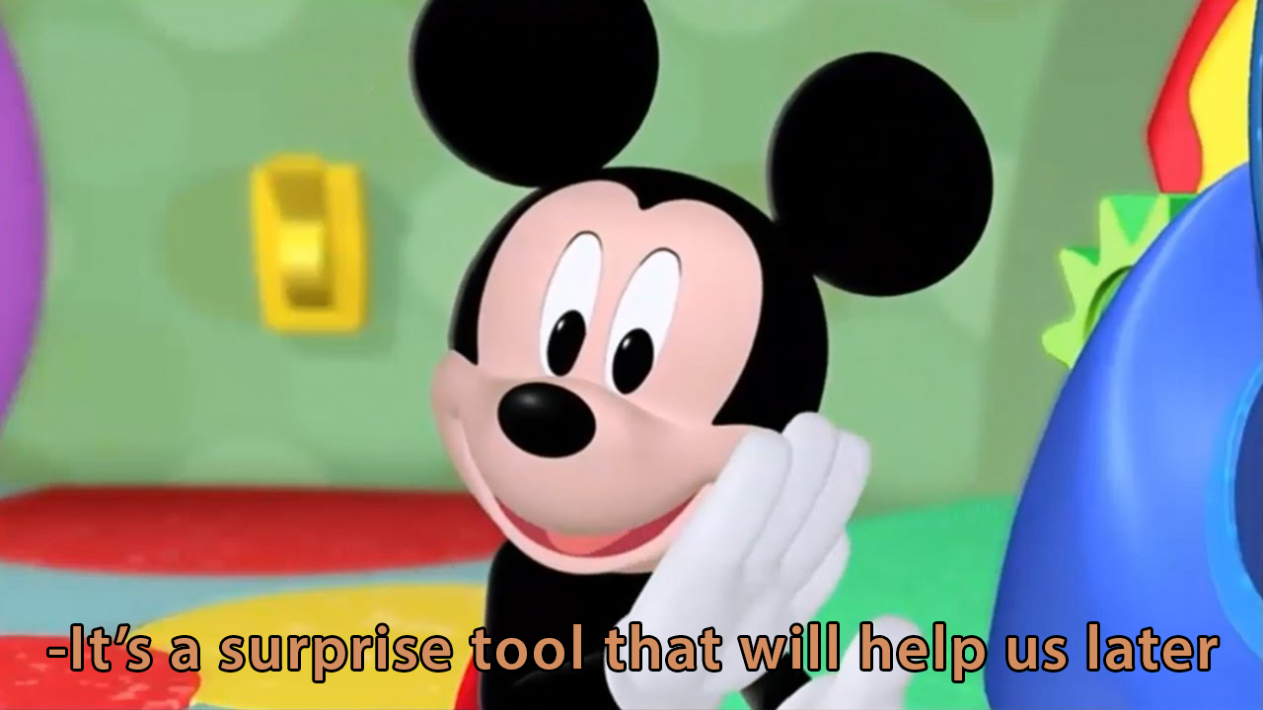
No, really, why are you here?
Seen Cop City in the news and wonder what it’s about
Environmentalist
You’re from PNHP and it’s the only workshop you were invited to
You tagged along with your friend
Curious how I’ll manage to connect these two concepts
Abolitionist
Cop City is already another issue you feel strongly about
Notes:
Have other things come in on click

Slide 4
Learning Objectives
Understand what Cop City proposes and costs
List the reasons that (some) healthcare workers oppose Cop City
Consider policing as a public health hazard
Using Stop Cop City as a model, practice identifying other stakeholders in single payer healthcare
Notes:
2nd point – and why all healthcare workers should

Slide 5
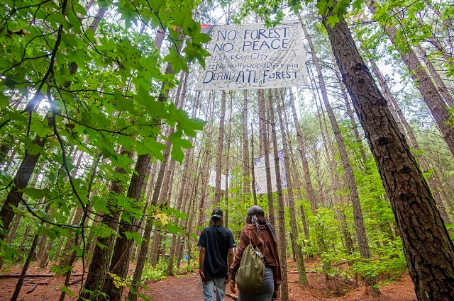
What is Cop City?
Proposed new training grounds for Atlanta police
85 acres of South River Forest → mock city, burn building, shooting range, classrooms
Budget of $90 million
$67 million from the city, $30 million corporate funding
Approved as of June 2023, but resistance ongoing
https://decaturish.com/2022/09/cop-city-explained-a-look-at-the-ongoing-controversy-surrounding-police-training-center/
Notes:
Possibly more, see: https://www.ajc.com/news/crime/public-cost-of-atlantas-police-and-fire-training-center-to-be-double/YJYKFOFZQJC27AL64MVFWWFBOA/
Voted on in 2021, funding approved in 2023 – original timeline was that it was operational by 2023, so effective movement in that it has been delayed at least 2 years

Slide 6
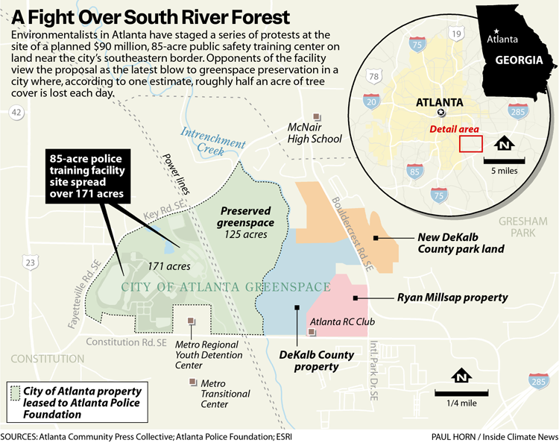
Where is Cop City?
Originally Weelaunee Forest, Muscogee Creek Nation
Old Atlanta Prison Farm (1918-1990’s)
Today: South River Forest, moving toward environmental conservation area

Slide 7
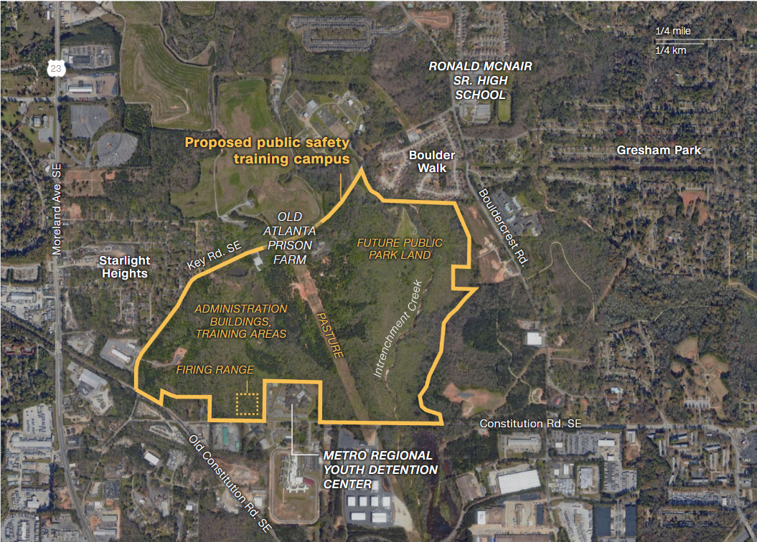
Cop City’s Neighbors
Poor, majority Black neighborhoods
Ranked 94th percentile for asthma, 88th percentile for impoverished households
Feeding into structural/environmental racism
Increased policing of marginalized groups
Graphic: Renée Rigdon, CNN

Slide 8
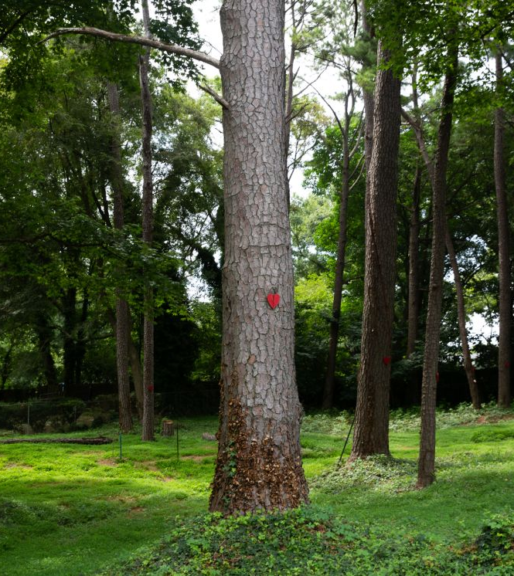
Why do Healthcare Workers Care?
Green spaces improve health
“Concrete Jungles” correlated with worse health outcomes, especially respiratory
Loss of forest worsens heat, flooding, water contamination, air quality
Other, better investments
Urban food forest
Affordable housing
Substance use clinics
Austin Steele/CNN
Notes:
Neighborhood is medically underserved, predominantly black (https://atlanta.capitalbnews.org/cop-city-health-implications/)
Environmental racism: wealthy neighborhoods can afford to protect their green spaces while poorer neighborhoods cannot

Slide 9
“Instead of strengthening community health, Cop City will be a dangerous attempt to invest in harmful and violent solutions . . . while simultaneously eroding and transforming natural and public spaces into privately owned property. The public health evidence for developing healthy and thriving communities strongly opposes the expansion of policing and its subsequent violence. ”
Notes:
https://defendtheatlantaforest.org/2023/01/23/emory-doctors-condemn-cop-city/

Slide 10
Policing in Medicine
Physicians are often told how to care for incarcerated/detained patients by police officers, often unlawfully
“Security” leads to inferior patient care
Criminalization dehumanizes, “permits” treatment of incarcerated people as second-class citizens
Many incarcerated/detained patients have NOT been convicted!
At Grady, we often hear pts can’t get prescribed meds
Including OUD treatment
High rates of death due to opioid overdose in and after incarceration
75,000 ED visits per year due to police violence
Notes:
Connect moreso criminalization as a project of dehumanization, which is why people are treated differently even in hospitals; “permission” to treat people as second class citizens
In opposition to single payer healthcare, which has the principle that all humans have the right to humane treatment via healthcare

Slide 11
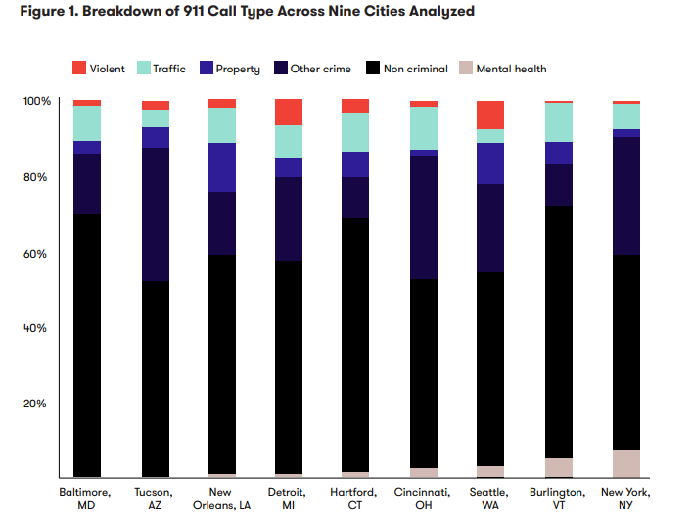
Policing as a Public Health Hazard
Does policing prevent harm?
Over 60 years, no correlation between funding/size of police force and crime rates
Police do not have constitutional duty to protect from crime (Castle Rock v. Gonzales)
Don’t have duty to intervene
In over 90% of 911 calls, there is no possibility of violence taking place
Incarceration does not reduce likelihood of someone committing crime again
Emphasis on punishment rather than prevention or rehabilitation
Source: Vera Institute of Justice, “911 Analysis”
Notes:
Possibly ask attendees to reflect on an encounter with an incarcerated patient or a patient affected in some way by the carceral system (past incarceration, incarceration of a loved one, encounters with police, etc.). Were they treated differently than other patients?
https://www.themarshallproject.org/2020/12/15/cops-could-use-first-aid-to-save-lives-many-never-try
Specify to emergency room encounters (over 90% of 911 calls, no possibility of violence taking place)
Basic values in medicare for all in comparison to actions of policing
Social determinants of health and who becomes incarcerated are very similar; crime =/= harm. Comparison of harm effected by insurance/pharmaceutical companies exceeds that of people locked up

Slide 12
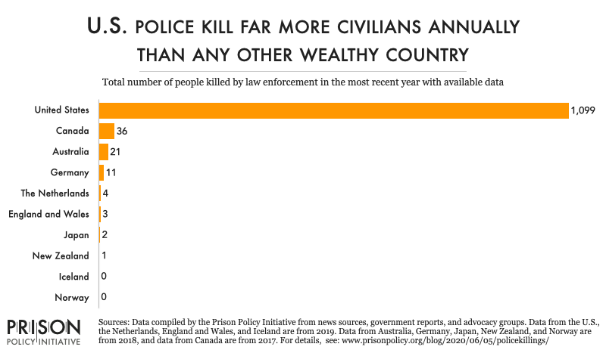
Policing as a Public Health Hazard
Does policing cause harm?
Police kill >1,000 citizens per year
More money is taken via civil asset forfeiture than all burglary combined
Policing causes psychological distress, may be considered an ACE
Consequences of policing are some of the original ACEs
Disproportionate affect on Black Americans
Notes:
https://www.11alive.com/article/news/local/atlanta-deacon-johnny-hollman-death-autopsy/85-5a4f592f-eade-4c55-afa8-c9c0bc6779be
Add graph of US compared to other countries
Over 75,000 ED visits per year related to police violence
Incarceration IS an ACE, we already know that consequences of policing are ACEs

Slide 13
Manuel “Tortuguita” Esteban Paez Terán (They/them)
Notes:
57 bullet wounds, sitting cross-legged with hands in the air. No body cam footage
They/them

Slide 14
Considering Relative Harm
What is the harm done by convicted crimes?
Vast majority drug offenses
Burglary, larceny, property offenses
Immigration
What is the harm done by policing AND incarceration?
What is the harm done by insurance companies denying, delaying, and overcharging for care?
Notes:
Tell story about police saying “we don’t go to that neighborhood”
Same principles that drive medicare for all should apply to justice (https://www.cbpp.org/research/health/medicaid-expansion-has-saved-at-least-19000-lives-new-research-finds) (https://connect.sgim.org/viewdocument/medicaid-expansion-a-pivotal-step) lives saved by medicare for all in comparison to
Maybe make this the reflection/share instead of slide 10
Policing focuses on interpersonal violence while not doing a good job of preventing OR solving crime, and contributes to structural violence (which insurance also does)

Slide 15
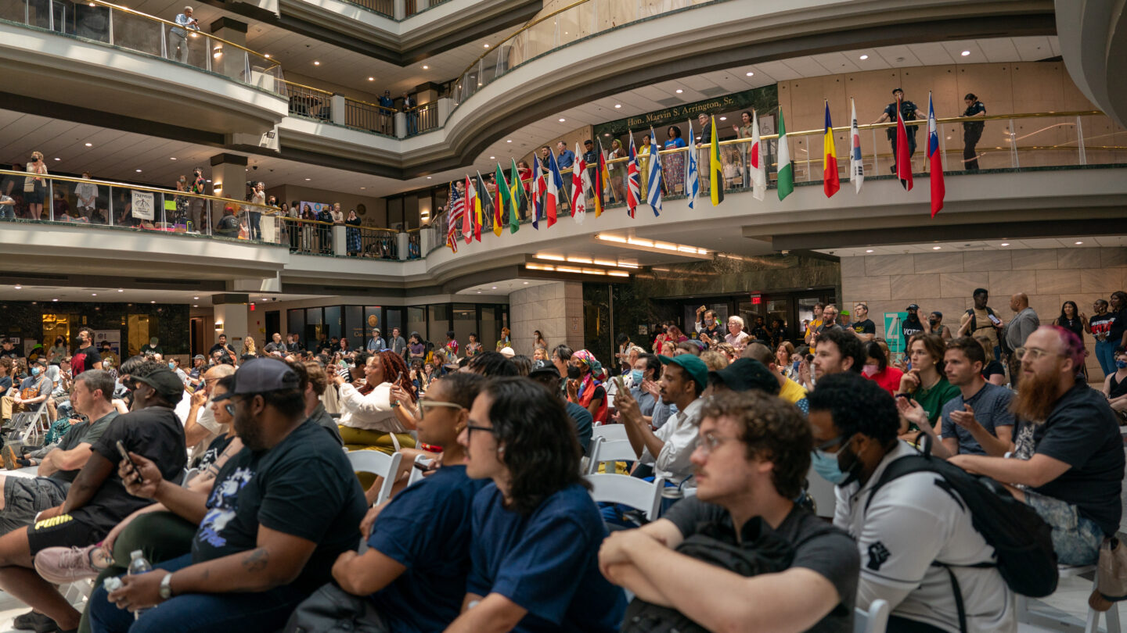
Stop Cop City as a Social Movement
Unsuccessful in that Cop City was approved
Successful in that:
Massive public support – 17 hours of public comment in 2021, 15 hours in 2023 (with many more denied time)
Combined efforts of diverse stakeholders
Environmental Justice, Neighborhood Associations, Police and Prison Reform and Abolition, Civil Rights, Voting Rights, University Students and Faculty, Clergy, Healthcare workers
Local, national, and internatinoal
Construction delayed 2 years
Sustained resistance with varied tactics
Tree sits
Protests
Direct action
Community political educators
Notes:
Broad Coalition: Environmental Justice, Neighborhood Associations, Police and Prison Reform and Abolition, Civil Rights, Voting Rights, University Students and Faculty, Clergy, Healthcare Workers and Students. Local, National, and International
Variety of Tactics: Tree sits, Protest, Direct Action, Pressure on politicians, contractors, board members, weeks of action, unprecedented voter referendum. 7th week of action ongoing now! Block cop city nonviolent action nov 13!! Public health protest to stop cop city nov 14th!
Add

Slide 16
Notes:
Who else opposes cop city?
X hours of public comment and hundreds didn’t get the chance to speak; reasons ranging from respect for original Native American land, opposing destruction of forest, disagreeing with investment in policing rather than other public services, disagreement with the amount allotted for the project, going because your friends are going, etc.

Slide 17
Motivations
Environmental concerns
Divestment in police
Land rights for Muscogee
Direct impact (neighbors)
Health concerns
Poor use of money
Anti-democratic proceedings
Supporting what your friends care about

Slide 18
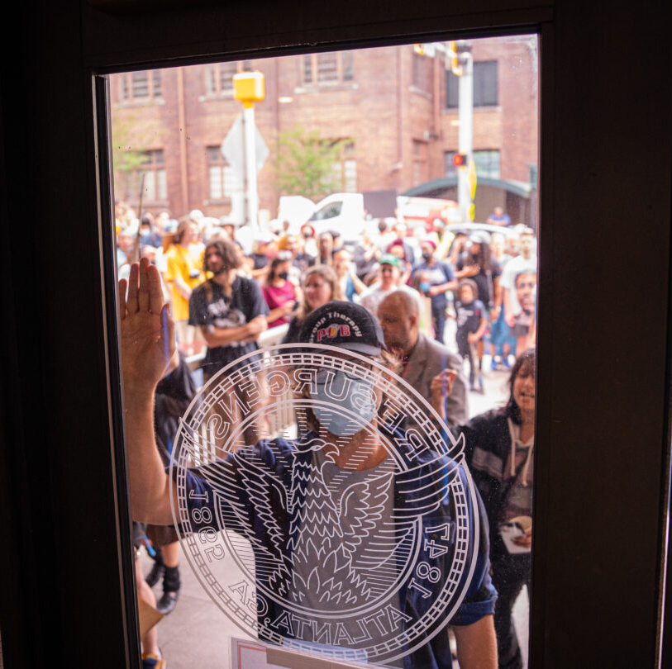
What can we learn from “Stop Cop City?”

Slide 19
What can we learn from “Stop Cop City?”
Find allies based on goals
Find allies based on shared values
Constant social media presence
Frequent and various modes of action
Leverage your connections
Including your friends!

Slide 20
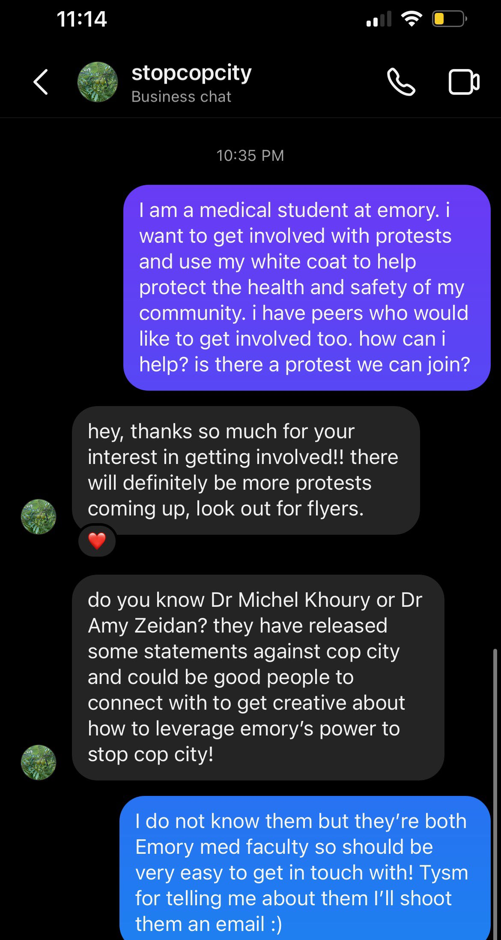
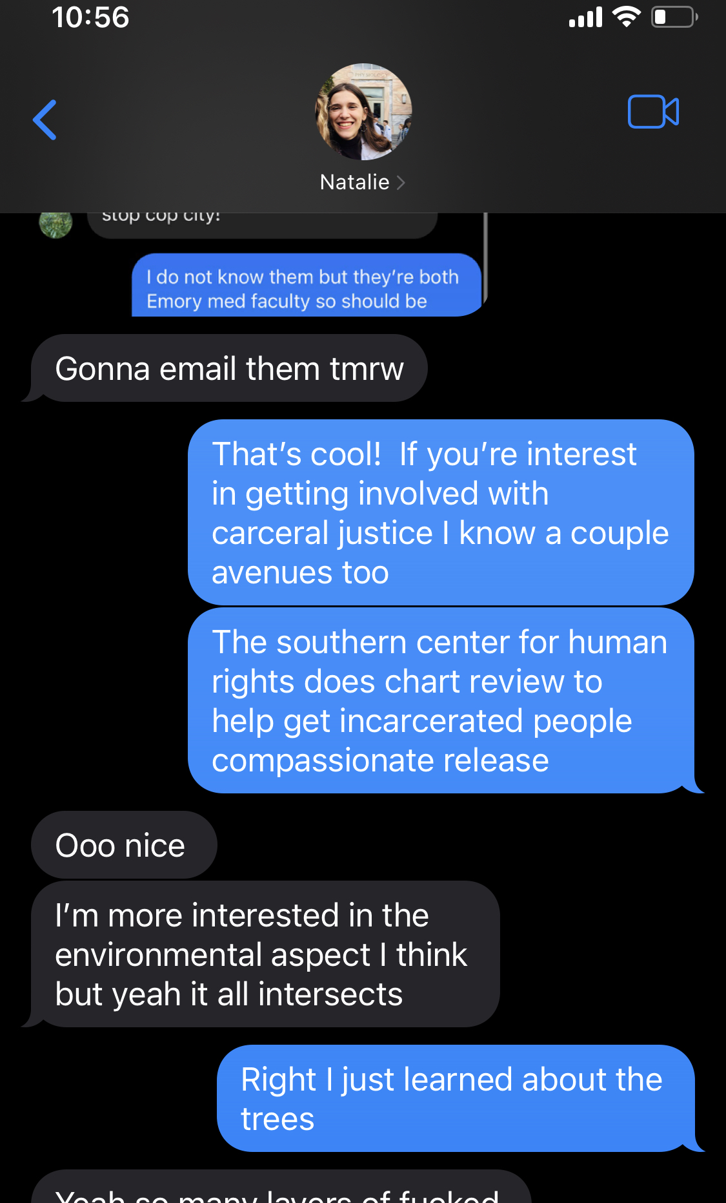

Slide 21
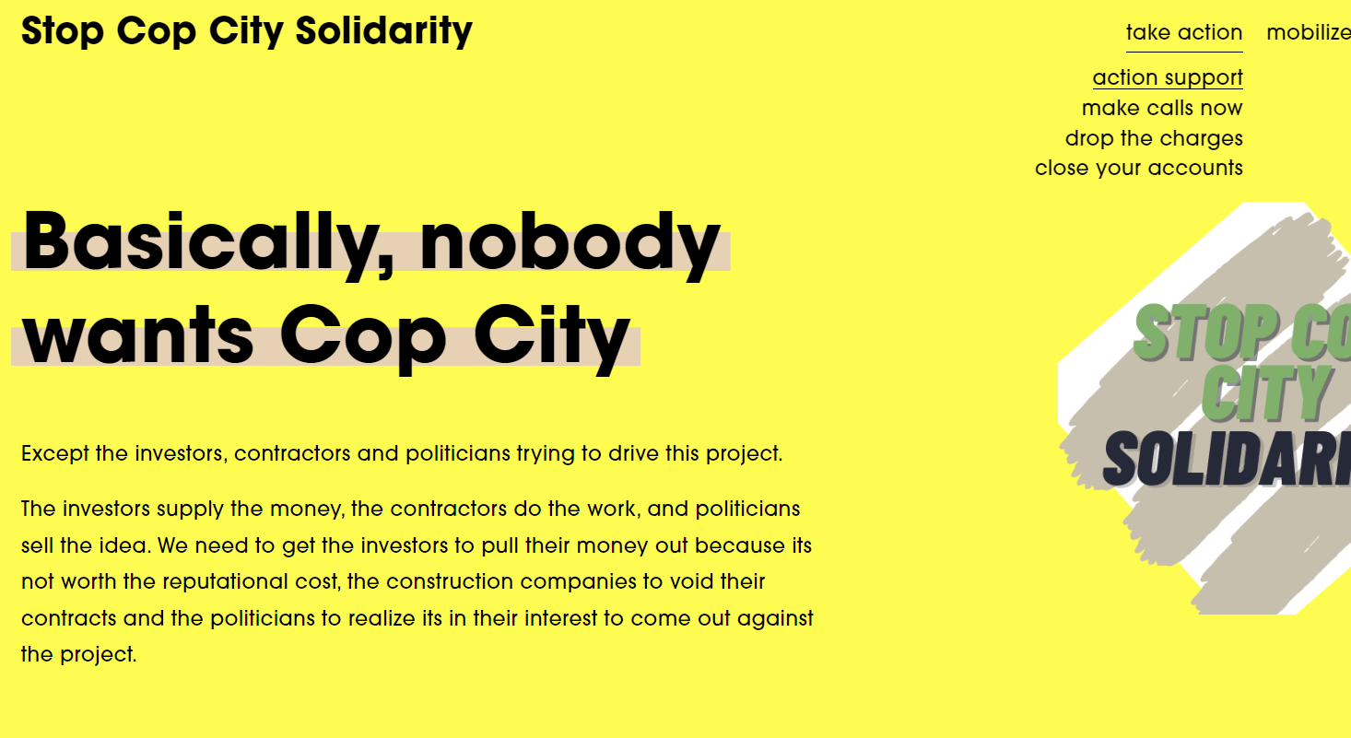
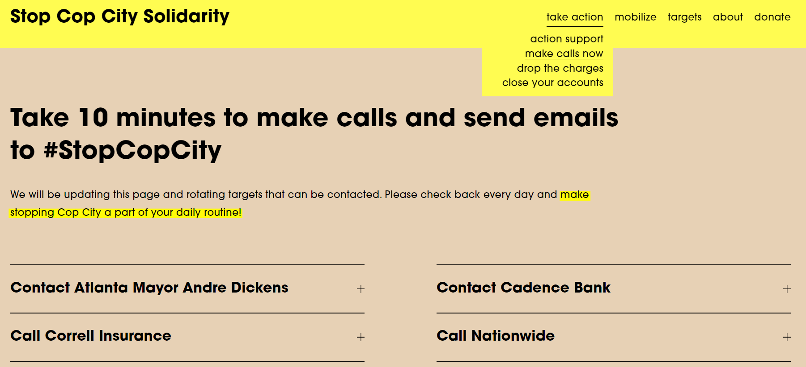
Notes:
“The illegal mass arrests, the heavy charges, the murder of Tortuhuita are part of a pattern of escalating violence and repression against the movement to Stop Cop City. People are charged with Domestic Terrorism for activities like sleeping in tents, having dirt on their shoes, or being at protests against police violence. “

Slide 22
Practice: who else can we draw to our cause?
Share your primary reason for supporting single payer healthcare
Consider a person you know (or a hypothetical person*) who is not an active advocate for single payer healthcare.
Easy: how might you draw on their experiences or values to open the conversation about single payer?
Hard: how might you convince them to engage in your PNHP/SNaHP chapter’s next event (and what kind of event would appeal to them most)?
*Ideas you can steal:
One of your relatives over Thanksgiving
A PCP from your city
An old friend the next time they complain about medical costs
One the organizers for Stop Cop city
A med student who runs the reproductive justice interest group
A 55 year old who could retire if employment weren’t tied to health insurance
Notes:
Don’t be afraid of disagreeing with people and taking stance on more than one issue
Even engaging with people who you don’t think will ever agree – get them thinking about it
Shared values are the same between medicare for all and divestment in policing
Medicaid expansion does reduce crime (!)

Slide 23
A Final Thought

Slide 24
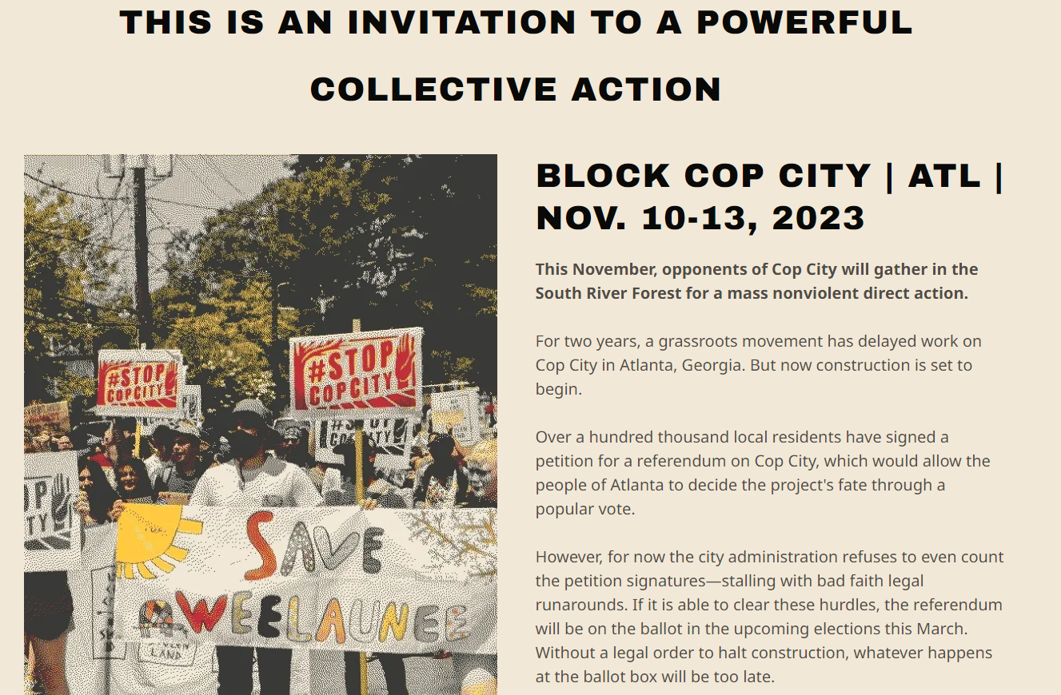

Slide 25
Sources
https://insideclimatenews.org/news/08032023/atlanta-cop-city-forest-justice-trees/
https://surj.org/stop-cop-city-organizing-for-abolition-and-climate-justice-in-atlanta/
https://www.theguardian.com/us-news/2023/jun/09/cop-city-cost-atlanta-city-council#:~:text=The%20city%20owns%20land%20in,the%20city%20at%20%2467m.
https://www.cnn.com/2022/09/24/us/atlanta-public-safety-training-center-plans-community/index.html
https://capitalbnews.org/cop-city-explainer/
https://www.npr.org/2023/03/07/1161343394/atlanta-cop-city-protests-explained
https://atlanta.capitalbnews.org/cop-city-health-implications/
https://screeningtool.geoplatform.gov/en/#12.22/33.69798/-84.32674
https://www.youtube.com/watch?v=P1HKfWZgt2w&t=913s
https://www.bop.gov/about/statistics/statistics_inmate_offenses.jsp
https://www.wabe.org/hundreds-voice-opposition-to-training-center-ahead-of-atlanta-city-council-vote/

