Slide 1
Talking About Single Payer Diljeet K Singh, MD, DrPH

Slide 2
Basics – INFO to convey
We spend (at least) twice as much on health care as rest of the world ($ 4.3 TRILLION) & have worse health outcomes & we do NOT cover everyone
3rd party entities who do not bring anything to table take 30-35 cents of every health care dollar in profit & bureaucratic waste (> $1 trillion)
We spend enough now to cover everyone & to add mental health, dental & vision coverage

Slide 3
Basics – Background concepts
We all benefit when everyone has healthcare unconnected to employment
Best Longest Quality Life in Safest & Happiest Society
Financial & creative freedom when employment is not source of health care coverage
Businesses (small & large) free of burden of providing care, better able to compete & succeed (nationally & internationally)
Healthcare is not a commodity & no benefits to “free market approach” – “Information asymmetry”
Hard to know what you will need & when you will need it
No time to shop
Limited by employer choices and/or geographic access

Slide 4
Basics – Art of Persuasion
Know your audience - the choir, the uninitiated or the enemy
Physicians, Specialty
General Public
Business forum
Know context/where & why you are speaking
Grand rounds
Debate
Virtual

Slide 5
Basics
Use who you are to help connect
“Identity” as physician, gynecologic oncologist, woman, 1st gen immigrant, brown person, etc.
Use data & clinical context you are most comfortable with
Know your topic - Multiple talks with over 300 awesome slides to choose from avail on PNHP website
Use your PNHP resources

Slide 6
Background for Us - How did we get here? Money, Racism, Classism, Sexism & Misogyny
Initial & ongoing opposition to universal coverage about not covering freed slaves & now immigrants
Control of women’s bodies & reproduction
Arrogance of rational/Western medicine – led to loss of traditional/indigenous/herbal medicine
Profit driven models that focused on disease & gave up preventive health concepts (lifestyle medicine)

Slide 7
Moral Injury & Activism as Self- care
Caring for myself is not self-indulgence, it is self-preservation & that is an act of political warfare.
Audre Lorde
Putting Physicians in position to have to weigh profits over what is best for patients is harmful to all involved & immoral
Party line that insurance companies are simply meeting their fiduciary responsibilities & somehow this excuses immoral behavior does not stand up
Role as an advocate is healing for you & for the system

Slide 8
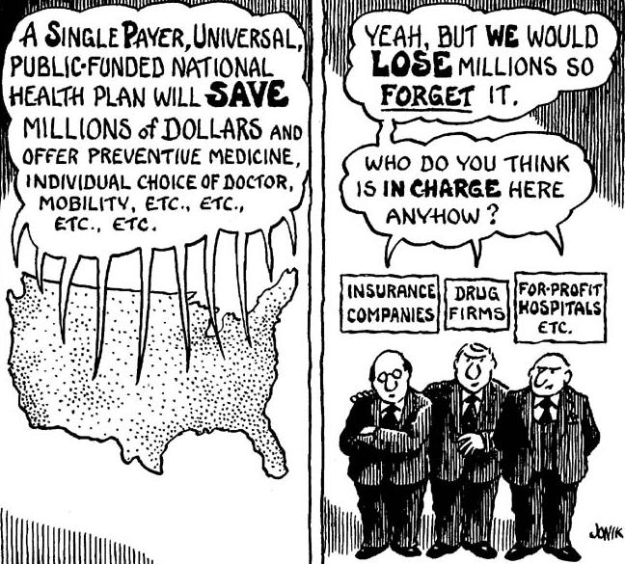
Examples of approaches
Presentation for physicians – Internal Medicine at GW
Presentation for local community group – social service oriented in Arizona
Focus on fallacies

Slide 9
M4A
SAVING LIVES & SAVING OUR HEALTH CARE SYSTEM
Diljeet K. Singh, MD, DrPH
Integrative Gynecologic Oncology
Physicians for a National Health Program
29 E Madison Suite 602, Chicago, IL 60602
Phone (312) 782-6006 | Fax: (312) 782-6007
email: info@pnhp.org
www.pnhp.org

Slide 10
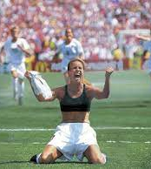
Goals
Identify shortcomings of our current healthcare system
Who it SHOULD serve
Who it DOES serve
Weigh impact of profit driven system on patients, providers, businesses & community health
Understand Benefits of Single Payer System/M4A

Slide 11
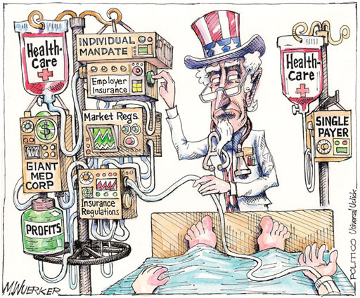
Who is NOT served?
NOT Patients
28 million uninsured
~37,000 die every year from lack of insurance (2021)
Medical costs lead to 2/3 of personal bankruptcies (77% had coverage @ time of diagnosis)
NOT Communities
Increased infant & maternal mortality
Decreased life expectancy
Decreased use of preventive methods
Decreased access to specialized care
Costs unsustainable
h “Health Insurance Coverage: Early Release of Estimates from the National Health Interview Survey, 2022 CDC
Notes:
42000 deaths from breast cancer
33000 deaths from prostate cancer
Studies variably reported prevalence estimates of overall burnout or burnout subcomponents: 67.0% (122/182) on overall burnout, 72.0% (131/182) on emotional exhaustion, 68.1% (124/182) on depersonalization, & 63.2% (115/182) on low personal accomplishment
Overall burnout prevalence ranged from 0% to 80.5%. Emotional exhaustion, depersonalization, & low personal accomplishment prevalence ranged from 0% to 86.2%, 0% to 89.9%, & 0% to 87.1%, respectively
2018 Sep 18;320(11):1131-1150.
doi: 10.1001/jama.2018.12777
The findings are featured in the report, “Health Insurance Coverage: Early Release of Estimates from the National Health Interview Survey, 2022.” It shows that among working-age Americans (those ages 18–64), 12.2% did not have health insurance in 2022, a decrease from 14.7% in 2019.
8.4% or 27.6 million Americans of all ages did not have health insurance in 2022 compared to 10.3% or 33.2 million in 2019.
In the same time period, 4.2% or 3 million children did not have health insurance compared with 5.1% or 3.7 million in 2019.
Almost two-thirds of people under age 65 were covered by private health insurance & more than a quarter (27.8%) were covered by public health insurance in 2022.
Among White, non-Hispanic adults aged 18–64, the percentage who were uninsured decreased by almost 30% from 10.5% in 2019 to 7.4% in 2022.
In 2022, more than 1 in 4 Hispanic adults ages 18–64 (27.6%) lacked health insurance, a greater percentage than Black, non-Hispanic adults (13.3%), White, non-Hispanic adults (7.4%) & Asian, non-Hispanic adults (7.1%).
Adults ages 18–64 who live in non-Medicaid expansion states (19.2%) were twice as likely to be uninsured compared to those living in Medicaid expansion states (9.1%) in 2022.
The percentage of Americans under age 65 with exchange-based private health insurance increased 16% from 3.7% in 2019 to 4.3% in 2022.

Slide 12
36,355 Deaths During 2021 Due to Uninsurance
State | % Uninsured | Excess Deaths
Texas | 18.0 | 6,793
California | 7.0 | 3,528
Florida | 12.1 | 3,378
Georgia | 12.6 | 1,741
North Carolina | 10.4 | 1,402
New York | 5.2 | 1,325
USA Total | 8.6 | 36,771
Woolhandler & Himmelsetin. Ann Int Med 2017;167:424
Based on best estimate from multiple studies of 1 death per 769 uninsured/year & number of uninsured at the time of the survey
Modified version of slides prepared by Drs. Steffie Woolhandler & David Himmelstein. Originals available at https://www.citizen.org/article/updated-powerpoint-presentations-on-health-policy-issues-relevant-to-health-care-reform-and-a-national-single-payer-health-system/ (accessed Apr 12 2023)
Notes:
43,700 deaths from breast ca 2023
34,700 deaths from prostate cancer 2023

Slide 13
Life Expectancy Lower in the U.S.
Years
Source: OECD 2022. Note: Data are for 2021
Modified version of slides prepared by Drs. Steffie Woolhandler & David Himmelstein. Originals available at https://www.citizen.org/article/updated-powerpoint-presentations-on-health-policy-issues-relevant-to-health-care-reform-and-a-national-single-payer-health-system/ (accessed Apr 12 2023)
Notes:
U.S. life expectancy is about five years shorter than other wealthy nations. In this chart I also included Costa Rica, which spends less than one-tenth of what the U.S. spends on health care. But unlike the U.S., Costa Rica has a national health system & invests heavily in public health & preventative care, & now has an average life expectancy nearly four years longer.

Slide 14
Infant Mortality Higher in the U.S.
Deaths in first year of life per 1,000 live births
Source: OECD 2022. Note: Data are for 2021 or most recent year available
Modified version of slides prepared by Drs. Steffie Woolhandler & David Himmelstein. Originals available at https://www.citizen.org/article/updated-powerpoint-presentations-on-health-policy-issues-relevant-to-health-care-reform-and-a-national-single-payer-health-system/ (accessed Apr 12 2023)
Notes:
Our infant mortality is twice as high as several similar nations.

Slide 15
Even Wealthy White Americans Have High Infant Mortality
Deaths in the first year of life / 1000 live births
Source: JAMA IM 2021;181:339 (note data are for 2015)
*White people living in the wealthiest 1% of US counties
Modified version of slides prepared by Drs. Steffie Woolhandler & David Himmelstein. Originals available at https://www.citizen.org/article/updated-powerpoint-presentations-on-health-policy-issues-relevant-to-health-care-reform-and-a-national-single-payer-health-system/ (accessed Apr 12 2023)

Slide 16
Maternal Mortality MUCH Higher in the U.S.
Maternal deaths per 100,000 live births
Maternal mortality: Death while pregnant or within 42 days of the end of pregnancy, irrespective of the duration & site of the pregnancy, from any cause related to or aggravated by the pregnancy or its management, but not from accidental or incidental causes. Used by the World Health Organization (WHO) in international comparisons. Date for 2021 or 2020 where available. Source: Trends in maternal mortality 2000 to 2020: estimates by WHO, UNICEF, UNFPA, World Bank Group & UNDESA/Population Division
Notes:
It’s not an exaggeration to say that the U.S. is in the midst of a maternal mortality crisis. Our maternal mortality rate is three times higher than the UK & Canada, nearly five times higher than Switzerland & New Zealand, & ten times higher than Australia & Norway.

Slide 17
Compared to 16 peer countries Medicare Makes Americans Healthier
1
3
5
7
9
11
13
15
17
USA
Rank
(Mortality Rate)
Age 65
Women
Men
 |  | 10 |  | 20 |  | 30 |  | 40 |  | 50 |  | 60 |  | 65 |  | 80 |  | 90
Age (years)
Institute of Medicine. Shorter Lives, Poorer Health.
Fig 1-9: Ranking of US mortality rates by age group among 17 peer countries, 2006-2008. 2013
Peer nations are Australia, Austria, Canada, Denmark, Finland, France, Germany, Italy, Japan, Norway, Portugal, Spain, Sweden, Switzerland, Netherlands, United Kingdom
Notes:
Good news: Look what happens once all get insurance

Slide 18
U.S. Public Spending for Health Exceeds Total Spending in Other Nations
Total Spending
U.S. Public
U.S. Private
$12,553
Annual $ per capita 2022
Note: “Public” includes benefit costs for gvt employees and tax subsidies for private insurance; expenditures reflect purchasing power parity. Source: OECD 2022; NCHS; AJPH 2016;106:449 (updated) and accessed Sept 5 2023
Notes:
We already know that the U.S. spends twice as much on health care compared to similar nations. [CLICK] But, if you subtract what individuals and private entities spend on health care, and only look at government spending, the U.S. STILL spends more than other nations who have national health plans. The money is already there!

Slide 19
Average Deductibles Tripled Since 2006
Average Deductible for Covered Workers (Single Coverage)
2022: $1,764
2006: $584
Source: Kaiser/HRET Survey of Employer-Sponsored Benefits
Modified version of slides prepared by Drs. Steffie Woolhandler and David Himmelstein. Originals available at https://www.citizen.org/article/updated-powerpoint-presentations-on-health-policy-issues-relevant-to-health-care-reform-and-a-national-single-payer-health-system/ (accessed Apr 12 2023)
Notes:
Let’s take a moment to look at the impact of commercial insurance on patients. While the percentage of uninsured Americans has declined somewhat since the Affordable Care Act, the bad news is that commercial insurers are passing more of their costs along to patients in the form of copays and deductibles. [A deducible is the amount a patient must spend out-of-pocket for care before insurance coverage even kicks in.] Insurers have more than tripled the average deductible for individual (not family) coverage, from $584 in 2006 to nearly $1,800 in 2022. Studies show that deductibles and copays keep patients from getting the care they need; of course for insurance companies, this is exactly the point.

Slide 20
Hospital Inpatient Days per Capita
Days / person / year
Source: OECD 2022 (Data are for 2021 or more recent year available)
Modified version of slides prepared by Drs. Steffie Woolhandler and David Himmelstein. Originals available at https://www.citizen.org/article/updated-powerpoint-presentations-on-health-policy-issues-relevant-to-health-care-reform-and-a-national-single-payer-health-system/ (accessed Apr 12 2023)

Slide 21
Physician Visits per Capita
Physician Visits / person / year
Source: OECD 2022 (Data are for 2021 or more recent year available)
Modified version of slides prepared by Drs. Steffie Woolhandler and David Himmelstein. Originals available at https://www.citizen.org/article/updated-powerpoint-presentations-on-health-policy-issues-relevant-to-health-care-reform-and-a-national-single-payer-health-system/ (accessed Apr 12 2023)

Slide 22
²/₃ of Bankruptcy Filers Cite Medical Bills or Illness-Related Work Loss as a Cause
“Work Loss” defined here as “Work loss due to illness”
National Survey of Debtors, 2013-2016
Source: Himmelstein, Thorne, Lawless, Foohey, Woolhandler. AJPH 2019;109:431

Slide 23
Most of the Medically Bankrupt Had Insurance at the Onset of Their Illness
Source: Himmelstein et al. Am J Med: August, 2009

Slide 24
Where Does Our Money Go?
Total US Healthcare Spending
$4.3 Trillion
Total US Healthcare Administrative Spending
34% (>$1 Trillion)
Where Does It Go?
Insurance companies
Hospital billing staff
Physician office staff

Slide 25
Total Healthcare System Administrative Expense
1.6%
30-35%
Brookings Institution, May 14, 2015

Slide 26
Administrative Overhead
Source: SEC filings for second quarter, 2022 (figure for Cigna is for first quarter 2022)
Note: “Overhead” = percent of premiums not spent on medical services
Modified version of slides prepared by Drs. Steffie Woolhandler and David Himmelstein. Originals available at https://www.citizen.org/article/updated-powerpoint-presentations-on-health-policy-issues-relevant-to-health-care-reform-and-a-national-single-payer-health-system/ (accessed Apr 12 2023)
Notes:
Because Medicare is so simple, the cost to run the program is very low, a little over 2% of the total budget. Let’s compare that to the nation’s biggest commercial insurer, United Healthcare. They pocket more than 18 cents of every dollar we pay in premiums to keep as profits, lavish executive salaries, and administrative overhead.

Slide 27
Growth of Physicians vs. Administrators
Administrators
Physicians
Bureau of Labor Statistics; NCHS; Himmelstein/Woolhandler analysis of CPS
Managers shown as moving average of current year and two previous years
Modified version of slides prepared by Drs. Steffie Woolhandler and David Himmelstein. Originals available at https://www.citizen.org/article/updated-powerpoint-presentations-on-health-policy-issues-relevant-to-health-care-reform-and-a-national-single-payer-health-system/ (accessed Apr 12 2023)
Notes:
What do these costs mean for our health care system as a whole? In 1973, President Nixon signed the HMO Act, which paved the way for so-called “managed care” and the explosion of the commercial health insurance industry. This also coincided with an explosion of administrators to manage the complexity of the modern multi-payer system. You may have to squint to see green area that represents the growth of physicians, which is nearly flat compared to the more than 4000% growth in the number of health care administrators.

Slide 28
US: Duke Medical Center
Canada: Univ. of Toronto
957 beds
1,600 billing clerks
1,272 beds
7 billing clerks
JAMA. 2018;319(7):691-697. doi:10.1001/jama.2017.19148
Jan 17 2019 note from Alex Radkewycz, Senior Public Affairs Advisor, UHN
Notes:
What does this complexity mean for hospitals? Let’s compare the staffing at a hospital in the U.S. and one in Canda, a nation with a single-payer system. Duke Medical Center in the U.S. has 957 beds, but 1,600 billing clerks. The University of Toronto hospital in Canada has almost 1,300 beds, but SEVEN billing clerks.

Slide 29
Who is NOT served?
NOT US business
37% small business owners – “cost of providing health insurance…is biggest challenge they face”.
Health care costs=25-40% of benefits
NOT Physicians
Throughout our system, significant pressure is placed on providers to participate in working the system to maximize billing with penalty of income & job loss
Hinders ability to compete internationally
Twice as much time on “documenting” vs with patients
80% of physicians report moral injury/burnout: 86% emotional exhaustion, 90% depersonalization, 87% low personal accomplishment

Slide 30
Doctors Spend Twice as Much Time on Electronic Billing Record as With Patients
Source: Sinsky et al. Ann Int Med 9/6/2016 – based on time/motion observation + home diary
Note: Figures are percent of office hours – exclude the 1-2 hrs/night of home EHR/desk work

Slide 31
EPIC EHR Notes Count
Number of Institutions
USA
Canada, UK, Australia,
Netherlands, Singapore,
United Arab Emirates
Average Number of Characters per Ambulatory Note in Epic
Source: Ann Intern Med 2018; 169:51
13 international organizations represent 140,000 notes
254 organizations within the United States represent 10 million notes.
Notes:
Not prolific, fulfilling needs of electronic billing records

Slide 32
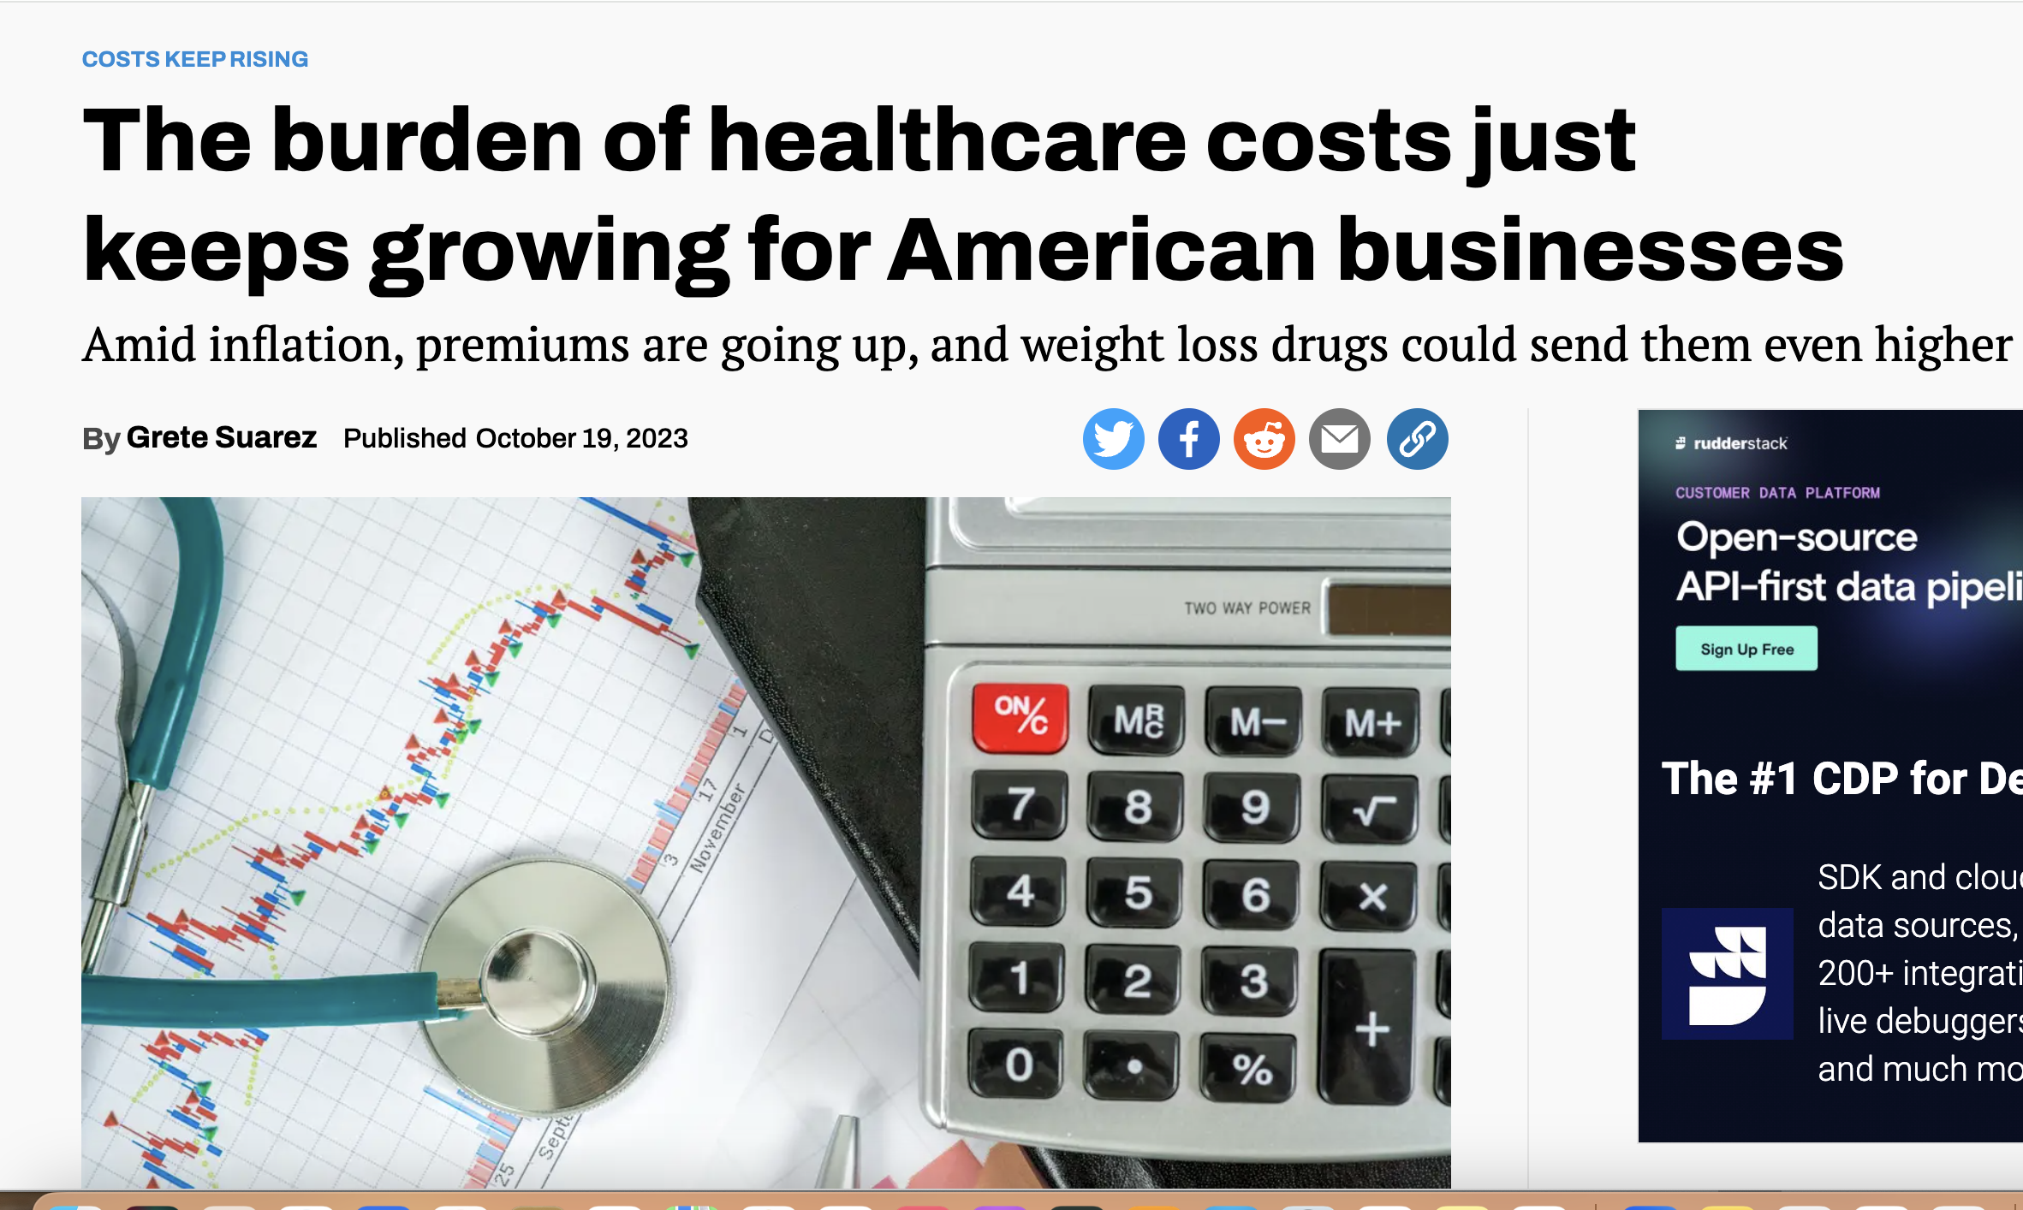
Drain on Businesses
Average cost of employer-sponsored health insurance premium for families rose 7%, in 2022
In 2022, average annual cost of employer-sponsored health insurance premiums per employee was $22,463 for family coverage & $7,911 for single coverage
Weight of health coverage & costs threatens competitiveness of businesses
https://qz.com/the-burden-of-healthcare-costs-just-keeps-growing-for-a-1850938824; Kaiser Family Foundation
https://www.reuters.com/world/us/us-employers-see-biggest-healthcare-cost-jump-decade-2024-2023-09-20/

Slide 33
Top Problems for Small-Business Owners
Exhibit 1
Which one of these do you consider the biggest challenge facing your business?
First- and second-choice answers combined (percent)
Data: Authors’ analysis of online nationwide poll of 500 small-business owners who provide health coverage to their employees, Apr. 4–10, 2019.

Slide 34
Who is served by our current system?
Health insurance industry
Pharmaceutical Industry
CEO’s & Shareholders
Pharmaceuticals | $117.1 Billion
Insurers | $28.3 Billion
Equipment / Supplies | $20.3 Billion
Pharmacy / Lab / Benefit Managers | $18.6 Billion
Providers | $10.1 Billion

Slide 35
Drug Companies’ Cost Structure
Marketing
and Admin
35%
Manufacturing
27%
Profits
(After Taxes)
18%
R&D
13%
Taxes
7%
Source: Health Affairs 2001;20(5):136

Slide 36
Health Care CEOs’ Pay, 2020
CEO | Firm | Total Pay
Leonard Schleifer | Regeneron | $453 million
Joe Hogan | Align Technology | $113 million
Mike Pykosz | Oak Street Health | $92.5 million
David Cordani | Cigna | $91.2 million
David Schlanger | Progyny | $80.4 million
Michael Mussallem | Edwards Life Sci. | $76.7 million
Helmy Eltoukhy | Guardant Health | $75.6 million
Tim Walbert | Horizon Therapeutics | $70.1 million
Steve MacMillan | Hologic | $68.5 million
Neil Kumar | BridgeBio Pharma | $62.8 million
Source: Herman et al, STAT+ 7/18/2022
Modified version of slides prepared by Drs. Steffie Woolhandler and David Himmelstein. Originals available at https://www.citizen.org/article/updated-powerpoint-presentations-on-health-policy-issues-relevant-to-health-care-reform-and-a-national-single-payer-health-system/ (accessed Apr 12 2023)

Slide 37
The Profits of “Non-Profit” Health Systems
Health System | 2020 Profit | 2019 Profit
Kaiser | $2,217 million | $2,732 million
UPMC | $836 million | $27 million
Intermountain | $743 million | $506 million
Mayo | $728 million | $1,063 million
AdventHealth | $694 million | $829 million
Indiana U. Health | $656 million | $679 million
Baylor Scott & White | $558 million | $725 million
Houston Methodist | $402 million | $651 million
Source: Modern Healthcare July 19, 2021:44
Modified version of slides prepared by Drs. Steffie Woolhandler and David Himmelstein. Originals available at https://www.citizen.org/article/updated-powerpoint-presentations-on-health-policy-issues-relevant-to-health-care-reform-and-a-national-single-payer-health-system/ (accessed Apr 12 2023)

Slide 38
Goldman Sachs asks in biotech research report: “Is Curing Patients a Sustainable Business Model?”
“The success of its [Gilead’s] hepatitis C franchise has gradually exhausted the available pool of treatable patients…
“In the case of infectious diseases such as hepatitis C, curing existing patients also decreases the number of carriers able to transmit the virus to new patients.”
Tae Kim, CNBC Investing. April 11 2018.
Modified version of slides prepared by Drs. Steffie Woolhandler and David Himmelstein. Originals available at https://www.citizen.org/article/updated-powerpoint-presentations-on-health-policy-issues-relevant-to-health-care-reform-and-a-national-single-payer-health-system/ (accessed Apr 12 2023)

Slide 39
Clarification of Terms
Universal Health Care: Everyone is covered
May be one or many payers (insurers)
Single-payer: One entity handles all billing and payment
Private delivery: Traditional Medicare (over 65), Traditional Medicaid (low-income), Canada
Socialized: VA, military, IHS, Britain, Cuba
Multi-payer: Many entities bill and pay
Universal regulated: Germany, France, Japan
US: non-universal, lightly regulated

Slide 40
National Health Insurance
Universal – covers everyone
Comprehensive – all needed care, no co-pays
Single, public payer – simplified reimbursement
No investor-owned HMOs, hospitals, etc.
Improved health planning
Public accountability for quality & cost, but minimal bureaucracy
Proposal of the Physicians Working Group for Single Payer NHI. JAMA 2003;290:798
Modified version of slides prepared by Drs. Steffie Woolhandler and David Himmelstein. Originals available at https://www.citizen.org/article/updated-powerpoint-presentations-on-health-policy-issues-relevant-to-health-care-reform-and-a-national-single-payer-health-system/ (accessed Apr 12 2023)

Slide 41
Prescription Drugs & Single Payer
Full coverage, no deductibles/copays
Prices reduced by negotiations, national formulary, threat of patent revocation
Funding for public drug development, testing, & (when necessary) manufacture
Raise standards & FDA funding for drug approval, marketing & post-approval surveillance
Eliminate tax deductions for advertising; prohibit pharma-funded CME & guideline development
Source: Gaffney, Lexchin, Angell, Carome et al. BMJ 2018;361:K1039
Modified version of slides prepared by Drs. Steffie Woolhandler and David Himmelstein. Originals available at https://www.citizen.org/article/updated-powerpoint-presentations-on-health-policy-issues-relevant-to-health-care-reform-and-a-national-single-payer-health-system/ (accessed Apr 12 2023)

Slide 42
FEASIBLE! Single Payer System Can Cover Everyone & Cost Less
New Expenses:
$325 Billion
Administrative Cost Reductions | $500 Billion
Drug and Device Negotiations | $150 Billion
Total Savings | $650 Billion
New Expenses | $325 Billion
Net Savings | $325 Billion
New Savings:
$650 Billion

Slide 43
Can We Afford Universal Healthcare??
95% of households will
pay less in taxes (“Medicare premiums”)
than they currently pay in
premiums, co-pays, & prescriptions.
And we will all have full
comprehensive first-dollar coverage
Gerald Friedman, Ph.D., UMass Amherst, Funding HR 676: July 31, 2013
Notes:
We are paying for single-payer without getting the benefits of it. A public program is only as good as the amount of money you put into it, and we are putting in more than anyone else in the world.

Slide 44
Funding for the NHP
Revenue Sources
Recipients of Money
NHP
Fund
Medicare and Medicaid
Hospital Operating Costs
Hospital Capital Costs
State / Local Governments
HMOs
Employers
Fee-for-Service Physicians
Private Insurance Revenues
Home Care Agencies
New Taxes
Long-Term Care
NEJM 1989;320:102

Slide 45
Hospital Payment Under an NHP
Hospitals remain privately owned
Capital purchases/expansion budgeted separately based on health planning goals
Negotiated global budget for operating costs. Operating funds cannot be diverted to capital
NEJM 1989;320:102

Slide 46
Single Payer Transition: For Displaced Clerical & Administrative Workers
All 400,000 health insurance workers & about ½ of the 2.6 million clerical/administrative employees in healthcare providers likely to be displaced – total 1.7 million.
Many likely to be redeployed in expanded clinical workforce.
Funding for income support & job retraining modeled on WWII GI Bill.
Job displacement is common in the US – 60 million/year, including 20 million who are fired: 1.7 million = number who are fired every 31 days. (source: People’s Policy Report)

Slide 47
Single Payer Transition: For Patients
Every U.S. resident receives an insurance card.
Full coverage for all medically necessary care, no copayments, deductibles or coinsurance.
Prescription drug formulary, with alternatives covered when medically indicated
Free choice of any participating provider or hospital.

Slide 48
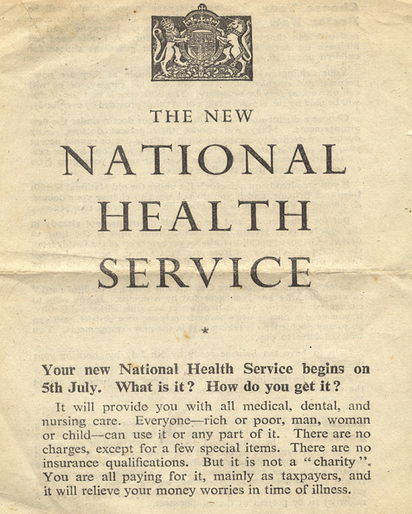
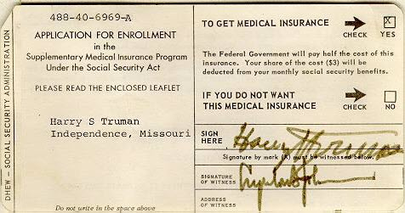
Medicare’s “Software”18.9 Million Seniors Enrolled in 11 Months
“…There are no charges, except for a few special items”
“…no insurance qualifications”
An equal right to healthcare
Source: http://museum.hackney.gov.uk/object9232
Modified version of slides prepared by Drs. Steffie Woolhandler & David Himmelstein. Originals available at https://www.citizen.org/article/updated-powerpoint-presentations-on-health-policy-issues-relevant-to-health-care-reform-and-a-national-single-payer-health-system/ (accessed Apr 12 2023)

Slide 49
2021 Poll: 60% Want Medicare for All
“Do you support/oppose changing our health care system so that all Americans would get health insurance from Medicare…
paid for by taxpayers…
often called Medicare for All?”
Source: Commonwealth Fund/Harvard Public Health School Survey January 2021
Modified version of slides prepared by Drs. Steffie Woolhandler & David Himmelstein. Originals available at https://www.citizen.org/article/updated-powerpoint-presentations-on-health-policy-issues-relevant-to-health-care-reform-and-a-national-single-payer-health-system/ (accessed Apr 12 2023)

Slide 50
Most Doctors Favor Single Payer Support Has Sharply Increased
2008
2017
Source: Merritt Hawkins surveys of physicians

Slide 51
TIME FOR QUESTIONS or other approaches?
diljeetksingh@gmail.com

Slide 52
Fallacies Based Talk (Debate)
It’s too expensive; we can’t afford it
Private insurance & big pharma are needed for innovation & efficiency
Americans use too much health care
Americans are inherently unhealthy (chicken or egg?)
We have best system in world; have to be willing to pay for it
If you have insurance, you have access to the best care in the world
“Not politically feasible”
What will happen to people who work in health insurance industry??

Slide 53
Single Payer Medicare for All The Basics & Why It Matters
Diljeet K. Singh, MD, DrPH
Integrative Gynecologic Oncology

Slide 54
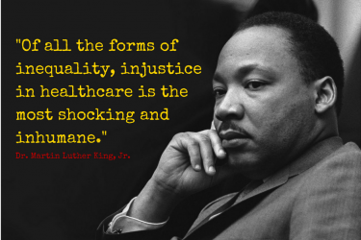
PERSPECTIVE - Philosophical
Health care is…
A Human Right
A social service distributed according to need
Not a commodity distributed according to ability to pay
Not a business whose “beneficiaries” are company executives & investors not patients
Most Americans believe everyone should have access to good care without financial hardship

Slide 55
PERSPECTIVE - Philosophical
US is only developed nation that does not provide comprehensive health care to all
28 million uninsured in 2022
Many insured not able to access care because high deductibles, limited providers
37,000 die a year from lack of coverage (2021)*
Markets are good for many things, not health care
Notes:
42000 deaths from breast cancer
33000 deaths from prostate cancer

Slide 56
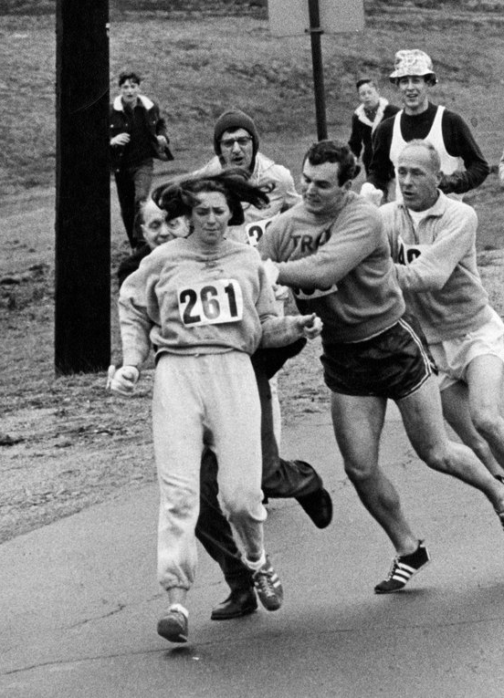
PERSPECTIVE Political
Roots & ongoing history of US opposition to universal health care are racist/sexist/classist
AMA opposed Truman’s plan because they did not want to provide health care to non-whites (1619 episode 4!)
Avoiding coverage of undocumented immigrants
Misogynist approaches to women’s care
Using “care” to control bodies
Care provision focused on incubation *
Legislated limitations on contraception
Multiple documented health benefits (pregnancy prevention, tx for anemia, cancer prevention)
Could be overcome if health decisions were in hands of care providers

Slide 57
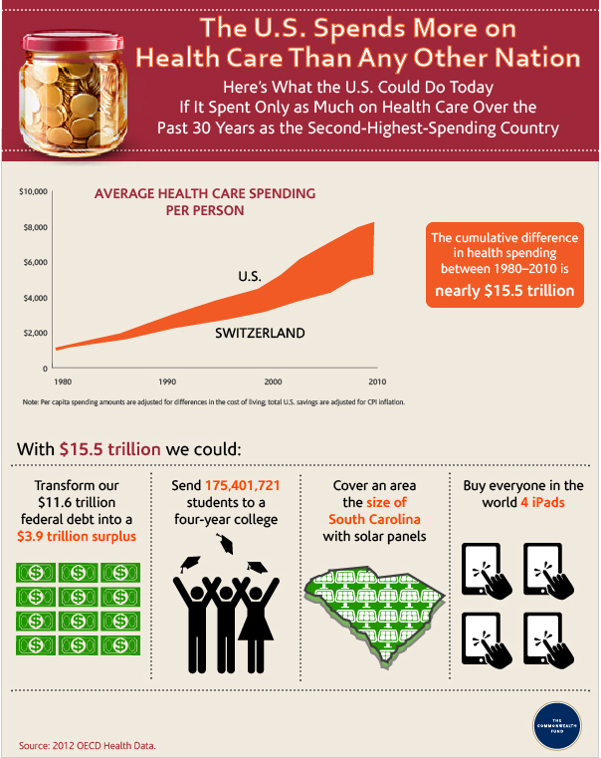
PERSPECTIVE - Practical
Current system is unsustainable
Burden on economy/businesses
Increasing premiums
Shrinking Coverage
Contributes to 2/3 of personal bankruptcies
Most expensive health care system in world

Slide 58
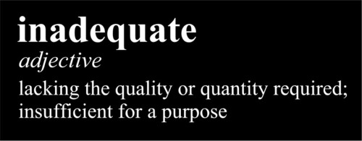
PERSPECTIVE - Practical
Spend TWICE as much as other developed nations (4 x as much as New Zealand)
Don’t get more care - Canadians see their doctors more often & spend more time in hospital
Don’t get better results – WORSE than most other developed countries on life expectancy, infant mortality, immunization rates
DON’T COVER EVERYONE
Outrageously expensive & inadequate. WHY???

Slide 59
Health care system based on avoiding the sick
Huge administrative costs & profits divert resources from clinical care
Compete not by ⬆ quality or ⬇ costs, but by avoiding unprofitable patients & limiting services
“Fiduciary responsibility” to shareholders drives decision making
Doctors & hospitals maintain costly admin staff to deal with bureaucracy
Consumes 34% of health care $*
Notes:
To understand what’s happening, let’s look at how the health care market works.
Most Americans receive tax-free health benefits from their employers, who pay insurers a portion of the premiums for health coverage. But not all employers offer benefits, & when they do, the benefits may not be comprehensive. It’s entirely voluntary. When employers are competing for workers, they offer good benefits; when unemployment rises, they drop them.
The insurers with whom employers do business are mostly investor-owned, for-profit managed care businesses. They try to keep premiums down & profits up by stinting on medical services. In fact, the best way for insurers to compete is by not insuring high-risk patients at all; limiting the coverage of those they do insure (for example, by excluding expensive services, such as heart transplantation); & by passing costs back to patients by denying claims or as deductibles & co-payments. We are the only nation in the world with a health care system based on dodging sick people. These practices add greatly to overhead costs because they require a mountain of paperwork. They also require creative marketing to attract the affluent & healthy & avoid the poor & sick. Not surprisingly, the U. S. has by far the highest overhead costs in the world.
It’s instructive to follow the health care dollar as it wends its way from employers toward the doctors & nurses & hospitals that actually provide medical services. First, private insurers regularly skim off the top a substantial fraction of the premiums – anywhere from 10 to 25 % – for their administrative costs, marketing, & profits. The remainder is then passed along a veritable gauntlet of satellite businesses that feed on the health care industry, including brokers to cut deals, disease-management & utilization review companies, drug-management companies, legal services, marketing consultants, billing agencies, information management firms, & so on & so on. Their function is often to limit services in one way or another. They, too, take a cut, including enough for their own administrative costs, marketing, & profits. I would estimate that no more than 50 cents of the health care dollar actually reaches the providers – who themselves face high overhead costs in dealing with multiple insurers.

