Slide 1
Why do most physicians want Medicare for All?

Slide 2
Growth of Physicians and Administrators 1970 – 2022
Growth since 1970
Bureau of Labor Statistics; NCHS; Himmelstein/Woolhandler analysis of CPS
Managers shown as moving average of current year and two previous years
Modified version of slides prepared by Drs. Steffie Woolhandler and David Himmelstein. Originals available at https://www.citizen.org/article/updated-powerpoint-presentations-on-health-policy-issues-relevant-to-health-care-reform-and-a-national-single-payer-health-system/ (accessed Apr 12 2023)

Slide 3
American Physicians Are Not Satisfied
Percent of primary care doctors satisfied with practicing medicine
2019
https://www.statista.com/statistics/1097249/proportion-primary-physicians-satisfied-with-practicing-medicine-select-countries-worldwide/ Accessed Nov 16 2022

Slide 4
“Moral injury describes the conundrum
of today’s medical professionals:
“They know how best to care for their patients but are blocked from doing so by systemic barriers related to
the business side of healthcare.”
https://www.fixmoralinjury.org Accessed Aug 9 2023

Slide 5
#1 Cause of Physician Burnout by Age
Millennial
Too many bureaucratic tasks
(e.g., charting, paperwork)
Generation X
Too many bureaucratic tasks
(e.g., charting, paperwork)
Boomer
Too many bureaucratic tasks
(e.g., charting, paperwork)
https://www.medscape.com/slideshow/2020-lifestyle-burnout-6012460#6

Slide 6
EPIC EHR Notes Count
Number of Institutions
USA
Canada, UK, Australia,
Netherlands, Singapore,
United Arab Emirates
Average Number of Characters per Ambulatory Note in Epic
Source: Ann Intern Med 2018; 169:51
13 international organizations represent 140,000 notes
254 organizations within the United States represent 10 million notes.

Slide 7
An Average Week of Family Medicine in Canada
Activity | Hours
Direct patient care | 29.4
Direct patient care with teaching | 4.4
Teaching without patient care | 1.2
Indirect patient care | 7.4
Health facility committees | 0.7
Administration | 2.4
Research | 0.7
Managing practice | 1.7
Continued professional development | 3.3
Other | 0.8
Canadian FPs average
2.4 hours
per week
on non-clinical administration
Includes GPs; Excludes on-call hours
2013 National Physician Survey. CFPC, CMA, Royal College
www.cma.ca/Assets/assets-library/document/en/advocacy/Family-e.pdf
Accessed April 6 2015

Slide 8
Malpractice Insurance Costs ($US)
Specialty | Ontario | Quebec | BC & Alberta | RI (average filed rates)
Family Med | $3,681 | $1,187 | $2,565 | $11,618
Psychiatry | $3,681 | $1,187 | $2,565 | $8,843
Cardiology | $6,336 | $1,686 | $3,771 | $19,318
Anesthesia | $9,711 | $2,354 | $6,354 | $18,782
Canadian dollars converted to USD at 0.75 exchange rate (average for 2019)
Canadian Medical Protective Association www.cmpa-acpm.ca
https://www.gallaghermalpractice.com/state-resources/rhode-island-medical-malpractice-insurance/
(Accessed Sept 26 2023)

Slide 9
Average Annual Income, 2021, USD
Specialty | Canada | USA
Derm | $364,000 | $394,000
Fam Med | $249,000 | $236,000
GI | $370,000 | $406,000
Neuro | $268,000 | $290,000
OB-GYN | $355,000 | $312,000
Specialty | Canada | USA
Ophtho | $660,000 | $379,000
Peds | $272,000 | $221,000
Psych | $239,000 | $275,000
Surg (Gen) | $405,000 | $373,000
Urology | $429,000 | $427,000
https://invested.mdm.ca/md-articles/physician-salary-canada#by%20specialty
All data in USD with a 0.75 exchange rate
https://www.statista.com/statistics/250160/median-compensation-earned-by-us-physicians-by-specialty/
All data accessed Nov 16 2022

Slide 10
Each of the major economic models assumes We Continue to Pay Physicians Well
Total payments to 1 million physicians
The Urban Institute’s headlines argued
“physician incomes would be squeezed”
even as they were modeling that
payments would rise by >$100 billion
$ Billion
Sources: Rand Corporation (2019), Urban Institute (2016), Mercatus Center (2018)
Note: Percentage estimates from original studies, applied to 2019 total physician expenditures

Slide 11
Most Doctors Now Favor Single Payer
2008
2017
Source: Merritt Hawkins surveys of physicians
Notes:
Perhaps the most dramatic increase of support is from doctors. Within a decade, doctors went from a majority opposing Medicare for All to a majority supporting. And our experience in PNHP shows that the next generation of doctors – medical students and residents – overwhelmingly support single payer.

Slide 12
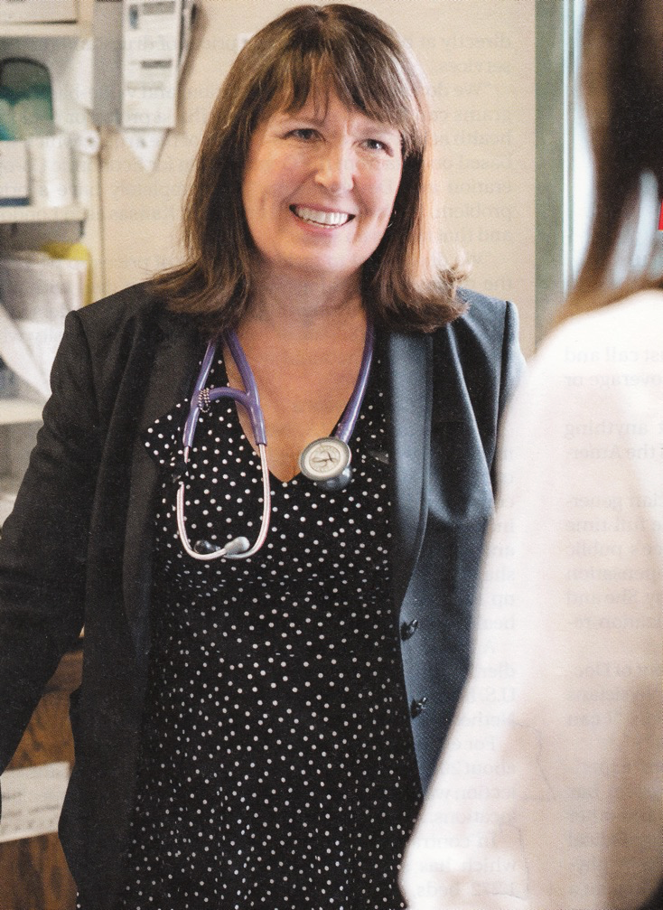
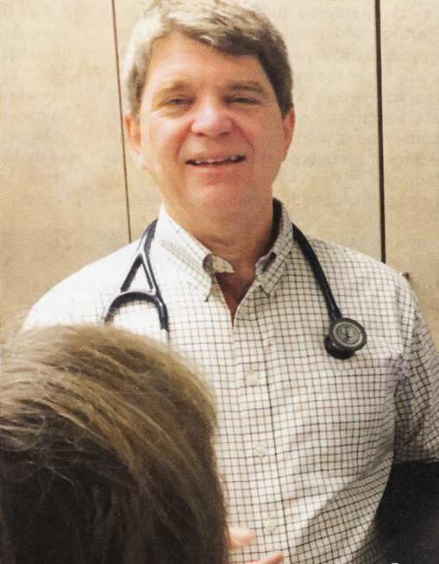
Dr. Trina Larsen Soles
Doctors of British Columbia
2017-2018 President
“It’s not a big hassle.
I can focus on patient issues,
not administrative issues.”
Dr. John Cullen
American Academy of Family Physicians
2018-2019 President
“It’s an incredible bureaucratic mess to get anything done for patients.”
Source: Modern Healthcare 4/9/18

