Slide 1
Lee-Ellen Macon
Special Ed Teacher
Baton Rouge

Slide 2
Lee-Ellen had beaten breast cancer once.
Her deductible was $4,000.
Bills piled up fast.
By June she was out of money.
Her sister started a GoFundMe campaign.

Slide 3
Infant Mortality Higher in the U.S.
Deaths in first year of life per 1,000 live births
Source: OECD 2022. Note: Data are for 2021 or most recent year available
Modified version of slides prepared by Drs. Steffie Woolhandler and David Himmelstein. Originals available at https://www.citizen.org/article/updated-powerpoint-presentations-on-health-policy-issues-relevant-to-health-care-reform-and-a-national-single-payer-health-system/ (accessed Apr 12 2023)
Notes:
Our infant mortality is twice as high as several similar nations.

Slide 4
Maternal Mortality MUCH Higher in the U.S.
Maternal deaths per 100,000 live births
Maternal mortality: Death while pregnant or within 42 days of the end of pregnancy, irrespective of the duration and site of the pregnancy, from any cause related to or aggravated by the pregnancy or its management, but not from accidental or incidental causes. Used by the World Health Organization (WHO) in international comparisons. Date for 2021 or 2020 where available. Source: Trends in maternal mortality 2000 to 2020: estimates by WHO, UNICEF, UNFPA, World Bank Group and UNDESA/Population Division
Notes:
It’s not an exaggeration to say that the U.S. is in the midst of a maternal mortality crisis. Our maternal mortality rate is three times higher than the UK and Canada, nearly five times higher than Switzerland and New Zealand, and ten times higher than Australia and Norway.

Slide 5
U.S. Public Spending for Health Exceeds Total Spending in Other Nations
Total Spending
U.S. Public
U.S. Private
$12,553
Annual $ per capita 2022
Note: “Public” includes benefit costs for gvt employees and tax subsidies for private insurance; expenditures reflect purchasing power parity. Source: OECD 2022; NCHS; AJPH 2016;106:449 (updated) and accessed Sept 5 2023
Notes:
We already know that the U.S. spends twice as much on health care compared to similar nations. [CLICK] But, if you subtract what individuals and private entities spend on health care, and only look at government spending, the U.S. STILL spends more than other nations who have national health plans. The money is already there!

Slide 6
Life Expectancy Lower in the U.S.
Years
Source: OECD 2022. Note: Data are for 2021
Modified version of slides prepared by Drs. Steffie Woolhandler and David Himmelstein. Originals available at https://www.citizen.org/article/updated-powerpoint-presentations-on-health-policy-issues-relevant-to-health-care-reform-and-a-national-single-payer-health-system/ (accessed Apr 12 2023)
Notes:
U.S. life expectancy is about five years shorter than other wealthy nations. In this chart I also included Costa Rica, which spends less than one-tenth of what the U.S. spends on health care. But unlike the U.S., Costa Rica has a national health system AND invests heavily in public health and preventative care, and now has an average life expectancy nearly four years longer.

Slide 7
Compared to 16 peer countries Medicare Makes Americans Healthier
1
3
5
7
9
11
13
15
17
USA
Rank
(Mortality Rate)
Age 65
Women
Men
 |  | 10 |  | 20 |  | 30 |  | 40 |  | 50 |  | 60 |  | 65 |  | 80 |  | 90
Age (years)
Institute of Medicine. Shorter Lives, Poorer Health.
Fig 1-9: Ranking of US mortality rates by age group among 17 peer countries, 2006-2008. 2013
Peer nations are Australia, Austria, Canada, Denmark, Finland, France, Germany, Italy, Japan, Norway, Portugal, Spain, Sweden, Switzerland, Netherlands, United Kingdom
Notes:
Good news: Look what happens once all get insurance

Slide 8
Why Do We Need to Do Anything?
We spend
too much
We spend twice as much per capita as other countries
30 million Americans remain uninsured
An additional 40 million are underinsured
Many Americans are left out
The very
human cost
Many forego medically necessary treatment
Many medical bankruptcies
They insure all their citizens
Notes:
HS teacher son & wife have $3000 ded per person = $9K family

Slide 9
Total US Healthcare Spending: $4.3 Trillion
34% (>$1 Trillion) goes to the cost of administration
Insurance companies
Hospital billing depts
Physician offices

Slide 10
Administrative Overhead
Source: SEC filings for second quarter, 2022 (figure for Cigna is for first quarter 2022)
Note: “Overhead” = percent of premiums not spent on medical services
Modified version of slides prepared by Drs. Steffie Woolhandler and David Himmelstein. Originals available at https://www.citizen.org/article/updated-powerpoint-presentations-on-health-policy-issues-relevant-to-health-care-reform-and-a-national-single-payer-health-system/ (accessed Apr 12 2023)
Notes:
Because Medicare is so simple, the cost to run the program is very low, a little over 2% of the total budget. Let’s compare that to the nation’s biggest commercial insurer, United Healthcare. They pocket more than 18 cents of every dollar we pay in premiums to keep as profits, lavish executive salaries, and administrative overhead.

Slide 11
Growth of Physicians vs. Administrators
Administrators
Physicians
Bureau of Labor Statistics; NCHS; Himmelstein/Woolhandler analysis of CPS
Managers shown as moving average of current year and two previous years
Modified version of slides prepared by Drs. Steffie Woolhandler and David Himmelstein. Originals available at https://www.citizen.org/article/updated-powerpoint-presentations-on-health-policy-issues-relevant-to-health-care-reform-and-a-national-single-payer-health-system/ (accessed Apr 12 2023)
Notes:
What do these costs mean for our health care system as a whole? In 1973, President Nixon signed the HMO Act, which paved the way for so-called “managed care” and the explosion of the commercial health insurance industry. This also coincided with an explosion of administrators to manage the complexity of the modern multi-payer system. You may have to squint to see green area that represents the growth of physicians, which is nearly flat compared to the more than 4000% growth in the number of health care administrators.

Slide 12
US: Duke Medical Center
Canada: Univ. of Toronto
957 beds
1,600 billing clerks
1,272 beds
7 billing clerks
JAMA. 2018;319(7):691-697. doi:10.1001/jama.2017.19148
Jan 17 2019 note from Alex Radkewycz, Senior Public Affairs Advisor, UHN
Notes:
What does this complexity mean for hospitals? Let’s compare the staffing at a hospital in the U.S. and one in Canda, a nation with a single-payer system. Duke Medical Center in the U.S. has 957 beds, but 1,600 billing clerks. The University of Toronto hospital in Canada has almost 1,300 beds, but SEVEN billing clerks.

Slide 14
Average Deductibles Tripled Since 2006
Average Deductible for Covered Workers (Single Coverage)
2022: $1,764
2006: $584
Source: Kaiser/HRET Survey of Employer-Sponsored Benefits
Modified version of slides prepared by Drs. Steffie Woolhandler and David Himmelstein. Originals available at https://www.citizen.org/article/updated-powerpoint-presentations-on-health-policy-issues-relevant-to-health-care-reform-and-a-national-single-payer-health-system/ (accessed Apr 12 2023)
Notes:
Let’s take a moment to look at the impact of commercial insurance on patients. While the percentage of uninsured Americans has declined somewhat since the Affordable Care Act, the bad news is that commercial insurers are passing more of their costs along to patients in the form of copays and deductibles. [A deducible is the amount a patient must spend out-of-pocket for care before insurance coverage even kicks in.] Insurers have more than tripled the average deductible for individual (not family) coverage, from $584 in 2006 to nearly $1,800 in 2022. Studies show that deductibles and copays keep patients from getting the care they need; of course for insurance companies, this is exactly the point.

Slide 15
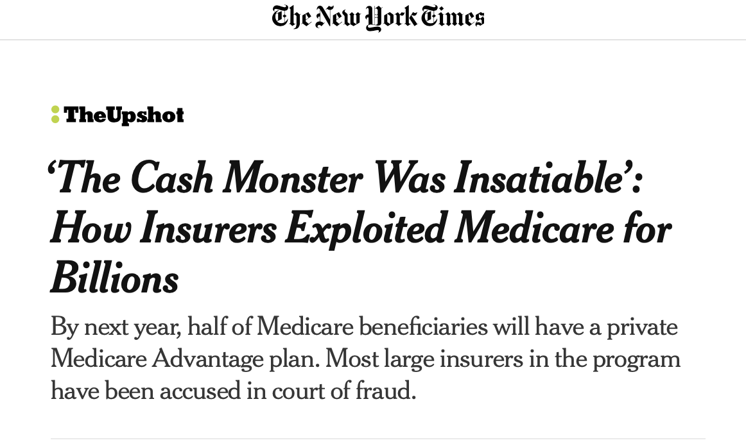

Slide 16
Clarification of Terms
Universal Health Care: Everyone is covered
May be one or many payers (insurers)
Single-payer: One entity handles all billing and payment
Private delivery: Medicare (over 65), Medicaid (low-income)
Socialized: VA, military, IHS, Britain, Cuba
Multi-payer: Many entities bill and pay
Universal regulated: Germany, France, Japan
US: non-universal, lightly regulated

Slide 17
Total Healthcare System Administrative Expense
1.6%
30-35%
Brookings Institution, May 14, 2015

Slide 19
Where Does Our Money Go?
Total US Healthcare Spending
$4.3 Trillion
Total US Healthcare Administrative Spending
34% (>$1 Trillion)
Where Does It Go?
Insurance companies
Hospital billing staff
Physician office staff

Slide 20
A Single Payer System Can Cover Everyone and Cost Less
New Expenses:
$325 Billion
Administrative Cost Reductions | $500 Billion
Drug and Device Negotiations | $150 Billion
Total Savings | $650 Billion
New Expenses | $325 Billion
Net Savings | $325 Billion
New Savings:
$650 Billion

Slide 21
Your total annual healthcare costs today
Your total costs for full-coverage Medicare for All

Slide 22
Can We Afford Universal Healthcare??
95% of households will
pay less in taxes (“Medicare premiums”)
than they currently pay in
premiums, co-pays, & prescriptions.
And we will all have full
comprehensive first-dollar coverage
Gerald Friedman, Ph.D., UMass Amherst, Funding HR 676: July 31, 2013
Notes:
We are paying for single-payer without getting the benefits of it. A public program is only as good as the amount of money you put into it, and we are putting in more than anyone else in the world.

