Slide 1
Update in Health Policy Physicians for a National Health Program 2023 Annual Conference
Adam Gaffney, MD MPH
Assistant Professor, Harvard Medical School
Pulmonary & Critical Care Medicine, Cambridge Health Alliance
Past President, Physicians for a National Health Program

Slide 2
I. Health

Slide 3
USA life expectancy continues to Fall Behind Other Wealthy Nations
Life expectancy at birth
Source of data: OECD.Stat, Accessed December 29, 2023.

Slide 4
US improvement in "Treatable Mortality" Continues to Lag Other Wealthy Nations
Source: OECD.Stat, Accessed October 1, 2023. https://stats.oecd.org/Index.aspx?DataSetCode=HEALTH_STAT#

Slide 5
Mortality hazard ratios (compared to incorporated business owners): Class Differential in Death is Widening
1986-1996
2001-2018
*
*
*
Data from: Eisenberg-Guyot J, Finsaas MC, Prins SJ. Dead Labor: Mortality Inequities by Class, Gender, and Race/Ethnicity in the United States, 1986–2019. Am J Public Health 2023;113(6):637–46.

Slide 6
II. Health Spending

Slide 7
USA healthcare spending continues to Outpace Other Wealthy Nations
Healthcare spending as a % of GDP
Source: OECD.stat. Available at: https://stats.oecd.org/Index.aspx?DataSetCode=SHA#. Accessed 09-29-23.

Slide 8
Private Insurance Overhead Exceeds 6% of National Health Expenditure
Private insurance overhead as a percentage of total national health expenditure
Source: CMS’ Historical National Health Expenditures Accounts, 1960-2021. Accessed 09-28-23.

Slide 9
Insurance Overhead by Payer
Source for Canada: Aliya Jiwani et al., “Billing and Insurance-Related Administrative Costs in United States’ Health Care: Synthesis of Micro-Costing Evidence,” BMC Health Services Research 14 (November 13, 2014).
Source for Traditional Medicare: Calculated from the 2023 Annual Report of the Board of Trustees of the Federal Hospital Insurance and Federal Supplementary Medical Insurance Trust Funds. Table II.B1. Excludes Medicare Part C and Part D Overhead and Expenditures.
Source for Private Insurance: Calculated from 2021 Historical National Health Expenditures Accounts, as net cost of health insurance for private health insurance divided by total NHE expenditures by private insurers.
Source for Medicare Advantage: Milliman, Medicare Advantage organizations financial results for 2021, Available at: https://www.milliman.com/en/insight/medicare-advantage-organizations-financial-results-for-2021. Figure is equal to 100 – MLR.

Slide 10
III. Healthcare Coverage, Access, Use, and Debt

Slide 11
Uninsured in the US
2022
Source for data before 2010: Council of Economic Advisers, “Methodological Appendix: Methods Used to Construct a Consistent Historical Time Series of Health Insurance Coverage,” 2014, https://obamawhitehouse.archives.gov/sites/default/files/docs/longtermhealthinsuranceseriesmethodologyfinal.pdf.
Source for data from 2010 – 2021: Early Release Estimates from the National Health Interview Survey, multiple years. Available at: https://www.cdc.gov/nchs/data/nhis/earlyrelease.pdf. Note that there was a change in survey methodology in 2019.

Slide 12
The Impact of “Medicaid Unwinding”
Total Medicaid Enrollment
ACA Medicaid Expansion
in effect
“Continuous Coverage” Provision
Figure drawn from data from: Total Monthly Medicaid & CHIP Enrollment and Pre-ACA Enrollment [Internet]. KFF. [cited 2023 Sep 26];Available from: https://www.kff.org/health-reform/state-indicator/total-monthly-medicaid-and-chip-enrollment/

Slide 14
CBO projects the number of uninsured will rise from 23 million (2023) to 28 million (2027)
Medicaid / CHIP
Millions of people
Uninsured
Data from: Hanson C, Hou C, Percy A, Vreeland E, Minicozzi A. Health Insurance For People Younger Than Age 65: Expiration Of Temporary Policies Projected To Reshuffle Coverage, 2023–33. Health Affairs 2023;42(6):742–52.

Slide 15
Michigan, 2011-2020 Continuity of Coverage after Enrollment in Medicaid
Share enrolled
Share continuously enrolled
Years after Medicaid Enrollment
Data from: Ndumele CD, Lollo A, Krumholz HM, Schlesinger M, Wallace J. Long-Term Stability of Coverage Among Michigan Medicaid Beneficiaries. Ann Intern Med 2023;176(1):22–8.

Slide 16
In the two years from 2018-2019, One in Five Americans Were Uninsured
Data from: Einav L, Finkelstein A. The risk of losing health insurance in the United States is large, and remained so after the Affordable Care Act. Proceedings of the National Academy of Sciences 2023;120(18):e2222100120. Results are from these authors’ analysis of the 2018-2019 MEPS.

Slide 17
Losing a primary care physician Changes Where Medicare Patients Get Care
Data from: Sabety AH, Jena AB, Barnett ML. Changes in Health Care Use and Outcomes After Turnover in Primary Care. JAMA Internal Medicine 2021;181(2):186–94.

Slide 18
Losing a primary care physician Has Dire Consequences for Medicare Patients
Change after losing a long-standing primary care physician
Data from: Sabety A. The value of relationships in healthcare. Journal of Public Economics 2023;225:104927.

Slide 19
A randomized trial of older men in the VA with Continuous vs. Discontinuous Providers
Data from: Wasson JH, Sauvigne AE, Mogielnicki RP, et al. Continuity of outpatient medical care in elderly men. A randomized trial. JAMA 1984;252(17):2413–7.

Slide 20
Cost Barriers to Care Among Non-Elderly Adults
20%
15%
10%
5%
Percent Non-Elderly Adults
Any foregone care in last year
Went without needed medicine due to cost
Went without needed medical care due to cost
Went without needed mental healthcare due to cost
1997
2022
 | 2000 | 2005 | 2010 | 2015
Note: Dotted vertical line indicates change in survey; trends across this line should be interpreted cautiously.
Source: National Health Interview Survey analysis by Adam Gaffney

Slide 21
In 2022, nearly half of Americans between ages 19 and 64 had Medical Bills or Debt
Any medical bill
or debt problem
“Had problems paying or
unable to pay medical bills”
“Medical bills/debt
being paid over time”
“Contacted by collection agency
for unpaid medical bills”
“Had to change way of life
to pay medical bills”
Source: Collins S, Haynes L, Masitha R. The State of U.S. Health Insurance in 2022. Commonwealth Fund [Internet]. 2022 Sep 29 [cited 2022 Nov 2]; Available from: https://www.commonwealthfund.org/publications/issue-briefs/2022/sep/state-us-health-insurance-2022-biennial-survey

Slide 22
2017 to 2018 Risk of New Acquisition of Medical Debt
Adjusted odds ratio
*Per $2,000 increase in OOP costs.
Data from: Himmelstein DU, Dickman SL, McCormick D, Bor DH, Gaffney A, Woolhandler S. Prevalence and Risk Factors for Medical Debt and Subsequent Changes in Social Determinants of Health in the US. JAMA Network Open 2022;5(9):e2231898.

Slide 23
Post-Partum Women Incur More Medical Debt Than Other Reproductive-Aged Women
Source: Cahn J, Sundaram A, Balachandar R, et al. The Association of Childbirth with Medical Debt in the USA, 2019–2020. J Gen Intern Med 2023;1–7.

Slide 24
Foregone care among adults with and without A Child with Diabetes in Household
Data from: Narm KE, Wen J, Sung L, Dar S, Kim P, Olson B, et al. Chronic Illness in Children and Foregone Care Among Household Adults in the United States: A National Study. Medical Care. 2022 Nov 4;10.1097/MLR.0000000000001791.

Slide 25
Adults with employer-sponsored insurance have had Rising Out-of-Pocket Costs for ICU Care
Figures are adjusted for inflation. ICU OOP costs shown for three conditions for illustrative purposes. Data from: Kannan S, Stevens J, Song Z. Growth In Patient Cost Sharing For Hospitalizations With And Without Intensive Care Among Commercially Insured Patients. Health Affairs 2023;42(9):1221–9.

Slide 26
Commercially insured patients, 2017-19 COPD Medication Abandonment by Benefit Design
“Deductible claims were defined as costing patients more than 50% of total reimbursement and more than $250 per claim or more than $500. Coinsurance claims were defined as costing $75 to $250 with the patient paying 5% to 25% of costs, or the patient paid a defined percentage up to 50% of costs, or 25% to 50% of total cost as well as more than $75. All other claims in which the patient paid less than $75 were classified as copay.”
Data from: Patel B, Mayne P, Patri T, Vandigo J, Yin PT, Bratti K, et al. Out-of-Pocket Costs and Prescription Filling Behavior of Commercially Insured Individuals With Chronic Obstructive Pulmonary Disease. JAMA Health Forum. 2022 May 27;3(5):e221167.

Slide 27
ACA-compliant individual insurance pays for screening colonoscopy, but Most Patients Have to Pay Related Costs
“The federal government has attempted to address some of these associated charges: In 2015 a document released by three federal agencies clarified that insurers should not charge patients for anesthesia costs related to undergoing colonoscopy. Yet a 2018 study found that out-of-pocket expenses remain a barrier to colorectal cancer screening even among fully insured adults.”
Data from: Makhoul AE, Hatcher JB, Sulieman L, Johnson D, Anderson DM. Patient Cost Exposure And Use Of Preventive Care Among ACA-Compliant Individual Plans. Health Affairs 2023;42(4):531–6.

Slide 28
IV. Reproductive Healthcare

Slide 29
SCOTUS Dobbs decision and the Distance to Closest Abortion Provider
June 2022
(Before Dobbs)
October 2023
(After Dobbs)
Miles
>180
120-180
60-120
<60
Data from the Myers Abortion Facility Database: Myers, C. K. (2023, November 2). Myers Abortion Facility Database. https://doi.org/10.17605/OSF.IO/8DG7R." Driving time equals the driving distance from the centroid of each county to the nearest abortion provider. Mapped by Adam Gaffney using Stata’s spmap command at cutoffs shown in legend.

Slide 30
Average Driving Distance to Closest Abortion Provider Before and After Dobbs: 2019 -2023
100
75
50
25
0
Mean driving distance (miles)
‘24
2009 | 2011 | 2013 | 2015 | 2017 | 2019 | 2021 | 2023
Driving distance calculated by Caitlin Myers; data accessed from the Myers Abortion Facility Database: Myers, C.K. (2023, November 2). Myers Abortion Facility Database. https://doi.org/10.17605/OSF.IO/8DG7R. Driving time equals the driving distance from the centroid of each county to the nearest abortion provider. Means calculated by Adam Gaffney with weights = 2010 population.
https://osf.io/pfxq3/

Slide 31
Projected annual health outcomes from Repeal of Dobbs
Foregone
abortions
Increased pregnancy-related deaths
Increased postpartum hemorrhage
76,612
15
1,967
30,404
6
782
Current ban states
Current ban states plus high-risk states
Gaffney A, Himmelstein DU, Dickman S, et al. Projected Health Outcomes Associated With 3 US Supreme Court Decisions in 2022 on COVID-19 Workplace Protections, Handgun-Carry Restrictions, and Abortion Rights. JAMA Network Open 2023;6(6):e2315578.

Slide 32
Median self-pay charges for Abortion Services in the US
(No data)
Median self-pay charges (inflation-adjusted)
Data from: Upadhyay UD, Ahlbach C, Kaller S, Cook C, Muñoz I. Trends In Self-Pay Charges And Insurance Acceptance For Abortion In The United States, 2017–20. Health Affairs 2022;41(4):507–15.

Slide 33
V. Medicare Advantage: A Brief Word

Slide 34
October 2023 Medicare Advantage Penetration by County
Penetration (%)
53.6 – 86.8
44.1 – 53.6
32.1 – 44.1
0.9 – 32.1
No data
Data from: https://www.cms.gov/research-statistics-data-and-systems/statistics-trends-and-reports/mcradvpartdenroldata/ma-state/ma-state/county-penetration-2023-10.
Mapped by Adam Gaffney using 2021 county shape files from IPUMS NHGIS.

Slide 35
2023 overpayments to Medicare Advantage Approaching 20% or $88 billion
Coding intensity estimate is for 2021; source: MedPAC MA coding intensity 9.7.23. Accessed September 15, 2023. https://www.documentcloud.org/documents/23944726-medpac-ma-coding-intensity-9723. Favorable selection estimate is for 2019; source: June 2023 Report to the Congress: Medicare and the Health Care Delivery System. Accessed August 10, 2023. https://www.medpac.gov/document/june-2023-report-to-the-congress-medicare-and-the-health-care-delivery-system/=. $88 billion estimate is from applying 19.2% to 2023 projected Medicare Spending per Trustees’ projections.

Slide 36
Medicare Advantage Overpayments Are Rapidly Increasing
15 years of overpayments
$547 Billion total
Billions of dollars
Amounts nominal, not inflation-adjusted. Coding intensity overpayment percentages are from March 2023 MedPac Report for 2008-2020, with year 2021 percentage from a recent MedPAC analysis that upwardly adjusted previous estimate of 4.9% for that year to 8.2%, which was carried forward to 2022-23. Favorable selection based on MedPAC’s June 2023 estimate for 2019, extrapolated to other years. Overpayment percentages multiplied by MA total actual or projected payments drawn from Medicare Trustees Reports. MedPAC based analysis by David Himmelstein, Steffie Woolhandler, and Adam Gaffney .

Slide 37
Relative difference in resource use by health condition MA vs. TM
Jung J, Carlin CS, Feldman R, Song G. Wide Variation In Differences In Resource Use Seen Across Conditions Between Medicare Advantage, Traditional Medicare. Health Affairs 2023;42(9):1212–20.

Slide 38
The Medicare Advantage “Paradox”
MA beneficiaries use less
healthcare than TM beneficiaries
How to
account for
this apparent
paradox?
MA plans receive much higher overall payments than TM
Providers are paid similarly
for MA and TM beneficiaries
MA plans have higher overhead (administration + profits) than TM
Profits are only a minority of MA overhead
Administrative spending reduces utilization
and is the motor of profit-generation

Slide 39
VI. Privatization, Corporatization, and Financialization

Slide 40
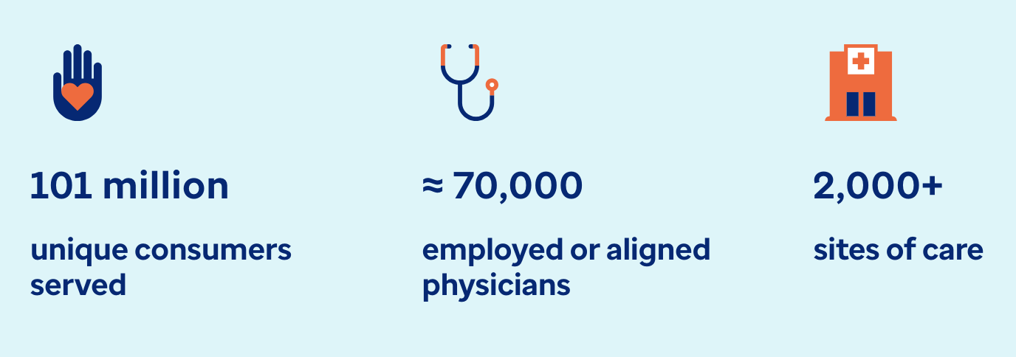
Optum Health “About Us”
Source : https://www.optum.com/about-us/optum-health.html

Slide 41
Screenshot from: https://www.healthcaredive.com/news/unitedhealth-optum-amedisys-acquisition-option-care/653870/

Slide 42
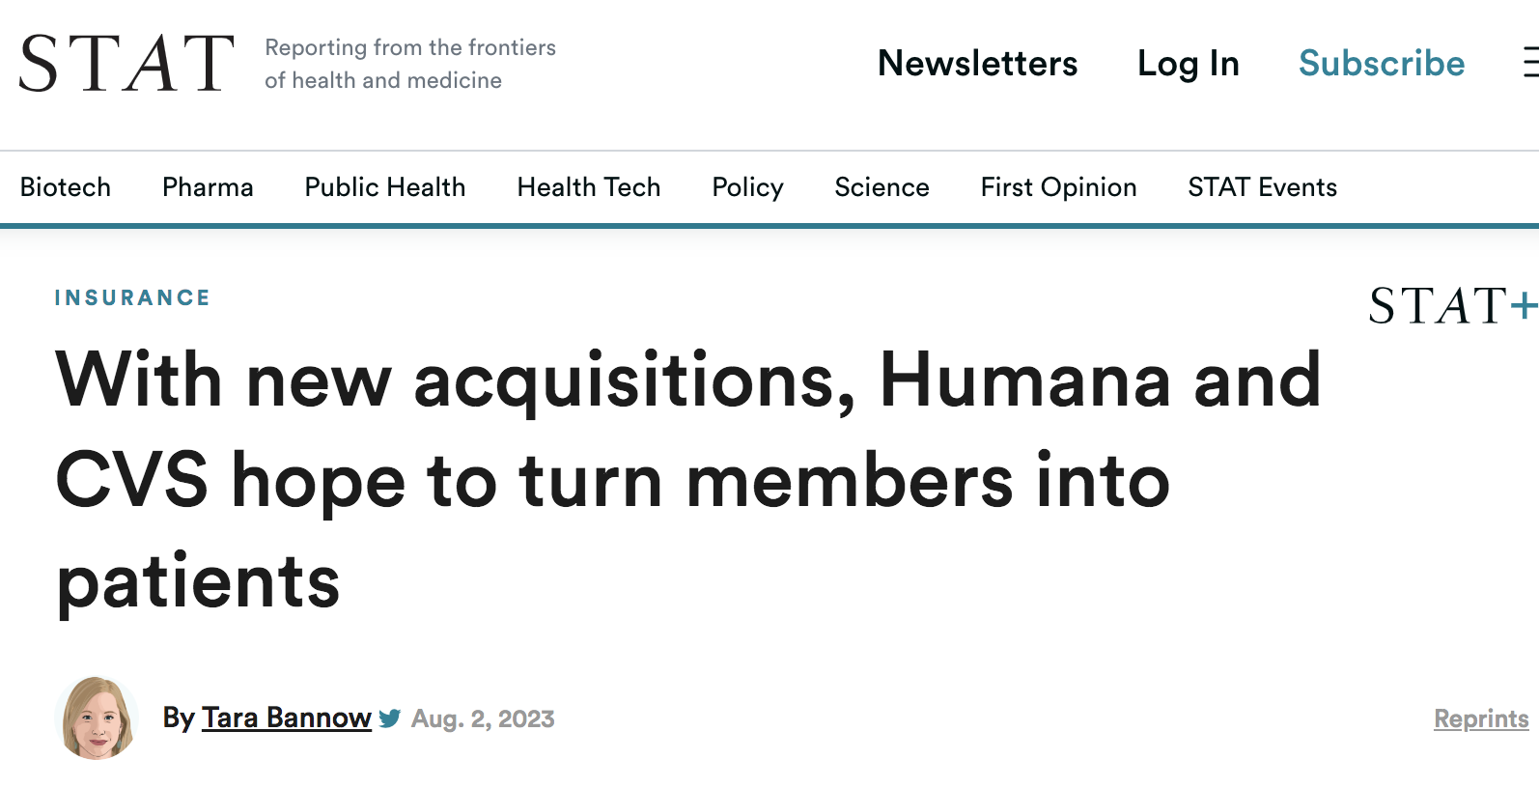
“Both Humana and CVS Health on Wednesday touted plans to aggressively scale their primary care clinics for seniors and funnel Medicare members into those clinics.”
“When insurers double as medical providers for their members,
they effectively pay themselves,
so they can generate enormous profit by lowering members’ health care costs.”
Source: https://www.statnews.com/2023/08/02/humana-cvs-senior-care/

Slide 43
169 medical practices in 21 states
Source: https://www.fiercehealthcare.com/providers/cvs-closes-106b-acquisition-oak-street-health-expand-primary-care-footprint

Slide 45
For-Profit Hospices More Likely Ranked as Low-Performing
Percentage of hospices ranked as low-performing by family assessments of care
Low-performing defined as hospices with a CAHPS Hospice Survey score 3 points or more below the national average. Data from: Anhang Price R, Parast L, Elliott MN, et al. Association of Hospice Profit Status With Family Caregivers’ Reported Care Experiences. JAMA Internal Medicine 2023;183(4):311–8.

Slide 46
“An overarching revenue strategy underlying Investors Appetite for Primary Care”
“Primary care practices can generate substantial profits by:
Growing their population of patients covered by Medicare Advantage (and other lucrative payers),
Maximizing the ‘budget’ for each patient’s care
using risk adjustment and quality bonuses,
Minimizing their health expenditures
with utilization management, and
Referring patients to other product and
service offerings, such as pharmacy.”
Shah S, Rooke-Ley H, Fuse Brown EC. Corporate Investors in Primary Care — Profits, Progress, and Pitfalls. New England Journal of Medicine 2023;388(2):99–101.

Slide 47
We now know the price of One Life to Amazon
Amazon bought health company “One Medical” for $3.9 billion
One Medical had 815,000 members and 214 medical offices in 20 markets
$3.9B / 815,000 =
$4,785 per life
Source: https://apnews.com/article/technology-amazoncom-inc-1life-healthcare-business-8440ff249f2af796d7b74b654eb86130

Slide 48
Source: https://www.fiercehealthcare.com/health-tech/amazon-offers-prime-members-access-one-medical-virtual-care-9-month

Slide 49
Global healthcare private equity deals in 2022: Second Highest on Record
Redrawn figure from Bain & Company. Global Healthcare Private Equity and M&A Report 2023 [Internet]. [cited 2023 Nov 6].
Available from: https://www.bain.com/insights/topics/global-healthcare-private-equity-ma-report/

Slide 50
Oncology Clinics and Oncologists with Private Equity Affiliations
Tyan K, Lam MB, Milligan M. Private Equity Acquisition of Oncology Clinics in the US From 2003 to 2022. JAMA Internal Medicine 2023;183(6):621–3.

Slide 51
VII. Health Planning (or lack thereof)

Slide 52
During periods of load imbalance during COVID-19 Probability of Hospital Overcapacity
Black Population Quartile of Hospital Zip Code
Data points are predicted probability of being overcapacity during periods of regional ICU load imbalance. From Exhibit 4 of Vohra et al.; predicted probability for quartiles 2-4 calculated by adding marginal effect to predicted probability of Quartile 1. Vohra AS, Khullar D, Kaushal R, Schpero WL. Many Intensive Care Units Were Overloaded While Nearby Hospitals Had Excess Capacity During The COVID-19 Pandemic. Health Affairs [Internet] 2023 [cited 2023 Jul 100].

Slide 53
Julian Tudor Hart, 1971: The “Inverse Care Law”
“…the availability of good medical care tends to vary inversely with the need of the population served.”
“The more health services are removed from the force of the market, the more successful we can be in redistributing care away from its ‘natural’ distribution in a market economy.”
Tudor Hart J. The Inverse Care Law. The Lancet 1971; 297: 405–12.

Slide 54
Mean revenue and profit per patient bed day, 2016-2018: Black-serving vs. Other US Hospitals
Black-serving Hospitals
Other Hospitals
Himmelstein G, Ceasar JN, Himmelstein KE. Hospitals That Serve Many Black Patients Have Lower Revenues and Profits: Structural Racism in Hospital Financing. J Gen Intern Med 2023;38(3):586–91.

Slide 55
Lack of association between the supply of NICU resources and The Medical Needs of Newborns
“A weak association of capacity with perinatal risk in 1991 was absent in 2017….
“Higher increases in perinatal risk were not associated with higher capacity growth.”
Fraction of variation in supply of NICU resources explainable by perinatal risk (R²)
Davis R, Stuchlik PM, Goodman DC. The Relationship Between Regional Growth in Neonatal Intensive Care Capacity and Perinatal Risk. Medical Care 2023;61(11):729.

Slide 56
Effect of a 10-percentage point increase in share of nearby hospitals offering invasive cardiac services on odds of a hospital adding that service
Note: “PCI” = Percutaneous Coronary Intervention
Data from: Horwitz Jill R., Nichols Austin, Nallamothu Brahmajee K., Sasson Comilla, Iwashyna Theodore J.
Expansion of Invasive Cardiac Services in the United States. Circulation 2013;128(8):803–10.

Slide 57
VIII. Policy Advantages of National Health of Insurance (NHI) and National Health Service (NHS) Systems

Slide 58
Quasi-experimental study: Effect of being taken by Ambulance to VA vs. Non-VA Hospital
Percent difference represents percentage point effect (from instrumental variable analysis) divided by outcome mean (Mortality/Spending relative effects reported by authors; data from Table 4 used to calculate relative changes for the utilization outcomes). Data from: Chan DC, Card D, Taylor L. Is There a VA Advantage? Evidence from Dually Eligible Veterans. American Economic Review 2023;113(11):3003–43.

Slide 59
Waiting time for appointments for Veterans in the VHA and Private Sector
Waiting Time (Days)
VHA
Private Sector
Feyman Y, Asfaw DA, Griffith KN. Geographic Variation in Appointment Wait Times for US Military Veterans. JAMA Network Open. 2022 Aug 25;5(8):e2228783.

Slide 60
Single Payer with Global Budgets Could Reduce 10-Year Hospital Spending from $17.2 to $14.7 trillion
Current hospital trajectory
Reduced growth rate
$ Billions
Administrative savings
Foregone profits & marketing
Single Payer hospital trajectory
Increased utilization and QI with SP
SP cost if no increase in utilization
Gaffney AW, Himmelstein DU, Woolhandler S, Kahn JG. Hospital Expenditures Under Global Budgeting and Single-Payer Financing: An Economic Analysis, 2021–2030. International Journal of Social Determinants of Health and Health Services 2023;27551938231152750.

